Slide 1
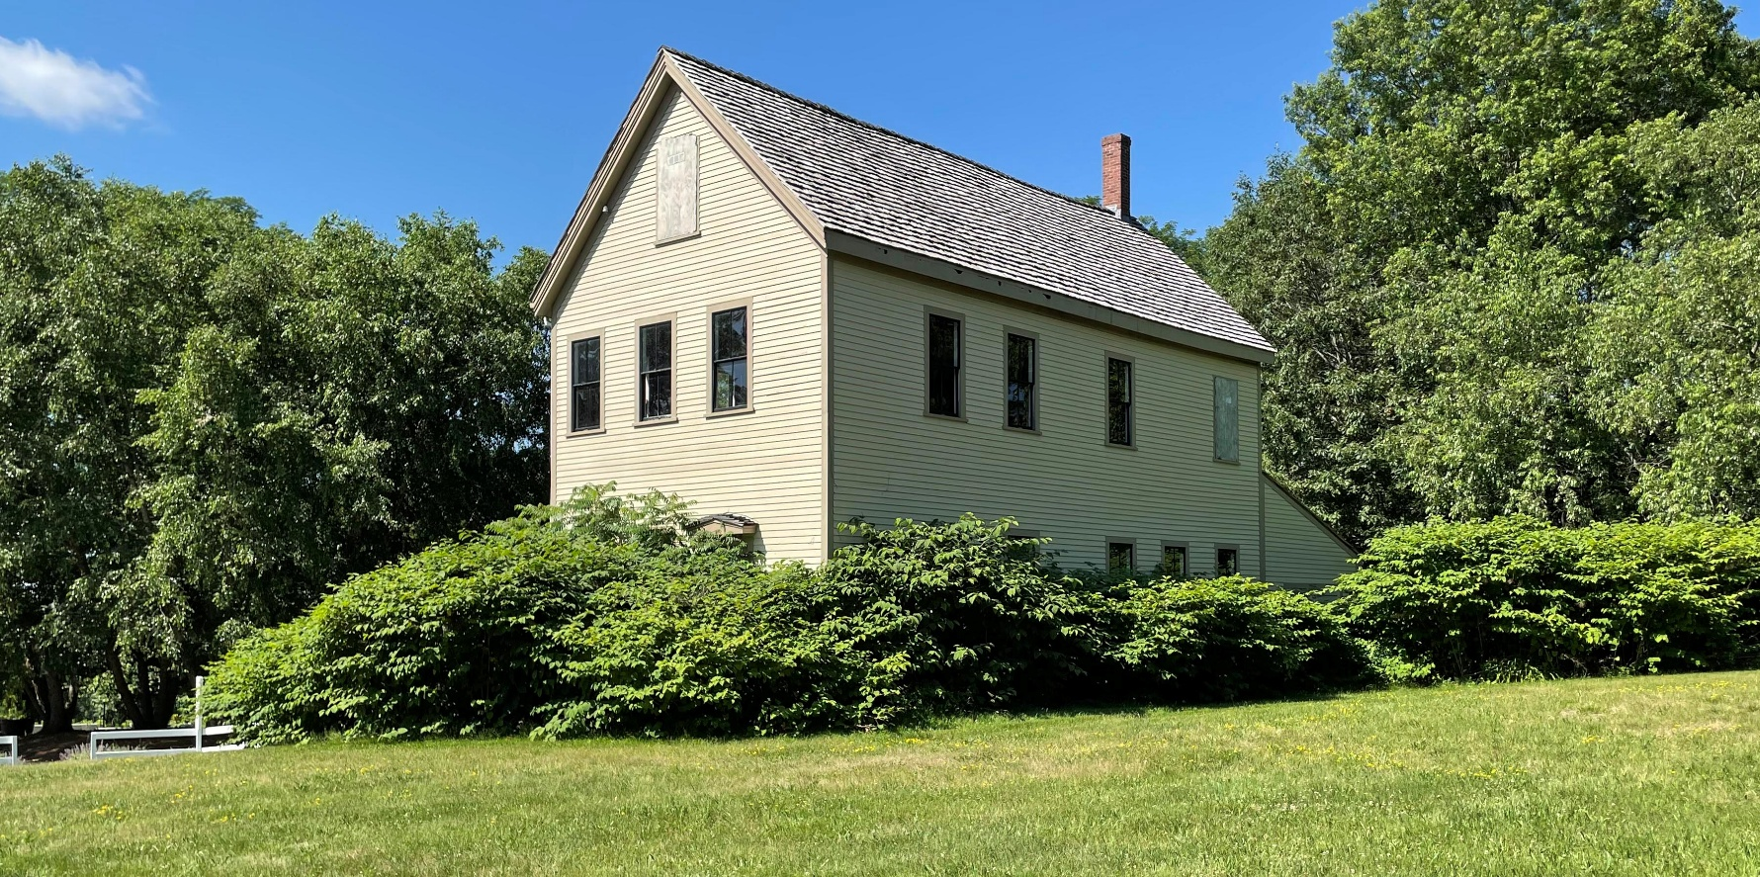
Public Information Meeting
BROOK FARM HISTORIC SITE
Conceptual Plan
Department of
Conservation and Recreation
Thursday, April 30, 2026
6:00 PM – 7:30 PM
Notes:
Dan Cushing

Slide 2
Commonwealth of MA
Notes:
Dan Cushing
2

Slide 3
DCR
Notes:
Dan Cushing
3

Slide 4
Meeting Logistics
Notes:
Dan Cushing
4

Slide 5
Agenda
Team Introductions
Project Scope
Site Location and Assessment
Overall Park Concept
Historic Core Landscape Treatment
Conceptual Plans
Q&A
Notes:
Dan Cushing
5

Slide 6
Project Team
Department of Conservation and Recreation
Wendy Pearl, Director, Office of Cultural Resources
Paul Cavanagh, Resource Management Planner
Aimee Graeber, Resource Management Planner
Dan Cushing, Director of Public Engagement
Ray Dunetz Landscape Architecture, Inc.
Ray Dunetz, PLA, ASLA, Principal
Michelle de Tarnowsky, PLA, Landscape Architect
Pian Zhang, Designer
Notes:
Dan Cushing
6

Slide 7
Project Scope
GOALS
Establish resource management framework;
Understand significance of the property and current conditions;
Identify opportunities to enhance visitor experience;
PRODUCTS
Resource Management Plan
Conceptual Design
Notes:
Wendy Pearl
7

Slide 8
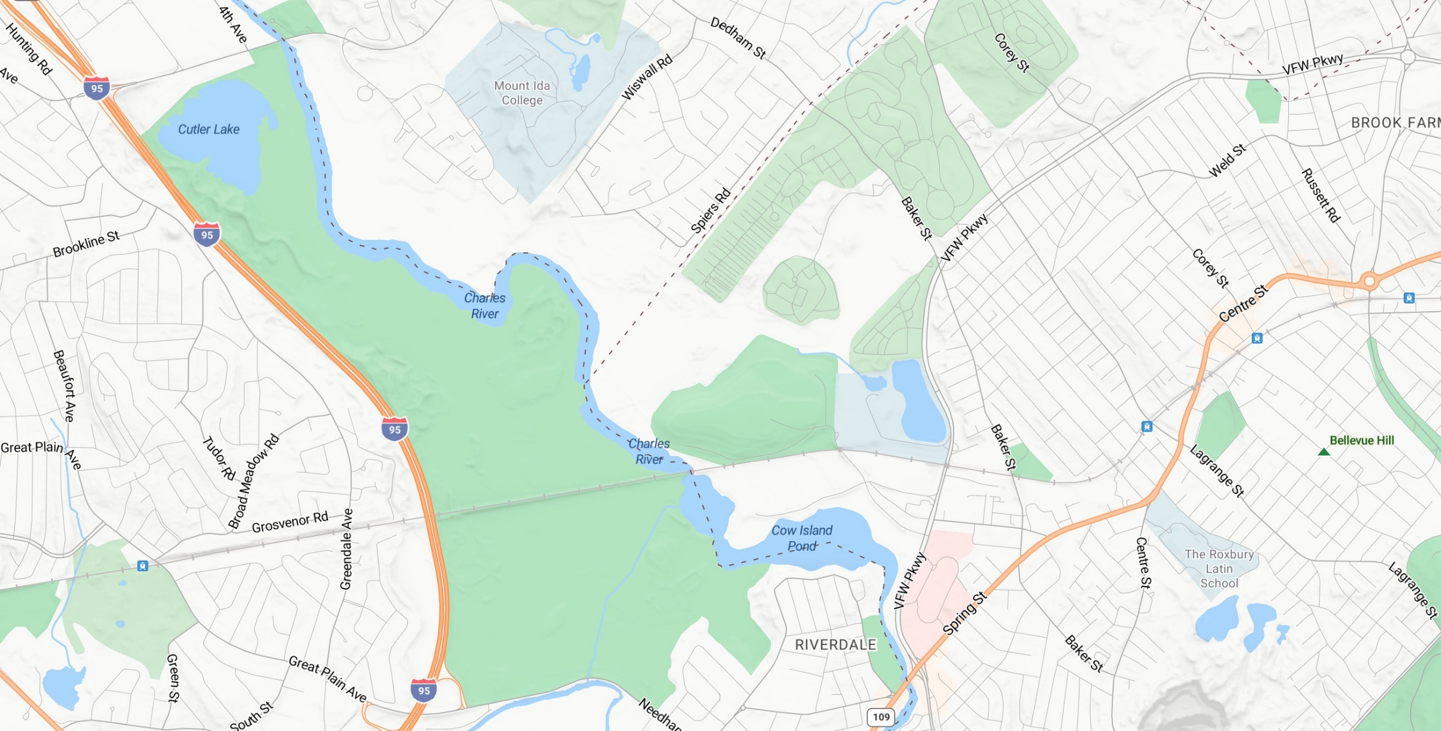
Site Location
Brook Farm
Historic Site
Notes:
The site is located in the West Roxbury neighborhood of Boston within close proximity to the Charles River
Nearby parks include Millennium Park to the south and Charles River Reservation to the North.
The site is abutted by cemetery land uses, including the Gardens Cemetery, which is completely surrounded by the DCR property.
8

Slide 9
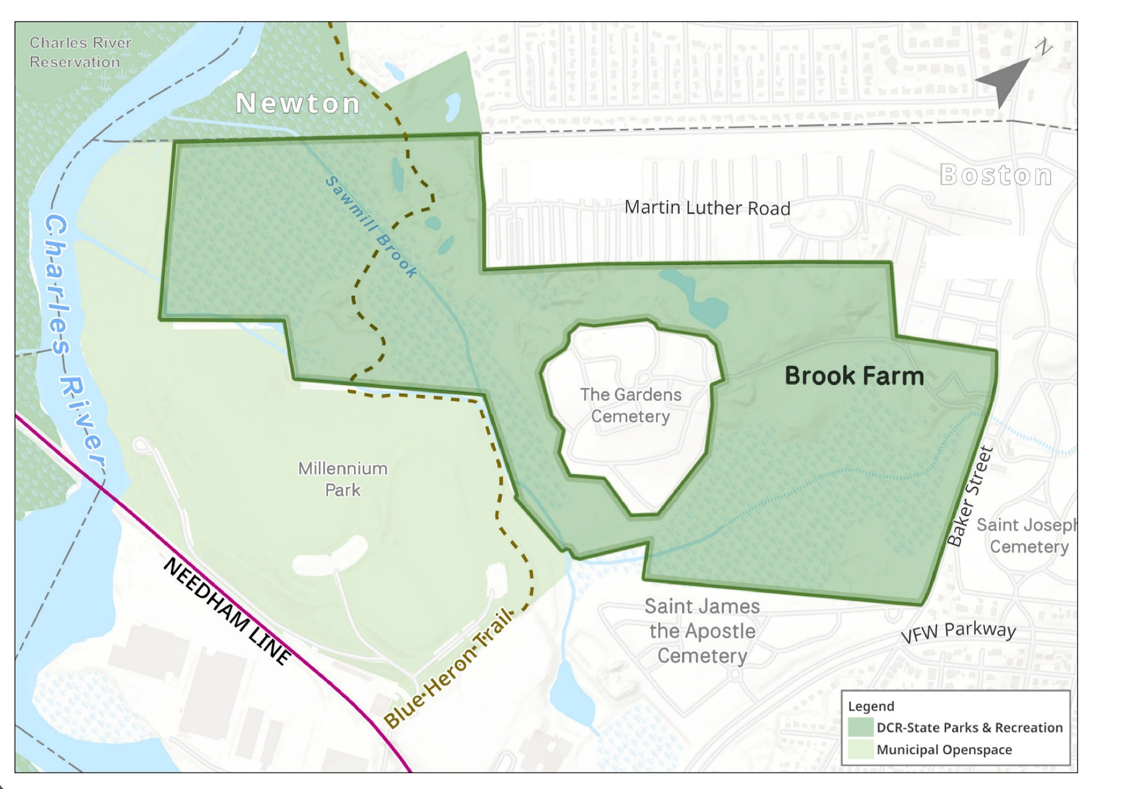
Site Context
Baker Street Jewish Cemeteries
Notes:
This slide provides an enlargement of the site located off Baker Street
The darker green area is DCR, while the lighter green represents municipally owned Open Space.
9

Slide 10
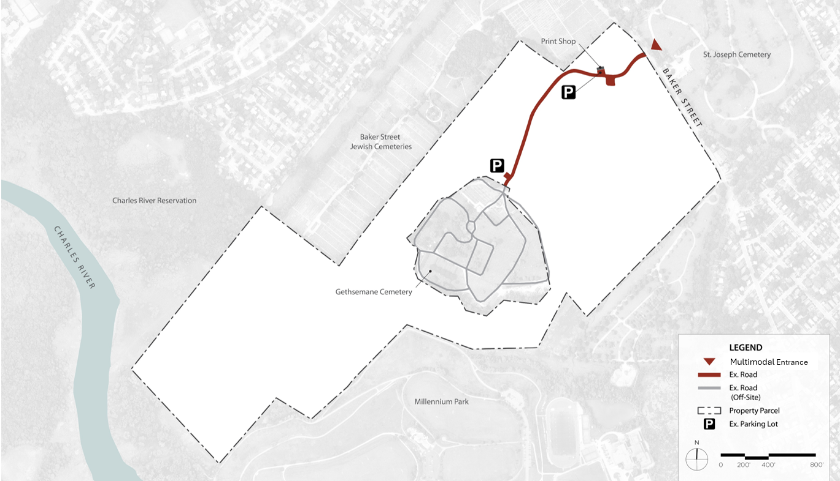
Site Analysis - Multimodal Circulation
Notes:
Multimodal circulation is defined by networks that enable people to reach destinations using multiple modes—such as walking, cycling, transit, and driving
The site is accessed from Baker Street by car, bike or on foot.
There is a nearby bus stop on Baker Street, allowing access to the site via public transportation
There are two existing informal parking areas, one adjacent to the Print Shop and one back towards the Garden Cemetery.
The site is also accessed by trails from abutting parks which we will discuss on the next slide.

Slide 11
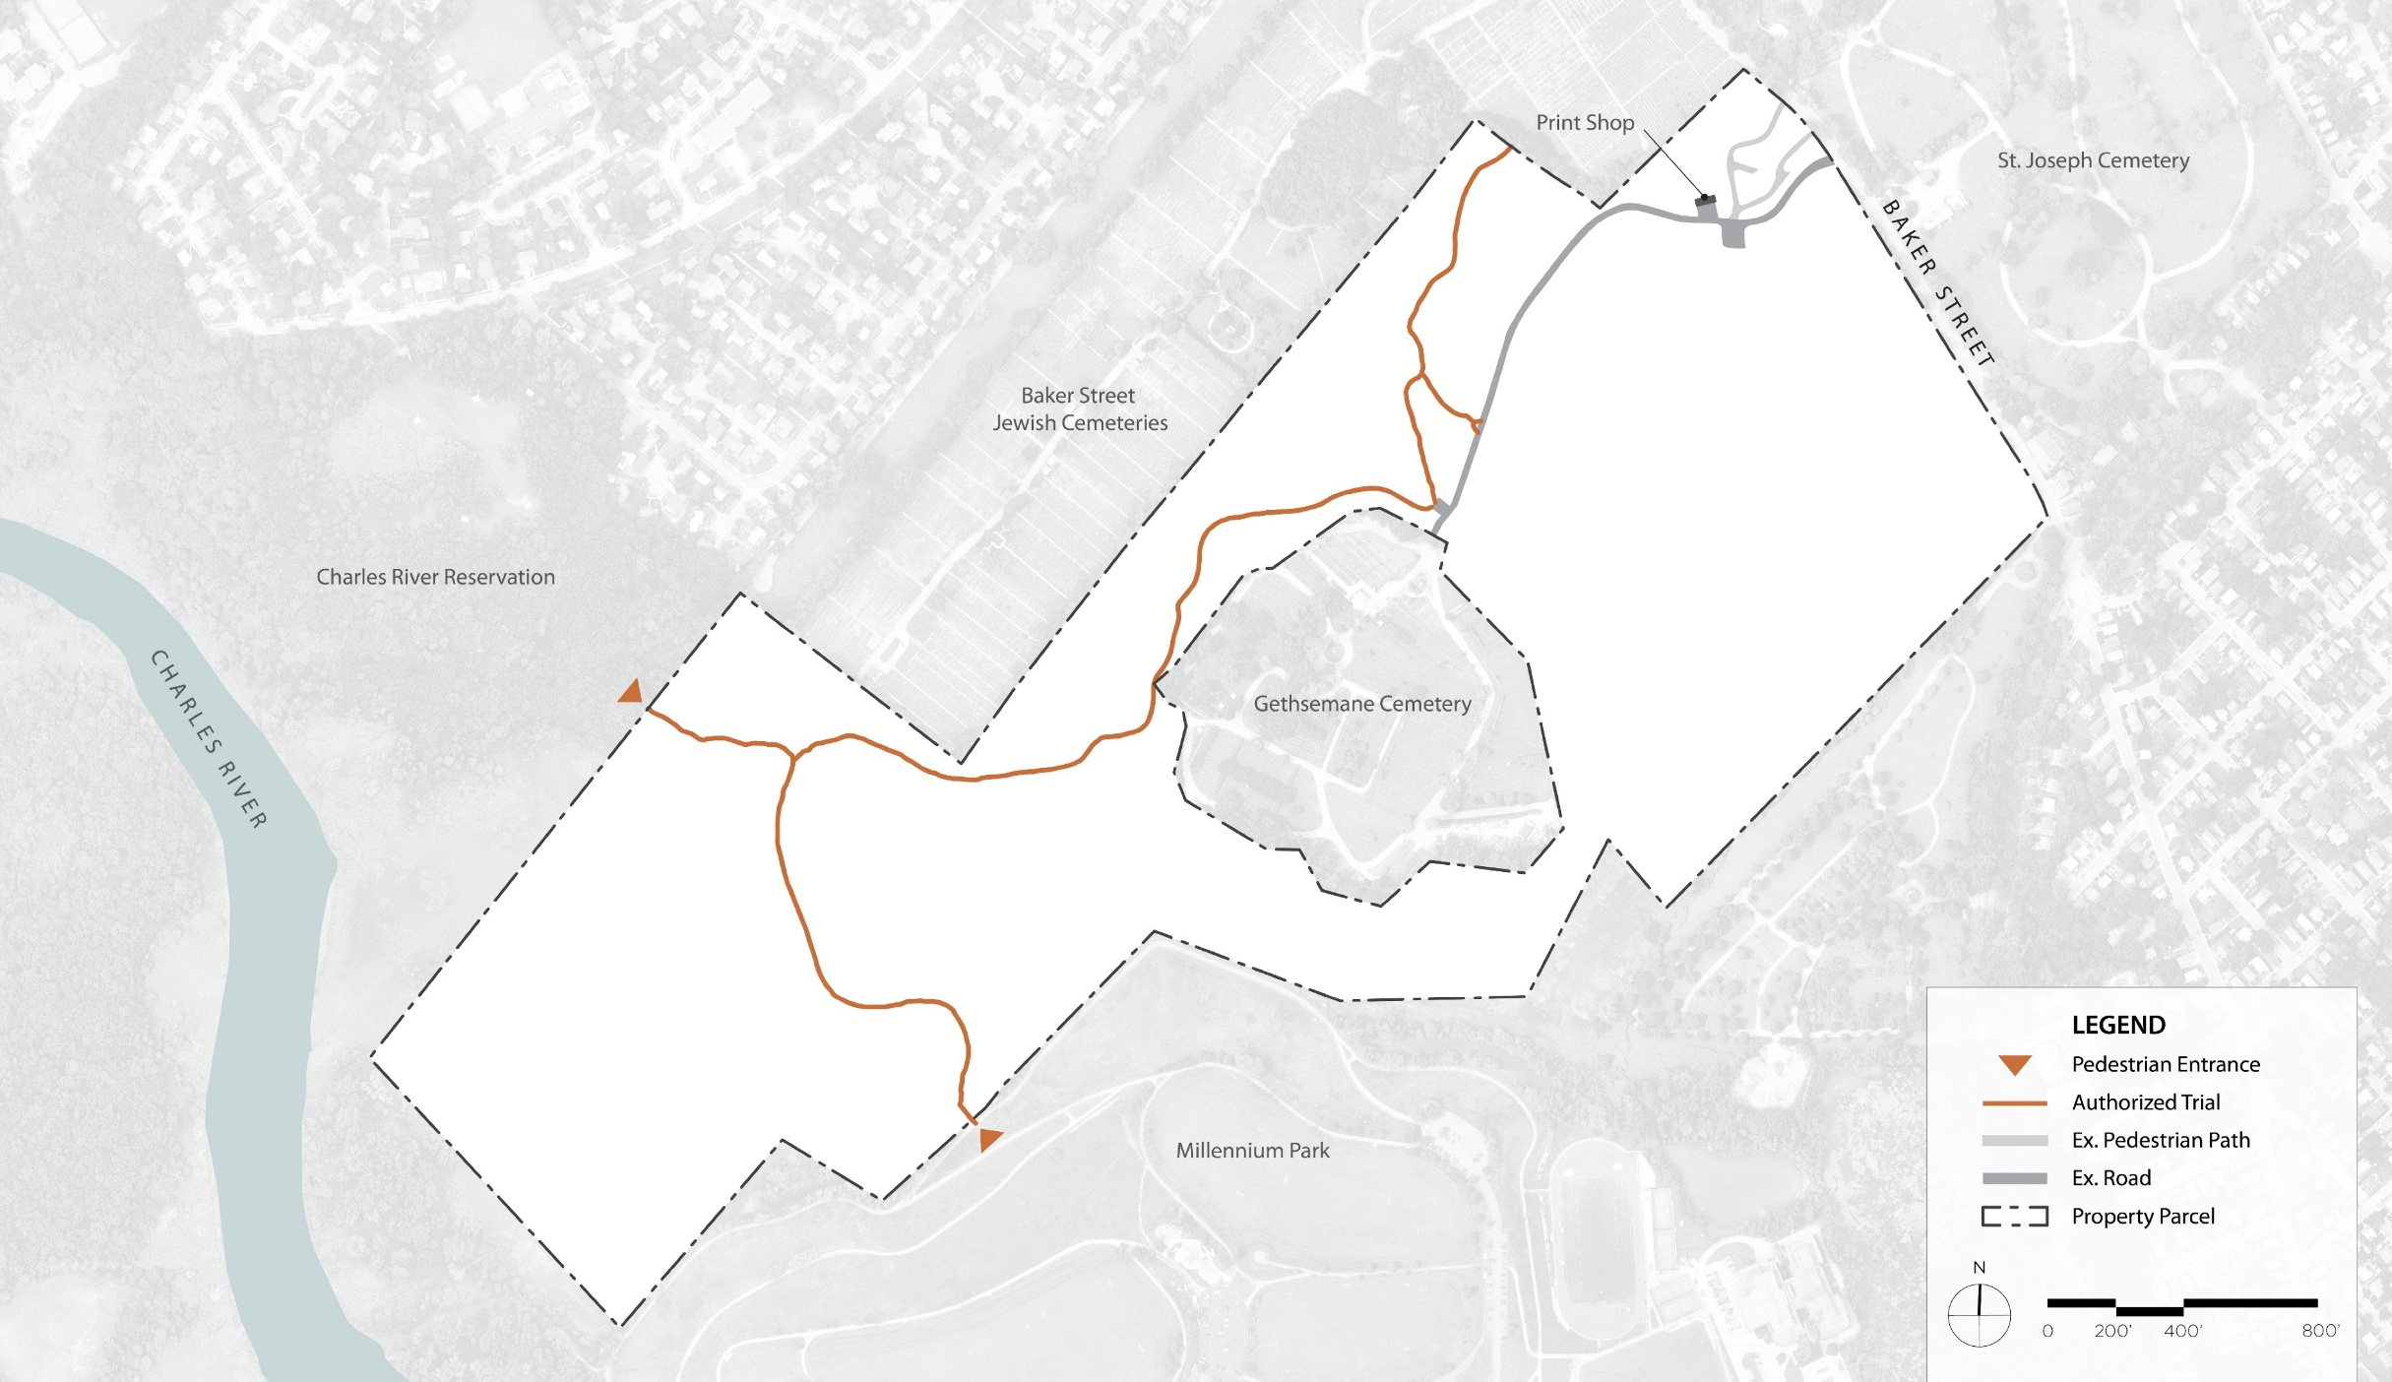
Site Analysis - Trails
Notes:
The site features a system of authorized trails, including the Blue Heron Trail, which connects to Millennium Park to the South.
These trails are indicated as brown lines.
The historic core features some paved walkways, some of which are not compliant with the Americans with Disabilities Act of 1996.
The site is accessed by trailheads at Charles River Reservation and Millennium Park.
The Blue Heron Trail connects Brook Farm to Millenium Park.

Slide 12
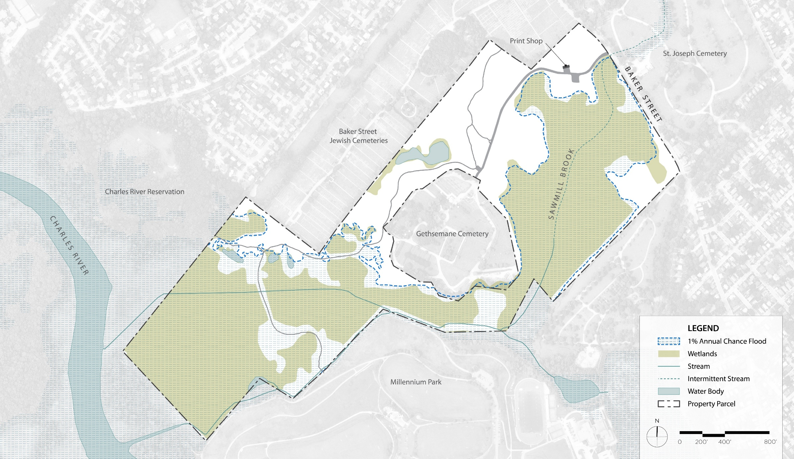
Site Analysis - Hydrology
Notes:
The site's hydrology is highly dynamic, featuring wetlands, vernal pools, streams and small ponds.
Much of the site is subject to a 1% annual chance of flooding, depicted by the dashed blue line.

Slide 13
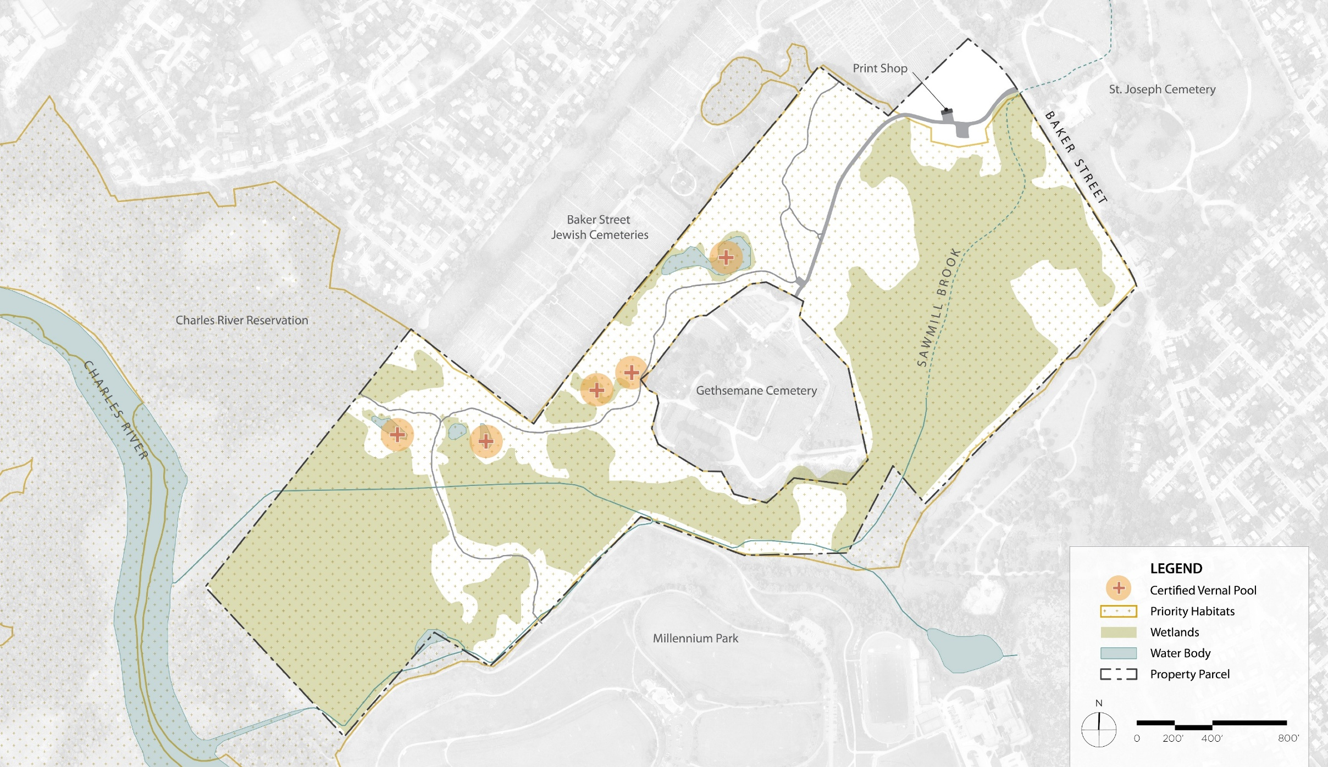
Site Analysis - Priority Habitat
Notes:
Much of the site is regulated as Priority Habitat, which makes Brook Farm an ecologically special place.
The site features vernal pools represented by the orange circles, wetland represented in green and water bodies shown in blue.
The historic core is outside of the Priority Habitat areas.

Slide 14
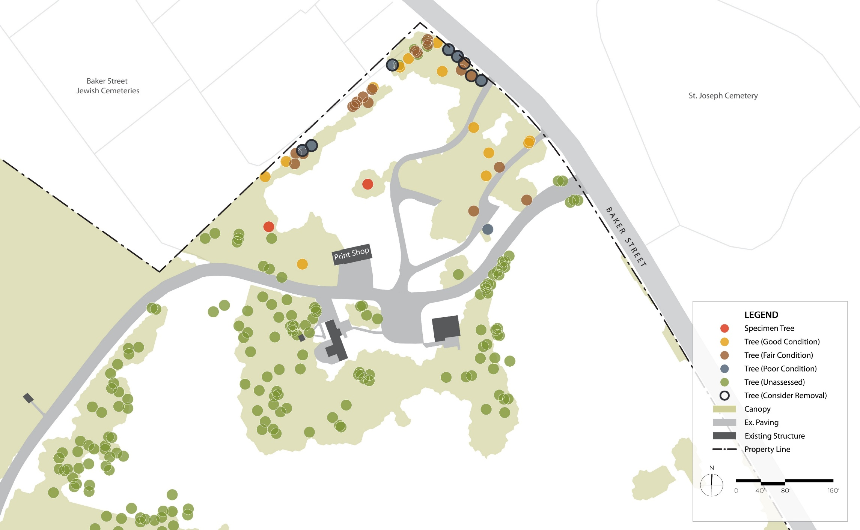
Site Analysis - Tree Assessment
Notes:
RDLA worked with a certified arborist to provide a Level One Tree Assessment in the historic core area.
A Level 1 assessment is a cursory, ground-based visual inspection intended to provide a rapid evaluation of tree condition and to identify obvious defects, hazards, or concerns.
The two red circles represent the specimen trees on the site. One is a 31” pin oak and the other is a 50” White Pine.
Orange circles represent trees in good condition.
Brown and blue circles represent trees in fair and poor condition, respectively.
Trees outlined in black should be considered for removal, as they pose a public safety risk. They are comprised of Mulberries, Cherries, White and Red Pines.
There have been reports of invasive Black Locust growing outside of our study area.
Provide data of trees in the area

Slide 15
Project Goals
Enhancing public use through:
Interpretation;
Accessibility improvements;
Potential adaptive reuse of the Print Shop;
Sustainable site improvements;
Convey historic land uses such as agriculture, and;
Passive recreational programming.
Notes:
Read the text.
Mention existing cellar holes with historic land uses.
These goals are consistent with those set in the RMP for the site.

Slide 16
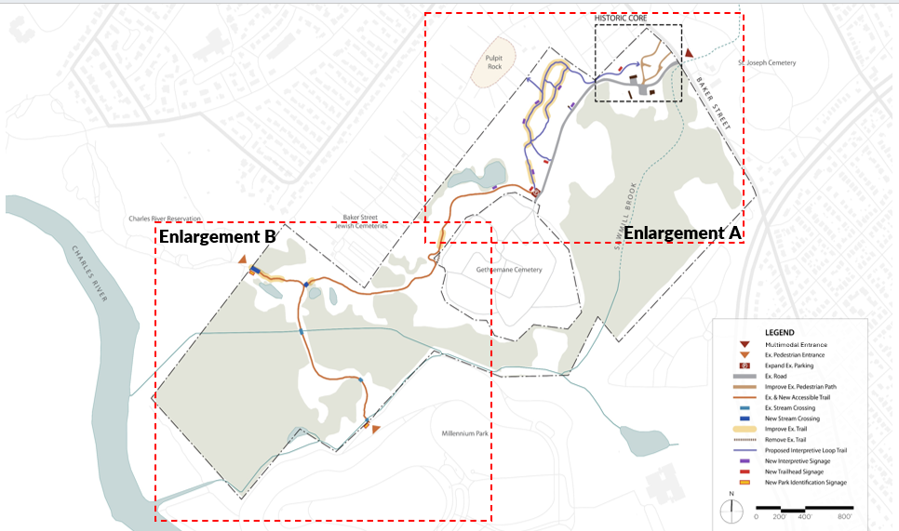
Full Site Concept
Notes:
Following our analysis of the site, we prepared a design concept for the full site.
This slide shows the full site to get your bearings. We broke our concept into two enlargement areas, north and south, outlined in a red dashed line.
We will now review each enlargement area.

Slide 17
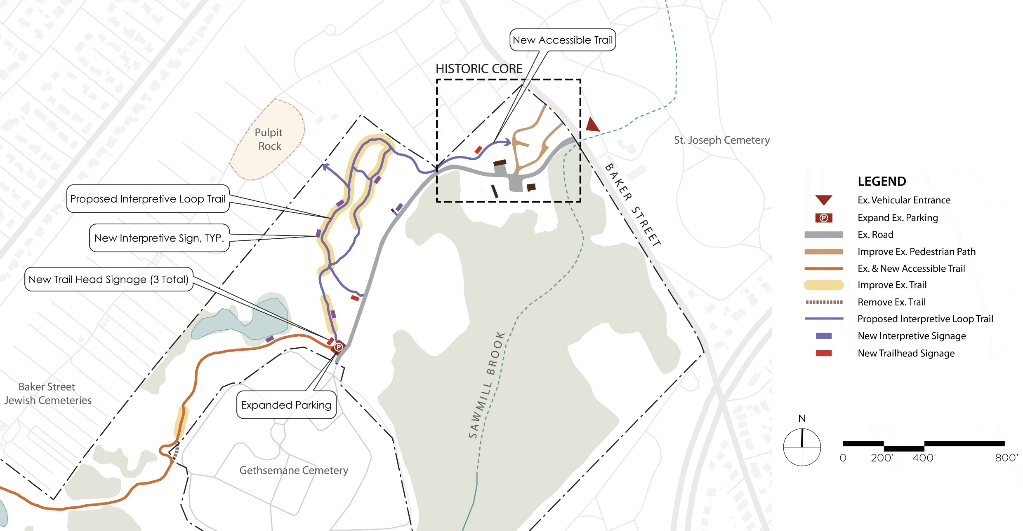
Full Site Concept - Enlargement A
Notes:
In the northern enlargement area, or enlargement A, we looked at how to connect the historic core to the sensitive resources and interpretive sites immediately to the west.
This concept creates an accessible trail from this historic core to a new interpretive trail loop system.
The accessible trail standard we used was the US Forest Service standard, which allows for up to 12% slopes.
DCR accessible trail standard width is 5’ and is surfaced with natural materials such as fine aggregates.
Each interpretive site would feature an accessible sign describing its history.
We recommended expanding the existing southern parking area by a couple of spaces to accommodate more visitors arriving by car.
The concepts for the historic core will be reviewed later in our presentation.

Slide 18
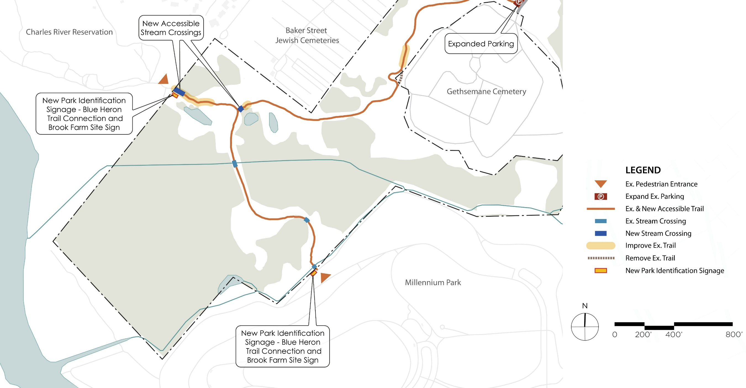
Full Park Concept - Enlargement B
Notes:
Improvements in the southern section of the site focus on new identification signage at the entrances from Millennium Park and the Charles River Reservation, and improved trails and accessible stream crossings, shown in dark blue.

Slide 19
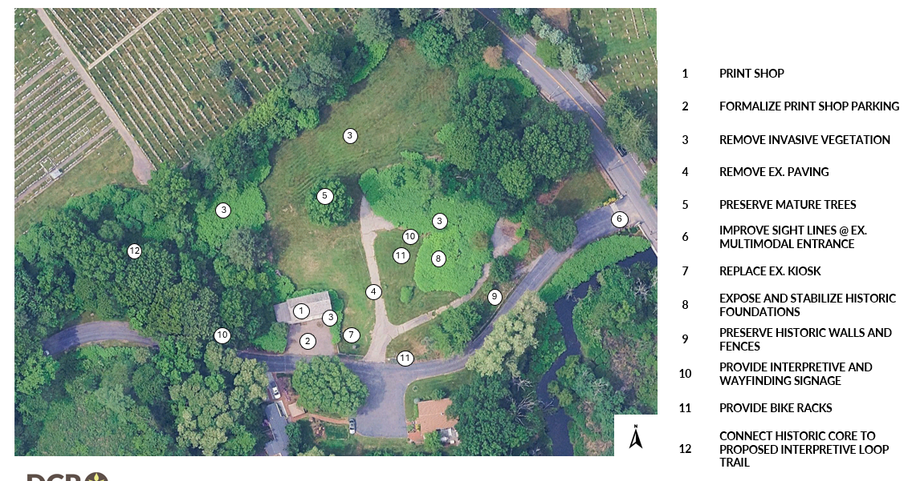
Historic Core - Landscape Treatment
Notes:
Our concepts for the historic core are guided by commonalities in the following landscape treatments.
Read the treatments and point to each.

Slide 20
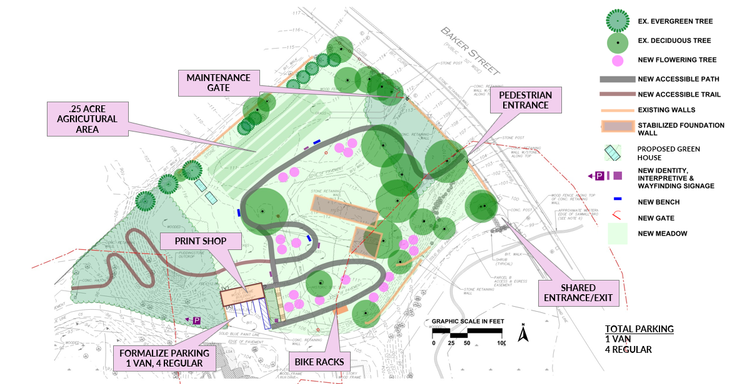
Historic Core - Concept A
Notes:
Now we would like to review three concepts for the historic core that align with the landscape treatment goals established on the previous slide.
Ray to walk through the improvements for concepts A, B and C.
Ray will describe concept A.

Slide 21
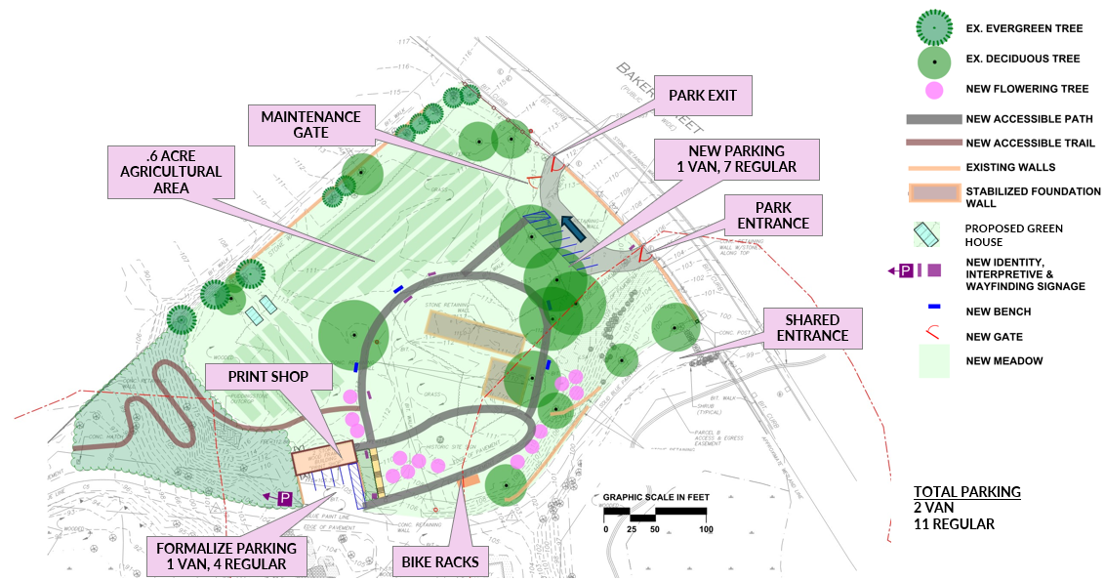
Historic Core - Concept B -1
Notes:
Ray will describe concept B-1.

Slide 22
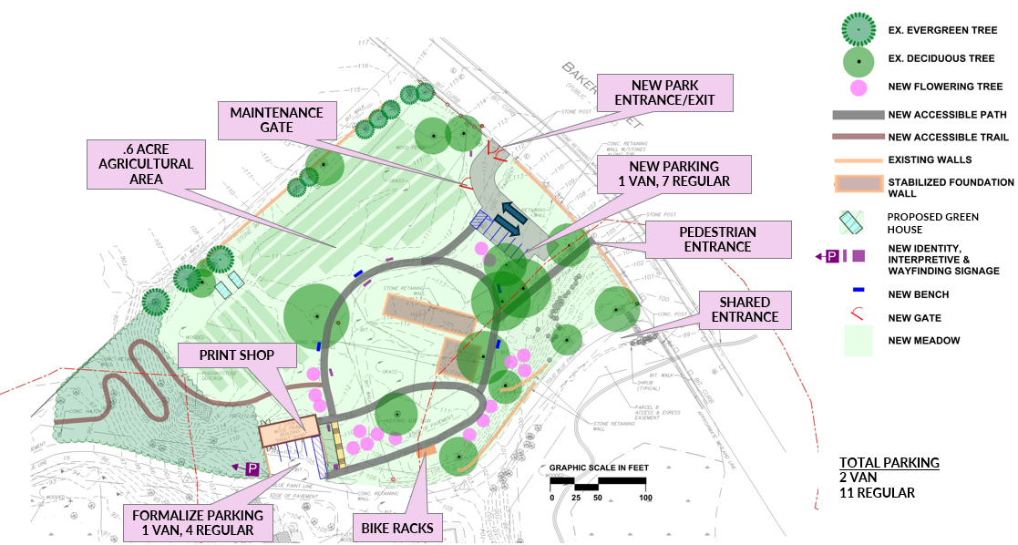
Historic Core - Concept B-2
Notes:
Ray will describe concept B-2.

Slide 23
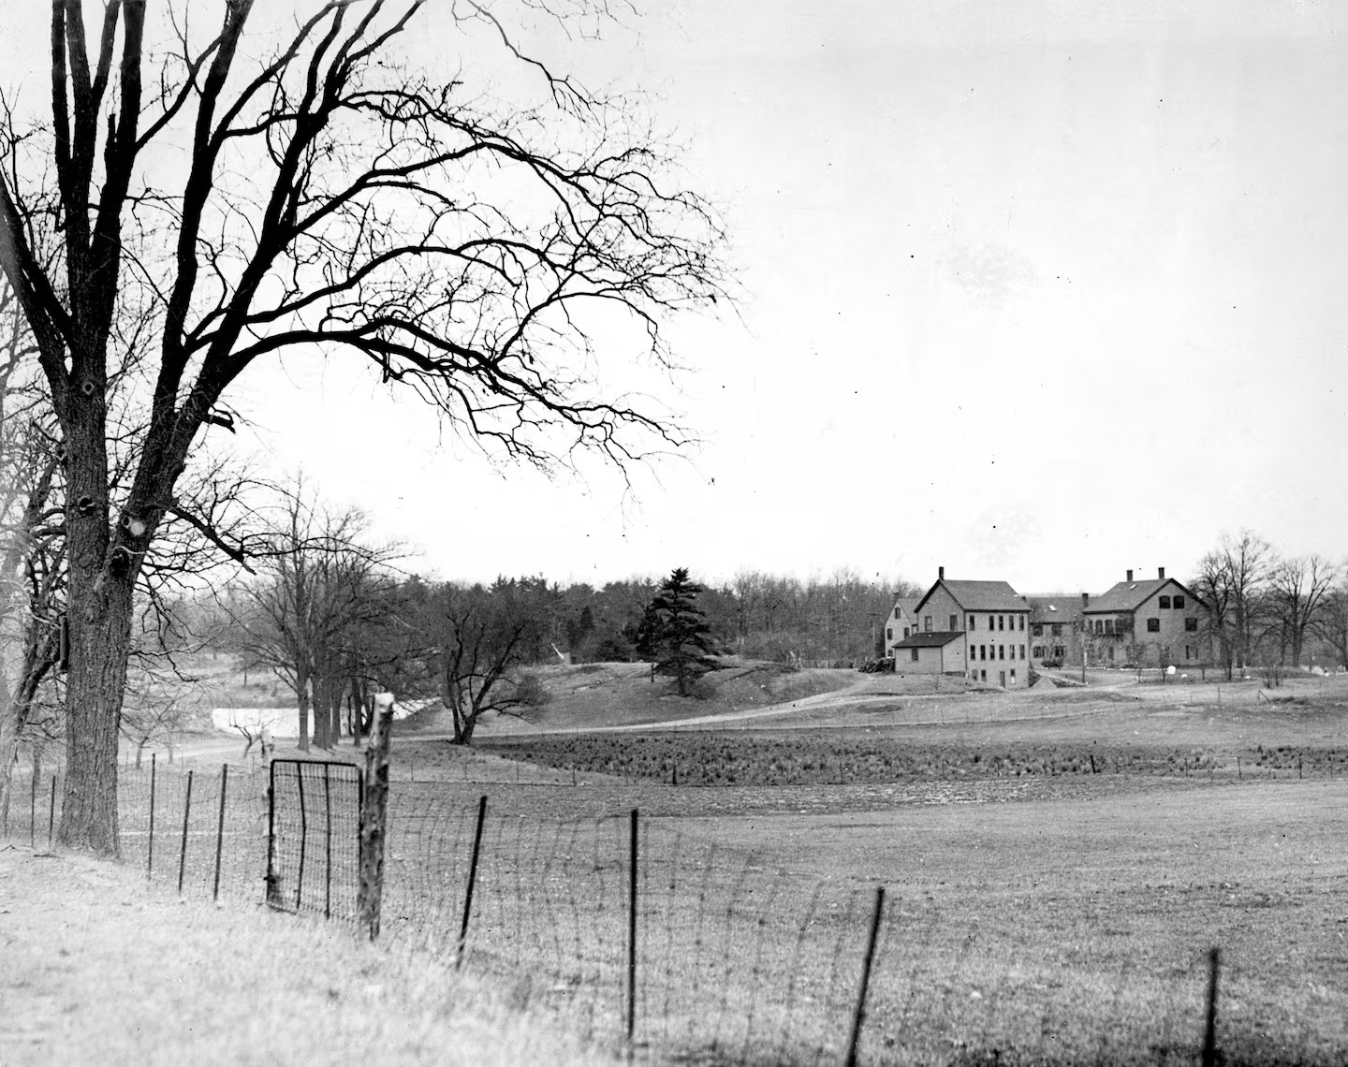
Questions and
Answers
Notes:
Dan Cushing

Slide 24
Additional Information
Recording and tonight’s slide deck will be available at DCR Past Public Meetings website.
If you have comments on this project:
  Submit online: DCR Public Comment website
  Deadline: Thursday, May 14, 2026
  Please note: the contents of comments submitted to DCR, including your name, town and zip code, will be posted on DCR’s website. Additional contact information provided, notably email address, will only be used for outreach on future updates to the subject project or property.
If you wish to subscribe to a DCR general information or project-related listserv: contact DCR’s Office of Community Relations via email at mass.parks@mass.gov
Notes:
Dan Cushing

Slide 25
Brook Farm Historic Site
Conceptual Plan
Notes:
25

