Slide 1
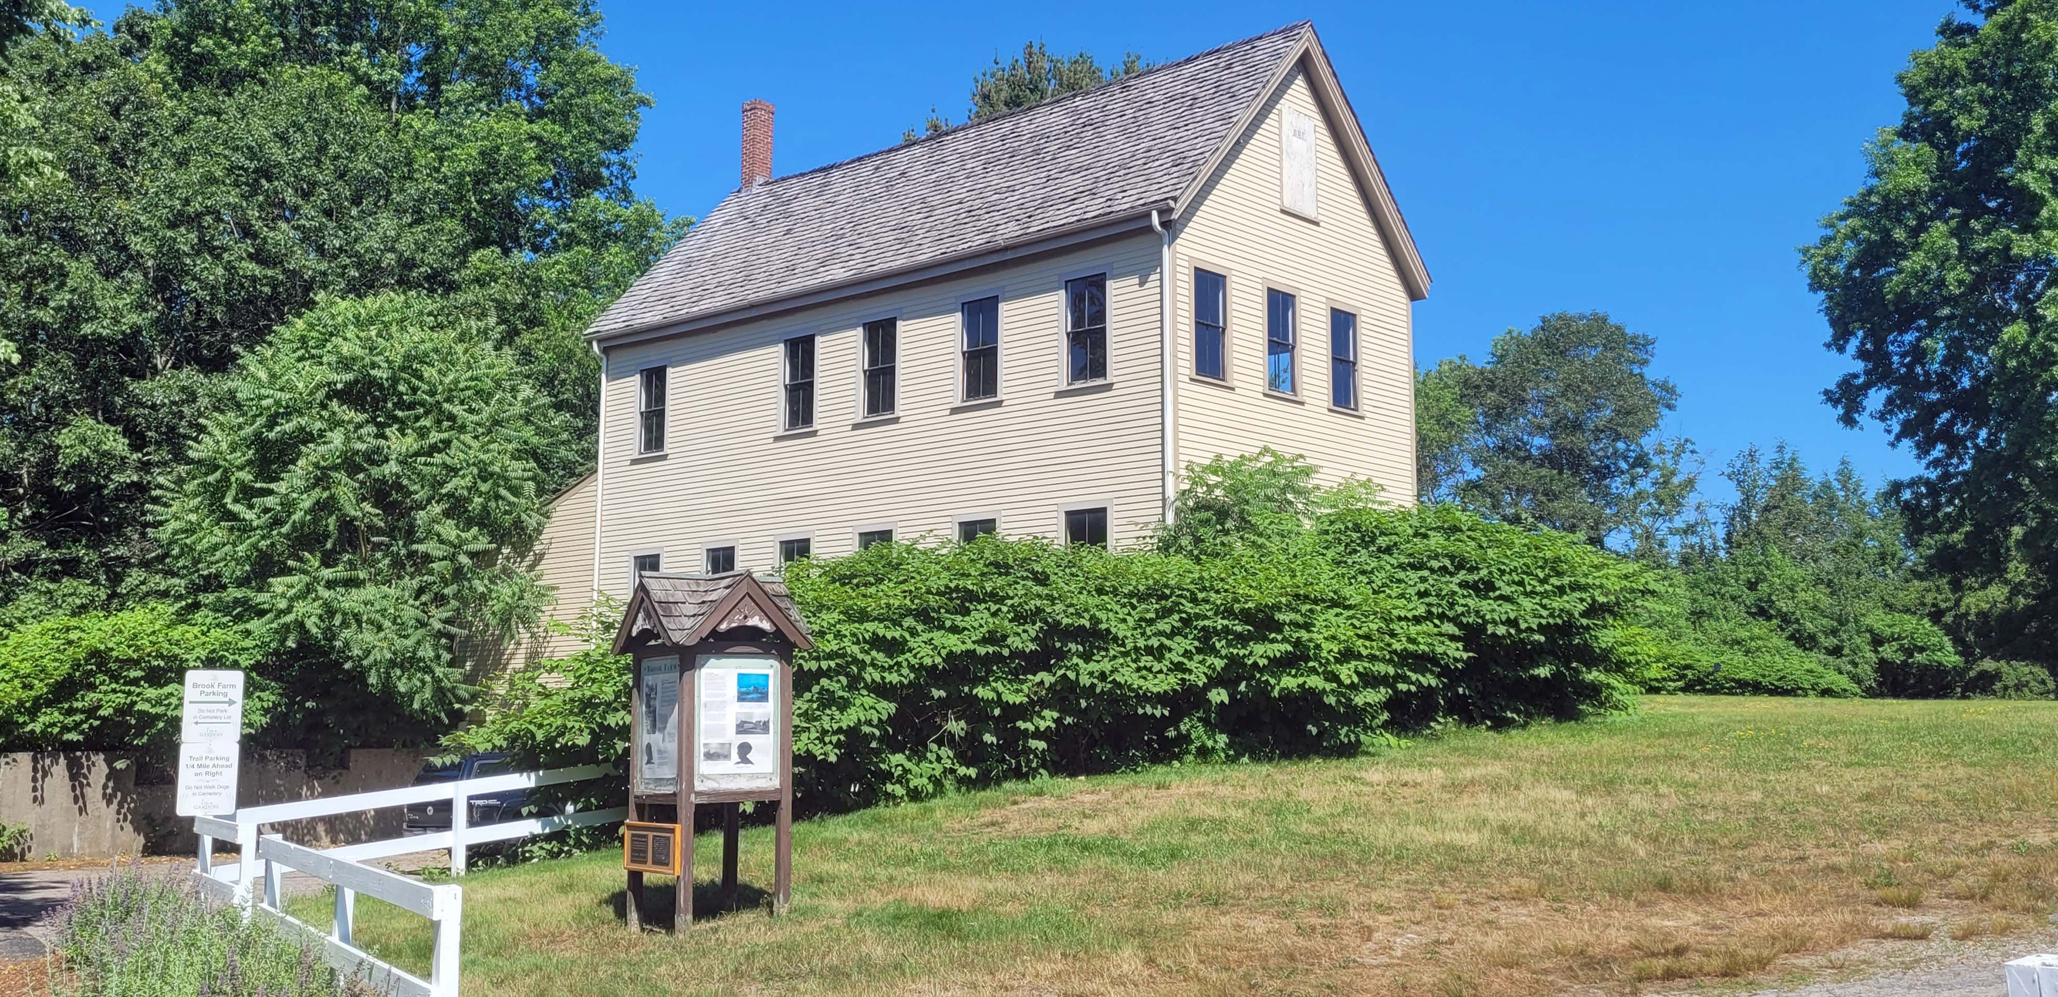
BROOK FARM HISTORIC SITE
Conceptual Plan
Public Information Meeting
Massachusetts Department of Conservation and Recreation
Thursday, June 25th
6:00 PM – 7:30 PM
Historical Print Shop building at Brook Farm
Notes:
Dan Cushing

Slide 2
Commonwealth of Massachusetts
Notes:
Dan Cushing
2

Slide 3
DCR Mission and Core Principles
Notes:
Dan Cushing
3

Slide 4
Meeting Logistics
Notes:
Dan Cushing
4

Slide 5
Agenda
Team Introductions
Project Scope
Summary of Public Comments on Draft Concepts
Site Location and Assessment
Overall Park Concept
Historic Core Landscape Treatment
Preferred Conceptual Plan
Precedent Images
Potential Timeline
Q&A
Notes:
Dan Cushing
5

Slide 6
Project Team
Department of Conservation and Recreation
Wendy Pearl, Director, Office of Cultural Resources
Paul Cavanagh, Resource Management Planner
Aimee Graeber, Resource Management Planner
Dan Cushing, Director of Public Engagement
Ray Dunetz Landscape Architecture, Inc.
Ray Dunetz, PLA, ASLA, Principal
Michelle de Tarnowsky, PLA, Landscape Architect
Pian Zhang, Designer
Notes:
Dan Cushing
6

Slide 7
Project Scope
GOALS
Establish resource management framework
Understand significance of the property and current conditions
Identify opportunities to enhance visitor experience
PRODUCTS
Resource Management Plan - Adopted by DCR Stewardship Council June 11th
Conceptual Design
Notes:
Wendy Pearl
7

Slide 8
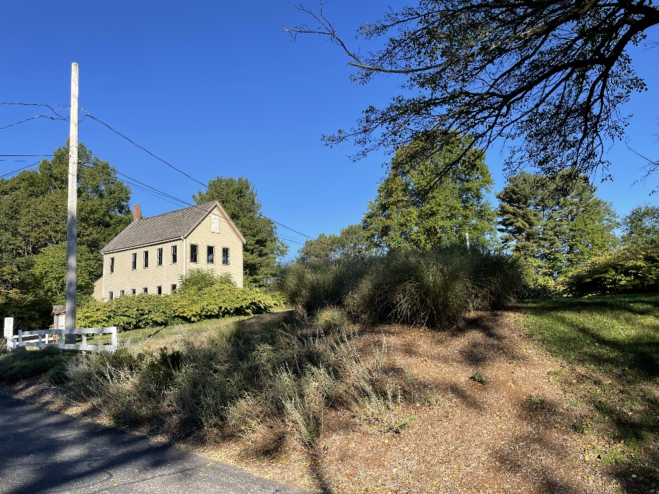
Comments (1 of 3)
72 individuals or organizations commented
Many people (44%) reiterated concerns raised during the RMP process including:
  Impacts of recreation on cemetery visitors and services
  Cemetery management authority over Parcel B
  Safety at entrance
  DCR coordination with Cemetery managers
Of those who commented on the two design options, all favored Option B, with a strong preference for B-2
Extensive support for a farm

Slide 9
Comments (2 of 3)
Concern over increased use leading to more bikes, dogs, noise, conflicts with cemetery operations
Support for continued and enhanced public access to the natural resources of Brook Farm and to the cultural sites and landscape including interpretive signage
Opposition to the “change in use” being presented by DCR.(5 comments) This was a misunderstanding – there is no change in use proposed to the Commonwealth property

Slide 10
Comments (3 of 3)
Many people at the first public meeting and a few written comments addressed the condition of the Baker Street sidewalk. DCR is consulting with the Boston Transportation Department on that issue
Comments on access to Pulpit Rock resulted in a new notation on the plans for a connecting trail (once rights can be secured)
Corrections:
  Cemetery confirmed the common name for their property is Gardens Cemetery
  One trail passes across cemetery land, now shown as a trail to be relocated

Slide 11
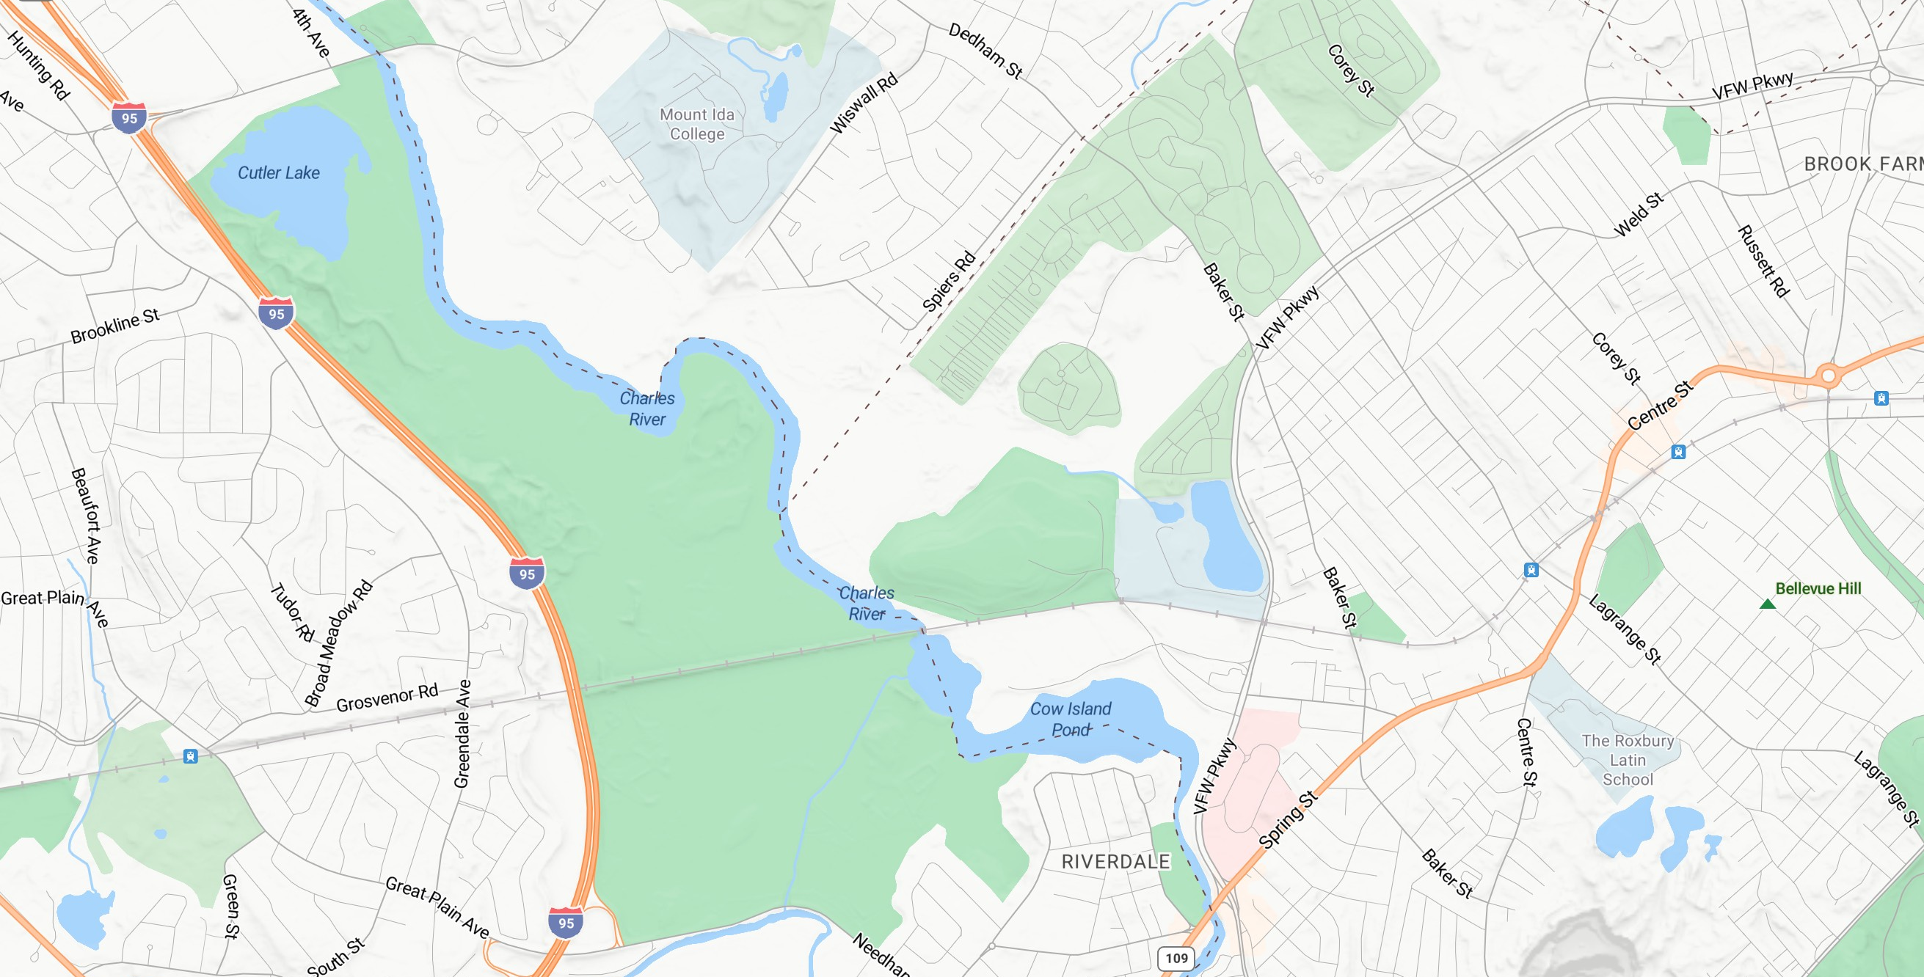
Site Location
Brook Farm
Historic Site
Notes:
The site is located in the West Roxbury neighborhood of Boston within close proximity to the Charles River
Nearby parks include Millennium Park to the south and Charles River Reservation to the North.
The site is abutted by cemetery land uses, including the Gardens Cemetery, which is completely surrounded by the DCR property.
11

Slide 12
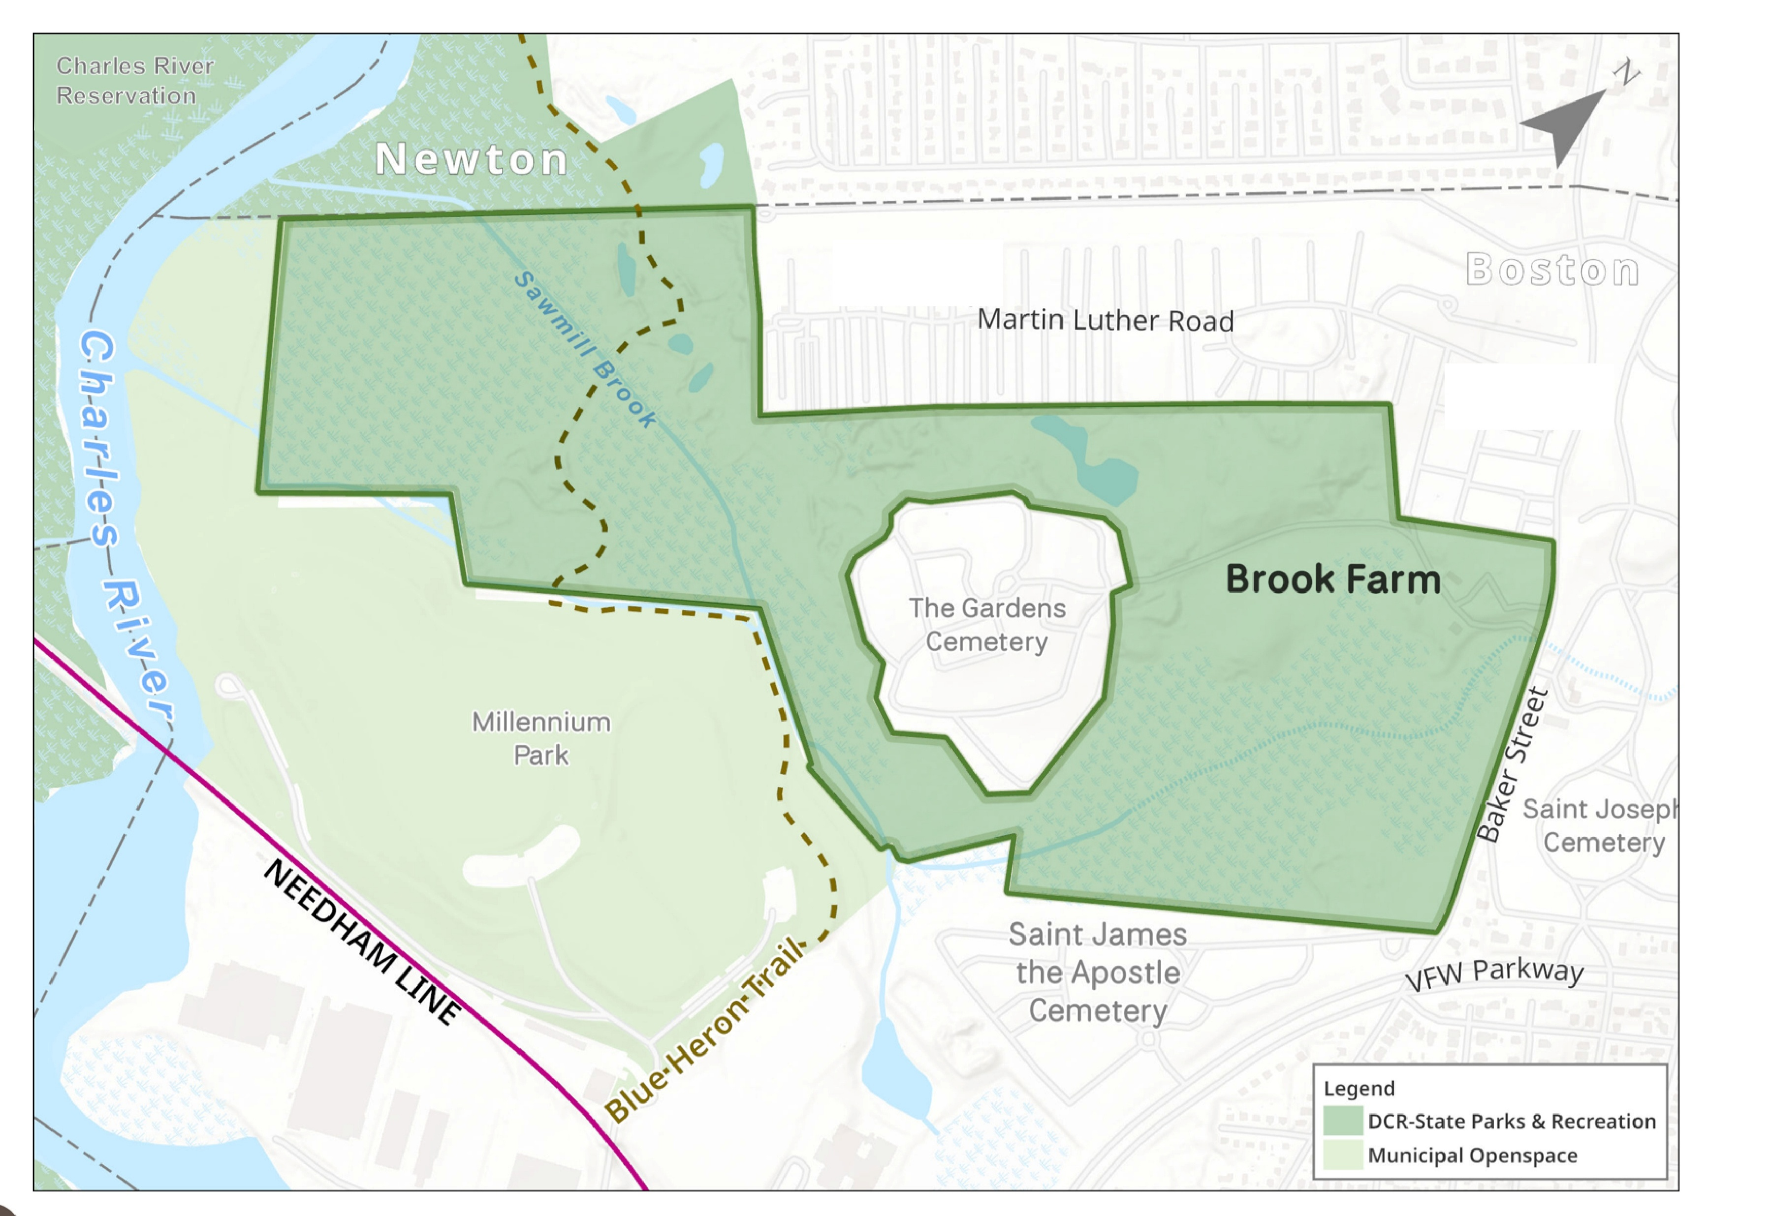
Site Context
Baker Street Jewish Cemeteries
Notes:
This slide provides an enlargement of the site located off Baker Street
The darker green area is DCR, while the lighter green represents municipally owned Open Space.
12

Slide 13
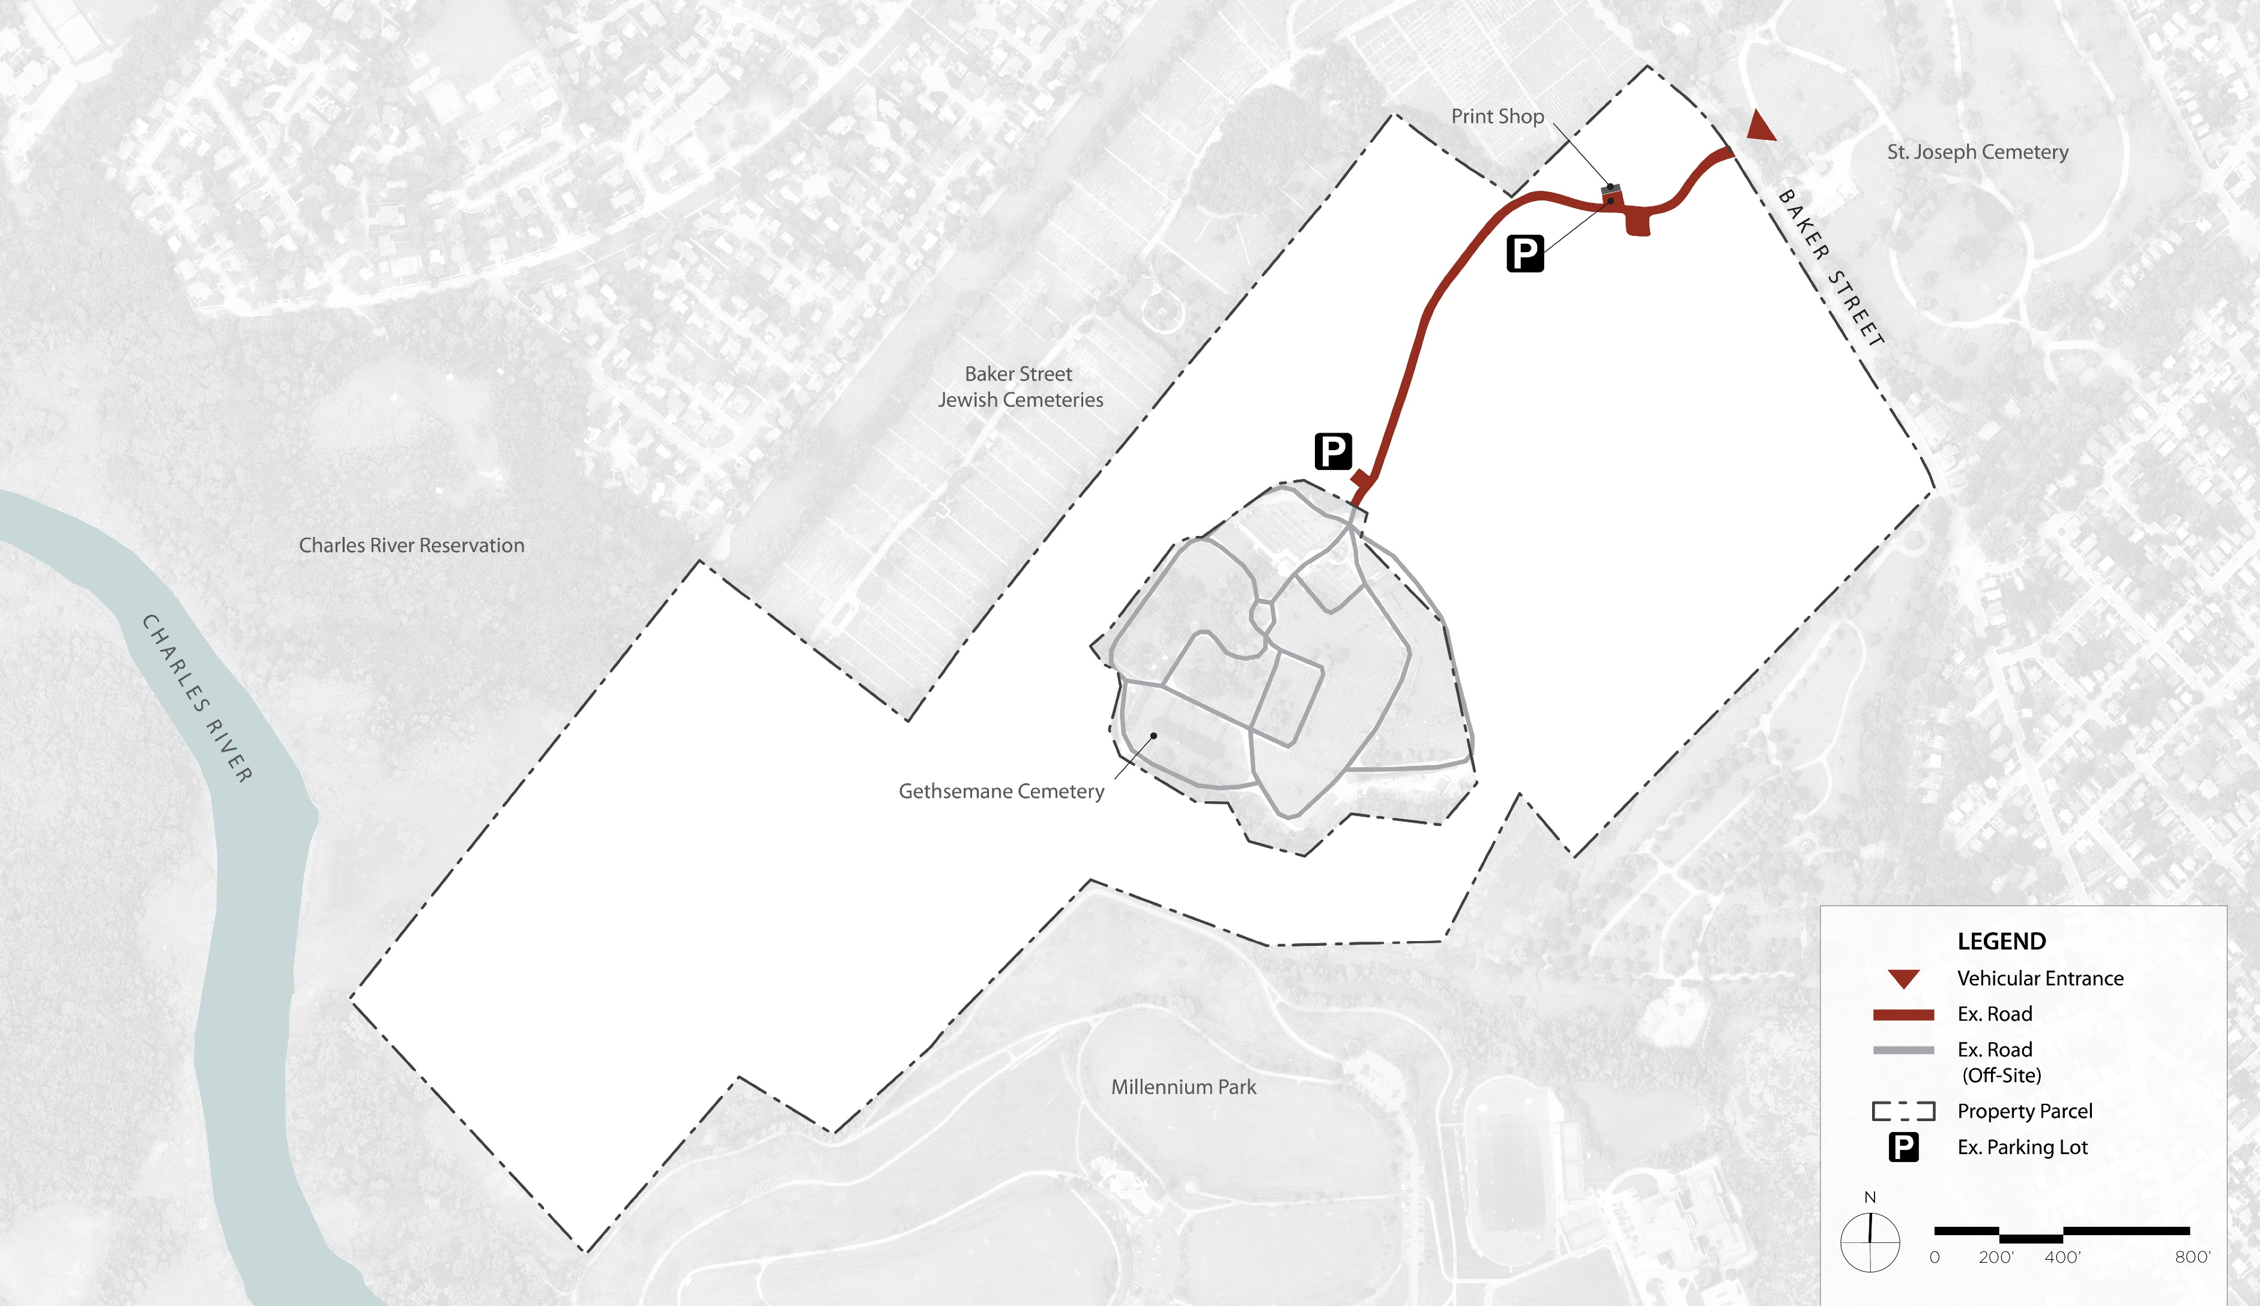
Site Analysis
Multimodal Circulation
The Gardens Cemetery
Multimodal Entrance
Notes:
Multimodal circulation is defined by networks that enable people to reach destinations using multiple modes—such as walking, cycling, transit, and driving
The site is accessed from Baker Street by car, bike or on foot.
There is a nearby bus stop on Baker Street, allowing access to the site via public transportation
There are two existing informal parking areas, one adjacent to the Print Shop and one back towards the Garden Cemetery.
The site is also accessed by trails from abutting parks which we will discuss on the next slide.

Slide 14
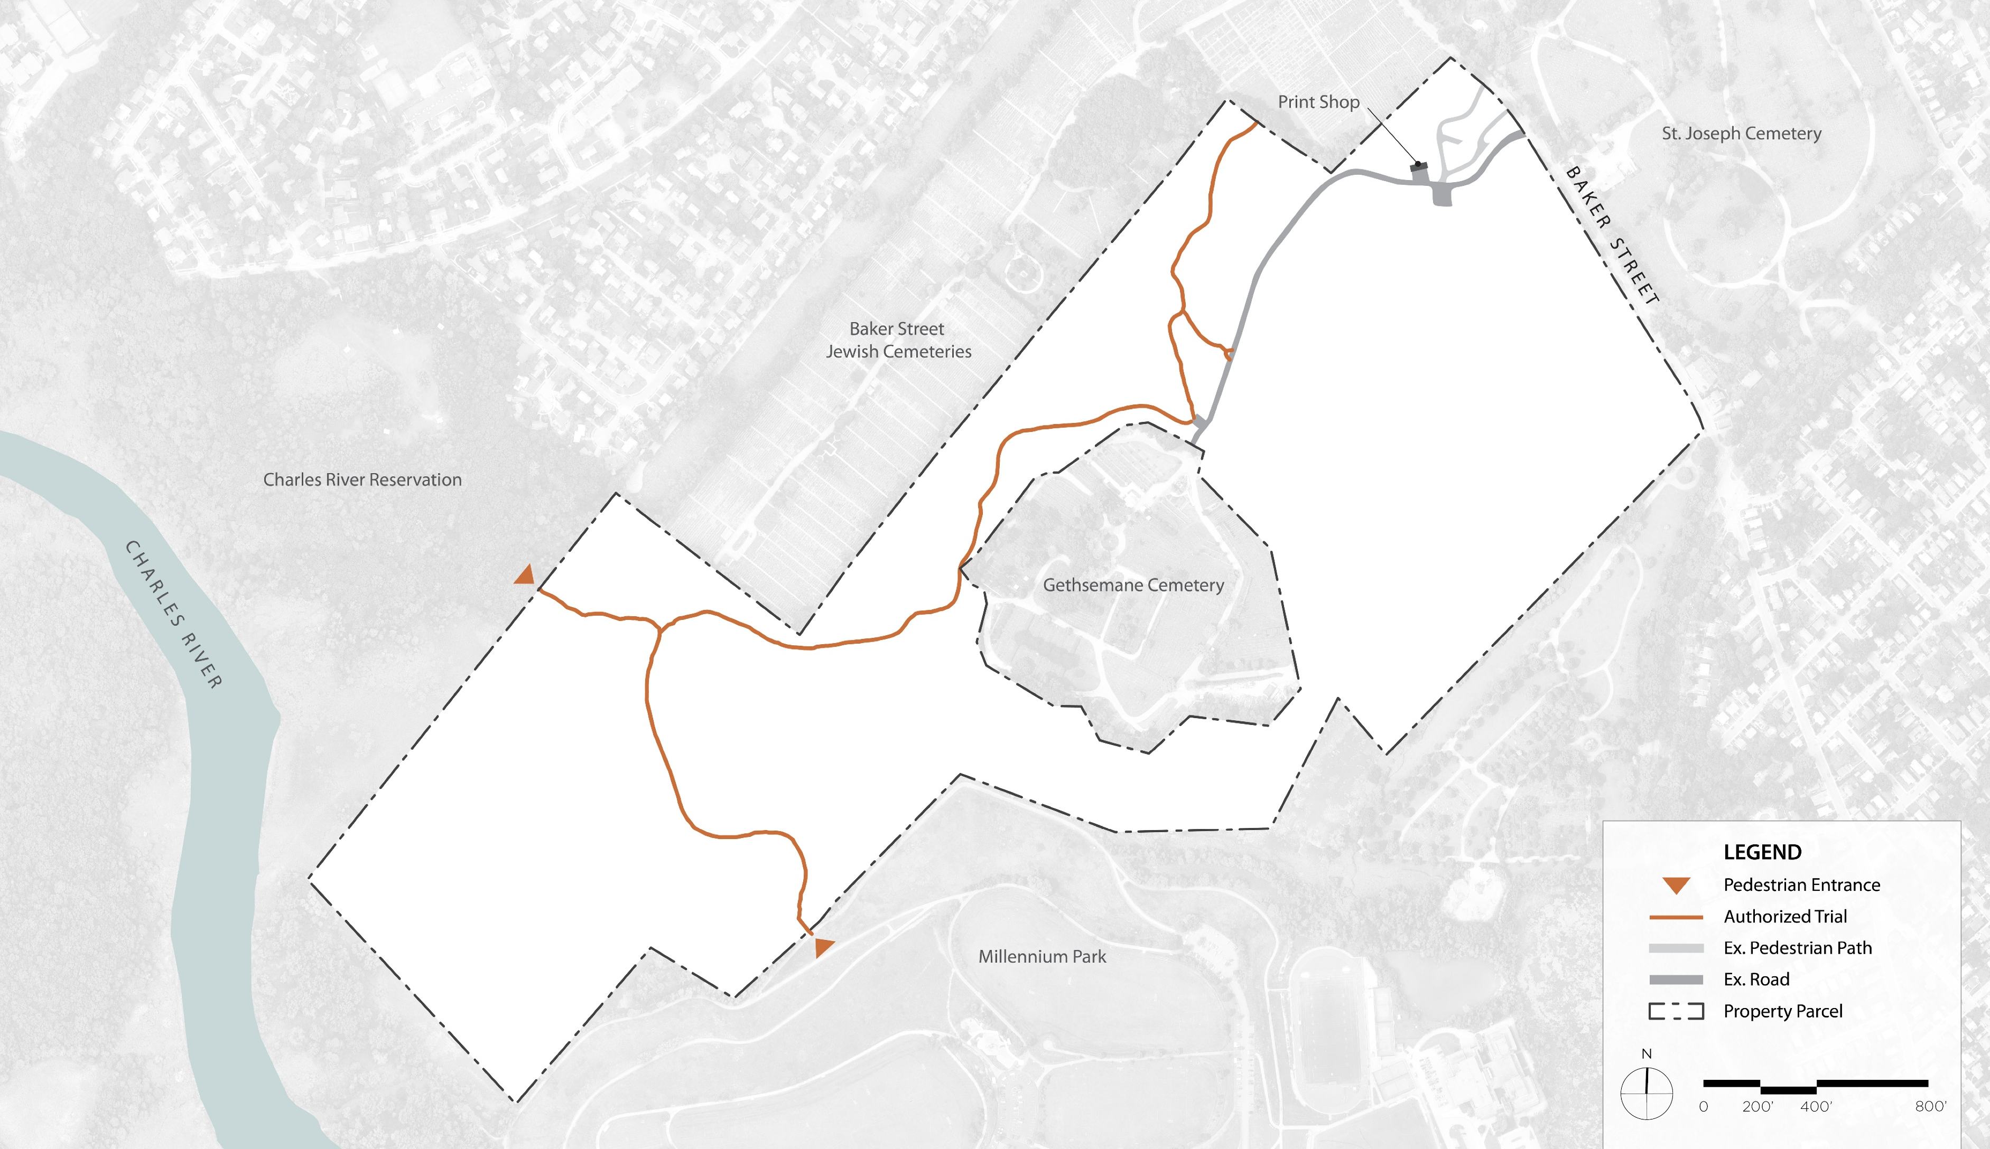

Site Analysis
Trails
The Gardens
Notes:
The site features a system of authorized trails, including the Blue Heron Trail, which connects to Millennium Park to the South.
These trails are indicated as brown lines.
The historic core features some paved walkways, some of which are not compliant with the Americans with Disabilities Act of 1996.
The site is accessed by trailheads at Charles River Reservation and Millennium Park.
The Blue Heron Trail connects Brook Farm to Millenium Park.

Slide 15
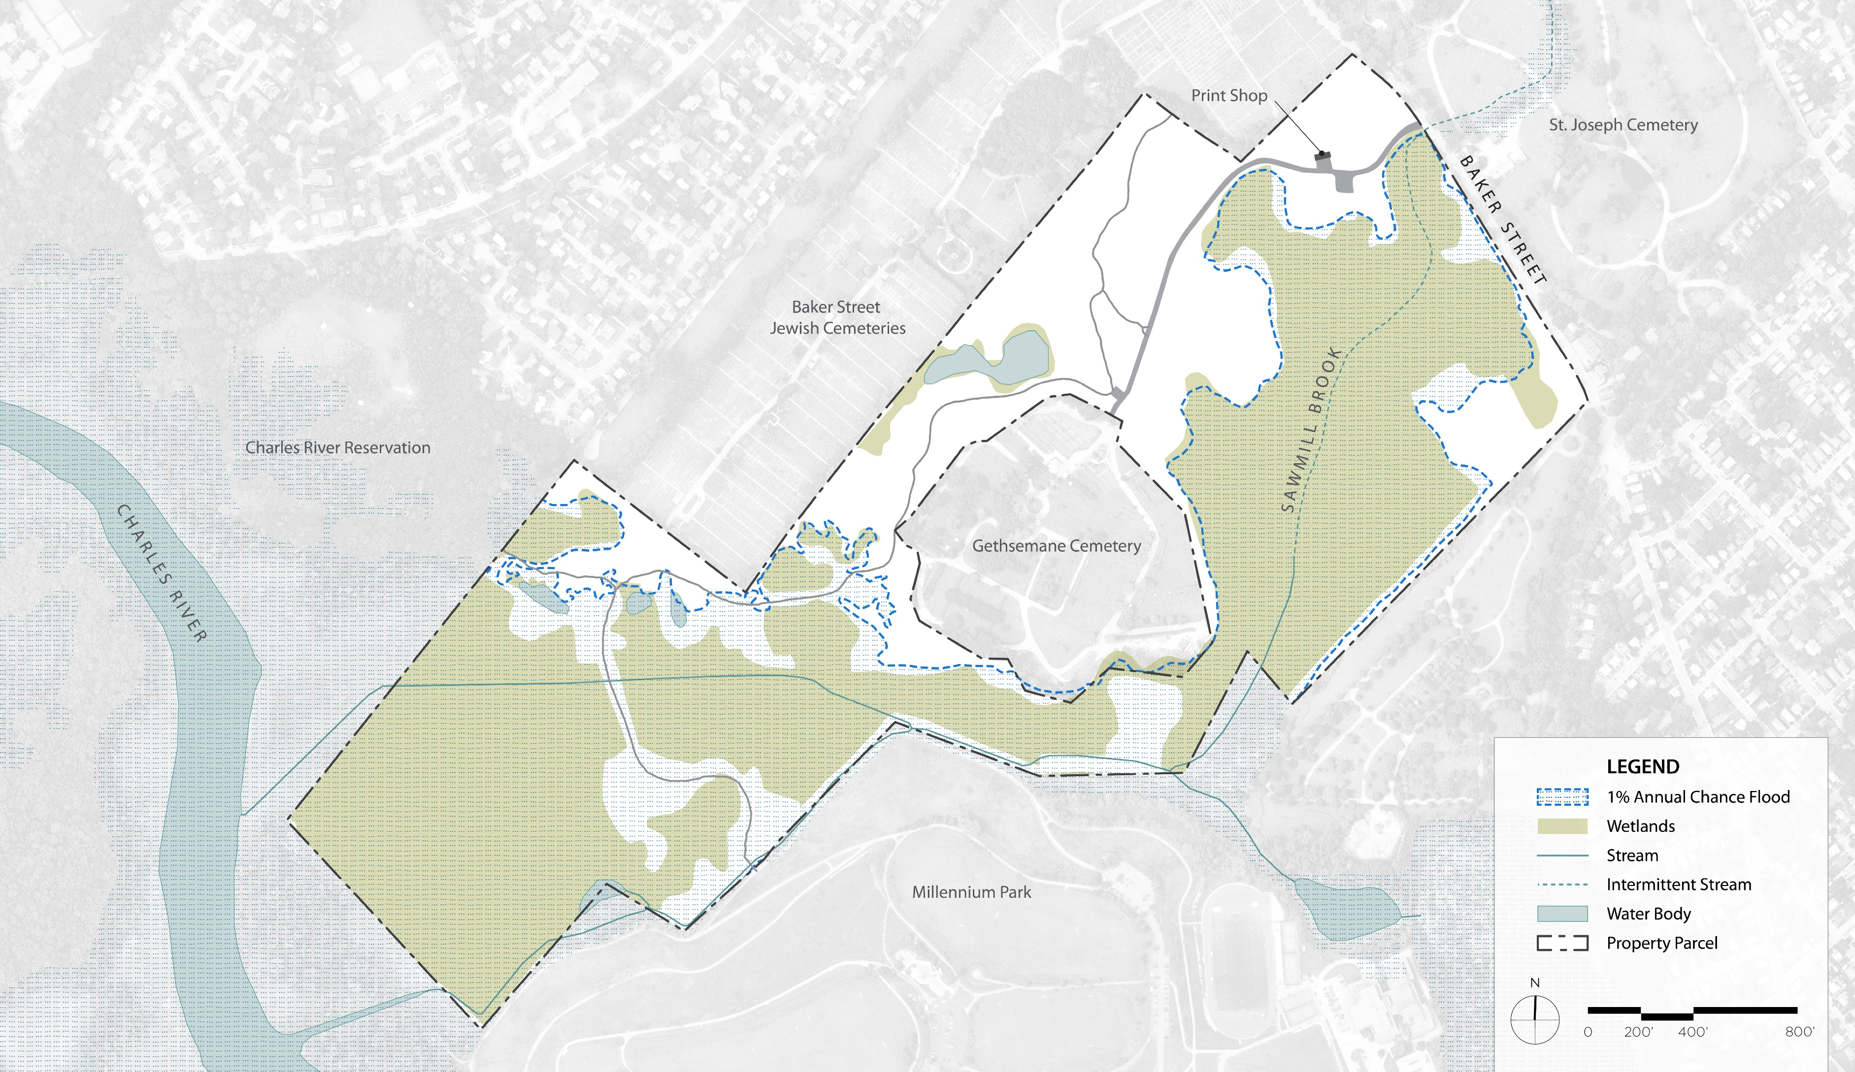
Site Analysis
Hydrology
The Gardens
Notes:
The site's hydrology is highly dynamic, featuring wetlands, vernal pools, streams and small ponds.
Much of the site is subject to a 1% annual chance of flooding, depicted by the dashed blue line.

Slide 16
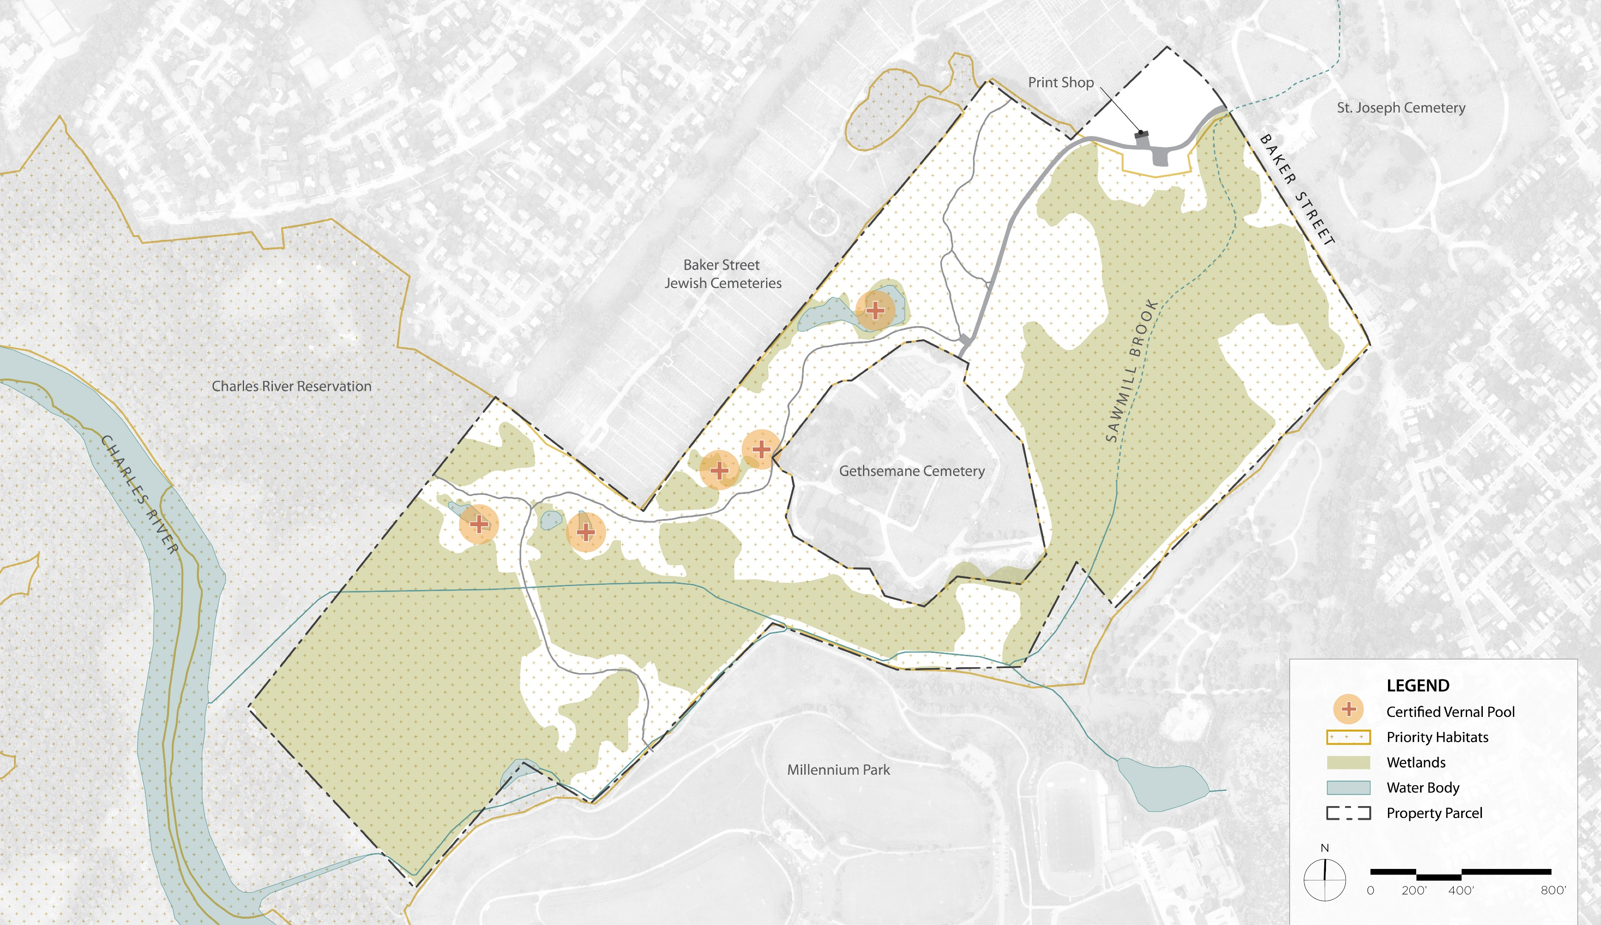
Site Analysis
Priority Habitat
The Gardens
Notes:
Much of the site is regulated as Priority Habitat, which makes Brook Farm an ecologically special place.
The site features vernal pools represented by the orange circles, wetland represented in green and water bodies shown in blue.
The historic core is outside of the Priority Habitat areas.

Slide 17
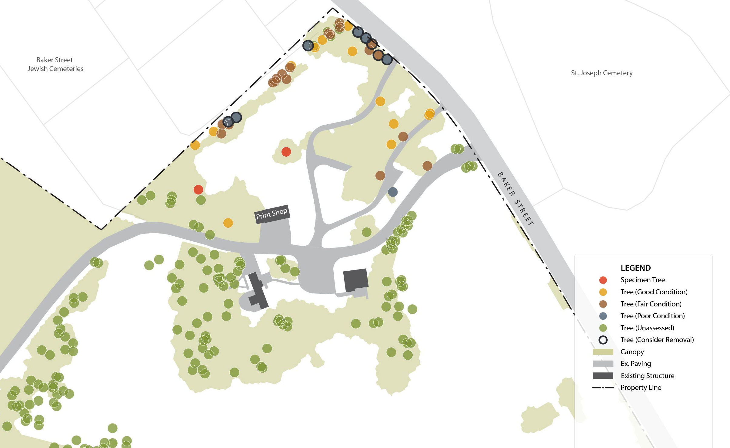
Site Analysis
Tree Assessment
Notes:
RDLA worked with a certified arborist to provide a Level One Tree Assessment in the historic core area.
A Level 1 assessment is a cursory, ground-based visual inspection intended to provide a rapid evaluation of tree condition and to identify obvious defects, hazards, or concerns.
The two red circles represent the specimen trees on the site. One is a 31” pin oak and the other is a 50” White Pine.
Orange circles represent trees in good condition.
Brown and blue circles represent trees in fair and poor condition, respectively.
Trees outlined in black should be considered for removal, as they pose a public safety risk. They are comprised of Mulberries, Cherries, White and Red Pines.
There have been reports of invasive Black Locust growing outside of our study area.
Provide data of trees in the area

Slide 18
Project Goals
Enhancing public use through
Interpretation
Accessibility improvements
Potential adaptive reuse of the Print Shop
Sustainable site improvements
Convey historic land uses such as agriculture, and
Passive recreational programming
Notes:
Read the text.
Mention existing cellar holes with historic land uses.
These goals are consistent with those set in the RMP for the site.

Slide 19
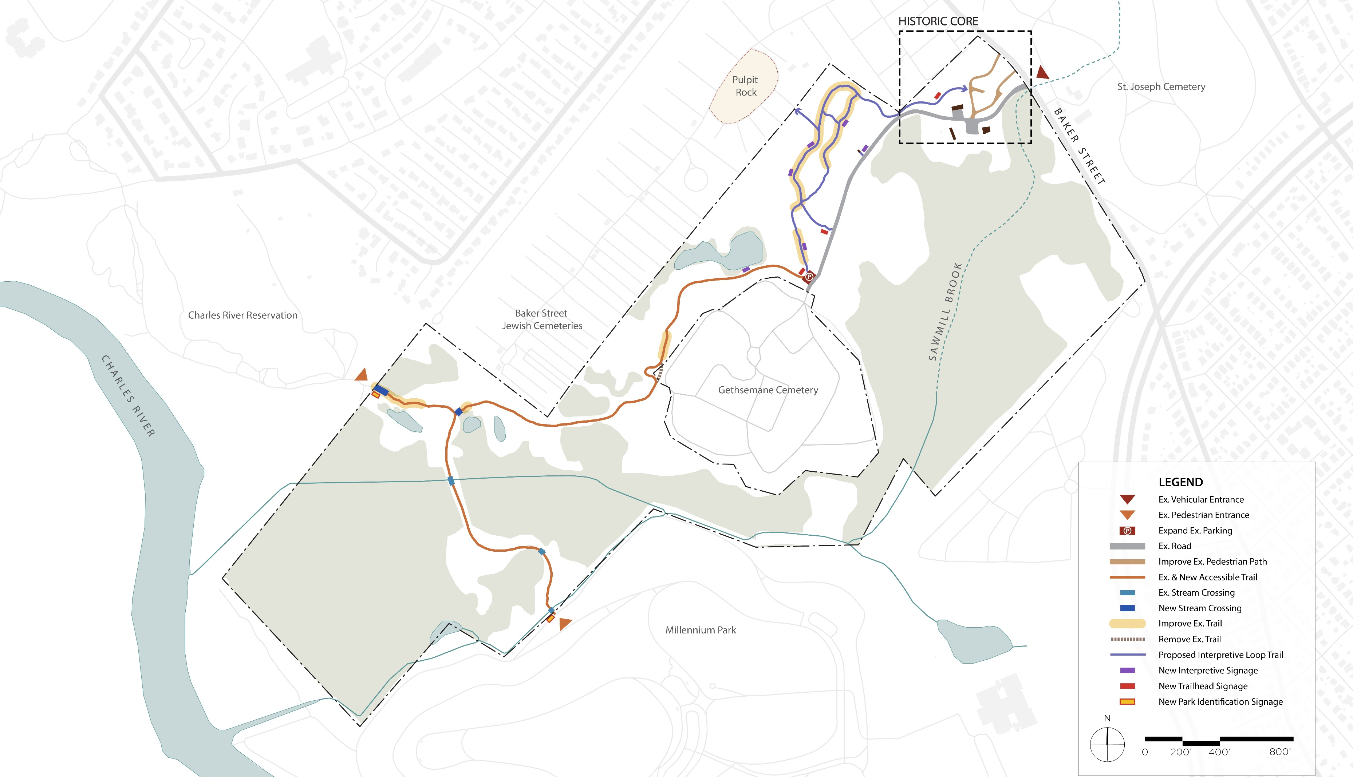
Full Site Concept
Enlargement B
Enlargement A
The Gardens
Multimodal Entrance
Notes:
Following our analysis of the site, we prepared a design concept for the full site.
This slide shows the full site to get your bearings. We broke our concept into two enlargement areas, north and south, outlined in a red dashed line.
We will now review each enlargement area.

Slide 20
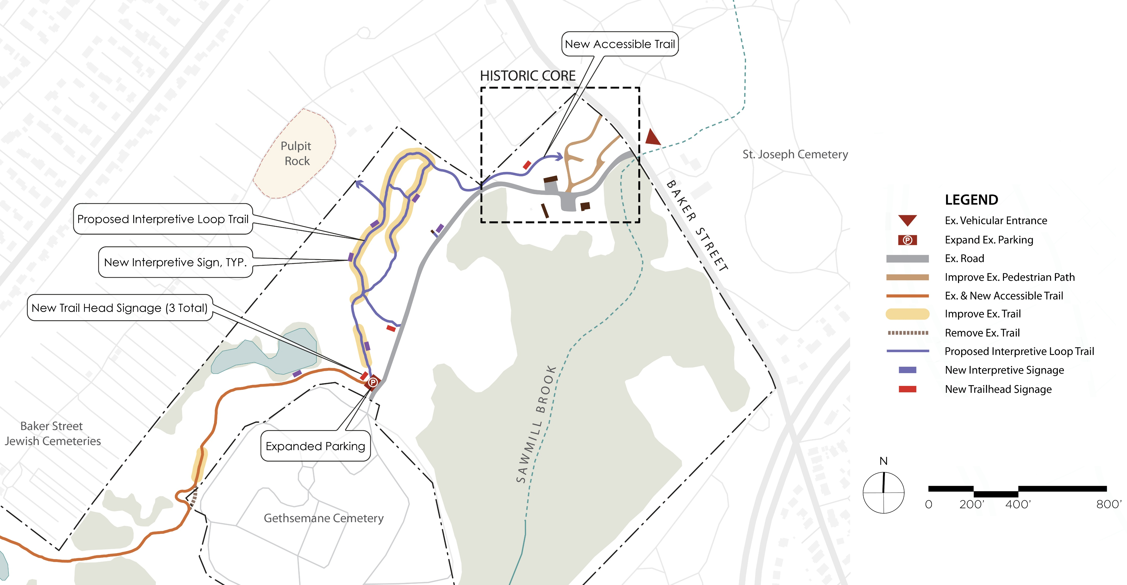
Full Site Concept
Enlargement A
Future Connection to Pulpit Rock
Relocate Trail onto DCR Property
The Gardens
Notes:
In the northern enlargement area, or enlargement A, we looked at how to connect the historic core to the sensitive resources and interpretive sites immediately to the west.
This concept creates an accessible trail from this historic core to a new interpretive trail loop system.
The accessible trail standard we used was the US Forest Service standard, which allows for up to 12% slopes.
DCR accessible trail standard width is 5’ and is surfaced with natural materials such as fine aggregates.
Each interpretive site would feature an accessible sign describing its history.
We recommended expanding the existing southern parking area by a couple of spaces to accommodate more visitors arriving by car.
The concepts for the historic core will be reviewed later in our presentation.

Slide 21
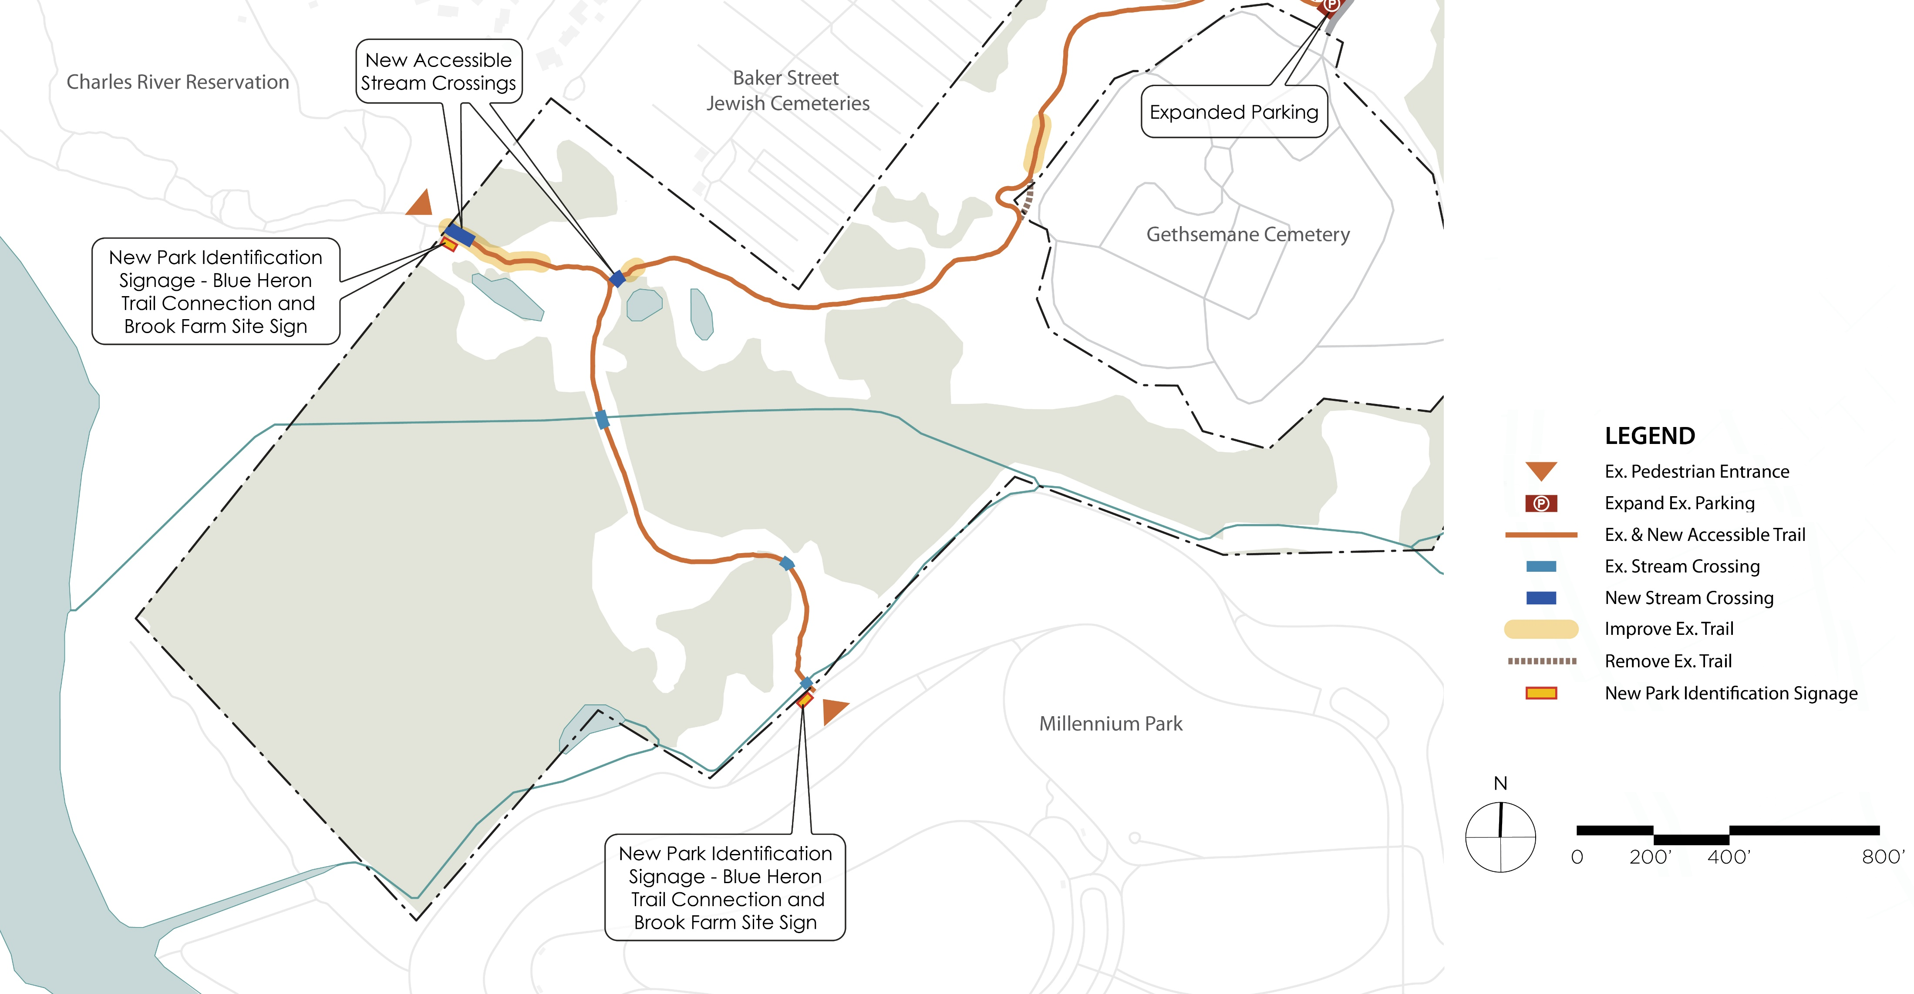
Full Site Concept
Enlargement B
Relocate Trail onto DCR Property
The Gardens
Notes:
Improvements in the southern section of the site focus on new identification signage at the entrances from Millennium Park and the Charles River Reservation, and improved trails and accessible stream crossings, shown in dark blue.

Slide 22
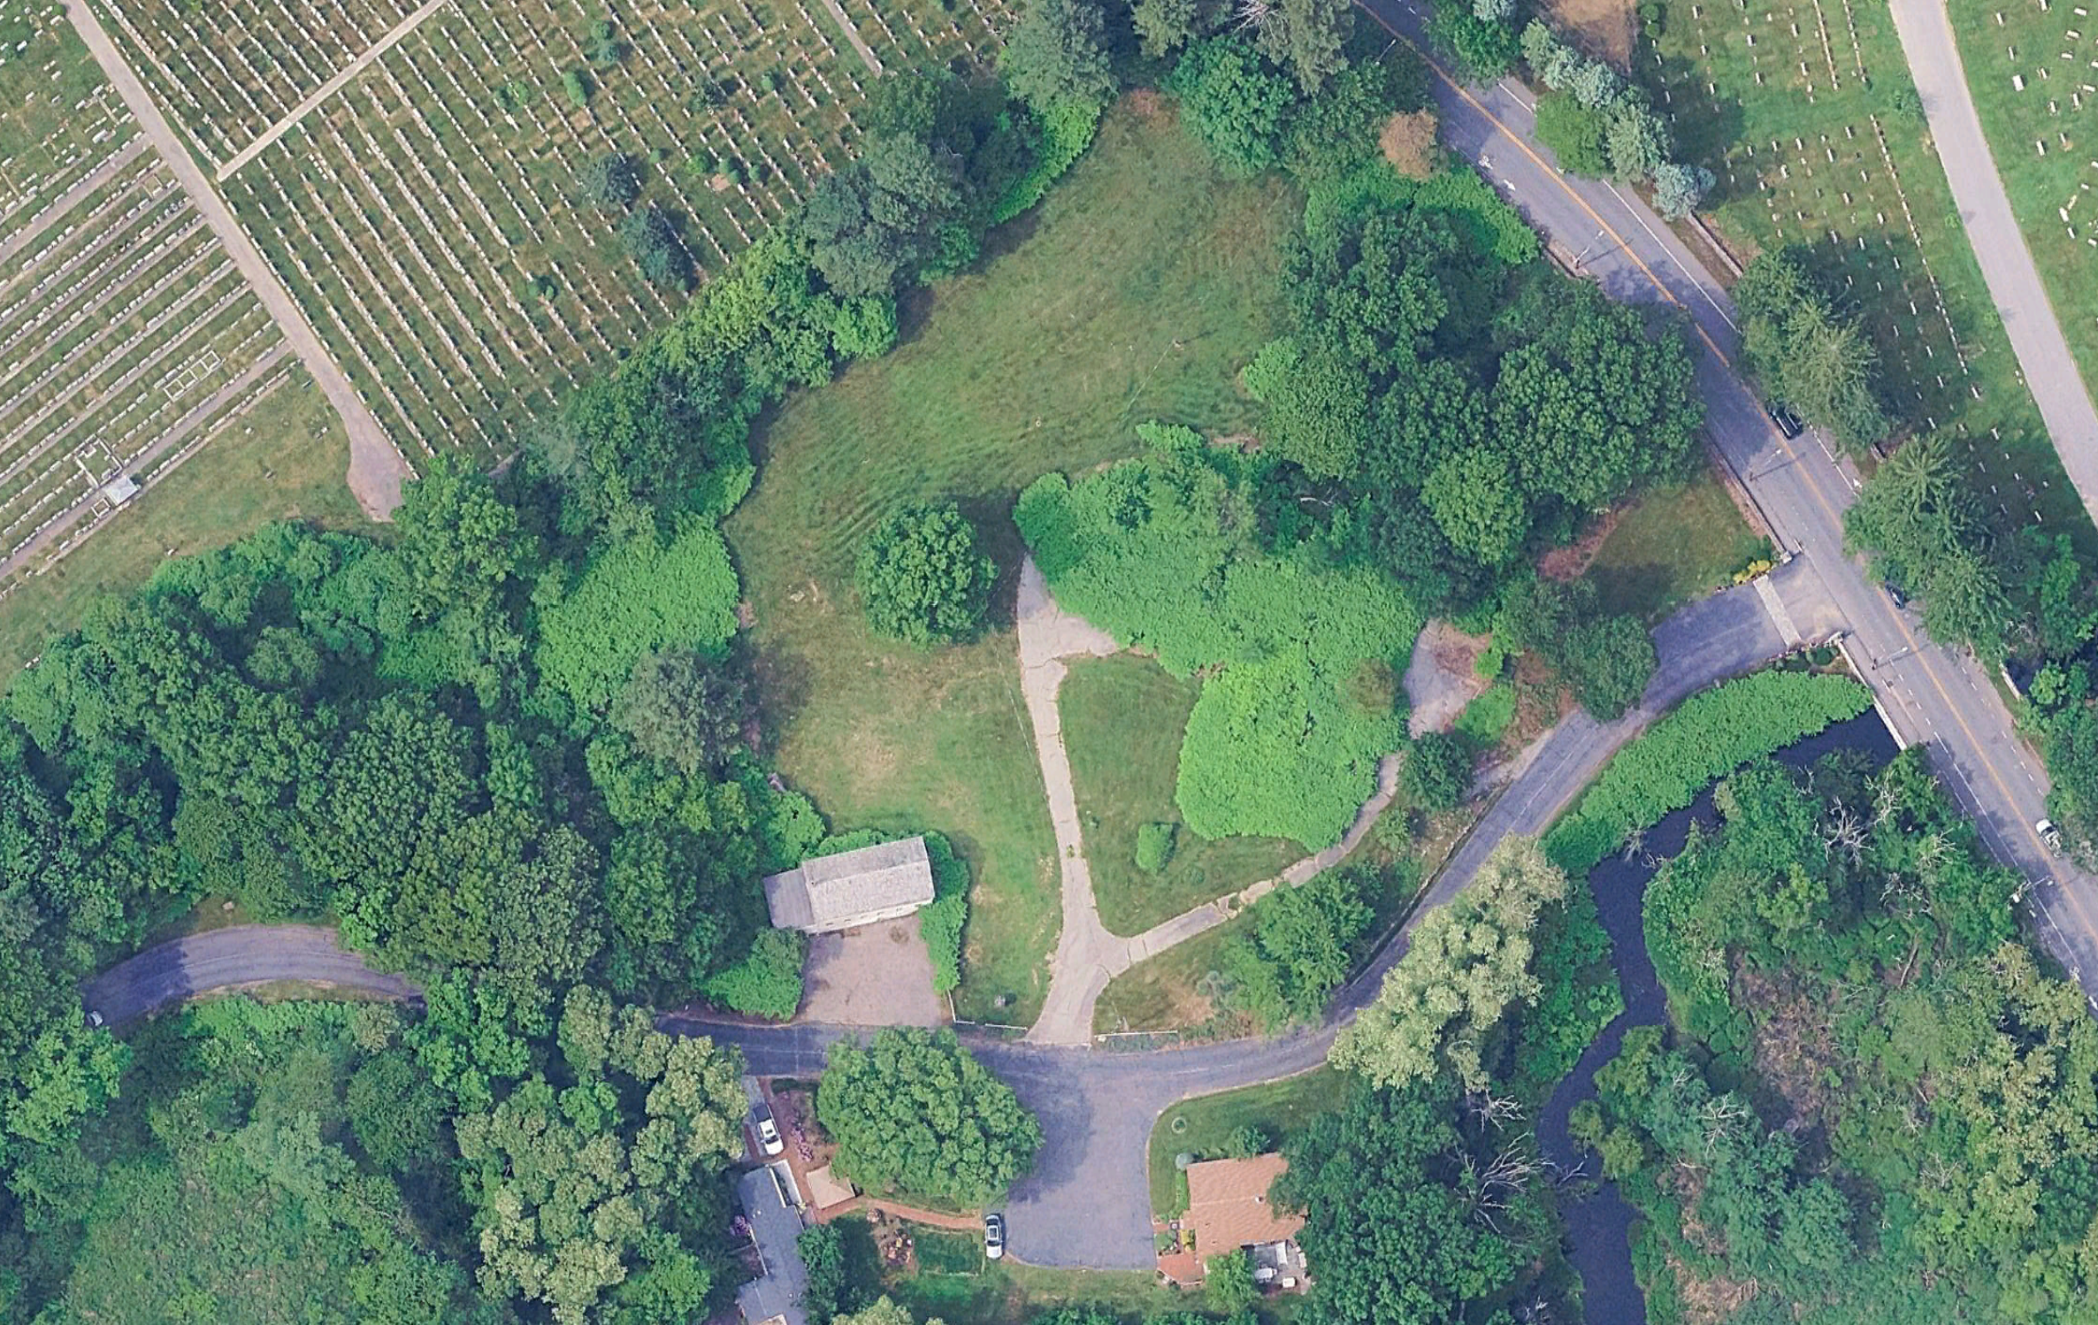

Historic Core
Landscape Treatment
No. | Feature/Treatment
1 | PRINT SHOP
2 | FORMALIZE PRINT SHOP PARKING
3 | REMOVE INVASIVE VEGETATION
4 | REMOVE EXISTING PAVING
5 | PRESERVE MATURE TREES
6 | IMPROVE SIGHT LINES AT EXISTING MULTIMODAL ENTRANCE
7 | REPLACE EXISTING KIOSK
8 | EXPOSE AND STABILIZE HISTORIC FOUNDATIONS
9 | PRESERVE HISTORIC WALLS AND FENCES
10 | PROVIDE INTERPRETIVE AND WAYFINDING SIGNAGE
11 | PROVIDE BIKE RACKS
12 | CONNECT HISTORIC CORE TO PROPOSED INTERPRETIVE LOOP
3
5
BAKER STREET
3
3
6
10
12
11
8
4
1
9
3
10
2
7
11
Notes:
Our concepts for the historic core are guided by commonalities in the following landscape treatments.
Read the treatments and point to each.

Slide 23
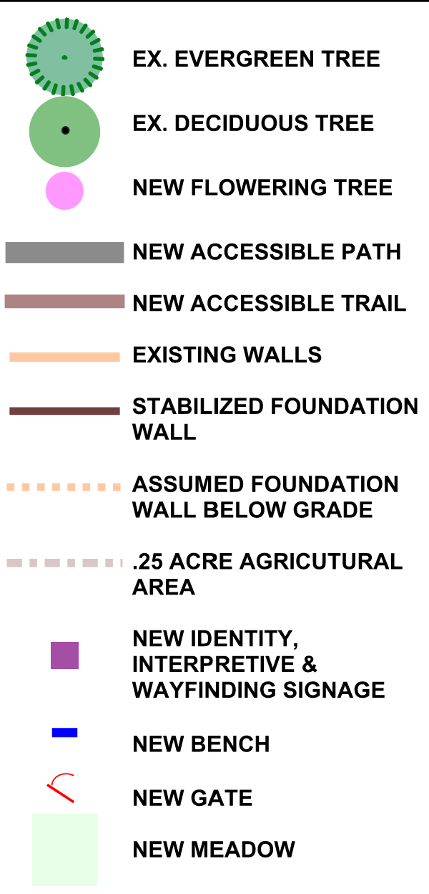
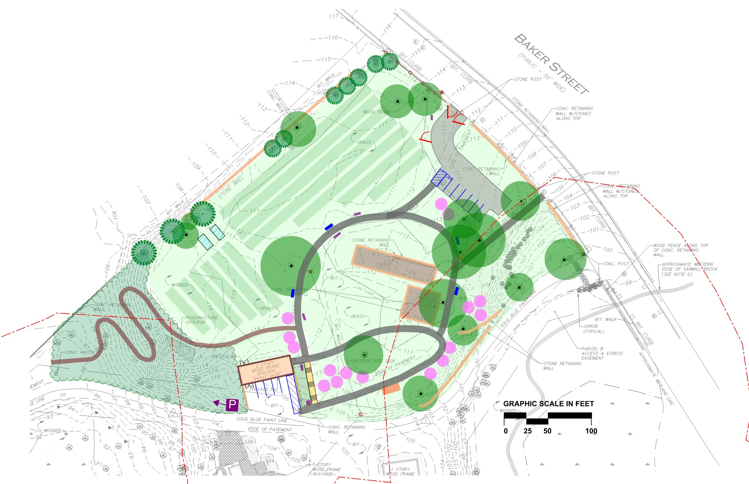

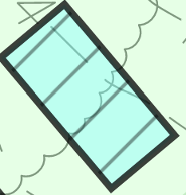

Historic Core
Preferred Concept
CITY OF BOSTON SIDEWALK
NEW PARK
ENTRANCE/EXIT
FARM GATE
.6 ACRE AGRICULTURAL AREA [BY OTHERS]
NEW PARKING
1 VAN, 7 REGULAR
PROPOSED GREEN HOUSE
PEDESTRIAN ENTRANCE
SHARED ENTRANCE
PRINT SHOP
TOTAL PARKING
2 VAN
11 REGULAR
PAVE AND STRIPE PARKING
1 VAN, 4 REGULAR
BIKE RACKS
Notes:
Ray will describe concept B-2.

Slide 24
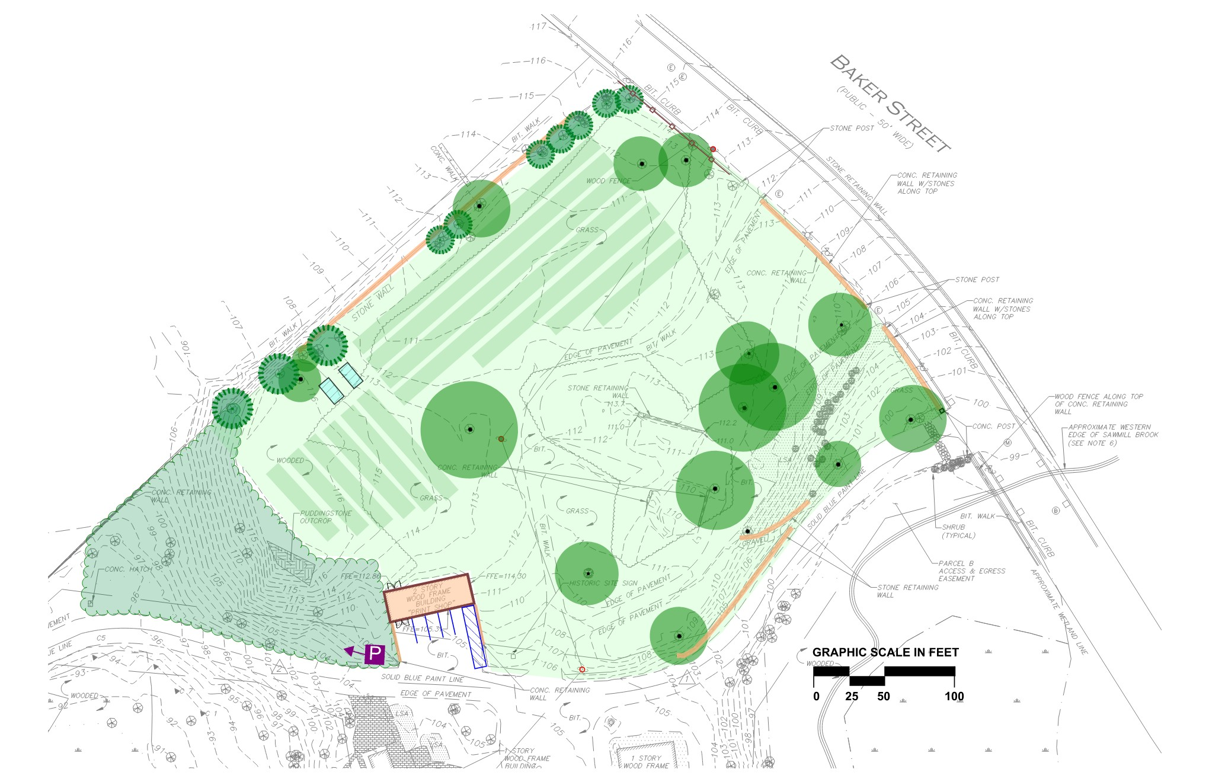
Phase One
CITY OF BOSTON SIDEWALK
TEMPORARY FARM ACCESS
REMOVE HAZARDOUS TREES
.6 ACRE AGRICULTURAL AREA [BY OTHERS]
REMOVE INVASIVE VEGETATION [est. 3-5 YRS]
HOOP HOUSES [BY OTHERS]
SHARED ENTRANCE
PRINT SHOP
WAYFINDING AND REGULATORY SIGNS
PAVE AND STRIPE EX. PARKING LOT
Notes:
Ray will describe concept B-2.

Slide 25

Phase Two
CITY OF BOSTON SIDEWALK
NEW PARK
ENTRANCE/EXIT
FARM GATE
NEW PARKING
1 VAN, 7 REGULAR
NEW ACCESSIBLE PATH
PROPOSED GREEN HOUSE
PEDESTRIAN ENTRANCE
ACCESSIBLE TRAIL
SHARED ENTRANCE
PRINT SHOP
STABLIZE FOUNDATION WALLS
TOTAL PARKING
2 VAN
11 REGULAR
NEW STAIR
BIKE RACKS
Notes:
Ray will describe concept B-2.

Slide 26
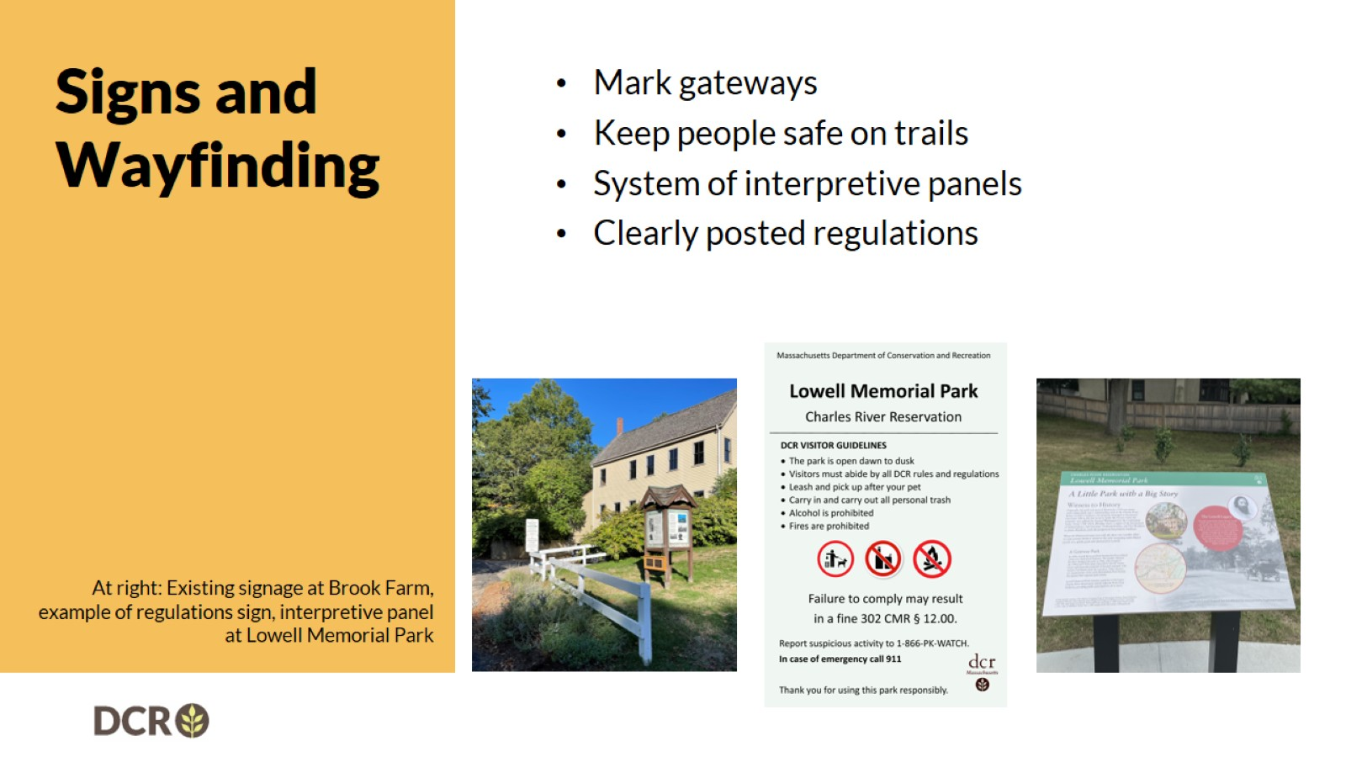
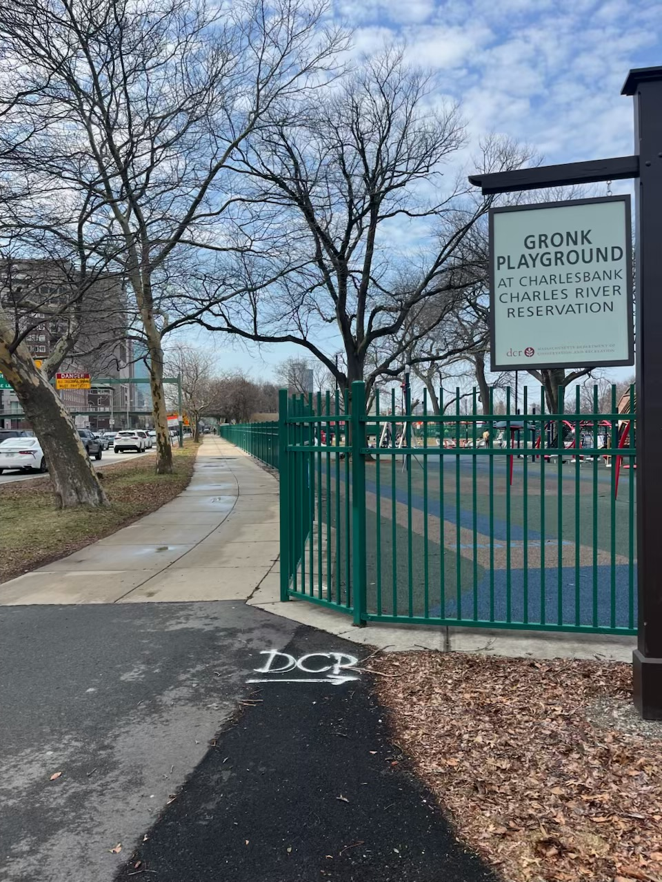
Signs and Wayfinding

Slide 27
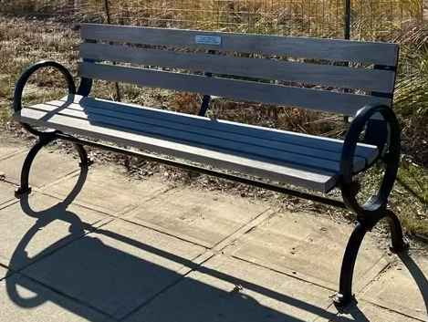
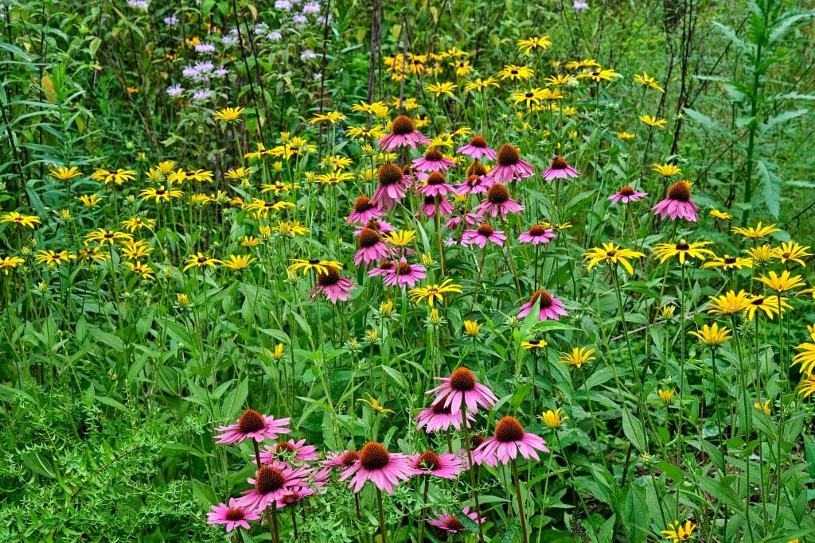
Precedents (1 of 3)
DCR BENCH
POLLINATOR MEADOW
Notes:
Ray will describe concept B-2.

Slide 28
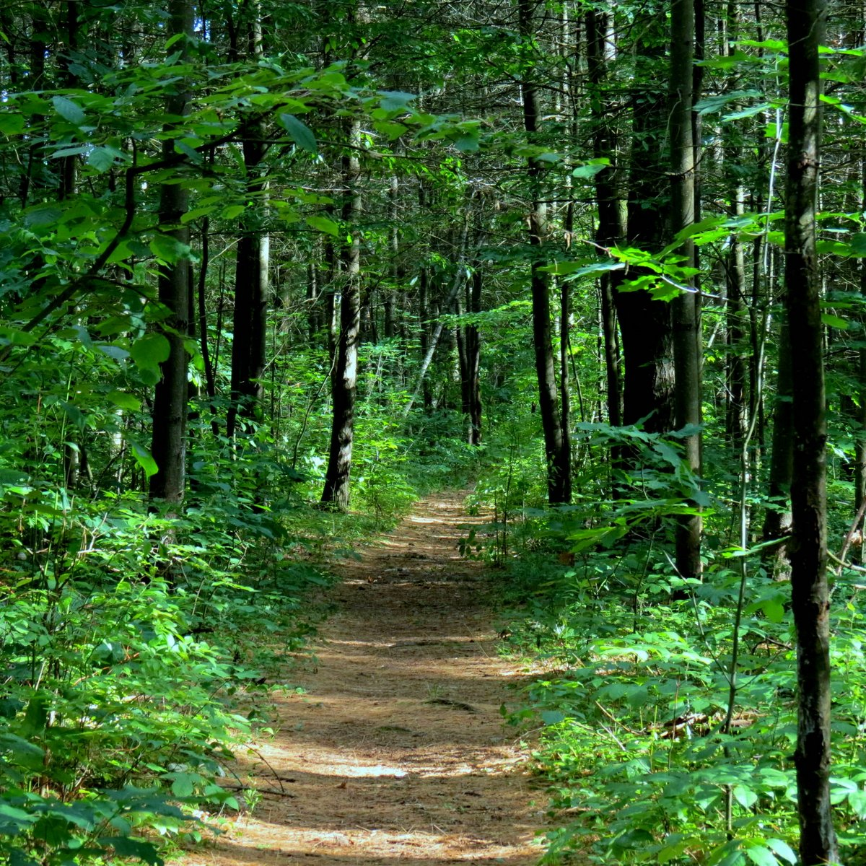
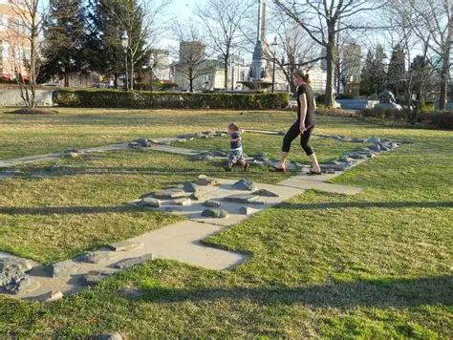
Precedents (2 of 3)
WOODLAND TRAIL
STABLIZED FOUNDATIONS
Notes:
Ray will describe concept B-2.

Slide 29
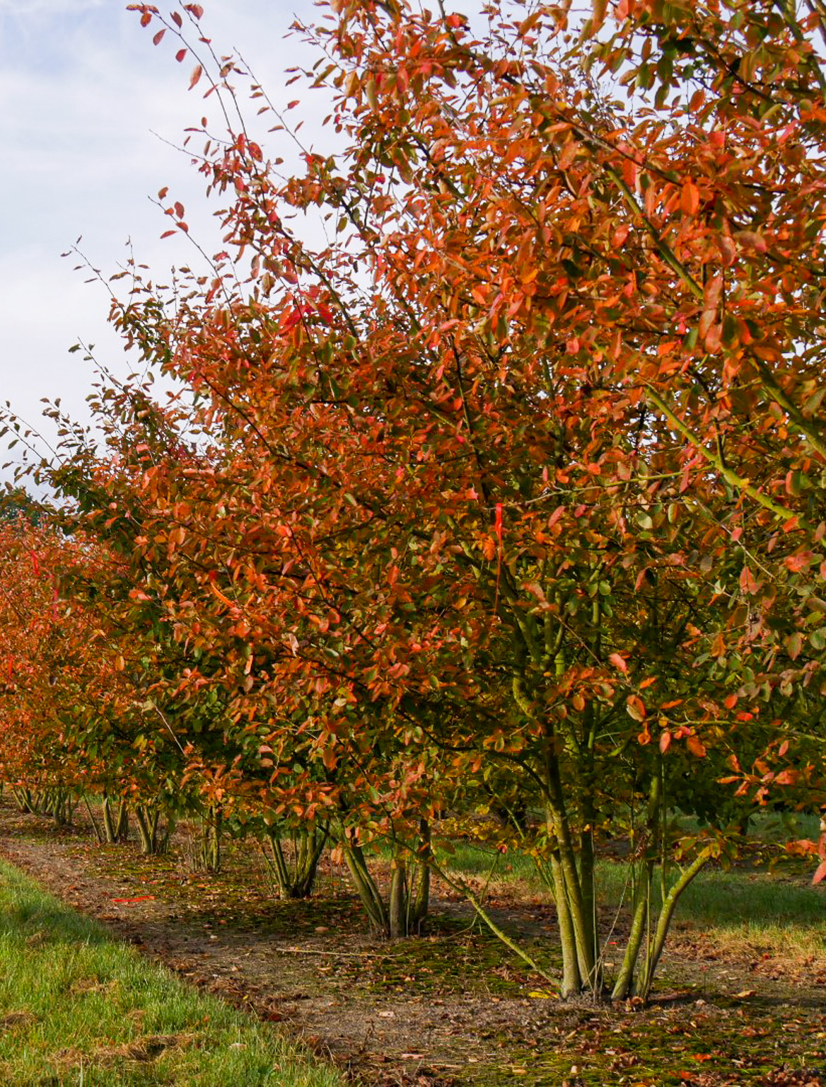
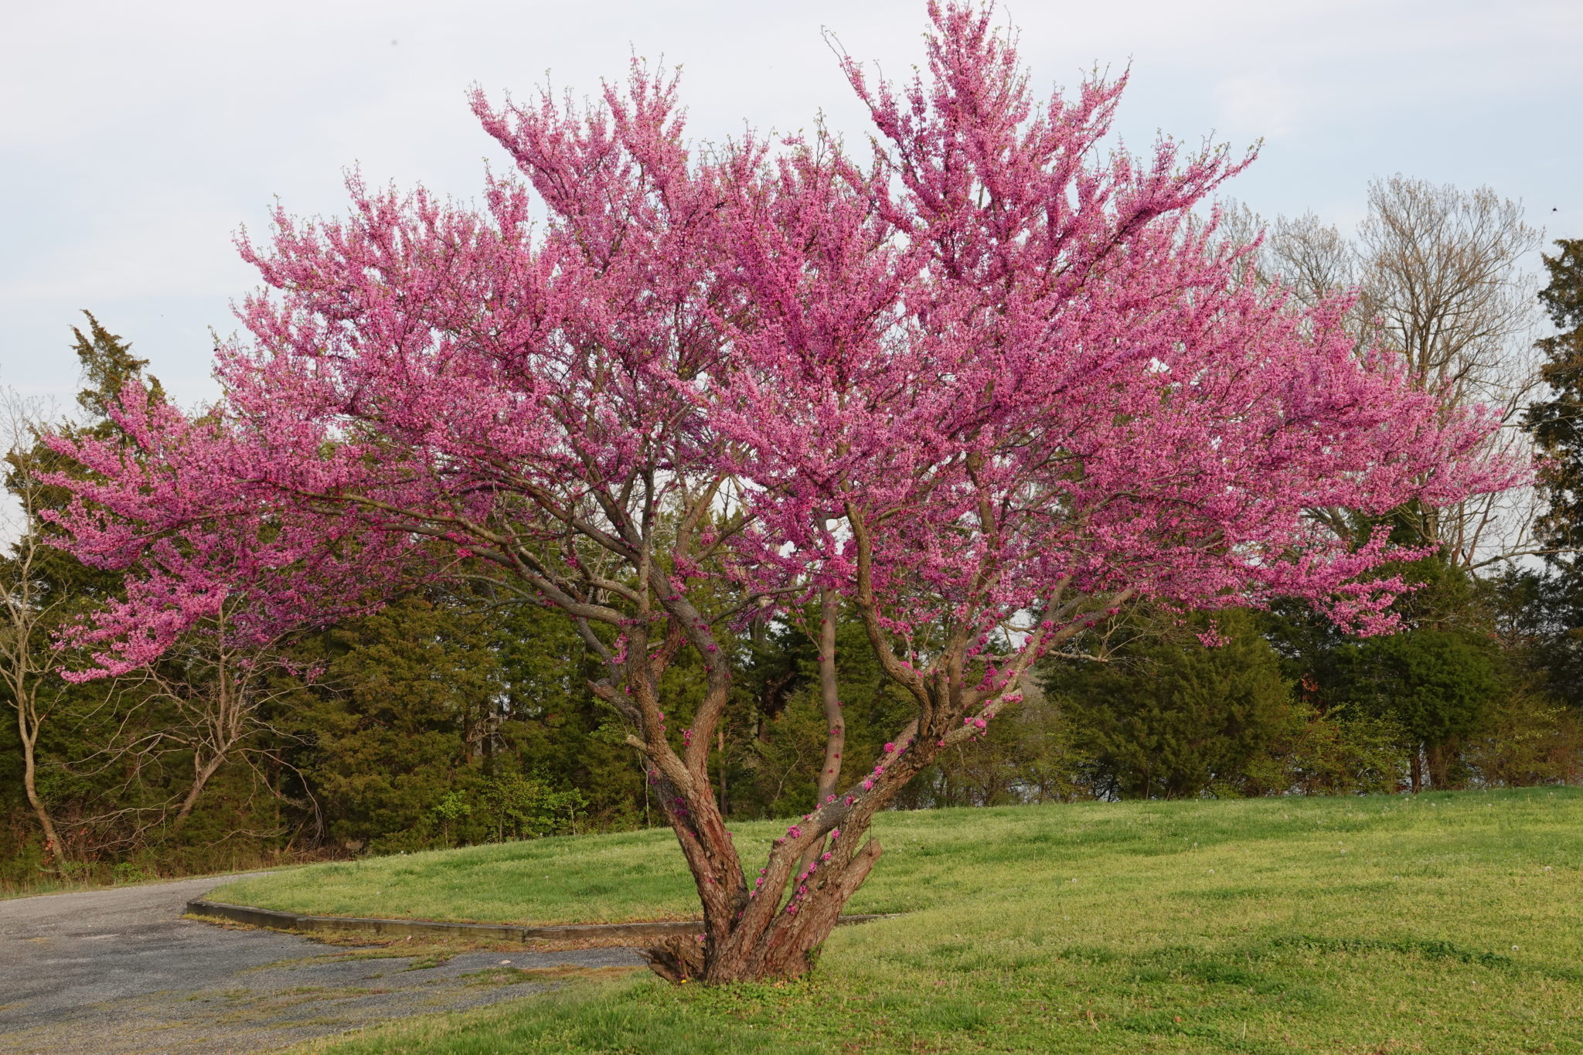
Precedents (3 of 3)
SERVICEBERRY
EASTERN REDBUD
Notes:
Ray will describe concept B-2.

Slide 30
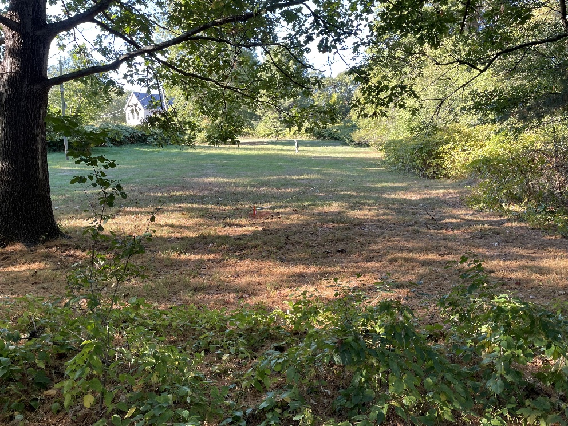
Potential Timeline
FY27 Phase I
Vegetation Management/Invasives Control
Striping at Print Shop parking area
  Farm Project and Sidewalk repairs (by others)
FY28 Design Development with Public Process
FY29 Phase 2 - Construction of parking and paved pathways, site amenities

Slide 31
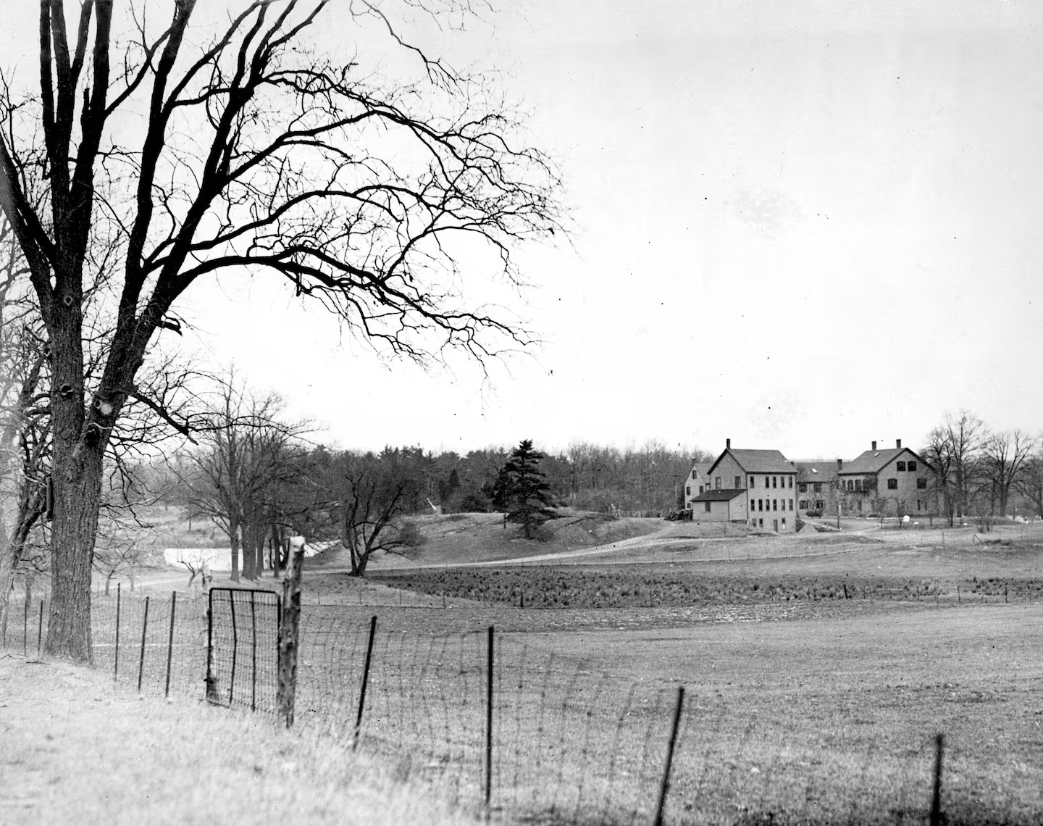
Q + A
Notes:
Dan Cushing

Slide 32
Additional Information
Recording and tonight’s slide deck will be available at:
  www.mass.gov/dcr/past-public-meetings
If you have comments on this project:
  Submit online: www.mass.gov/dcr/public-comment
  Deadline: Thursday, July 14th, 2026
  Please note: the contents of comments submitted to DCR, including your name, town and zip code, will be posted on DCR’s website. Additional contact information provided, notably email address, will only be used for outreach on future updates to the subject project or property.
If you wish to subscribe to a DCR general information or project-related listserv: contact DCR’s Office of Community Relations via email at mass.parks@mass.gov
Notes:
Dan Cushing

Slide 33
Thank you.
Brook Farm Historic Site
Conceptual Plan
Notes:
33

