Slide 1
Automatic MOSES Attendance using WebEx Meetings and WebEx Webinars

Slide 2
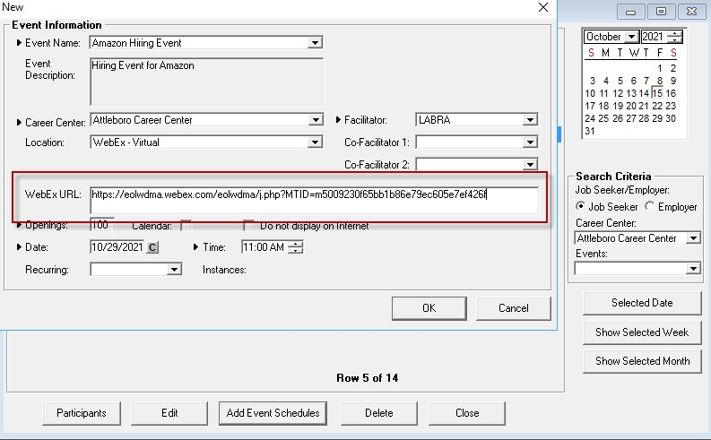
Create MOSES Event Schedule
Create event in MOSES via Event Scheduler as usual – keep this window open, you will need to add more information

Slide 3
Create WebEx Webinar/Meeting Event
WebEx Meetings can be created from either the WebEx app OR the WebEx website
WebEx Webinars can ONLY be created via the WebEx website
State staff can log in at https://eolwdma.webex.com
On “Home” or “Calendar” tab, click “Schedule a meeting” or “Schedule a webinar”

Slide 4
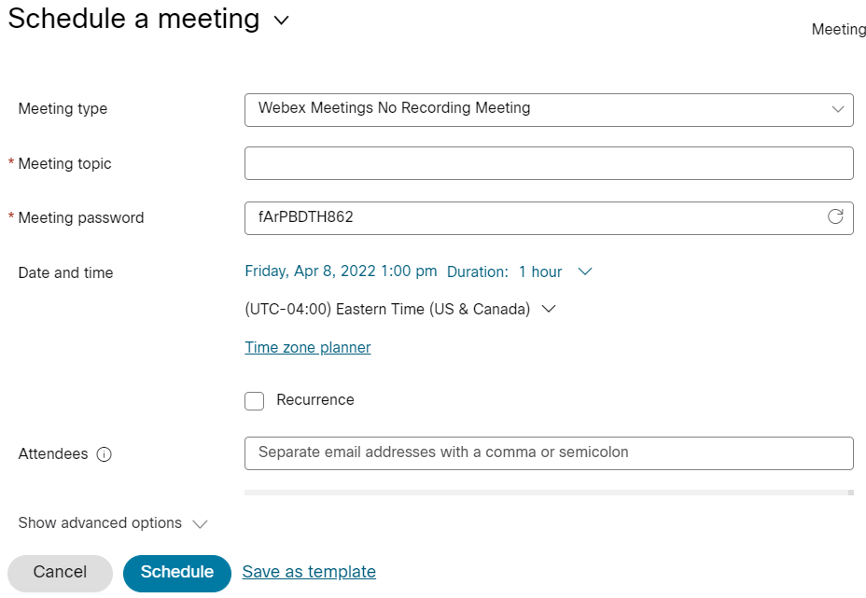
Create WebEx Webinar/Meeting Event
Fill out basic details (event title, time, etc)

Slide 5
Invite JQ Events User & Make Co-host
At the bottom, invite mdcs-jq-events@mass.gov as a panelist (webinar)/attendee (meeting)
Click person symbol next to name to make cohost
Click “Schedule” button at the bottom of this webpage

Slide 6
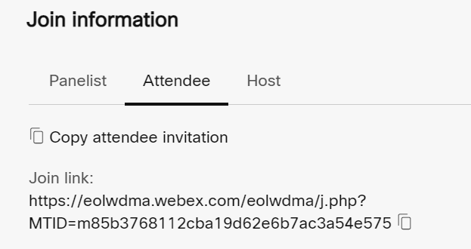
Copy Event Link into MOSES Event
Copy the full Join Link from the webpage and paste into “WebEx URL” field in MOSES event details

Slide 7
Copy Event Link into MOSES Event
Copy the full Join Link from the webpage and paste into “WebEx URL” field in MOSES event details
Save MOSES event

Slide 8
What happens automatically…
An hourly* invite batch job will run, which will do two things:
Add registered customers to the WebEx meeting, and
Send the WebEx invitation to the email addresses registered in MOSES.
An hourly* attendance batch job will run to do two things:
Determine which attendees attended for at least 90% of the meeting time, and
Update the MOSES database to reflect their attendance.
*Batch jobs run Monday-Friday, 7:00am to 7:30pm.
Things to consider:
You may want to review the results of attendance and adjust credit as needed in MOSES.
Manually entering ANY attendance will prevent the automated system from doing it for that event.

Slide 9
Rules that determine 90% attendance
Start time will be logged as the later of:
the WebEx event scheduled start time, OR
the time the host starts the meeting.
The end time will be logged as the earliest of;
the scheduled WebEx meeting end time, OR
when the participant leaves before the meeting end time, OR
when the host ends the meeting
If an attendee leaves and comes back, these rules still apply, and they must attend for a total of 90% of the scheduled WebEx meeting time.

Slide 10
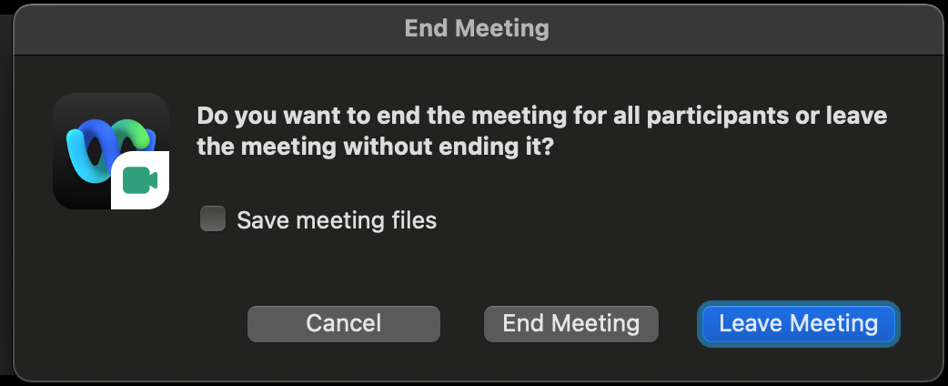
Ending the meeting/webinar

Slide 11
Questions?

