Slide 1
MassHire Programs & Services are funded in full by US Department of Labor (USDOL) Employment and Training Administration grants.
Additional details furnished upon request.
Grow with Google (GwG)
All-Staff Training
https://www.mass.gov/masshire-career-centers
April 2022

Slide 2
Welcome
Please stay muted so all participants can hear the presenters
Type any questions you have in the chat function and there will be time for Q&A at the end
The session will be recorded and PPT will be sent
Closed caption is located at the bottom, left corner of your screen, and you can change to your language of choice
CC

Slide 3
Overview of the Grow with Google (GwG) Scholarship Program
Customer Flow Process for Coursera Learners
Overview of Coursera Course Options
MOSES Data Entry
Next Steps

Slide 4
Grow with Google Scholarship Program
Grow with Google (GwG) is partnering with NASWA to distribute scholarships for the Google Career Certificate program to state workforce agencies
National Association of State Workforce Agencies (NASWA) coordinates with Google and Coursera on all aspects of the program
2-year project - 30,000+ Scholarships nationwide (500 for MA) - 5 Google Career Certificates
Data Analytics
IT Support
Project Management
User Experience (UX) Design
IT Automation with Python
Scholarships last from three to six months depending on the training time needed by recipients
No experience* is required and there are no prerequisites, such as a college degree
*Experience is required for the Python Certificate
Veterans, Transitioning Service Members (TSMs) and military spouses are a primary target –but Google wants to help all underserved and economically disadvantaged populations.

Slide 5
What is the State’s Role?
There is no cost to a state workforce agency to participate
Certificates are not available for state workforce agency or partner staff
Participating states are expected to support / monitor candidates through completion and employment success
There are 500 certificates for Massachusetts
Outcome goals
● 75% Activation rate across all learners
● 50% Completion of the certificate
● 70% Positive job outcomes

Slide 6
What is the MassHire Career Center’s Role?
Identify candidates for GwG Scholarships – a pre-enrollment assessment survey is available to assist with interviewing candidates
Candidates do not have to be unemployed (note: training does not meet Section 30 requirements)
Candidates must be authorized to work in the United States
Enroll candidates in MOSES – upload to Coursera – Coursera sends the candidate a link to the course
Monitor the learner’s training and follow-up on training progression and completion
Assist successful candidates with their job search

Slide 7
GwG Administrators at MassHire Career Centers
A GwG Administrator has been identified for each career center
The Administrator will send the learner’s information to Coursera
Coursera will then send a course link to the learner
The Administrator will access information on the learner’s progress toward completion through Coursera
The Administrator will update staff on the progress of their GwG learners
The Administrator will determine when a learner is no longer participating in the program and recommend that their Scholarship be withdrawn
A withdrawn Scholarship will be available for reassignment

Slide 8
GwG: Program Overview
The GwG pilot program began in the late summer to early fall of 2021 with five states. The program is being offered to other agencies, such as Community Colleges.
GwG is a Google Program - Proprietary
Google sets all standards and requirements
Cannot alter, change, or create marketing materials, unless approved by Google
Only approved documents can be shared on your Career Center’s website
GwG: Why are the courses being offered for free through Coursera?
The objective for offering GwG Scholarships is to continue to support Economic Recovery efforts by providing tangible training and job opportunities for individuals impacted by the economic downturn and looking to get into another field.
Priority is given to racial minorities and those from economically disadvantaged backgrounds (Title I, WPP) including, Black, Latinx, Indigenous, female, LGBTQ+, persons from low-income backgrounds, justice-involved individuals, older workers, persons with disabilities, dislocated workers, at-risk youth, transitioning service members, Veterans and military spouses.

Slide 9
GwG: Eligibility and Vetting
GwG: Who is Google targeting for this program?
Learners can be employed or unemployed
Do not need experience (except for IT Automation with Python certificate)
Learners who are looking to get into another field that has growth and sustainability
Learners who can be successful and benefit from this opportunity? It is not for everyone
GwG: Importance of Vetting Process
Program is about QUALITY not QUANTITY
Certificates are online and self-paced, rigorous, time consuming, and requires self-discipline of the learner
Google does not want to diminish the value of these certificates
GwG: Results of Completion
Opportunity to get hired at excellent starting salary with a recognized certificate
Join Google’s Employer Consortium

Slide 10
Incorporating GwG in your Customer Flow
Registration in JobQuest
Complete CCS
Start Individual Needs Assessment (INA)
•RESUME
(create, update, edits, etc.)
•LMI Research
•Referrals to
Re-employment Services
•Assessments including GwG, if appropriate
Job Search
Training
Customer
Customer
Employment
Career Center Contact
Referrals
•RESUME
(create, update, edits, etc.)
•LMI Research
•Referrals to
Re-employment Services
•Assessments including GwG, if appropriate
Review UI eligibility

Slide 11
Coursera Licenses: Customer Process Flow
Staff interviews customer using Pre-Assessment form and determines appropriateness for participation
Staff sends learner information to the Administrator:
•Customer name
•Email address
•Job Seeker ID#
•Selected Course Name
Administrator enters learner information into Coursera
•Coursera sends email with training link to learner to join the selected training

Slide 12
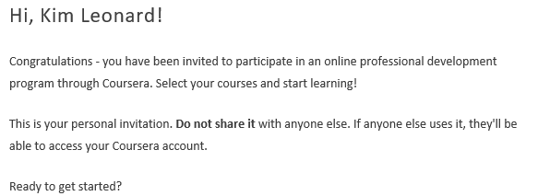
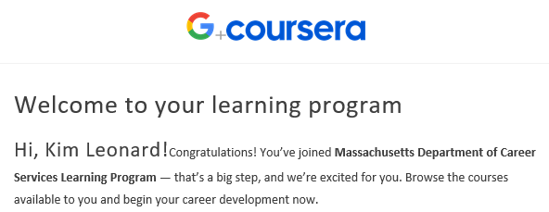
Emails from Coursera
Two emails are received by learners on the same date the Administrator adds them to Coursera

Slide 13
Coursera Licenses: Customer Process Flow – Active Learner
Administrator monitors reports for learner activity
•Informs staff of pertinent information related to the learner’s progress towards completion of the course
Staff must stay in communication with customers for success of program
•Staff maintains contact and provides case management support
•Maintain MOSES documentation
For Learners who complete training:
1. Get access to GwG employer consortium
2. Receive job search assistance from Career Center BSRs or other staff

Slide 14
Coursera Licenses: Customer Process Flow – Inactive Learner
Administrator monitors reports for learner activity
•Informs staff of pertinent information related to non-enrollment or inactivity
Follow-up and Support Services
•Discusses lack of activity with the learner
•Periodic contact providing specific deadlines; suggested follow-up three times
•If not accessed within reasonable time frame, i.e., 2 weeks
•Maintains MOSES Documentation
Scholarship withdrawn for inactivity
•After multiple attempts, decision to withdraw
•Administrator withdraws Scholarship in Coursera
•Maintains MOSES Documentation

Slide 15
Withdrawing a Scholarship: Failure to Enroll
Withdrawal of Scholarships may be necessary for learners who are not accessing their training
Staff should communicate with learners after 5 workdays if they have not enrolled in the course (as notified by their Coursera Administrator)
Google will send a reminder email to learners 8 days after the date the Administrator adds them to Coursera if they have not yet enrolled
Staff must communicate with learners to find out why they have not enrolled in the course. Issues may include:
Course load was more than they anticipated
Personal responsibilities are keeping them from completing the course
The training was not what they thought it would be
Learners who do not enroll in the course within 1 week following communication will be notified that their scholarship has been withdrawn and they can reapply at a later date
Lack of response from a learner will result in the withdrawal of the scholarship
Administrator/Staff will notify the learner that the scholarship is being withdrawn and they can apply again later if they choose to try again

Slide 16
Withdrawing a Scholarship: Failure to Progress
Withdrawal of Scholarships may be necessary for learners who are not accessing or progressing in their training
Staff should communicate with learners after 5 workdays if they have not progressed in the course (as notified by their Coursera Administrator)
Coursera may also send an email if they do not see progression in the course
Learners who enroll in the course and fail to progress may need to be followed-up more frequently
Staff must communicate with learners to find out why they are not progressing or doing the coursework. Issues may include:
Course load was more than they anticipated
Personal responsibilities are keeping them from completing the course
The training was not what they thought it would be
If the learner has not engaged for 2 weeks, staff should discuss with the Administrator regarding withdrawal of their scholarship
Administrator/Staff will notify the learner that the scholarship is being withdrawn and they can apply again later if they choose to try again

Slide 17
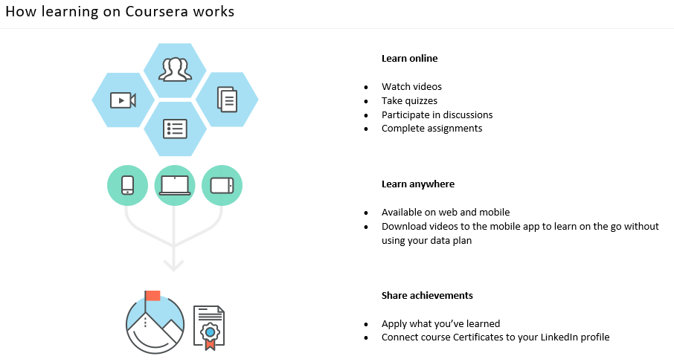
Learning on Coursera

Slide 18
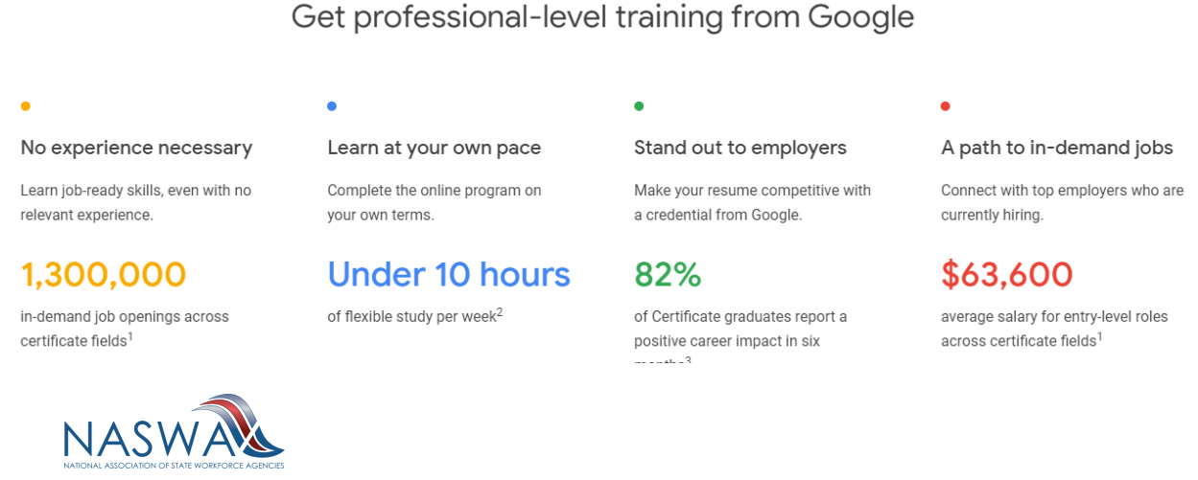
GwG: Career Path

Slide 19
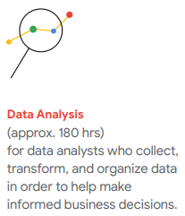

Slide 20
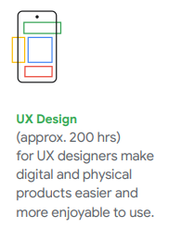

Slide 21
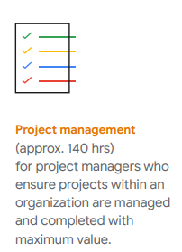

Slide 22
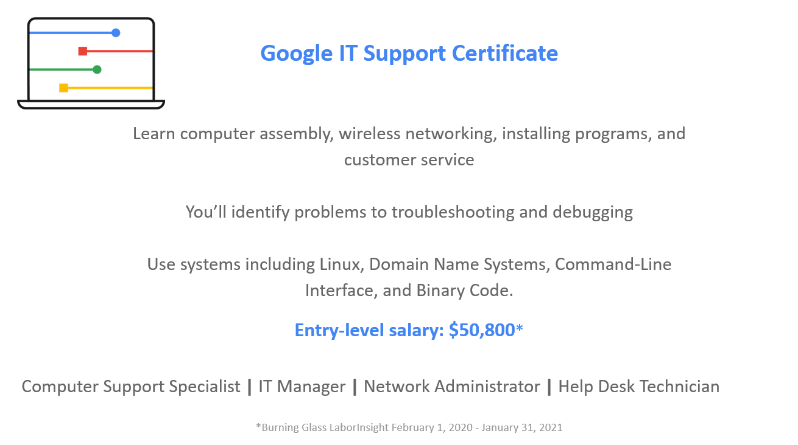
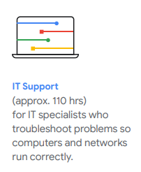

Slide 23
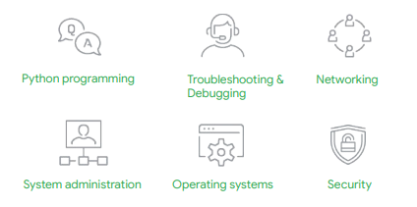
IT Automation with Python
PRE-REQUISITE: To enroll in Python, the learner must have successfully completed the IT Support certificate and have a minimum of 24 months of education and/or experience in information technology. This is considered beginning level Python, but it is not for a novice.

Slide 24
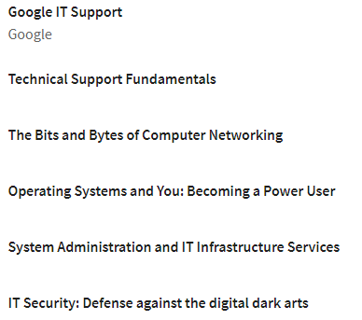
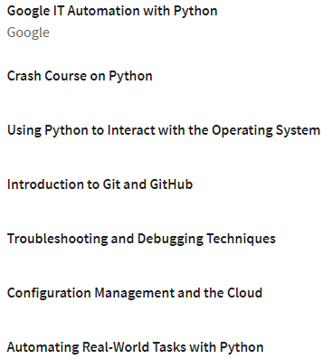
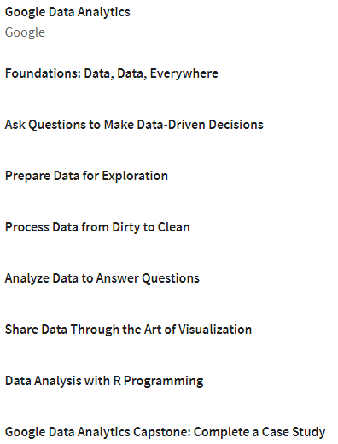
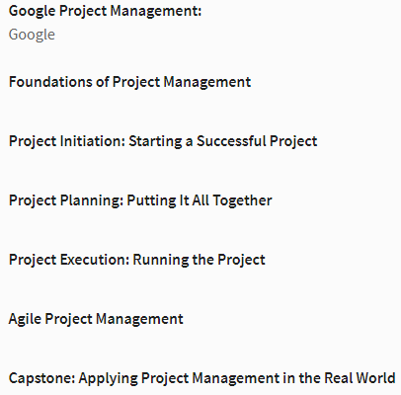
Prerequisites Required

Slide 25
Program Completion: Learner Outcomes

Slide 26
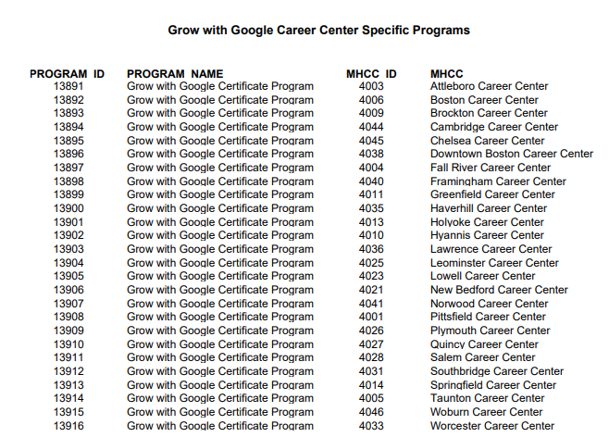
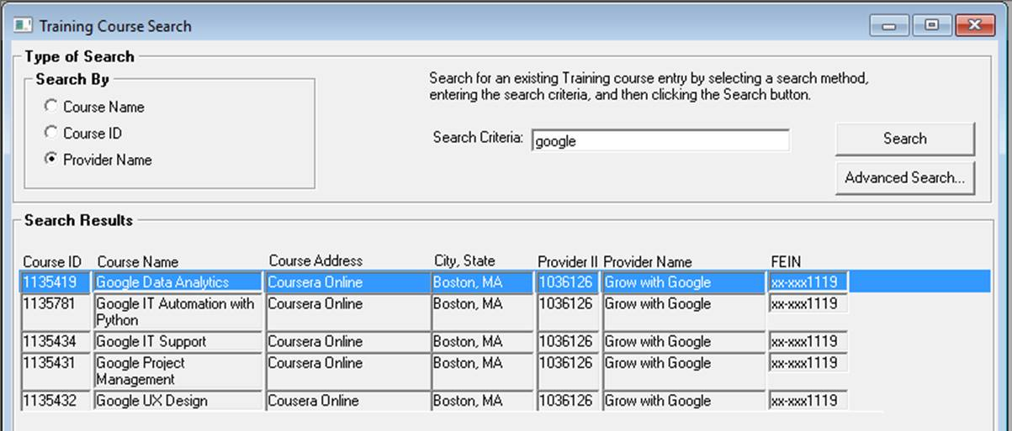
MOSES Data Entry for Tracking Grow with Google (GwG) Activity
GwG Career Center Specific Programs were created for all Career Centers
Created a GwG training provider and five (5) GwG courses – one per certificate

Slide 27
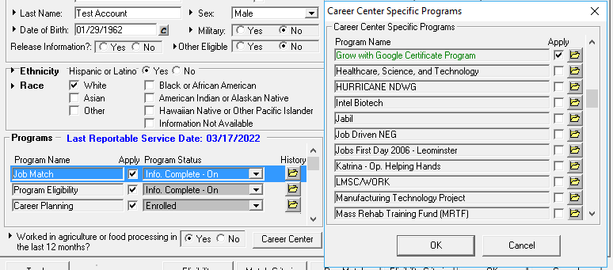
Enrollment into the Grow with Google (GwG) CC Specific Program
On the basic tab of MOSES click on the Career Center button to display the Career Center Specific Programs and then check the “Apply” box next to the GwG program for customers who are referred to GwG.

Slide 28
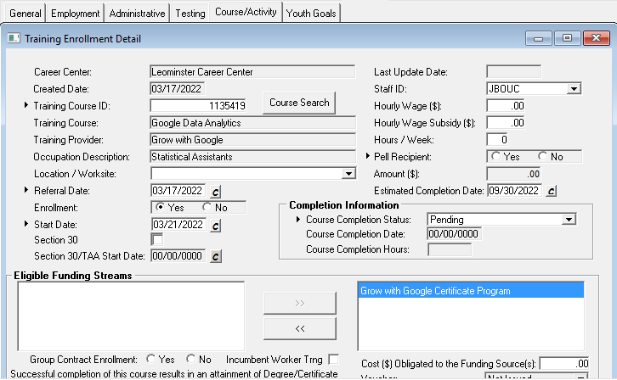
Grow with Google (GwG) Course Enrollment and Service Tracking
On the Course/Activity tab of MOSES enroll the customer into the appropriate GwG Certificate program
All relevant services; career planning, credential attainment etc. should also be entered in MOSES

Slide 29
Co-Enrollment: GwG and WIOA
If the scholarship recipient is eligible under Title I Adult, DW or youth, and is enrolled in one of those programs:
The scholarship could be considered a free certificate/upskill
Provide Career Planning Services
Enter the learner’s completion and credential upon finishing the course
The ETPL is necessary if WIOA is paying for the Google certificates, and they are not
Ex: A customer wants Digital Marketing, Web Design and Data Analytics
The customer can be enrolled into an ITA program for Digital Marketing with Web Design
Data Analytics can be offered as part of Coursera’s programming, when ready to commit to the GwG course

Slide 30
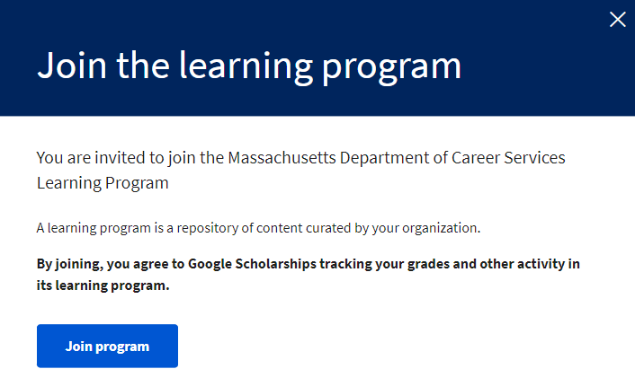

Slide 31
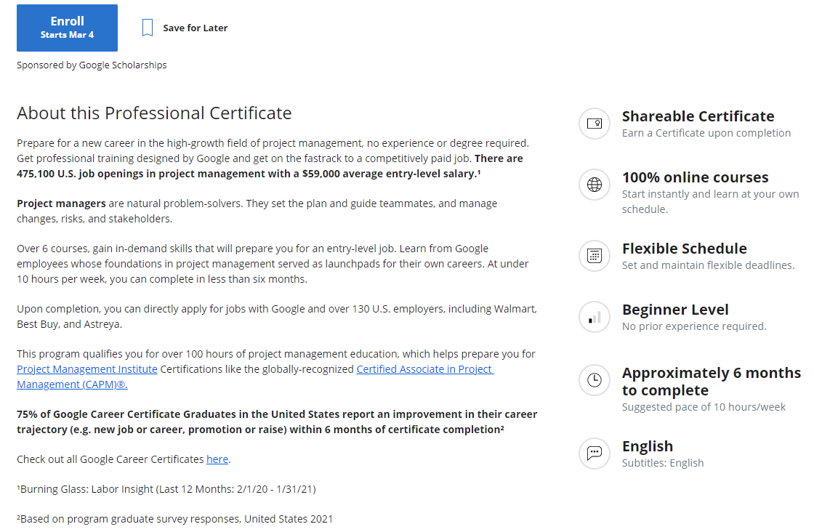
About the Course

Slide 32
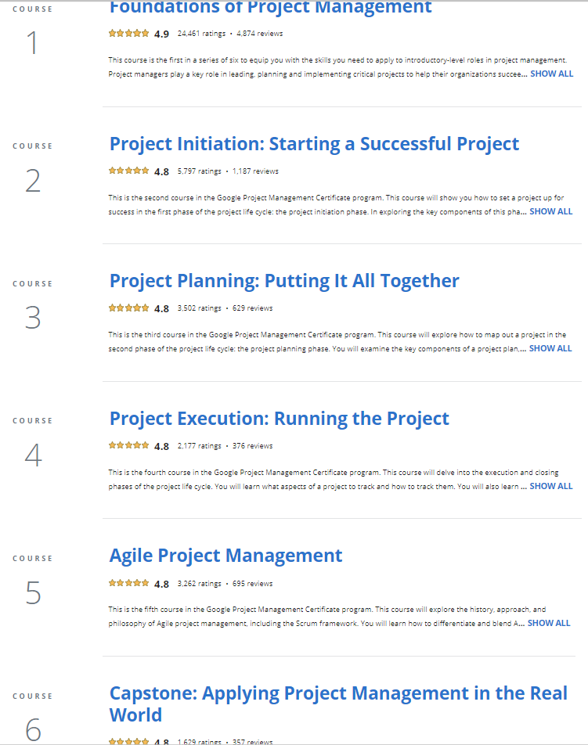
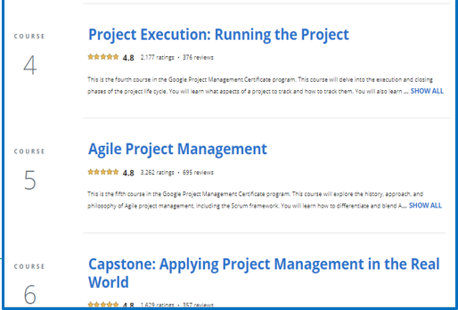
Program Courses

Slide 33
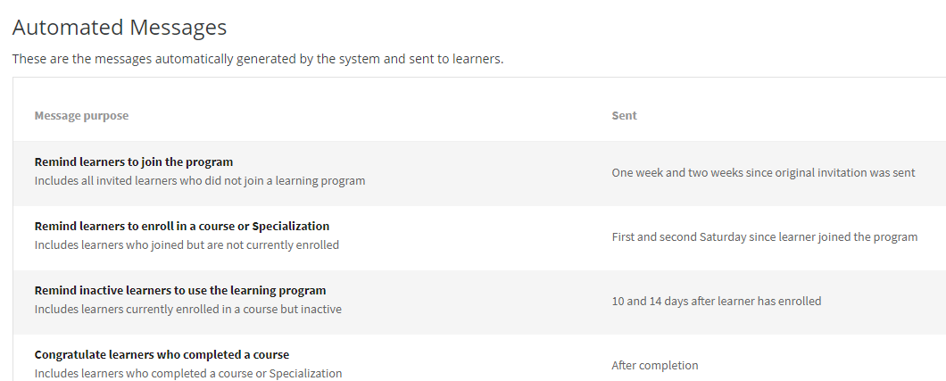
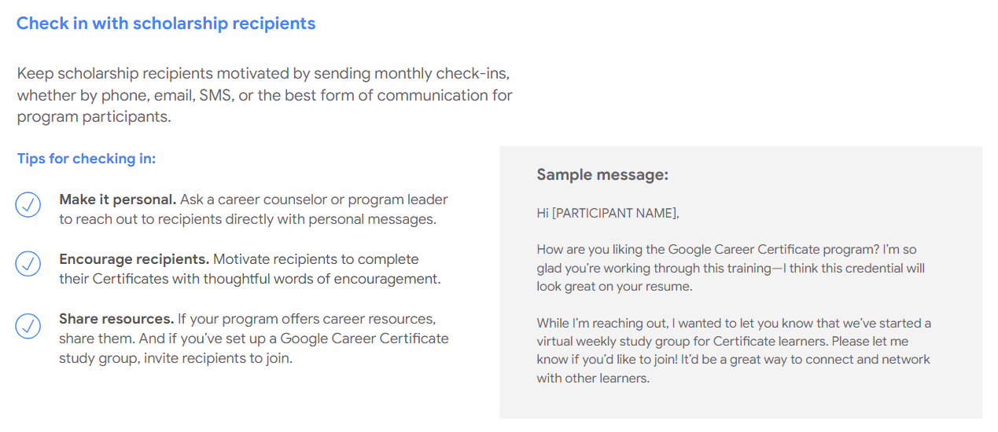
Coursera: Messaging and Follow-up

Slide 34
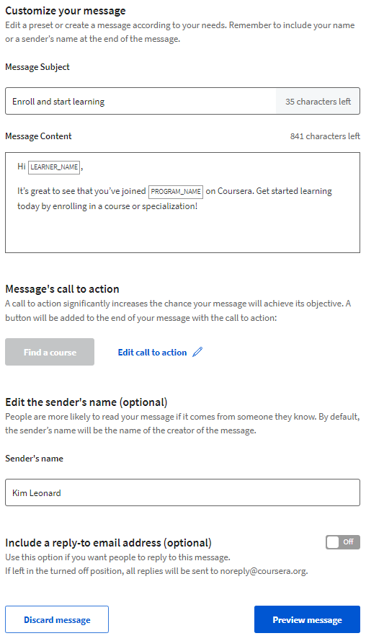
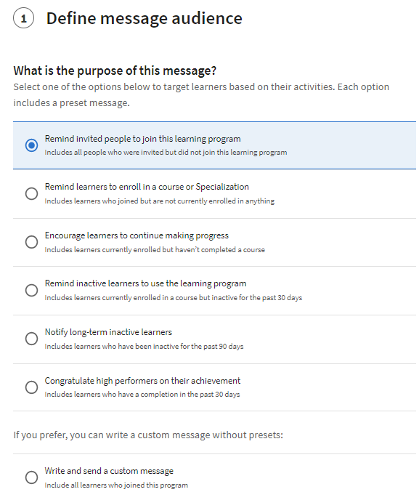
Reminder Emails

Slide 35
Emails from Coursera
Two emails are received by learners on the same date the Administrator adds them to Coursera

Slide 36
Emails from Coursera
If the learners do not enroll eight days from the date the Administrator adds them to Coursera, they receive a reminder email to enroll

Slide 37
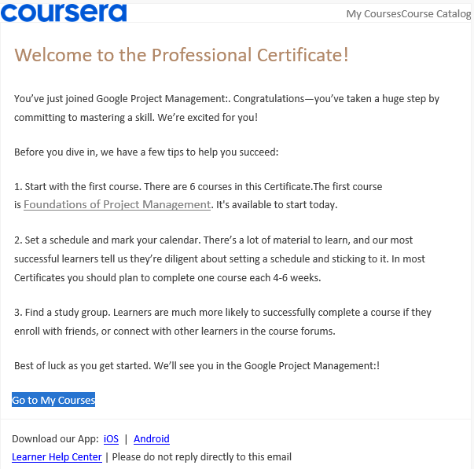
Coursera Email – Learner Enrolled
Email sent by Coursera once the learner enrolls

Slide 38
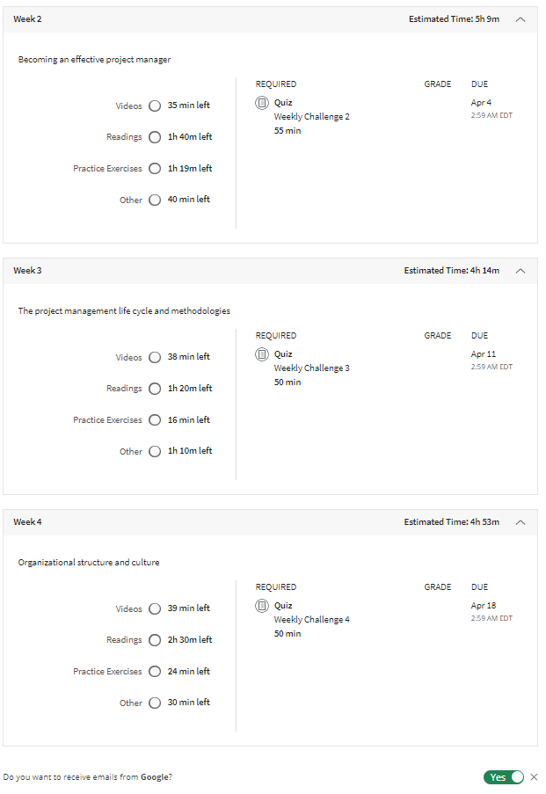
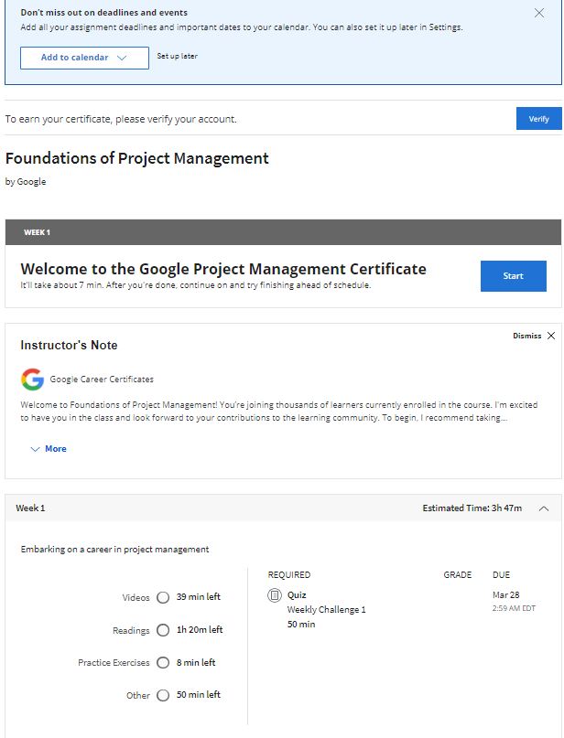
Enrolled Learner

Slide 39
Coursera Report

Slide 40
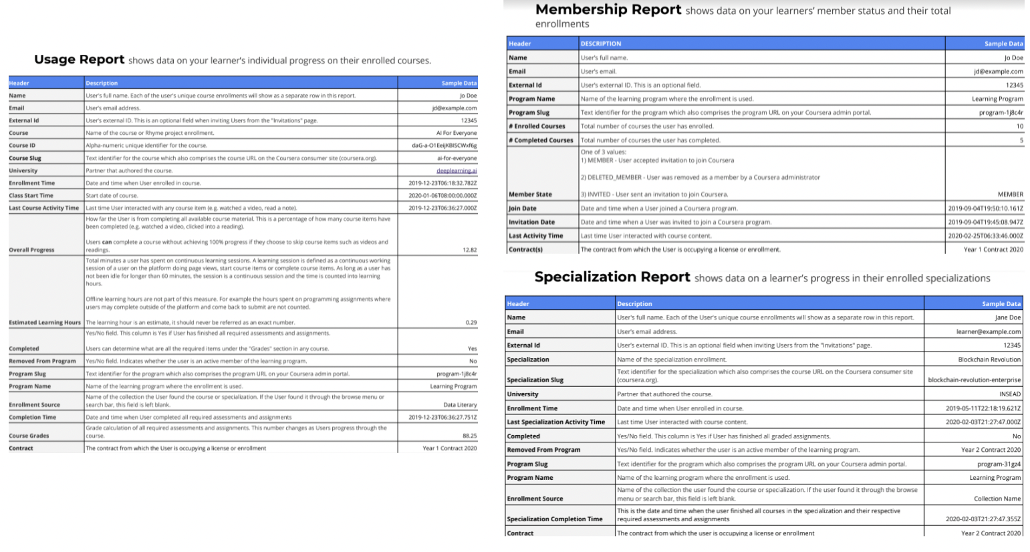
Coursera Data Tracking

Slide 41
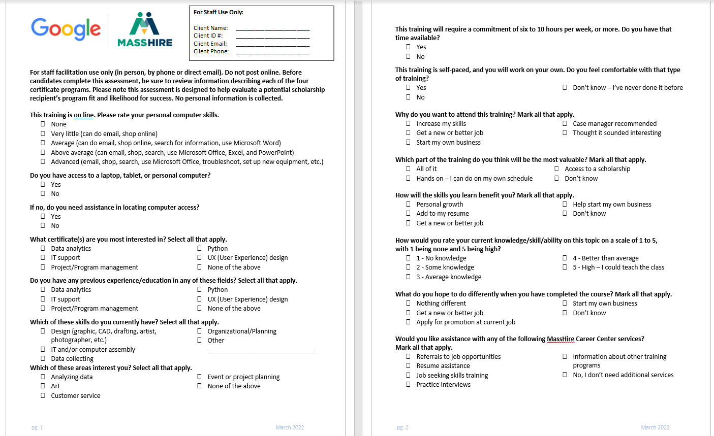
Pre-Enrollment Assessment Survey (Fillable)

Slide 42
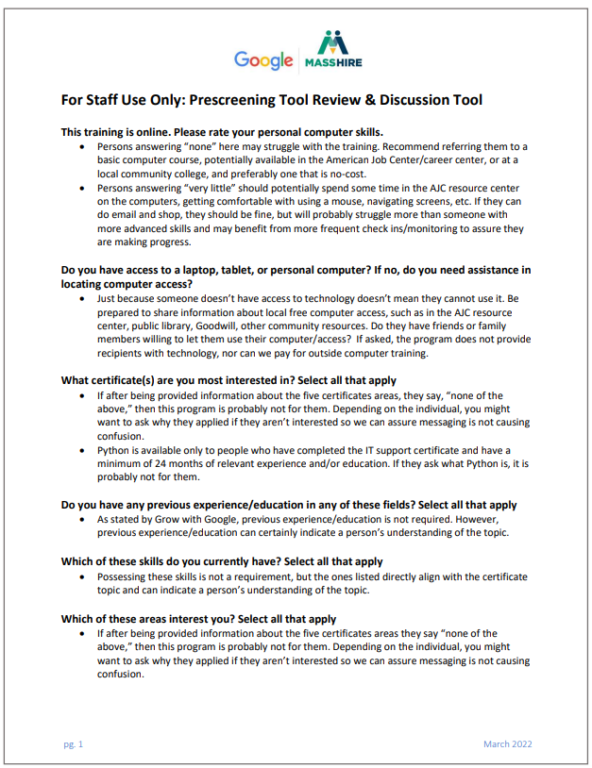
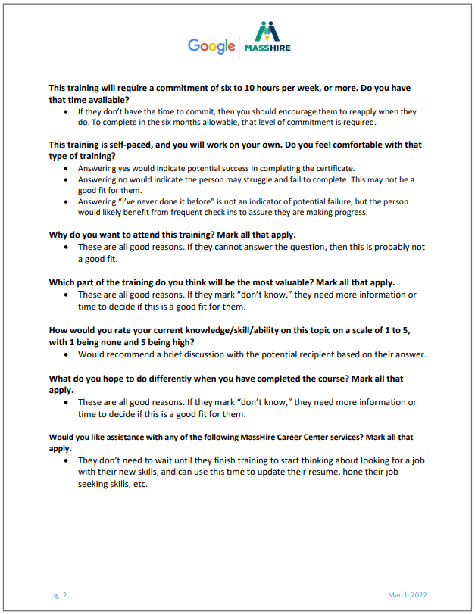
Pre-Assessment Staff Guide

Slide 43
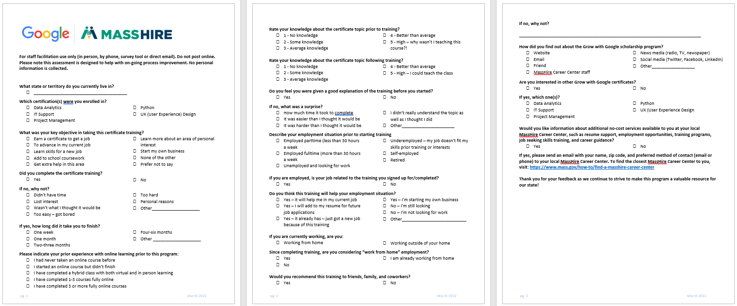
Fillable Follow-up Survey

Slide 44
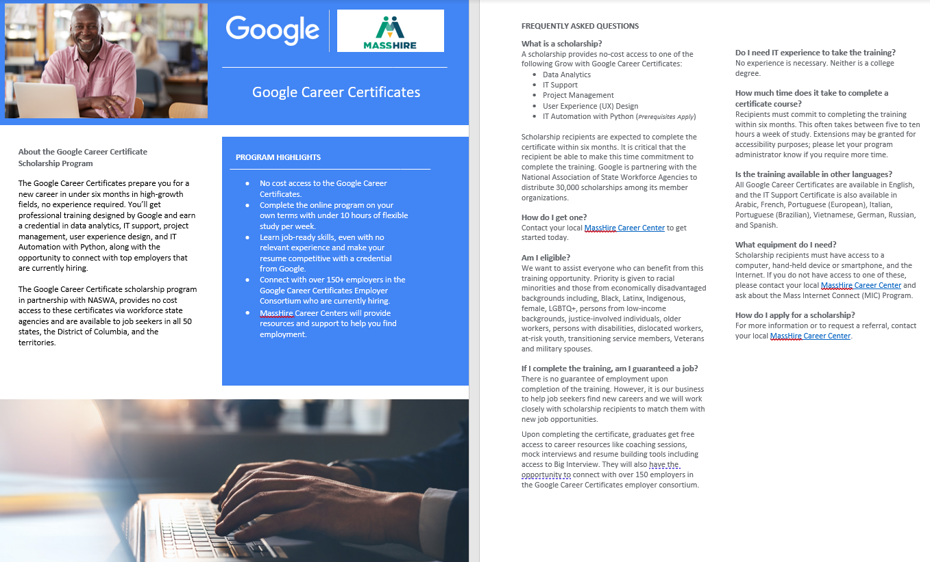
Tools Provided by NASWA
The following tools have been created to support the states:
GwG mailbox (googlecerts@naswa.org)
Flyer states can customize
Pre-Enrollment Assessment Tool states can customize/digitize
Follow-up Survey states can customize/digitize
Public–facing content on the NASWA website
Spanish language documents
Press kit coming soon!

Slide 45
Google Career Certificates
Employer Consortium
Google Career Certificate graduates can connect with employers actively looking for people trained in IT support, user experience design, data analytics, project management, and Python
Free to join, Google’s consortium includes 150+ employers able to connect directly with a skilled, diverse talent pipeline through their job platform. Employers can also use the Google Career Certificates to upskill their existing workforce
State business service teams can tell employers about the consortium, and the tools, options and opportunities for them to connect with program graduates served through NASWA’s partnership with Grow with Google
Who is in the consortium? Some of the participating employers include Accenture, Bayer, intel, Bank of America, hulu, Smuckers, Home Depot, Verizon and Nasdaq, and . . . .
NASWA has joined the employer consortium and are looking fill analyst roles from the GwG learners!
For more information, go to https://grow.google/employers/

Slide 46
Other useful information
If Coursera platform has an outage make sure that your participants are advised to contact the Coursera helpdesk, and not to enter financial information to restart the course.

Slide 47
Next Steps
Soft Launch in early April at the Career Center level
Staff to reach out to their current customers
Feedback meeting with Administrators and staff mid-April
Attend all staff training if you have questions or concerns
Overview Training for all staff:
Tues, April 5th @ 2:30-4pm and Thurs, April 7th @ 11-12:30pm

Slide 48
Thank You!
and
Questions
https://www.mass.gov/masshire-career-centers

