Slide 1
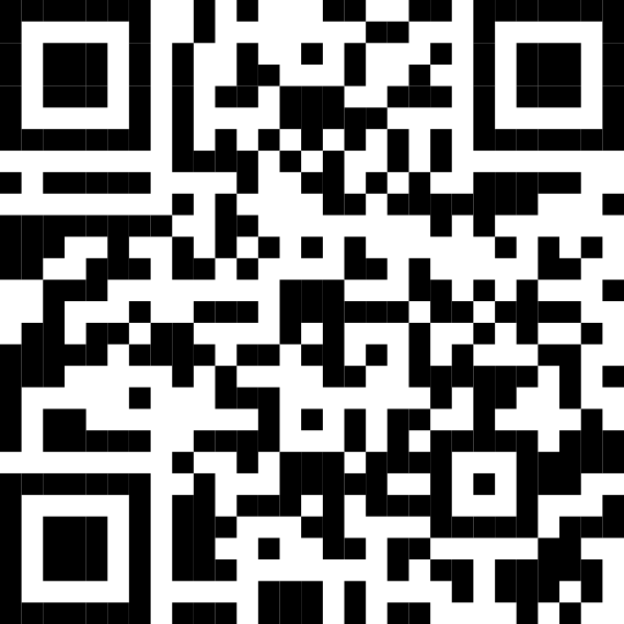
Microsoft AI Skills Fest
Microsoft
AI Skills Fest
Unlock the future with 50 days of AI discovery and learning April 8–May 28, 2025
Hear from Microsoft and industry experts on why AI skills are important and how to build them. Join us to build and showcase your AI skills while attempting a GUINNESS WORLD RECORDS™ title.
April 8: Kickoff Celebration
Let’s make history together. Build and showcase your AI skills while attempting a GUINNESS WORLD RECORDS title for most users to take an online multi-level artificial intelligence lesson in 24 hours. We’ll kick things off on April 8 in Australia at 9 a.m. Australian Eastern Standard Time and finish on April 8 at 4 p.m. Pacific Daylight Time, with learning events scheduled around the globe.
April 8–May 28: 50 days of AI learning
To deepen your skills, continue with 50 days of curated AI training in your preferred way, including hackathons, live in-person and virtual events, self-paced tutorials, community events, Microsoft Learn Challenges, and more. By the end of your 50-day skill-building adventure, you’ll have leveled up your AI skills so you can unleash your creativity, empowered by AI.
Register today and explore experiences
aka.ms/AISkillsFest

Slide 2
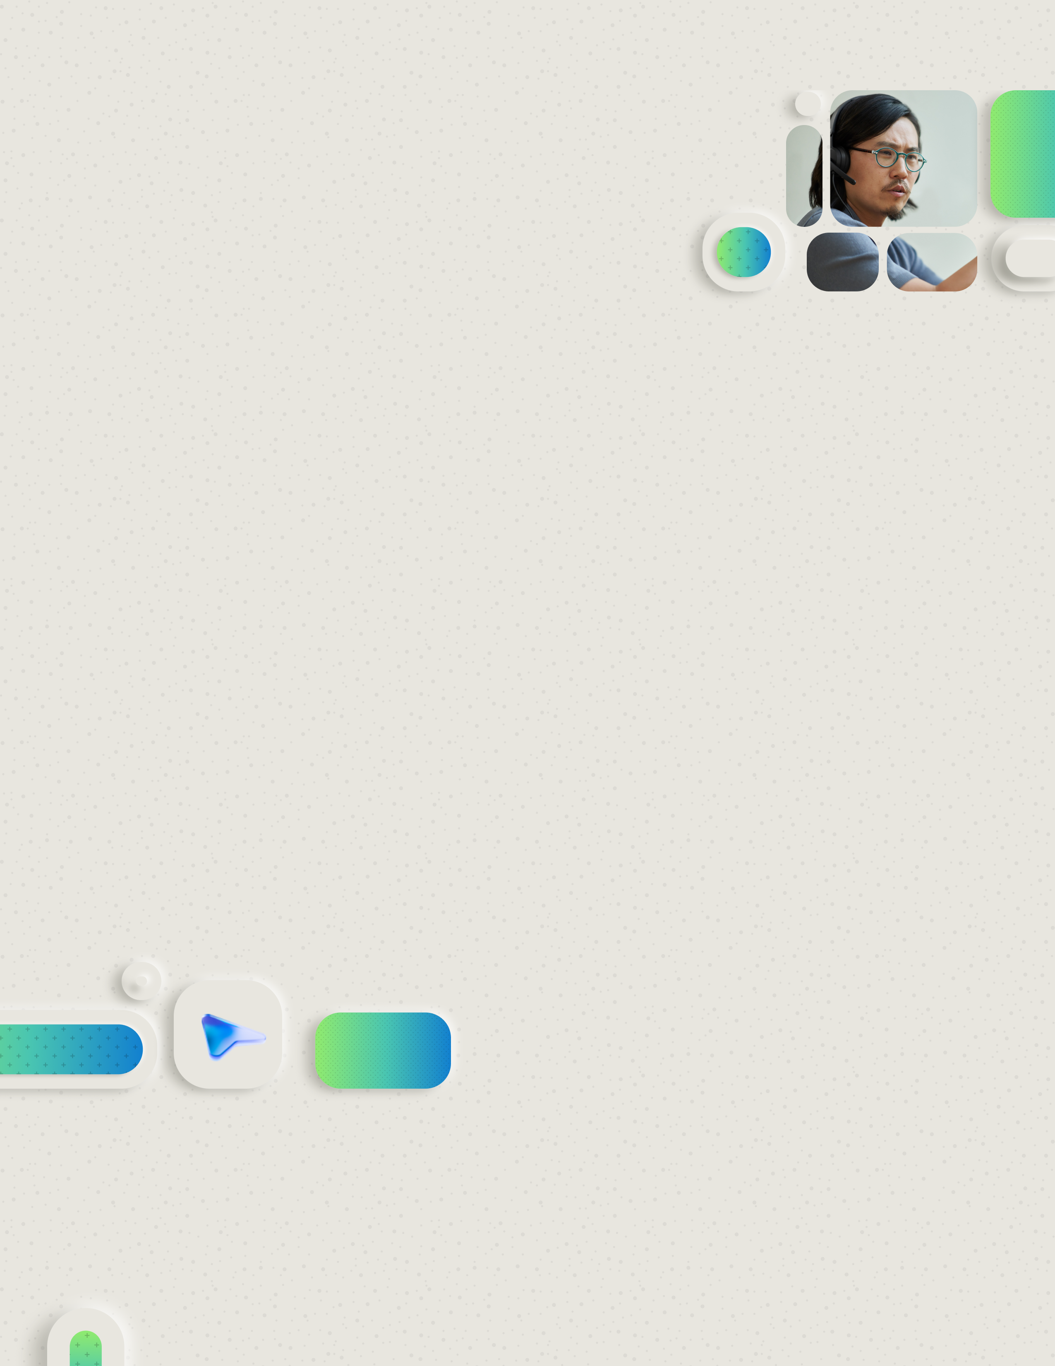
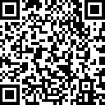
Tech Professional - Microsoft AI Skills Fest
Microsoft
AI Skills Fest
Build your dream AI-powered solutions April 8–May 28, 2025
Hear from Microsoft and industry experts on why AI skills are important and how to build them. Join us to build and showcase your AI skills while attempting a GUINNESS WORLD RECORDS™ title.
April 8: Kickoff Celebration
Let’s make history together. Build and showcase your AI skills while attempting a GUINNESS WORLD RECORDS title for most users to take an online multi-level artificial intelligence lesson in 24 hours. We’ll kick things off on April 8 in Australia at 9 a.m. Australian Eastern Standard Time and finish on April 8 at 4 p.m. Pacific Daylight Time, with learning events scheduled around the globe.
April 8–May 28: 50 days of AI learning
To deepen your skills, continue with 50 days of curated AI training that will empower you to build innovative solutions quickly with Microsoft’s AI apps and services. Acquire skills in agents, AI Security, Azure AI Foundry, Fabric, and more. Engage in deep dives, experiential content, hackathons, and practical sessions that will help you hone your skills.
Register today and explore experiences
aka.ms/AISkillsFest

Slide 3
Business User - Microsoft AI Skills Fest
Microsoft AI Skills Fest
Build AI skills that can help you improve productivity and gain better insights April 8–May 28, 2025
Hear from Microsoft and industry experts on why AI skills are important and how to build them. Join us to build and showcase your AI skills while attempting a GUINNESS WORLD RECORDS™ title.
April 8: Kickoff Celebration
Let’s make history together. Build and showcase your AI skills while attempting a GUINNESS WORLD RECORDS title for most users to take an online multi-level artificial intelligence lesson in 24 hours. We’ll kick things off on April 8 in Australia at 9 a.m. Australian Eastern Standard Time and finish on April 8 at 4 p.m. Pacific Daylight Time, with learning events scheduled around the globe.
April 8–May 28: 50 days of AI learning
Build AI skills that can help you improve productivity and gain better insights. Discover how to use Microsoft Copilot to simplify time consuming and repetitive tasks, giving you more space to create and innovate—while still using the tools you already know and love. Enjoy self-paced lessons, hybrid and in-person training, and connect with us via LinkedIn Live sessions.
Register today and explore experiences
aka.ms/AISkillsFest

Slide 4
Next Gen - Microsoft AI Skills Fest
Microsoft
AI Skills Fest
You’ve already got great ideas—now gain the skills to help you realize your vision April 8–May 28, 2025
Hear from Microsoft and industry experts on why AI skills are important and how to build them. Join us to build and showcase your AI skills while attempting a GUINNESS WORLD RECORDS™ title.
April 8: Kickoff Celebration
Let’s make history together. Build and showcase your AI skills while attempting a GUINNESS WORLD RECORDS title for most users to take an online multi-level artificial intelligence lesson in 24 hours. We’ll kick things off on April 8 in Australia at 9 a.m. Australian Eastern Standard Time and finish on April 8 at 4 p.m. Pacific Daylight Time, with learning events scheduled around the globe.
April 8–May 28: 50 days of AI learning
Deepen your skills with 50 days of learning. Whether you’re just starting your AI journey or are hoping to strengthen your skills, we can help you achieve your goals. Learn how to use AI to unleash your creative potential. See what you can become when you are empowered by AI.
Register today and explore experiences
aka.ms/AISkillsFest

Slide 5
Business Leader - Microsoft AI Skills Fest
Microsoft
AI Skills Fest
Unlock your team’s innovation April 8–May 28, 2025
Hear from Microsoft and industry experts on why AI skills are important and how to build them. Join us to build and showcase your AI skills while attempting a GUINNESS WORLD RECORDS™ title.
April 8: Kickoff Celebration
Let’s make history together. Build and showcase your AI skills while attempting a GUINNESS WORLD RECORDS title for most users to take an online multi-level artificial intelligence lesson in 24 hours. We’ll kick things off on April 8 in Australia at 9 a.m. Australian Eastern Standard Time and finish on April 8 at 4 p.m. Pacific Daylight Time, with learning events scheduled around the globe.
April 8–May 28: 50 days of AI learning
We’ll have curated AI skill-building opportunities that work for everyone, regardless of their preferred learning style. See how your team can improve productivity and unleash their creative potential with 50 days of learning.
Register today and explore experiences
aka.ms/AISkillsFest

