Slide 1
Market Maker Onboarding Materials

Slide 2
Market Maker Onboarding Materials
The objectives of these materials are to help the Market Maker:
  Understand the context of the Market Maker role
  Engage employers to support their hiring needs
  Access additional resources to support employer and training provider engagement

Slide 3

Table of contents for Market Maker onboarding
  ARPA workforce strategy, and how Market Makers support it
  Market Maker role and responsibilities
  Market Maker role in MassHire Workforce System
    Market Maker collaboration with Business
    Service Representatives
    Initial events for Market Makers to attend
1
Market Maker
role
2
3
  ARPA pipeline training grants
    Points of contact for additional questions
    Employer-facing grant summaries
    Training partner-facing grant summaries
    Internal stakeholder-facing grant summaries
    Occupations vs grants
4
ARPA pipeline
training grants
  Market Maker collaboration with training providers
    CTI occupations overview
    CTI training partners and programs by region
  Employer engagement guidebook
  Market Maker target outcomes
  Tracking employer interactions in MOSES
5
Connecting employers to
training programs
6
7
8
  Regional blueprints
  Target occupations for Market Maker outreach by region
  Additional collateral for Market Maker outreach to employers
  Market Maker onboarding checklist
Additional supports
9
10
11
12

Slide 4
1
ARPA workforce strategy, and how Market Makers support it

Slide 5
Workforce Skills Cabinet aligns 3 Secretaries to support a comprehensive economic growth agenda to benefit all corners of the Commonwealth
1
ARPA workforce strategy, and how Market Makers support it
Workforce Skills Cabinet (WSC)
Executive Office of Labor and Workforce Development
Executive Office of Housing and Economic Development
Executive Office of Education

Slide 6
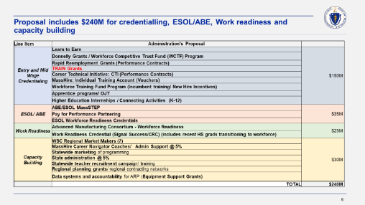
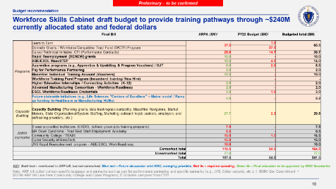
ARPA Context: ~$240M currently allocated to WSC workforce upskilling efforts inclusive of FY22 Commonwealth budget and ARP allocations
1
ARPA workforce strategy, and how Market Makers support it
Original WSC proposal totaled $240M
Actual Appropriations: Three funding allocations made through FY22 totaling $242M
WSC implementing original framework for upskilling rolling out capacity and program investments
$54M in FY22 Commonwealth budget
1
Yearly Commonwealth budget for July 21 – June 22
$50M in ARP advanced authorization
2
Focused legislative proposal on upskilling for unemployed impacted by COVID:
Entry level technical roles
Mid-wage, credentials
ESOL/ABE, and work readiness
Capacity building for system
Governor advanced allocation from ARP for workforce
3
$137.5M in ARP legislature line items
Line-items and earmarks flowing through WSC for upskilling from Dec 2021 legislature ARP bill
Note: Funding amounts not inclusive of proposed line items in Commonwealth FY23 budget

Slide 7
WSC Framework for ARPA: ARPA is increasing the resources available in the workforce system, and WSC is building capacity to make sure employers and people know about available resources
1
ARPA workforce strategy, and how Market Makers support it
Demand
Grant support
Market
Makers
  Workforce Competitiveness Trust Fund (WCTF)
  Career Technical Initiative (CTI)
Strategy
  Replenishing Employer iNvestment in Education and Workforce Training (RENEW)
State
Seven
Regional
Teams
Engage employers and match to
training providers
  Workforce Training Fund Programs (WTFP)
Define investment plan, identify gaps, run healthcare and manufacturing hubs
Supply
WSC core staff
Upskilling
Navigators
WSC funding opportunities
  Healthcare/Manufacturing Hubs
Other agencies (e.g., HHS, MOBD, MLSC)
  HHS ($100M behavioral health)
Future: Develop linkages to other partners
  Clean Energy (TBD)
Recruit, screen, and enroll participants
  Life Sciences (TBD)

Slide 8
To support the WSC & regional strategies, Market Makers engage employers, match them with training providers, and help them build pipelines of skilled employees
1
ARPA workforce strategy, and how Market Makers support it
Demand
Grant support
Market
Makers
  Workforce Competitiveness Trust Fund (WCTF)
  Career Technical Initiative (CTI)
Strategy
  Replenishing Employer iNvestment in Education and Workforce Training (RENEW)
State
Seven
Regional
Teams
Engage employers and match them to
training providers
  Workforce Training Fund Programs (WTFP)
Define investment plan, identify gaps, run healthcare and manufacturing hubs
Supply
WSC core staff
Upskilling
Navigators
WSC funding opportunities
  Healthcare/Manufacturing Hubs
Other agencies (e.g., HHS, MOBD, MLSC)
  HHS ($100M behavioral health)
Future: Develop linkages to other partners
  Clean Energy (TBD)
Recruit, screen, and enroll participants
  Life Sciences (TBD)

Slide 9
Market Makers are new regional roles that will help employers connect to training pipelines
1
ARPA workforce strategy, and how Market Makers support it
The mission of Market Makers is to reach out to businesses, advocate for the grants available, and connect businesses to training programs and job seekers
Starting with 1 Market Maker per region across Commonwealth
1
2
3
4
Market Makers are new regional roles, and will need to partner with other workforce players like Business Service Representatives and Team MA affiliates to support employer engagement
5
6
WSC is planning to allocate $1M+ of workforce budget for 7 Market Makers at regional Workforce Development Boards
7
Market Makers' primary focus will be on CTI, WCTF, "RENEW," and other new ARPA training grants that support skilled training pipelines

Slide 10
Market Maker hiring as of 4/30/22
1
ARPA workforce strategy, and how Market Makers support it
 | Region | Leadership for standing up Market Maker | Market Maker staffing
 | Berkshires | Heather Boulger | Paul Mattingly is Market Maker
 | Pioneer Valley | Rebecca Bialecki | Jen Droesch is Market Maker
 | Central | Jeff Roberge | Penny Doolittle is Market Maker
 | Northeast | Meelynn Wong Shaun McCarthy | Will Ren is Market Maker
 | Greater Boston | Angela McCabe Ashley Hazleton | Mark Wigfall is Market Maker
 | Southeast | Tom Perreira | Joana Mateus is temporary Market Maker
 | Cape & Islands | Kara O'Donnell-Galvin Neila Neary | Neila is temporary Market Maker. Hoping to hire new MM soon
1
2
3
4
1
2
5
3
6
4
5
7
6
7

Slide 11
2
Market Maker role and responsibilities

Slide 12
4 overarching goals for Market Maker positions
2
Market Maker role and responsibilities
Increase the number of employers participating in “upskilling” partnerships (funded through ARPA grants) to create a pipeline of TRAINED workers to address hiring needs
Build stronger connections between businesses, community-based organizations (CBOs), institutions, regional state partners¹, and WSC/CommCorp
Increase awareness and effectiveness of state training resources within the broader workforce community
Manage the administrative process and reporting
1. Workforce boards, regional industry structures (e.g. HC hubs, manufacturing collaborative)

Slide 13
14 standardized responsibilities drive progress toward the Market Maker's four goals
2
Market Maker role and responsibilities
      Determine business need for TRAINED workers
      Build stronger connections
      Increase effective use of state training funds
      Process and
      reporting
1
6
  Identify businesses or connect with referrals in priority industries/ occupations¹ seeking trained workers with a skill set
  Consult on workforce needs and refer to other supports as needed
  Understand businesses' existing talent pipelines, need for new pipelines
  Guide businesses toward existing training prog. or available state funds and training partners
  Assist companies to hire from existing pipeline programs or apply for grants to build new pipelines
  Build relationships with training providers² and industry organizing structures³ to understand and enhance their current employer engagement strategies
  Partner with training providers and MassHire to understand labor market and recruitment
  Pro-actively convene key players (e.g., via webinars, info sessions, events) for educational and networking purposes
  Build relationships with and refer employers to internal stakeholders, in order to focus on skilled talent demand
  Provide expertise on state and regional training funds
  Assess regional supply and demand in training landscape; identify regional solutions to balance supply and develop new pipelines
  Receive employer referrals from CommCorp and MassHire Career Center
  Monthly calls with CommCorp (group
  and 1:1)
  At least monthly engagement with MassHire Career Center service reps
10
13
11
2
14
3
7
12
4
8
  Market Maker outcomes
  # of new business/training partnerships formed / applying for funding
  # business connected to existing training partnerships
5
9
1.Working with MassHire Career Center reps. High priority industries/occupations include: manufacturing, construction/trades, healthcare, IT, other sectors identified in regional blueprints ; 2.Including community-based organizations and academic institutions; 3. Including HC hubs, Advanced manufacturing collaborative, etc.

Slide 14
3
Market Maker role within MassHire workforce system

Slide 15
Market Maker's Ecosystem: Landscape of types of players Market Makers should partner with to support connecting employers to training providers
3
Not-exhaustive
Market Maker role within MassHire workforce system
Market Makers may have strong relationships with other regional-focused players, but should also develop
relationships with industry-focused organizations who can broker employer connections
      Training providers
      Workforce
      Employers
Massachusetts Association of Vocational Administrators
Association of educational leaders who administer career and technical programs
​
Quasi-public organizations (Team MA)
Industry-focused groups that help employers access grants and hire talent, including
  MassCEC
  MassTech
  MassDevelopment
  MLSC
Industry groups
Industry-focused associations of businesses supporting their industry interests, including
  MassMEDIC
Industry
focus
MassHire (Workforce Boards)
Region-focused groups that help employers access grants and hire talent. This is where Market Makers sit
Chambers of commerce
Region-focused associations
of businesses supporting their community interests
Regional
focus

Slide 16
Market Makers will interact with various internal workforce stakeholders regularly
3
Not-exhaustive
Market Maker role within MassHire workforce system
CommCorp
  State-level staff responsible for administering and delivering a wide range of publicly and privately funded programs
  Oversee Market Maker role design & strategy and support Market Makers via technical assistance
State
Workforce Boards
  Regional staff working to help employers navigate available resources
  Provide Market Makers supervision and TA
  Source of referrals for Market Makers when employers reach out to them
Market Maker
  Regional staff working at the workforce boards to help employers with pipeline training needs
  Healthcare/ Manufacturing Hubs
  Regional staff supporting healthcare/manufacturing employers to upskill, train, and/or hire workers
  Can provide Market Makers with expertise on training grants related to their specific industries
Rapid Response
  Regional staff working to coordinate employer engagement across regions via BizWorks
  Source of referrals for Market Makers and can connect Market Maker to other BizWorks resources
MOBD
  Regional staff assisting businesses relocating to MA as well as businesses wishing to expand current operation
  Source of referrals for Market Makers
Regional
Business Service Representatives
  Career Center staff working to address employer's immediate hiring and incumbent training needs
  Source of referrals for Market Makers and vice versa
Upskilling Navigators
  Career Center staff helping MassHire customers enroll in training programs
  Help Market Makers by driving training enrollment
Local

Slide 17
Ecosystem of employer-facing workforce roles: Market Makers may partner with quasi-public organizations to support employer engagement
3
Not-exhaustive
Market Maker role within MassHire workforce system
Purpose: Industry partners are valuable sources of referrals for Market Makers.
      Industry-focused quasi-public organizations (Team MA affiliates)
Market Makers should make contact periodically with industry partner representatives to support lead referrals
MassCEC
Works to accelerate growth of the
clean energy sector across the Commonwealth
MLSC
Support the growth and development of the life sciences
MassDevelopment
Offers financing and real estate solutions to support companies and nonprofits
MassTech, incl. MassCyber and
Centers for Advanced Manufacturing
Drive economic growth through tech,
cybersecurity, and manufacturing innovation

Slide 18
MassCEC contacts
3
Market Maker role within MassHire workforce system
Best practice is to reach out to MassCEC's shared inbox:
workforce@masscec.com
Name | Contact information
Tamika Jacques. Ed.D. | tjacques@masscec.com

Slide 19
MLSC contacts
3
Market Maker role within MassHire workforce system
Name | Contact information
Ryan Mudawar | RMudawar@masslifesciences.com

Slide 20
MassMEDIC contacts
3
Market Maker role within MassHire workforce system
Name | Contact information
Brian Johnson | brian@massmedic.com

Slide 21
MassTech contacts
3
Market Maker role within MassHire workforce system
 | Name | Contact information
Innovation Institute | Pat Larkin | Larkin@Masstech.org
Center for Advanced Manufacturing | Christine Nolan | Nolan@Masstech.org
MassCyberCenter | Stephanie Helm | Helm@Masstech.org

Slide 22
MOBD contacts as of 3/30/22
3
Market Maker role within MassHire workforce system
Region | Name | Contact information
Central | Kevin Kuros, Regional Director | kevin.j.kuros@mass.gov (617) 549-1803​
Greater Boston | Margaret Laforest, Regional Director | margaret.laforest@mass.gov (617) 939-3097
 | Susan Whitaker, Regional Director | susan. whitaker@mass.gov (617) 620-1005
Metrowest & Merrimack Valley | Peter Milano | peter.milano@mass.gov (617) 939-4380
Northeast | Maria DiStefano, Regional Director | maria.g.distefano@mass.gov (617) 519-9380
Southeast | Will Crocker, Regional Director | william.i.crocker@mass.gov (857) 268-3849
Western | Peter Milano | peter.milano@mass.gov (617) 939-4380

Slide 23
Rapid Response contacts as of 3/30/22
3
Market Maker role within MassHire workforce system
Region | Name | Contact information
Boston/ Metro North | Chuck Bennett | charles.bennett@detma.org (617) 620-4695​
Central & Metro South/West | Sandra Foley​ | sandra.foley@detma.org​ (617) 438-7894​
Northeast​ | Norca Disla-Shannon​ | norca.disla-shannon@detma.org​ (617) 438-7897​
Southeast​ | Helder Teixeira​ | helder.teixeira@detma.org​ (857) 772-9324​
Western ​ | Carol Snyder​ | carol.snyder@detma.org​ (617) 438-7896​

Slide 24
Market Maker collaboration with Business Service Representatives

Slide 25
3
Market Maker role within MassHire workforce system
Map of MassHire Career Centers
MassHire is an extensive network of workforce development supports that seeks to address job seekers and employer's hiring needs
Business Service Reps are located at each of the MassHire Career Centers

Slide 26
Market Makers complement the Business Service Rep role by exclusively supporting ARPA pipeline training grants
3
Market Maker role within MassHire workforce system
The Market Maker and Business Service Reps within their region need to have strong relationships, as they complement each others work to support employer's hiring needs
Employer & training program focused
MassHire Career Center Business Service Reps
Career Center staff working with employers to market job opportunities via the MassHire network
Market Makers
Market Makers is a new role – staffed regionally – that connect businesses with training grant opportunities, and partner with training providers to enhance their employer value proposition
Dedicated capacity building roles focused on supporting CTI, WCTF, RENEW, and other ARPA-funded pipeline training grants
Customer & training program focused
MassHire Career
Center Counselor
Career Center staff connecting students to career center supports
Upskilling Navigator
Upskilling Navigators are Career Center staff that support the recruitment, screening, and enrollment of customers into ARPA-funded upskilling
training programs

Slide 27
3
Market Maker role within MassHire workforce system
Market Maker activities will complement BSR work
Key themes
BSR perspectives
Market Makers help BSRs address employers' need for skilled training hires
  "I don't get no when I ask employers if they want to get connected to training programs that can help meet their skilled hiring needs."
                —BSR
Market Makers provide employers timely visibility into upskilled talent pipeline
  "Employers come to us looking for skilled hires. It would be great to have a point person who knows the training pipeline of nearby programs. They can make those timely connections to fill immediate skilled hiring needs."
                —BSR
Market Makers free up BSR time to focus on non-training pipeline recruiting
  "One of the biggest things I wish I had is extra support. To have an additional person to manage follow-up when I'm overstretched would be huge"
              —BSR

Slide 28
Elements of employer handoffs that will need to be locally determined with Business Service Reps
3
Market Maker role within MassHire workforce system
Checklist
Agree on referral email structure
Align on expectations around
acknowledgement/follow-up timeline
  Discuss how to enable tracking on passive
  tools e.g., shared database
  Align on expectations around reporting
  e.g., cadence, information shared, etc

Slide 29
Berkshires
MassHire Business Service Representatives and Managers contact information
3
Market Maker role within MassHire workforce system
Career Center | Name | Contact information
MassHireBerkshire Career Ctr | Melanie Herzig | mherzig@masshireberkshirecc.com 413-499-2220 x124
MassHireBerkshire Career Ctr | Elizabeth Rolison | erolison@masshireberkshirecc.com 413-499-2220 x 138

Slide 30
Greater Boston
MassHire Business Service Representatives and Managers contact information
3
Market Maker role within MassHire workforce system
Career Center | Name | Contact information
MassHireBerkshire Career Ctr-Cambridge | Craig Desmarais | cdesmarais@mhmncc.com 617-661-7867 x 224
MassHireMetroNorth Career Ctr | Mary Beth Beatrice | mbeatrice@mhmncc.com 781-932-5508
MassHireMetroNorth Career Ctr | Lisa Chakalos-Ryan | lchakalos-ryan@mhmncc.com 781-932-5547
MassHireBoston Career Ctr | Antonio Thomas | antoniothomas@MassHireBostonCareerCtr.org 17-541-1477
MassHireBoston Career Ctr | Eddie Malloy | eddiemalloy@MassHireBostonCareerCtr.org 617-541-1485
MassHireBoston Career Ctr | Stephanie Remy-Marquez | sremymarquez@MassHireBostonCareerCtr.org 617-541-1480
MassHireDowntown Boston Ctr | Susan Buckey | sbuckey@masshiredowntownboston.org 617-399-3354
MassHireDowntown Boston Ctr | Jacob Landis | jlandis@masshiredowntownboston.org 617-399-3354

Slide 31
Central
MassHire Business Service Representatives and Managers contact information
3
Market Maker role within MassHire workforce system
Career Center | Name | Contact information
MassHire Framingham & Norwood | Sean Marshall | smarshall@masshiremsw.com 516-317-3069
MassHireFraminghamCareer Ctr | Christine Moreira | Cmoreira@masshiremsw.com 508-861-7993
MassHireFraminghamCareer Ctr | Jennifer McKenna | jmckenna@masshiremsw.com 508-861-7993 x722
MassHireFraminghamCareer Ctr | Eric Fernandez | efernandez@masshiremsw.com 508-861-7993 x738
MassHireNorwood Career Ctr | Karla Torrez | ktorrez@masshiremsw.com 781-269-5494 x114
MassHireNorthCentralCareer Ctr | Scott Percifull | spercifull@masshirenorthcentralcc.com 978-534-1481 x209
MassHIre Southbridge & Worcester | Jibrael Younis | younisj@masshirecentralcc.com 508-765-7618
MassHIreSouthbridge Career Ctr | Donna Joyce | joyced@masshirecentralcc.com 508-765-6430 x55313
MassHire Worcester Career Ctr | Yesenia Aponte | apontey@masshirecentralcc.com 413-297-6118

Slide 32
Northeast
MassHire Business Service Representatives and Managers contact information
3
Market Maker role within MassHire workforce system
Career Center | Name | Contact information
MassHireLowellCareer Ctr | Shaun McCarthy | 978-805-4751 shaun.mccarthy@masshirelowellcc.com
MassHireMerrimack Valley Career Ctr | Eric Nelson | eric.nelson@detma.org 978-722-7039
MassHireMerrimack Valley Career Ctr | Leta McDonald | leta.mcdonald@detma.org 978-722-7005
MassHireMerrimack Valley Career Ctr | Shirley Lusty | slusty@masshiremvcc.com 978-722-7008
MassHireLowell Career Ctr | Marianne (Rena) Segool | marianne.segool@masshirelowellcc.com 978-805-4702
MassHireLowell Career Ctr | Timothy Hovey | Timothy.Hovey@masshirelowellcc.com 978-805-4784
MassHireLowell Career Ctr | Thavrith Thao | Thavrith.Thao@masshirelowellcc.com 978-805-4875
MassHireNorthShoreCareerCtr | Open | ealcala@masshire-nscareers.org 781-691-7414
MassHireNorthShoreCareerCtr | Charlene Snow | csnow@masshire-nscareers.org 978-825-7242
MassHireNorthShoreCareerCtr | Lesley Smythe | lsmythe@masshire-nscareers.org 978-825-7272

Slide 33
Cape & Islands
MassHire Business Service Representatives and Managers contact information
3
Market Maker role within MassHire workforce system
Career Center | Name | Contact information
MassHireCape and Islands | Neila Neary | 508-862-6134 nneary@masshire-capeandislands.com
MassHireCape and Islands | Cathie LeBlanc | cleblanc@masshire-capeandislands.com 508-862-6128

Slide 34
Southeast
MassHire Business Service Representatives and Managers contact information
3
Market Maker role within MassHire workforce system
Career Center | Name | Contact information
MassHireAttleboro Career Ctr | Amilcar Ferreira | aferreira@masshirebristol.org 508-222-1950 x102
MassHireTaunton Career Ctr | Kim Frank | kfrank@masshirebristol.org 508-977-1484
MassHireBrocktonCareer Ctr | Andrea Kingman | akingman@masshiregbcc.org 508-513-3442
MassHireBrocktonCareer Ctr | Jeff Cahill | jcahill@masshiregbcc.org 508-513-3482
MassHireSouthShoreCC | Cheryl Alexis | calexis@masshiresouthshorecc.com 617-745-4019
MassHireSouthShoreCC | Ashley Terrill | aterrill@masshiresouthshorecc.com 617-745-4016
MassHireGreaterNewBeford CC | Sharon Martin | sharon.martin@detma.org 508-990-4115
MassHireGreaterNewBeford CC | Karen Lazaro | klazaro@masshiregnbcc.com 508-990-4140
MassHireGreaterNewBeford CC | Paul Levesque | plevesque@masshiregnbcc.com 508-990-4131

Slide 35
Pioneer Valley
MassHire Business Service Representatives and Managers contact information
3
Market Maker role within MassHire workforce system
Career Center | Name | Contact information
MassHireFranklinHampshire | Penni Menard | pennimenard@masshirefhcareers.org 413-774-4361 x329
MassHireFranklinHampshire | Marija Boily | mboily@masshirefhcareers.org 413-774-4361 x359
MassHireHolyoke Career Ctr | Imanol Cruz | icruz@masshireholyoke.org 413-561-0305
MassHireHolyoke Career Ctr | Marlene Corales | mcorales@masshireholyoke.org 413-532-4900 x126
MassHireSpringfield Career Ctr | Yolanda Rodriguez | yrodriguez@masshirespringfield.org 413-858-2890
MassHireSpringfield Career Ctr | Quentin Murray | qmurray@masshirespringfield.org 413-858-2854

Slide 36
Initial events for Market Makers to attend
3

Slide 37
To support the Market Maker cohort, CommCorp is leading two types of Market Maker meetings where resources, trainings, and TA are provided
3
Market Maker role within MassHire workforce system
Invitations and agendas will come from BCG initially until CommCorp staff takes on
      Community of practice
      Individual technical assistance
Monthly group meetings to convene Market Makers and supporting internal stakeholders
Attendees include:
  Market Makers
  Regional leadership
Example topics include:
  Participate in Market Maker trainings
  Share best practices
  Troubleshoot challenges
  Update on relevant state initiatives
Monthly individual meetings with program leadership to provide Market Makers support
Attendees include:
  Market Makers
  Regional leadership
  CommCorp Grant Manager (TBC)
Example topics include:
  Region-specific business engagement strategy and initial hypotheses for promising outreach
  Review progress updates and outcome metrics
  Other relevant regional and state efforts

Slide 38
Market Makers should ensure they are included in these meetings to leverage connectivity with employers and training programs
3
Market Maker role within MassHire workforce system
Initial list of events (Non-exhaustive)
Market Maker events
  Community of practice
  1:1 technical assistance
Workforce board/Career Center events
  Market Maker / BSR convenings
  Regional BizWorks meetings
  Hub convenings
  Regional workforce board planning meetings
External partner events
  Chambers of commerce convenings
  Industry association convenings
  Employer pitches on upskilling
  Vocational High School convenings

Slide 39
4
ARPA pipeline training grants

Slide 40
ARPA Grant Summaries
4
ARPA pipeline training grants
Objective of materials are to equip Market Makers with
  Points of contact at CommCorp to reach out to if Market Makers have specific grant questions beyond what is in these materials
  Baseline knowledge of ARPA grants
  Grant materials to share with various stakeholders
Materials include
  CommCorp points of contact for ARPA grants
  Grant summaries for various audiences including
    Employers
    Training partners
    Internal stakeholders

Slide 41
Points of contact for additional questions

Slide 42

4
ARPA pipeline training grants
ARPA grant points of contact
(as of 3/302022)
Grant | Point of contact for Market Makers | Contact information
WCTF | Theresa Rowland | trowland@commcorp.org
RENEW | Theresa Rowland | trowland@commcorp.org
CTI | Dottie Catlin | dcatlin@commcorp.org
If school/training provider has procurement question for application, they need to reach out to names on RFP

Slide 43
Employer-facing grant summaries

Slide 44



Workforce Competitiveness Trust Fund (WCTF)
c
RELEASE DATE: OCTOBER 18th
RESPONSES DUE: ONGOING
The Workforce Skills Cabinet and Commonwealth Corporation have launched WCTF to supply employers and training providers with the funding to develop programs that will train new workers to address employers’ hiring needs
The program is designed to match employers with local training providers with the goal of establishing sustainable talent development pipelines. Within these partnerships employers will give input into curriculum design and the types of workers they need help recruiting
In addition to program funding, employer/training provider partnerships will receive technical assistance and recruiting support from MassHire Career Centers and regional workforce boards
Awardees can apply for up to $500k in funding, with the potential for higher amounts subject to consideration
The state of Massachusetts has identified five priority industries*
Healthcare
  Certified Nursing Assistant
  Home Health Aid
  Pharmacy Tech
  Medical Clinical Lab Techs
  Medical Records/Health Info
  Substance Abuse & Behavioral
  Disorder Counselors
Finance
  Customer Service Agent
  Teller
  Loan Officers (incld., Mortgage)
  Loan Interviewer and Clerk
  (Loan Processor, Specialist, etc.)
  Credit Analyst
Information Technology
  Web Developers
  Computer User Support Specialist
  Computer Network Support Administrators
  Information Security Analysts
Construction/Skilled Trades
  HVAC Mechanics and Installers
  Automotive Service Techs
  Electricians
  Plumbers
Transportation
  Heavy and Tractor-Trailer Truck Driver
To learn more about this opportunity please visit CommCorp’s website at: commcorp.org/available-funding
Are you interested in hiring talent?
Reach out to your local Masshire Career Center or visit the talent access portal at https://commcorp.softr.io
*If you are interested in recruiting for an occupation not listed here, please reach out to a CommCorp representative at commcorp.org/cbe/contact/

Slide 45

RENEW Demonstration Initiative
RELEASE DATE: OCTOBER 22nd
RESPONSES DUE: ONGOING
Industries are facing the dual challenge of finding skilled talent in a tight labor market and ensuring the development of a diverse and equitable workforce.
The Workforce Skills Cabinet and Commonwealth Corporation have launched RENEW to reduce this fiction by funding to develop programs that will train workers to address employers' hiring needs and help companies meet their diversity hiring goals.
The program is designed to bridge the gap between employers and local training providers with the goal of establishing sustainable talent development pipelines. Within these partnerships employers will provide input into curriculum design, specify the types of workers they need help recruiting, and pay upon completion of training and job placement.
In addition to funding, partnerships will receive technical assistance and recruiting support from MassHire Career Centers and regional workforce boards.
The state of Massachusetts has identified six priority industries*
Healthcare
  Certified Nursing Assistant
  Home Health Aid
  Pharmacy Tech
  Medical Clinical Lab Techs
  Medical Records/Health Info
  Substance Abuse & Behavioral
  Disorder Counselors
Finance
  Customer Service Agent
  Teller
  Loan Officers (incld., Mortgage)
  Loan Interviewer and Clerk
  (Loan Processor, Specialist, etc.)
  Credit Analyst
Construction/Skilled Trades
  HVAC Mechanics and Installers
  Automotive Service Techs
  Electricians
  Plumbers
Information Technology
  Web Developers
  Computer User Support Specialist
  Computer Network Support Administrators
  Information Security Analysts
Manufacturing
  Biolab, Medical, and Clinical Lab Techs
  CNC Machine Operator
  Sheet Metal worker
  Electrical Tech
Transportation
  Heavy and Tractor-Trailer Truck Driver
To learn more about this opportunity please visit CommCorp’s website at: commcorp.org/available-funding
Are you interested in hiring talent?
Reach out to your local Masshire Career Center or visit the talent access portal at https://commcorp.softr.io
*If you are interested in recruiting for an occupation not listed here, please reach out to a CommCorp representative at commcorp.org/cbe/contact/

Slide 46

Career Technical Initiative (CTI)
RESPONSES DUE: APRIL 29TH
The Workforce Skills Cabinet and Commonwealth Corporation have launched CTI to supply Vocational Technical Schools with the funding to expand new “third shift” training capacity that will upskill new workers to address employers’ hiring needs
This program pairs employers with local Vocational Technical Schools that are training new workers with the skills necessary to fill in-demand occupations. The ultimate goal of these partnerships will be to create sustainable talent development pipelines
As part of these partnerships, employers will be encouraged to provide feedback on curriculum and screening methodologies
In addition to funding, employer/training provider partnerships will receive technical assistance and recruiting support from MassHire Career Centers and regional workforce boards
CTI trains employees to work in over seventeen priority occupations*
Construction/trades
  HVAC Mechanics and Installers
  Automotive Services Techs and Mechanics
  Automotive Body Repairers
  Electricians
  Plumbers
  Carpenter
  Welder
  Craft Laborer
  Building & General Maintenance Tech
  Diesel Tech
  Marine Trades Technician
  Cooks
  Groundskeeping and
  Equipment Operators
Manufacturing
  Machine Operator
  Sheet Metal Workers
  Biolab, Medical & Clinical Lab Tech
  CNC Machine Operator
  Electrical Tech
  Electronics Tech
  Robotics
To learn more about this opportunity please visit CommCorp’s website at: commcorp.org/available-funding
Are you interested in hiring talent?
Reach out to your local Masshire Career Center or visit the talent access portal at https://commcorp.softr.io
*If you are interested in recruiting for an occupation not listed here, please reach out to a CommCorp representative at commcorp.org/cbe/contact/

Slide 47
Training partner-facing grant summaries

Slide 48
Summary of key facts for three newest ARPA funded programs
4
ARPA pipeline training grants
Key dates
Target industries
Target population
Eligible applicants
Available funding
Allowable costs
WCTF
  Launch: Oct 18th
  Due: rolling
  All priority occupations ex. Advanced Manufacturing
  Under/unemployed workers
  Education institutions
  Employers/industry members
  Community orgs
  Up to $10k per student
  Awardee needs to cover 30%
  Program costs
  Student support costs
  Participant stipends
RENEW
  Launch: Oct 22nd
  Due: rolling
  All priority occupations
  Under/unemployed workers (focus on people of color)
  Education institutions
  Employers/industry members
  Community orgs
  Up to $10k per student
  Employer pays back 50% upon hire
  Program costs
  Student support costs
  Participant stipends
CTI
  Due: April 29th
  Construction/skilled trades
  Manufacturing
  Under/unemployed workers
  High schools with aligned C74 vocational programs
  Up to $6k per student
  Up to $40k startup funds for new grantees
  Program costs
  Student support costs
  Participant stipends
Not included: Other supports and funding programs e.g., Workforce training fund, MassSTEP (ESOL), etc.

Slide 49

Workforce Competitiveness Trust Fund (WCTF)
Eligible applicants
  Community organizations, adult basic education providers, employers, employer associations, higher ed institutions, labor organizations, workforce development entities, workforce boards, nonprofit education/training providers, career centers, vocational education institutions
Target sectors and occupations
  All priority occupations (exl. manufacturing) as listed in the regional blueprint available here – applicants focused on manufacturing or other industries not listed in the regional blueprint should contact CommCorp prior to applying
  Applicants can propose multiple high-demand occupations
The Workforce Skills Cabinet and Commonwealth Corporation have launched WCTF to supply training providers with funding to develop and scale new and existing programs that train and place under/unemployed adults
The program is available to a broad range of training institutions and encourages applications for programs across all priority sectors and occupations outlined in MA's regional blueprint matrix
Awardees can apply for up to $500k in funding, with the potential for higher amounts subject to consideration
Target population
  Unemployed/underemployed workers at 65% or less of median income
  Learn to Earn (LTE) population included
Grant value and duration
  Up to $500k for single provider grants
  Grants with multiple providers / multi-regional / high throughput can be over $500k but require discussion with CommCorp and will be subject to ARPA rules
  2-year program with potential consideration for a 3rd year (subject to CommCorp review)
Program requirements
  Established partnership of training partner, two or more committed employers
  Demonstrated collaboration with regional stakeholders strengthens application but is not required (e.g., MassHire Workforce Board, MassHire Career Center, Unions)
  Applicants match funds equal to 30% of total award
  For additional information on program requirements and reporting see RFP online
Allowable costs
  Program costs (e.g., outreach, recruitment, selection, training delivery, marketing)
  Student support costs (e.g., transportation, childcare, uniforms, tools, car repairs, verifiable emergencies)
  Participant stipends
Release date: October 18th
Responses due: Rolling

Slide 50
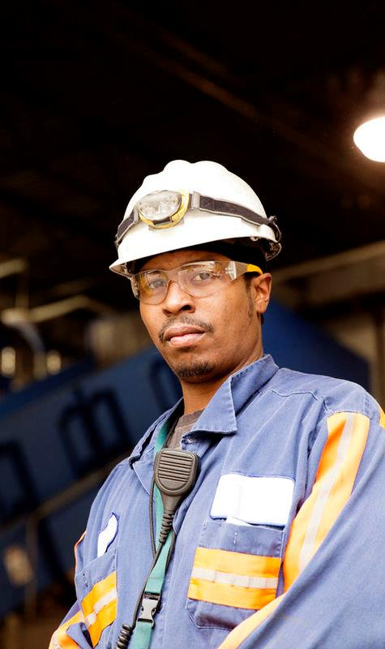
Replenishing employer investment in education & workforce training (RENEW)
Eligible applicants
  Community organizations, adult basic education providers, employer associations, higher ed institutions, labor organizations, workforce development entities, workforce boards, nonprofit education/training providers, career centers, vocational education institutions
Target sectors and occupations
  Open to any industry / occupation, preference for in-demand occupations associated with an industry-recognized credential as listed in the regional blueprint available here
  Massachusetts priority industries: Healthcare, Finance, Information Technology, Construction/Skilled Trades, and Transportation.
The Workforce Skills Cabinet and Commonwealth Corporation have launched RENEW to supply training providers with funding to develop and scale new and existing programs that train and place under/unemployed adults with a focus members of the BIPOC community
The program is available to a broad range of training institutions and encourages applications for programs across all priority sectors and occupations outlined in MA's regional blueprint matrix
Committed employers agree to pay back 50% of training costs for each hired person
Target population
  Unemployed/underemployed workers
  Focus on members of the BIPOC community at or below 65% median income
Grant value and duration
  Up to $10k per trainee
  Additional funding available for pilot
  3-year program duration
Program requirements
  Established partnership of training partner, two or more committed employers (plus local workforce boards and Career Centers)
  Employers required to pay back at least 50% of training costs per participant retained after 30 days
  For additional information on program requirements and reporting see RFP online
Allowable costs
  Program costs (e.g., outreach, recruitment, selection, training delivery, marketing)
  Student support costs (e.g., transportation, childcare, uniforms, tools, car repairs, verifiable emergencies)
  Participant stipends
Release date: October 22nd
Responses due: Rolling

Slide 51

Career Technical Initiative (CTI)
Eligible applicants
  High schools with aligned Chapter 74 vocational programs
Target sectors and occupations
  Construction/skilled trades: HVAC Mechanics and Installers, Automotive Services Techs and Mechanics, Automotive Body Repairers, Electricians, Plumbers, Carpenter, Welder, Craft Laborer, Building & General Maintenance Tech, Diesel Tech, Marine Trades Technician, Cooks, Groundskeeping and Equipment Operators
  Manufacturing: Machine Operator, Sheet Metal Workers, Biolab, Medical & Clinical Lab Tech, CNC Machine Operator, Electrical Tech, Electronics Tech, Robotics
The Workforce Skills Cabinet and Commonwealth Corporation have launched CTI to expand adult access to construction/skilled trades and manufacturing
training programs
CTI will provide High Schools with aligned C74 programs with funding to expand "third shift" training capacity and develop programs that train and place under/unemployed adults
Through the program, schools receive technical assistance and recruiting support from MassHire Career Centers and regional workforce boards
Target population
  Unemployed/underemployed workers at 65% or less of median income
Grant value and duration
  Up to $6k per student
  2-year program
Program requirements
  Training in 1+ target occupations with 1-6 cohorts (cohort minimum is 10 students)
  200-300 hours of training with industry recognized credential upon program completion
  Established partnership must include training partner, three or more committed employers, MassHire Career Center, Regional Hub/MassHire Workforce Board, and Union (if applicable)
  For additional information on program requirements and reporting see RFP online
Allowable costs
  Program costs (e.g., recruitment and marketing, training delivery, administrative costs, etc.)
  Student support costs (e.g., transportation, childcare, uniforms, tools, car repairs, verifiable emergencies)
  Participant stipends
Responses due: April 29th

Slide 52
Internal stakeholder-facing grant summaries

Slide 53
Summary of key facts for three newest ARPA funded programs
4
ARPA pipeline training grants
Key
dates
Target industries
Target population
Eligible applicants
Value & Duration
Allowable costs
WCTF
  Launch: Oct 18th
  Due: rolling
  All priority occupations ex. Advanced Manufacturing
  Under/ unemployed adult workers (with special consideration given to LTE populations)
  Education institutions
  Employers/
  industry members
  Community orgs
  2-year program with consideration for 3
  Up to $10k per student
  Awardee needs to
  cover 30%
  Program costs
  Student support costs
  Participant stipends
RENEW
  Launch: Oct 22nd
  Due: rolling
  All priority occupations
  Under/ unemployed adult workers (with focus on traditionally underserved communities)
  Education institutions
  Employers/
  industry members
  Community orgs
  3-year program
  Up to $10k per student
  Employer pays back 50% upon hire
  Program costs
  Student support costs
  Participant stipends
CTI
  Due: April 29th
  Construction/skilled trades
  Manufacturing
  Under/ unemployed adult workers (with added flexibility for workers with day responsibilities)
  High schools with aligned C74 vocational programs
  2-year program
  Up to $6k per student
  Up to $40k startup funds for new grantees
  Program costs
  Student support costs
  Participant stipends
Not included: Other supports and funding programs e.g., Workforce training fund, MassSTEP (ESOL), etc

Slide 54
Workforce Competitiveness Trust Fund (WCTF)
Replenishing Employer iNvestment in Education & Workforce Training (RENEW)
Career Technical Initiative (CTI)
Supports employer led partnerships that train workers with the skillset demanded by employers
Provides funding for programs that identify, train, and place low-income populations with additional funds available to support job seekers on public assistance
Supports programs across all priority sectors and occupations (excluding manufacturing)
Provides partnerships with marketing and recruiting support
Mobilizes employer-led partnerships that support the employers in meeting their diversity hiring goals by developing programs that train and place under/unemployed members of the BIPOC community
Employers pay into the training fund as an alternative to traditional recruiting costs
High degree of flexibility across all priority sectors and occupations
Gives employers and training partners technical assistance, marketing funds, and recruiting support
Expands access to training for construction/skilled trades and manufacturing
Helps schools with aligned C74 programs to expand "third shift" training programs
Maximizes the utilization of existing resources and provides additional flexible capacity
Gives training partners technical assistance, marketing funds, and recruiting support
1
1
1
2
2
2
3
3
3
4
4
4

Slide 55



Workforce Competitiveness Trust Fund
WCTF
1
Supports employer led partnerships that train workers with the specific skillset demanded by employers
Open to a variety of sectors and occupations
  All state and regional priority industries and occupations (excluding manufacturing) as listed in the MA regional blueprint
Focuses on low-income populations
  Unemployed/underemployed workers at 65% or less of median income
  Additional wrap around support for individuals on public assistance
Provides funding for programs that identify, train, and place low-income populations with additional funds available to support job seekers on public assistance
2
Supplies larger grant values for high throughout programs
  Up to $500k for single provider grants
  Up to $1M for multiple provider / multi-regional / high throughput applicants
Establish sustainable talent development pipelines across all priority sectors and occupations (excluding manufacturing)
3
Emphasizes sustainable employer/trainer partnership
  Established partnership of training partner, two or more committed employers
  Applicants match funds equal to 30% of total award
4
Give employers and training partners technical assistance, marketing funds, and recruiting support
Provides flexible funding for student support
  Program administration costs
  Student support costs
  Participant stipends
Available to broad range of training providers, institutions, and employers
Release date: October 18th
Responses due: Ongoing

Slide 56



Replenishing Employer Investment in Education & Workforce Training
RENEW
Mobilizes employer-led partnerships that support the employers in meeting their diversity hiring goals by developing programs that train and place under/unemployed members of the BIPOC community
Open to all sectors and occupations
  Open to any industry/occupation, preference for in-demand occupations associated with an industry-recognized credential
1
Emphasizes meeting employers' diversity hiring goals
  Focus on BIPOC below at or below 60% median income
  Unemployed/underemployed workers
2
Employers pay into the training fund as an alternative to traditional recruiting costs
Scales available funding by program size
  $10k per student trained
  Additional funding available for pilot
  3-year program duration
3
High degree of flexibility across all priority sectors and occupations
Mobilizes large employers to support equitable outcomes
  Committed employers agree to pay back 50% of training costs for each trained and
  hired person
  Partnership with training partner, and one or more employers
4
Gives employers and training partners technical assistance, marketing funds, and recruiting support
Provides flexible funding for student support
  Program administration costs
  Student support costs
  Participant stipends
Release date: October 22nd
Responses due: Ongoing
Available to broad range of training providers, institutions, and employers

Slide 57



Career Technical Initiative
CTI
1
Expands access to training for construction/skilled trades and manufacturing
Targeted list of occupations within construction/skilled trades
and manufacturing
  Construction/skilled trades (13 occupations)
  Manufacturing (7 occupations).
  For additional info see RFP online
2
Helps schools with aligned C74 programs to expand "third shift" training programs
Supports under/unemployed workers
  Unemployed/underemployed workers at 65% or less of median income
Scales available funding by program size
  Up to $6k per student
  2-year program
3
Maximizes the utilization of existing resources and provides additional flexible capacity
Emphasizes sustainable employer/trainer partnership
  Training in 1+ target occupations with 1-6 cohorts (cohort minimum = 10)
  Partnership must include training provider, 3+ employers, and MassHire
4
Give training partners technical assistance, marketing funds, and recruiting support
Provides flexible funding for program development and student support
  Program costs (e.g., recruitment and marketing, training delivery, administrative costs, etc.)
  Student support costs
  Participant stipends
Responses due: April 29th
All aligned Chapter 74 vocational programs eligible

Slide 58
Occupations vs grants

Slide 59
Backup: Occupations supported across several grants
4
ARPA pipeline training grants
Construction/Skilled Trades | ✔️ | ✔️ | ✔️ | ✔️ | ✔️ | ✔️ | ✔️
Manufacturing |  | ✔️ | ✔️ | ✔️ | ✔️ | ✔️ | ✔️ | ✔️
Automotive Services | ✔️ | ✔️ | ✔️ | ✔️ | ✔️ | ✔️ | ✔️
Transportation, Warehousing, Logistics | ✔️ | ✔️ |  | ✔️ | ✔️ | ✔️ | ✔️
Healthcare and Social Assistance | ✔️ | ✔️ |  | ✔️ | ✔️ | ✔️ | ✔️
Information technology/data science | ✔️ | ✔️ |  | ✔️ | ✔️ | ✔️ | ✔️ | ✔️
Professional and Technical Services | ✔️ | ✔️ |  | ✔️ | ✔️ | ✔️ | ✔️
Office and Administrative Support | ✔️ | ✔️ |  | ✔️ | ✔️ | ✔️ | ✔️ | ✔️
Finance and Insurance | ✔️ | ✔️ |  | ✔️ | ✔️ | ✔️ | ✔️ | ✔️
Education, Training, and Library | ✔️ | ✔️ |  | ✔️ | ✔️ | ✔️ | ✔️
Arts, Entertainment, Recreation | ✔️ | ✔️ |  | ✔️ | ✔️ | ✔️ | ✔️
Hospitality | ✔️ | ✔️ |  | ✔️ | ✔️ | ✔️ | ✔️
Retail | ✔️ | ✔️ |  | ✔️ | ✔️ | ✔️ | ✔️
Food Services | ✔️ | ✔️ | ✔️ | ✔️ | ✔️ | ✔️ | ✔️
Horticulture/landscaping |  |  | ✔️
Regulatory Affairs |  |  |  | ✔️ | ✔️ | ✔️ | ✔️ | ✔️
Other Life Science Occupations (other life sciences roles not included in the above) | ✔️ | ✔️ |  | ✔️ | ✔️ | ✔️ | ✔️ | ✔️
Occupation category
WCTF
RENEW
CTI
YAWD
Reentry
TRAIN
MassSTEP
WDCP

Slide 60
Backup: Example occupations by occupation category
4
ARPA pipeline training grants
Occupation category
Construction/Skilled Trades
Manufacturing
Automotive Services
Transportation, Warehousing, Logistics
Healthcare and Social Assistance
Information technology/data science
Professional and Technical Services
Office and Administrative Support
Finance and Insurance
Education, Training, and Library
Arts, Entertainment, Recreation
Hospitality
Retail
Food Services
Horticulture/landscaping
Regulatory Affairs
Other Life Science Occupations (other life sciences roles not included in the above)
Example occupations
e.g., HVAC Mechanic, Electrician, Plumber, Carpenter, etc.
e.g., Machine Operator, CNC Machine Operator, other manufacturing/biomanufacturing roles, etc.
e.g., Vehicle/Truck/Farm Equipment Mechanic, Repairer, Installer, Automotive Technician, Diesel Tech, etc.
e.g., CDL, Heavy & Tractor Trailer Truck Drivers, warehousing/logistics positions, etc.
e.g., CAN, LPN, RN, Pharmaceutical technician, Direct care worker, etc.
e.g., IT Support Specialist, Software Developer/Programmer, Cybersecurity, etc.
e.g., Designer, Scientific Research & Development, etc.
e.g., Bookkeeping, Accounting, Administrative Support, etc.
e.g., Customer Service Rep, Clerk, Teller, Loan Officer, etc.
e.g., Educators (all levels), Teacher Assistant, Family Day Care, College Faculty, etc.
e.g., Recreation attendant, Talent agent, Fitness instructor, Tour guide, etc.
e.g., Hotel clerk, Concierge, Event Planner, Housekeeper, etc.
e.g., Cashier, Sales Associate, Advertising/Marketing Manager, etc.
e.g., Chef, Cooks, Food service manager, etc.
e.g., Horticulturist, Landscaper, Groundskeeping, Equipment operators, etc
e.g., Compliance specialist, Inspector, Regulatory affairs manager, etc.
e.g., Lab facilities management, Quality control, Quality assurance, etc.

Slide 61
Market Maker collaboration with training providers
5

Slide 62
Training providers
5
Market Maker collaboration with training providers
Objective of subsequent training partner materials are to help Market Makers know:
  What in-demand occupations does CTI fund?
  What programs are CTI training partners running?
  Who are the CTI training partners in their regions?

Slide 63


CTI funds training for 20 in-demand occupations
Construction/
skilled trades
Occupation | Corresponding C74 program
HVAC Mechanics & Installers | Heating Ventilation Air Conditioning Refrigeration
Automotive Service Techs & Mechanics | Automotive Technology
Automotive Body Repairers | Automotive Collision Repair & Refinishing
Electrical | Electricity
Plumbers | Plumbing
Carpenter | Carpentry
Welder | Metal Fabrication & Joining Technologies
Craft Laborer | Construction Craft Laborer
Building & General Maintenance Tech | Building/Property Maintenance
Diesel Tech | Diesel Technology
Marine Trades Technician | Marine Service Technology
Cooks | Culinary Arts
Groundskeeping & Equipment Operator | Horticulture
Manufacturing
Occupation | Corresponding C74 program
Machine Operator | Advanced Manufacturing Technology
CNC Machine Operator | Advanced Manufacturing Technology
Sheet Metal Workers | Sheet Metalworking
Biolab, Medical & Clinical Lab Tech | Biotechnology
Electrical Tech | Electricity
Electronics Tech | Electronics
Robotics | Robotics and Automation Technology

Slide 64

As of 3/29/2022, 12 schools currently engaged in CTI adult education training across 16 occupations
5
Market Maker collaboration with training providers
 | Northeast |  |  |  |  | Greater Boston |  |  |  | Southeast |  | Central
 | Essex North Shore Agricultural | Greater Lawrence Technical | Greater Lowell Technical | Nashoba Valley Technical | Whittier Regional | Assabet Valley Regional | Madison Park Technical | Minuteman Regional Vocational | Tri County Regional | Greater Fall River Vocational | Southeastern Regional | Montachusett Regional Vocational
Advanced manufacturing (incl. CNC operator) | l |  |  |  | ll | l |  | ll | l |  |  | l
Automotive collision and repair |  |  |  |  | l
Automotive technology | lll | l |  | ll |  | l | l
Biotechnology lab technician | l | ll |  |  |  |  |  | l
Property maintenance |  |  |  |  |  |  |  |  |  |  |  | l
Carpentry | l | ll | l |  | l |  | l | ll
Construction labor | ll
Cooks / Culinary | l |  |  |  | l | l |  |  |  |  | l | l
Diesel Tech |  |  |  |  |  | l
Electrical | l | ll | l |  | l |  |  |  |  |  |  | l
Electronics Tech |  |  |  |  |  |  |  |  | l
Groundskeeping and equipment operator |  | l
HVAC (incl. oil burner tech) | ll | ll |  |  |  |  | l |  | l |  |  | ll
Marine trades technician |  |  |  |  | l
Metal fabrication (welding) | ll | l | ll |  | ll | l | l |  |  | l | ll | ll
Plumbing | ll | lll | l | ll
l Pathway previously completed l Pathway currently in progress l Pathway pending award / start
Note: Based on Jan 2021 data, pathway phase (completed, in progress, pending award / start) may have shifted

Slide 65
CTI training partners and programs by region

Slide 66
Berkshires: CTI eligible C74 pathways by school
5
Market Maker collaboration with training providers
Charles McCann Vocational Technical
Advanced Manufacturing Technology
Automotive Technology
Carpentry
Culinary Arts
Electricity
Metal Fabrication and Joining Technologies
Monument Mt Regional High
Automotive Technology
Horticulture
Taconic High
Advanced Manufacturing Technology
Automotive Technology
Carpentry
Culinary Arts
Electricity
Horticulture
Metal Fabrication and Joining Technologies
Already implementing CTI
Eligible for 3/16 planning seminar

Slide 67
Cape & Islands: CTI eligible C74 pathways by school
5
Market Maker collaboration with training providers
Cape Cod Regional Vocational Technical
Automotive Collision Repair and Refinishing
Automotive Technology
Carpentry
Culinary Arts
Electricity
Heating—Ventilation—Air Conditioning—Refrigeration
Horticulture
Marine Service Technology
Plumbing
Martha’s Vineyard Regional High
Automotive Technology
Carpentry
Culinary Arts
Horticulture
Upper Cape Cod Vocational Technical
Automotive Collision Repair and Refinishing
Automotive Technology
Carpentry
Culinary Arts
Electricity
Heating—Ventilation—Air Conditioning—Refrigeration
Horticulture
Marine Service Technology
Plumbing
Already implementing CTI
Eligible for 3/16 planning seminar

Slide 68
Central: CTI eligible C74 pathways by school (I/II)
5
Market Maker collaboration with training providers
Bay Path Regional Vocational Technical High School
Advanced Manufacturing Technology
Automotive Collision Repair and Refinishing
Automotive Technology
Building/Property Maintenance
Carpentry
Culinary Arts
Electricity
Electronics
Heating—Ventilation—Air Conditioning—Refrigeration
Metal Fabrication and Joining Technologies
Plumbing
Blackstone Valley
Advanced Manufacturing Technology
Automotive Collision Repair and Refinishing
Automotive Technology
Carpentry
Culinary Arts
Electricity
Electronics
Heating—Ventilation—Air Conditioning—Refrigeration
Plumbing
Center For Technical Education Innovation
Advanced Manufacturing Technology
Automotive Collision Repair and Refinishing
Automotive Technology
Carpentry
Culinary Arts
Electricity
Electronics
Heating—Ventilation—Air Conditioning—Refrigeration
Plumbing
Montachusett Regional Vocational Technical
Advanced Manufacturing Technology
Automotive Collision Repair and Refinishing
Automotive Technology
Building/Property Maintenance
Carpentry
Culinary Arts
Electricity
Metal Fabrication and Joining Technologies
Plumbing
South High Community
Culinary Arts
Diesel Technology
Tantasqua Regional Vocational
Advanced Manufacturing Technology
Carpentry
Culinary Arts
Electricity
Already implementing CTI
Eligible for 3/16 planning seminar

Slide 69
Central: CTI eligible C74 pathways by school (II/II)
5
Market Maker collaboration with training providers
Worcester Technical High
Advanced Manufacturing Technology
Automotive Collision Repair and Refinishing
Automotive Technology
Biotechnology
Carpentry
Culinary Arts
Electricity
Heating—Ventilation—Air Conditioning—Refrigeration
Metal Fabrication and Joining Technologies
Plumbing
Robotics and Automation Technology
Already implementing CTI
Eligible for 3/16 planning seminar

Slide 70
Greater Boston: CTI eligible C74 pathways by school (I/III)
5
Market Maker collaboration with training providers
Assabet Valley Vocational High School
Advanced Manufacturing Technology
Automotive Collision Repair and Refinishing
Automotive Technology
Biotechnology
Carpentry
Culinary Arts
Electricity
Heating—Ventilation—Air Conditioning—Refrigeration
Metal Fabrication and Joining Technologies
Plumbing
Blue Hills Regional Vocational Technical
Automotive Collision Repair and Refinishing
Automotive Technology
Carpentry
Culinary Arts
Electricity
Electronics
Heating—Ventilation—Air Conditioning—Refrigeration
Metal Fabrication and Joining Technologies
Cambridge Rindge and Latin
Automotive Technology
Biotechnology
Carpentry
Culinary Arts
Everett High
Advanced Manufacturing Technology
Carpentry
Culinary Arts
Joseph P Keefe Technical High School
Automotive Technology
Carpentry
Culinary Arts
Electricity
Horticulture
Metal Fabrication and Joining Technologies
Plumbing
Madison Park High
Automotive Collision Repair and Refinishing
Automotive Technology
Building/Property Maintenance
Carpentry
Culinary Arts
Electricity
Heating—Ventilation—Air Conditioning—Refrigeration
Metal Fabrication and Joining Technologies
Plumbing
Already implementing CTI
Eligible for 3/16 planning seminar

Slide 71
Greater Boston: CTI eligible C74 pathways by school (II/III)
5
Market Maker collaboration with training providers
Medford High
Automotive Collision Repair and Refinishing
Automotive Technology
Biotechnology
Carpentry
Construction Craft Laborer
Culinary Arts
Electricity
Metal Fabrication and Joining Technologies
Robotics and Automation Technology
Minuteman Regional High
Advanced Manufacturing Technology
Automotive Technology
Biotechnology
Carpentry
Culinary Arts
Electricity
Horticulture
Metal Fabrication and Joining Technologies
Plumbing
Robotics and Automation Technology
Newton North High
Automotive Technology
Carpentry
Culinary Arts
Northeast Metro Regional Vocational
Automotive Collision Repair and Refinishing
Automotive Technology
Carpentry
Culinary Arts
Electricity
Heating—Ventilation—Air Conditioning—Refrigeration
Metal Fabrication and Joining Technologies
Plumbing
Robotics and Automation Technology
Norfolk County Agricultural
Horticulture
Somerville High
Advanced Manufacturing Technology
Automotive Technology
Carpentry
Culinary Arts
Electricity
Metal Fabrication and Joining Technologies
Already implementing CTI
Eligible for 3/16 planning seminar

Slide 72
Greater Boston: CTI eligible C74 pathways by school (III/III)
5
Market Maker collaboration with training providers
Tri-County Regional Vocational Technical
Automotive Collision Repair and Refinishing
Automotive Technology
Carpentry
Culinary Arts
Electricity
Heating—Ventilation—Air Conditioning—Refrigeration
Metal Fabrication and Joining Technologies
Plumbing
Waltham Sr High
Automotive Collision Repair and Refinishing
Automotive Technology
Carpentry
Culinary Arts
Electricity
Electronics
Metal Fabrication and Joining Technologies
Already implementing CTI
Eligible for 3/16 planning seminar

Slide 73
Northeast: CTI eligible C74 pathways by school (I/II)
5
Market Maker collaboration with training providers
Essex North Shore Agricultural and Technical School
Advanced Manufacturing Technology
Automotive Collision Repair and Refinishing
Automotive Technology
Biotechnology
Carpentry
Construction Craft Laborer
Culinary Arts
Electricity
Heating—Ventilation—Air Conditioning—Refrigeration
Horticulture
Plumbing
Gloucester High
Automotive Technology
Carpentry
Electricity
Gr Lawrence Regional Vocational Technical
Advanced Manufacturing Technology
Automotive Collision Repair and Refinishing
Automotive Technology
Biotechnology
Carpentry
Culinary Arts
Electricity
Heating—Ventilation—Air Conditioning—Refrigeration
Horticulture
Metal Fabrication and Joining Technologies
Plumbing
Robotics and Automation Technology
Gr Lowell Regional Vocational Technical
Advanced Manufacturing Technology
Automotive Collision Repair and Refinishing
Automotive Technology
Carpentry
Culinary Arts
Electricity
Electronics
Heating—Ventilation—Air Conditioning—Refrigeration
Metal Fabrication and Joining Technologies
Plumbing
Lynn Vocational Technical Institute
Advanced Manufacturing Technology
Automotive Collision Repair and Refinishing
Automotive Technology
Carpentry
Culinary Arts
Electricity
Heating—Ventilation—Air Conditioning—Refrigeration
Metal Fabrication and Joining Technologies
Plumbing
Methuen High
Biotechnology
Already implementing CTI
Eligible for 3/16 planning seminar

Slide 74
Northeast: CTI eligible C74 pathways by school (II/II)
5
Market Maker collaboration with training providers
Nashoba Valley Technical High School
Advanced Manufacturing Technology
Automotive Collision Repair and Refinishing
Automotive Technology
Biotechnology
Carpentry
Culinary Arts
Electricity
Plumbing
Robotics and Automation Technology
Peabody Veterans Memorial High
Culinary Arts
Electronics
Salem High
Automotive Technology
Building/Property Maintenance
Culinary Arts
Electricity
Shawsheen Valley Vocational Technical High School
Advanced Manufacturing Technology
Automotive Collision Repair and Refinishing
Automotive Technology
Carpentry
Culinary Arts
Electricity
Electronics
Heating—Ventilation—Air Conditioning—Refrigeration
Metal Fabrication and Joining Technologies
Plumbing
Whittier Regional Vocational
Advanced Manufacturing Technology
Automotive Collision Repair and Refinishing
Automotive Technology
Carpentry
Culinary Arts
Electricity
Electronics
Heating—Ventilation—Air Conditioning—Refrigeration
Metal Fabrication and Joining Technologies
Plumbing
Already implementing CTI
Eligible for 3/16 planning seminar

Slide 75
Pioneer Valley: CTI eligible C74 pathways by school (I/II)
5
Market Maker collaboration with training providers
Chicopee Comprehensive High School
Advanced Manufacturing Technology
Automotive Technology
Carpentry
Culinary Arts
Electricity
Horticulture
Metal Fabrication and Joining Technologies
Franklin County Technical
Advanced Manufacturing Technology
Automotive Collision Repair and Refinishing
Automotive Technology
Carpentry
Culinary Arts
Electricity
Horticulture
Metal Fabrication and Joining Technologies
Plumbing
Gateway Regional High
Metal Fabrication and Joining Technologies
Holyoke High
Advanced Manufacturing Technology
Automotive Collision Repair and Refinishing
Carpentry
Culinary Arts
Diesel Technology
Electricity
Pathfinder Vocational Technical
Advanced Manufacturing Technology
Automotive Collision Repair and Refinishing
Automotive Technology
Carpentry
Culinary Arts
Electricity
Electronics
Heating—Ventilation—Air Conditioning—Refrigeration
Horticulture
Plumbing
Roger L. Putnam Vocational Technical Academy
Advanced Manufacturing Technology
Automotive Collision Repair and Refinishing
Automotive Technology
Carpentry
Culinary Arts
Electricity
Heating—Ventilation—Air Conditioning—Refrigeration
Horticulture
Metal Fabrication and Joining Technologies
Robotics and Automation Technology
Sheet Metalworking
Already implementing CTI
Eligible for 3/16 planning seminar

Slide 76
Pioneer Valley: CTI eligible C74 pathways by school (II/II)
5
Market Maker collaboration with training providers
Smith Vocational and Agricultural High
Advanced Manufacturing Technology
Automotive Collision Repair and Refinishing
Automotive Technology
Carpentry
Culinary Arts
Electricity
Horticulture
Plumbing
South Hadley High
Carpentry
Culinary Arts
Westfield Technical Academy
Advanced Manufacturing Technology
Automotive Collision Repair and Refinishing
Automotive Technology
Carpentry
Culinary Arts
Electricity
Electronics
Horticulture
Already implementing CTI
Eligible for 3/16 planning seminar

Slide 77
Southeast: CTI eligible C74 pathways by school (I/III)
5
Market Maker collaboration with training providers
Attleboro High
Automotive Technology
Carpentry
Culinary Arts
Electricity
Metal Fabrication and Joining Technologies
Plumbing
B M C Durfee High
Construction Craft Laborer
Culinary Arts
Bristol County Agricultural High
Horticulture
Bristol-Plymouth Vocational Technical
Advanced Manufacturing Technology
Automotive Collision Repair and Refinishing
Automotive Technology
Biotechnology
Carpentry
Culinary Arts
Electricity
Heating—Ventilation—Air Conditioning—Refrigeration
Metal Fabrication and Joining Technologies
Plumbing
Robotics and Automation Technology
Brockton High
Automotive Technology
Carpentry
Dighton-Rehoboth Regional High School
Advanced Manufacturing Technology
Automotive Technology
Carpentry
Already implementing CTI
Eligible for 3/16 planning seminar

Slide 78
Southeast: CTI eligible C74 pathways by school (II/III)
5
Market Maker collaboration with training providers
Diman Regional Vocational Technical High
Advanced Manufacturing Technology
Automotive Collision Repair and Refinishing
Automotive Technology
Building/Property Maintenance
Carpentry
Culinary Arts
Electricity
Electronics
Heating—Ventilation—Air Conditioning—Refrigeration
Metal Fabrication and Joining Technologies
Plumbing
Gr New Bedford Vocational Technical
Advanced Manufacturing Technology
Automotive Collision Repair and Refinishing
Automotive Technology
Carpentry
Culinary Arts
Diesel Technology
Electricity
Heating—Ventilation—Air Conditioning—Refrigeration
Marine Service Technology
Metal Fabrication and Joining Technologies
Plumbing
Old Colony Regional Vocational Technical
Advanced Manufacturing Technology
Automotive Technology
Carpentry
Culinary Arts
Electricity
Electronics
Metal Fabrication and Joining Technologies
Plymouth South High
Automotive Technology
Carpentry
Culinary Arts
Electricity
Plumbing
Quincy High
Automotive Technology
Carpentry
Culinary Arts
Electricity
Metal Fabrication and Joining Technologies
Plumbing
Silver Lake Regional High
Automotive Technology
Carpentry
Culinary Arts
Horticulture
Metal Fabrication and Joining Technologies
Already implementing CTI
Eligible for 3/16 planning seminar

Slide 79
Southeast: CTI eligible C74 pathways by school (III/III)
5
Market Maker collaboration with training providers
South Shore Vocational Technical High
Advanced Manufacturing Technology
Automotive Technology
Carpentry
Culinary Arts
Electricity
Electronics
Heating—Ventilation—Air Conditioning—Refrigeration
Horticulture
Metal Fabrication and Joining Technologies
Southeastern Regional Vocational Technical
Advanced Manufacturing Technology
Automotive Collision Repair and Refinishing
Automotive Technology
Carpentry
Culinary Arts
Electricity
Heating—Ventilation—Air Conditioning—Refrigeration
Metal Fabrication and Joining Technologies
Plumbing
Taunton High
Culinary Arts
Weymouth High School
Automotive Technology
Carpentry
Culinary Arts
Metal Fabrication and Joining Technologies
Already implementing CTI
Eligible for 3/16 planning seminar

Slide 80
Employer engagement guidebook
6

Slide 81

Employer engagement guidebook is a standalone document providing Market Makers resources to successfully navigate employer engagements
6
Employer engagement guidebook
Employer engagement guidebook was created to help Commonwealth employees and partners navigate the roll out of new ARPA funded programs, particularly for Market Makers when engaging and supporting employers.
Guidebook resources include:
  Steps and roles to engage employers
  Example employer engagements
  Employer-ready materials
  Support options for immediate hiring, future pipeline, and upskilling incumbents
Employer engagement guidebook should be used in conjunction with this guide

Slide 82
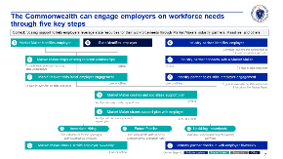
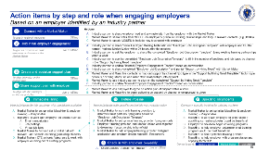
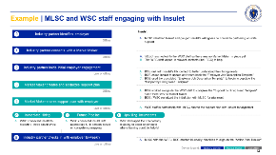
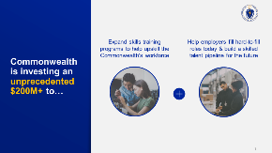
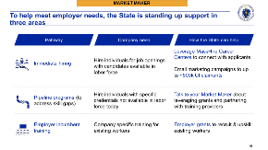
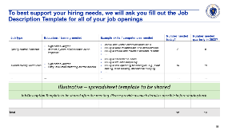
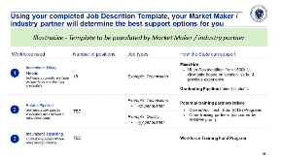
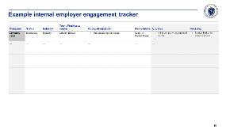
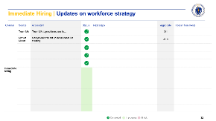
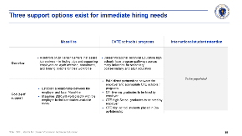
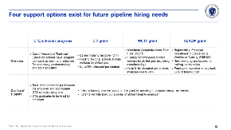
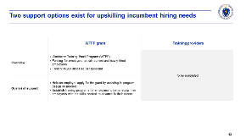
Preview: Materials available in each guidebook section
Guidebook sections
Materials by section
What are the steps and roles to engage employers?
What are the actions by step / role when engaging employers?
What example employer engagements exist?
What materials are available when engaging employers?
Initial engagement materials
Workforce need intake form
Workforce need support plan
Internal employer tracker
Action Plan Tracker
What support options exist for immediate hiring?
What support options exist for future pipeline?
What support options exist for upskilling incumbents?
1
2
3
1
2
3
4
4A
4A
4B
A
B
C
4C
4D
4E
D
E
5
5
6
7
6
7
Please refer to the Employer Engagement Guidebook for these resources

Slide 83





Preview: Summary of employer engagement materials
 | Name | Description
 | Initial engagement materials | Compiled materials to share during initial employer meeting that covers what the Commonwealth resources and how to move forward with support
 | Workforce need intake form | Template with excel sheet that can be shared with an employer to provide deeper details on open job roles to help create the workforce support plan
 | Workforce need support plan | Template to map open job roles to specific state support options by hiring channel (e.g., immediate hiring, future pipeline, and upskilling incumbents)
 | Internal employer tracker | Template to track employer engagements over time
 | Action plan tracker | Template to track aligned on action items across hiring channels
4A
4B
4C
4D
4E
Please refer to the Employer Engagement Guidebook for these resources

Slide 84
7
Market Maker target outcomes

Slide 85

Monthly target outcomes are 2-4 new training/business partnerships formed and 4-7 businesses connected to existing training providers
7
Market Maker target outcomes
  Target outcomes are meant to be guideposts, not criteria that the Market Maker will be evaluated against
  Target outcomes averaged across Commonwealth and do not take into consideration regional variation in employer demand
  Market Maker outcomes
  2-4 new business/training partnerships formed / applying for funding
  4-7 businesses connected to existing training partnerships
1
2

Slide 86
New partnerships: Each Market Maker to target forming 2-4 new business/training partnerships a month
7
Market Maker target outcomes
1
2-4 new business/training partnerships per month estimated using grant sizing approach
Steps to estimate:
Employers needed to be referred per Market Maker monthly
Employers referred per Market Maker in each year of funding
Employers referred per Market Maker
Total employers referred to start training partnerships
Number of CTI, WCTF, RENEW
grants submitted
~28-43 employers annually
~85-130 employers across funding years
~600-900
employers
~300 grants
$72.5M funding
2-4 employers monthly
12 months
3 years of funding
7 Market Makers
~2-3 employers per grant
~$250K average grant size
Assumptions:
Timeline of ARPA
funding is 3 years
Average required number of employers across
3 grants is 2-3
Average award value for CTI, WCTF, and RENEW is ~$250K and total funding is fully deployed
Relies on a key assumption
Source: BCG analysis

Slide 87
Existing partnerships: Each Market Maker to target making 4–7 business connections to existing training programs a month
7
Market Maker target outcomes
2
4-7 business connections per month estimated using trainee placed approach:
Steps to estimate:
Employers needed to be referred per Market Maker monthly
Employers referred per Market Maker in each year of funding
Employers referred per Market Maker
Total employers needed to be referred
Total expected trainees placed
~45-90 employers annually
~130-160 employers across funding years
~900-1800
employers
~9000 trainees
$72.5M funding
4-7 employers monthly
12 months
3 years of funding
7 Market Makers
~5-10 trainees hired per employer
~$8K cost per trainee placement
Assumptions:
Timeline of ARPA
funding is 3 years
Average number of trainees hired by
employer is 5-10
Average trainee placement cost is $8K and total funding for CTI, WCTF, and RENEW is fully deployed
Relies on a key assumption
Source: BCG analysis

Slide 88
Tracking employer interactions in MOSES
8

Slide 89
Market Maker MOSES Training
8
Tracking employer interactions in MOSES
Logging into MOSES
Switching Career Centers
Search for Employer Record
  Find the Employer, Switch Career Centers if necessary
  Using the Advanced Search to find Employer
  Business Service Rep (BSR) works with you to add new employer if needed
Overview of MOSES Employer Record
Employer Enrollment into the FutureSkills Program*
Adding Services to the Employer Record
  Lead service
  Qualified Lead
  Referral
  Outcome
*FutureSkills unifies a range of Massachusetts workforce development programs for employers and training partners and provides employers with access to a pipeline of trained workers

Slide 90
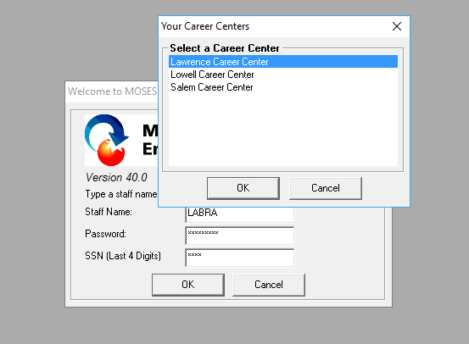
Logging in to a career center
8
Tracking employer interactions in MOSES
When logging in to MOSES,
make sure to login to the correct
career center from the list of centers available to you; that is, the career center that you would like to add service records to for a specific employer.

Slide 91
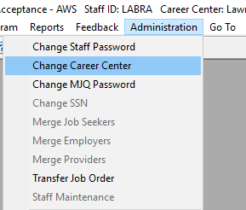
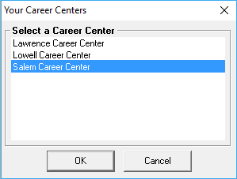
Switching local offices
8
Tracking employer interactions in MOSES
Once logged in to MOSES,
you can switch to a different career center without logging out so that you can add service records to the correct career center office; again, the career center that you would like to add service records to for a specific employer.

Slide 92
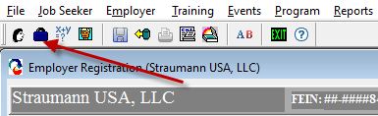
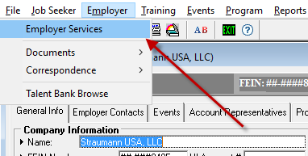
Employer search
8
Tracking employer interactions in MOSES
Open the Employer search window by either using the
Briefcase icon
OR
Employer > Employer Services

Slide 93
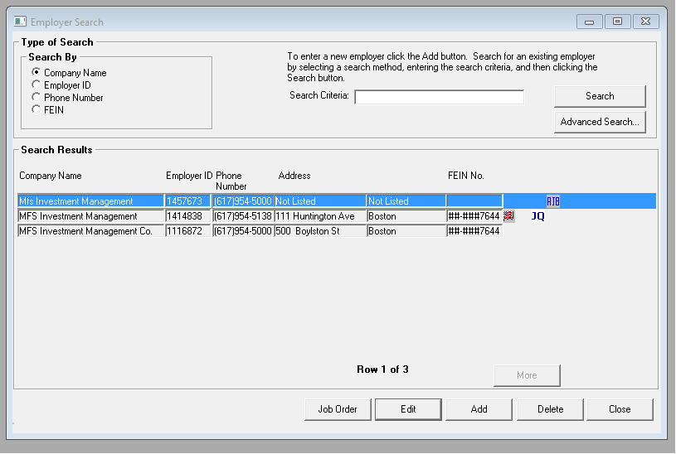
Search for employer record
8
Tracking employer interactions in MOSES
Search for the employer in MOSES
  There are many duplicate employer records in MOSES. If not sure which one to use, check with
  Business Service Rep (BSR)
  Don’t use employers with AJB icon
Find the city/town of employer
Determine which career center is associated with that city/town
[spreadsheet handout]
  Make sure you are logged into the correct career center office!
Add services
GET TO KNOW YOUR BSRs!!!

Slide 94
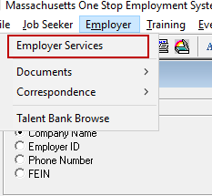
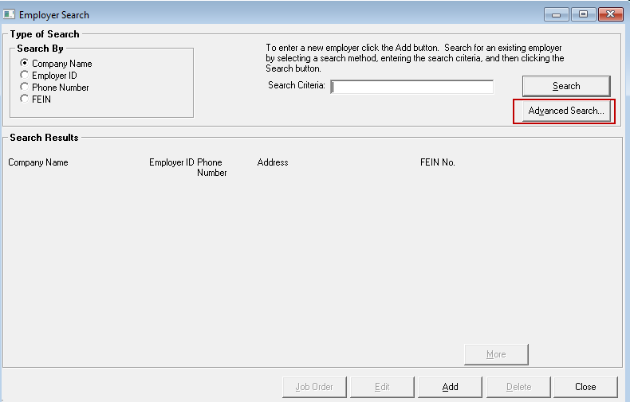
MOSES advanced search
8
Tracking employer interactions in MOSES
You can also use the Advanced Search feature of MOSES to find employers.
Use the Employer dropdown menu item and click on Employer Services
Then click on the Advanced Search button

Slide 95
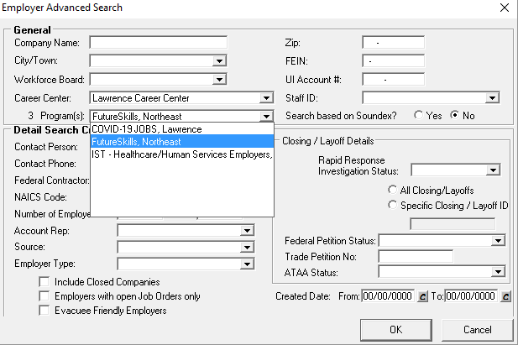
MOSES advanced search
8
Tracking employer interactions in MOSES
Choose the Career Center from the dropdown, then select the FutureSkills Regional Program
Click OK.
This is an option to see a complete
list of your employers currently
enrolled in the program.

Slide 96
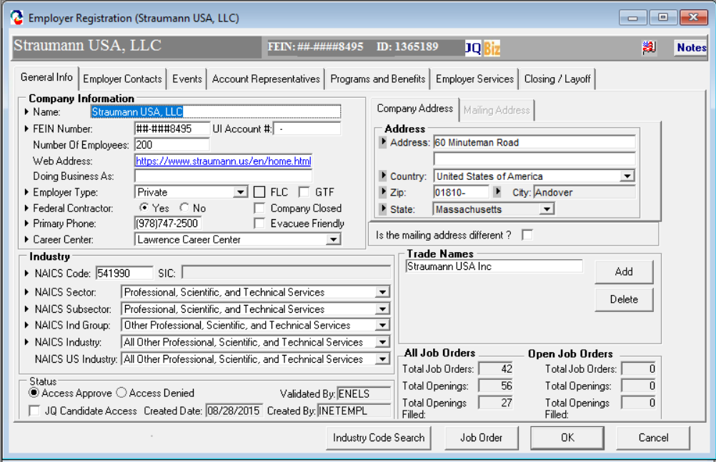
MOSES employer record
8
Tracking employer interactions in MOSES
The Employer Record has seven tabs:
TAB 1: General Info
This tab contains basic information about the
business i.e. name, address, NAICS Code,
FEIN, and snapshot data i.e. number of job
orders , etc.
The buttons at the bottom of the screen allow
the BSR to update the NAICS Code, access
the Job Order page, and save/cancel
functions for saving updates.
These four buttons appear on
every tab. You will also see a Notes button
on the top right, Notes are also accessible
from every tab.

Slide 97
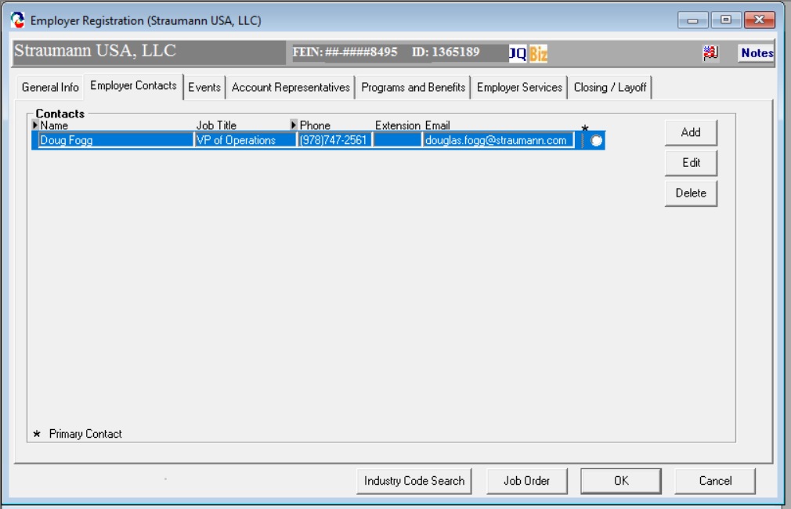
MOSES employer record
8
Tracking employer interactions in MOSES
TAB 2: Employer Contacts
This tab contains a list of
business contacts
within the company. Typically,
these will be owners or HR contacts.

Slide 98
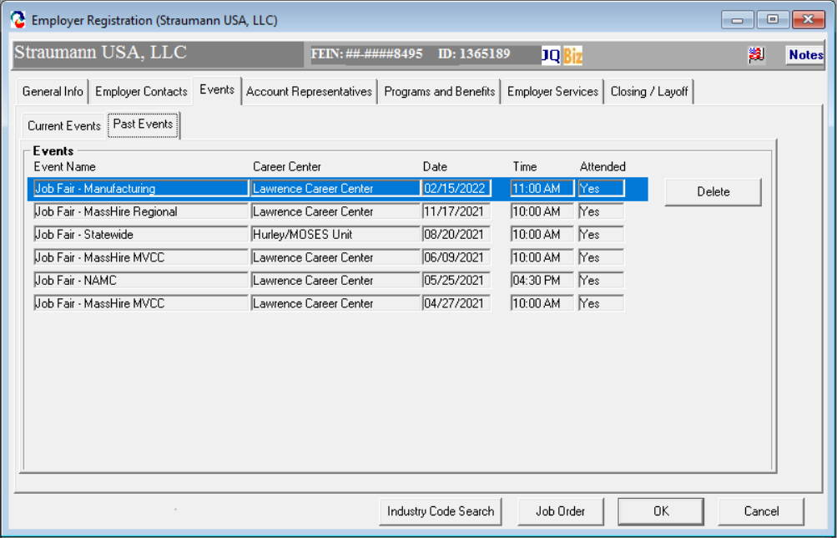
MOSES employer record
8
Tracking employer interactions in MOSES
TAB 3: Events
This tab contains a list of events the business is scheduled to attend
(Current Events) or has
attended in the past (Past Events)

Slide 99
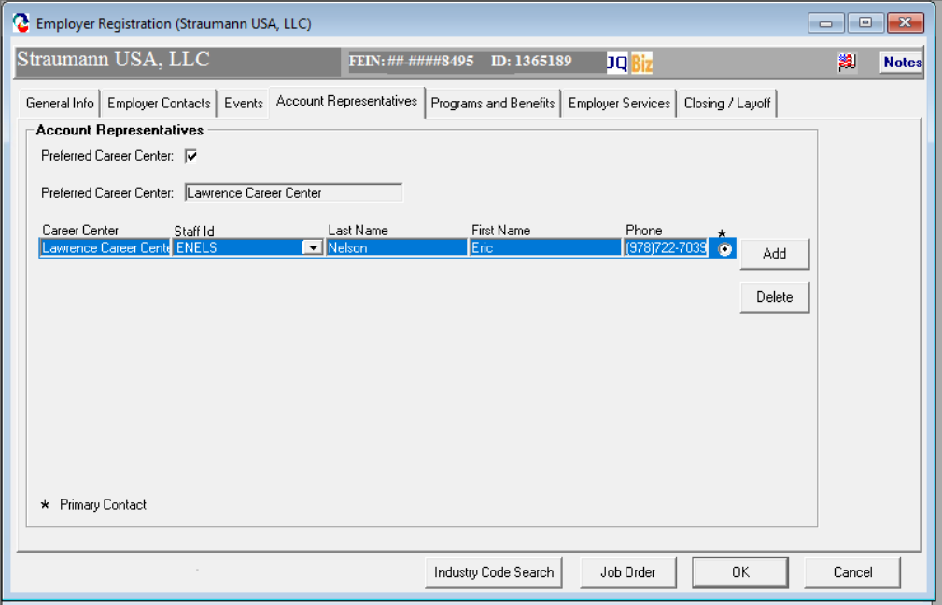
MOSES employer record
8
Tracking employer interactions in MOSES
TAB 4: Account Representatives
This tab is reserved for
the career center BSR.
This tab allows a BSR to identify themselves as the primary contact for
the business. Entering information on t
his tab is not required.

Slide 100
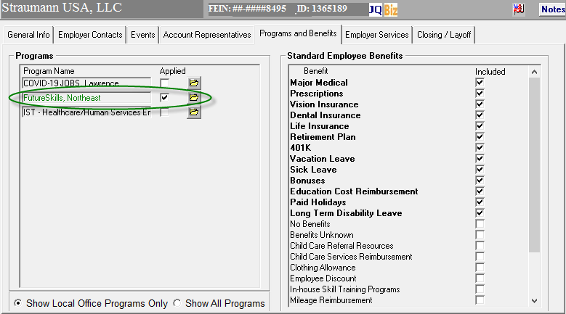
MOSES employer record
8
Tracking employer interactions in MOSES
TAB 5: Programs and Benefits
The Programs window allows staff to check
any state or local programs that
the business is enrolled in.
There are seven (7) Employer Programs to
align with the planning regions.
Market Makers should check off
the appropriate regional program for each employer they have both a lead for and have made contact with regarding the FutureSkills program.
Make sure to have the Show Local Office Programs Only checked on.

Slide 101
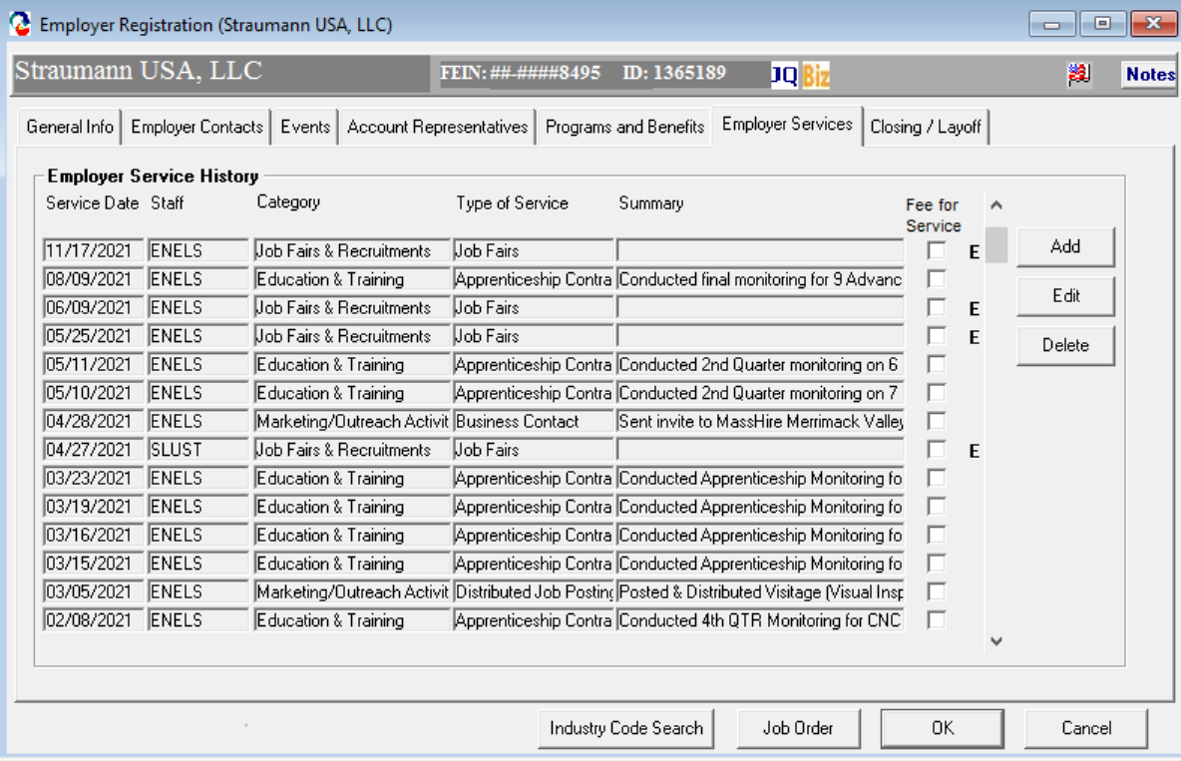
MOSES employer record
8
Tracking employer interactions in MOSES
TAB 6: Employer Services
Adding an Employer Service in MOSES
  Move to the Employer Services tab
  Click the Add button to add a service
Note that for every service entered there should be a comprehensive summary of the conversation with the employer.

Slide 102
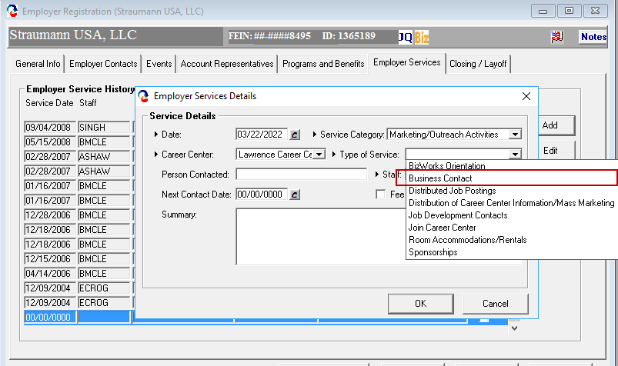
MOSES employer record
8
Tracking employer interactions in MOSES
TAB 6: Employer Services
Each employer enrolled in the FutureSkills regional program, must also
have a "Lead" service recorded.
To define “Lead”: Market Makers will add a Marketing and Outreach Services – Business Contact service for each employer they have identified as a lead for the FutureSkills program.
To define “Qualified Lead”:
The Market Maker will add a Business Information and Incentives – Business Assessment service for each employer they have identified as
a qualified lead for the FutureSkills program.

Slide 103
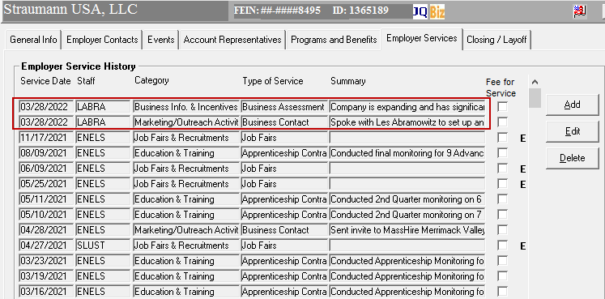
MOSES employer record
8
Tracking employer interactions in MOSES
TAB 6: Employer Services
New services appear at the top of
the service summary screen.
Services will show history
of interaction with employer.
Again, remember that for
every service entered there should be a comprehensive summary of the conversation with the employer.

Slide 104
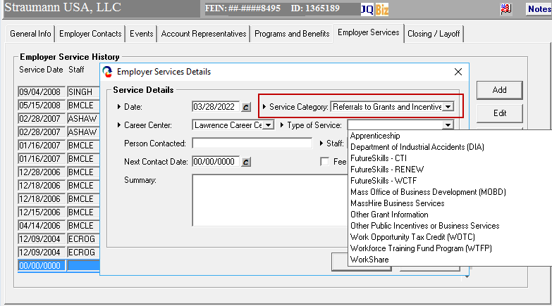
MOSES employer record
8
Tracking employer interactions in MOSES
TAB 6: Employer Services
To define “Referral”:
The Market Maker will add a
Referrals to Grants and Incentives service
for each employer they refer for training and/or support.
New FutureSkills Services for MOSES:
Under the category of Referrals
to Grants and Incentives:
  MassHire for Business Services
  FutureSkills - CTI
  FutureSkills - RENEW
  FutureSkills – WCTF

Slide 105
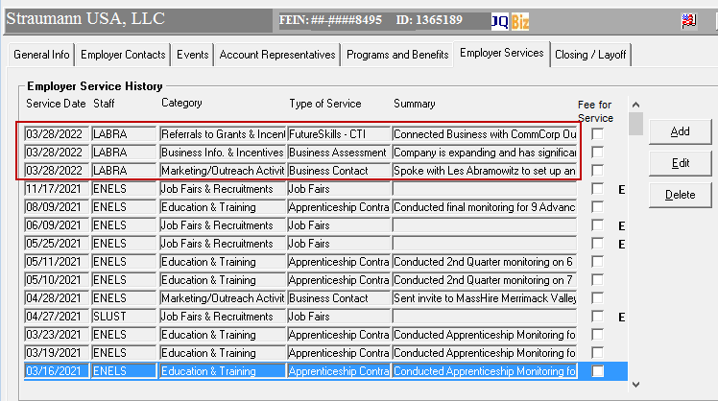
MOSES employer record
8
Tracking employer interactions in MOSES
TAB 6: Employer Services
New services appear at the top of
the service summary screen.
Services will show history
of interaction with employer.

Slide 106
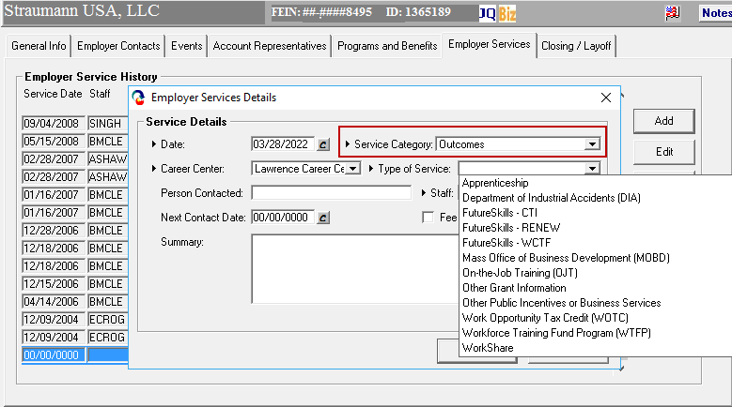
MOSES employer record
8
Tracking employer interactions in MOSES
TAB 6: Employer Services
Once a referral is made for an employer and there is a successful outcome, add an outcome service to the employer record indicating a successful referral; i.e.; a grant from the Commonwealth Corporation for training.
FutureSkills Services for MOSES:
Under the category of Outcomes
  FutureSkills - CTI
  FutureSkills - RENEW
  FutureSkills - WCTF

Slide 107
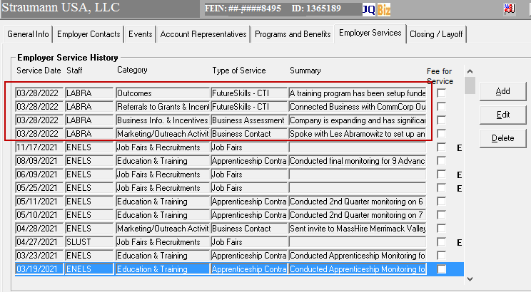
MOSES employer record
8
Tracking employer interactions in MOSES
TAB 6: Employer Services
An outcome service is a companion
to the referral service to indicate a successful referral has been made.

Slide 108
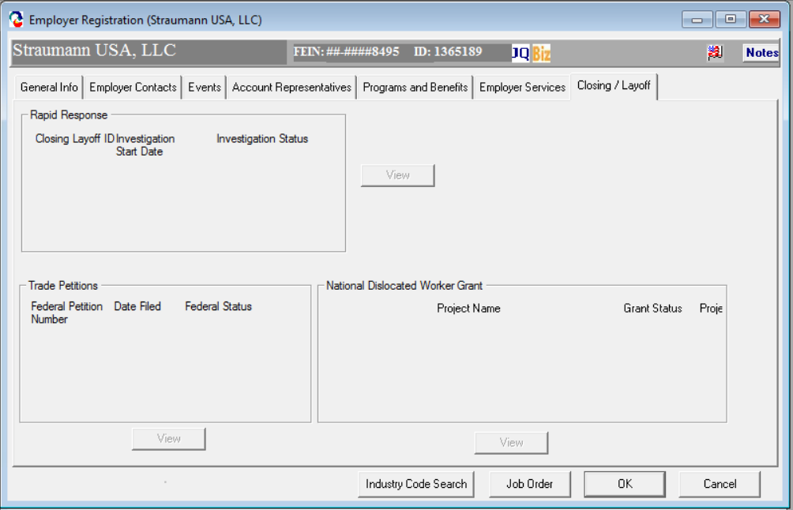
MOSES employer record
8
Tracking employer interactions in MOSES
TAB 7: Closing / Layoff
This tab is for the exclusive use of
the MassHire Rapid Response Team and Central Office. In this tab, the user can record the status Of Closings / Layoffs, Trade Petitions filed, and National Dislocated Worker Grant information.

Slide 109
Regional blueprints
9

Slide 110
2020 regional blueprints
9
Regional blueprints
Region
Berkshire
Cape & Islands
Central
Greater Boston
Northeast
Pioneer Valley
Southeast

Slide 111
Target occupations for Market Maker outreach by region
10

Slide 112
10
Greater Boston: Target occupations for Market Maker outreach by region
Greater Boston: Market Makers should target in-demand occupations with high number of job openings compared to UI claimants – training programs can help close the gap between openings and claimants
Occupation category¹ | Annual growth rate² | UI claimants, 9/2021 (K)³ | Job openings, 9/2021 (K)⁴ | Openings v. claimants (K)
Management Occupations | 0.8% | 2.5 | 18.9 | 16.4
Computer and Mathematical Occupations | 1.3% | 0.5 | 14.3 | 13.8
Office and Administrative Support Occupations | -0.5% | 2.1 | 10.1 | 8.1
Sales and Related Occupations | 0.1% | 1.4 | 9.1 | 7.7
Business and Financial Operations Occupations | 0.8% | 0.7 | 7.9 | 7.1
Healthcare Practitioners and Technical Occupations | 0.5% | 0.5 | 7.2 | 6.7
Transportation and Material Moving Occupations | 0.4% | 1.1 | 5.8 | 4.7
Food Preparation and Serving Related Occupations | 0.6% | 1.4 | 5.3 | 3.9
Education, Training, and Library Occupations | 0.4% | 0.6 | 3.8 | 3.2
Arts, Design, Entertainment, Sports, and Media Occupations | 0.8% | 0.3 | 3.0 | 2.7
Life, Physical, and Social Science Occupations | 0.4% | 0.2 | 2.5 | 2.4
Architecture and Engineering Occupations | 0.7% | 0.3 | 2.6 | 2.3
Installation, Maintenance, and Repair Occupations | 0.4% | 0.3 | 2.0 | 1.8
Healthcare Support Occupations | 0.8% | 0.6 | 2.1 | 1.5
Community and Social Service Occupations | 0.7% | 0.3 | 1.7 | 1.4
Personal Care and Service Occupations | 1.1% | 0.8 | 2.0 | 1.1
Protective Service Occupations | 0.1% | 0.4 | 1.5 | 1.1
Production Occupations | -0.5% | 0.4 | 1.4 | 0.9
Building and Grounds Cleaning and Maintenance Occupations | 0.4% | 0.6 | 1.2 | 0.6
In-demand occupations with a high number of job openings compared to UI claimants
Occupations with fewer job openings compared to UI claimants
MA priority occupations
Regional priority occupations (2-digit SOC code), 2020⁵
1. Construction, farming, legal, and military occupations excluded from analysis; healthcare support occupations include therapy, dental, medical, and pharmacy assistants 2. Weighted CAGR between 2018 - 2028 calculated using LMI long-term occupation projections; not all occupations available; 3. UI claimants weekly average, 9/2021; PEUC and EB excluded given expiration date in first week of 9/2021; 4. More detail in Appendix; 5. Regional priority occupations sourced from Regional Labor Market Blueprints, 2018 - 2020

Slide 113
10
Pioneer Valley: Target occupations for Market Maker outreach by region
Pioneer Valley: Market Makers should target in-demand occupations with high number of job openings compared to UI claimants – training programs can help close the gap between openings and claimants
Occupation category¹ | Annual growth rate² | UI claimants, 9/2021³ | Job openings, 9/2021 | Openings v. claimants
Healthcare Practitioners and Technical Occupations | 0.65% | 171 | 2,031 | 1,860
Management Occupations | 0.49% | 498 | 2,087 | 1,590
Sales and Related Occupations | -0.45% | 469 | 1,908 | 1,439
Office and Administrative Support Occupations | -0.72% | 707 | 2,034 | 1,327
Education, Training, and Library Occupations | -0.29% | 206 | 1,160 | 954
Computer and Mathematical Occupations | N/A | 55 | 964 | 909
Transportation and Material Moving Occupations | 0.17% | 577 | 1,282 | 705
Business and Financial Operations Occupations | 0.23% | 159 | 776 | 617
Food Preparation and Serving Related Occupations | 0.38% | 478 | 1,057 | 580
Arts, Design, Entertainment, Sports, and Media Occupations | 0.65% | 47 | 521 | 474
Installation, Maintenance, and Repair Occupations | 0.25% | 176 | 639 | 463
Community and Social Service Occupations | 0.28% | 182 | 547 | 365
Architecture and Engineering Occupations | N/A | 44 | 327 | 283
Healthcare Support Occupations | 0.43% | 392 | 619 | 227
Building and Grounds Cleaning and Maintenance Occupations | 0.67% | 187 | 413 | 226
Production Occupations | -0.49% | 411 | 604 | 193
Protective Service Occupations | 0.21% | 90 | 244 | 154
Life, Physical, and Social Science Occupations | N/A | 27 | 160 | 133
Legal Occupations | 0.80% | 19 | 78 | 60
Personal Care and Service Occupations | 1.24% | 678 | 488 | -190
In-demand occupations with a high number of job openings compared to UI claimants
Occupations with fewer job openings compared to UI claimants
MA priority occupations
Regional priority occupations (2-digit SOC code), 2020⁴
1. Construction, farming, and military occupations excluded from analysis; 2. Weighted CAGR between 2018 - 2028 calculated using LMI long-term occupation projections; not all occupations available; 3. UI claimants weekly average, 9/2021; PEUC and EB excluded given expiration date in first week of 9/2021; 4. Regional priority occupations sourced from Regional Labor Market Blueprints, 2018 - 2020

Slide 114
10
Berkshires: Target occupations for Market Maker outreach by region
Berkshires: Market Makers should target in-demand occupations with high number of job openings compared to UI claimants – training programs can help close the gap between openings and claimants
Occupation category¹ | Annual growth rate² | UI claimants, 9/2021³ | Job openings, 9/2021 | Openings v. claimants
Healthcare Practitioners and Technical Occupations | 0.6% | 35 | 252 | 217
Sales and Related Occupations | 0.2% | 80 | 295 | 215
Management Occupations | 0.4% | 82 | 223 | 142
Office and Administrative Support Occupations | -0.7% | 115 | 250 | 136
Education, Training, and Library Occupations | -0.2% | 37 | 140 | 103
Food Preparation and Serving Related Occupations | 0.2% | 70 | 149 | 80
Computer and Mathematical Occupations | N/A | 8 | 83 | 76
Arts, Design, Entertainment, Sports, and Media Occupations | 0.3% | 9 | 70 | 61
Community and Social Service Occupations | 0.5% | 20 | 67 | 48
Building and Grounds Cleaning and Maintenance Occupations | 0.4% | 35 | 75 | 41
Business and Financial Operations Occupations | 0.7% | 23 | 61 | 38
Installation, Maintenance, and Repair Occupations | 0.0% | 30 | 60 | 31
Healthcare Support Occupations | 0.7% | 49 | 77 | 29
Personal Care and Service Occupations | 1.3% | 66 | 93 | 27
Transportation and Material Moving Occupations | 0.4% | 65 | 89 | 24
Architecture and Engineering Occupations | 2.0% | 6 | 30 | 24
Protective Service Occupations | 0.3% | 12 | 27 | 15
Life, Physical, and Social Science Occupations | N/A | 1 | 13 | 12
Production Occupations | -0.5% | 50 | 49 | -1
In-demand occupations with a high number of job openings compared to UI claimants
Occupations with fewer job openings compared to UI claimants
MA priority occupations
Regional priority occupations (2-digit SOC code), 2020⁴
1. Construction, farming, legal, and military occupations excluded from analysis; 2. Weighted CAGR between 2018 - 2028 calculated using LMI long-term occupation projections; not all occupations available; 3. UI claimants weekly average, 9/2021; PEUC and EB excluded given expiration date in first week of 9/2021; 4. Regional priority occupations sourced from Regional Labor Market Blueprints, 2018 - 2020

Slide 115
10
Cape & Islands: Target occupations for Market Maker outreach by region
Cape & Islands: Market Makers should target in-demand occupations with high number of job openings compared to UI claimants – training programs can help close the gap between openings and claimants
Occupation category¹ | Annual growth rate² | UI claimants, 9/2021³ | Job openings, 9/2021 | Openings v. claimants
Healthcare Practitioners and Technical Occupations | 0.71% | 63 | 161 | 98
Sales and Related Occupations | -0.43% | 138 | 218 | 80
Personal Care and Service Occupations | 0.87% | 52 | 100 | 48
Healthcare Support Occupations | 0.56% | 64 | 110 | 46
Computer and Mathematical Occupations | N/A | 18 | 54 | 37
Food Preparation and Serving Related Occupations | 0.42% | 151 | 186 | 35
Education, Training, and Library Occupations | -0.32% | 54 | 89 | 35
Arts, Design, Entertainment, Sports, and Media Occupations | 0.68% | 32 | 57 | 26
Protective Service Occupations | 0.48% | 15 | 39 | 24
Installation, Maintenance, and Repair Occupations | 0.24% | 31 | 52 | 22
Transportation and Material Moving Occupations | 0.64% | 87 | 101 | 14
Building and Grounds Cleaning and Maintenance Occupations | 0.44% | 68 | 79 | 12
Architecture and Engineering Occupations | N/A | 10 | 19 | 9
Community and Social Service Occupations | 0.42% | 34 | 40 | 6
Life, Physical, and Social Science Occupations | -0.49% | 8 | 10 | 2
Production Occupations | 0.78% | 26 | 25 | -1
Office and Administrative Support Occupations | -0.53% | 172 | 162 | -10
Business and Financial Operations Occupations | 0.71% | 52 | 35 | -17
Management Occupations | 0.60% | 242 | 145 | -97
In-demand occupations with a high number of job openings compared to UI claimants
Occupations with fewer job openings compared to UI claimants
MA priority occupations
Regional priority occupations (2-digit SOC code), 2020⁴
1. Construction, farming, and military occupations excluded from analysis; 2. Weighted CAGR between 2018 - 2028 calculated using LMI long-term occupation projections; not all occupations available; 3. UI claimants weekly average, 9/2021; PEUC and EB excluded given expiration date in first week of 9/2021; 4. Regional priority occupations sourced from Regional Labor Market Blueprints, 2018 - 2020

Slide 116
10
Northeast: Target occupations for Market Maker outreach by region
Northeast: Market Makers should target in-demand occupations with high number of job openings compared to UI claimants – training programs can help close the gap between openings and claimants
Occupation category¹ | Annual growth rate² | UI claimants, 9/2021³ | Job openings, 9/2021 | Openings v. claimants
Healthcare Practitioners and Technical Occupations | 1.0% | 252 | 2,996 | 2,744
Office and Administrative Support Occupations | -0.5% | 1,170 | 3,311 | 2,141
Management Occupations | 0.5% | 1,029 | 3,068 | 2,039
Sales and Related Occupations | -0.1% | 589 | 2,513 | 1,924
Transportation and Material Moving Occupations | -0.1% | 824 | 2,619 | 1,795
Education, Training, and Library Occupations | 0.0% | 252 | 1,705 | 1,453
Computer and Mathematical Occupations | 1.1% | 192 | 1,573 | 1,382
Food Preparation and Serving Related Occupations | 0.5% | 650 | 1,721 | 1,071
Architecture and Engineering Occupations | 0.4% | 150 | 1,050 | 900
Business and Financial Operations Occupations | 0.6% | 349 | 1,238 | 889
Healthcare Support Occupations | 1.0% | 476 | 1,256 | 780
Installation, Maintenance, and Repair Occupations | 0.3% | 202 | 890 | 688
Arts, Design, Entertainment, Sports, and Media Occupations | 0.3% | 114 | 765 | 651
Community and Social Service Occupations | 0.7% | 128 | 718 | 590
Building and Grounds Cleaning and Maintenance Occupations | 0.3% | 260 | 599 | 339
Personal Care and Service Occupations | 1.1% | 547 | 882 | 335
Production Occupations | 0.0% | 574 | 897 | 323
Life, Physical, and Social Science Occupations | N/A | 46 | 357 | 311
Protective Service Occupations | 0.0% | 104 | 411 | 307
Legal Occupations | 0.1% | 41 | 136 | 96
In-demand occupations with a high number of job openings compared to UI claimants
Occupations with fewer job openings compared to UI claimants
MA priority occupations
Regional priority occupations (2-digit SOC code), 2020⁴
1. Construction, farming, and military occupations excluded from analysis; 2. Weighted CAGR between 2018 - 2028 calculated using LMI long-term occupation projections; not all occupations available; 3. UI claimants weekly average, 9/2021; PEUC and EB excluded given expiration date in first week of 9/2021; 4. Regional priority occupations sourced from Regional Labor Market Blueprints, 2018 - 2020

Slide 117
10
Central: Target occupations for Market Maker outreach by region
Central: Market Makers should target in-demand occupations with high number of job openings compared to UI claimants – training programs can help close the gap between openings and claimants
Occupation category¹ | Annual growth rate² | UI claimants, 9/2021³ (K) | Job openings, 9/2021 (K) | Openings v. claimants (K)
Healthcare Practitioners and Technical Occupations | 1.0% | 0.5 | 2.3 | 1.8
Transportation and Material Moving Occupations | 0.5% | 0.6 | 2.3 | 1.7
Office and Administrative Support Occupations | -0.5% | 0.9 | 2.6 | 1.7
Sales and Related Occupations | -0.1% | 0.5 | 2.0 | 1.5
Management Occupations | 0.6% | 0.8 | 2.2 | 1.4
Education, Training, and Library Occupations | -0.1% | 0.2 | 1.0 | 0.7
Computer and Mathematical Occupations | N/A | 0.1 | 0.9 | 0.7
Food Preparation and Serving Related Occupations | 0.6% | 0.5 | 1.1 | 0.7
Community and Social Service Occupations | 0.8% | 0.1 | 0.7 | 0.5
Healthcare Support Occupations | 0.9% | 0.3 | 0.8 | 0.5
Business and Financial Operations Occupations | 0.5% | 0.3 | 0.7 | 0.5
Installation, Maintenance, and Repair Occupations | 0.3% | 0.2 | 0.6 | 0.4
Arts, Design, Entertainment, Sports, and Media Occupations | 0.4% | 0.1 | 0.5 | 0.4
Architecture and Engineering Occupations | 0.9% | 0.1 | 0.5 | 0.3
Building and Grounds Cleaning and Maintenance Occupations | 0.4% | 0.2 | 0.4 | 0.2
Life, Physical, and Social Science Occupations | 0.2% | 0.0 | 0.3 | 0.2
Production Occupations | -0.4% | 0.5 | 0.7 | 0.2
Personal Care and Service Occupations | 1.1% | 0.4 | 0.6 | 0.2
Protective Service Occupations | 0.3% | 0.1 | 0.2 | 0.1
In-demand occupations with a high number of job openings compared to UI claimants
Occupations with fewer job openings compared to UI claimants
MA priority occupations
Regional priority occupations (2-digit SOC code), 2020⁴
1. Construction, farming, legal, and military occupations excluded from analysis; 2. Weighted CAGR between 2018 - 2028 calculated using LMI long-term occupation projections; not all occupations available; 3. UI claimants weekly average, 9/2021; PEUC and EB excluded given expiration date in first week of 9/2021; 4. Regional priority occupations sourced from Regional Labor Market Blueprints, 2018 - 2020

Slide 118
10
Southeast: Target occupations for Market Maker outreach by region
Southeast: Market Makers should target in-demand occupations with high number of job openings compared to UI claimants – training programs can help close the gap between openings and claimants
Occupation category¹ | Annual growth rate² | UI claimants, 9/2021³ (K) | Job openings, 9/2021 (K) | Openings v. claimants (K)
Healthcare Practitioners and Technical | 0.6% | 0.4 | 2.6 | 2.2
Sales and Related | 0.0% | 0.9 | 2.9 | 2.0
Transportation and Material Moving | 0.2% | 1.3 | 2.8 | 1.5
Office and Administrative Support | -0.4% | 1.5 | 2.8 | 1.3
Management | 0.6% | 1.4 | 2.2 | 0.8
Education, Training, and Library | 0.2% | 0.4 | 1.2 | 0.8
Computer and Mathematical | N/A | 0.2 | 0.9 | 0.7
Installation, Maintenance, and Repair | 0.4% | 0.3 | 0.8 | 0.5
Arts, Design, Entertainment, Sports, and Media | 1.0% | 0.1 | 0.6 | 0.5
Business and Financial Operations | 0.7% | 0.5 | 0.9 | 0.5
Food Preparation and Serving Related | 0.4% | 1.0 | 1.4 | 0.4
Community and Social Service | 0.8% | 0.2 | 0.6 | 0.3
Healthcare Support | 0.9% | 0.6 | 0.9 | 0.3
Building and Grounds Cleaning and Maintenance | 0.4% | 0.3 | 0.5 | 0.2
Architecture and Engineering | 0.6% | 0.1 | 0.3 | 0.2
Protective Service | 0.3% | 0.2 | 0.3 | 0.1
Life, Physical, and Social Science | N/A | 0.0 | 0.1 | 0.1
Personal Care and Service | 1.0% | 0.6 | 0.7 | 0.1
Production | -0.6% | 0.5 | 0.6 | 0.0
In-demand occupations with a high number of job openings compared to UI claimants
Occupations with fewer job openings compared to UI claimants
MA priority occupations
Regional priority occupations (2-digit SOC code), 2020⁴
1. Construction, farming, legal, and military occupations excluded from analysis; 2. Weighted CAGR between 2018 - 2028 calculated using LMI long-term occupation projections; not all occupations available; 3. UI claimants weekly average, 9/2021; PEUC and EB excluded given expiration date in first week of 9/2021; 4. Regional priority occupations sourced from Regional Labor Market Blueprints, 2018 - 2020

Slide 119
11
Additional collateral for Market Maker outreach to employers

Slide 120
Employer journey: Employers are supported by Market Makers across five simple steps to hire newly-trained employees
Feel free to use this for employer engagement
Market Makers support employers across these steps through regular conversations with employers, as well as coordinating with other workforce roles and training providers
5
4
Hire
3
Employer hires
program graduates upon completion
Agree
2
Employer agrees to program curriculum
and hiring expectation
Employer’s
actions
Connect
1
Employer connects
to training provider
Share
Employer shares
hiring needs with Market Maker
Learn
Employer learns
about training programs and ARPA grants

Slide 121
Market Makers help employers by assessing their training needs, creating a support plan, and helping employers take action on the plan
Illustrative; feel free to use this for employer engagement
In as few as 4 conversations, Market Makers can help employers start connecting to training programs to to build pipelines of skilled talent
1
  AB Carpentry was looking to hire 6 carpenters
  When a local Business Service Representative learned about this need, they told AB Carpentry that Market Makers could potentially help them fill those spots via training pipelines
  The local Business Service Representative introduced AB Carpentry to their local Market Maker to discuss how to fill those spots
1
2
Learn
2
Share
  In the initial conversation the Market Maker assessed the hiring requirements for the 6 carpenters AB Carpentry was looking to fill
3
3
  The Market Maker came back shortly to AB Carpentry with a plan for addressing their hiring needs:
    1 carpenter could be hired by connecting to Greater Lawrence Technical, a training provider with upcoming carpentry graduates
    2 carpenters could be hired 3 months later if a Greater Lawrence Technical launched a new carpentry program with AB Carpentry agreeing to partner on a training grant
    MassHire would run email campaigns to support hiring remaining 3 carpenters
  AB Carpentry agreed to the plan and the Market Maker made the introduction to Greater Lawrence Technical
4
Connect
5
4
Agree
  AB Carpentry and Greater Lawrence Technical aligned on the curriculum and AB Carpentry committed to hiring 1 or more of the carpenters trained
5
Hire
  AB Carpentry hired 2 carpenter 3 months later and has continued to go back to Greater Lawrence Technical as a source of talent

Slide 122
Market Makers help employers by assessing their training needs, creating a support plan, and helping employers take action on the plan
Illustrative; feel free to use this for employer engagement
In as few as 4 conversations, Market Makers can help employers start connecting to training programs to to build pipelines of skilled talent
1
  [Company] was looking to fill [#] [Role]
  When [referral source] learned about this need, they told [Company] that Market Makers could potentially help them fill those spots via training pipelines
  [Referral source] introduced [Company A] to their local Market Maker to discuss how to fill those spots
1
2
Learn
2
Share
  In the initial conversation the Market Maker assessed the hiring requirements for the [#] [Role] [Company] was looking to fill
3
3
  The Market Maker came back shortly to [Company] with a plan for addressing their hiring needs
    [#] [role] could be hired by connecting to [training provider], a training provider with upcoming carpentry graduates
    [#] [role] could be hired if a [training provider] launched a new [role] program with [Company] agreeing to partner on a training grant
    MassHire would run email campaigns to support hiring remaining [#] [role]
  [Company] agreed to the plan and the Market Maker made the introduction to [Training provider]
4
Connect
5
4
Agree
  [Company] and [Training provider] aligned on the curriculum and [Company] committed to hiring [#] of [role]
5
Hire
  [Company] hired [#] of [role] 3 months later and has continued to go back to [Training provider] as a source of talent

Slide 123
Market Maker Checklist
Use this checklist to help with initial steps as a Market Maker
Checklist of actions for Market Makers
Review reference materials provided by BCG/WSC/CommCorp, including
  One-pagers on ARPA grants
  One-pager comparing ARPA grants
  Regional blueprints
  Training materials on MOSES
  List of other workforce regional stakeholders in your regions
Initiate connections with regional workforce entities (MOBD, MassHire BSRs, Hubs)
  Map out regional econ/workforce partners with support from MassHire Board leaders to understand
  their roles and organize outreach
  Conduct introductions with regional econ/workforce partners to align on goals and ways
  of working
  Agree on communications guidelines and establish cadence as needed
Coordinate with MassHire Boards/Career Centers/BSRs and economic development (MOBD etc) stakeholders to build an outreach plan to engage companies:
  Create “short list” of employers with existing relationships (working with MassHire, MOBD etc) who need to hire people with specific skill (cert/degree etc) that can be solved through training
    Organize introductions and discuss context and history of employers on the short list
    Identify skilled training needs from employers
  Develop outreach plans to develop new relationships with employers
    Utilize LaborInsight tool (Burning Glass for each area) to identify specific companies in the region with job openings that require skill/certs/degrees and data (i.e., LMI, Burning Glass, EconoVue) and could be a good fit for an ARP funded grant
    Work together with econ and workforce partners to determine an outreach plan for employers that are not partners today and may have skilled worker needs
  Request introductions to regional training providers, and then reach out to better understand their training programs
  Utilize data to understand priority occupation training program timelines and the number of people enrolling and completing these programs, in order to communicate skilled worker pipelines to employers
  Confirm invitations to regional employer convenings and consortiums to be on agendas to promote new ARP resources and ability to connect companies to MassHire and training partners

