Slide 1

FutureSkills MARKET MAKER TRAINING
https://www.mass.gov/masshire-career-centers
April 14, 2022
  MassHire Programs & Services are funded in full by US Department of Labor (USDOL) Employment and Training Administration grants. (Additional details furnished upon request.)

Slide 2
Agenda
Introductions
Logging into MOSES/Switching Career Centers
Search for Employer/Training Provider Record
  Find the Employer, Switch Career Centers if necessary
  Using the Advanced Search to find Employer/Training Partner
  Create MOSES FutureSkills, Region Program
  Business Service Rep (BSR) works with you to add new employer or training partner/create job orders if needed
Overview of MOSES Employer Record
Employer Enrollment into the FutureSkills Program
Adding Services to the Employer/Training Partner Record
  Lead service
  Qualified Lead
  Referral
  Outcome

Slide 3
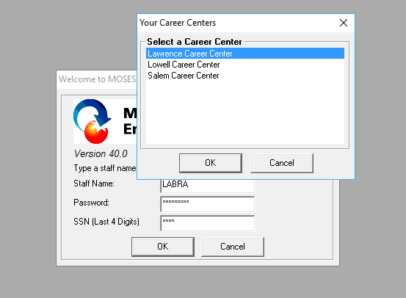
Logging in to a Career Center
When logging in to MOSES,
make sure to login to the correct career center from the list of centers available to you; that is, the career center that you would like to add service records to for a specific employer or training partner.

Slide 4
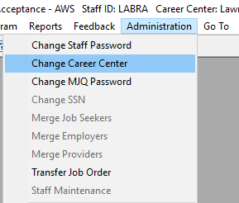
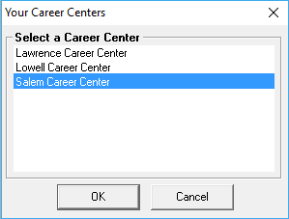
Switching Local Offices
Once logged in to MOSES,
you can switch to a different career center without logging out so that you can add service records to the correct career center office; again, the career center that you would like to add service records to for a specific employer or training partner.

Slide 5
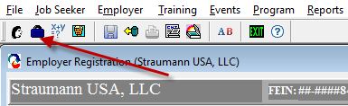
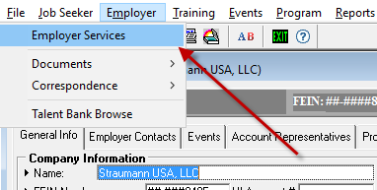
Employer Search
Open the Employer search window by either using the
Briefcase icon
OR
Employer > Employer Services

Slide 6
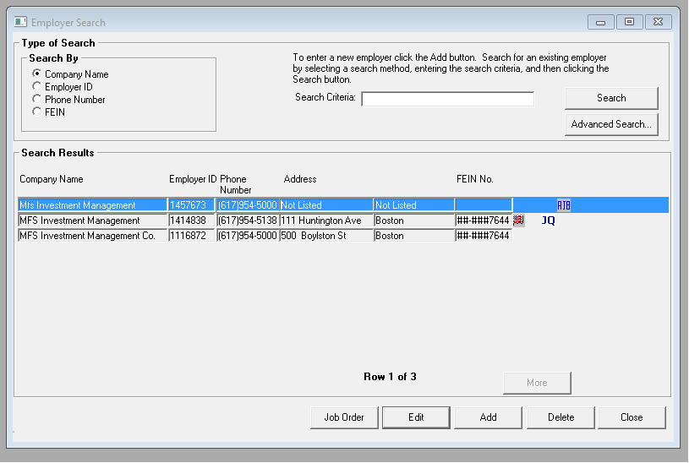
Search for Employer or Training Provider Record
Search for the employer in MOSES
  There are many duplicate employer records in MOSES. If not sure which one to use, check with Business Service Rep (BSR)
  Don’t use employers with AJB icon
Find the city/town of employer or training partner
Determine which career center is associated with that city/town
  [spreadsheet handout]
  Make sure you are logged into the correct career center office!
Add services
GET TO KNOW YOUR BSRs!!!

Slide 7
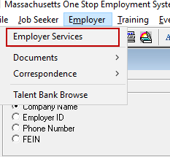
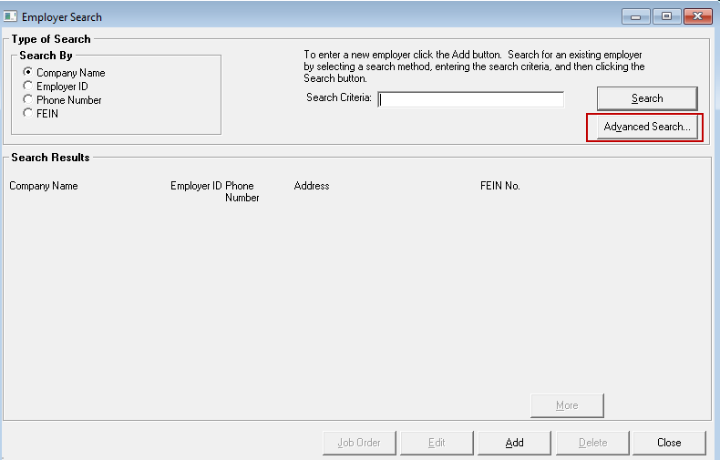
MOSES Advanced Search
You can also use the Advanced Search feature of MOSES to find employer or training partner.
Use the Employer dropdown menu item and click on Employer Services
Then click on the Advanced Search button

Slide 8
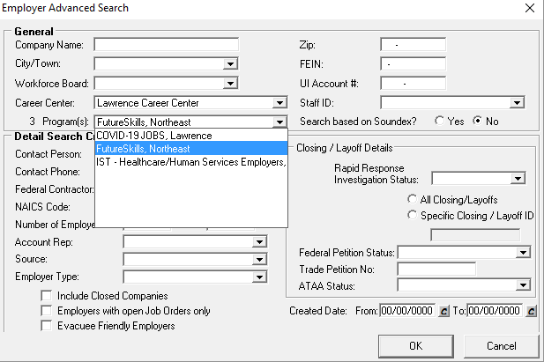
MOSES Advanced Search
Choose the Career Center from the dropdown, then select the FutureSkills Regional Program
Click OK.
This is an option to see a complete list of your employers and training partners currently enrolled in the program.

Slide 9
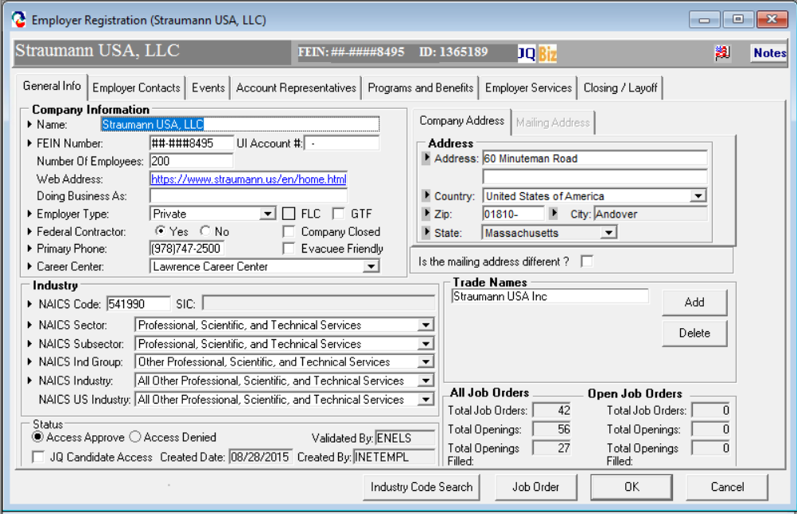
MOSES EMPLOYER RECORD
The Employer Record has seven tabs:
TAB 1: General Info
This tab contains basic information about the
business or training partner i.e. name, address, NAICS Code,
FEIN, and snapshot data i.e. number of job
orders , etc.
The buttons at the bottom of the screen allow the BSR to update the NAICS Code, access the Job Order page, and save/cancel functions for saving updates. These four buttons appear on every tab. You will also see a Notes button on the top right, Notes are also accessible from every tab.

Slide 10
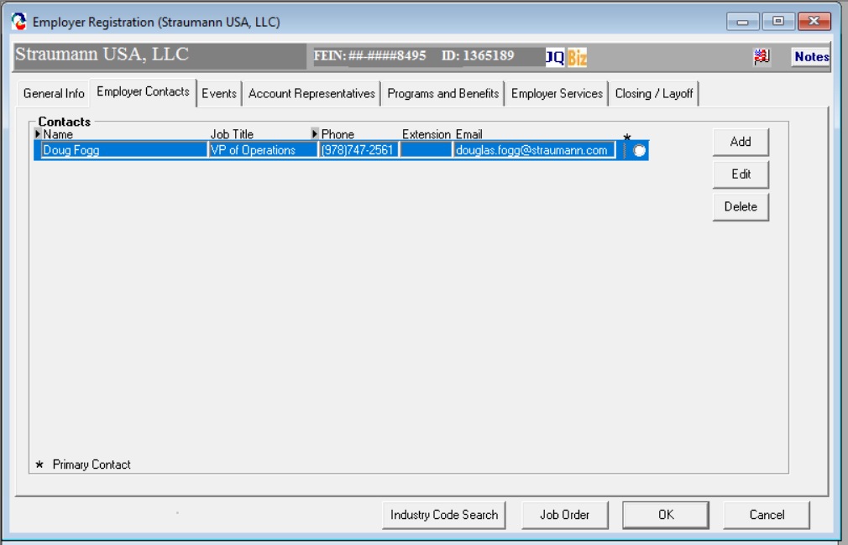
MOSES EMPLOYER RECORD
TAB 2: Employer Contacts
This tab contains a list of business contacts within the company or educational institution. Typically, these will be owners, HR contacts, Vocational Program Manager or another Facility member.
10

Slide 11
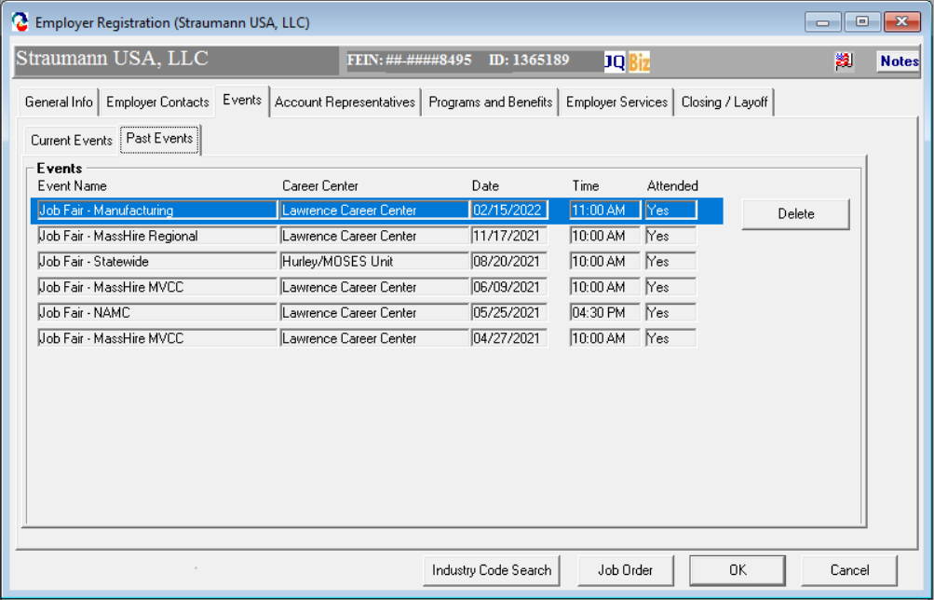
MOSES EMPLOYER RECORD
TAB 3: Events
This tab contains a list of events the business
is scheduled to attend (Current Events) or has
attended in the past (Past Events)
Notes:
MassHire DCS Field Management & Oversight routinely monitors the following program systems to ensure the regulatory requirements are consistently met

Slide 12
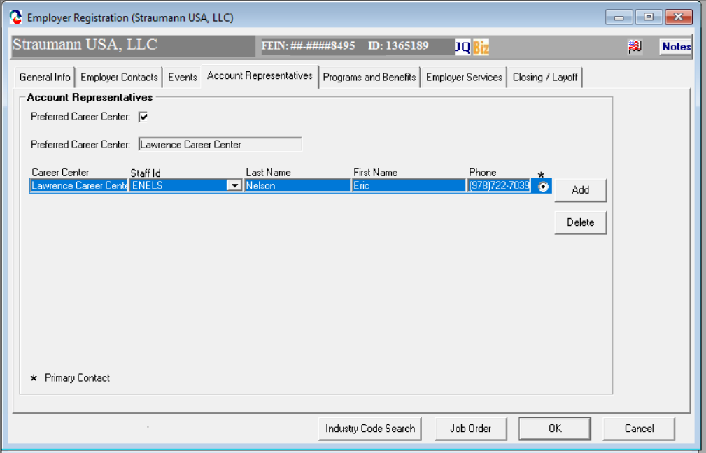
MOSES EMPLOYER RECORD
TAB 4: Account Representatives
This tab is reserved for the career center BSR.
This tab allows a BSR to identify themselves
as the primary contact for the business.
Entering information on this tab is not
required.

Slide 13
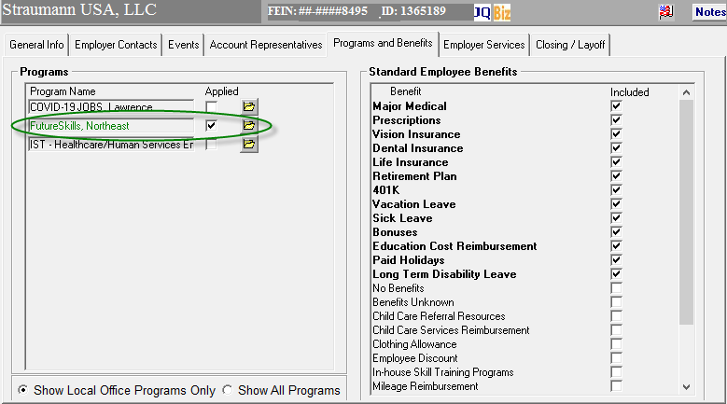
MOSES EMPLOYER RECORD
TAB 5: Programs and Benefits
The Programs window allows staff to check any state or local programs that the business or training partner is enrolled in.
There are seven (7) Employer Programs to align with the planning regions.
Market Makers should check off the appropriate regional program for each employer and training partner they have both a lead for and have made contact with regarding the FutureSkills program.
Make sure to have the Show Local Office Programs Only checked on.

Slide 14
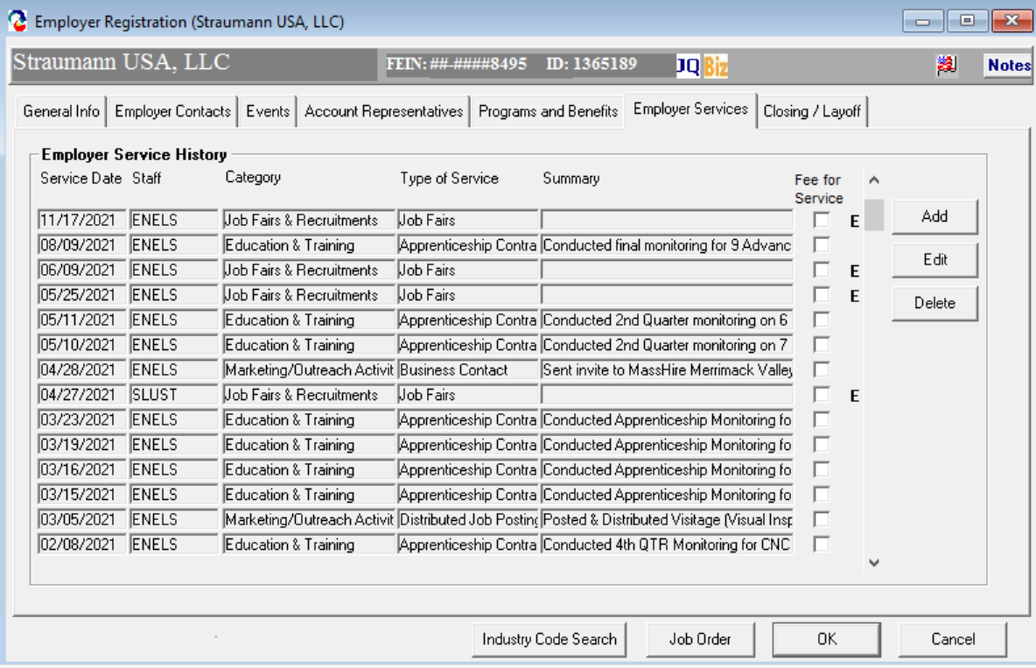
MOSES EMPLOYER RECORD
TAB 6: Employer Services
Adding an Employer Service in MOSES
- Move to the Employer Services tab
- Click the Add button to add a service
Note that for every service entered there should be a comprehensive summary of the conversation with the employer or training partner.

Slide 15
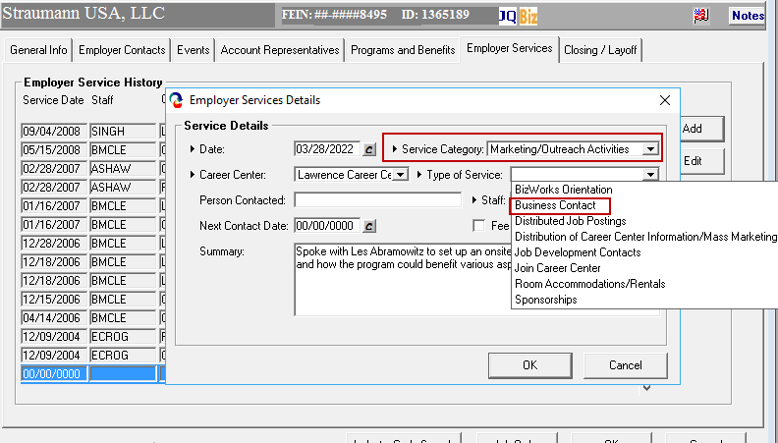
MOSES EMPLOYER RECORD
TAB 6: Employer Services
To define “Lead”:
Market Makers will add a Marketing and Outreach Services – Business Contact service for each employer or training partner they have identified as a lead for the FutureSkills program.
Lead defined as a company that has expressed interest in training pipelines.
To define “Qualified Lead”:
The Market Maker will add a Business Information and Incentives – Business Assessment service for each employer or training partner they have identified as a qualified lead for the FutureSkills program.
Qualified lead defined as a company that Market Maker has defined needs for e.g., training pipelines, incumbent training, immediate hiring via MassHire, etc.

Slide 16
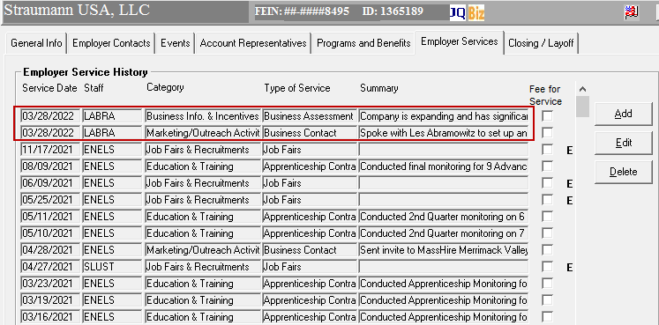
MOSES EMPLOYER RECORD
TAB 6: Employer Services
New services appear at the top of the service summary screen.
Services will show history of interaction with employer or training partner.
Again, remember that for every service entered there should be a comprehensive summary of the conversation with the employer or training partner.

Slide 17
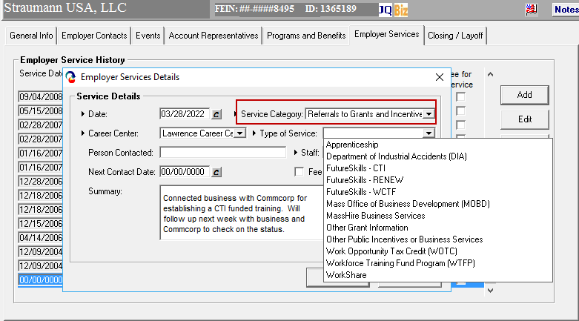
MOSES EMPLOYER RECORD
TAB 6: Employer Services
To define “Referral”:
The Market Maker will add a Referrals to Grants and Incentives service for each employer and training partner they refer for training and/or support.
New FutureSkills Services for MOSES:
Under the category of Referrals to Grants and Incentives:
MassHire for Business Services
FutureSkills - CTI
FutureSkills - RENEW
FutureSkills – WCTF
Referred defined as a company or training parnter that Market Maker has referred to support e.g., training partner, MassHire Career Center, MOBD, etc.

Slide 18
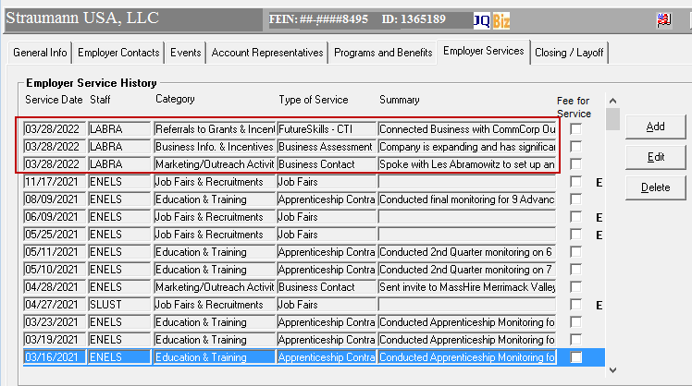
MOSES EMPLOYER RECORD
TAB 6: Employer Services
New services appear at the top of the service summary screen.
Services will show history of interaction with employer and training partner.

Slide 19
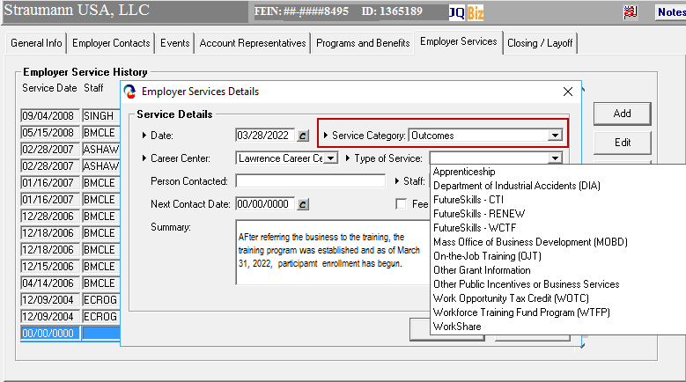
MOSES EMPLOYER RECORD
TAB 6: Employer Services
Once a referral is made for an employer or training partner and there is a successful outcome, add an outcome service to the employer record indicating a successful referral; i.e.; a grant from the Commonwealth Corporation for training.
FutureSkills Services for MOSES:
Under the category of Outcomes
FutureSkills - CTI
FutureSkills - RENEW
FutureSkills - WCTF

Slide 20
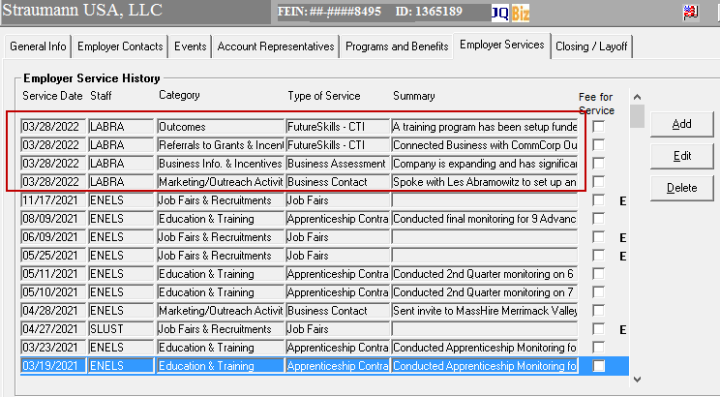
MOSES EMPLOYER RECORD
TAB 6: Employer Services
An outcome service is a companion to the referral service to indicate a successful referral has been made.

Slide 21
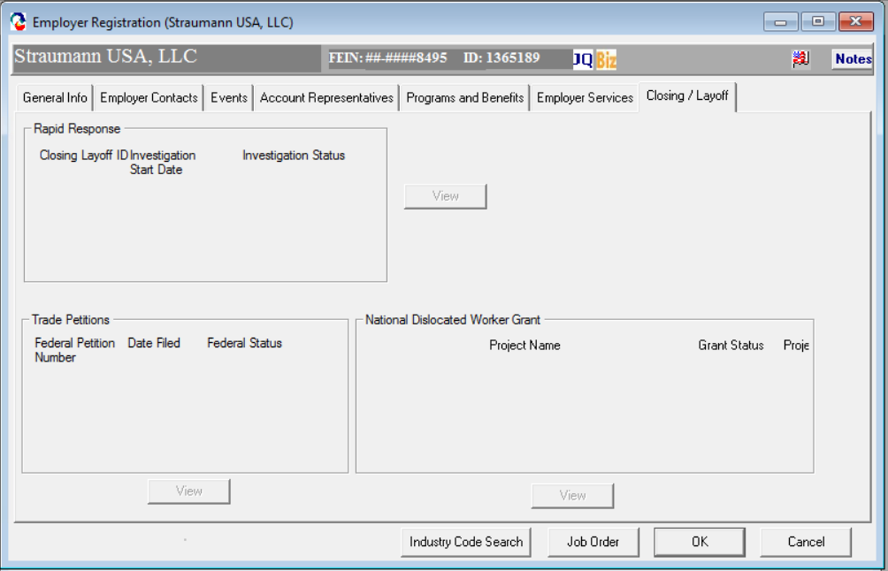
MOSES EMPLOYER RECORD
TAB 7: Closing / Layoff
This tab is for the exclusive use of the
MassHire Rapid Response Team and
Central Office. In this tab, the user can
record the status Of Closings / Layoffs,
Trade Petitions filed, and National
Dislocated Worker Grant information.

Slide 22
Employer Services
Appendix

Slide 23
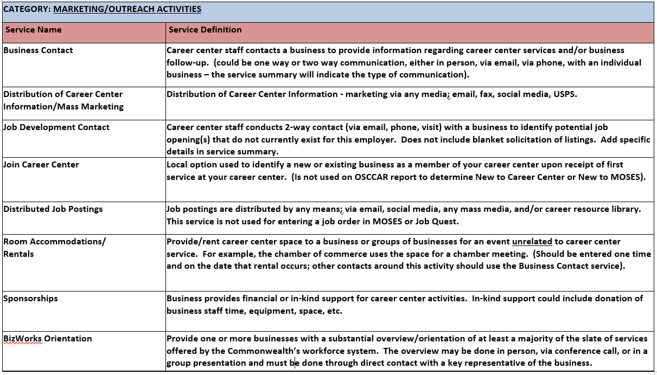
MOSES EMPLOYER SERVICES

Slide 24
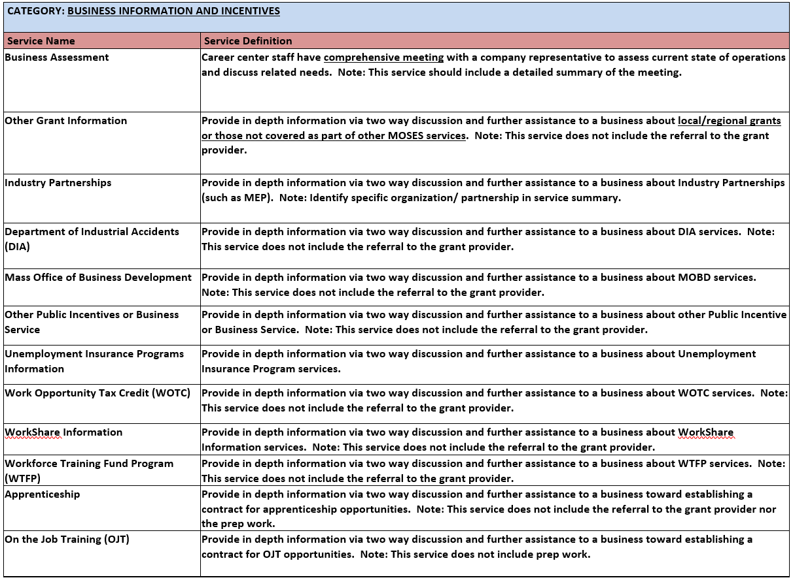
MOSES EMPLOYER SERVICES

Slide 25
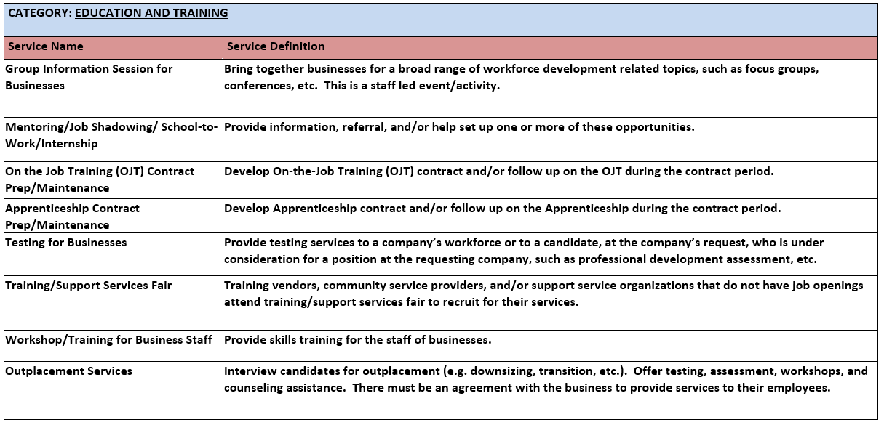
MOSES EMPLOYER SERVICES

Slide 26
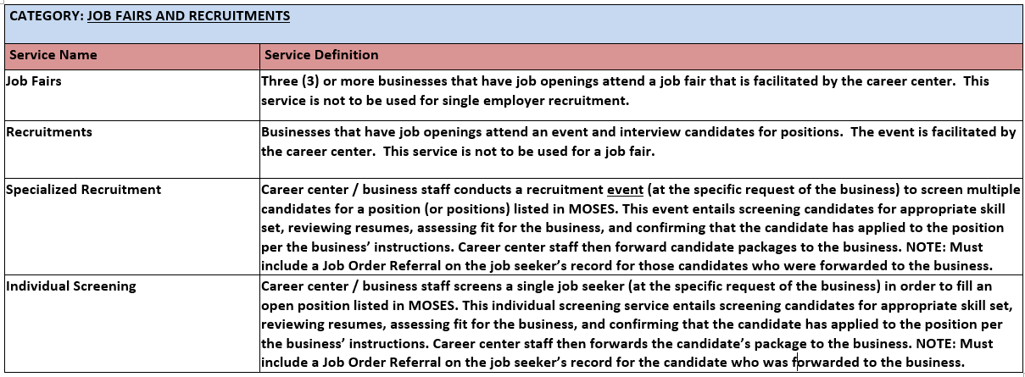
MOSES EMPLOYER SERVICES

Slide 27
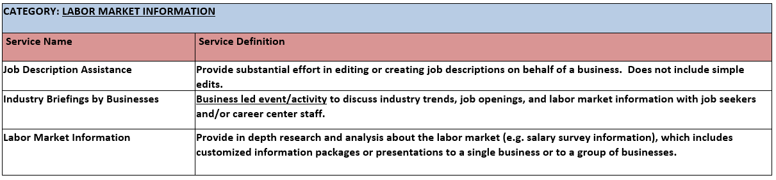
MOSES EMPLOYER SERVICES

Slide 28
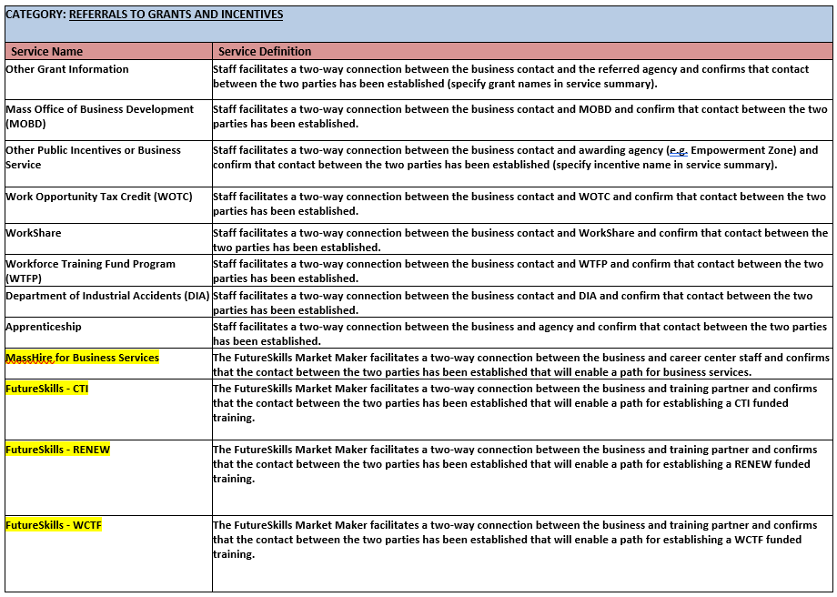
MOSES EMPLOYER SERVICES

Slide 29
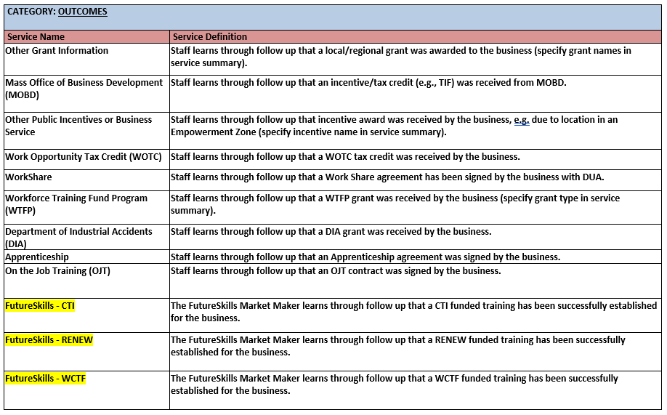
MOSES EMPLOYER SERVICES

