Slide 1
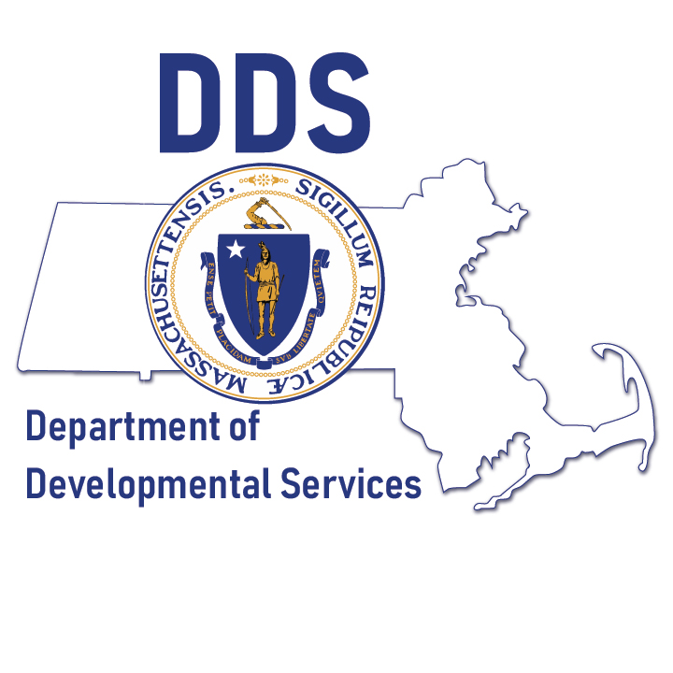
Next Steps: Supporting Older Caregivers
May 2023

Slide 2
Mission of DDS
The Department is dedicated to creating, in partnership with others, innovative and genuine opportunities for individuals with intellectual and developmental disabilities including Autism Spectrum Disorders to participate fully and meaningfully in, and contribute to, their communities as valued members.

Slide 3

DDS Operations Unit
Vision Themes
All about person-centered and family-oriented practices.
Ensure that services and resources are flexible, cost effective, allocated according to a standard of fairness and equity, and provided in the most culturally competent way.
Make available to the public clear, concise information in all formats (accessible).
Ensure that access to information about services is user friendly.
Provide flexible supports that are built around people’s dreams, aspirations & the potential for reciprocal relationships.
Collaborate with internal and external stakeholders, individuals, families, provider agencies.
Serve as a strategic resource.
Use innovation and engagement to develop person-centric policy and language.
Use both process & outcome level data to influence policy decisions.
We believe all people have the right to live, love, work, play and pursue their own life aspirations in their community.

Slide 4
Needs Assessment Summary
Meeting the Needs of Older Caregivers for People with I/DD
March 16, 2023
Notes:
A

Slide 5
Needs Assessment Summary
Background
DDS received funding from the Massachusetts State legislature to address the needs of older adults with intellectual and developmental disabilities (IDD).
One of our recent goals was to learn more about the needs and concerns of older and aging parents, siblings, and caregivers.
DDS asked the Center for Developmental Disabilities Evaluation and Research (CDDER) to conduct the needs assessment.
The needs assessment took place during the spring/summer of 2022.

Slide 6
Needs Assessment Summary
Method
Participants included family caregivers, Family Support Center staff, DDS and other government agency staff, DDS provider staff and community organizations
  122 participants
Most of the groups were held over Zoom, with one held in-person and one hybrid

Slide 7
Needs Assessment Summary
Themes
Older Caregivers and Families who are not engaged with DDS
  range and variety of reasons from not understanding the system and fear of losing control
Engagement and Navigation Supports
  services are difficult to navigate and varying levels of support are provided
Cultural and Linguistic Competency
  varies by location and there is limited translated materials and interpreters available

Slide 8
Needs Assessment Summary
Themes
Planning for the Future and Person-Centered Support
  many families are reluctant to plan for the future; and there is an unclear system of who and where planning takes place
Interagency and Public-Private Partnership and Relationships
  collaboration between state agencies is limited

Slide 9
Next Steps
Data Review and Analysis- how to identify older caregivers
Identify Best Practices on engaging and guiding Older Caregivers in planning for the Future and provide Training for our Family Support Navigators and our Service Coordinators
Strengthen interagency relationships and Partnerships with sister agencies to better support caregivers and improve efforts to identify older caregivers and find ways to support them through local partnerships
Examine current local programs and supports that exist to engage and support older caregivers and determine capacity for replication and sustainability throughout the state.

Slide 10
Family & Autism Support Centers
DDS funds Family & Autism Support Centers, which help to inform, connect and support families with children or adults as long as they live together. Families may use both their Family and Autism Support Centers.
Services Available to Anyone:
Information & Referral: Call your Center with questions!
Services Available to DDS Eligible Families:
Service Navigation helps families navigate health insurance, special education, elder services...
Family Trainings on topics like special education, legal matters, public benefits, etc.
Family Networking to connect parents, grandparents, siblings and self-advocates, etc.
DDS Eligibility Application: Support Centers can help you apply for DDS.
Community Connections & Resources helping families learn about what is in their community
Social/Recreational Activities both at the Center and in the community.
Flexible Funding to purchase goods and services.

Slide 11
Thank you !

