Slide 1
December 2025 Meeting
Alice Colegrove
Ayala Livny & Thaliana Paulino
Director, Homeless Youth Services
Chair, UHYC on behalf of Secretary Walsh
Senior Consultants
Homeless Youth Services & UHYC

Slide 2
Welcome !
Please introduce yourself in the chat with your name, pronouns, org/role
what is one outcome you hope we achieve today?

Slide 3
Agenda
Announcements
Winter response
  Connecting YYA to shelter and support services
Notes:
1:05 Alice

Slide 4
Agreements
Assume good intentions
Use respectful language
Ask for and use people’s pronouns
Engage in differences of opinion with courtesy and respect
Welcome all into the conversation, especially young adults
Understand that a commitment to inclusion may mean that the norms of “professional meetings” may need to be altered

Slide 5
Acronyms
UHYC= Unaccompanied Homeless Youth Commission
HYS = Homeless Youth Services
YYA= Youth and Young Adult
EOHHS= Executive Office of Health & Human Services
UHY= Unaccompanied Homeless Youth
BIPOC= Black, Indigenous, and People of Color
ESN: Exchanging Sex to Meet Basic Needs

Slide 6
The purpose
of the MA Unaccompanied Homeless Youth
Commission is to “study and
make recommendations for services
for unaccompanied youth and young adults experiencing homelessness in Massachusetts, to ultimately
provide comprehensive & effective responses to the unique needs of this population.”
www.mass.gov/orgs/ma-unaccompanied-homeless-youth-commission

Slide 7
The purpose of
Homeless Youth Services
is to ensure that every region in Massachusetts has both prevention and intervention services specifically for young adults,
including emergency shelter or crisis housing.
www.mass.gov/orgs/homeless-youth-services
Notes:
We will leave you with resources today on how to connect to these services!

Slide 8
MA defines an unaccompanied homeless youth (UHY) as a person who:
1) Is 24 years of age or younger; and
2) Is not in the physical custody or care of a parent or legal guardian; and
3) Lacks a fixed, regular, and adequate nighttime residence.

Slide 9

GOAL
To make experiences of youth homelessness in Massachusetts
rare
brief
& non-recurring
UHYC January 2024 Meeting

Slide 10
Ultimate Goal:
Youth Housing Stability!
UHYC January 2024 Meeting

Slide 11


Announcements!

Slide 12

UHYC Workgroups
Minors: 12/17/25
3rd Wed 11-noon
Parents Under 25: 12/10/25
2nd Wed 4-5pm
ESN: 1/13/26

Slide 13



Research To Action 2024
2024
Notes:
https://www.mass.gov/orgs/ma-unaccompanied-homeless-youth-commission
https://www.mass.gov/doc/2022-uhyc-research-to-action-briefs/download

Slide 14

HUD NOFO Update

Slide 15
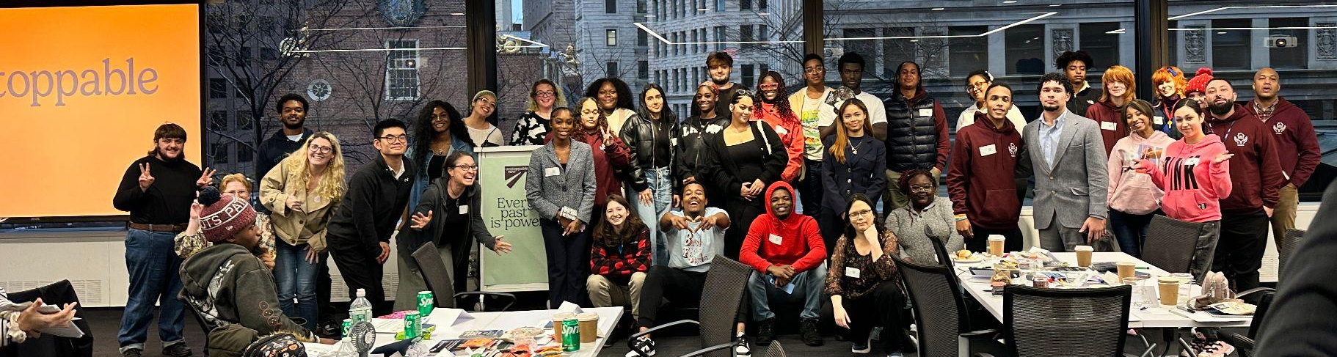


Slide 16
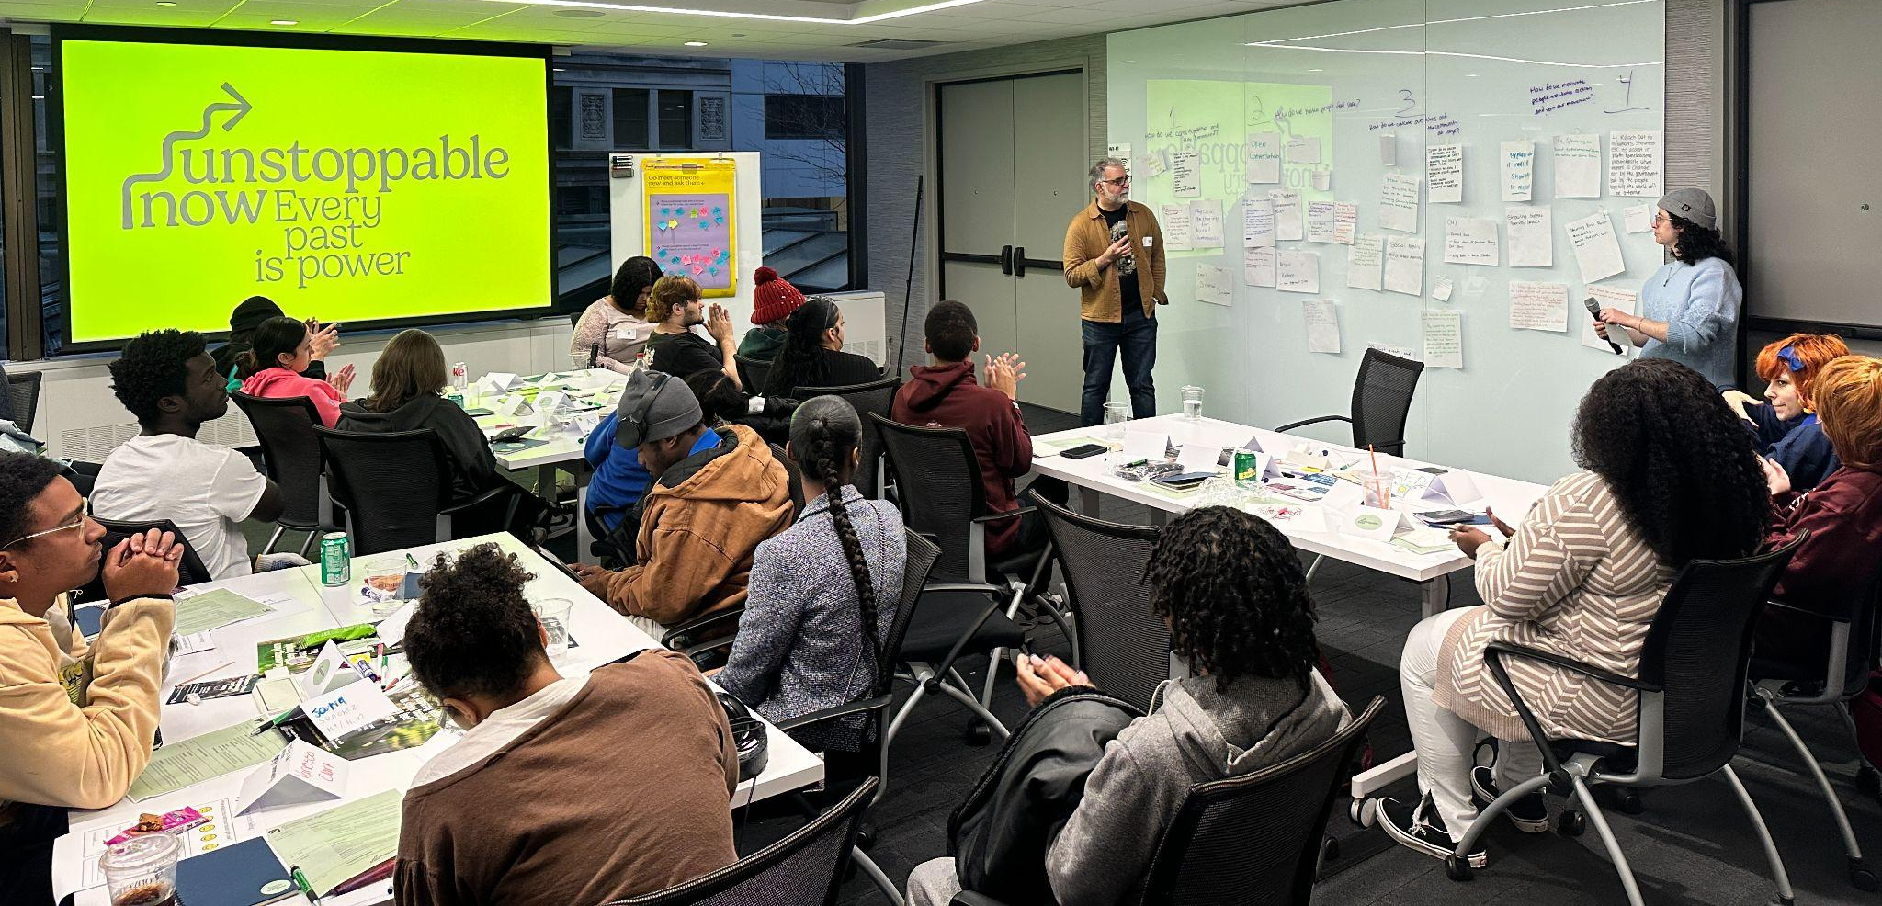
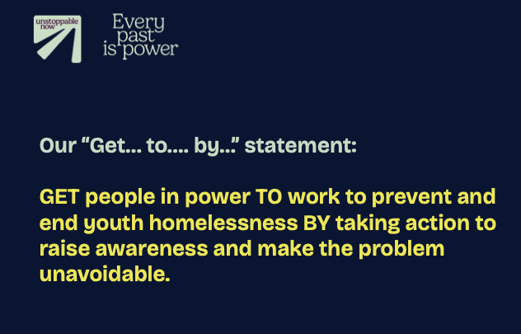
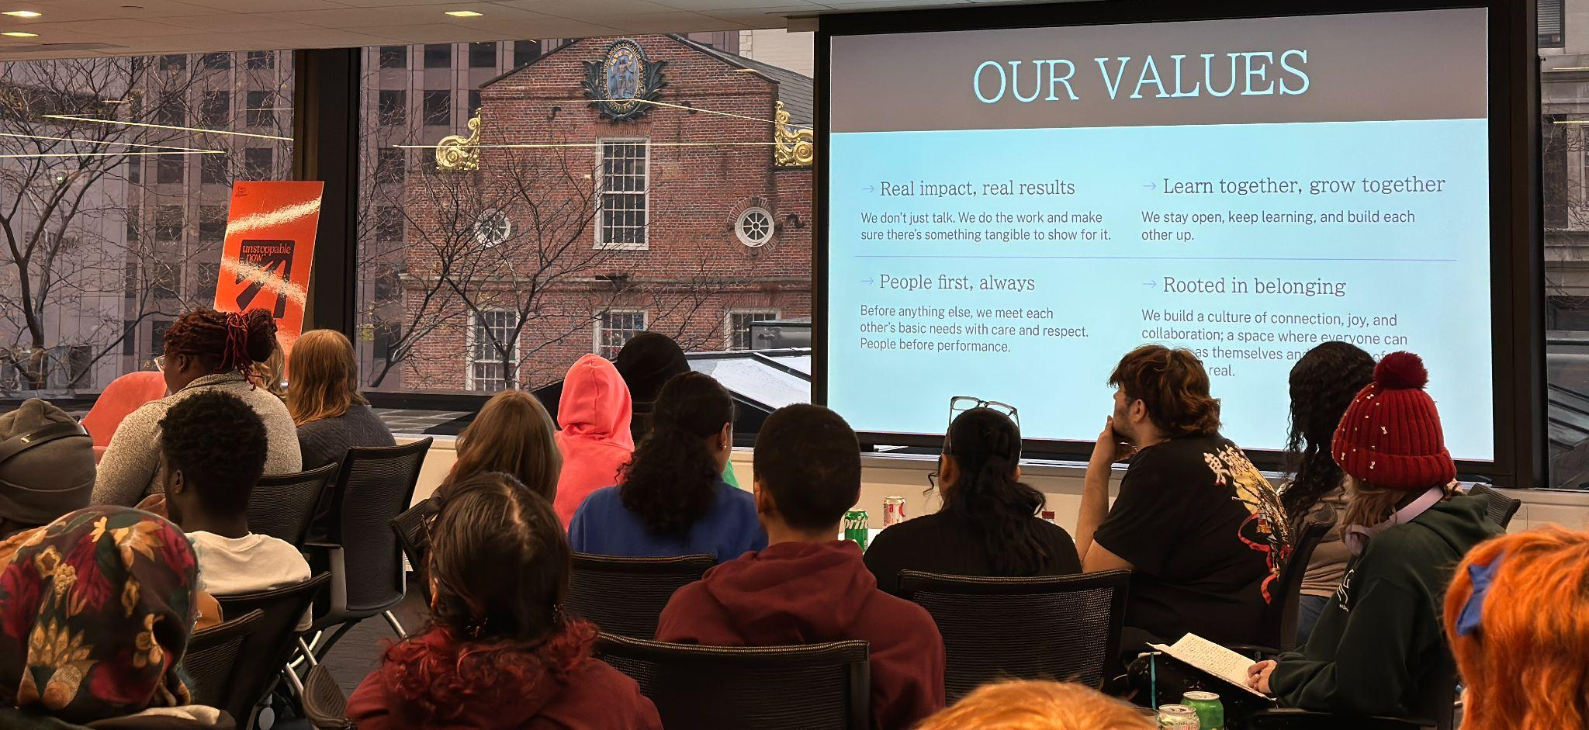
Notes:
Youth feel unseen and want people to hear their stories and do something to help them.

Slide 17
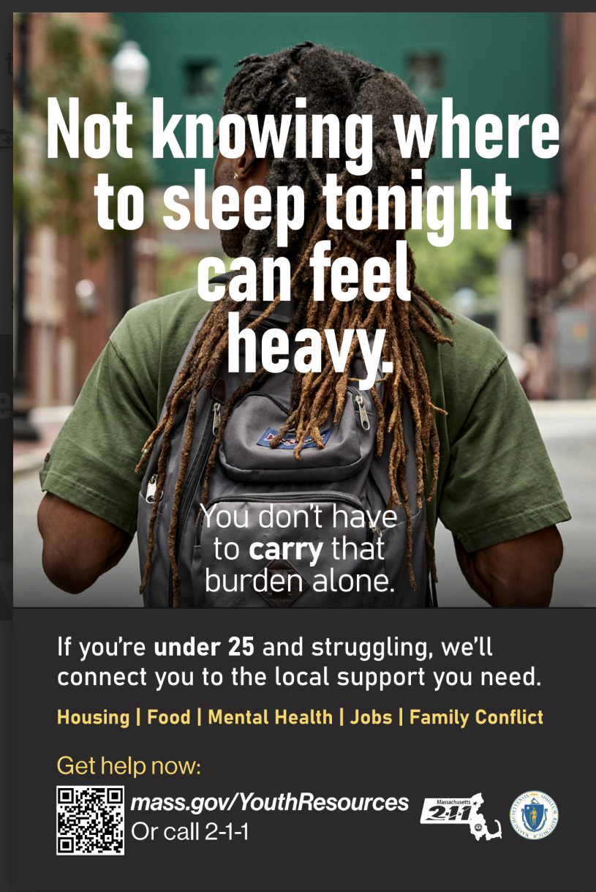
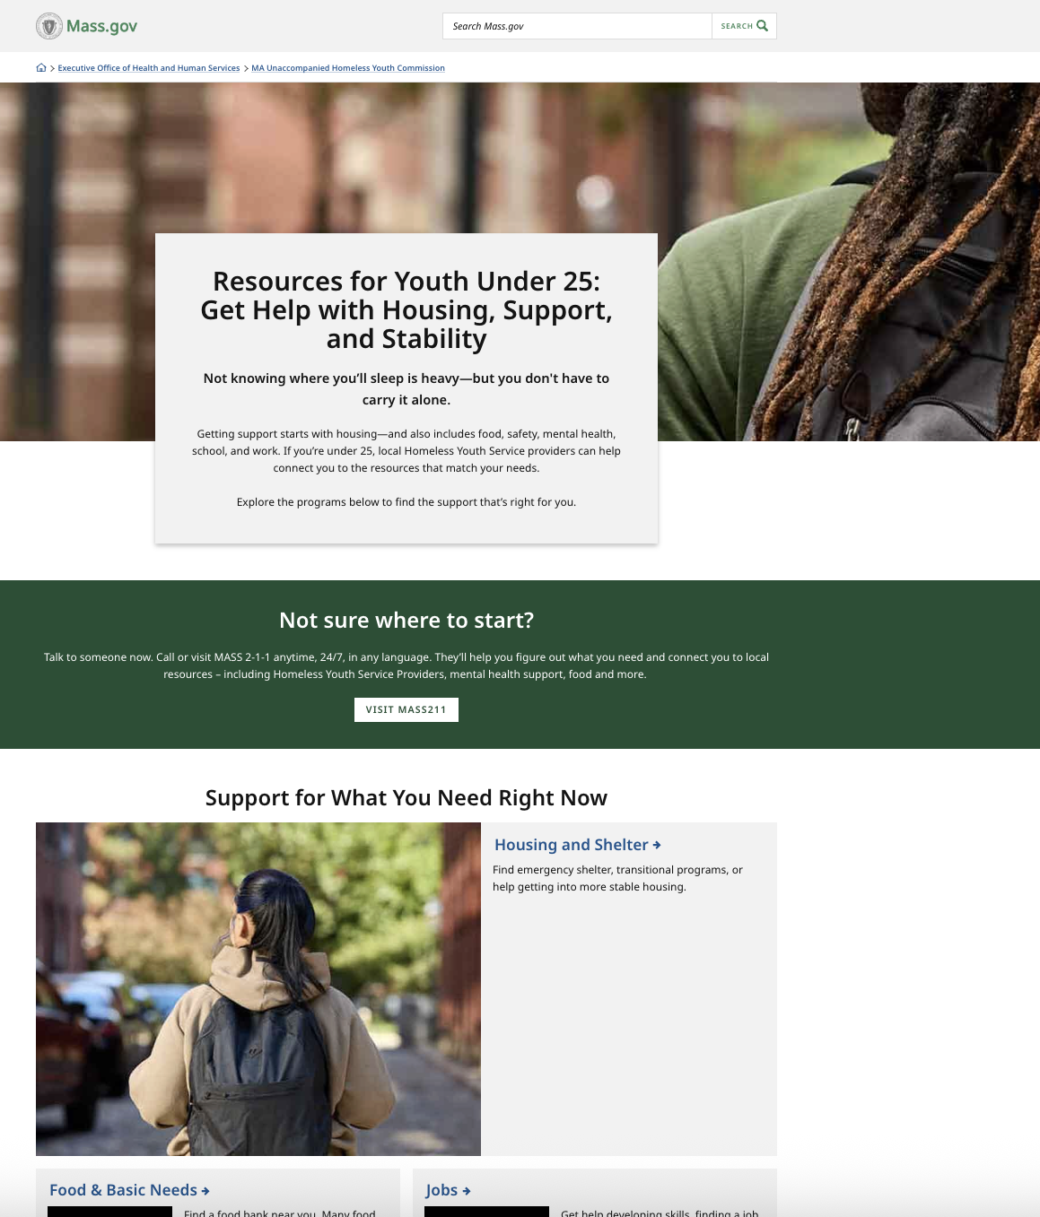
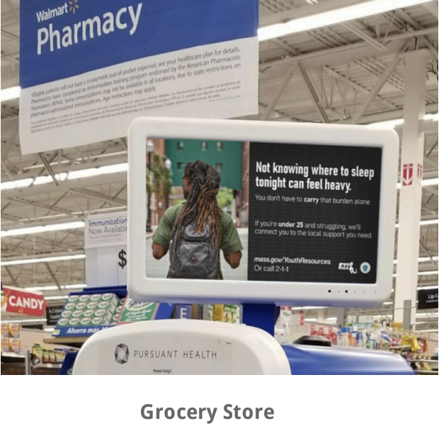
www.mass.gov/youth-young-adult-resources
Notes:
www.mass.gov/youthresources

Slide 18
www.mass.gov/youth-young-adult-resources
Webpage increased from 8 views/week to nearly 3,000 views/week post-launch.
Two million impressions on social media
More than double the national click-through rate of social media ads
In October alone over 4000 minors clicked through & visited the webpage
211 call volume from young adults seeking shelter doubled (as compared to 2024)
Notes:
www.mass.gov/youthresources

Slide 19


Winter
Response
for YYA

Slide 20
Learn Resources
+
Understand gaps

Slide 21
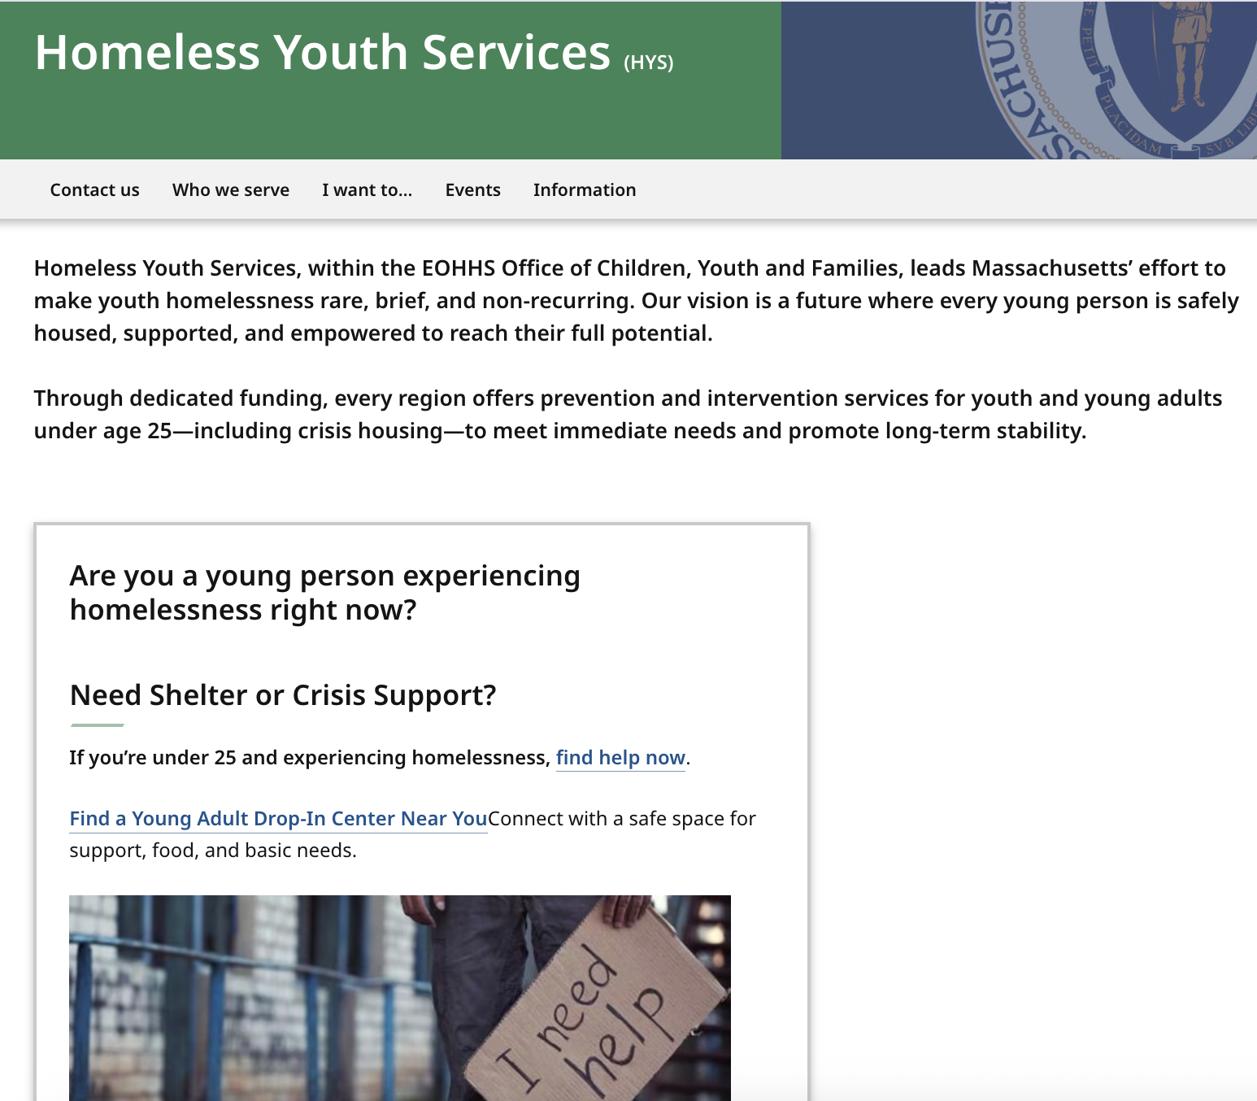

Notes:
Connecting YYA to Shelter & Crisis Support

Slide 22
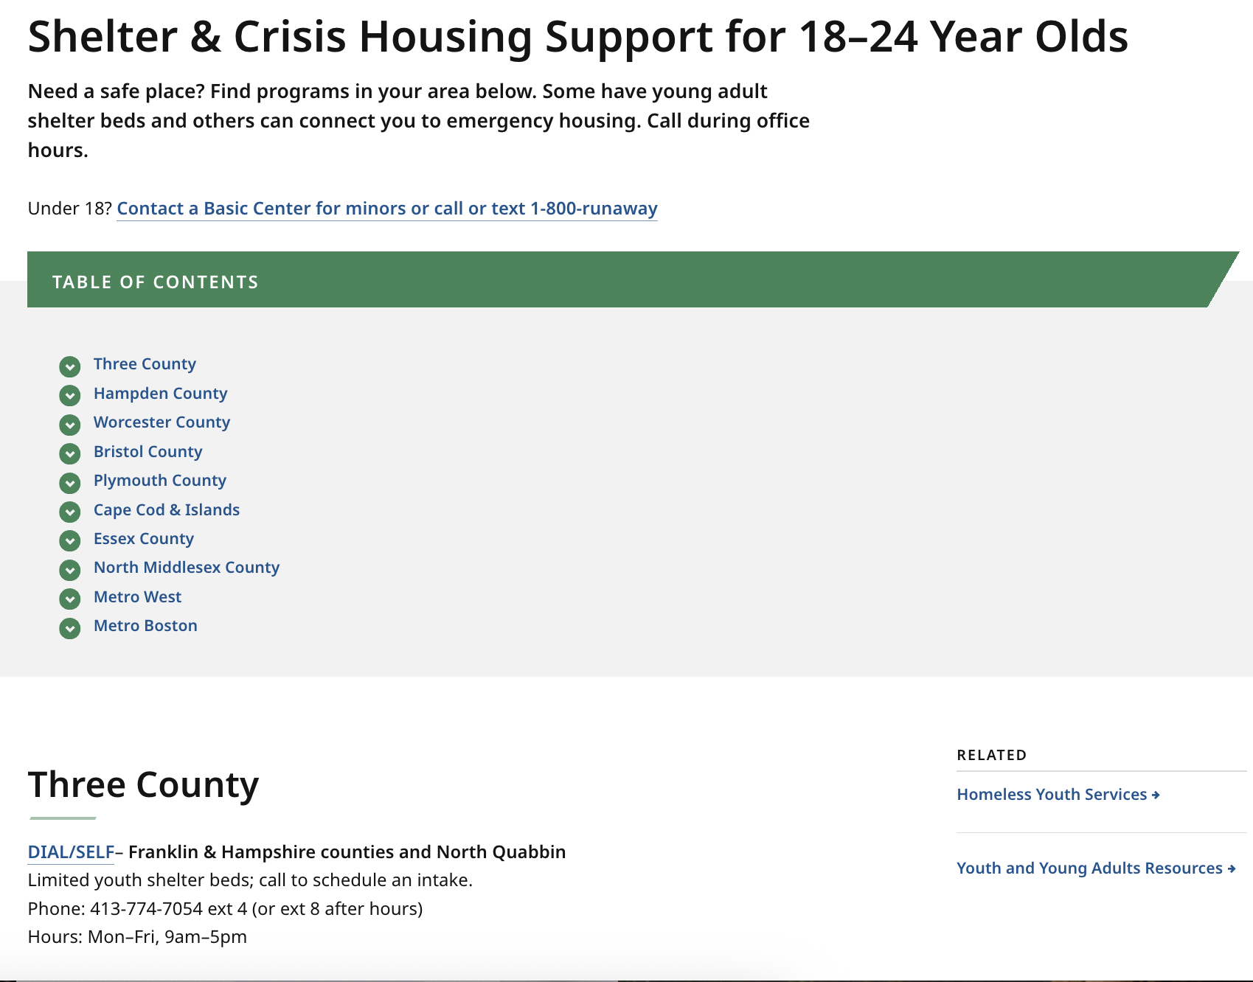
www.mass.gov/info-details/shelter-crisis-housing-support-for-18-24- year-olds
www.mass.gov/emergency-housing-assistance
50% of the web traffic to YYA shelter page comes from HLC’s page
Crisis services in all regions
Notes:
There are services but not necessarily fixed shelter beds in every region. Some HYS providers can offer short term motel stays.

Slide 23
Top locations where people searched for youth shelter:
Worcester (no youth shelter)
Boston
Essex County/North Shore (no youth shelter)
Springfield
Notes:
From web analytics.

Slide 24
Young Adult Shelter locations: (about 80 beds)
Boston (Bridge, Y2Y)
Bristol Co (Catholic Charities, very limited)
Lowell (CTI)
Springfield (Brighter Futures)
Three County (DialSelf, Louison House)
Notes:
From web analytics.
Prompt: “What does this data confirm—or contradict—from your daily work?”

Slide 25
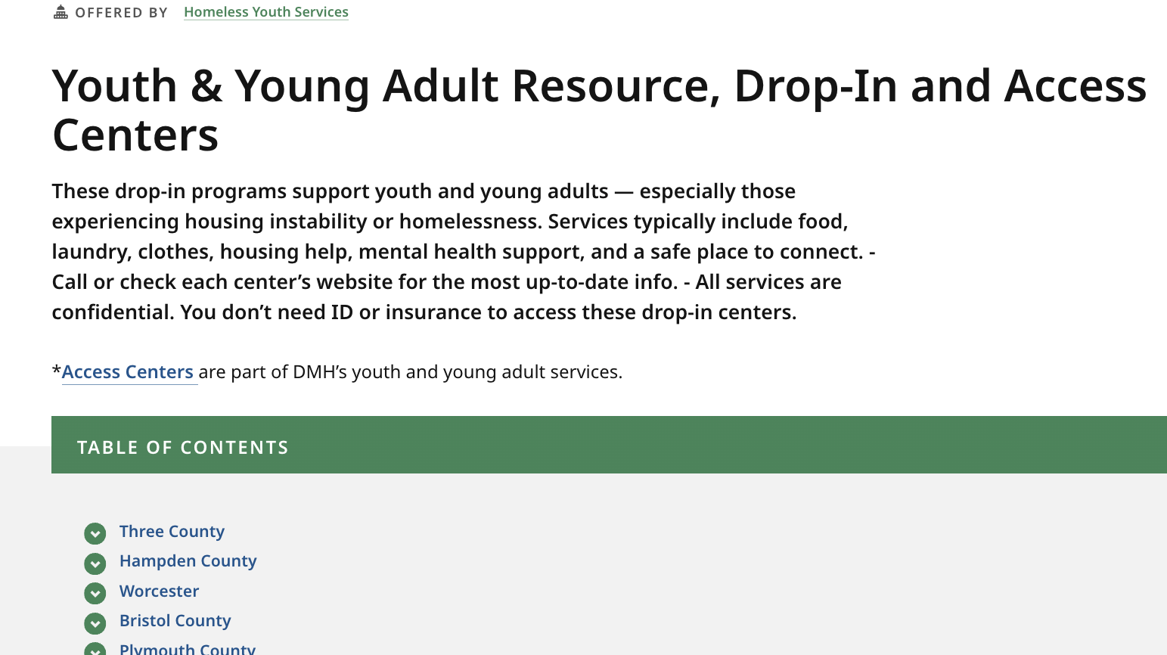
www.mass.gov/info-details/youth-young-adult-resource-drop-in-and-access-centers
Daytime Resources for YYA
Notes:
There are services but not necessarily fixed shelter beds in every region. Some HYS providers can offer short term motel stays.

Slide 26
Daytime Resources: Youth Drop In Centers
Boston (Bridge, Y2Y)
Bristol Co (Catholic Charities, very limited)
Lowell (CTI)
Springfield (Brighter Futures)
Three County (DialSelf, Louison House)
Notes:
From web analytics.
Prompt: “What does this data confirm—or contradict—from your daily work?”

Slide 27
Winter
Response:
other agencies & programs

Slide 28
Next Steps
Join working groups
Keep an ear out for the Youth Count
Next meeting: March 17, 2026; 1-2:30pm
Email Alice with questions: Alice.j.colegrove@mass.gov

