Slide 1
EPIA External Report December 2024
Does not include referrals received via BHTRP

Slide 2
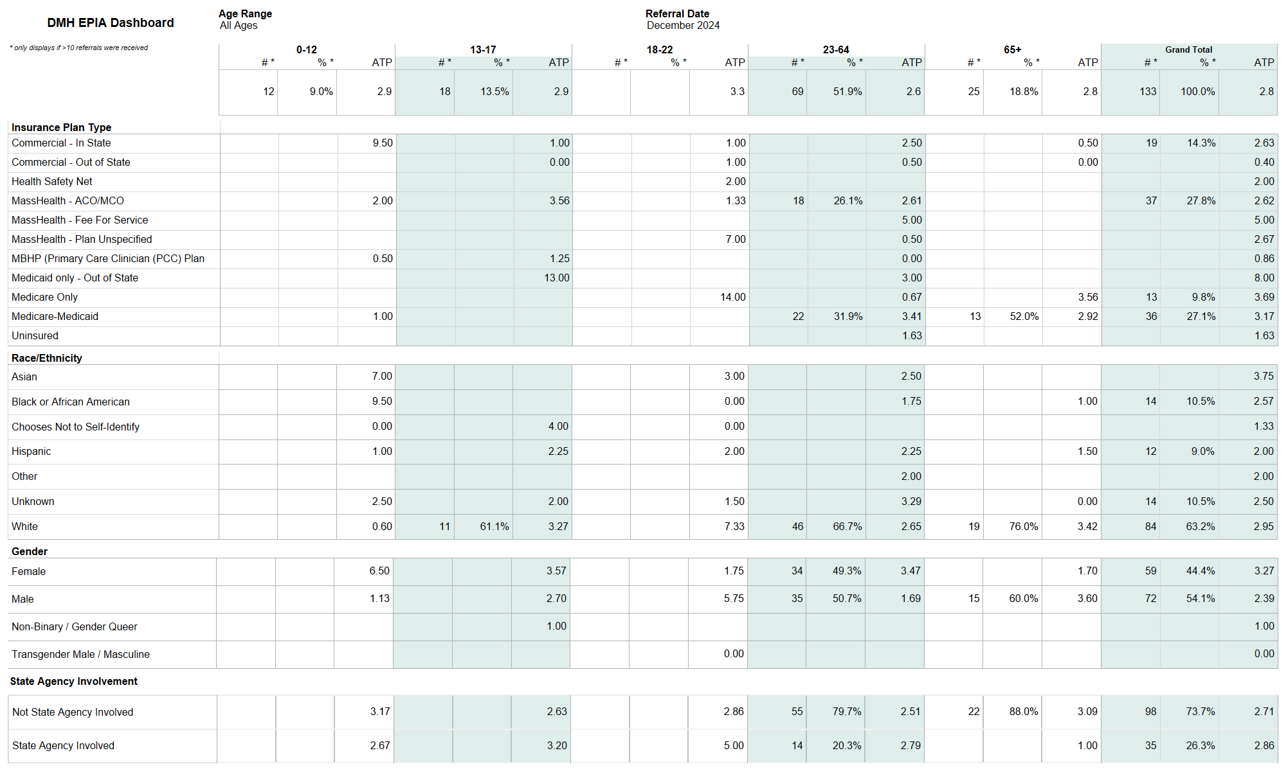

Slide 3
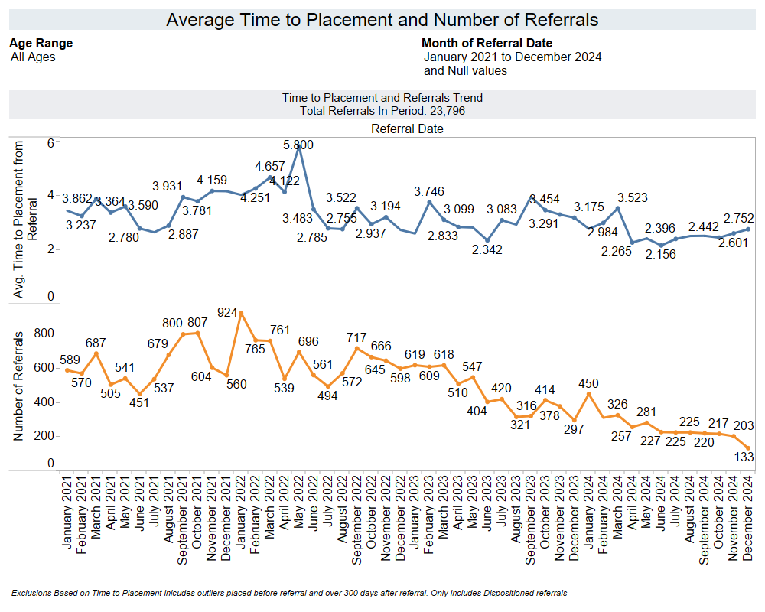

Slide 4
