Slide 1
Quality in Nursing Facilities in Massachusetts
December 20, 2019
Nursing Facility Task Force Meeting
Bureau of Health Care Safety and Quality
Notes:
10-15 minutes for your presentation, and 3-8 minutes for questions and discussion

Slide 2
Overview
Background
Surveillance
State: Nursing Home Survey Performance Tool (NHSPT)
Federal: Nursing Home Compare
Department Efforts to Address Quality
CMP Fund
LTC QI Fund
Medications for Opioid Use Disorder Technical Assistance
Suitability
Conclusion
Notes:
First, I’ll share background about nursing and rest homes in MA.
Then, discuss surveillance of quality using both state and federal tools.
Next, we will share how the Department of Public Health works to address and improve quality in nursing and rest homes.
Finally, we will share an overview of the suitability process.

Slide 3
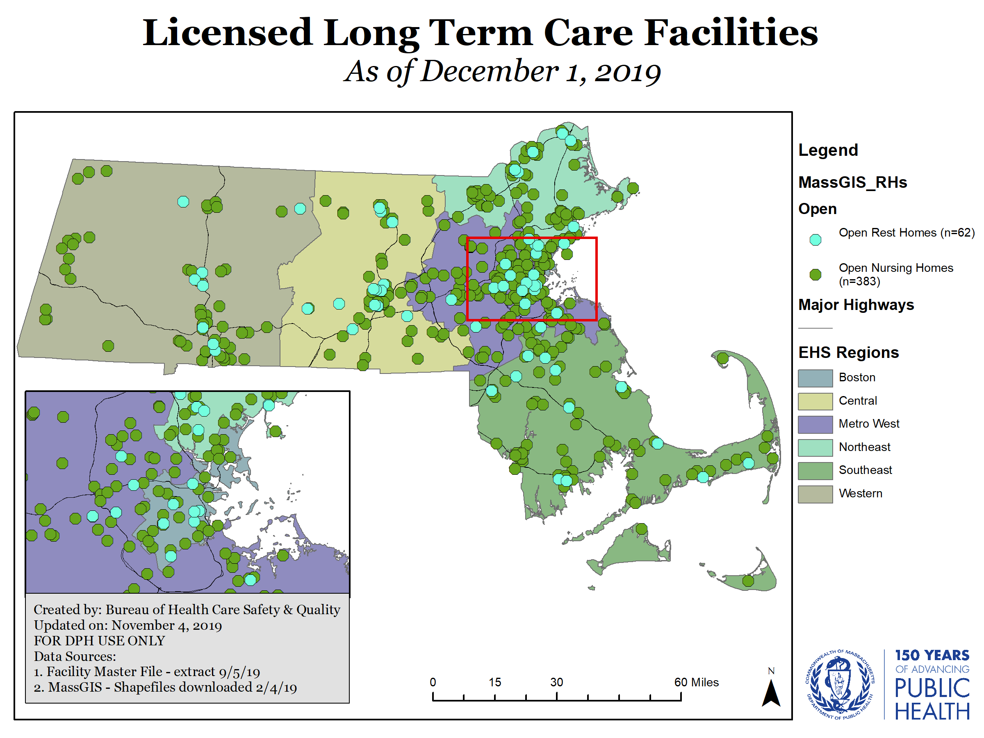
Long Term Care Facilities
Massachusetts Long Term Care Facts
383 Skilled Nursing Homes
Average Number of Beds: 118
62 Free-standing Rest Homes
Average Number of Beds: 33
Notes:
There are 6.9 million residents in MA
The Department, using work performed by UMass, estimates that there are 1.1 million residents over the age of 65
In 2017 the number of residents is based upon CMS Provider Information.
% of MA residents 65+ who resided in nursing homes (on average) in 2017: 3.58%
There are 62 free-standing rest homes. In addition, there are 850 rest home beds attached to nursing homes.

Slide 4
Department of Public Health Oversight
The Bureau of Health Care Safety and Quality (BHCSQ) ensures compliance with federal and state regulations through its three oversight units:
Licensure
Conducts initial licensure visits and evaluates changes to licensure as appropriate
Manages the Nurse Aide Registry System
Oversees transfer of ownership and suitability determinations
Reviews health care facility construction plans to ensure alignment with state and federal guidelines
Survey Operations/Certification
Conducts an onsite recertification inspection of all nursing homes every 9-15 months
During the onsite inspection, surveyors evaluate life safety, administration, nursing, resident rights, food service, and environment
Complaints
Receives and responds to consumer allegations and facility-reported incidents, conducting onsite complaint investigations when necessary
July 1, 2018-June 30, 2019
16,032 complaints received
368 recertification surveys completed
423 relicensure surveys completed
92,568 Nurse Aide Registry inquiries
Notes:
4
As a reminder, there are three oversight units
If a facility is found not to be in compliance with regulation, deficiencies may be cited as part of a recertification survey or complaint investigation.
Complaints: Wide range of incidents reported such as delays in meal service resulting in cold food to falls that result in injury
11,801 facility reported incidents or consumer allegations reported in 2018 in nursing homes.
In 2018 we had (after IDR):
9 Jeopardies
26 substandard quality of care
10 admissions freezes were placed

Slide 5
Department of Public Health Focus on Quality Improvement
In addition to the three oversight units, BHCSQ also works with long term care partners to improve quality of care provided in nursing homes and rest homes.
Quality Monitoring
Utilize a new resident-centered survey process
Public-facing survey performance tool that translates survey results into easy-to-understand information for consumers
Utilize data collected from long term care facilities to identify focus areas for Quality Improvement
Stakeholder Education and Training
Provide in-person training on a range of topics for long-term care staff, including Administrators, Directors of Nursing, social workers, and infection control professionals
Lead annual webinars to share observations and best practices to prevent and address infections that commonly occur in long term care facilities
Quality Improvement Initiatives and Technical Assistance
Reinvest Civil Monetary Penalty (CMP) funds and Long Term Care Quality Improvement Funds in QI opportunities for facilities
Utilize funding from the CDC to provide individualized, in-person technical assistance to bolster infection prevention and control capacity
Lead QI initiatives that address timely issues facing long term care facilities, such as caring for residents with opioid use disorder
Notes:
5
As a reminder, there are three oversight units
If a facility is found not to be in compliance with regulation, deficiencies may be cited as part of a recertification survey or complaint investigation.
Complaints: Wide range of incidents reported such as delays in meal service resulting in cold food to falls that result in injury
11,801 facility reported incidents or consumer allegations reported in 2018 in nursing homes.
In 2018 we had (after IDR):
9 Jeopardies
26 substandard quality of care
10 admissions freezes were placed

Slide 6
New Resident-Centered Process and Rules for Surveying Nursing Homes
On November 28, 2017, DPH surveyors began surveying Massachusetts nursing homes using a new federal computer based, resident-centered inspection process
Specific changes included:
DPH surveyors spend more time interviewing residents and conducting direct observations of care
DPH surveyors independently tour the nursing home upon start of the survey
Use of software to improve efficiency and workflow
DPH surveyors observe, evaluate, and document a wider range of care areas and issues due to the change in federal regulations
Notes:
This update was the first major revision of these federal requirements since 1995
Surveyors also evaluate nursing homes for compliance with the updated federal Conditions of Participation, which promote person-centered care, quality of care, and quality of life
It is referred to as the Long Term Care Survey Process (“LTCSP”) and was developed by the Centers for Medicare and Medicaid Services (“CMS”) for use by surveyors nationwide to effectively evaluate the quality of care and quality of life of nursing home residents, and promote consistency in survey findings
Some things that change:
Using Software - to improve efficiency, workflow, and includes regulations, probes, & prompts
Floor Time - More direct observations & resident interview time.
Entrance - Team no longer conducts initial tour with staff
Systematic - Improved consistency, accuracy of problem identification, & reporting accuracy
Updated Regulations & F tags – Surveyors observe, evaluate, and document a wider range of care areas and issues
In November 2019 the final phase of revisions will be implemented. As an example each nursing home must now have an infection preventionist. The professional is responsible for infection control oversight and prevention.

Slide 7
Nursing Home Survey Performance Tool: Background
Bureau of Health Care Safety and Quality (BHCSQ) initially developed the Nursing Home Survey Performance Tool (NHSPT) in the early 1990s, in collaboration with stakeholders, to aid consumers in selecting and evaluating a nursing home
The Tool’s purpose is also to translate survey results into an understandable metric for consumers
The Tool is available on the Mass.gov website and is updated weekly
It is a Centers for Medicare and Medicaid Services (CMS) requirement that each state maintain a consumer-facing website that shares nursing home quality information (Section 1902(a)(9) of the Social Security Act)

Slide 8
NHSPT: Information Sources
The Tool uses findings from the three most current standard surveys as well as complaint survey findings from the previous year
The Tool focuses on findings from five domains that are considered to be important to consumers and have a significant impact on a resident’s quality of life:
Administration
Environment
Food Services
Nursing
Resident Rights
Facilities that do not participate in Medicare or Medicaid are not included in the Tool

Slide 9
NHSPT: Current Score Calculation
The federal tags included in the Tool are within the five domains:
The numeric score calculated has a potential maximum 132 points and represents being deficiency-free in these domains
Any deficiencies cited for a federal tag that is included in the Tool represent the loss of between one and eight points, depending on the scope and severity
An additional point is subtracted if the tag is also a substandard quality of care tag
Currently, the average Nursing Home Survey Performance Tool score is 120
Domain | Administration | Environment | Food Services | Nursing | Resident Rights
# of Tags | 16 | 7 | 4 | 15 | 9

Slide 10
NHSPT: All Facility Score Distribution
Lowest 10%

Slide 11
Department Efforts to Address Quality
Supportive Planning and Operations Team (SPOT): SPOT Initiative’s objective was to facilitate quality assurance and performance infrastructure in nursing homes identified as needing assistance
SPOT was funded for the maximum of three years from federal civil monetary penalties (CMP) collected from nursing homes
60 nursing homes received individualized support, including participation in regional learning sessions, onsite technical assistance visits and telephone outreach and email support
Nursing homes identified and executed a quality assurance and performance improve project based upon their individual QI needs
Long Term Care Quality Improvement Fund: DPH will utilize funds to reimburse nursing and rest homes that achieve 90% health care personnel vaccination rate during the 2019-2020 influenza season for their relicensure fee
Infection Control Assessment and Response (ICAR) Program: Build infection prevention and control capacity through individualized onsite assistance
DPH completed 123 ICAR site assessment visits in past three years
Medication for Opioid Use Disorder (MOUD) in LTC Initiative:
DPH is partnering with 40 nursing and rest homes and 10 opioid treatment providers across the Commonwealth to support care provided to residents receiving MOUD.
Facilities will participate learning collaboratives, receive training, and have access to a specialized toolkit featuring resources and strategies for caring for residents with a history of OUD and about transitions of care
Long Term Care QI Initiatives
60 Nursing homes participate in SPOT
123 ICAR assessments performed at nursing homes
40 Nursing homes and rest homes that will be connected with OTPs to improve care to residents needing MOUD
Notes:
LTC QI Fund: primary source of revenue for the Fund consists of fines generated from penalties imposed by the Department of Public Health on long-term care facilities under section 73 of chapter 111 of the M.G.L.

Slide 12
State Licensure Transfer of Ownership Process
At least 90 days before a proposed transfer of ownership, the applicant submits Notice of Intent to Acquire (NOIA) to DPH
DPH reviews documents submitted and determines the NOIA is complete
Within 7 days of NOIA being submitted:
Applicant must publish notice in the daily paper, post the notice on the facility’s website and, Submit copy of published notice to DPH
Current licensee must provide copy of notice to residents, family & other required parties and a signed statement that notice was provided.
DPH completes a multi-faceted suitability review of the applicant within 90 days
Applicant deemed suitable; applicant may submit application for an initial license and transfer may proceed
Applicant found to be not suitable
Within 14 days of notice being published:
A group of 10 adults can request a public hearing to be held no later than 45 days before the proposed date for the transfer of ownership.
Applicant must file proof of transfer of ownership within two business days of transfer
Applicant cannot establish or maintain any LTC facility in MA for 10 years
Massachusetts Department of Public Health mass.gov/dph
12
Notes:
The complete process for a change of ownership is outlined in the long term care facility regulations at 105 CMR 153.022 Transfer of Ownership.
At least 90 calendar days in advance of a proposed transfer of ownership, any applicant who intends to acquire a long-term care facility submits a Notice of Intent to Acquire (NOIA) form to DPH.
DPH reviews the NOIA to ensure that it is completed, and within 90 days of DPH’s determination that the NOIA submitted by the applicant is complete, DPH will complete a suitability review of the applicant. All long term care facility licensure applicants that are applying to operate a nursing home through a transfer of ownership must undergo a suitability review.
DPH may extend the 90-day suitability determination period for a maximum of 30 days with the consent of the applicant, should more time be needed.
DPH reviews information provided by the applicant to determine whether they are suitable to operate and maintain a long term care facility. If DPH finds that the applicant is suitable, the transfer of ownership may proceed.
Applicants are required to publish notice of the proposed acquisition in the city or town’s daily newspaper and prominently display this notice on the website of the long-term care facility being acquired. The notice must include statements that a public hearing on the change of ownership can be requested upon petition of ten adults within 14 days of the publication of the newspaper. If requested, a hearing will be held no later than 45 days before the proposed date for the transfer of ownership.

Slide 13
Transfer of Ownership Process: Suitability Review
DPH’s multi-faceted review of an applicant’s suitability to operate a nursing home in Massachusetts includes:
Evaluation of the information provided in the NOIA related to:
Applicant’s ownership structure
Real property ownership (new in April 2016)
Compliance history
Criminal history
Financial capacity
Review of CORI forms for Officers, Directors, and Owners of proposed licensee
Coordination with state and federal agencies to ensure applicant is up-to-date on all User Fee, MassHealth (Rate Settlement or PNA Audit), CHIA, and CMS liabilities (CMPs) for any facilities owned in MA or in other states
Assessment of the MA Nursing Home Survey Performance Tool for quality scores of other facilities owned/operated by the applicant and the CMS Nursing Home Compare rating for facilities outside of MA
Check of OIG “List of Excluded Individuals and Entities” to see if excluded from federally-funded health care programs pursuant to sections 1128 and 1156 of the Social Security Act
Massachusetts Department of Public Health mass.gov/dph
13

Slide 14
Appendix

Slide 15
Additional NHSPT Information
Based upon the survey findings, the Tool also provides information on state and federal regulatory actions:
Change of Ownership
Jeopardy
Denial of Payments
Termination
Admission Freeze

Slide 16
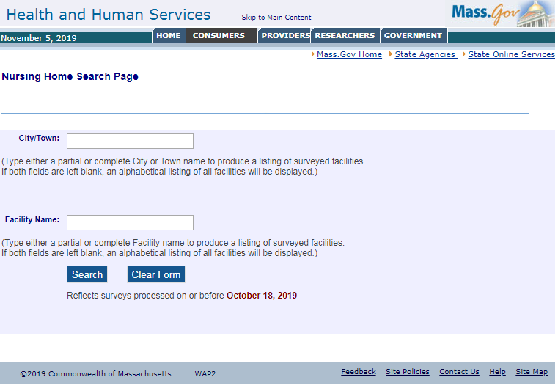
NHSPT: Search Webpage

Slide 17
NHSPT: Results Webpage
NURSING HOME
Nursing Home Name
Address
Phone

Slide 18
Nursing Home Compare
The Centers for Medicare and Medicaid Services (CMS) creates an overall star rating for certified nursing homes from three measures/areas:
Health inspections
Quality of resident care measures
Staffing
CMS also creates domain ratings, as an example, for the quality of resident care rating:
CMS combines the values of 17 quality measures to create three quality of resident care ratings: a short-stay quality measure rating, a long-stay quality measure rating, and an overall quality measure rating.
QMs are derived from clinical data reported by the nursing home and from Medicare claims data submitted for payment
CMS star ratings use a relative scale where a specific percentage of nursing homes are assigned each health inspection star rating and then it is adjusted up or down depending on performance on quality of care and staffing .
Notes:
Data comes from:
CMS's health inspection database
Payroll-Based Journal (PBJ) system
The Minimum Data Set (MDS) national database
Medicare claims data
The top 10% of nursing homes with the lowest health inspection scores in each state get a health inspection rating of 5 stars.
The middle 70% of nursing homes get a rating of 2, 3, or 4 stars, with an almost equal number of nursing homes in each rating category.
The bottom 20% get a 1 star rating.

