Slide 1
Nursing Facility Task Force: Analyses for December Meeting
December 2019

Slide 2
Agenda
Maps of Massachusetts Nursing Facilities
DPH Presentation
Possible Points of Agreement
Outline of a Sensible, Sustainable Rate Structure
Aligning Payments with Quality and Member Complexity
Possible Points of Agreement (Cont.)

Slide 3
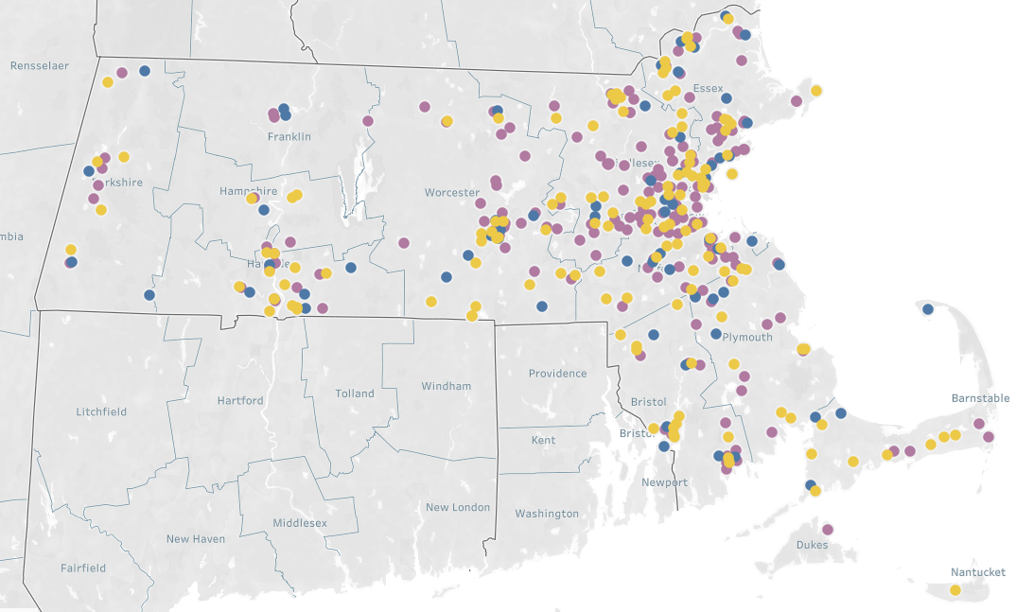
Map of Nursing Facilities by CMS Star Rating Overall Score
1 or 2 CMS Stars or SFF
3 CMS Stars
4 or 5 CMS Stars
Note: Special Focus Facility (SFF) have a history of serious quality issues and therefore do not receive a CMS Star rating
Source: Medicare Star Quality Score October 2019 (380 facilities)

Slide 4
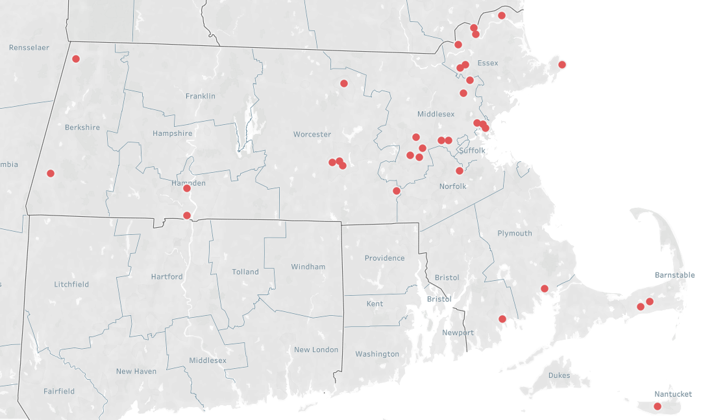
Map of low quality and low occupancy facilities
0
25 Miles
Low Quality (1 or 2 Stars or SFF) & Low Occupancy (<80%)
Note: Facilities without a reported occupancy rate or quality score are excluded from this analysis
Source: MassHealth Occupancy Survey (April 2019), Medicare Star Quality Score (October 2019)

Slide 5
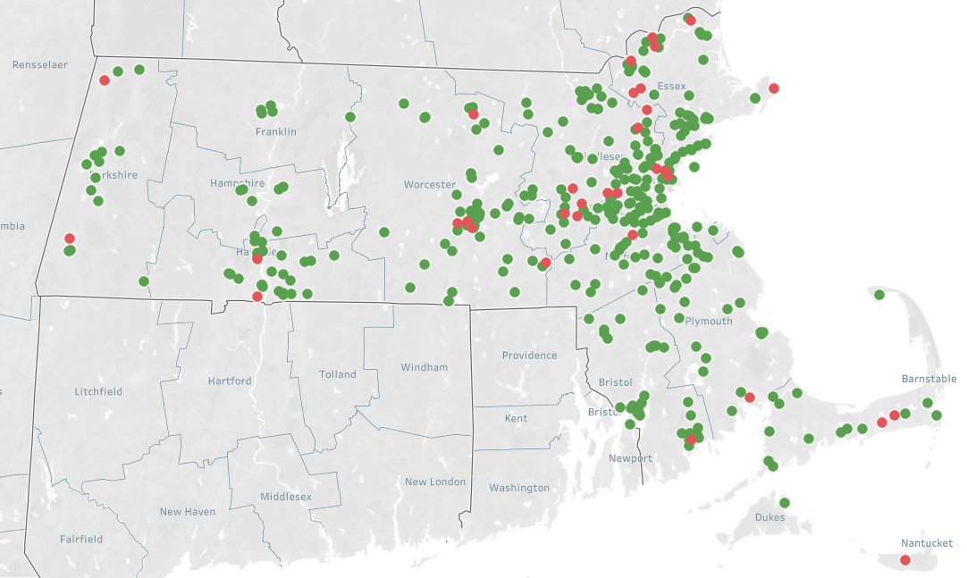
Map of low quality and low occupancy facilities w/ 3+ Star facilities overlaid
0
25 Miles
Low Quality (1 or 2 Stars or SFF) & Low Occupancy (<80%)
3+ Star Facilities, All Occupancy Levels
Note: Facilities without a reported occupancy rate or quality score are excluded from this analysis
Source: MassHealth Occupancy Survey (April 2019), Medicare Star Quality Score (October 2019)

Slide 6
Agenda
Maps of Massachusetts Nursing Facilities
DPH Presentation
Possible Points of Agreement
Outline of a Sensible, Sustainable Rate Structure
Aligning Payments with Quality and Member Complexity
Possible Points of Agreement (Cont.)

Slide 7
Agenda
Maps of Massachusetts Nursing Facilities
DPH Presentation
Possible Points of Agreement
Outline of a Sensible, Sustainable Rate Structure
Aligning Payments with Quality and Member Complexity
Possible Points of Agreement (Cont.)

Slide 8
Nursing Facility Task Force Possible Points of Agreement
Sourced from members prior to meeting
It is important to have quality nursing facilities available for those who need this level of care
32% of long term facilities are low quality, as defined as 1 or 2 CMS stars
Nursing facilities are struggling financially; margins have fallen over the last few years
Nursing facilities in the top quartile of Medicaid mix, operate with negative median total margins of -6.2% compared to the industry’s median total margin of -3.2% (CHIA, 2017)
There is excess capacity in the system
Beds need to be taken offline to solve for excess capacity in the system
Structural changes to the industry are needed to ensure longer term financial sustainability
We should incentivize the conversion of nursing facilities to alternative models such as affordable senior housing and or assisted living units
The state should focus on expanding other community based services (e.g. PACE and Adult Day Health)
A greater share of payments should be based on utilization and quality
The current payment system does not adequately account for acuity or complex patient populations
A new payment system should include a transition from the current MMQ system to the MDS
The nursing home user fee should be enforced
The DPH licensing process for nursing facilities should be modified to strengthen ‘suitability review’
Current state oversight and reporting standards limit the state’s and other stakeholders’ opportunities to monitor nursing facility’s financial stability, the quality of their care, their staffing sufficiency, and their worker readiness to meet anticipated care needs.
Nursing homes are challenged to recruit and retain enough certified nurse assistants and other direct care staff.
Rates and market forces are not enough to preserve quality nursing facilities and reduce low-quality beds. The state should consider other tools including, but not limited to, incentives, assistance and sanctions to achieve those goals.

Slide 9
Agenda
Maps of Massachusetts Nursing Facilities
DPH Presentation
Possible Points of Agreement
Outline of a Sensible, Sustainable Rate Structure
Aligning Payments with Quality and Member Complexity
Possible Points of Agreement (Cont.)

Slide 10
Rate Challenges: For historical reasons, MassHealth nursing facility rates are complex and do not adequately account for patient acuity and quality
Complex, outdated (20+ year old) rate structure
$80M+ in historical “add-ons” not included in the base rates
Structure is poorly understood
Based on state-specific MMQ assessment (vs. CMS MDS tool)
Administratively burdensome
Rates do not achieve certain policy goals
Inadequately accounts for acuity, especially for patients with behavioral health complexities
Limited alignment to quality
Rates are regressive
High Medicaid occupancy facilities receive lower rates on average than low Medicaid occupancy facilities, mainly due to differences in capital payments

Slide 11
Concept: building blocks of a sensible, sustainable Nursing Facility rate structure
One integrated rate structure (no hold harmless provisions, roll historic add-ons into the base, use a more recent cost year)
1
Differentiated levels of payment based on complexity and acuity of members
2
Rate structure that incentivizes higher occupancy – and does not invest more funds in paying for empty beds
3
Progressive rate structure – facilities with a large percentage of MassHealth members should receive higher reimbursement
4
Material incentives for quality (achieving high quality or improving quality)
5

Slide 12
Concept: what this would look like
Current System
New simplified rate structure
1
Integrated Rate Structure
Rate structure is NOT integrated
$80M+ in non-user fee add-ons (Direct Care Staff, PASRR Level II, Cape & Islands, Kosher Kitchen, etc.)
Cost base year: 2014
Rate structure difficult for facilities and EOHHS to administer
Integrated rate structure builds historic add-ons and capital into base rates
No hold harmless add-ons
All-in payments are equivalent to a more recent cost base year
Rate structure substantially simpler to administer
2
Differentiated rates for member complexity and acuity
Acuity adjustment based on ADLs only; use state-specific MMQ assessment that inadequately accounts for acuity
Acuity-adjust payments based on: (1) Medicare’s MDS assessment, and (2) additional factors like SUD or behavioral complexity
3
Incentives for higher occupancy
Facilities with high and low occupancy are paid the same
Create rate structure that incentivizes higher occupancy– and does not invest more funds in paying for empty beds
4
Progressive rate structure
Current structure is regressive because of capital
Partially offset: $5M add-on for High Medicaid facilities
All else equal, level of payment should be higher for high Medicaid facilities
5
Material Incentives for quality
~1% of rate (Quality Achievement and Improvement Add-on, 3+ Star Add-on)
Significant payments (e.g., ~5-10% of rate) linked to quality achievement and improvement

Slide 13
Agenda
Maps of Massachusetts Nursing Facilities
DPH Presentation
Possible Points of Agreement
Outline of a Sensible, Sustainable Rate Structure
Aligning Payments with Quality and Member Complexity
Possible Points of Agreement (Cont.)

Slide 14
Discussion: Strategies to direct funding towards high quality facilities and those with highly acute or complex patient populations
Special/complex patient populations
What complex or special patient populations require the greatest staff time and or greatest investments?
How can adequate compensation be ensured to nursing facilities for complex or special patient populations? Does the transition to the MDS system help achieve this goal?
Quality measures
What role should quality play in determining nursing facility rates and are quality based payment incentives an effective way to improve quality?
Where should we prioritize quality investments? Should we support high quality facilities or provide additional funding to low quality facilities?
What factors or improvements have been shown to enhance quality?

Slide 15
Agenda
Maps of Massachusetts Nursing Facilities
DPH Presentation
Possible Points of Agreement
Outline of a Sensible, Sustainable Rate Structure
Aligning Payments with Quality and Member Complexity
Possible Points of Agreement (Cont.)

Slide 16
Nursing Facility Task Force Possible Points of Agreement
Sourced from members prior to meeting
It is important to have quality nursing facilities available for those who need this level of care
32% of long term facilities are low quality, as defined as 1 or 2 CMS stars
Nursing facilities are struggling financially; margins have fallen over the last few years
Nursing facilities in the top quartile of Medicaid mix, operate with negative median total margins of -6.2% compared to the industry’s median total margin of -3.2% (CHIA, 2017)
There is excess capacity in the system
Beds need to be taken offline to solve for excess capacity in the system
Structural changes to the industry are needed to ensure longer term financial sustainability
We should incentivize the conversion of nursing facilities to alternative models such as affordable senior housing and or assisted living units
The state should focus on expanding other community based services (e.g. PACE and Adult Day Health)
A greater share of payments should be based on utilization and quality
The current payment system does not adequately account for acuity or complex patient populations
A new payment system should include a transition from the current MMQ system to the MDS
The nursing home user fee should be enforced
The DPH licensing process for nursing facilities should be modified to strengthen ‘suitability review’
Current state oversight and reporting standards limit the state’s and other stakeholders’ opportunities to monitor nursing facility’s financial stability, the quality of their care, their staffing sufficiency, and their worker readiness to meet anticipated care needs.
Nursing homes are challenged to recruit and retain enough certified nurse assistants and other direct care staff.
Rates and market forces are not enough to preserve quality nursing facilities and reduce low-quality beds. The state should consider other tools including, but not limited to, incentives, assistance and sanctions to achieve those goals.

Slide 17
Appendix

Slide 18
Nursing Facility Occupancy Rates: MA is second lowest among New England states
Kaiser Family Foundation: Nursing Facility Occupancy Rates CY 2013-CY 2017
 | Nursing Facility Occupancy Rates
Location | 2013 | 2014 | 2015 | 2016 | 2017
Vermont | 85% | 85% | 82% | 82% | 79%
Massachusetts | 87% | 87% | 85% | 85% | 84%
Connecticut | 88% | 88% | 87% | 85% | 85%
Maine | 90% | 90% | 90% | 89% | 87%
New Hampshire | 91% | 90% | 89% | 88% | 87%
Rhode Island | 92% | 92% | 91% | 91% | 90%
Source: Kaiser Family Foundation, CASPER 2013-2017

Slide 19
Nursing Facility Residents by Primary Payer Source: MA Medicaid share a similar Medicaid mix with other New England states
Kaiser Family Foundation: Nursing Facilities by Primary Payer Source CY 2017
Location | Medicaid | Medicare | Private/Other
Rhode Island | 61% | 8% | 32%
Massachusetts | 63% | 12% | 25%
Vermont | 63% | 18% | 19%
New Hampshire | 64% | 14% | 22%
Maine | 67% | 12% | 21%
Connecticut | 70% | 11% | 19%
Source: Kaiser Family Foundation, CASPER Data 2017

Slide 20
Percent of Certified Nursing Facilities Receiving a Deficiency for Actual Harm or Jeopardy: MA is Second Highest Among New England States
Kaiser Family Foundation: Serious deficiencies as defined by CMS, CY 2017
 | % of Nursing Facilities with Serious Deficiencies
Location | 2013 | 2014 | 2015 | 2016 | 2017
Maine | 12% | 10% | 4% | 7% | 3%
New Hampshire | 8% | 5% | 5% | 1% | 3%
Rhode Island | 3% | 4% | 5% | 5% | 4%
Vermont | 17% | 22% | 24% | 13% | 22%
Massachusetts | 25% | 27% | 25% | 25% | 23%
Connecticut | 41% | 42% | 47% | 39% | 36%
Source: Kaiser Family Foundation, CASPER 2017

Slide 21
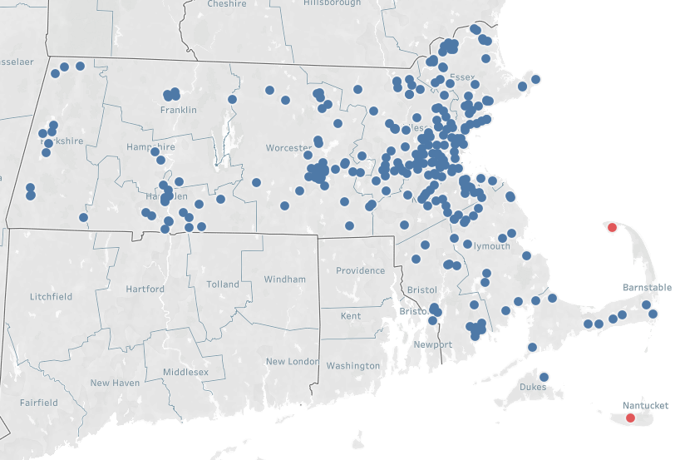
Nearly all nursing facilities have at least one 3+ Star nursing facility with capacity within a reasonable radius
MA Nursing Facilities by Radius in Miles
Map at a 25 Mile Threshold
Distance Threshold | No Facilities within 25 Miles with at least 3+ Stars and Capacity
5 Miles | 79
10 Miles | 20
15 Miles | 7
20 Miles | 3
25 Miles | 2
30 Miles | 2
0
25M
Note: The 2 facilities not within 25 miles are in Provincetown and Nantucket; “Capacity” is defined as <95% occupancy
Source: MassHealth Occupancy Survey (April 2019), Medicare Star Quality Score (October 2019)

Slide 22
List of low quality and low occupancy facilities (1/2)
Facility Name | Operating Company | Overall Occupancy (as of 4.1.19) | MassHealth Share of Residents (as of 4.1.19) | DPH Score (as of December 2019) | Medicare Score (as of October 2019) - Overall | # of Licensed Beds (as of 12.18.19)
ACADEMY MANOR | Genesis HealthCare Corp. | 79% | 77% | 117 | 2 | 174
AGAWAM HEALTHCARE | Next Step Healthcare | 51% | 84% | 105 | 2 | 176
BRANDON WOODS OF NEW BEDFORD | Essex Group Management Corp. | 78% | 90% | 123 | 1 | 135
CEDAR VIEW REHABILITATION AND HEALTHCARE CENTER | Marquis Health Services | 76% | 71% | 116 | 2 | 106
DEDHAM HEALTHCARE | Next Step Healthcare | 63% | 87% | 101 | 1 | 145
DEN-MAR HEALTH AND REHABILITATION CENTER | Wachusett Healthcare Management Company, LLC | 72% | 76% | 119 | 2 | 76
DEXTER HOUSE HEALTHCARE | Next Step Healthcare | 69% | 84% | 119 | 2 | 130
ELIOT CENTER FOR HEALTH & REHABILITATION | National Health Care Associates, Inc. | 71% | 65% | 116 | 1 | 114
FAIRVIEW COMMONS NURSING & REHABILITATION CENTER | Berkshire Healthcare Systems | 78% | 69% | 116 | 1 | 146
FITCHBURG GARDENS FOR NURSING AND REHABILITATION | Priority Healthcare Group | 80% | 89% | 106 | 2 | 87
HERMITAGE HEALTHCARE | Next Step Healthcare | 78% | 81% | 110 | 2 | 101
CASA DE RAMANA REHABILITATION CENTER | Landmark Management Solutions | 60% | 80% | 99 | 2 | 124
MAPLEWOOD REHAB AND NURSING | RegalCare Management Group | 79% | 49% | 109 | 1 | 120
MILFORD CENTER | Genesis HealthCare Corp. | 73% | 68% | 117 | 2 | 135
OUR ISLAND HOME | Town of Nantucket | 73% | 64% | 124 | 2 | 45
PENACOOK PLACE, INC | Covenant Health Systems | 78% | 81% | 115 | 2 | 160
Source: MassHealth Nursing Facility Occupancy Survey April 2019

Slide 23
List of low quality and low occupancy facilities (2/2)
Facility Name | Operating Company | Overall Occupancy (as of 4.1.19) | MassHealth Share of Residents (as of 4.1.19) | DPH Score (as of December 2019) | Medicare Score (as of October 2019) - Overall | # of Licensed Beds (as of 12.18.19)
REHABILITATION & NURSING CENTER AT EVERETT | Personal Healthcare LLC | 80% | 86% | 106 | 1 | 183
ROYAL AT WAYLAND REHABILITATION & NURSING CENTER | Royal Health Group | 75% | 84% | 112 | 2 | 40
ROYAL MEADOW VIEW CENTER | Royal Health Group | 80% | 84% | 111 | 1 | 113
SOUTH DENNIS HEALTHCARE | Next Step Healthcare | 78% | 74% | 109 | 1 | 128
WAREHAM HEALTHCARE | Next Step Healthcare | 59% | 81% | 85 | 1 | 175
WEST NEWTON HEALTHCARE | Next Step Healthcare | 80% | 83% | 103 | 1 | 123
WEST SIDE HOUSE LTC FACILITY | Essex Group Management Corp. | 67% | 94% | 103 | 2 | 91
WINDSOR NURSING & RETIREMENT HOME | Berkshire Healthcare Systems | 74% | 72% | 108 | 2 | 120
BEAR MOUNTAIN AT ANDOVER | Bear Mountain Healthcare | 61% | 80% | 121 | 1 | 135
WINGATE AT HAVERHILL | Wingate Healthcare, Inc. | 77% | 66% | 120 | 2 | 146
BEAR MOUNTAIN AT SUDBURY | Bear Mountain Healthcare | 71% | 72% | 112 | 2 | 142
BEAR MOUNTAIN WEST SPRINGFIELD | Bear Mountain Healthcare | 71% | 77% | 112 | 2 | 165
WINGATE AT WESTON | Wingate Healthcare, Inc. | 63% | 67% | 107 | 1 | 160
WILMINGTON REHAB CENTER | The Pointe Group | 70% | 80% | 112 | 1 | 142
WORCESTER REHABILITATION & HEALTH CARE | Athena Health Care Systems | 79% | 87% | 95 | 1 | 160
WORCESTER HEALTH CENTER | Synergy Health Centers | 88% | 92% | 117 | N/A | 160
OXFORD REHABILITATION & HEALTHCARE CENTER | Athena Health Care Systems | 84% | 71% | 82 | 1 | 120
SWEET BROOK OF WILLIAMSTOWN REHABILITATION & N CTR | SB Operating Company LLC | 65% | 88% | 69 | N/A | 146
Source: MassHealth Nursing Facility Occupancy Survey April 2019

