Slide 1

Commonwealth of Massachusetts
Health Information Sessions
December 2024

Slide 2
Merged Market Health Rate Increases
Review authority
Pursuant to M.G.L. c. 176J, section 6.
1) The Commissioner shall disapprove any proposed changes to base rates that are excessive, inadequate or unreasonable in relation to the benefits charged. The Commissioner shall disapprove any change to small group rating factors that is discriminatory or not actuarially sound.
2) If a carrier files a base rate change and the administrative expense loading component, not including taxes and assessments, increases by more than the most recent calendar year's percentage increase in the New England medical CPI or if a carrier's reported contribution to surplus exceeds 1.9 % or if the aggregate medical loss ratio for all plans offered under this chapter is less than 88 %, then such carrier's rate shall be presumptively disapproved as excessive by the Commissioner.

Slide 3
Merged Market Health Rate Increases
Premium Refunds
Pursuant to M.G.L. c. 176J, section 6:
If the annual aggregate medical loss ratio for all plans offered under this chapter is less than 88%, or less than the medical loss ratio that was not presumptively disapproved by the commissioner for being in excess of 1 per cent of the carrier's prior year base rate, over the applicable 12–month period, the carrier shall refund the excess premium to its eligible individuals and eligible small groups. A carrier shall communicate within 30 days to all individuals and small groups that were covered under plans during the relevant 12–month period that such individuals and small groups qualify for a refund to be issued under this paragraph, which may take the form of either a refund on the premium for the applicable 12–month period or, if the individual or groups are still covered by the carrier, a credit on the premium for the subsequent 12–month period. The total of all refunds issued shall equal the amount of a carrier's earned premium that exceeds that amount necessary to achieve a medical loss ratio of the applicable percentage set forth in subsection (e), calculated using data reported by the carrier as prescribed under regulations promulgated by the commissioner. The Commissioner may authorize a waiver or adjustment of this requirement only if it is determined that issuing refunds would result in financial impairment for the carrier.

Slide 4
Merged Market Health Rate Increases
DOI Authority
The DOI may:
1) Require that carrier networks are adequate;
2) Require coverage of mandated benefits; and
3) Require MHPAEA equity in medical and behavioral health benefits and treatments.
The DOI does NOT have the authority to:
1) Modify submitted rates;
2) Change hospital/provider reimbursements;
3) Change pharmacy reimbursements;
4) Reduce carriers’ underlying costs; or
5) Intercede in contractual discussions.

Slide 5


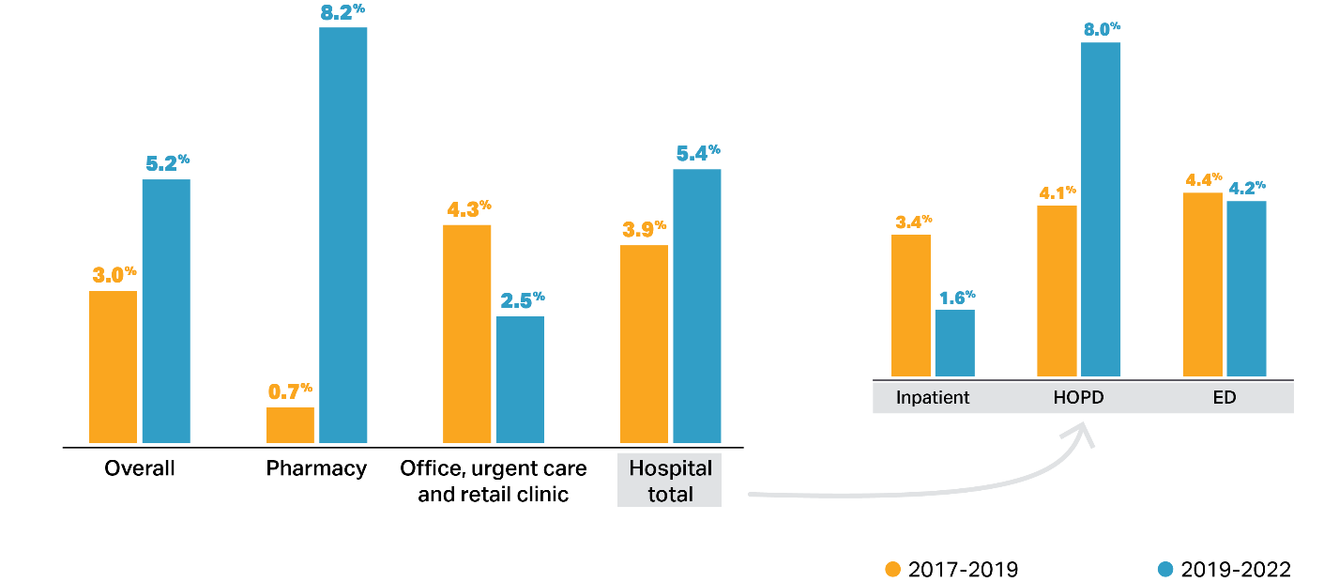
Faster commercial spending growth in the most recent three-year period reflects
accelerating growth in prescription drug spending and hospital outpatient spending.
Average annual growth in commercial spending per enrollee by site of care, 2017-2019 vs 2019-2022
Hospital spending patterns partly reflect a shift of some surgeries from inpatient to outpatient settings.
Prescription drug spending grew 10x faster from 2019 – 2022 as it did from 2017 – 2019.
Notes: Pharmacy spending is net of rebates.
Sources: HPC analysis of Center for Health Information and Analysis All-Payer Claims Database V2021 and V2022 (for hospital and office spending); Center for Health
Information and Analysis Annual Report on the Performance of the Massachusetts Health Care System, 2019-2022 (for pharmacy and overall spending).
13

Slide 6
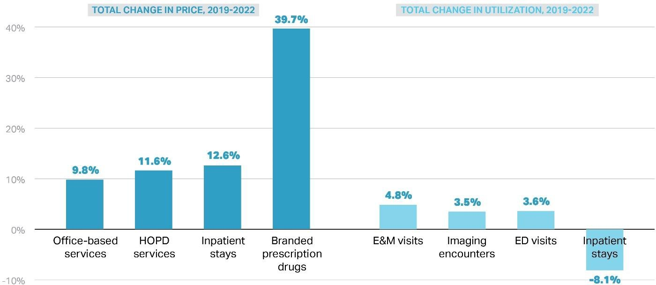
Price changes, more than utilization changes, drove commercial spending growth
from 2019-2022
Total (cumulative) percentage change, 2019-2022
Notes: Price changes for office-based services, hospital outpatient department and inpatient care are reported elsewhere in this report (see Chartpack) while average prescription drug price increases are gross of rebates and are for branded drugs
excluding COVID-19 vaccines. E&M visits include all visits with codes 99201-99205 and 99211-99215. Imaging represents encounters for all types of imaging.
Sources: HPC analysis of Center for Health Information and Analysis All-Payer Claims Database, V2022 (2019-2022), Hospital inpatient discharge database (HDD) and emergency department discharge database (EDD).
14

Slide 7
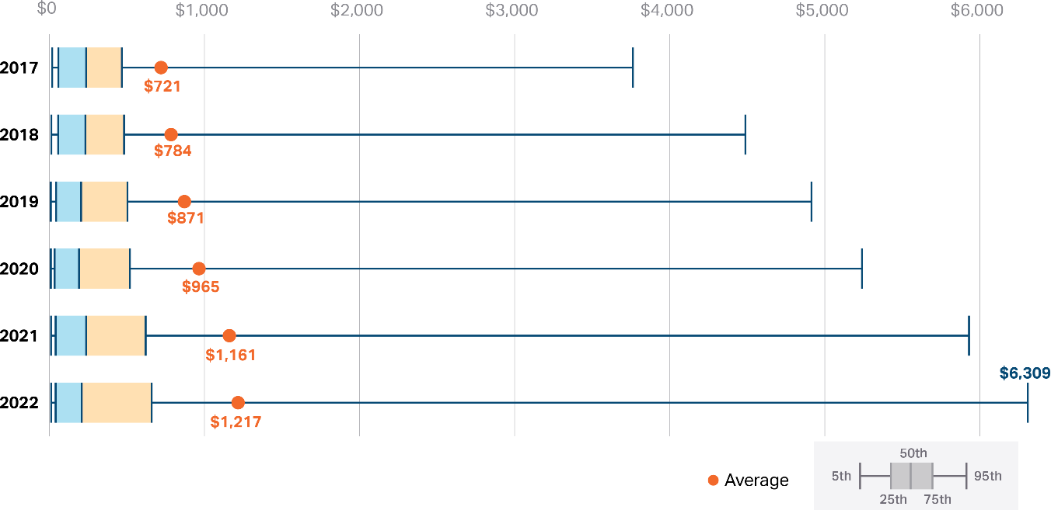
The average price per branded prescription grew 69% from 2017 to 2022, from $721
to $1,217, with 5% priced over $6,300 in 2022.
Average and percentile distribution of branded prescription drug prices, not accounting for rebates, 2017 -2022
More than 60% of prescription drug spending growth from 2018 – 2022 was due to higher prices and use of immunosuppressants such as Humira.
Notes: Pharmacy claims include data from five payers: BCBSMA, Tufts, HPHC, MGB Health Plan, and HNE. COVID-19 vaccines are excluded.
Sources: HPC analysis of Center for Health Information and Analysis All-Payer Claims Database, V2021 (2017) and V2022 (2018-2022)
15

Slide 8
Health Care Access Bureau
Pursuant to M.G.L. c. 26, section 7A:
There shall be in the division of insurance a health care access bureau overseen by a deputy commissioner for health care access, whose duties shall include, subject to the direction of the commissioner of insurance, administration of the division's statutory and regulatory authority for oversight of the small group and individual health insurance market, oversight of affordable health plans, including coverage for young adults, as well as the dissemination of appropriate information to consumers about health insurance coverage and access to affordable products.
The Health Care Access Bureau needs to
balance access and affordability of insured health plan products
consider the financial solvency of all health carriers
Review all filings according to statutory and actuarial standards
Develop information for consumers about available insured health coverage

Slide 9
Benefit Changes
The Health Care Access Bureau also develops bulletins and other documents to explain other benefits, including the following added since 2018:
Behavioral Health for Children and Adolescents
Naloxone
Pain Management Alternatives to Opiate Products
Tobacco Cessation Products without cost sharing
Coronavirus Testing, Vaccines and Treatment
Contraceptive Care without cost sharing
Services Provided via Telehealth
Treatment for PANS/PANDAS
HIV PrEP Preventive Care
Abortion and Abortion-Related Care without cost sharing
Behavioral Health Wellness Examinations
Psychiatric Collaborative Model of Care
Community Behavioral Health Centers
Step Therapy Protocols for Prescriptions

Slide 10
Health Plan Process to Develop Rate Filings
Presentation by
David Naramore
VP and Chief Actuary
Fallon Community Health Plan, Inc.

Slide 11
Merged Market Health Rate Filings
Carrier merged market rate filings are reviewed annually:
Carriers submit rates on May 15 in year before rates are effective.
Carriers are required to submit a standardized rate filing summary that will be made public and includes the following:
List of products subject to the rate filing;
Key drivers for the proposed rate change;
Range of rate changes and the overall average proposed rate change; and
Number of renewing Eligible Individuals and renewing Eligible Small Groups and Small Group Members.
DOI publishes summary of filings to website within 10 business days.
DOI holds public session in mid-June so that carriers can explain filing and public can raise issues for DOI to consider in reviewing filings.
DOI must complete review by mid-August to meet Connector timelines.
DOI publishes summary of final rates in September.

Slide 12
Merged Market Health Rate Review Process
Carriers file a standard data workbook with detail about membership, claims history, administrative expenses and projected actuarial assumptions about claims trends, risk adjustment, taxes, contribution-to-surplus, and other expenses.
DOI assigns an independent consulting actuary to review all filed assumptions and projections within carrier rate filings.
Consulting actuaries report findings to DOI about debatable assumptions.
DOI staff engage with carriers to address any debatable assumptions.
If the DOI is satisfied that a filing meets all applicable statutory and regulatory requirements, it is placed on file and may be used by the carrier.
If filed rates do not meet DOI standards, the DOI will disapprove a filing, and the carrier will have the opportunity to request a hearing.

Slide 13
Merged Market Health Rate Disapprovals
According to M.G.L. c. 176J and 211 CMR 66.00, the DOI has the authority to disapprove rates.
The DOI does not have the authority to modify rate filings.
DOI will presumptively disapprove rates if:
Projected medical loss ratio is under 88%;
(projected claims payments in relation to projected premium revenue is under 88%);
Contribution-to-surplus (profit) is greater than 1.9%; or
Administrative expenses increase by more than medical CPI for Boston area.
In addition to presumptive disapproval standards, the DOI may disapprove a filing:
If rates are excessive, inadequate, or unreasonable in relation to the benefits charged; or
If any filed rating factor change is discriminatory or not actuarially sound.
If DOI disapproves a carrier’s rate filing:
DOI must state its disapproval reasons in writing.
The carrier may request a hearing about the validity of the disapproval reasons.
The rates for the carrier are frozen at prior year rates when offered in market.
If disapproval is overturned, the filed rate increase may take effect.

Slide 14
Final CY2025 Rate Changes

Slide 15
Information Sessions

