Slide 1
DESE & DEEC Physical Restraint
Data, Regulations, and Reporting Requirements
maaps
March 22, 2019

Slide 2
01
Current Data
02
Regulation Review
CONTENTS
03
Where Things Get Confusing…
04
Reporting Requirements
05
Regulations and How They Relate to DESE PR/Mid-Cycle & DEEC Monitoring

Slide 3
Current Data
01

Slide 4
DESE & DEEC Reported Restraint Data 2016 – Present
DESE
DEEC

Slide 5
DESE Reported Restraints & Student Count Reported
* Appears schools are on trajectory for restraints to decrease this school year; however, not all schools report data in real time

Slide 6
DEEC Reported Restraints and Bed Days

Slide 7
DESE Restraint By Restraint Type
Notes:
Other Restraints = CPI Transport, Escort, CPI Escort, CPI Interim Control Position, TCI Blocking, TCI – Physical Altercation position

Slide 8
DEEC Restraint By Restraint Type

Slide 9
DESE Restraint Data Reported By Duration

Slide 10
DEEC Restraint Data Reported By Duration

Slide 11
DESE Reported Restraint Injuries
*Reporting Requirements have changed from:
Report serious injuries Report ALL injuries to students and staff

Slide 12
DEEC Reported Restraint Injuries

Slide 13
Regulation Review
02

Slide 14
Regulation Review
Prone Restraint Requirements
Do Not use Physical Restraint
use of restraint

Slide 15
Regulation Review
Use of Restraints
Do NOT use Physical Restraint
Prone restraints are prohibited (except when ALL of the below are true and documented)
Not a form of treatment or punishment
Are an emergency procedure
Used only as a last resort when a student’s behavior poses a threat of assault or imminent, serious, physical harm to self or others
If the student cannot safely be restrained; including medical contraindications
As a standard response for any student
When non-physical interventions could be used
As a means of discipline or punishment
As a response to property destruction, school disruption, refusal to comply, or verbal threats
Note: The use of restraints must not be included in behavioral plans or IEPs
The student has a documented history of repeated dangerous behavior to self or others
All other forms of restraints have been unsuccessful
There are no medical contraindications
There is psychological/behavioral justification with no contraindications
The program has obtained consent to use prone restraint.
Note: The program must document all of the above in advance of the use of prone restraint for a student.
Notes:
Note: Consent for Restraint is not allowed

Slide 16
Where Things Get Confusing…
03

Slide 17


Physical Escort vs. Physical Restraint
PHYSICAL ESCORT
PHYSICAL RESTRAINT
“Shall mean a temporary touching or holding, without the use of force, of the hand, wrist, arm, shoulder, or back for the purpose of inducing a student who is agitated to walk to a safe location.”
603 CMR 46.02 & 606 CMR 3.07
“Shall mean direct physical contact that prevents or significantly restricts a student’s freedom of movement.” 603 CMR 46.02
Physical restraint does not include:
  brief physical contact to promote student safety
  providing physical guidance
  prompting when teaching a skill
  redirecting attention
  providing comfort
  physical escort See 603 CMR 46.02 & 606 CMR 3.07

Slide 18
Reporting Requirements
04

Slide 19
DESE Reporting Requirements
Verbal Report to Principal
as soon as possible
Verbal Report to Parents
within 24 hours
Written Restraint Report
no later then the next school working day to Principal
Written Report to Parents
within 3 school working days
Restraint Injuries (staff and/or student) to DESE
within 3 school working days into Security Portal
Notes:
When an injury report is filed – 30 day log of all students restraints is required.

Slide 20
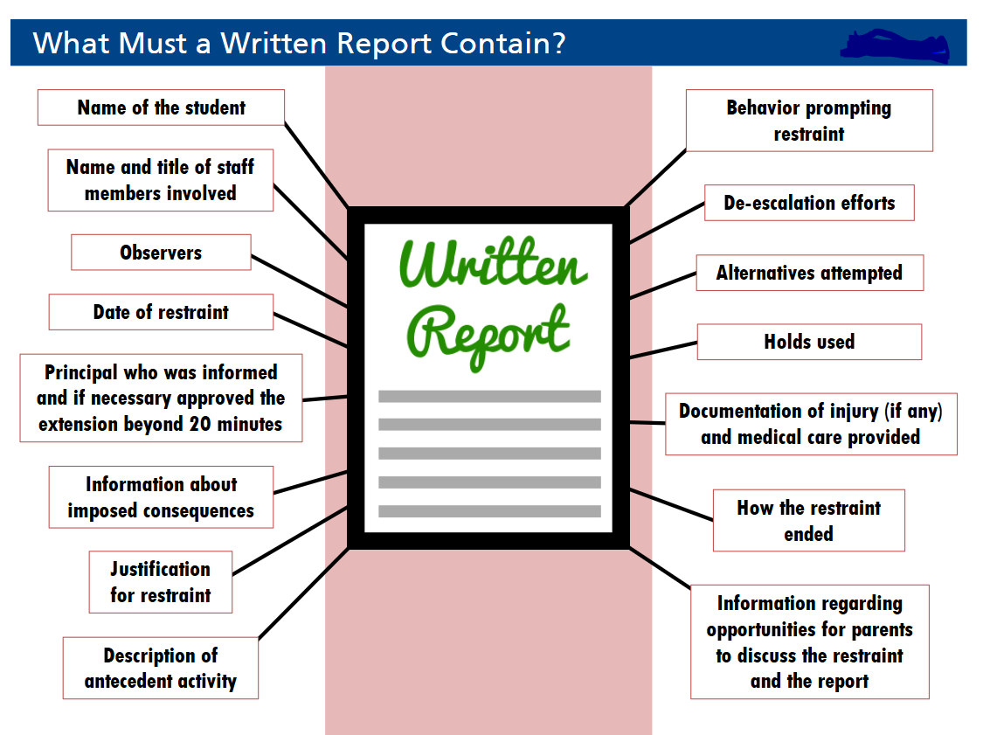
DESE Reporting Requirements
Security Portal Restraint Report
All sections of the report should be completed, but form cannot be submitted until all required sections, marked with an asterisk (*), are complete.
Restraint Report should be completed for an episode of dysregulation.
  In the incident report, answer:
    Whether episode involved multiple restraints
    NOTE: Hold used should be categorized according to the most restrictive hold.
Restraint Report can be printed and used as the written report to be sent to the parent/guardian

Slide 21
DESE Data Review Requirements
Individual Review Record
Principal must record Weekly Individual Reviews of multiple restraints
Principal Log
Monthly Review of Restraint Data Program-Wide
Reporting Annual Data to DESE
Program is required to submit all restraint data from July 1, 2018 through June 30, 2019 using the security portal

Slide 22
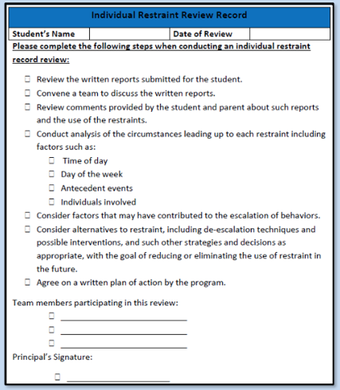
DESE Data Review Requirements
Individual Weekly Review Should Include:
Whether a review team was convened
Whether restraints were reviewed
Whether parent and student comments were reviewed
Whether an analysis of circumstances was completed
Whether future alternatives were considered
Whether a written plan of action was developed See 603 CMR 46.06(5)”

Slide 23

DESE Data Review Requirements
Reporting Annual Data to DESE
Restraint Reports must be submitted by June 30, 2019
Restraint Data must be uploaded into the security portal by June 30, 2019.
Reminder: Any restraint that results in an injury to student and/or staff must be reported to DESE no later than 3 school working days using the security Portal.
Notes:
30 day log for restraints

Slide 24
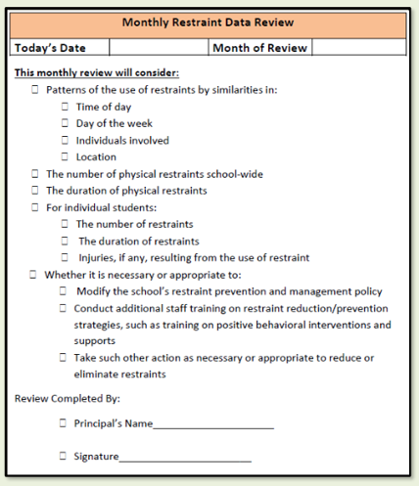
DESE Data Review Requirements
Principal Log/Monthly Review Should Include:
Patterns of restraint use
Number of restraints
Duration of restraints
Injuries, if any, resulting from restraint
Any follow up or action steps
IMPORTANT:
Programs should maintain copies of weekly and monthly review materials
DESE may ask to see them as part of a program or mid-cycle review or as follow-up to a complaint or injury
See 603 CMR 46.06(6)

Slide 25

DEEC Data Review Requirements
Requirements for additional oversight at program/agency level:
Restraint Coordinator – Licensee staff member responsible for oversight of all matters related to restraint
Restraint Committee – Comprised of child care staff, clinical staff, and restraint coordinator
Names and positions of the restraint safety committee
See 606 CMR 3.02(2), 3.04(2)(e), 3.07(7)(a)(7)

Slide 26
INSTRUCTION SHEET FOR RESIDENTIAL FACILITY PHYSICAL
RESTRAINT DATA:
DEEC Data Review Requirements
You must file a report on each residential program which is approved to use physical restraint every quarter via the EEC Portal (even if no restraints occur in that facility during the quarter).
1st Qtr. – Jan-March
2nd Qtr. – Apr – June
3rd Qtr. – July-Sept.
4th Qtr. - Oct-Dec.
Time frame for submitting is approx. 10 days into the following month}
Restraint Statistics by Position and Minutes (Standing, Sitting, Floor): enter the total number of physical restraints which occurred this quarter.
Number of Minor Injuries to Residents: a minor injury is one which requires only first aid provided on site. Report the number of residents’ minor injuries resulting from/related to any restraint.
Number of Serious Injuries to Residents: a serious injury is one which requires a visit to a physician, ER or hospitalization. An injury which the parent-guardian chooses to have reviewed by a physician would be classified by the outcome of that visit. Report the number of residents’ serious injuries resulting from/related to a restraint.

Slide 27
INSTRUCTION SHEET FOR RESIDENTIAL FACILITY PHYSICAL
RESTRAINT DATA:
DEEC Data Review Requirements
Number of Minor Injuries to Staff: a minor injury is one which requires only first aid provided on site. Report the number of staff minor injuries resulting from/related to any restraint.
Number of Serious Injuries to Staff: a serious injury is one which requires a visit to a physician, ER or hospitalization. Report the number of staff serious injuries resulting from/related to a restraint.
Number of Restraints Which Led to Youth Injury: Enter the total number of restraints which resulted in any injury to a youth.
Number of Restraints Which Led to Staff Injury: Enter the total number of restraints which resulted in any injury to a staff member.
Unduplicated Count of Youth Restrained: Enter the total number of youth who were restrained this quarter without counting any youth more than once. Example: Youth A was restrained 6 times this quarter count him once. Youth B was restrained once this quarter count him once. Total Unduplicated Count of Youth Restrained for those two youth would be 2.
***Unduplicated Count of Youth Served: Enter the total number of youth who were served by the residential facility this quarter. Count each youth who is served only once, regardless of length of stay or multiple stays.

Slide 28
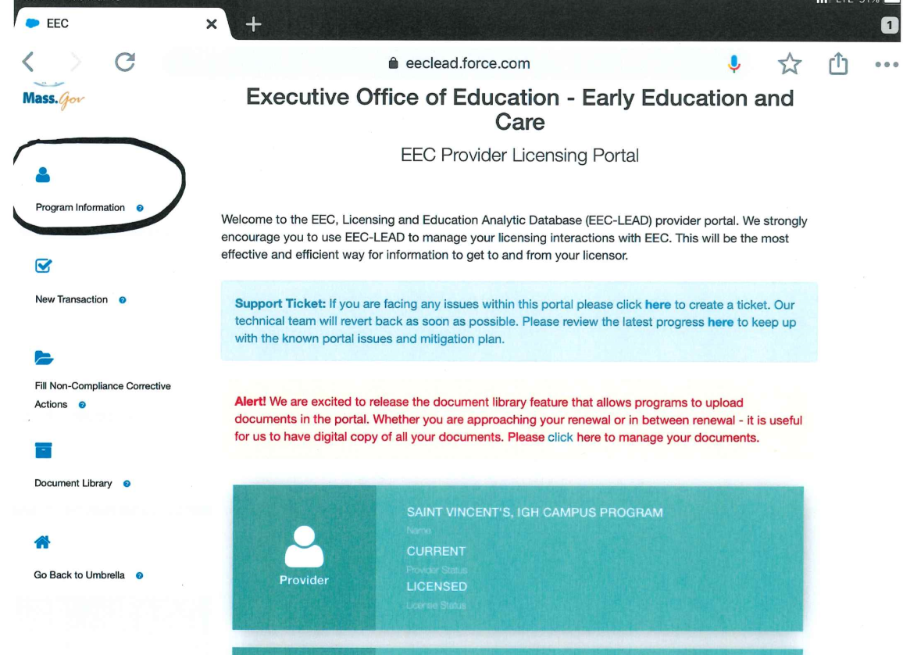
DEEC Data Review Requirements – Using LEAD

Slide 29
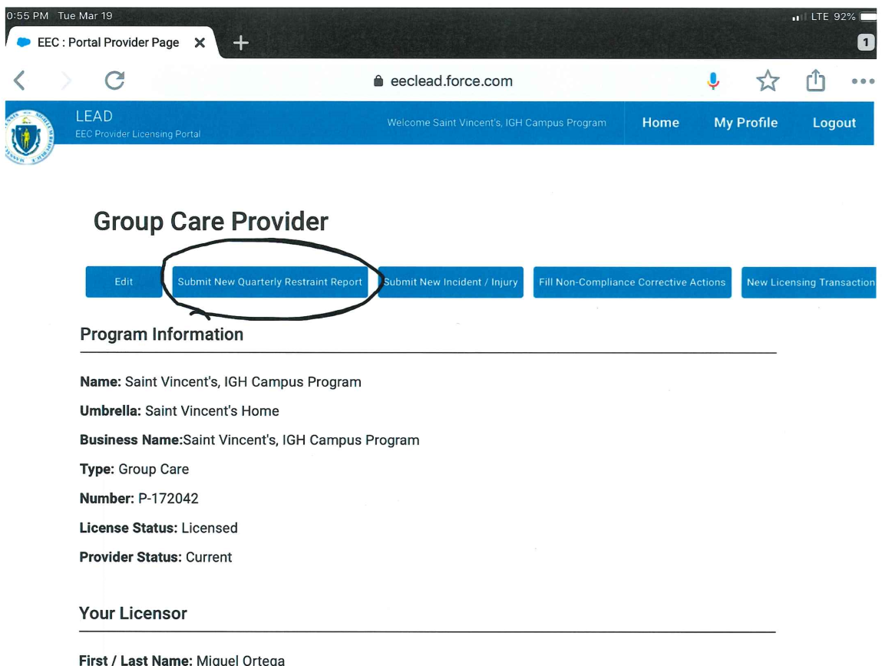
DEEC Data Review Requirements – Using LEAD

Slide 30
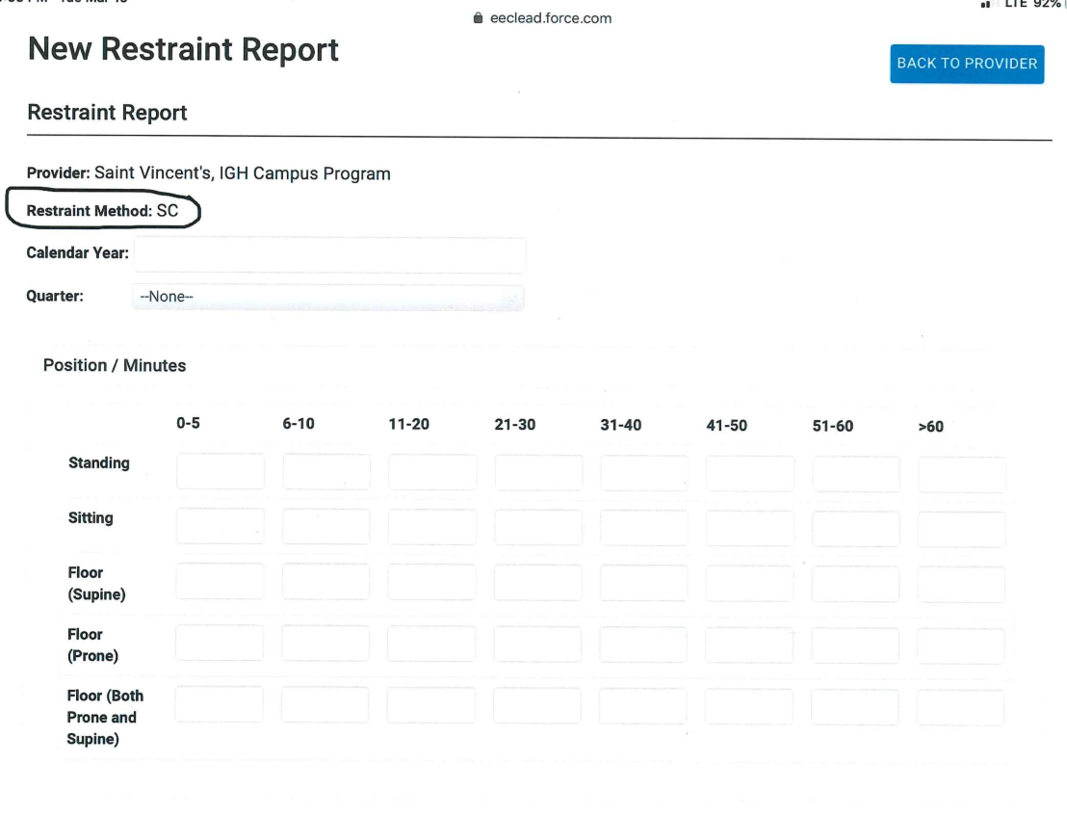
DEEC Data Review Requirements – Using LEAD

Slide 31
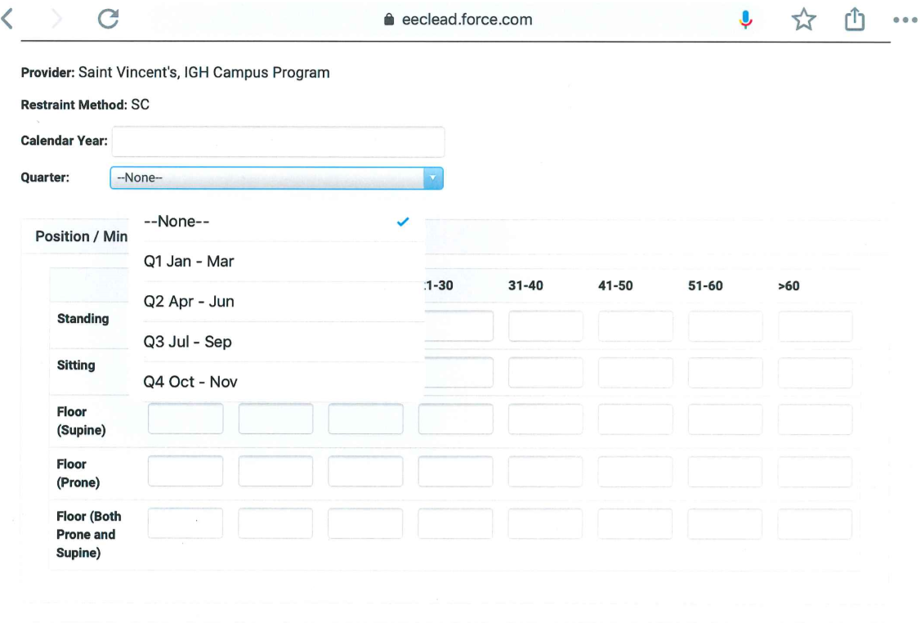
DEEC Data Review Requirements – Using LEAD

Slide 32
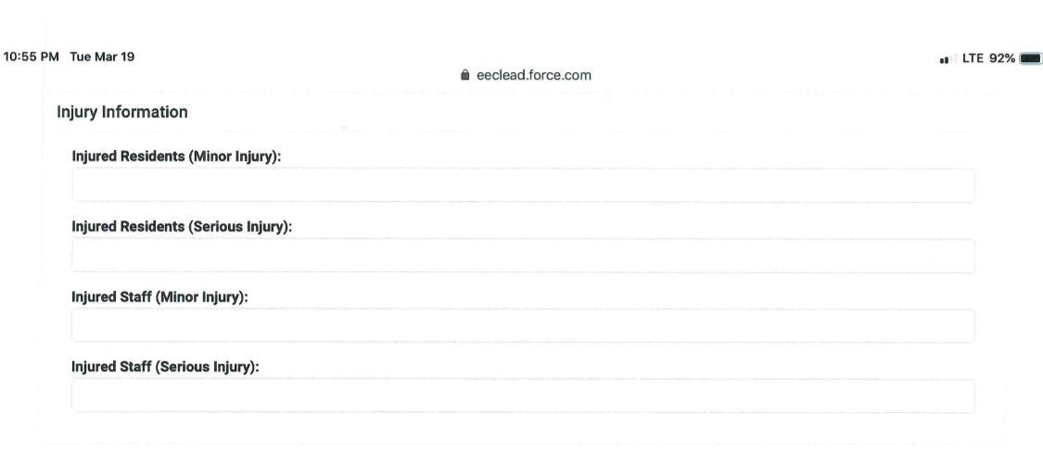
DEEC Data Review Requirements – Using LEAD

Slide 33
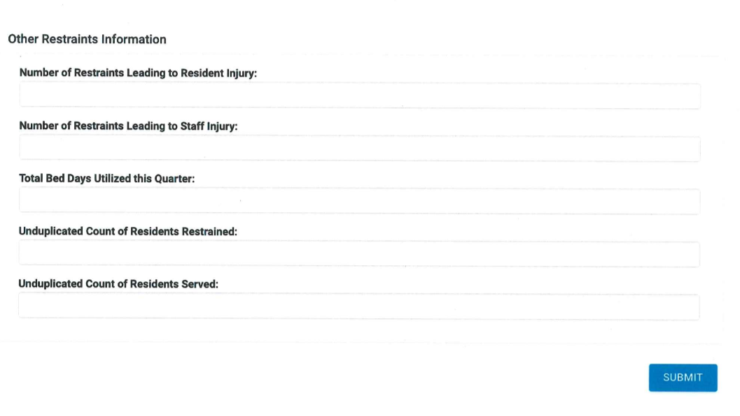
DEEC Data Review Requirements – Using LEAD

Slide 34
Regulations and How They Relate to DESE PR/Mid-Cycle & DEEC Monitoring
05

Slide 35
Common Themes with DESE Program or Mid-Cycle Reviews
9.1 Behavior Support
1. Explain the methods your program uses for preventing student violence, self-injurious behaviors, and suicidal ideations.
2. Ensure elements of the policy that DESE is reviewing have all the reporting requirements and clearly identify the responsible staff member for each reporting requirement.
3. Policy should be about supporting student behaviors, i.e. Form 2 serious incidents, not focused on physical restraint.
9.4 Physical Restraint
1. Ensure that you include what methods your program uses for engaging parents.
2. Ensure when you are developing the policy that you note: restraints are used “only when needed to protect a student and/or a member of the school community from assault or imminent, serious physical harm.”
3. Identify who serves as the restraint resource for your program. (Who does your program go to for guidance on restraints? What training do these individuals receive?)

Slide 36
Common Themes with DEEC Monitoring Licensing
Documented Restraint Safety Committee activity/protocols
Evidence of Restraint Coordinator Review

Slide 37

DESE Restraint Data Collection Application User Guide

Slide 38

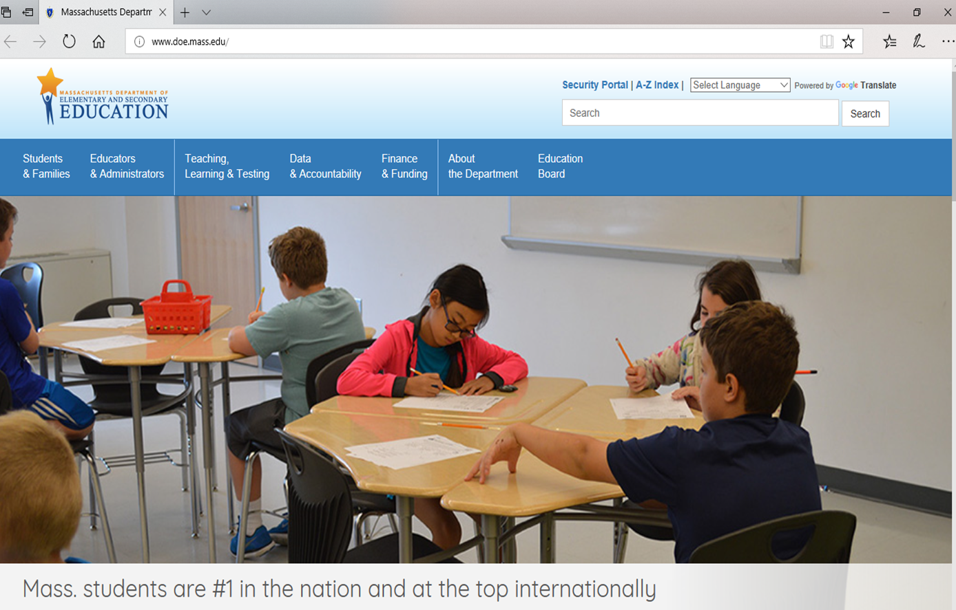
Restraint Data Collection Application User Guide
Go to the Department’s home page (www.doe.mass.edu) and click on Security Portal

Slide 39
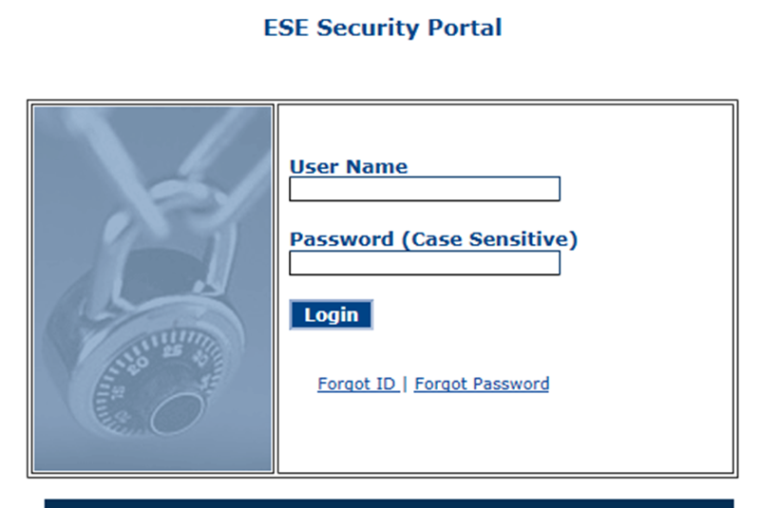
Restraint Data Collection Application User Guide
Log into the Security Portal
If you do not have access to the Security Portal, please contact your Directory Administrator
  To identify the Directory Administrator: http://www.doe.mass.edu/infoservices/data/diradmin/list.aspx

Slide 40
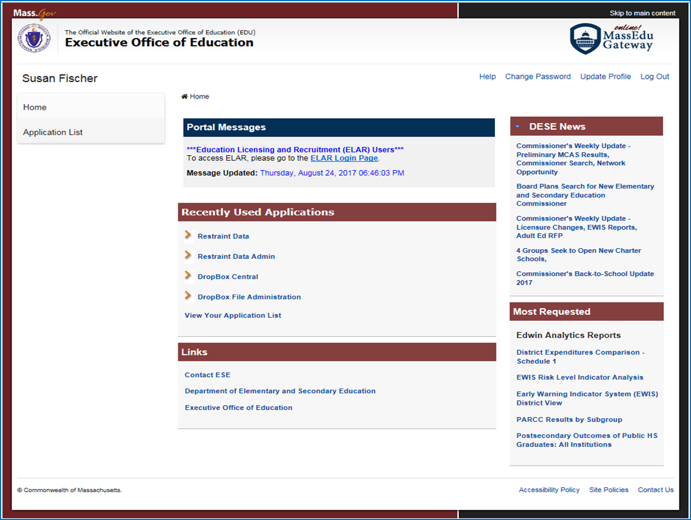
Restraint Data Collection Application User Guide
Click on Application List

Slide 41
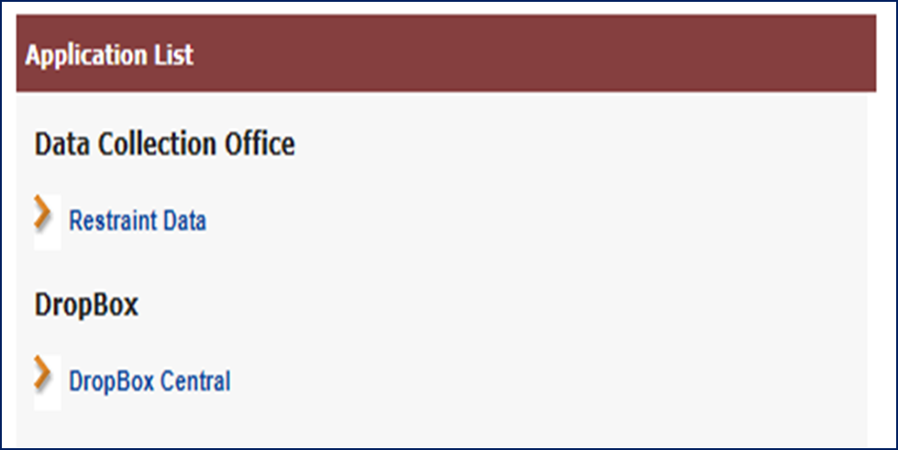
Restraint Data Collection Application User Guide
Click on Restraint Data
If you do not have access to the Security Portal or the Restraint Data application, please contact your Directory Administrator.

Slide 42
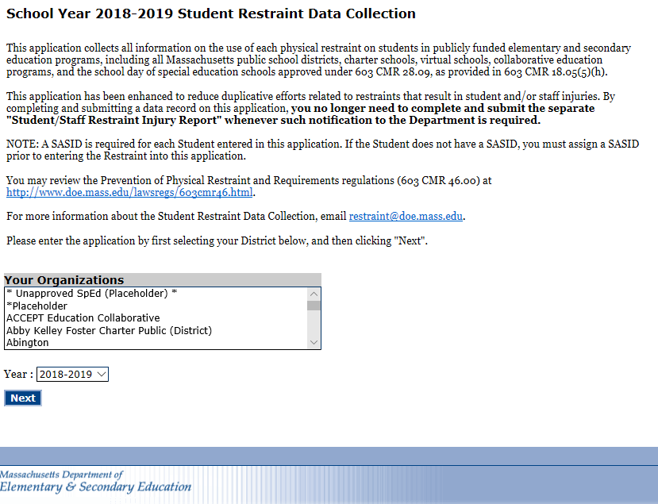
Restraint Data Collection Application User Guide
Select your organization and the correct year, then click on “Next.”

Slide 43
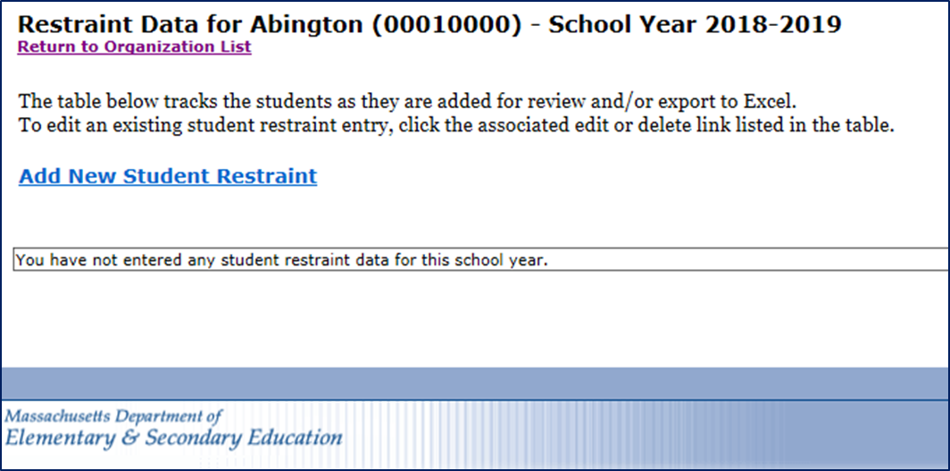

Restraint Data Collection Application User Guide
To create new restraint record, click “Add New Student Restraint”

Slide 44
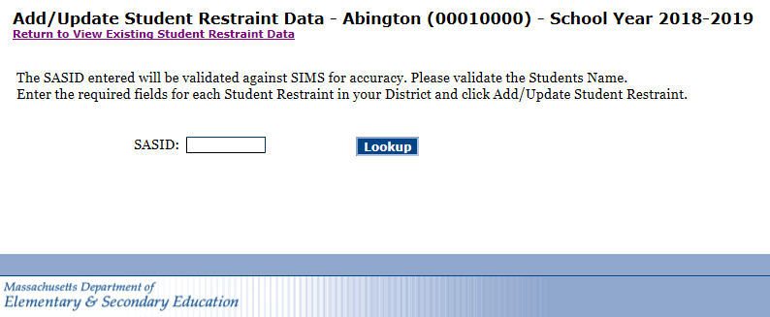
Restraint Data Collection Application User Guide
Enter the SASID of the student and click “Lookup.”
This data collection is only for MA enrolled students and only for restraints occurring during the school day.
Note: DESE encourages programs to maintain this data for all students as the regulations apply to all students.

Slide 45
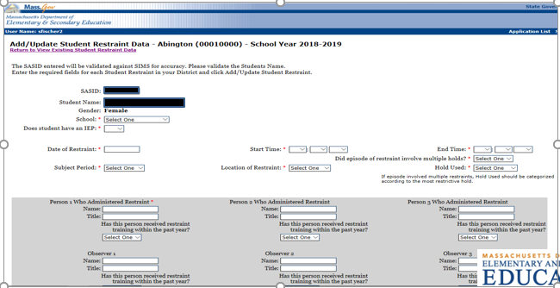
Restraint Data Collection Application User Guide
Enter restraint information
Sections with an asterisk (*) are required to be selected in order to close/submit the record but all fields should be completed.
The “School” section has a dropdown of individual schools/programs to select from.
At any time during the school year, a record is able to be edited to add information and/or to delete.

Slide 46
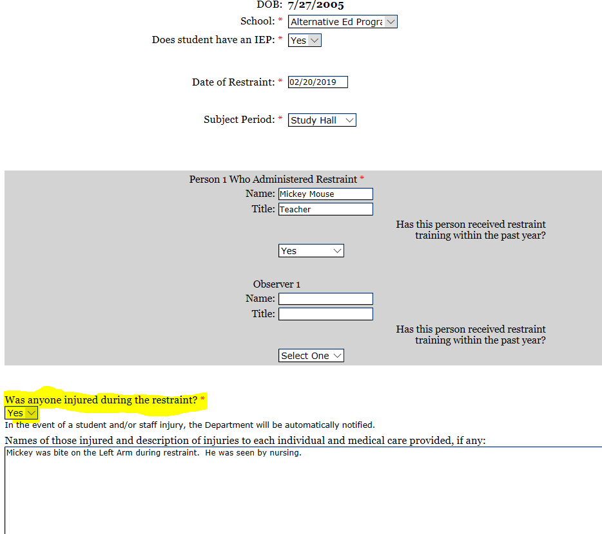
Restraint Data Collection Application User Guide
To report an injury that occurred during a restraint click ”YES.”
Add the names of the those injured, description of injuries and if medical care was provided.
This is for STAFF and STUDENTS.

Slide 47
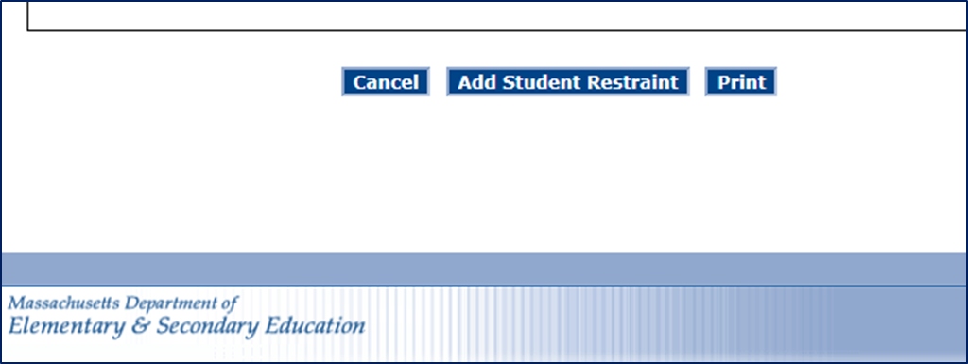
Restraint Data Collection Application User Guide
Print, save and submit your record
Print: To print this record, scroll to the bottom of the form, click “Print” and proceed as you usually would when printing.
Save and submit: To save this record to the database, click “Add Student Restraint.” Once saved to the database, you will be able to access this record to edit at any time before June 30, 2019. Once saved, records can be accessed at any time for printing.

Slide 48
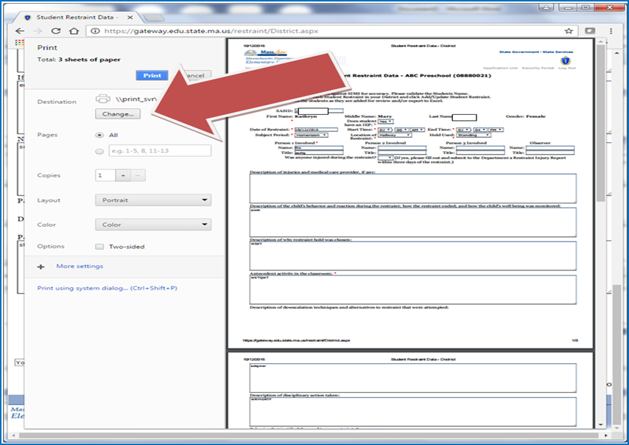
Restraint Data Collection Application User Guide
Optional: If using Google Chrome, the form can be saved to your computer as a PDF.
1) Click print then click “Change” when the following box opens.
2) Click on “Save as PDF.”

Slide 49
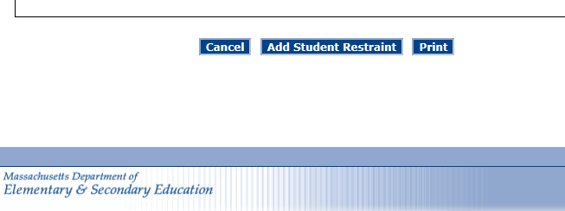
Restraint Data Collection Application User Guide
When you are done printing and/or editing a record make sure to
click
“Add Student Restraint.”
This will save your record to the database.
PLEASE REMEMBER TO DO THIS.
The information will not be saved and recorded if this step is not completed.

Slide 50
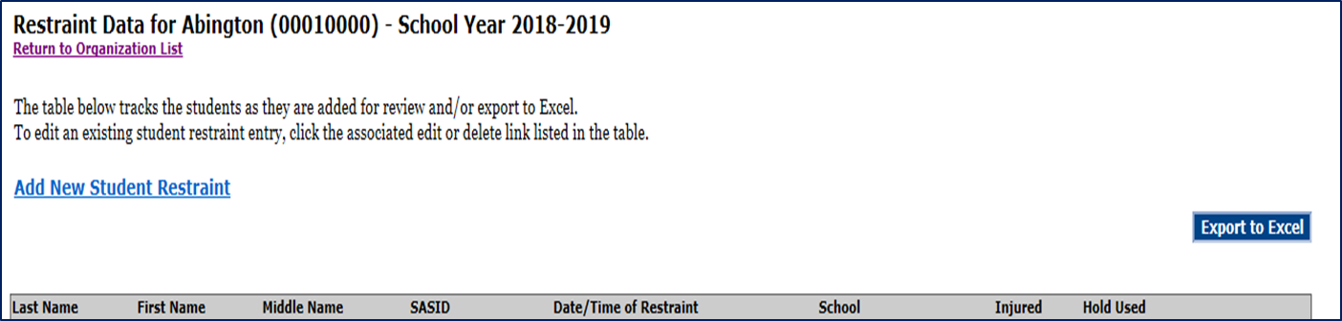
Restraint Data Collection Application User Guide
Saved restraint record data sets can be exported to an Excel spreadsheet. Click “Export to Excel.”
Any questions you can email: restraints@doe.mass.edu
Notes:
NOTE: Data Services checks email daily and addresses technical issues and sends content issues to Joanne. That way we keep track and have all of the information shared on ONE place for consistency.

Slide 51
Highlights of differences of Restraint Regulations for DESE and DEEC
DESE
DEEC
603 CMR 46.00
Report data for school hours only in Security Portal
Report requirements due by June 30, 2019 in Security Portal
Injury notification within 3 working days for ALL injuries to students and staff in portal
606 CMR 3.00
Report data for non-school/ residential hours only in Lead for each program listed.
Report quarterly all restraints and injuries related to restraints in non-school/residential hours only.

Slide 52

“Every child deserves a champion – an adult who will never give up on them, who understands the power of connection and insists that they become the best that they can possibly be.”
-Rita Pierson

Slide 53





THANK YOU
Joanne Morris, DESE Supervisor, Jannelle Roberts, DESE Ed Liaison,
Andrew Eppich, EEC Field Operations Policy Counsel &
Timothy Keane, DEEC Residential and Placement Supervisor
781.338.3738
781.338.3722
413-881-1535
Joanne.Morris@doe.mass.edu
Jannelle.Roberts@doe.mass.edu
Timothy.Keane@mass.gov

