Slide 1
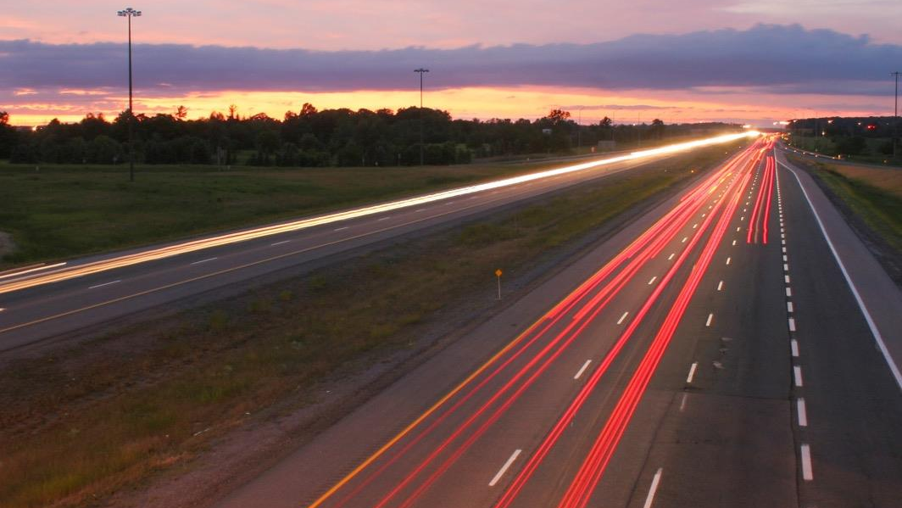
Drive change. Drive electric. campaign
Rachel Ackerman, Senior Manager
June 24, 2019
Notes:
Drive Change. Drive Electric. represents a unique public-private partnership between auto manufacturers and Northeast states to advance consumer awareness, understanding, consideration and adoption of electric cars, including battery electric, plug-in hybrid electric, and fuel cell electric vehicles.
By showcasing to drivers and passengers the convenience, affordability, technology, sustainability and power performance of electric vehicles, Drive Change. Drive Electric. aims to put more electric cars on the road than ever before.
This collaborative campaign includes the following automakers: BMW Group, Fiat Chrysler Automobiles US, Ford Motor Company, General Motors, American Honda Motor Co., Inc., Hyundai Motor America, Jaguar Land Rover Automotive PLC, Kia Motors America, Mazda USA, Mercedes-Benz USA, Mitsubishi Motors, Nissan North America, Subaru of America, Inc., Toyota Motor North America, Volkswagen Group, and Volvo Cars. State partners include: New York, Connecticut, the Commonwealth of Massachusetts, Rhode Island, New Hampshire, Vermont and New Jersey.
Association of Global Automakers, Alliance of Automobile Manufacturers

Slide 2
Drive change. Drive electric. evolution
2016
Automakers and ZEV states retained a professional agency to conduct market research and develop a campaign strategy under two or more budget scenarios.
2017
Campaign partners procured professional agency (Edelman) to activate campaign. Media selection, geographic scope and duration determined by funding and campaign partners.
2018
Raised awareness of and consideration for the adoption of EVs, chiefly measured by clicks to the Drive Change. Drive Electric. website (awareness) and referrals to OEM partner sites (consideration) by digital advertisements.
2019
Destination Electric promotes an EV lifestyle. Showcases experiences at cool, up-and-coming restaurants, cafes, entertainment venues, boutiques, B&Bs, etc. that are within a short distance of charging infrastructure.
Notes:
Phase 1 – 2018
Phase 2 – 2019
OEM = original equipment manufacturer

Slide 3
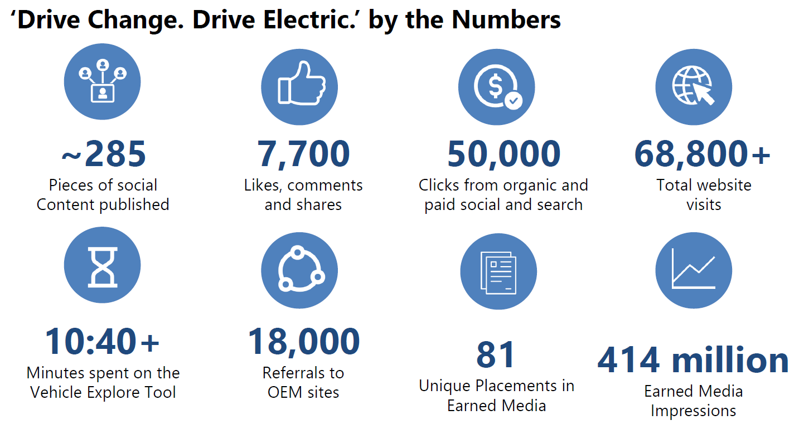
Drive change. Drive electric. 2018 results

Slide 4
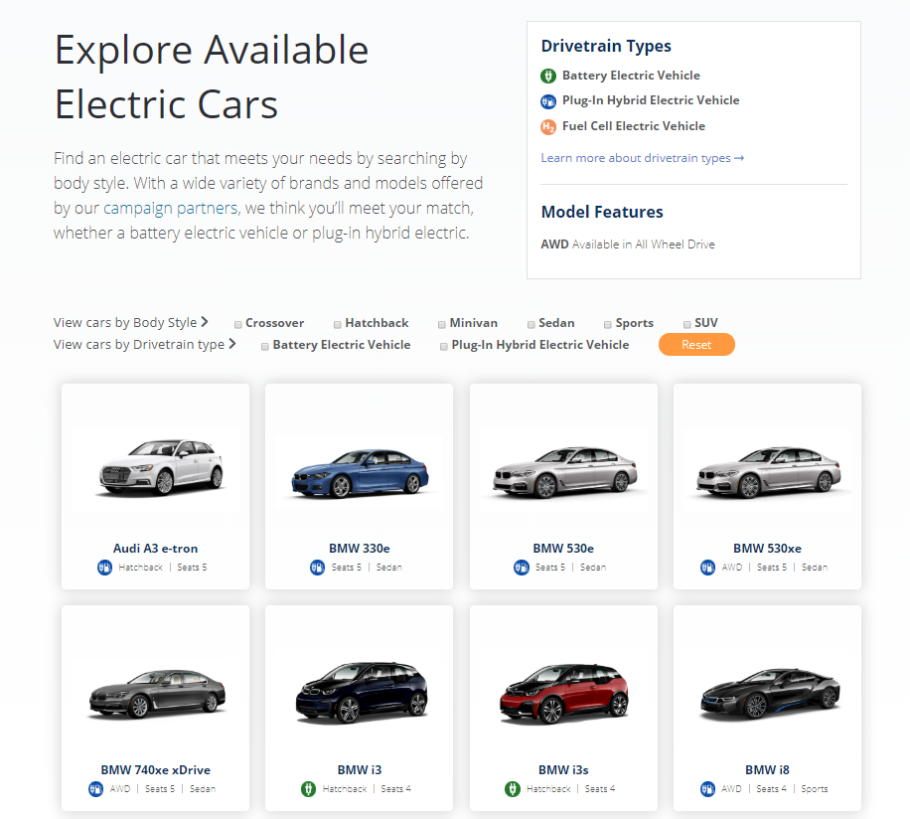
“Explore electric cars” tool was popular on driveelectricus.com
Most popular sub-page on the campaign website with 23K page views
Generated nearly 18K referrals to automotive manufacturer (OEM) websites
Users on average spent over 10 minutes on the Explore Electric Cars page, as compared with 1-2 minutes on the other website pages
Notes:
23% of page traffic was to Explore tool
Time on a webpage varies by site & by audience; on MassCEC’s website visitors this year on average spent 42 seconds on a page

Slide 5
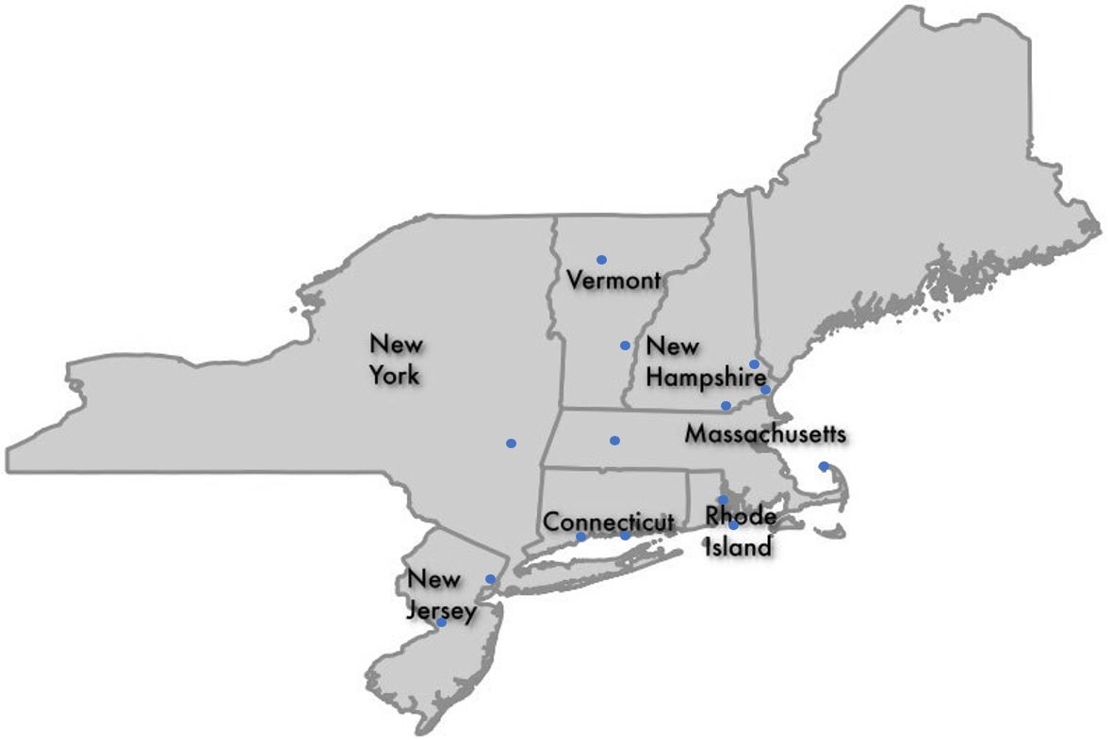
2019: Destination Electric
The Destination Electric campaign showcases to drivers and passengers the convenience, affordability, technology, sustainability and power performance of electric vehicles. Partner states highlight their towns as ideal destinations to travel to in electric vehicles.
Notes:
Campaign Survey findings in early 2019 helped shape Destination Electric:
Availability of charging stations is the number one concern of drivers: 83 percent say there are not currently enough charging locations for electric vehicles but encouragingly, nearly 50 percent have noticed more electric vehicle charging stations in their area over the past year.
There is a real question mark around electric driving distances: 81 percent of Northeast motorists are concerned about the distance you can drive an electric vehicle before needing to re-charge.

Slide 6
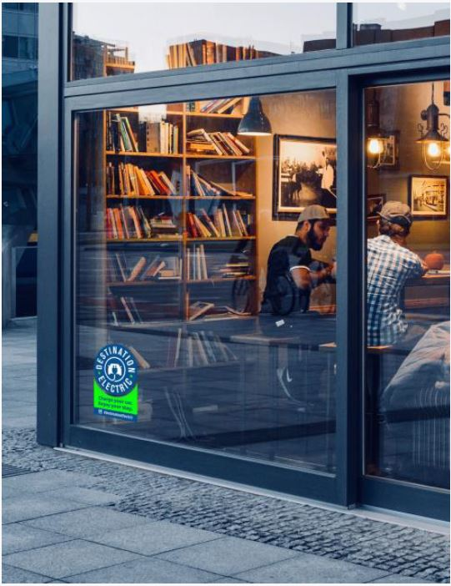
Campaign Materials
Over 115 participating businesses (and counting) received materials to put on display for the campaign.

Slide 7
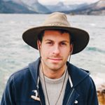
Social Media Business Campaign
Instagram Influencer Zach Houghton, is the face of the Destination Electric campaign.
Between June 7-10, he visited 4 campaign locations in a Honda Clarity PHEV and engaged with 14 participating businesses
Hudson Valley
Portsmouth
White River Junction
Madison
In the coming weeks, Zach will post 3 in-feed (permanent) posts of his travels, which will reach his nearly 300k followers
@zachspassport

Slide 8
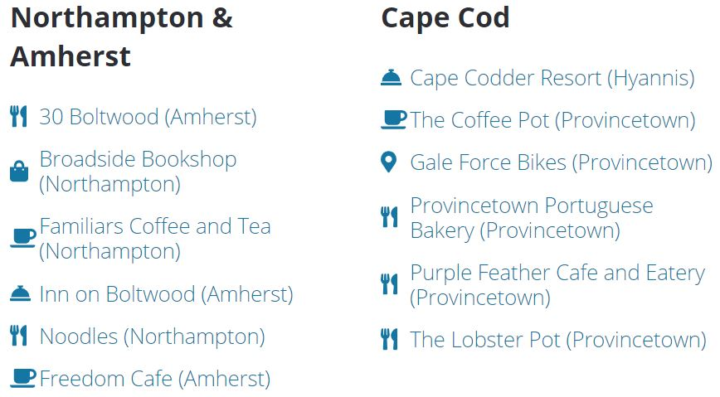
Participating Massachusetts Businesses

Slide 9
Notes:
Encourage everyone in the audience to follow, like, retweet, share, etc.!

