Slide 1
Devens Working Group
Meeting #2
February 25, 2025

Slide 2
Agenda for Today
Agenda (1 Hour)
Welcome & Updates (10 mins)
Sub-group Reports (45 mins)
  Devens Fundamentals (15 mins)
  Discussion (5 mins)
  Community Considerations (10 mins)
  Discussion (5 mins)
  Innovation in Development and Sustainable Housing (5 mins)
  Discussion (5 mins)
Next Steps & Closing Comments (5 mins)

Slide 3
Agenda
Agenda
Welcome & Updates (10 mins)
Sub-group Reports (45 mins)
Next Steps & Closing Comments (5 mins)

Slide 4
Mission and Charge of the Working Group
The Charge (per Section 298 of Chapter 238 of the Acts of 2024)
The secretary of economic development and the secretary of housing and livable communities shall convene a working group that shall include:
representatives from the towns of Ayer, Harvard and Shirley, the Massachusetts Development Finance Agency, the Devens committee and the Devens Enterprise Commission
The working group shall determine a strategy and plan to provide for increased housing production within Devens, including, but not limited to, the feasibility of allowing not more than 400 multi-family residential units in the Innovation and Technology Center zoning district established by Article V(A)(13) of the zoning by-laws of the Devens Regional Enterprise Zone.
EOED and EOHLC shall report the findings of the working group to the Legislature not later than 180 days after the effective date.
Focus on:
  The scope outlined above relative to housing at Devens, including Vicksburg Square
Note, this Working Group is not here to discuss issues or topics beyond this scope outlined by the Legislature. Those topics will be left to the appropriate committees and governing bodies.
Goal: Provide a vision for increasing housing production within Devens

Slide 5
Working Group Members
Devens Working Group
Yvonne Hao, Secretary of Economic Development
Chris Kluchman, Director, HLC Livable Communities Division (Designee for the Executive Office of Housing and Livable Communities)
Navjeet Bal, President and CEO, MassDevelopment
Neil Angus, Director/Land Use Administrator, Devens Enterprise Commission
Laura Scott, Chairperson, Devens Committee
Brian Hildebrant, Select Board Member, Town of Shirley
SusanMary Redinger, Select Board Member, Town of Harvard
Shaun Copeland, Select Board Member, Town of Ayer
We also want to recognize the state legislative delegation:
Senator Jamie Eldridge, Middlesex and Worcester District
Senator John Cronin, Worcester and Middlesex District
Representative Dan Sena, 37th Middlesex District

Slide 6
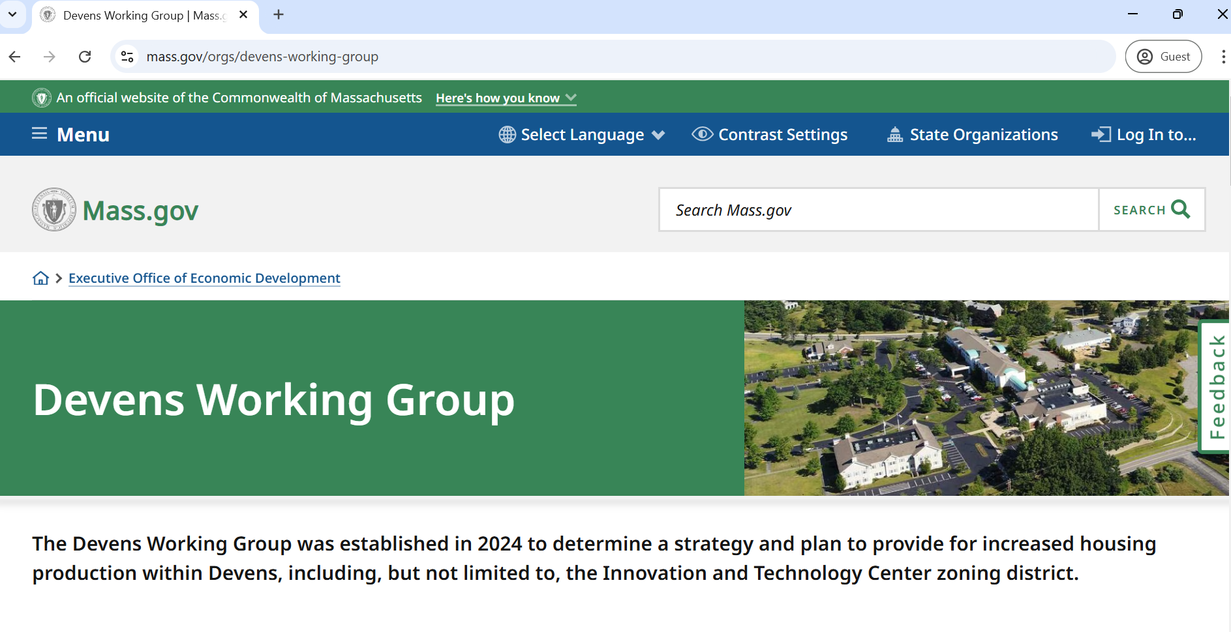
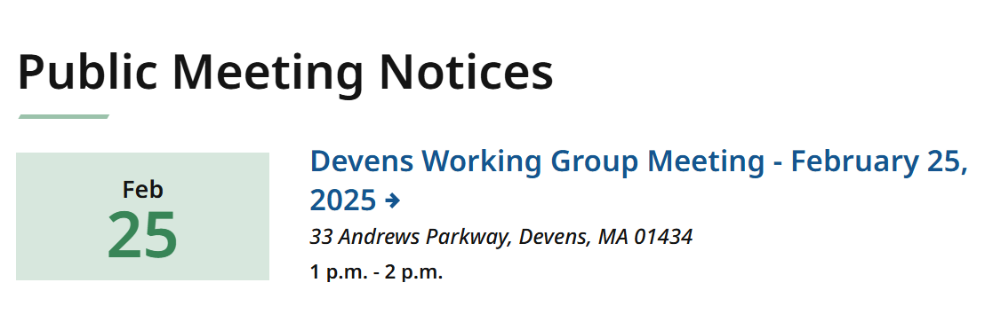
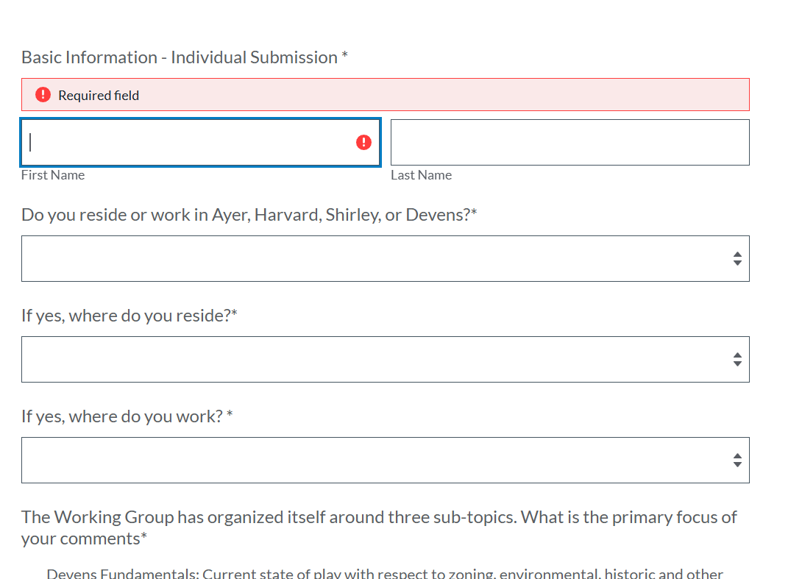
Updates
Devens Working Group Webpage
  Can be accessed at: www.mass.gov/orgs/devens-working-group
  Contains resources on Mass Leads, links to the Devens Enterprise Commission website, and hosts our public meeting notices for this group.
Public Comment Form
  The DWG webpage contains a public comment collection form.
  We are asking members of the public – especially residents of Devens, Ayer, Harvard, and Shirley – to share their thoughts.

Slide 7
Agenda
Agenda
Welcome & Updates (10 mins)
Sub-group Reports (45 mins)
Next Steps & Closing Comments (5 mins

Slide 8
Devens Fundamentals
Current state of play with respect to zoning, environmental, historic and other regulations governing development at Devens.
Captain: Neil Angus, Devens Enterprise Commission

Slide 9
DEVENS HOUSING WORKING GROUP
DEVENS FUNDAMENTALS: Current state of play with respect to zoning, environmental, historic, and other regulations governing development at Devens.
Devens Fundamentals Group participants:
Rep. Danilo Sena – Legislative
Melissa Fetterhoff – Business Community
Duncan Chapman – Real Estate/DEC
Peter Lowitt – Retired DEC Director/Planner
Patrick Hughes – Net Zero Building Consultant - Ayer
Regina Todd – Devens Resident
Lorena Novak – United Native American Cultural Center
Kara Fossey – Devens Museum
Danny Ruiz – Ayer Town Planner
Mark Archambault – Shirley Town Planner
Dan Nason – Town Administrator, Town of Harvard
Robert Pontbriand – Town Manager, Town of Ayer
Bryan Sawyer – Town Administrator, Town of Shirley
Beth Suedmeyer – DEC Planner
Neil Angus – DEC Director
Meg Delorier – Interim EVP Devens Ops./MassDev.
Chris Kluchman – Director, Livable Communities, EOHLC

Slide 10
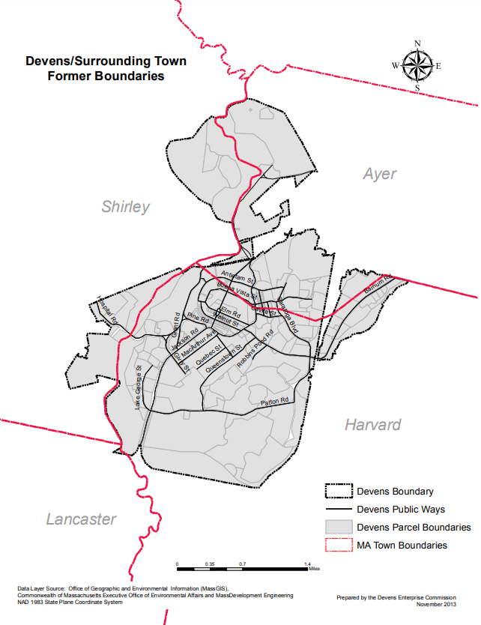
Overview
Regional Context and Housing
Foundational Documents
ITC Overview & Supporting Info.
Surrounding Land Uses
Additional Regulatory Considerations
Other Relevant Background

Slide 11
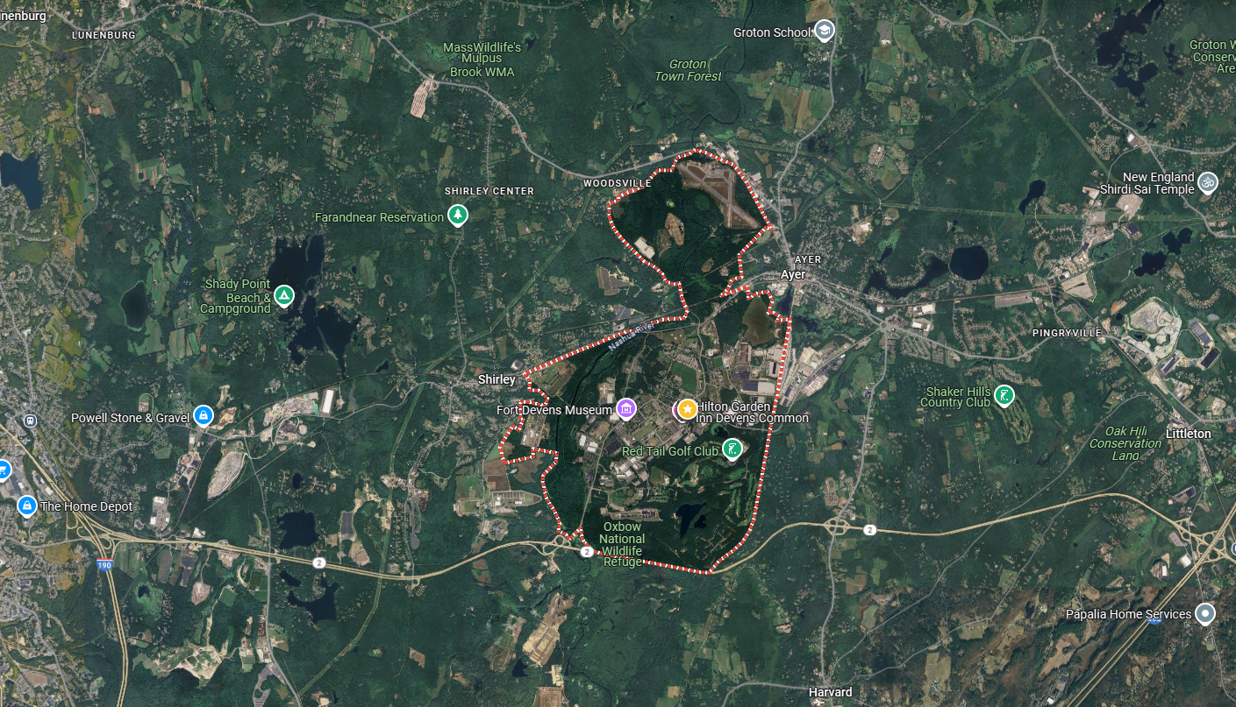
Regional Context:
35 mi. - Boston, 5 mi - Leominster
Ayer, Harvard, Shirley
Route 2, 2A and I-495, MBTA, CSX
MART Shuttle Service Area
ITC – Core of Devens

Slide 12
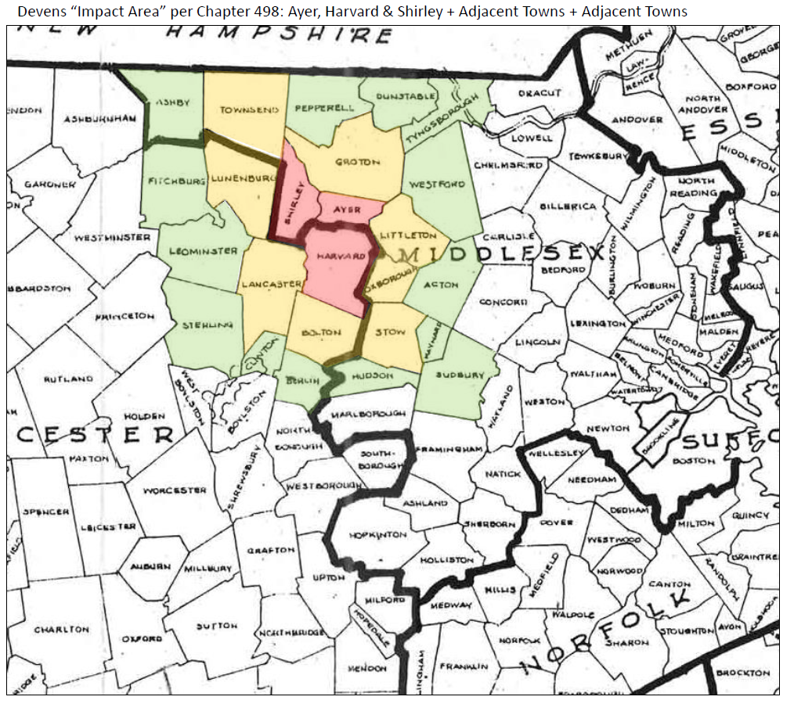
Devens Region:
As per Ch. 498

Slide 13
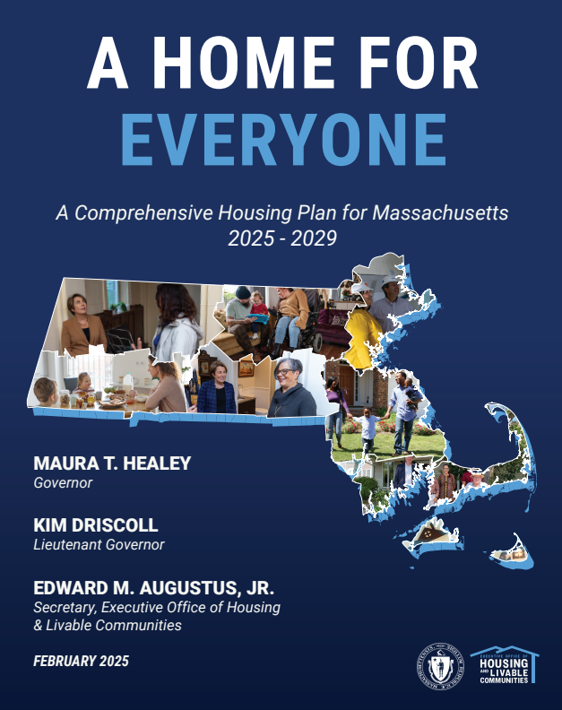
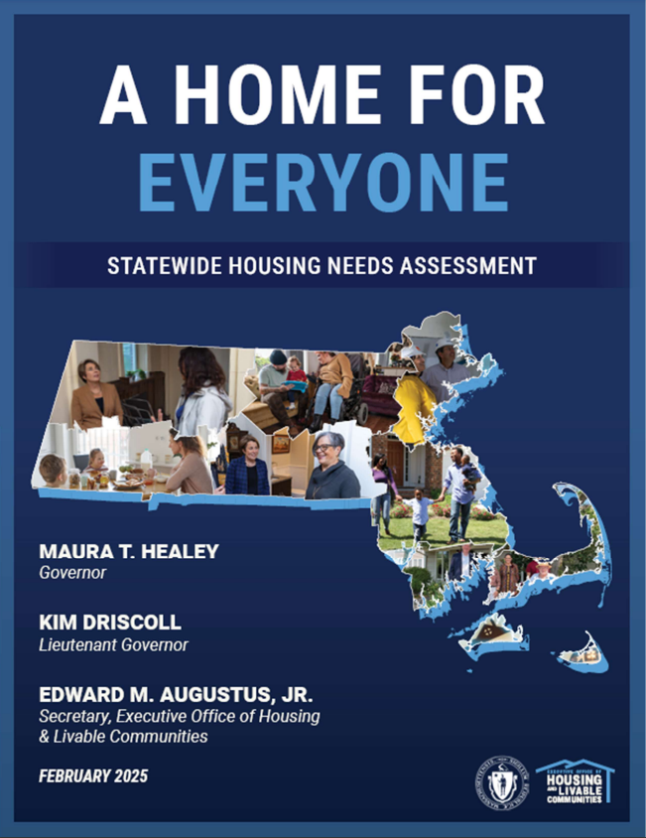
State Housing Needs and Plan:
MA Comprehensive Housing Plan (2025)
MA Statewide Housing Needs Assessment (2025)

Slide 14
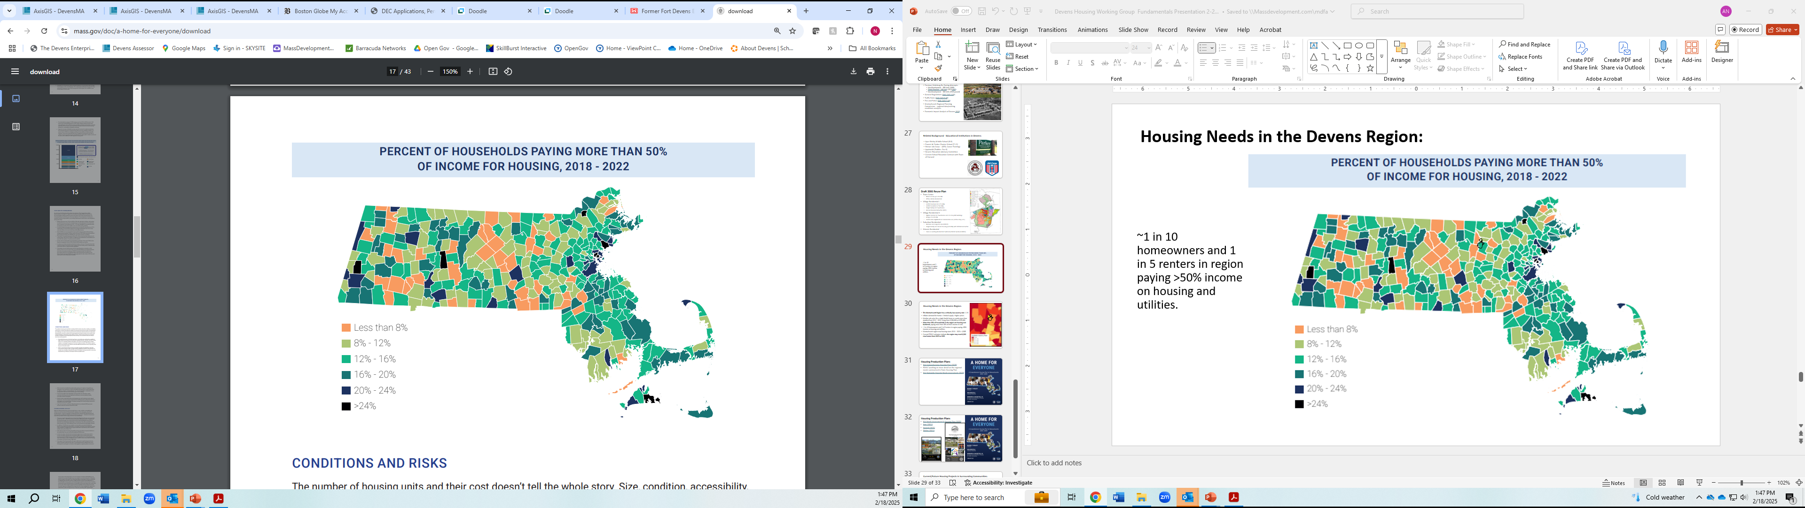
Housing Needs in the Devens Region:
10% of homeowners and 20% of renters in region paying >50% income on housing and utilities.
30% of households in the region are housing cost burdened, paying more than 30% of their income in rent.

Slide 15
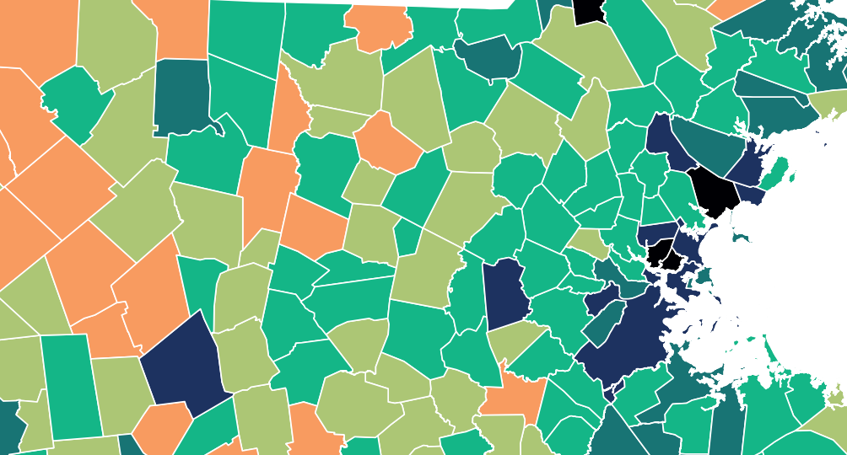
Housing Needs in the Devens Region:
~10% of homeowners and 20% of renters in region paying >50% income on housing and utilities.
30% of households in the region are housing cost burdened, paying more than 30% of their income in rent
(>50% = severely cost burdened
>30% is cost burdened)

Slide 16
Housing Needs in the Devens Region:
The Montachusett Region has a critically low vacancy rate: 1.1%
Inflates demand for homes + limited supply = higher prices.
Median sale price for a single family home or condo more than doubled from 2012 –2023, rising from $158,000 to $375,000.
Montachusett region new housing starts 2013 – 2023 = 3,505
Current EOHLC estimates indicate the region may need 6,300 new homes from 2025 to 2035.

Slide 17
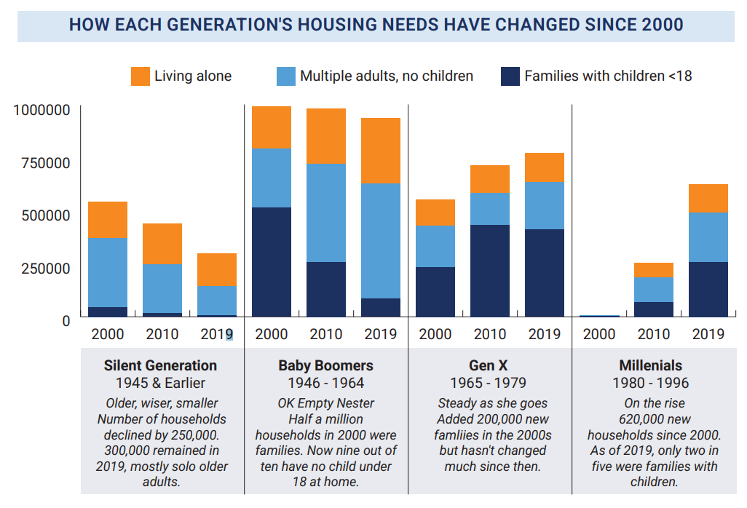
State Housing Needs and Plan:
Strategies to Create a Competing and Growing Massachusetts
  222,000 homes needed 2025-2030
  Diversity of housing types and levels of affordability
  Protection of existing housing stock
  Mix of rental and ownership
  Flexible financing and funding options
  Lower cost-burden
  Collaboration
  Considerations:
  Changing demographics
  Ability to age-in-place
  Supporting infrastructure
  Building in the right places
https://www.mass.gov/doc/a-home-for-everyone/download

Slide 18
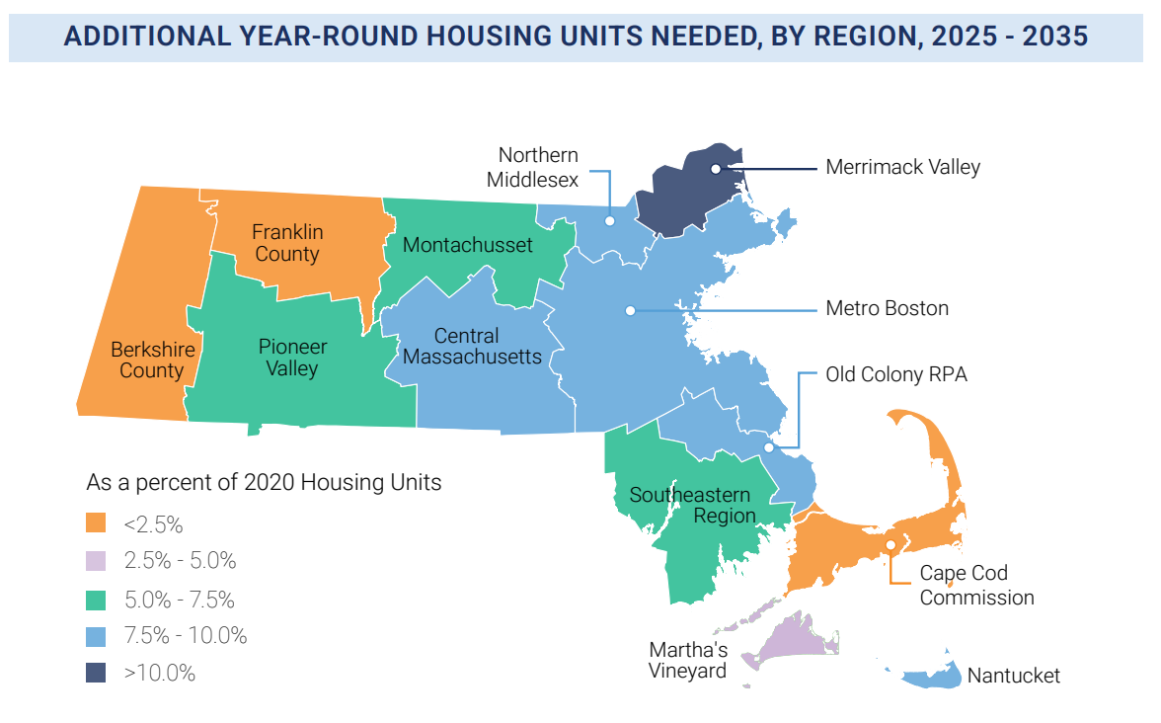
Housing Needs in the Devens Region:
Coming soon: more detail on the regional needs summarized in State Housing Plan

Slide 19
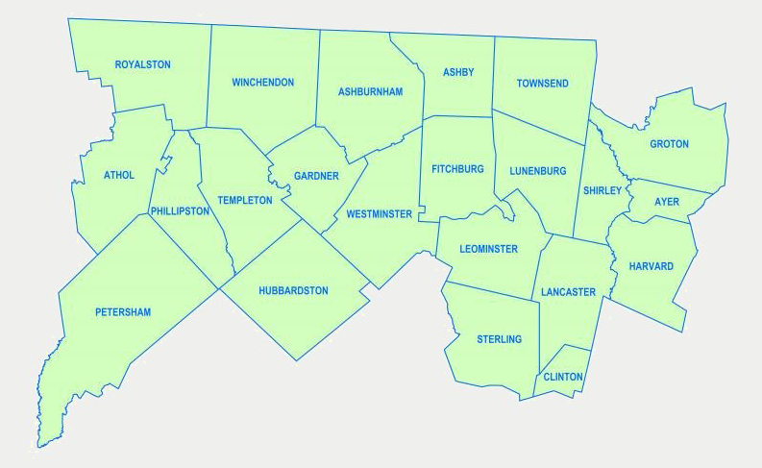
MRPC Region:

Slide 20
Regional Context: Current Conditions
 | DEVENS | AYER | HARVARD | SHIRLEY
Area (mi²) | 6.8 | 9.6 | 26.4 | 15.9
Population (2022) | 1,763 | 8,408 | 6,881 | 6,851
Median Household Income (2022) | $106,875 | $101,688 | 200,688 | 121,875
Employment Rate | 99.41 | 95.32 | 94.61 | 91.45
Workforce (2022) (#of Employees) | 6,092* | 4,907 | 2,804 | 1,853
Housing Units (2023) | 256** | 3,616 | 2,229 | 2,404
Subsidized Housing Inventory (SHI): % of total 2020 year-round housing units | 37.5*** | 5.97 | 4.91 | 4.09
Persons/household | 2.5 | 2.25 | 2.89 | 2.39
Sources:
EOHLC SHI Inventory 2023
Housing Units: ACS 2023 5-Year data
* UMass Donahue Report 2020
** Devens actual # of housing units in 2024
*** Devens % of SHI qualifying units out of 256 units total in Devens
Employment Rates
Workforce: Data USA

Slide 21
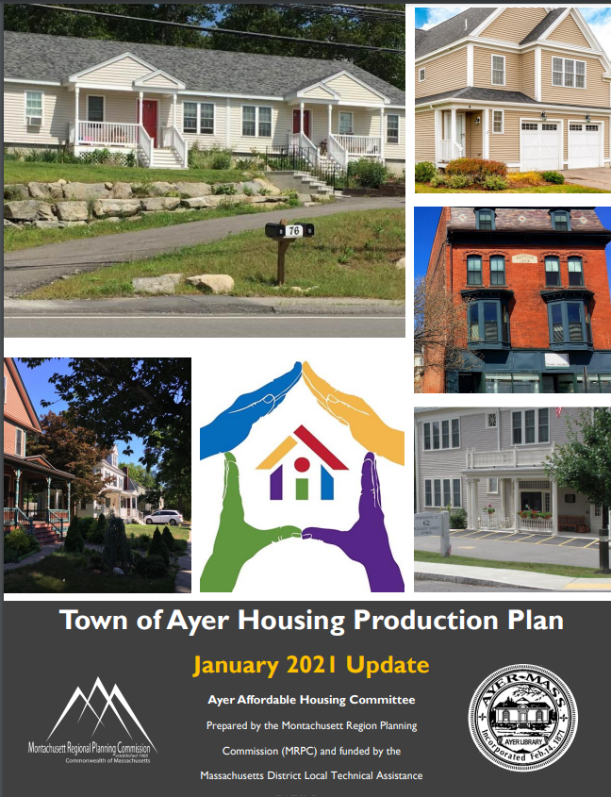
Local Housing Production Plans
Ayer (2021)
Ayer Junction – railroad heritage
Changing demographics
More diverse housing options
Inclusionary housing bylaw
Support mixed use and high density downtown
Cluster development

Slide 22
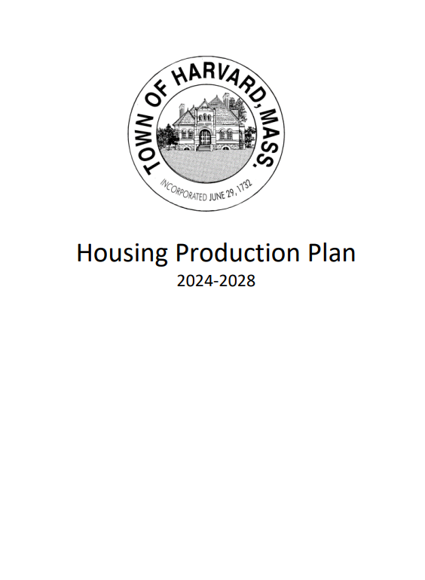
Local Housing Production Plans
Havard (2024)
Aging population/population decline
Housing assistance/affordability
Diversity of housing stock (86% single family)
Regional Partnerships/collaboration
Regulation amendments to support housing needs
Financial Incentives
Explore raising the Devens housing cap
Utility/Service limitations/opportunities
Community outreach

Slide 23
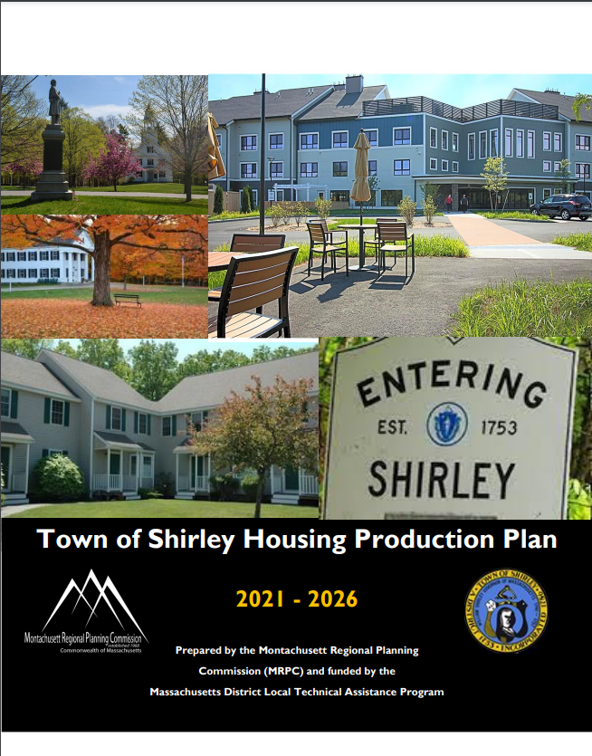
Local Housing Production Plans
Shirley (2021)
Changing demographics
Diversity of housing stock
Smart growth development
Maintaining and increasing affordability
Balance housing needs with rural character
Planning and Zoning support to facilitate growth

Slide 24
Current Housing Projects in Surrounding Communities:
Ayer | Havard | Shirley | Devens
Stratton Hill: 34 units (17 duplex) | 203 Ayer Road Village - TBD | Village at Shirley Station - 48 units (24 duplex). | Emerson Green: 72 units (46 apartment, 8 MF, 18 SF)
Lincoln Hills: 55 units (3 SF, 7Duplex, 7 triplex, 3 quad, 1 -5 unit) | Craftsman Village – 20 Units (cottage) | Parker Village - 40B proposal - 48 units. | Shirley Meadows: 62 units (senior housing)
65 Fitchburg Road: 106 units (mix of 1,2 and 3br) | Pine Hill Village – 24 Units (mix single and duplex)
201 West Main Street: TBD | Village at Robin Lane – 24 units (12 duplex)
210 West Main Street Plaza: TBD
TOTAL # OF UNITS: 195 | 68 | 96 | 134
493 UNITS TOTAL
Current EOHLC estimates indicate the region may need 6,300 new homes from 2025 to 2035

Slide 25
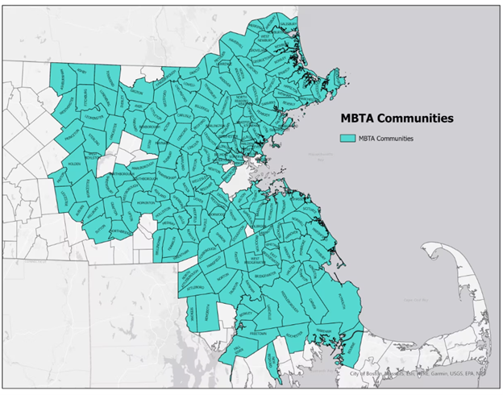
MBTA Communities Act Impact on Housing:
https://www.mass.gov/info-details/mbta-communities-law-qa
Zoned Capacity vs. Market realities
Actual impact on housing starts will vary
Increased housing supply and diversity of housing types
More affordable options

Slide 26

Foundational Documents
Devens Final Environmental Impact Report
      Vehicle trips per day
      Water use
      Water withdrawal
      Wastewater generation
      Water and sewer mains
      Acres of Altered Land
      Acres of Impervious
      Wetland Impacts
Chapter 498 of the Acts of 1993
Devens Reuse Plan (Development Goals for ITC, Open Space, Residential, Historic)
Devens Bylaws – Permitted Uses, Dimensional Requirements, Innovative Dev., Reuse
DEC Development Rules and Regulations (Site Plan, Residential, Historic, SWM, IPS, traffic)

Slide 27
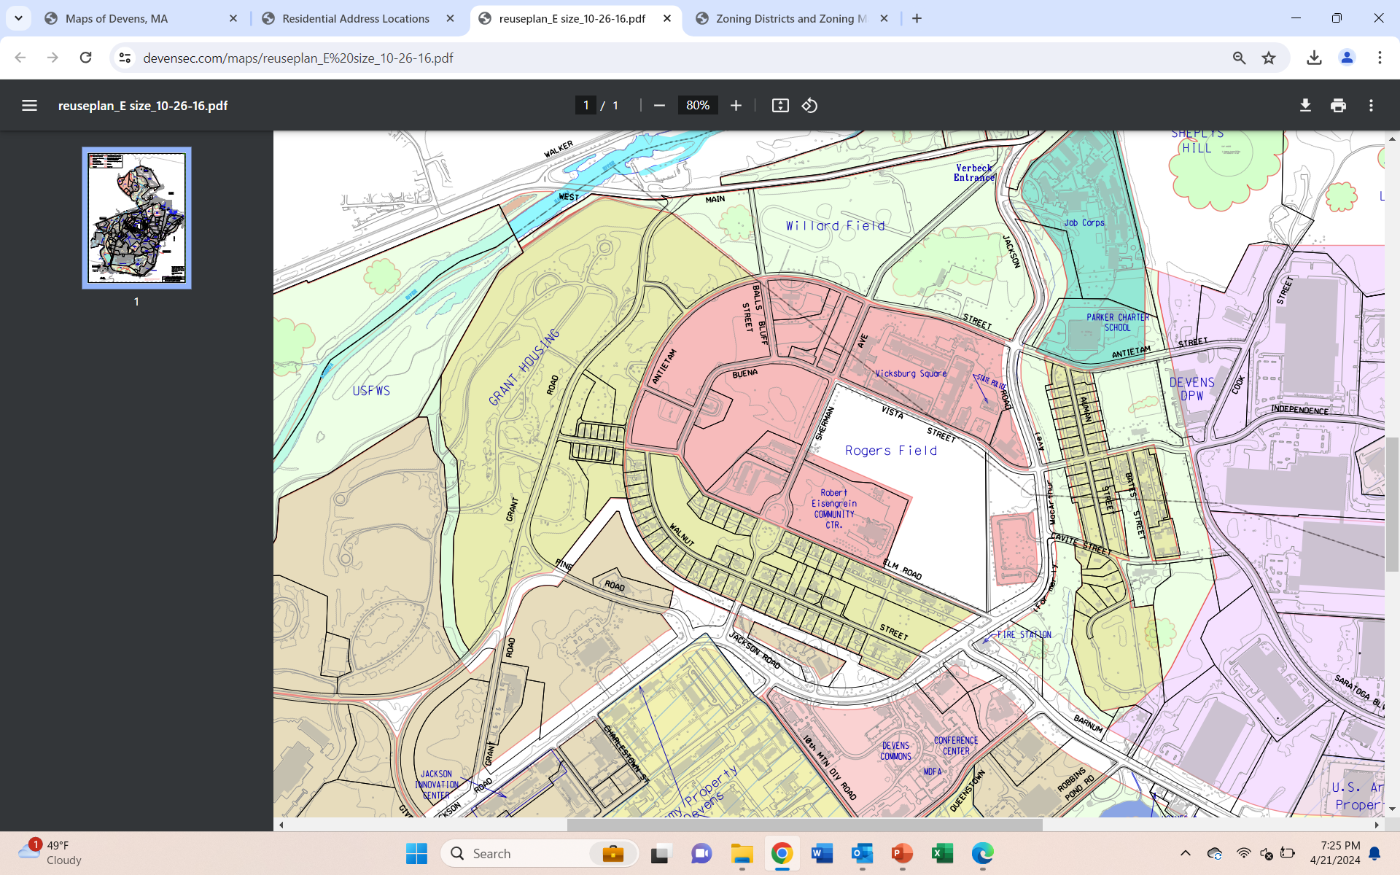
Innovation and Technology Center District
~86 acres
26 ac. in Ayer
60 ac. In Havard
Current Development Goals:
Urban center
Incubator business
Historic buildings & open space (unique)
Flexibility to accommodate a wide range of uses
Academic/educational support links for DREZ
Allowed Uses: Educational, Office, LI, R&D, Cultural, Conference, Municipal, Small-scale retail
Max. Building Height: 50-62’
Innovation & Technology Center Design Guidelines
Ayer (Middlesex County)
Harvard (Worcester County)
~3.7 ac.

Slide 28
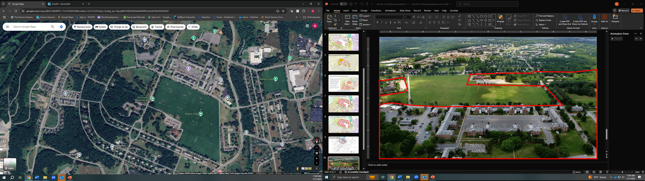

Slide 29
Devens Historic District &
Water Resource Protection
Related Regulations/Policies:
Historic District – Vicksburg Square Preservation Plan
Army Programmatic Agreement/MHC (alt., remediation)
Water Resources Protection Plan
Stormwater Pollution Prevention Plan

Slide 30
Devens Historic District:
Areas of Significance
Former Post Commander’s House and treed allée to Flagpole
Flagpole and Warrior Memorial
Foreman Garden (first commander)
Review Stand and Hornet Field
Rogers Field
Sweetheart Memorial
Corregidor Theater
Vicksburg Square
Former Firehouse and Guardhouse
The Freedom Tree (POW/MIA)
Post Headquarters/Foreman Hall
Radio, Telephone, Telegraph Bldg.
Post Hospital (Admin Building)
13
10
9
12
11
8
3
4
6
1
7
2
5
Additional Resources:
Monument Guide
Devens Museum
Walk Devens

Slide 31
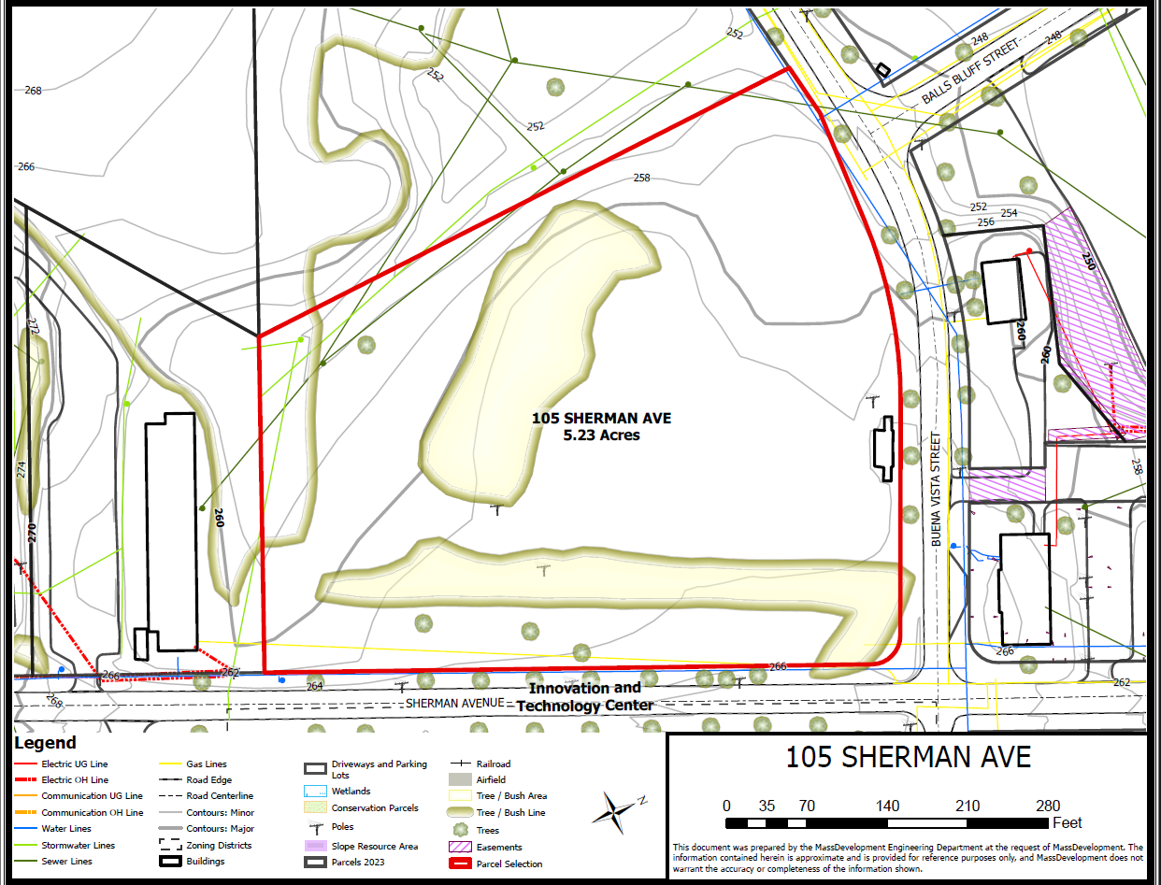
Existing Parcel Mapping:
Existing Conditions
Easements
Utilities
Topography
Land Cover

Slide 32
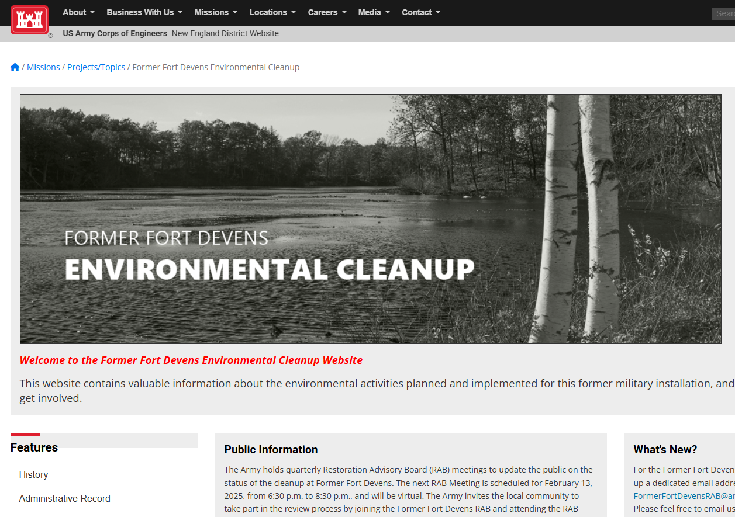
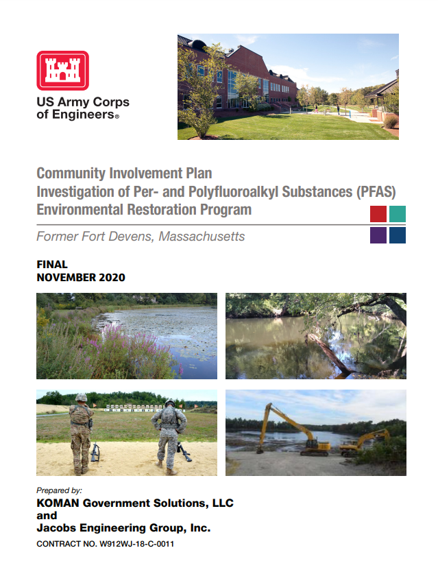
Environmental:
Abatement of Buildings –MassDev Responsibility
Legacy contamination of sites – Army Responsibility
Fort Devens Clean-Up
USACE Community Involvement Plan
Condition of Existing Buildings:
  Vicksburg Square
    Structural/Architectural - 2017
    Hazardous Materials - 2017
  BOQ’s
    Adaptive Reuse Study - 2010
Updated Studies Needed
Army Programmatic Agreement
Wetlands (974 CMR 4.06)
Devens Soil Management Policy

Slide 33
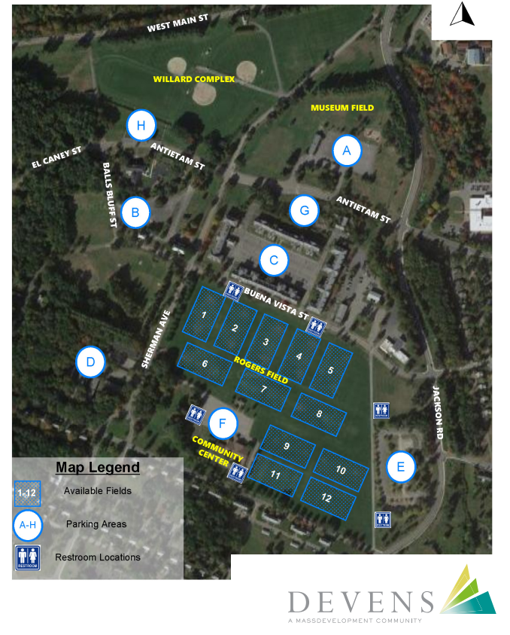
Parking/Traffic:
Devens Parking Maximums
Parking Demand/Shared Parking
Recent Traffic Counts (2020)
2021 Count: 20,562 VPD (FEIR limit 50,585)
Upcoming Traffic Counts (spring 2025)
Current Recreational Activities
Transportation Demand Management (TDM)
MART Shuttle Services:
  Shirley & Ayer MBTA On-Demand
  Leominster/Fitchburg On-Demand
  Boston Hospitals
  Alewife-Devens
  Shirely Meadows-Ayer

Slide 34
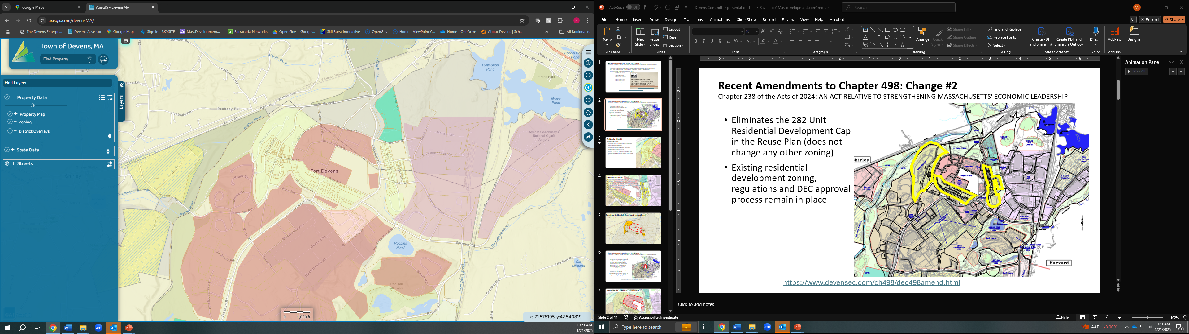
Current Residential Development Goals
Surrounding Land Uses:
Create housing that:
Is compatible with adjacent residential areas.
Accommodates variety of household types, sizes, and income levels.
Serves those who live/work in Devens region
Is sustainable
Preserve OS, trails, community amenities.
integrates system of roads and utilities.
To preserve mature trees, street trees, wooded areas and existing topography, and
Minimizes impact on natural areas

Slide 35
Residential I District
Surrounding Land Uses:
Development Goals:
Evolution of new residential neighborhood
Additional housing types
Innovative Residential Development Options
Demolition of housing stock, as needed
Max Building Height: 45- 56’
Density ~3-5/8-12 UPA + min 7UPA for IRD
Compatibility with adjacent land uses/visual impacts
Mix of Housing types key
Shirley Meadows:
58 existing units of deeply affordable age-restricted rental units – zoned for 62 additional age-restricted units

Slide 36
Residential II District
Reuse of the existing historic housing and new infill
Housing and accessory home-based businesses
Compatibility with adjacent land uses/visual impacts
Parking (garage master plan, carport driveway expansion
Max Building Height: 45- 56’
Historic compatibility
Density ~3-5/8-12 UPA

Slide 37
Surrounding Land Uses:
Open Space and Recreation
Active and passive uses/trail connections
Proximity to residential (health/wellness)
Green Infrastructure connectivity
Preserve vistas of Rogers Field
Related Regulations/Policies:
Devens OSRP (incl. Main Post Trails Plan)
Green and Complete Streets Policy
Green Infrastructure Guidelines

Slide 38
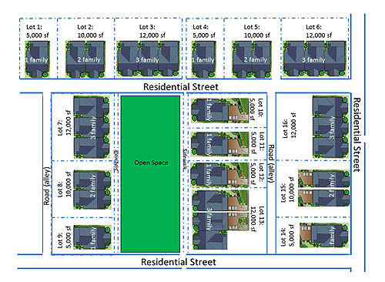
Additional Regulatory Considerations - Innovative Development Bylaws:
Innovative Development Options – Devens Bylaws Article III.F.
Encourage innovative development strategies, including site design and clustering techniques, higher densities
Can include zero (0) lot line requirements
Relief from dimensional requirements of By-Laws
Special frontage, set back requirements
Differentiate between large (>25ac.) and small (<25ac.) developments
Compatibility and sensitivity to existing conditions and adjacent uses (screening, visual impact on abutting users)
Public health and safety
Preservation of open space, minimize environmental disruption, more efficient services
Reuse of Existing Buildings
Example: Grant Road IRD Regulations: Cluster dev/mix of housing types in exchange for Energy Efficiency (LEED ND model) – min 7UPA, 15% MF, WE, EE, Low VOC

Slide 39
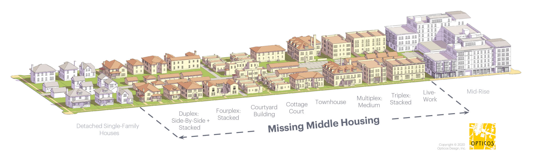
Additional Regulatory Considerations – Innovative & Affordable Housing:
25% reserved for low and moderate income individuals or families, and/or special needs populations.
Low-Income = households earning 80% or less of AMI
Moderate-income = households earning 120% or less of AMI (see guidelines)
Boston AMI – uniformity/consistency across DREZ
RD requires min. of 10% Low-income and 15% be moderate-income
Balance between market rate and mix of affordable
Diversity of housing types
Current market-rates are unaffordable due to increased demand and lack of supply of missing middle housing types

Slide 40
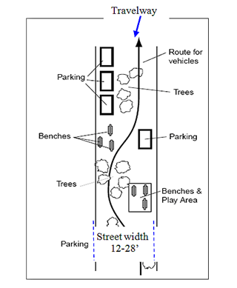
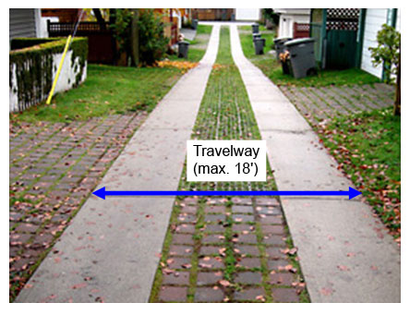
Additional Regulatory Considerations:
Innovative Street typologies (974 CMR 2.07)
Dark-Sky lighting (974 CMR 3.04)
Low-Impact Development Requirements (974 CMR 3.04/4.08)
Tree Preservation – Historic, beauty, public health [974 CMR 3.04(8)]
Native Landscaping Requirements [974 CMR 3.04(8)]
Renewable Energy Reg. and Incentives (974 CMR 4.10)
Greenhouse Gas Mitigation Regulations (974 CMR 4.11)

Slide 41



Additional Planning Considerations
Sustainable Redevelopment Initiatives:
Devens Forward Climate Action Plan
Embodied Carbon Reduction Guidelines
Green Building Incentive Grants
USGBC LEED for Cities and Communities Certified
Eco-Industrial/Devens Eco-Efficiency Center
Healthy Communities Proclamation (active/accessible design)
Biometric Research – designing neighborhoods for people first

Slide 42

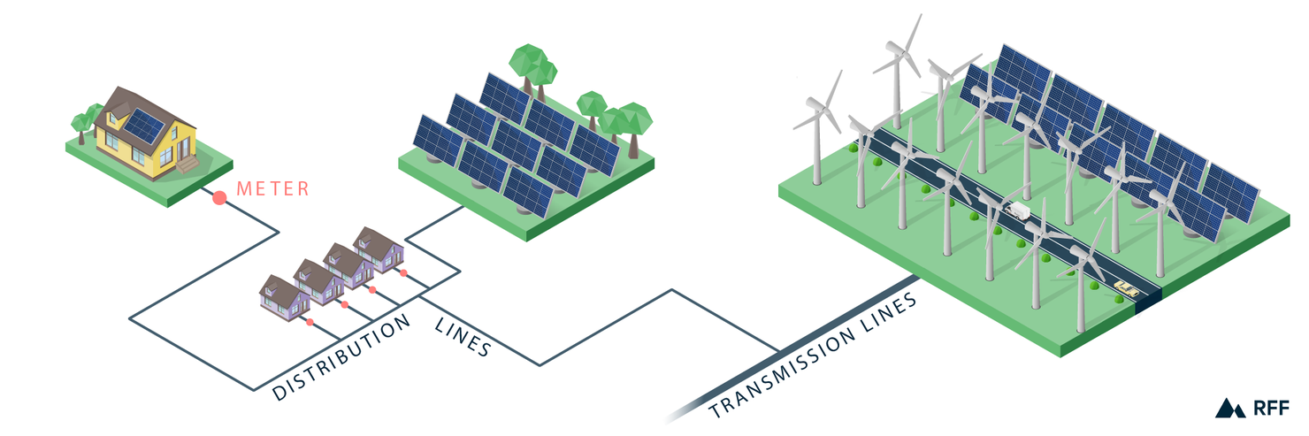
Related Background – Utility & Infrastructure Services:
Water, sewer, gas, electric managed by Devens Utilities (Municipal Utility)
Renewable Energy – Net Metering (Res) DG – Load Reducing (Commercial)
Contribute to 2030 goal of 50% carbon-free energy and 2050 goal of 100%.
Capacity to accommodate utilities and RE for future res. growth
May require infrastructure upgrades depending on location
Devens DPW – managing and maintaining roads, SWM systems, open space

Slide 43

Related background - Devens Social Services and Healthcare:
Tara Vista Behavioral Health Center (co-occurring disorders)
Aspire Adult Daycare
Forge Health (mental health, substance and trauma treatment)
Applebury Behavior Associates (autism testing and therapy)
Clear Path for Veterans (veterans training, support & services)
Loaves and Fishes Food Pantry
Transitions Women's Shelter
Devens Community Center
Senior Services important consideration with aging population
Closure of Nashoba Valley Medical Center an important factor

Slide 44



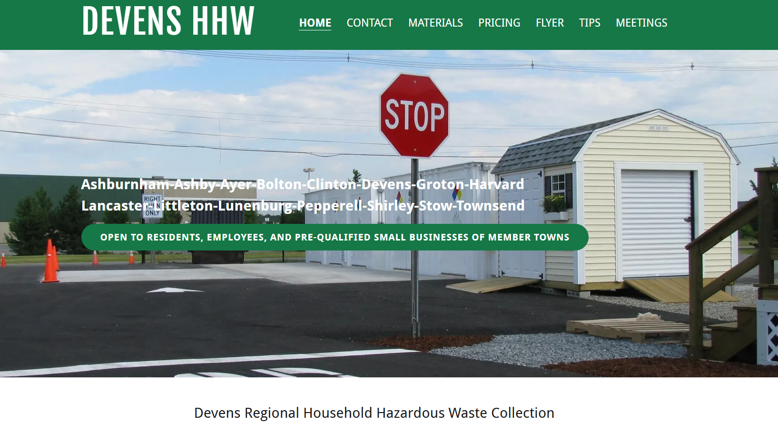
Related Background - Devens Emergency & Regional Services:
Devens Fire Department
State Police
Regional 911 Dispatch
Devens Public Works
  Recycling Drop-Off
  Yard Waste Pick-up
  No municipal waste collection services
Regional Household Hazardous Products Collection Facility

Slide 45
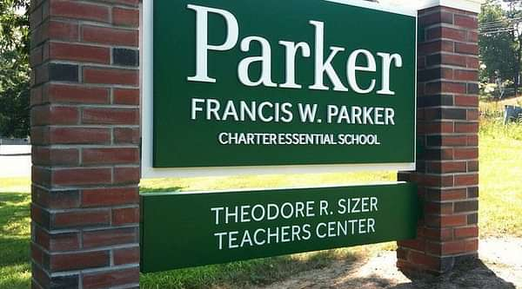


Related Background - Educational Institutions in Devens:
  Ayer-Shirley Middle School (6-8)
  Francis W. Parker Charter School (7-12)
  Shriver Job Corps – (GED, Career Training)
  Applewild (Toddler- Pre-K)
  Devens Education Advisory Committee
  Current School Education Contract with Town of Harvard

Slide 46
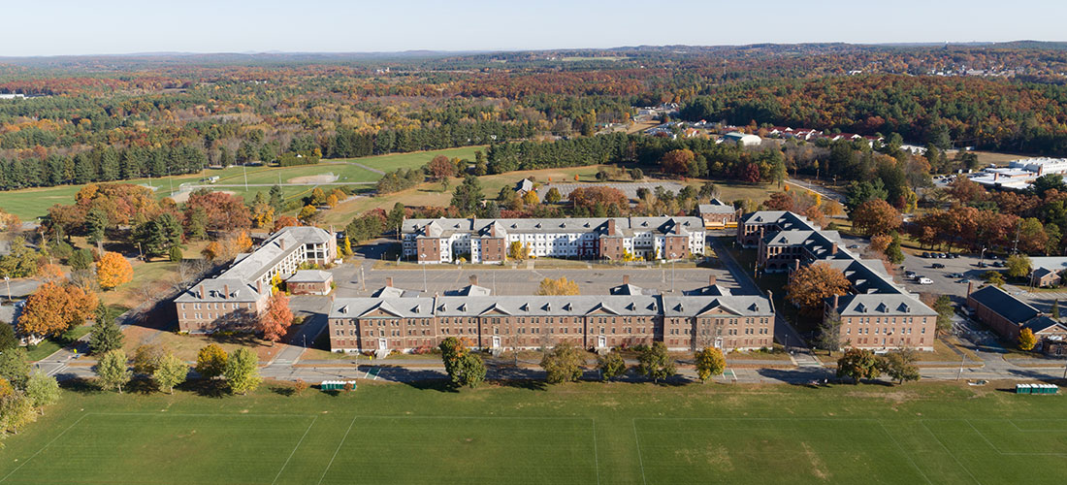
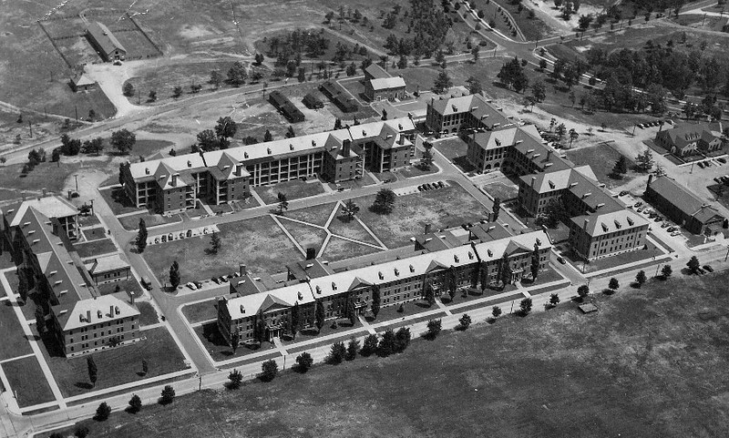
Related Background - Other Relevant Resources:
Previous Vicksburg Re-Zoning Attempts:
  MassDevelopment – 350 Units (2009)
  Trinity Financial – 246 Units (2012) FAQ’s
  MassDevelopment – 300 Units (2018 paused)
General Regulations (946 CMR 4.00)
Traffic Rules (946 CMR 5.00)
Fire and Police (946 CMR 7.00)
Montachusett Regional Planning Commission – regional data/existing conditions analyses
Economic impact Analysis of Devens 2020

Slide 47
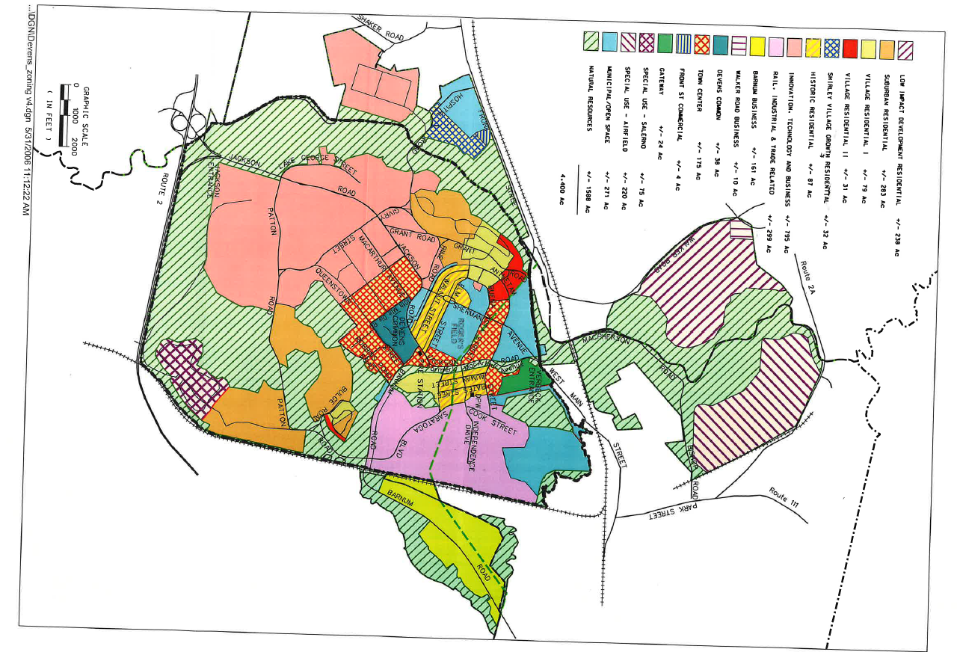
Draft 2006 Reuse Plan
Town Center
  Mixed use & up to 24 UPA
  Office, Retail, Residential
Village Residential I
  6,000sf medium lots (~6 UPA)
  4,000sf small lots (~14 UPA)
  Single family and townhomes
  Historic Residential buffer (100’)
Village Residential II
  Higher density for Townhomes and 3.5 story MF buildings
  Range of 6-24 UPA
  Small-scale neighborhood commercial uses (coffee shop, etc.)
Suburban Residential
  Medium and Large lots (6-8,000sft)
  Single Family and cluster housing (4-8 UPA) with 100’Historic buffer
Historic Residential
  Same as existing Residential 2 (Historic) District (include BOQ’s)

Slide 48
DEVENS HOUSING WORKING GROUP
DEVENS FUNDAMENTALS: Current state of play with respect to zoning, environmental, historic, and other regulations governing development at Devens.
Devens Fundamentals Group participants:
Rep. Danilo Sena – Legislative
Melissa Fetterhoff – Business Community
Duncan Chapman – Real Estate/DEC
Peter Lowitt – Retired DEC Director/Planner
Patrick Hughes – Net Zero Building Consultant - Ayer
Regina Todd – Devens Resident
Lorena Novak – United Native American Cultural Center
Kara Fossey – Devens Museum
Danny Ruiz – Ayer Town Planner
Mark Archambault – Shirley Town Planner
Dan Nason – Town Administrator, Town of Harvard
Robert Pontbriand – Town Manager, Town of Ayer
Bryan Sawyer – Town Administrator, Town of Shirley
Beth Suedmeyer – DEC Planner
Neil Angus – DEC Director
Meg Delorier – Interim EVP Devens Ops./MassDev.
Chris Kluchman – Director, Livable Communities, EOHLC

Slide 49
Community Considerations
Impact on and opportunities for Devens and the surrounding communities.
Captain: Laura Scott, Devens Committee

Slide 50
Innovation in Development and Sustainable Housing
Explore opportunities for Devens to be a leader in producing housing that meets the needs of the community, and that is consistent with the Devens’ commitment to sustainability.
Captain: Chris Kluchman, EOHLC

Slide 51
Agenda
Agenda
Welcome & Updates (10 mins)
Sub-group Reports (45 mins)
Next Steps & Closing Comments (5 mins

Slide 52
Next Steps
Next Meeting:
April 1st at 2:00 pm
Any last thoughts or questions?

