Slide 1
Devens Housing Production Working Group Meeting #4
May 8, 2025

Slide 2
Agenda for Today
Agenda
Welcome
General Updates
Presentation of Revised Draft Report
Discussion
Next Steps and Closing Comments

Slide 3
Devens Working Group Goal and Charge
Per Section 298 of Chapter 238 of the Acts of 2024
Charge: Submit a report to the legislature that will determine a strategy and plan to provide for increased housing production within the Innovation and Technology Center zoning district in Devens.
The report is due May 18, 2025.
GOAL: Provide a vision for increasing housing production within Devens.

Slide 4
General Updates
Devens Working Group Webpage
All public comments and letters received throughout the Working Group’s deliberations have been uploaded and can be viewed
The latest draft of the report has been uploaded
Access page at: www.mass.gov/orgs/devens-working-group
Contains resources on Mass Leads, links to the Devens Enterprise Commission website, and hosts our public meeting notices for this group.
The Public Comment Period has Concluded
Members of the public have been invited to participate and discuss at all DWG Meetings to date
The Working Group collected written public comments from February 25th until April 28th
We received 11 submissions in total:
7 public comments from residents
6 Devens residents
1 Ayer resident
4 letters from 3 municipalities (Ayer, Harvard x2, Shirley)
The Working Group Has 1 Meeting before the May 18th Report Deadline
Final Meeting: May 14th at 1:00pm via Zoom

Slide 5
Revised Draft Report
Key Updates and Additions

Slide 6
Regional Housing Context
Regional Housing Context:
A new section detailing the housing crisis in the Montachusett region was added, highlighting:
1.1% vacancy rate (critically low)
Median home prices more than doubled (2012–2023)
Projected need for 6,400 new homes by 2035
Significant cost burdens on renters and homeowners

Slide 7
Public Comments and Select Board Letters
Public Comments and Select Board Letters:
A new Appendix B summarizes all the public input that was received, including letters from Ayer, Harvard, and Shirley.
The final report will include copies of all public comments and letters received, in the appendix.

Slide 8
Draft Zoning Amendment Language
Draft Zoning Amendment Language:
The initial draft had a general recommendation to include a zoning amendment; no draft language was provided.
Appendix C contains a red-line proposed zoning bylaw changes, including:
Removing outdated references to the 282-unit cap, to reflect elimination of the cap by the Mass Leads Act
Permitting residential uses in the ITC District
Clarifying definitions of multi-family housing
Table of Permitted Uses is included

Slide 9
DEC Regulation Adoption Process
DEC Regulation Adoption Process
Appendix D was added to explain how the Devens Enterprise Commission (DEC) will revise or create new regulations after any zoning amendment is approved.
It details a formal public rulemaking process, including:
Drafting regulations specific to housing in the ITC District
Notification to the Local Government Advisory Committee (LGAC)
30-day public comment period
Public hearing in Devens
Filing with the Massachusetts Register to finalize changes
The process ensures transparency and continued public involvement before any housing development is permitted.

Slide 10
Additional Revisions (1/2)
Strategies and Principles for Housing in ITC:
Language was clarified and expanded (e.g., more detail on missing-middle housing, emphasis on innovative, low-carbon design).
Acknowledgement that the reuse of Vicksburg Square requires feasibility studies.
Zoning Amendment Method:
The report states the group makes no recommendation on the method (super town meeting vs. legislation), only that zoning should be amended.

Slide 11
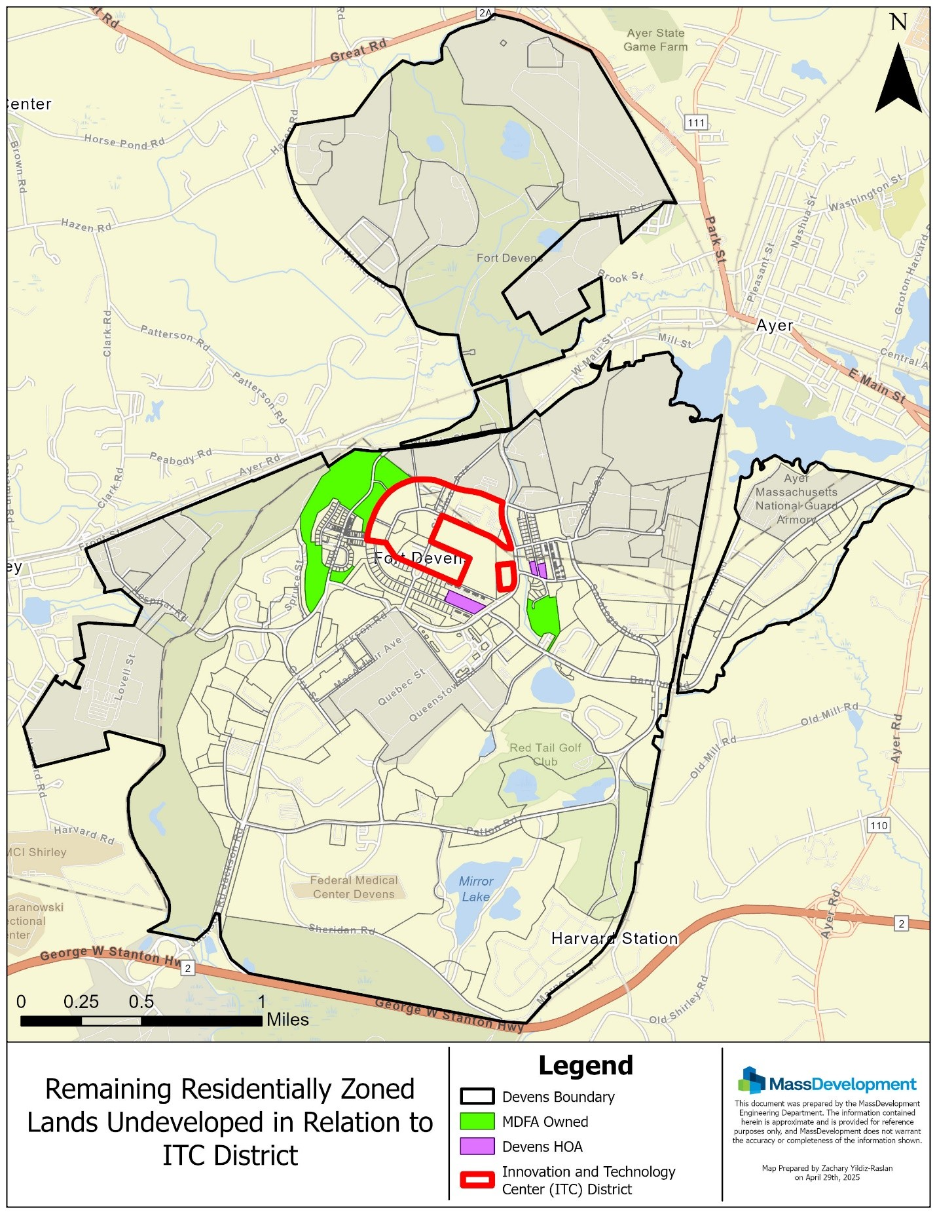
Additional Revisions (2/2)
Planning & Studies:
Planning for any additional housing within the ITC District to consider the existing undeveloped residentially zoned lands within Devens (context-sensitive planning and design).
Expanded detail on School Needs Assessment, acknowledging the importance of understanding enrollment forecasting.
Rewording of community engagement strategy to include design charrettes and study of topographic/utilities constraints.

Slide 12
Discussion

Slide 13
Next Steps
The subgroup will take back today’s discussion and feedback and prepare a final report.
Final report will be sent to DWG Members ASAP for review before the final meeting
We will submit the report on time to the Legislature on time.
Final Meeting: May 14th at 1:00 pm via Zoom
EOED will post a link for the public to view the final meeting at: mass.gov/orgs/devens-working-group

