Slide 1
Drug Formulary Commission
Bureau of Health Professions Licensure
Department of Public Health
May 17, 2018

Slide 2
Presentation Agenda
Review of March 15th meeting
Cost Impact Presentation
Draft Formulary Regulations
  105 CMR 720: Drug Formulary Commission
  (FKA: List of Interchangeable Drug Products)
  Schedule
  Guidance
Remarks
Next Steps

Slide 3
Formulary Review and Evaluation
Component 1: Opioids with a Heightened Public Health Risk
Component 2: Interchangeable Abuse Deterrent Opioids
Component 3: “Cross Walk” – Chemically Equivalent Substitutions
Draft Amended Formulary

Slide 4
Drug Formulary Commission
Cost Impact Presentation

Slide 5
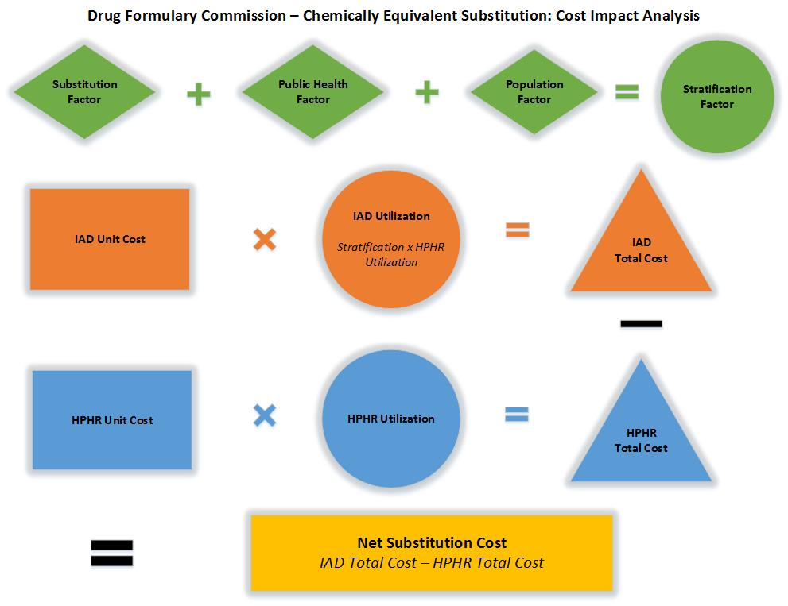
Substitution Cost Algorithm

Slide 6
Chemically Equivalent Substitution Stratification Factors
 | Element | Element Score | Factor Score
Substitution Factor IAD-specific calculation | IAD current market share
 | Length of approval
 | ADP efficacy
 | Routes of deterrence
 | Discounts available (Medicaid)
 | Generic available
 | HPHR of concern
 | ER or IR
Public Health Factor Potential costs/ savings/benefit Applied to all crosswalks | Criminal Justice
 | Direct Healthcare (OUD treatment, OD/NFO response)
 | Ancillary Healthcare (first responders, NAS, disability)
 | Death
 | Prescribing/dispensing education
Population Factor Risk/value assessment Applied to all crosswalks | Medicaid/Medicare patient (2x scripts; 3-6x OUD)
 | First time script (36 months to OD/NFO)
 | Diversion (hospice/LTCF)
 | Co-morbid psych (opioid + benzo, etc.)
TOTAL |  |  | %

Slide 7
Promulgation of Regulation and Formulary
History
Proposed 105 CMR 720, List of Interchangeable Drug Products, including draft formulary, as redrafted, to the Public Health Council (PHC) (11/9/2016)
Public hearing held on proposed changes to regulation (1/19/2017)
DPH staff reviewed comments and further amended, including the addition of several new DFC approved IADs.
Public hearing held on proposed changes to regulation (7/7/2017)
PHC promulgated 105 CMR 720, Drug Formulary Commission (fka List of Interchangeable Drug Products), including draft formulary (8/9/2017)
Next Steps
Issue guidance, including special substitution considerations, and the requirements and process of substitution.
Review by Secretary of State → Regulation becomes effective (TBD).
Conduct prescriber education on abuse deterrent substitutes.

Slide 8
Formulary Guidance Background
This draft formulary is a tool for prescribers when continuing and initiating the treatment of pain.
Guidance will be issued approximately one month prior to the regulation, including the draft formulary, becoming effective.
“No Substitution”
The following items on a Schedule II prescription may not be changed by a pharmacist, pursuant to applicable DEA rules:
  Name of Patient
  Name of the Drug
  Name of the Prescriber
  Date of the Prescription
Prescriber unavailable

Slide 9
Membership Terms
Term Expires Members
June 10, 2018 4
June 17, 2018 1
June 23, 2018 1
*July 27, 2018 4
August 6, 2018 1
August 14, 2018 1
August 17, 2018 1
Ex Officio 3
* Next Meeting - July 19, 2018

Slide 10
Meeting Schedule
Tentative 3rd Thursday Schedule
June 21, 2018
July 19, 2018
  August 16, 2018 **
  ** Optional if Non-opioid List update has not been completed. Update required by 8/30/18.

Slide 11
Meeting Summary
Meeting Recap
Next Steps
Next Meeting
  July 19, 2018
  9:00AM to 12:00PM
  @ 250 Washington Street (Boston, MA)

