Slide 1
Discharge Planning to Support People Experiencing or at Risk of Homelessness - For Hospitals
March 2025

Slide 2
Online Resources
  MassHealth guidance for hospitals and managed care plans related to discharges of admitted patients who are experiencing or at risk of homelessness
  Decision tree to customize for specific discharge situations
  Training for hospital discharge planners
  Shelter contact information
  State guidance for shelters
  Links to EHS Discharge Support
  Helping Patients who are Homeless or Housing Unstable

Slide 3
MassHealth Requirements

Slide 4
Three MassHealth Bulletins
  For MassHealth contracted Psychiatric Inpatient Hospitals (PIHs) PIH 27
  For MassHealth contracted Acute Inpatient Hospitals (AIHs) AIH 186
  For MassHealth contracted Managed Care Entities (MCEs) MCE 64
Similar content, designed to mirror one another
Focused on members who are homeless or housing unstable prior to admission or at discharge
Focused on inpatient admissions
Incorporated into hospital Requests for Applications (RFAs)
Hospitals must incorporate the discharge planning procedures into their own discharge planning processes for MassHealth members
  The goal is to promote early and frequent conversations between hospital discharge staff, MCEs, Community Partners, Department of Mental Health (DMH), Department of Disability Services (DDS), Massachusetts Rehabilitation Commission (MRC) now MassAbility (MBY), or other case managers, shelter providers, and family or other involved parties to problem-solve together

Slide 5
For DMH Licensed Facilities/Units
  In addition to MassHealth guidance, DMH regulations 104 CMR 27 requires:
  104 CMR 27.09 (b):
    A facility shall make every effort to avoid discharge to a shelter or the street. The facility shall take steps to identify and offer alternative options to a patient and shall document such measures, including the competent refusal of alternative options by a patient, in the medical record.
    In the case of such discharge, the facility shall nonetheless arrange for or, in the case of a competent refusal, identify post-discharge support and clinical services.
    The facility shall keep a record of all discharges to a shelter or the street, in a form approved by the Department, and submit such information to the Department on a quarterly basis

Slide 6
Bulletin Content – Discharge Planning Activities at the Time of Admission (1)
Must assess each admitted member’s current housing situation to determine whether such member is experiencing or at risk of homelessness
  Screen admission data, including but not limited to age, diagnosis, and housing status, within 24 hours of admission
  For any member determined to be experiencing or at risk of homelessness, discharge planning activities must commence within three working days of admission
Must invite and encourage to participate in or otherwise contribute to discharge planning activities: the member; the member’s family members, guardians, primary care providers, behavioral health providers, key specialists, Community Partners, case managers or other representatives, emergency shelter outreach or case management staff, or care coordinators; and any other supports identified by the member
  For any such member who is a DMH, DDS, MBY client, must invite and encourage designated staff from each such agency to participate in discharge planning activities
Must seek consent to the extent that any applicable federal or state privacy law or regulation requires member consent as a prerequisite to any activity

Slide 7
Bulletin Content – Discharge Planning Activities at the Time of Admission (2)
Must determine whether any non-DMH, non-DDS, or non-MBY-involved member experiencing or at risk of homelessness may be eligible to receive services from these agencies
  Within two business days of admission, offer to assist the member with completing and submitting an application to receive services
  Bulletin includes information about the process of applying to receive services from DMH, DDS, and MBY
Must determine whether any member experiencing or at risk of homelessness has any substance use disorder and contact the DPH-Sponsored Helpline (800) 327-5050) to understand the available treatment services and their options
Must seek consent to the extent that any applicable federal or state privacy law or regulation requires member consent as a prerequisite to any activity

Slide 8
Bulletin Content – Discharge Planning Activities at the Time of Admission (3)
Must contact MassHealth Managed Care Entity (MCE) at the time of admission in order to collaborate in identifying resources to assist with the housing insecurity of members experiencing or at risk of homelessness
Each MCE must designate an individual as a point of contact (POC) for network hospitals to contact, disseminate this information to discharge staff at network hospitals and ensure that the information is current and updated as needed. POC must:
    Be accessible
      Ensure that the POC or a substitute is easily reached (via phone/email) during between 8AM and 6PM each day of the week (including weekends)
      POC must respond to inquiries from network hospitals within 12 hours of receipt
      MCEs may not use an existing customer service line and must designate a separate POC
    Be able to respond to and triage the inquiry
      POC must be able to look the member up in the MCE electronic health record system and identify an MCE Care Coordinator (or other staff) knowledgeable of the member’s health status and care.
      Provide the hospital with contact information for the identified MCE Care Coordinator
      Collect contact information of hospital discharge staff working with the member
      Contact the identified MCE Care Coordinator the same day and provide information about the hospital inquiry
    Keep a log of the inquiries received from hospitals and must also be able to enter a note in the member’s case file regarding the inquiry
Must seek consent to the extent that any applicable federal or state privacy law or regulation requires member consent as a prerequisite to any activity

Slide 9
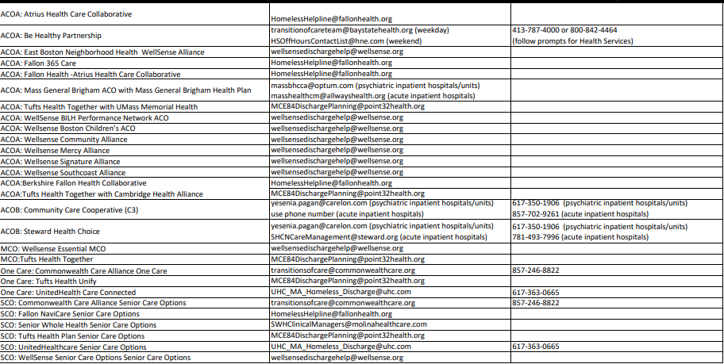
MCE Points of Contact for Hospitals

Slide 10
  For barriers related to housing, MCE staff are prepared to:
As applicable, leverage contracts with housing agencies through ACO Health Related Social Needs (HRSN) services if the member is enrolled or can be enrolled in ACO HRSN services
As applicable, arrange for or directly provide assistance completing applications for housing resources
As applicable, make referrals to community-based agencies that provide housing related assistance
As applicable, arrange for or directly provide assistance completing applications for services through EOHHS state agencies
As needed, make the hospital aware that the network hospital may bill the MCE at the Administratively Necessary Day (AND) rate for each such day on which the member remains in the hospital

Slide 11
Bulletin Content – Discharge Planning Activities at the Time of Admission for Expected Length of Stay (LOS) fewer than 14 days
Members who experienced homelessness prior to admission and who are expected to remain in the hospital for fewer than 14 days may be able to return to a shelter if they do not have a skilled care need or need assistance with activities of daily living
In these situations, the hospitals must contact the emergency shelter in which the member most recently resided, if known, to discuss the member’s housing options post discharge
If the member has not resided in an emergency shelter, or if the emergency shelter in which the member most recently resided is unknown, the hospital must contact the local emergency shelter to discuss the member’s housing options post discharge
Contacting the emergency shelter should occur at time of admission
Emergency shelter information
Must seek consent to the extent that any applicable federal or state privacy law or regulation requires member consent as a prerequisite to any activity

Slide 12
Bulletin Content – Assessing Discharge Options
Must ensure that their discharge planning staff are aware of and utilize available community resources to assist with discharge planning for members experiencing homelessness or at risk of homelessness.
  Must provide regular training to discharge planning staff on available resources and/or up-to-date resource guides
Must make all reasonable efforts to prevent discharges to emergency shelters of members who have skilled care needs, members who need assistance with activities of daily living, or members whose behavioral health condition would impact the health and safety of individuals residing in the shelter
EOHHS has established a website to assist provider hospital discharge staff when helping patients with skilled nursing or other long term care needs
Must seek consent to the extent that any applicable federal or state privacy law or regulation requires member consent as a prerequisite to any activity

Slide 13
Bulletin Content – Discharging to Shelter
For members with short inpatient stays (<14 days) or for those situations when discharge to an emergency shelter or the streets may be unavoidable despite the best efforts of the Hospital, must
  Discharge the member only during daytime hours
  Provide the member a meal prior to discharge
  Ensure that the member is wearing weather appropriate clothing and footwear
  Provide the member a copy of their health insurance information
  Provide the member with a written copy of all prescriptions and at least one week’s worth of filled prescription medications
  Provide at least 24 hours advance notice to the shelter prior to discharge
  Provide the member with access to paid transportation
  Ensure that the shelter has an available bed for the member.
    In the event that a shelter bed is unavailable on the planned discharge date, but a bed will be available soon, delay discharge until a bed is available and bill MassHealth at the administrative day rate for each such day on which the member remains in the Hospital.
Must seek consent to the extent that any applicable federal or state privacy law or regulation requires member consent as a prerequisite to any activity

Slide 14
Bulletin Content – Tracking and Reporting
Must document in each member’s medical record all efforts related to the discharge planning activities, including:
  Options presented to the member
  If applicable, the member’s refusal of any alternatives to discharge to the streets or emergency shelters
For Psychiatric Inpatient Hospitals, DMH reporting form captures data related to discharges to the streets and shelter
For Shelters, online form to report discharges from hospitals that may not be appropriate

Slide 15
MassHealth Guidance – Frequently Asked Questions (1)
What type of patients do the Bulletins apply to?
The requirements documented in AIH-186 and PIH-27 apply to all MassHealth members who are admitted to an Acute Inpatient Hospital or Psychiatric Inpatient Hospital participating in MassHealth and are experiencing homelessness or at risk of homelessness. These requirements only apply to inpatient admissions.
Do the Bulletins apply to patients that are enrolled in both Medicaid/MassHealth and Medicare?
Yes. The requirements in AIH-186 and PIH-27 apply to all MassHealth members who are admitted to an Acute Inpatient Hospital or Psychiatric Inpatient Hospital participating in MassHealth and are experiencing homelessness or at risk of homelessness. This includes members who are dually enrolled in MassHealth and Medicare.
Do the Bulletins apply to patients that are enrolled in MassHealth and are involuntarily committed to a hospital for a 3-day stay?
MassHealth recognizes that hospital staff may be limited in what they can accomplish within a 3-day involuntary stay. However, hospital staff are still encouraged to flag any members experiencing homelessness at admission and communicate with any involved shelters, case managers, and/or DMH about the situation.
More Frequently Asked Questions available online at
EHS Agency Targeted Resources

Slide 16
MassHealth Guidance – Frequently Asked Questions (2)
What the expected turnaround time for responses from shelters?
EOHLC has instructed shelters to answer the phone when discharging facilities call and return voicemails, all with the overall goal of finding suitable alternatives to placement into shelter. If hospital discharge staff is routinely having a difficult time reaching shelter staff, please email EHSDischargeSupport@mass.gov with a description of these outreach efforts, including details about the number of attempts and the dates.
What are the expectations for shelters to work with hospital discharge Staff?
EOHLC has issued guidance and expectations for EOHLC shelters to communicate and collaborate with hospital staff including shelters:
  May not place geographic/community of origin restrictions on access; however, shelters may help individuals return to a shelter or housing in their home community
  May not refuse entry to individuals taking prescribed medication, including, but not limited to, opiates, oxygen, and benzodiazepines.
  Should be prepared to receive and be receptive to inquiries from hospitals who may have an individual who previously resided in shelter. In these situations, the shelter should:
    Share information about the individual’s housing history and any other support systems they may have (family, friends, case managers, housing leads, etc.)
    Coordinate placement from the discharging facility into shelter if space is available in the shelter, the person does not require higher levels of care, and no other safe alternative placements exist.
  Should be prepared to receive and be receptive to inquiries from hospitals who may have an individual who may not be known to the shelter. In these situations, the shelters should:
    Engage in conversations with discharge staff to determine if an alternative placement or safe and alternative housing would be appropriate, and use Rapid Transitions for Individuals funds where possible
    Coordinate placement from the discharging facility into shelter if space is available in the shelter, the person does not require higher levels of care, and no other safe alternative placements exist.

Slide 17
MassHealth Guidance – Frequently Asked Questions (3)
Will shelters be holding beds for patients who will be discharged from hospitals?
As described in the Online Housing Tool for Hospital Discharge Staff and MassHealth guidance, for any member experiencing homelessness who is expected to remain in the hospital for fewer than 14 days, the hospital must contact the shelter in which the member most recently resided, if known, to discuss the member’s housing options post discharge; or if the member has not resided in an emergency shelter, or if the emergency shelter in which the member most recently resided is unknown, the local shelter to discuss the member’s housing options post discharge.
As part of this conversation, the hospital discharge staff should review the member’s needs and the anticipated discharge date. With this information the shelter should be able to determine if they are able to meet the member’s needs and when a bed may be available. If the discharge date is more than 2 days from the conversation, the hospital discharge staff will need to contact the shelter again to determine the availability of a bed. In the event that a shelter bed is unavailable on the planned discharge date, but a bed will be available soon, the hospital should delay discharge until a bed is available. In these cases, the hospital should bill the administrative day rate for each such day on which the member remains in the hospital.

Slide 18
MassHealth Guidance – Frequently Asked Questions (4)
Are hospital discharge staff expected to complete DMH/DDS/MBY applications?
Yes. Within two business days of admission, and to the extent consistent with all applicable federal and state privacy laws and regulations, offer to assist the patient with completing and submitting an application to receive services from DMH, DDS, or MBY, as described below. This should occur for all inpatient admissions, as applicable, regardless of anticipated length of stay.
Note that prior to completing an application, hospital discharge staff should contact the appropriate state agency to discuss whether completing an application is necessary (i.e., is the member already an enrolled consumer) or appropriate (i.e., is the member potentially eligible for services). This conversation will help determine whether an application should be completed or submitted
What if hospital discharge staff need assistance completing DMH applications as these staff are often not experienced nor routinely trained in filling out these applications?
DMH licensed facilities/units should contact their designated DMH Liaison for assistance in completing applications or accessing DMH resources. Acute Inpatient Hospitals that do not have a DMH licensed unit should contact the local Department of Mental Health (DMH) Area Office for assistance in completing applications or accessing DMH resources.

Slide 19
MassHealth Guidance – Frequently Asked Questions (5)
For MassHealth members who are admitted, are hospitals expected to extend their stay if they do not have an appropriate discharge option? How would these extra days be paid for?
In the event that a discharge option, including shelter, is not currently available but may be available shortly, the hospital should delay discharge until an appropriate option is identified. In these cases, the hospital should bill MassHealth at the Administrative Day (AD) rate for each such day on which the member remains in the hospital. This expectation has also been communicated to MassHealth managed and integrated care plans, who are expected to work with hospital discharge staff to identify an option, including approving administrative days as needed and appropriate.
If a member is dually eligible for Medicare and MassHealth and stays at a hospital for an administratively necessary day, since Medicare doesn’t cover Administrative Day, the claim will cross over to MassHealth and be paid.
The hospital's billing department should be familiar with the billing process. Specifically, hospitals are required to split their claims when billing for a continued inpatient stay that includes both acute hospital level of care and AD level of care and must also enter an Occurrence Span Code on their AD claims. For the AD level of care stay, acute hospitals should bill with an Occurrence Span Code of 31 along with the Occurrence Span Dates for the member's stay. The member’s status on the last day of acute level of care, when immediately preceding the AD stay, should indicate the member is still a patient in the hospital.

Slide 20
EHS Discharge Support

Slide 21
What is EHS Discharge Support?
Discharge support is available to assist staff from acute hospitals, behavioral health facilities, and other publicly assisted systems of care, who are working with current to secure appropriate housing post- discharge
EHS Discharge Support staff aid with trouble-shooting benefits issues, connecting with resources not known to the facility, and coordinating with state government partners to address the individual’s needs
Staff will attempt to identify any agency that is currently assigned to work with the specific patient, such as a managed care organization or state agency, and bring that entity into the conversation about discharge options
Staff will also attempt to identify any untapped resource that may be of assistance, such as resources from MassHealth, the Department of Mental Health, or the VA

Slide 22
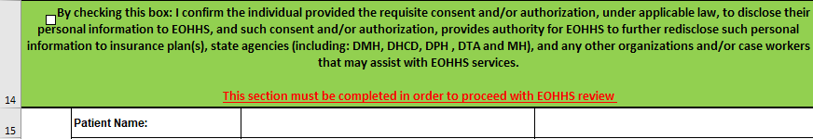
Contacting EHS Discharge Support
Discharge staff should contact the EHS Discharge Support only after they have exhausted all efforts
Email EHSDischargesupport@mass.gov to describe the situation and request a copy of the EHS Discharge Intake Form
Complete the EHS Discharge Intake Form
    Make sure to check the box on line 14 of the form
Email completed form to EHSDischargesupport@mass.gov via the state secure email system
  To use the state secure email system, you will need to go to Mass.gov Encrypted Email Login

