Slide 1
Promotion and Prevention Activities

Slide 2
Handhold is an interactive, family-friendly website designed for parents and caretakers with highly accessible answers to the following questions:
Should I Worry? Information they need to understand changes in their child’s behavior and figure out when they might need help
What Can I Do? Curated resources for parents looking to help their child cope and heal from mental health challenges, promote healthy social and emotional development, de-escalate challenging situations, and connect to others who have been through this
Who Can Help? A user-friendly “front door” to existing behavioral health system navigation and treatment locator tools, including guides on what to expect, how to find support, and how to prepare for a first visit
Notes:
Emerged from a research project that DMH undertook this past spring to better understand how we might reach youth and their families earlier in their journey

Slide 4
What if we talked about and treated mental health the same as physical health?
In Isaac’s Story, Mia and Isaac openly share how they needed treatment and help with their different medical issues, drawing on the similarities between their experiences and speaking and listening without judgement.
Isaac’s Story is part of a national campaign aimed at:
Destigmatizing and reframing how we talk about mental health.
Making mental health and well-being a part of educational curriculum.
Assuaging fear and confusion for children and caregivers dealing with mental health challenges.
Empowering kids with a shared vocabulary to talk about mental health.
Encouraging empathy, kindness, listening and sharing

Slide 5
Different Kinds of Hurt: Isaac’s Story
The campaign includes a short animated film of “Isaac’s Story,” a picture book and collateral materials such as posters, teacher guides, a student coloring book/work sheet and other campaign materials.
Available In: English, Cape Verdean Creole, Haitian Creole, Spanish

Slide 6
Young Adult Access Centers provide opportunities for young adults to engage in communities that provide a variety of supports including peer support, arts & social activities, connections to housing, employment & education resources in a space that is welcoming and safe. There are also opportunities to gain leadership skills and learn to advocate for choice & voice in treatment and recovery. No applications or appointments are needed!

Slide 7
There are seven access centers across the state
Lawrence and Everett
Springfield
Worcester
Framingham
Gloucester
Lowell
Braintree

Slide 8
The goal of MCPAP is to improve access to treatment for children with behavioral health needs and their families by making child psychiatry services accessible to primary care providers across Massachusetts.
MCPAP provides quick access to psychiatric consultation and facilitates referrals for accessing ongoing behavioral health care. It encourages and supports PCPs integrating behavioral health resources into their practices and work with behavioral health providers as well as primary care providers. MCPAP is available for all children and families, through their primary care providers, regardless of insurance. MCPAP is free to all PCPs.

Slide 9
MCPAP for Moms
MCPAP for Moms aims to promote maternal and child health by building the capacity of providers serving pregnant and postpartum women and their children up to one year after delivery to effectively prevent, identify, and manage depression.
MCPAP for Moms provides obstetricians, midwives, and PCPs with psychiatric consultation for behavioral health concerns and questions around medications when pregnant or breastfeeding.
MCPAP for Moms also supports connections with community-based services and support groups.
The program is free and available throughout Massachusetts regardless of type of health insurance.

Slide 10
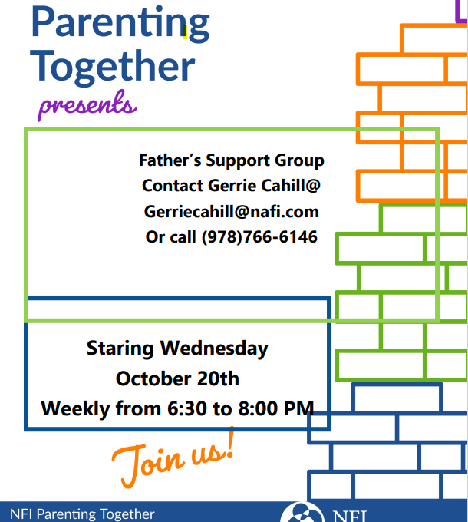
Support Groups for Families
DMH’s Community and School Therapeutic Support services include local family support specialists who facilitate parent support groups and provide advocacy and consultation to community partners.
Support groups are offered in English and other languages, and to specific caregiver populations such as grandparents, fathers, parenting teens and adoptive parents.

Slide 11
Each lesson is roughly ten minutes in length, though you can take as much time as you need and replay the lessons as often as you like.
This interactive online course was created by parents for parents. It will teach you about a communication style called "motivational interviewing" that you can use to have better conversations with teens and young adults.

