Slide 1
Comprehensive Fleet Electrification Initiative​
(CFEI) EPA CPRG Grant Application
Eric Friedman
Director, Leading by Example Division
MA Dept. of Energy Resources

Slide 2

What is CPRG?
EPA Climate Pollution Reduction Grants
CPRG Goals
  Achieve significant GHG reductions by 2030 and 2050
  Improve air quality, particularly in disadvantaged communities
  Complement other funding
  Be replicable/scalable
$4.3 billion for implementation grants
Grant Ranges | Anticipated Number of Grants to be Awarded
$200,000,000 – $500,000,000 | 4-10
$100,000,000 – $199,999,999 | 6-13
$50,000,000 – $99,999,999 | 6-12
$10,000,000 – $49,999,999 | 6-30
$2,000,000 – $9,999,999 | 10-50
CFEI application

Slide 3
Why a Truck Electrification Focus?
Transportation the largest contributor to emissions in MA
Medium/heavy-duty (MHD) diesel vehicles comprise 5% of vehicles but 20% of emissions
Air pollution impacts concentrated in urban areas and low-income and disadvantaged communities (LIDACs)
Extremely low uptake among Class 3-8 zero emission fleet vehicles (ZEVs) due to vehicle cost, charging challenges, and lack of understanding options
Not sufficient state funding for both light and MHD incentives
Notes:
ch

Slide 4
Grant Development Outreach
During grant development process, outreach included broad and targeted discussions with:
  Regional Planning Associations
  Municipalities with EJ Populations
  Community Based Organizations
  Massachusetts Trucking Association
  Various Fleet Operators in Massachusetts

Slide 5

Goals of DOER CPRG Application
Goals
Accelerate adoption of MHD ZEVs in support of Advanced Clean Trucks rule requirements in early years​
Prioritize small fleet electrification in LIDACs​
Target initial electrification efforts across 200+ fleets to facilitate/streamline future ZEV adoption
Details
Submitted: April 1, 2024
Award Announcement: July 2024
Performance Period: 2025-2030
Grant Request: $95,100,619
Primary Applicant: Massachusetts Dept. of Energy Resources

Slide 6
Key Proposal Components
1) Fleet Advisory Services
2) Vehicle Rebates
3) Charging Infrastructure
4) Outreach and Engagement
5) Workforce Development

Slide 7
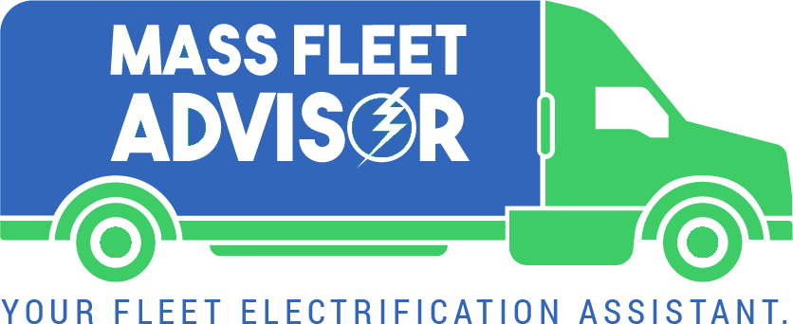
1) Fleet Advisory Services 2.0
Funding to Mass. Clean Energy Center (MassCEC) to support expansion of existing Mass. Fleet Advisor Program to provide full concierge services across the planning, funding, implementation, and operational phases.
New Services include, but not limited to:
Information hotline​
One-stop-shop portal for cross-program applications ​
Charging infrastructure assistance post-procurement ​
Creation of fleet communities or forums ​

Slide 8

2) Vehicle Rebates
CFEI funding will utilize existing MOR-EV structure to allow for increased MHD ZEV rebates, prioritizing small fleets operating in LIDACs.
Rebate adders:
  Small fleets
  Fleets in LIDACs
  Diesel vehicle scrappage
Rebate subtractor for large fleets
10 vehicle limit

Slide 9


3) Charging Infrastructure
Partnership with utilities to utilize make-ready funding with supplemental CPRG funding when utility funds are not available.
CFEI funds will support:
Municipal light plant projects
Multiyear networking costs
Multiyear maintenance costs
Ancillary costs like signage, bollards, etc.

Slide 10

4) Community-Based Outreach & Education
CFEI will establish a robust outreach , marketing, and education program in direct partnership with multiple community-based organizations (CBOs), while providing fair compensation to these CBOs.
DOER will partner with EEA’s environmental justice staff and Justice40 working group to develop and launch this effort

Slide 11
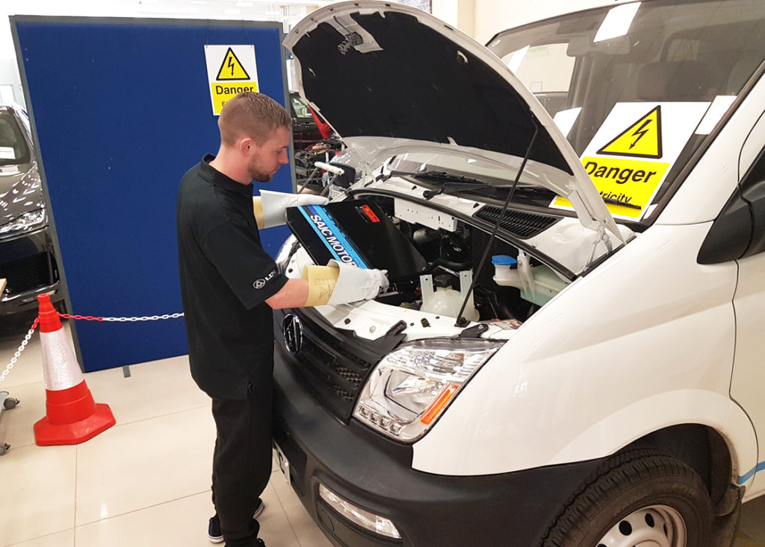
5) Workforce Development
CFEI will establish a new training opportunities to ensure an ongoing pipeline of automotive technicians skilled in MHD battery electric vehicle maintenance and repair​.
Funding to support curriculum development, administration, and equipment costs at existing automotive programs: Massasoit community college and 3-5 technical education schools

Slide 12
CFEI Partners
MA DOER
(Primary Applicant & Project Manager)
Rebates
Center for Sustainable Energy
Charging Infrastructure
Electric utilities
MassDEP
Fleet Advisory Services
MassCEC
Center for Sustainable Energy
Outreach & Engagement
EEA EJ Office
MAPC
CBOs
Workforce Development
Massasoit Community College
DESE
Career & Technical Educational Schools
Bold = CPRG Application Coalition Partner; MOU to be signed by July 1st

Slide 13
Thank You!

