Slide 1
2024 LBE Fleet EV Charging Deployment Grant
May 8, 2024
EVICCC Meeting

Slide 2
EVSE for State Fleets
$11 million for state fleet EVSE deployment
  $9.5 million for DCAMM
  $1.5 million for LBE/DOER
Executive Order 594 goals: 5% of entire fleet electrified by 2025 and 20% by 2030
Current status of EVSE deployment
  Total EV ports installed at state sites: 720
  Total EV ports installed for state fleets: 140

Slide 3
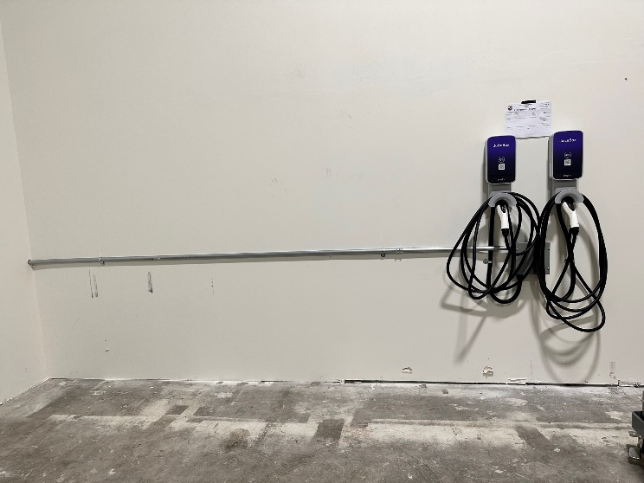
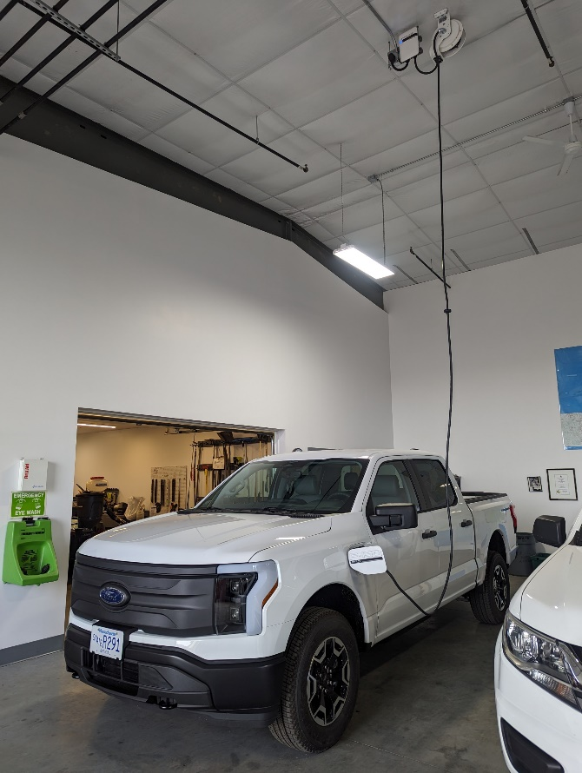
2023 LBE Fleet EVSE Grant: State Entity Awards
Entities Awarded LBE Fleet Charging via Prior (2023) LBE Grant Program
State Entity | # of Fleet Charging Ports | # of Sites | Grant Amount
UMass Amherst | 30 | 1 | $175,000
Dept. of Conservation & Recreation | 23 | 7 | $173,878
UMass Chan Medical School | 16 | 1 | $125,000
Plymouth County Mosquito Control Project | 8 | 1 | $29,424
Dept. of Fire Services | 6 | 2 | $96,875
Military Division | 4 | 1 | $115,971
Division of Marine Fisheries | 4 | 1 | $46,277
Division of Fisheries and Wildlife | 4 | 1 | $28,520
Bridgewater State University | 4 | 1 | $100,000
Cape Cod Mosquito Control Project | 4 | 1 | $71,301
Dept. of Public Health | 4 | 2 | $68,516
Division of Standards | 2 | 1 | $26,140
Total | 109 | 20 | $1,056,902

Slide 4
LBE Fleet EV Charging Grant
LBE FLEET EV CHARGING GRANT DETAILS
Grant covers 100% of the cost of equipment & installation for fleet EV charging at state sites (as well as 3 years of prepaid warranty, maintenance, & networking packages if applicable)
Eligible entities | State entities not receiving funding through DCAMM’s EV charging station programs
Total available funding | $1,800,000
Per entity funding cap | $300,000*
Eligible property types | Owned & leased** sites
Rolling application deadline | September 15, 2024
ARPA Fund Encumbrance Deadline | December 31, 2024
Have questions? | Contact Sophia (sophia.vitello@mass.gov)
*EJ adder for EVSE deployment in EJ communities **Lease must have at least 1 year remaining; mobile charging as a service also eligible for funding under this grant
LBE funding is targeting:
Leased facilities Non-executive branch agencies Agencies with fewer than 10 light-duty vehicles Mobile EV charging Domicile vehicles

Slide 5
Fleet EVSE Grant Progress
As of May 1, 2024, three applications for 10 ports at 4 sites for a total of $146,039 have been approved
Specific discussions underway with 17+ sites to submit applications for 66 ports, totaling $850,000+

