Slide 1
Preliminary data show 507 confirmed and estimated opioid-related overdose deaths in the first three months of 2021, an estimated 2% increase compared with the same period in 2020.
Estimated 498 deaths
Estimated 507 deaths
Notes:
We are releasing the latest quarterly opioid-related deaths report. This report captures opioid-related overdose deaths through the first three months of 2021.

Slide 2
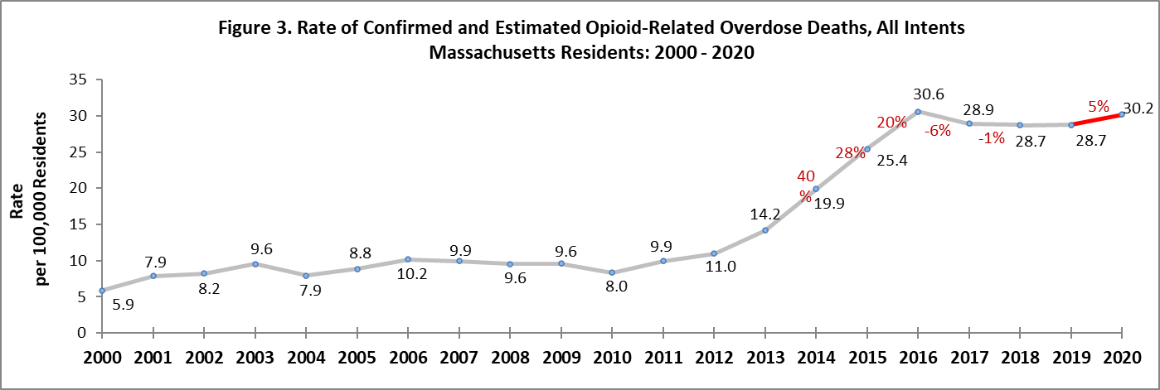
The rate of opioid-related overdose deaths has increased 5% in 2020 compared with 2019 and is
1% lower than the 2016 peak.
Notes:
Overall, there was approximately 1 percent decline in the opioid-related overdose death rate between 2016 and 2020.
Nationwide, Massachusetts is among the states with the smallest increases in drug overdose deaths. Preliminary data released last month from the CDC show drug overdose deaths surged by 29 percent nationally in the year between September 2019 and September 2020, with Massachusetts showing a slight increase in the single digits.
Backup Notes: This figure shows the annual opioid-related overdose death rate per 100,000 population. Overdose death rates increased 40% between 2013 and 2014, 28% between 2014 and 2015, and 20% between 2015 and 2016. In 2020 the rate of opioid-related overdose deaths has increased to a number comparable with the 2016 peak of 30.6%.

Slide 3
Fentanyl remains a key factor in opioid-related overdose deaths (92% present in toxicology screen in 2020).
Notes:
In 2020, there were 1,895 opioid-related overdose deaths where a toxicology screen was also available.
Fentanyl continues to be a major factor fueling the opioid crisis and was detected in 92% of cases with a toxicology screen in 2020. Since 2014, the rate of heroin or likely heroin present in opioid-related overdose deaths has been decreasing while the presence of fentanyl remains high.
Optional additional information regarding toxicology:
Heroin was present in 14% and prescription opioids in 17%
cocaine in 46%
benzodiazepines in 31%
amphetamines in 9%
Optional additional TP to explain the dotted line at year 2017:
DPH issued a clinical advisory this month warning about the dangers of polysubstance use and urging health care providers to ensure individuals using stimulants have access to Narcan
Beginning with the November 2019 quarterly report, DPH began to use a new method to identify specific drugs present in opioid-related overdose deaths for deaths from 2017 onward (this figure). This new method cannot be applied to data prior to 2017.
Prior to adopting the new methodology, testing was done to compare the old and new methods. Although the new methodology is more appropriate for the purposes of the Opioid Quarterly Report, both the old and new methods produced the same overall trends for the substances included in this figure.

Slide 4
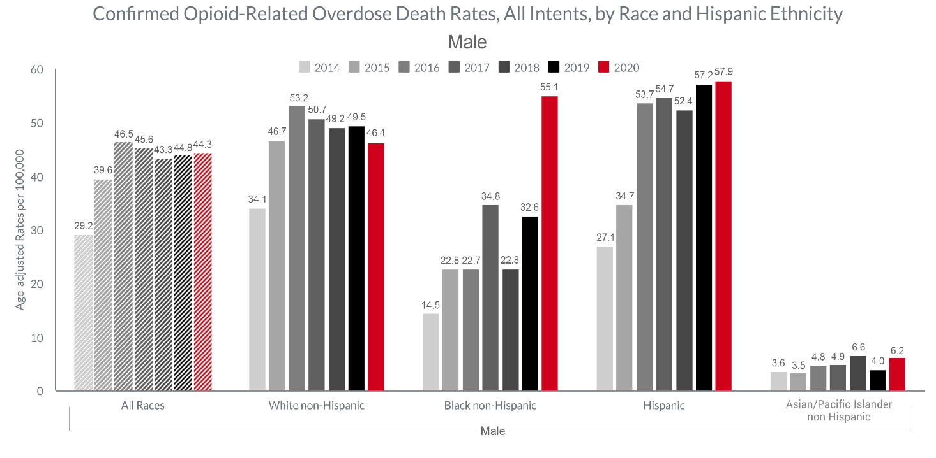
Between 2019 & 2020, the confirmed opioid-related overdose death rates for Black non-Hispanic men increased significantly at 69%.
Notes:
Men comprise 73% of all opioid-related overdose deaths occurring in 2020.
Between 2019 and 2020 the rate for Black non-Hispanic men increased significantly 69% from 33 to 55 (per 100,000).
While he only significant change shown here was for Black non-Hispanic men, the rate for Asian Pacific Islander non-Hispanic men increased 55% from 4 to 6, and the rate for Hispanic men increased 1% from 57 to 58. The rate for White non-Hispanic men decreased 6% from 50 to 46.

Slide 5
DPH/BSAS is implementing new investments to enhance treatment and recovery support, particularly in communities of color
BSAS is dedicating a significant portion of supplemental funding from SAMHSA’s Substance Abuse Prevention & Treatment Block Grant towards addressing racial equity, including:
  Increasing behavioral healthcare workforce diversity, recruitment, and retention through workforce development initiatives
  Funding community-led programming in communities of color through grant making and support for increasing community-based organizations’ ability to contract with the Commonwealth
  Increasing the number of culturally-specific programs across the continuum of prevention, outreach/engagement, treatment, and recovery support services
  Increasing investments in pre-arrest diversion/co-response models, in order to divert people with SUD from the criminal justice system, in partnership with the Department of Mental Health
  Increasing funding for low-threshold housing/housing first models in Suffolk County, with program expansions expected in Merrimack Valley, Springfield, and Worcester to address communities in need

Slide 6
DPH/BSAS addresses health and racial equity by continuing and enhancing existing programs
  Current BSAS programs dedicated to addressing overdoses in the Black/Latinx community include:
    Recovery-Based Re-Entry Services for Black and Latino Men, a pilot program for Black and Latino men leaving incarceration that will be provided by the following agencies:
      Fathers’ Uplift
      Casa Esperanza
      Legendary Legacies
      New North Citizens’ Council
      Greater Lawrence Family Health Center/Lynn Community Health Center
    Increased investments in the Black Addiction Counselor Education (BACE) and Latinx Addiction Counselor Education (LACE) programs to support Black and Latinx people seeking to enter the SUD workforce
BSAS is also partnering with other existing culturally-specific agencies/programs in the Commonwealth to expand their services and provide increased access for communities of color
Notes:
Recovery-Based Re-Entry Services for Black and Latino Men: This $2.3M grant is meant to address communities with higher rates of fatal overdoses, particularly among Black and Latino men, including Essex, Hampden, Suffolk, and Worcester counties.
This pilot program will provide enhanced support to Black and Latino men at risk for overdose following their release from incarceration.
This includes culturally-responsive, wrap-around re-entry services provided both pre- and post-release, including person-centered support for recovery from any substances used.
This program will complement current re-entry initiatives (such as MassHealth’s Behavioral Health - Justice-Involved Initiative) with an enhanced focus on the unique needs and risks faced by Black and Latino men.
Latinx Addiction Counselor Education (LACE) Program/Black Addiction Counselor Education (BACE) Program: BSAS supports highly affordable and flexible programming by providing 300 education hours and practicum needed towards Licensure specifically for individuals that identify as Black and Latinx

Slide 7
DPH/BSAS has aggressively maximized access to SUD treatment during the COVID-19 pandemic, and is continuing the fight against the opiate crisis
Increasing access to naloxone – from March 2020 to April 2021 over 110 thousand naloxone kits have been distributed to Opioid Treatment Providers (OTP), Syringe Service Programs, community health centers, hospital emergency departments, and county Houses of Correction.
Implementing a new standing order for naloxone allowing providers/organizations such as first responders, co-response/jail diversion teams, criminal justice personnel, and health and human services workers (such as those in homeless shelters, drop-in centers, and soup kitchens) to give naloxone to individuals at risk and their friends/family.
Obtaining a blanket exception from SAMHSA on behalf of Massachusetts Opioid Treatment Programs (OTP) for take home doses of MOUD. As of December 2020, 48.5% of OTP patients are receiving take home doses, compared to the pre-COVID average of 15.6% in December 2019.
Implementing the broad adoption of a DEA waiver allowing prescriptions for buprenorphine and naltrexone to patients for whom providers have conducted telehealth sessions, as well as induct patients on buprenorphine and naltrexone.
Reimbursing contracted Office Based Opioid Treatment (OBOT) providers for cell phones and data plans to maintain patients’ ability to keep in contact with their providers for telehealth.
Establishing COVID+ ATS and CSS units to facilitate positive patient transfers and maintain capacity within the rest of the treatment system.
Leveraging the second round of State Opioid Response (SOR) funding from SAMHSA to increase access in Massachusetts to all FDA-approved forms of MOUD, reduce unmet treatment needs, and reduce opioid/stimulant misuse and overdose.
Working with programs to prevent and mitigate the spread of COVID-19, including distributing guidance on surveillance testing, screening and isolation of patients/staff, and increased flexibility in bed allocation between different service settings to accommodate changing patient needs at individual programs.

