Slide 1
Methamphetamine Use Commission
Overview of Methamphetamine and Stimulant Use in Massachusetts
DPH/BSAS
December 8, 2021

Slide 2
Key Definitions
Amphetamines: a class of central nervous system stimulants. Can be legally prescribed and used to treat attention-deficit hyperactivity disorder (ADHD) under the name Adderall and Ritalin. They can be highly addictive if used incorrectly/recreationally.
Methamphetamines: a potent amphetamine, which can be legally-prescribed for certain medical conditions. Regular methamphetamine is a pill or powder. Crystal methamphetamine resembles glass fragments or shiny blue-white “rocks” of various sizes.
All Stimulants: we will use this term to include all amphetamines, methamphetamine, and crack/cocaine.
Notes:
DEA Fact Sheet sourced.
These are the definitions that will be used throughout this presentation in which data related to All Stimulants will be presented as well as related to Methamphetamine.

Slide 3
Methamphetamine & Other Stimulant Data - Key Points
An increase in Methamphetamine use in MA is visible in DPH data sources, although rates are low compared to other stimulants.
Crack/Cocaine use continues to be used at much higher rates and cross-contamination with fentanyl is of great concern.
Methamphetamine use is higher in Suffolk County and the eastern portions of the state and in BSAS treatment data is seen largely among the white non-Hispanic population.
Crack/Cocaine use is seen statewide and has higher prevalence among black African/American and Latinx populations in BSAS treatment data.

Slide 4
Data Sources in this Overview
BSAS Substance Use Helpline Calls/Searches
Hospital Emergency Department Admissions
DPH Vital Records Mortality Data
BSAS Treatment Admission Data
Notes:
From these data sets we have pulled information related to all Stimulants and to Methamphetamine as a sub-set. Slides will sometimes include all Stimulants and sometimes focus on Methamphetamine. We also will distinguish Crack/Cocaine and Methamphetamine within the stimulant data in some cases.

Slide 5
Proportion of all Calls/Searches to BSAS Substance Use Helpline for Stimulants (July 2018 - July 2021)
In CY2021, 4% of all Helpline calls/searches were for Stimulants;
Of these calls/searches, 14% were for Methamphetamine and 76% for Crack/Cocaine
Data source: Massachusetts Substance Use Helpline, https://helplinema.org/
*Please exercise caution when interpreting these data. One user may conduct several searches/calls or seeking referral/information for other persons.
**These data refer to all helpline calls, web searches, and live chats conducted between July 2018 and July 2021

Slide 6
BSAS Helpline Stimulant Calls & Rates (CY2020)
Over 50% of the calls for stimulants during the July 2018-July2021 period originated from Middlesex, Suffolk and Worcester
Data source: Massachusetts Substance Use Helpline, https://helplinema.org/
*Please exercise caution when interpreting these data. One user may conduct several searches/calls or seeking referral/information for other persons.
**These data refer to all helpline calls, web searches, and live chats conducted between July 2018 and July 2021

Slide 7
BSAS Helpline Methamphetamine Calls & Rates (CY2020)
60% of the Methamphetamine related calls during the July 2018-July2021 originated in Essex, Middlesex, and Suffolk counties.
Data source: Massachusetts Substance Use Helpline, https://helplinema.org/
*Please exercise caution when interpreting these data. One user may conduct several searches/calls or seeking referral/information for other persons.
**These data refer to all helpline calls, web searches, and live chats conducted between July 2018 and July 2021

Slide 8
All Stimulants and Methamphetamine-Related Emergency Department (ED) Admissions (FY2017-2020)
ED Admissions increased by approx. 5,000 for stimulants between FY19-FY20
Of this increase in admissions, approx. one-half of these were due to an increase in methamphetamine-related incidents.
Source: Case Mix data is administered by CHIA and includes discharge records from approximately 70 acute hospitals in Massachusetts.
Notes:
Data from 70 MA acute hospitals were analyzed to assess the trend of emergency department and inpatient admissions for methamphetamine-related and any stimulant-related incidents.

Slide 9
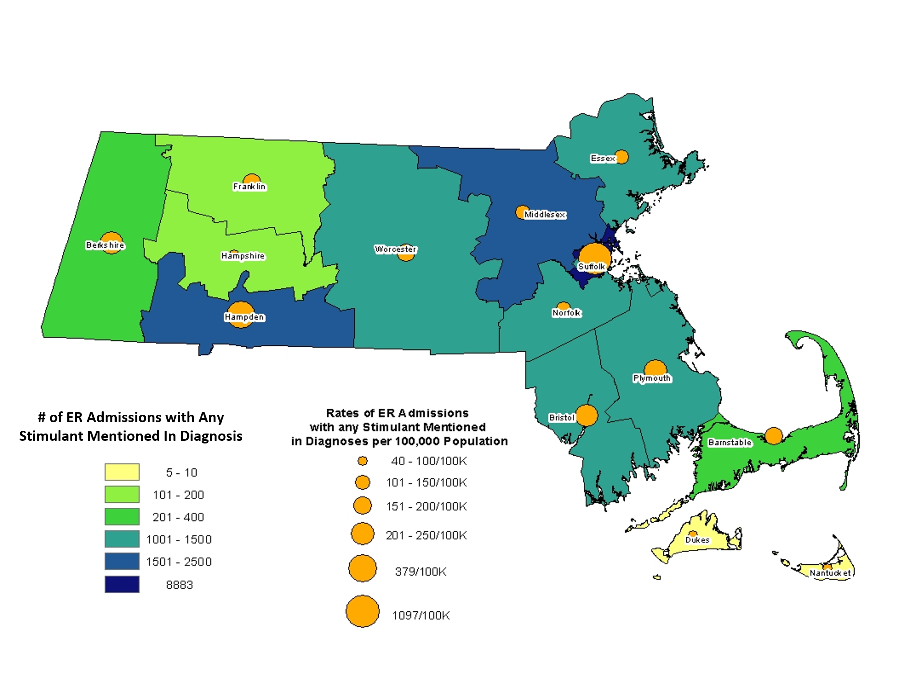
Stimulant-Related ED Admissions and Rates by County of Residence (FY2020)
Highest number of ED admissions in FY2020 were from Suffolk, Hampden and Middlesex counties.
Source: Case Mix data is administered by CHIA and includes discharge records from approximately 70 acute hospitals in Massachusetts.

Slide 10
Methamphetamine-Related ED Admissions and Rates per 100,000 Population by County of Residence (FY2020)
Methamphetamine related ED admissions and rates are the highest in the eastern part of the state.
Source: Case Mix data is administered by CHIA and includes discharge records from approximately 70 acute hospitals in Massachusetts.

Slide 11
Stimulant-Related ED Admission Rates by County (FY2017-2020)
When examining the data on ED admissions by county, the spike in ED admissions related to any stimulant were driven by a large spike in Suffolk county, while trends for other counties remained flat.
Source: Case Mix data is administered by CHIA and includes discharge records from approximately 70 acute hospitals in Massachusetts.
Notes:
The previous slide was for 2020 only, this shows the increase in the rate of stimulant related ED admissions in 2020 in Suffolk County as compared to the other counties 2017-2020

Slide 12
All Stimulants and Methamphetamine-Related Deaths in Massachusetts (CY2017-2020)
Source: Mortality data is maintained by the Registry of Vital Records and Statistics, and includes annual death record files for deaths occurring in Massachusetts.
Notes:
MA death data files from 2017-2020 were analyzed to identify methamphetamine and any stimulant related deaths during this time frame. (not related to opioids)
The rate of stimulant (any) related deaths increased by 10% from 2018 to 2019 and 18% from 2019 to 2020, while the rate of methamphetamine related deaths increased by 54% from 2018-2019 and 81% from 2019 to 2020.

Slide 13
All Stimulant-Related Death Counts and Rates by County of Residence (CY2020)
The largest number of stimulant-related deaths were concentrated in Eastern part of the state
The highest rates were seen in Berkshire followed by Suffolk and Essex.
Source: Mortality data is maintained by the Registry of Vital Records and Statistics, and includes annual death record files for deaths occurring in Massachusetts.
Notes:
All Stimulant includes crack/cocaine & methamphetamine as well as other amphetamines.

Slide 14
Methamphetamine-Related Death Counts and Rates by County of Residence (CY2020)
Most of the Methamphetamine deaths are seen in the Eastern part of the state with the highest rates observed in Suffolk and Essex
* Dukes county has a very high rate but relatively small numbers.
Source: Mortality data is maintained by the Registry of Vital Records and Statistics, and includes annual death record files for deaths occurring in Massachusetts.
Notes:
Methamphetamine related deaths (counts and rates) are seen more in the eastern/northeastern portion of the state

Slide 15
Substances Reported at Admission as a Percentage of All BSAS Admissions (CY2005-2021)
Source: Treatment statistics prepared by the Office of Statistics and Evaluation, Bureau of Substance Addiction Services, Massachusetts Department of Public Health
Notes:
This represents all mentions of primary, secondary or tertiary drugs of choice at all BSAS admissions in this time period.
This provides the larger context for understanding stimulant admission trends by including admissions trends for alcohol and opioids during the same time period.

Slide 16
BSAS Admission Trends for Crack/Cocaine and Methamphetamine (CY2005-2021)
Stimulant admissions have been rising since 2015.
Methamphetamine represented 9.7% of all stimulant related admissions in 2021, up from 1.4% in 2005
Source: Treatment statistics prepared by the Office of Statistics and Evaluation, Bureau of Substance Addiction Services, Massachusetts Department of Public Health

Slide 17
Stimulants Use Reported at BSAS Admission by Race (CY2010-2020)
The percentage of enrollments reporting stimulants use at the time of enrollment increased from 18% in 2015 to 27% in 2020.
Black non-Hispanic and Hispanic enrollments consistently report higher rates of stimulant use than White non-Hispanics.
Source: Treatment statistics prepared by the Office of Statistics and Evaluation, Bureau of Substance Addiction Services, Massachusetts Department of Public Health

Slide 18
Methamphetamine Use as a Percentage of All Stimulants Reported at BSAS Admission by Race (CY2010-2020)
Methamphetamine use reported by BSAS enrollments has been on the rise since 2010.
While this increase was noticed across all races, white non-Hispanic, other and multi-racial enrollments experienced the highest increase.
Source: Treatment statistics prepared by the Office of Statistics and Evaluation, Bureau of Substance Addiction Services, Massachusetts Department of Public Health

Slide 19
BSAS Enrollments Who Reported Methamphetamine Use by Race (CY2010- CY 2020)
Enrollments reporting Methamphetamine as a problem substance increased sharply from 2015 - 2020.
White non-Hispanics represented majority of these admissions.
Source: Treatment statistics prepared by the Office of Statistics and Evaluation, Bureau of Substance Addiction Services, Massachusetts Department of Public Health

