Slide 1
Inquiry On Pole Attachment and Conduit Access on Public Rights of Way, D.P.U. 25-10/D.T.C. 25-1
Technical Session Presentations
Topic 4: National Joint Utilities Notification System (NJUNS)
Stephanie Magnan and Daryl Cullivan

Slide 2
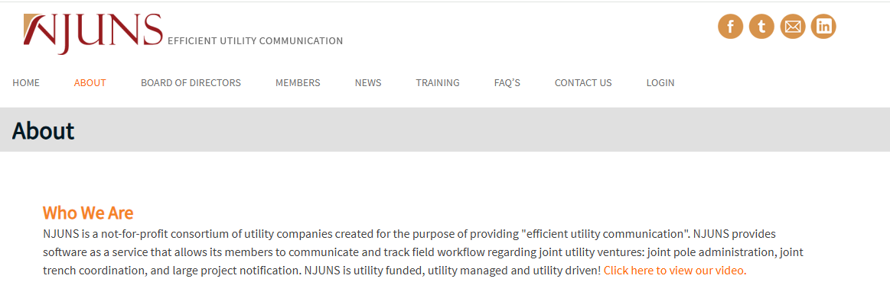
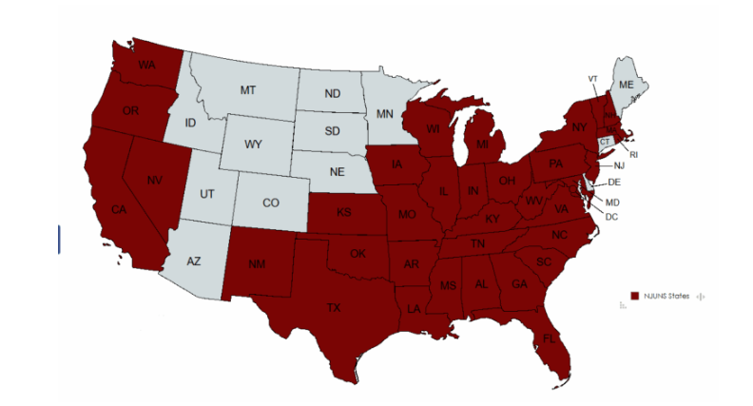
NJUNS Home Page

Slide 3
A. Describe and discuss the NJUNS database, including a description of the different functionalities of the database currently utilized and available to pole owners and enrolled attachers. Provide screenshots, if available.
NJUNS efficiently manages pole attachment communications and tracks pole work via electronic tickets.
The system enhances transparency by notifying attachers of their next-to-go status for transfers related to pole replacements, and can be used for other make-ready work. Verizon, cable providers, and major electric companies use NJUNS in MA for work relating to pole replacements.
Mandating NJUNS for pole work by all pole owners and attachers would make attachment transfers faster and more efficient and thus reduce double poles. Requiring that NJUNS be used for other make-ready work such as facility rearrangements also would increase efficiency.
New York is considering adoption of a requirement that NJUNS be used for all pole work.

Slide 4
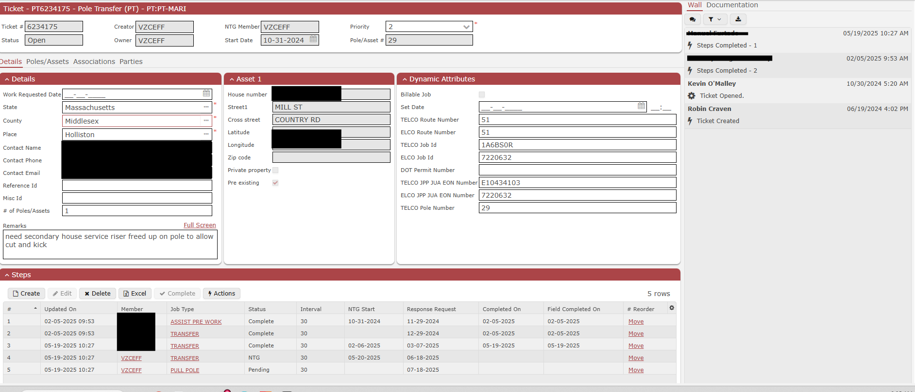
NJUNS TICKET SAMPLE

Slide 5
i. Discuss whether/how temporary attachments are or could be accounted for in NJUNS
Temporary attachments have been the exception, not the norm for Verizon, and are rarely granted due to safety concerns. When permitted, such attachments can be accounted for in NJUNS.
Temporary attachments should be prohibited under all circumstances unless the attacher is an NJUNS member.
Requiring NJUNS membership facilitates a smoother transfer of attachments and removal of double poles, because all attached parties will be listed on the NJUNS ticket.
ii. Discuss whether/how wireless attachments are or could be accounted for in NJUNS
The process for wireless attachments is the same as the one used for wireline attachments.
If the wireless entity uses the NJUNS database, it will receive a notification when it is the wireless entity’s turn to transfer its equipment to a new pole.
Wireless attachments can be managed by NJUNS. The system offers various functionalities, including a remarks section for each step of the process.
iii. Discuss whether/how EVSE attachments are or could be accounted for in NJUNS
Verizon does not support a requirement that pole owners must allow EVSE to be attached to their poles, but our concern does not relate to NJUNS.
EVSE can be accounted for in NJUNS in the same manner as wireline attachments.

Slide 6
iv. Describe your company’s processes and protocols for identifying and addressing abandoned attachments in NJUNS
When Verizon discovers an abandoned facility, it seeks to determine the facility type and owner, and then informs the responsible party
To determine the owner, Verizon reviews its records and attempts to find contact information.
Verizon’s state government affairs team works with municipal officials to address abandoned municipal attachments.
v. Define and explain the term “non-participating 3rd party” as reflected in Verizon’s bi-annual double pole reported submitted in D.T.E. 03-87. Similarly, discuss how unregistered attachers are accounted for in NJUNS
A non-participating third party in the communication space refers to an individual or entity that is not a registered user of NJUNS. When Verizon knows who the individual or entity is, we will identify the non-user in the remarks section of NJUNS.
Verizon regularly reviews NJUNS for newly registered members and, when such members are found, replaces their entries in NJUNS with active member codes.

Slide 7
vi. Discuss why specific non-participating municipal attachers are assigned codes in NJUNS
The inclusion of such codes for non-participating municipal attachers assists pole owners in identifying the next-to-go entity for each pole. When that entity is the municipality, NJUNS generates reports that enable us to notify the municipality that it is next to go.
The inclusion of these codes helps reduce the turnaround time for the removal of poles with municipal attachments.
vii. Describe and discuss additional functional capabilities not being utilized by your company. Provide screenshots, if available
NJUNS can be used to track third-party attachments, manage requests, and monitor project capabilities. Verizon proposes that NJUNS be used for all make ready work.
See next slide for sample NJUNS make ready ticket.

Slide 8
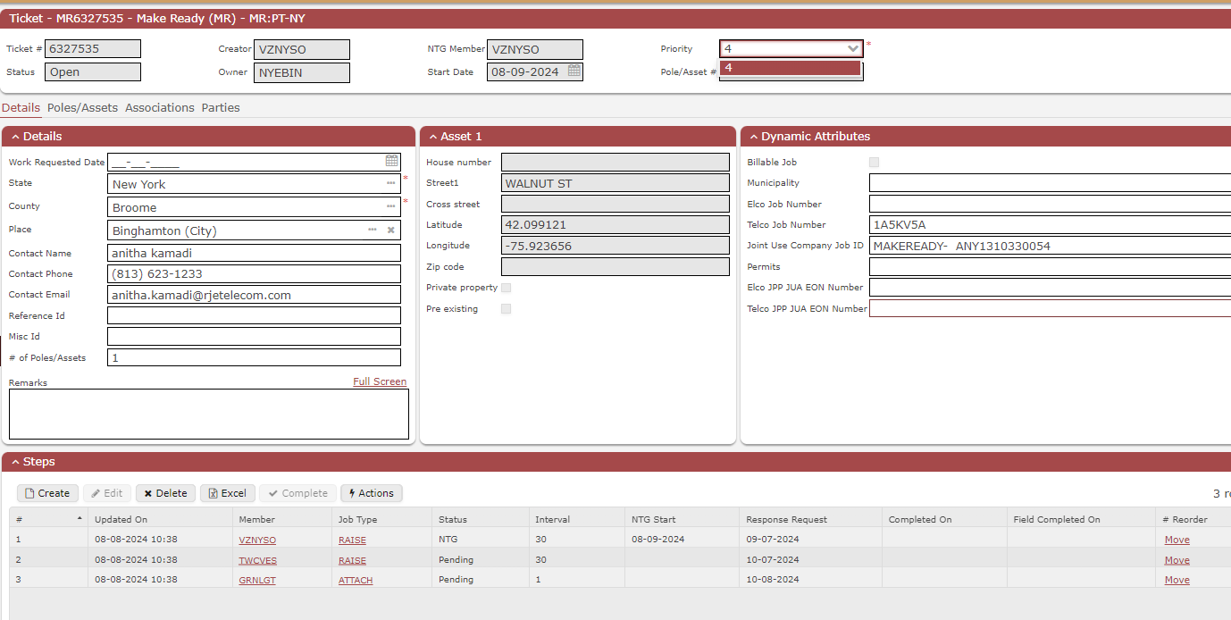
Make-Ready NJUNS TICKET SAMPLE

Slide 9
viii. Describe how NJUNS and your entity notifies attachers when they need to shift or move their attachments. Provide screenshots, if available
NJUNS automatically sends an email to the entity that is next to go for upcoming transfer work. NJUNS also generates a weekly next-to-go report on activity volumes.
Verizon may supplement NJUNs notices with emails and phone notifications when deemed necessary.
NJUNS members may monitor their next to go volumes to help them manage their workload.
ix. Discuss how NJUNS is funded and whether MLPs or attachers must pay to register and input data into NJUNS
NJUNS is a non-profit utility supported by an annual fee paid by pole owners. Third parties may use this system for free.

Slide 10
x. Explain whether your company currently mandates attacher participation in NJUNS and if this is accomplished through your company’s aerial license agreements. Discuss why or why not.
xi. Explain whether your company currently mandates municipal attacher participation in NJUNS. Discuss why or why not.
Verizon does not currently mandate that attachers be NJUNS members and it is not certain that Verizon could require them to do so.
A rule by the Departments requiring NJUNS membership and participation would be the most effective way to drive universal engagement.

Slide 11
xii. Explain whether the Departments should mandate registration with NJUNS by attachers and discuss why. What additional considerations apply?
NJUNS membership should be mandated.
NJUNS enhances efficiency and transparency for all pole work. Widespread membership is necessary to realize these advantages fully.
Requiring NJUNS membership would help ensure that pole owners know all the parties with attachments on a pole that needs to be replaced or upgraded. And it would ensure that each party would receive timely notifications for any required work on their facilities.
A state mandate would significantly accelerate the removal of double poles.
NJUNS is a robust and well-designed communication, notification, and reporting tool known for its reliability and the excellent management of its internal team. NJUNS user support is responsive and helpful, providing reports upon request.

Slide 12
xiii. In your company’s experience, discuss how often registered attachers fail to update NJUNS in a timely manner when they shift their attachments. Discuss whether and how the company’s aerial license agreements(s) accounts for an attacher’s failure to update NJUNS.
Practices regarding updates differ among companies and individual system users.
Some members postpone updates until completion of a project involving a large number of poles.
The best practice that should be followed is to update NJUNS as changes are made.
Verizon’s current pole attachment agreement in MA does not address NJUNS or NJUNS updates. As new make-ready rules have been adopted in other states, such as NY and PA, Verizon has updated pole attachment agreements to include the use of NJUNS.
xiv. Describe your company’s processes and protocols for identifying and addressing errors in NJUNS, e.g., wrong attacher listed, missing attacher, etc.
​Verizon uses NJUNs to pull reports for accuracy checks, update member codes, and resolve disputes.
A requirement to submit an NJUNS ticket upon completion of work would ensure timely notification for the next party in the process, improving efficiency and transparency. This simple practice has the potential to significantly reduce errors.
When a company makes any edits or changes to NJUNS data, the company name and contact information are automatically recorded within the ticket. This feature allows users to easily reach out when there are questions about accuracy.

Slide 13


