Slide 1
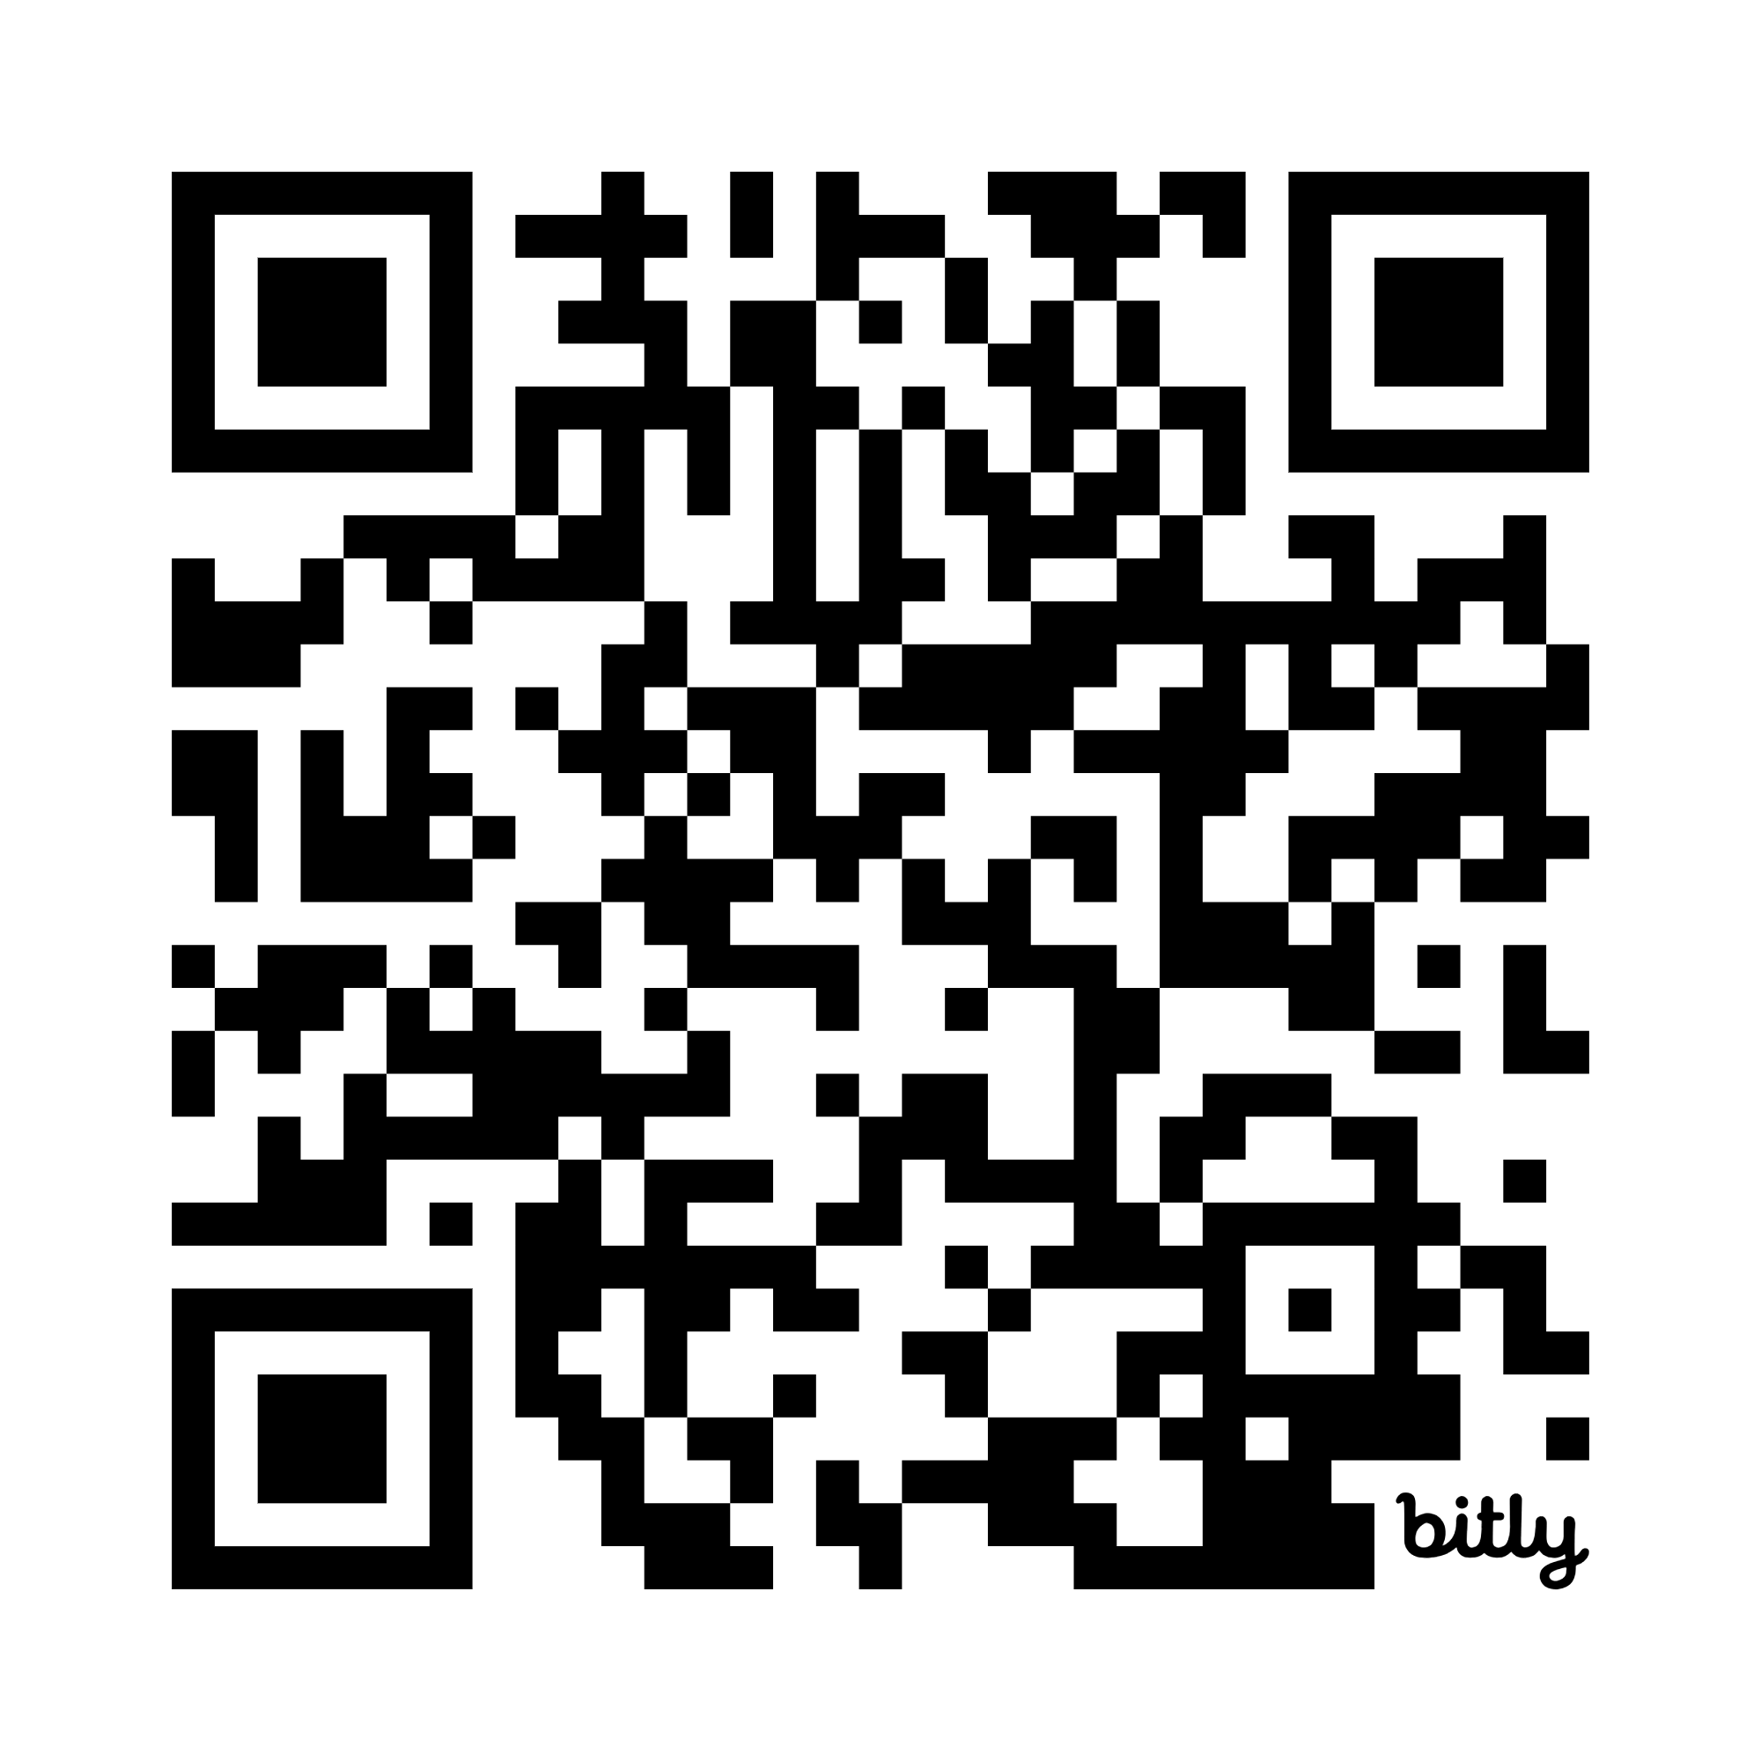
The Department of Public Utilities (DPU)
To view this slideshow in another language or an accessible format, please visit https://www.mass.gov/lists/dpu-reception-area-presentation
Or use the QR below
Department of Public Utilities
Privileged, confidential, protected communication, for intended recipient only

Slide 2
Mission Statement
The Department of Public Utilities (DPU) is an adjudicatory agency overseen by a three-member Commission. It is responsible for oversight of investor-owned electric power, natural gas, and water utilities in the Commonwealth. In addition, the DPU is charged with developing alternatives to traditional regulation, monitoring service quality, regulating safety in the transportation and gas pipeline areas, and the siting of energy facilities. The mission of the DPU is to ensure that consumers’ rights are protected, and that utility companies are providing the most reliable service at the lowest possible cost. The DPU oversees the public safety from transportation and gas pipeline-related accidents, and the energy facilities siting process. The DPU seeks to promote safety, security, reliability of service, affordability, equity, and greenhouse gas emission reductions.
Department of Public Utilities
Privileged, confidential, protected communication, for intended recipient only

Slide 3
The DPU Commission
The Department is overseen by the three-member Commonwealth Utilities Commission appointed by the Secretary of the Executive Office of Energy and Environmental Affairs with approval by the Governor. The Secretary designates one of the Commissioners as Chair.
Department of Public Utilities
Privileged, confidential, protected communication, for intended recipient only

Slide 4
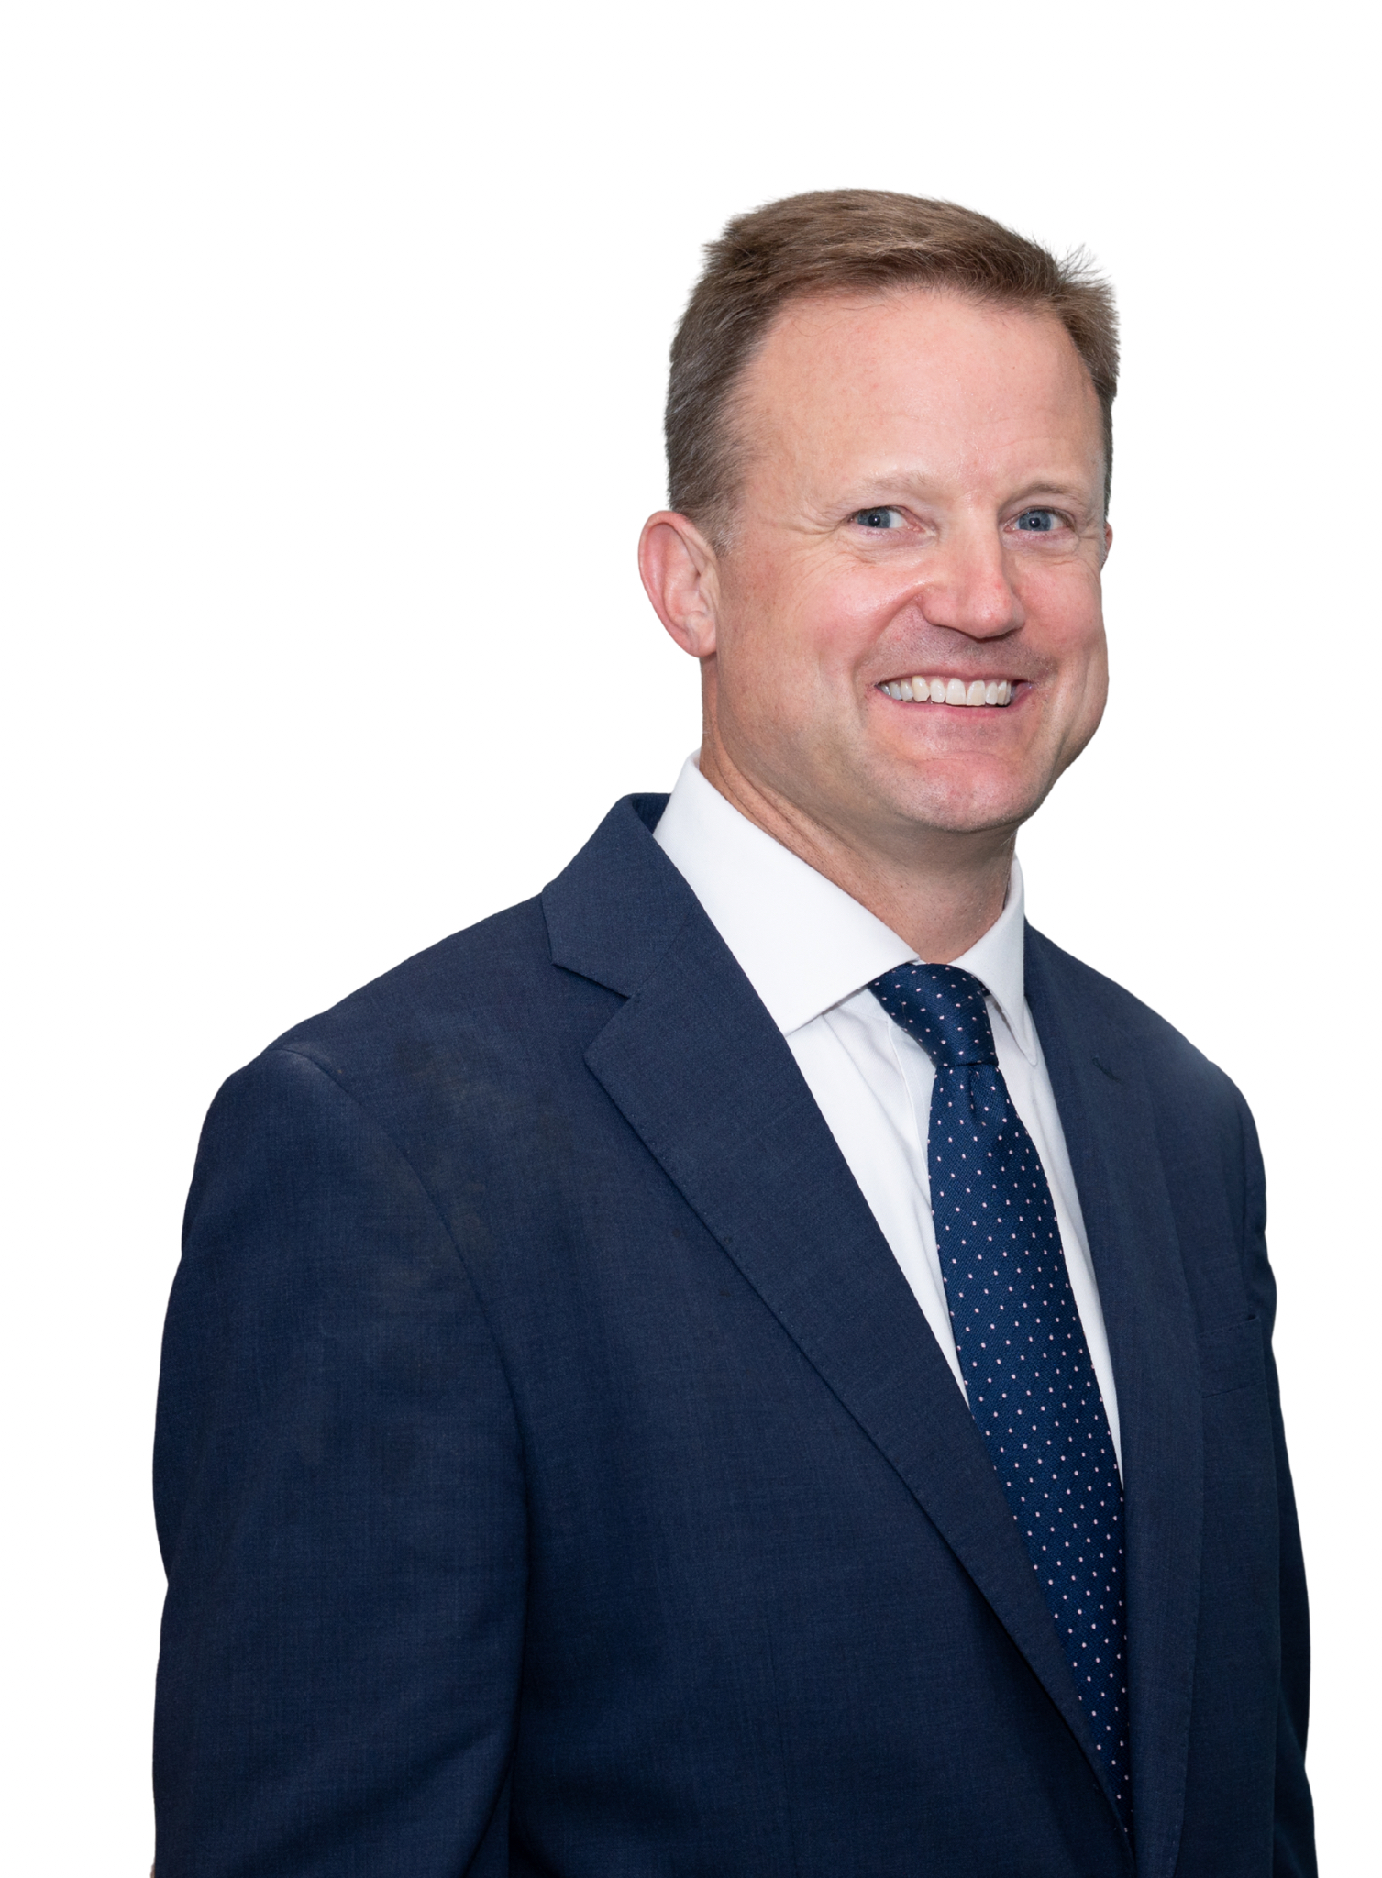
Chair Jeremy McDiarmid
The DPU Commission
Jeremy McDiarmid was appointed Chair on October 20, 2025, and first started as a Commissioner on September 29, 2025.
Prior to his appointment to the DPU, McDiarmid was the Managing Director and General Counsel for the national business association Advanced Energy United. During that time, McDiarmid served on Governor Healey’s Commission on Energy Infrastructure Siting and Permitting, led multiple efforts at the intersection of clean energy and affordability, and developed policies to support advanced transmission technologies in multiple states.
Previously, McDiarmid served as Vice President for Policy & Government Affairs at the Northeast Clean Energy Council, leading efforts to develop new interconnection policies and opening market opportunities for energy companies.
Department of Public Utilities
Privileged, confidential, protected communication, for intended recipient only

Slide 5
Chair Jeremy McDiarmid Continued
The DPU Commission
McDiarmid also worked as a Senior Advisor at Acadia Center and as the Senior Director of Innovation and Industry Support at Massachusetts Clean Energy Center. Before that, McDiarmid was the Massachusetts Director at Acadia Center and worked at the Office of Consumer Affairs and Business Regulation. He is a graduate of Syracuse University and Boston College Law School.
Department of Public Utilities
Privileged, confidential, protected communication, for intended recipient only

Slide 6
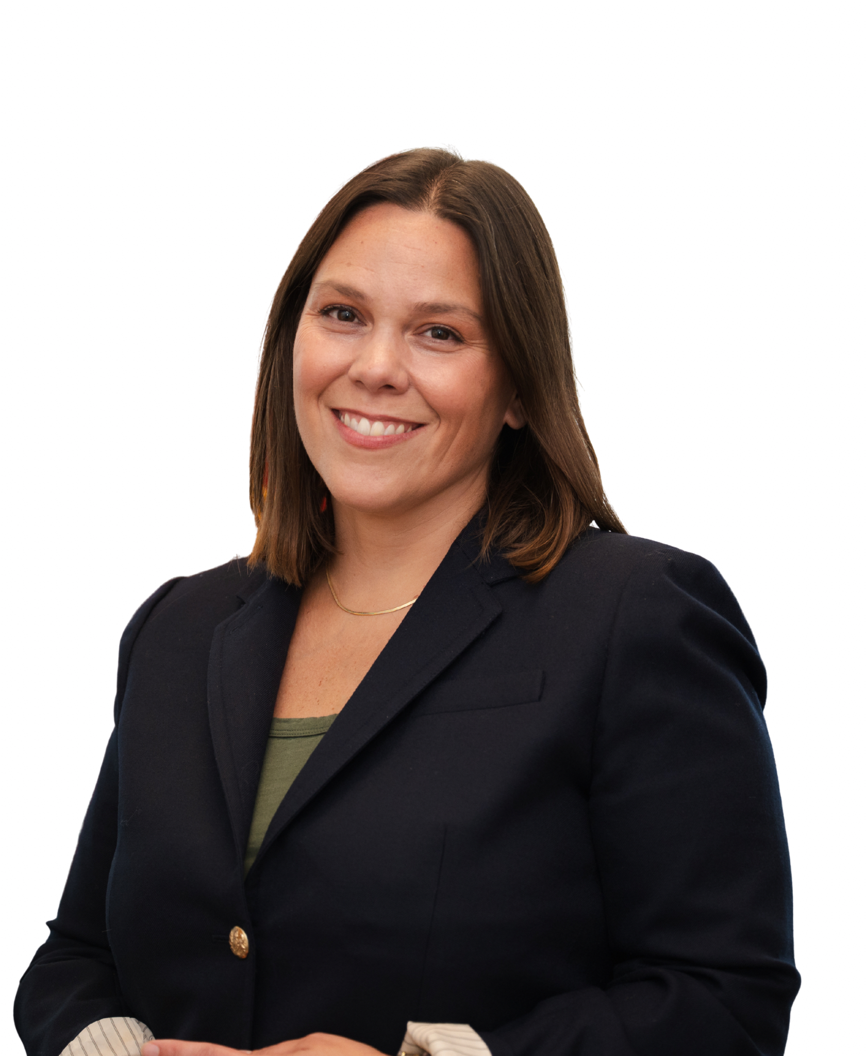
Commissioner Liz Anderson, Esq.
The DPU Commission
Liz Anderson was appointed as a Commissioner to the Department of Public Utilities in October of 2025. Anderson was the Chief of the Energy and Ratepayer Advocacy Division (ERA) in the Office of Massachusetts Attorney General Andrea Campbell before becoming appointed to the Commission. As Division Chief, Anderson oversaw ERA’s ratepayer advocacy at the DPU, ISO-New England and New England Power Pool (NEPOOL), and the Federal Energy Regulatory Commission, as well as ERA’s consumer protection enforcement practice related to retail electric suppliers and solar companies.
Department of Public Utilities
Privileged, confidential, protected communication, for intended recipient only

Slide 7
Commissioner Liz Anderson, Esq. Continued
The DPU Commission
Anderson also served on the Executive Committee for the National Association of State Utility Consumer Advocates (NASUCA) and spent time as Vice Chair of the NASUCA Consumer Protection Committee as well as Chair of the Coordinating Committee for ISO New England’s Consumer Liaison Group.
Prior to her role as Chief in the Attorney General's Office, Anderson helped manage ERA as Deputy Chief. She also was an associate for Rich May, P.C. in the firm’s Energy, Renewables & Regulated Industries Group, and spent several years as an Assistant Attorney General and Managing Attorney in ERA advocating for consumers in a wide range of matters concerning electricity, gas, and water regulation. Anderson is a graduate of New England School of Law and received her B.A. from the University of Virginia.
Department of Public Utilities
Privileged, confidential, protected communication, for intended recipient only

Slide 8
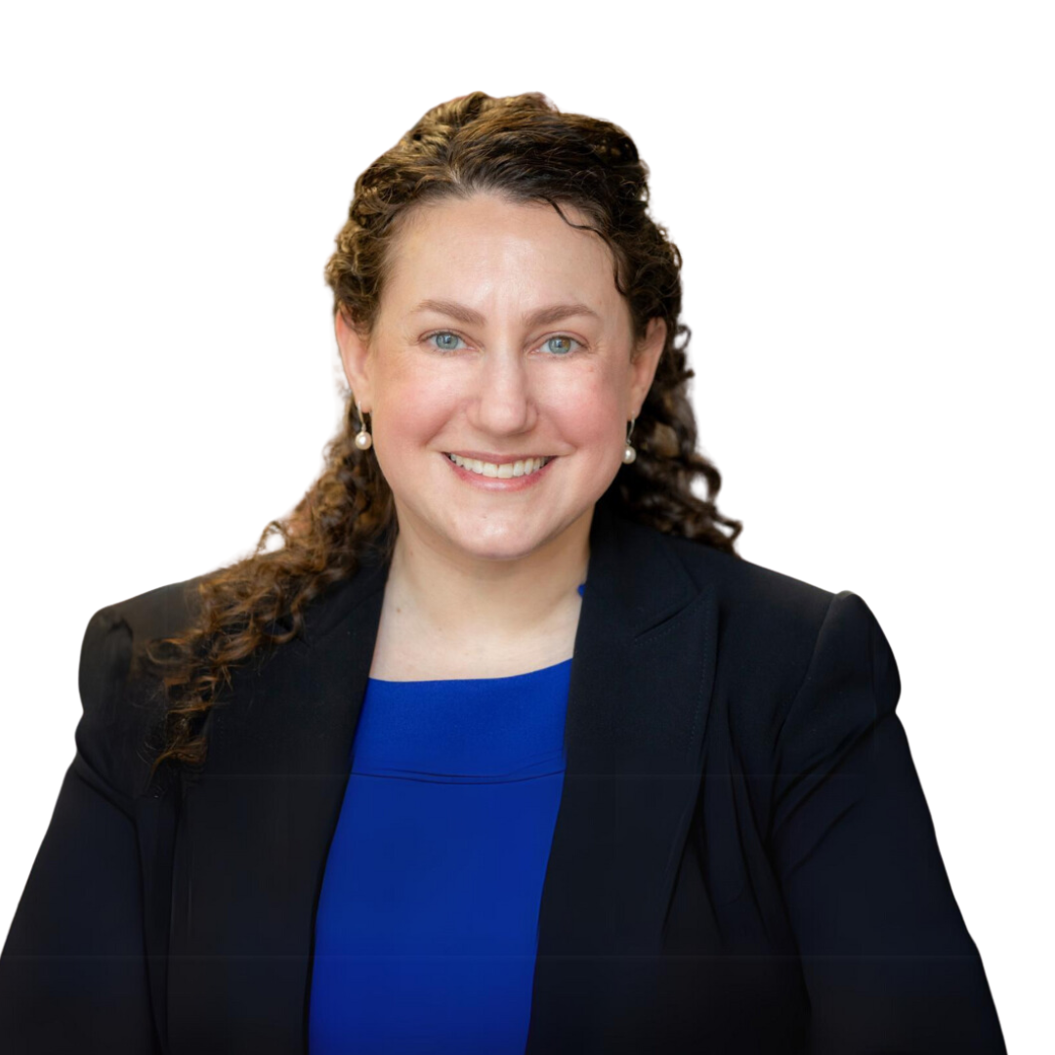
Commissioner Staci Rubin, Esq., MPH, MELP
The DPU Commission
Staci Rubin was appointed as a Commissioner to the Department of Public Utilities in April 2023 marking her return to the agency. Prior to her appointment, Rubin was the Vice President, Environmental Justice at Conservation Law Foundation (CLF) where she partnered with residents of historically marginalized communities to address challenges regarding transportation, climate justice, zero waste, and lead poisoning prevention in the six New England states. She embedded environmental justice throughout CLF’s culture and achieved victories using a community lawyering approach to improve transit operations and prevent energy and waste facilities in low-income communities and communities of color. Rubin successfully advocated for environmental justice laws in Massachusetts and Vermont.
Department of Public Utilities
Privileged, confidential, protected communication, for intended recipient only

Slide 9
Commissioner Staci Rubin, Esq., MPH, MELP Continued
The DPU Commission
Prior to CLF, Rubin served as Senior Counsel and Hearing Officer at the Department of Public Utilities where she specialized in distributed generation and public records matters. Preceding her role in state government, she was the Senior Attorney and Director of the Environmental Justice Legal Services program at Alternatives for Community & Environment, Inc. where she provided legal representation to resident groups and nonprofit organizations in low-income communities and communities of color regarding energy efficiency, transit fare programs, energy facility siting, community gardening, and other community-led initiatives. She has also taught Energy Law and Policy at Northeastern University School of Law.
Rubin earned a law degree from Northeastern University School of Law, a Master of Public Health degree from Tufts University School of Medicine, a Master of Environmental Law and Policy degree from Vermont Law School, and an undergraduate degree from New York University.
Department of Public Utilities
Privileged, confidential, protected communication, for intended recipient only

Slide 10
DPU Divisions
The Department of Public Utilities (DPU) oversees investor-owned electric power, natural gas, and water companies in Massachusetts. In addition, the DPU regulates the safety of bus companies, moving companies, and transportation network companies. We also oversee the safety of natural gas pipelines.
To facilitate its work in these areas, the Department of Public Utilities has created the following divisions: Consumer Division, Electric Power Division, Gas Division, Pipeline Safety Division, Transportation Network Companies (TNC) Division and Transportation Oversight Division.
Department of Public Utilities
Privileged, confidential, protected communication, for intended recipient only

Slide 11
Consumer Division
DPU Divisions
The Consumer Division of the Department of Public Utilities (DPU) assists consumers with their utility companies through dispute resolution, evaluation of regulatory compliance and customer service, and education. Contact us if you need help resolving a problem with your electric, gas, or investor-owned water utility.
Department of Public Utilities
Privileged, confidential, protected communication, for intended recipient only

Slide 12
Electric Power Division
DPU Divisions
The mission of the Electric Power Division is to ensure that electric distribution companies in Massachusetts provide their customers with the most reliable resource at the lowest possible cost. EPD also oversees and implements initiatives that encourage clean and renewable energy.
Department of Public Utilities
Privileged, confidential, protected communication, for intended recipient only

Slide 13
Gas Division
DPU Divisions
The mission of the Gas Division is to ensure that gas companies in Massachusetts provide their customers with the most reliable resource at the lowest possible cost.
Department of Public Utilities
Privileged, confidential, protected communication, for intended recipient only

Slide 14
Pipeline Safety Division
DPU Divisions
The Pipeline Safety Division acts as the enforcement arm of the Department of Public Utilities, ensuring that operators of natural gas distribution companies, municipal gas departments, steam distribution companies, and other intrastate operators are in compliance with state and federal regulations governing safety. The Division also oversees utility operators and excavators to preserve public utility service through enforcement of the Dig Safe Law.
Department of Public Utilities
Privileged, confidential, protected communication, for intended recipient only

Slide 15
Siting Division
DPU Divisions
The DPU Siting Division reviews requests to construct and operate transmission lines and issues necessary exemptions from municipal zoning for energy facilities. The DPU Siting Division administers DPU siting functions, and also serves as staff to the Energy Facilities Siting Board (EFSB). When proposed energy facilities involve both the DPU and EFSB, the DPU assigns its responsibilities to the EFSB in a consolidated proceeding.
Department of Public Utilities
Privileged, confidential, protected communication, for intended recipient only

Slide 16
Siting Division Continued
DPU Divisions
While the Energy Facilities Siting Board oversees the siting of many large energy facilities, the DPU also plays a complementary role that long pre-dates the creation of the EFSB.
The DPU reviews proposals to:
Construct and operate electric transmission lines
Exempt necessary energy facilities from municipal zoning ordinances
Authorize the survey of land for proposed energy facilities
Authorize the taking of land (or easements) for necessary energy facilities
Department of Public Utilities
Privileged, confidential, protected communication, for intended recipient only

Slide 17
Transportation Oversight Division
DPU Divisions
The Transportation Oversight Division regulates the rates and practices of common carriers used to transport passengers and property, including trucks, railways, buses, household moving companies, towing companies, and hazardous waste companies. In addition, we license all intrastate Massachusetts-based motor bus companies. The most critical function of the Division is public safety.
Department of Public Utilities
Privileged, confidential, protected communication, for intended recipient only

Slide 18
Transportation Network Company (TNC) Division
DPU Divisions
The Transportation Network Company (TNC) Division of the Department of Public Utilities oversees rideshare companies, rideshare services, and rideshare drivers in Massachusetts. This would include companies like Uber and Lyft as well as their drivers.
Department of Public Utilities
Privileged, confidential, protected communication, for intended recipient only

