Slide 1
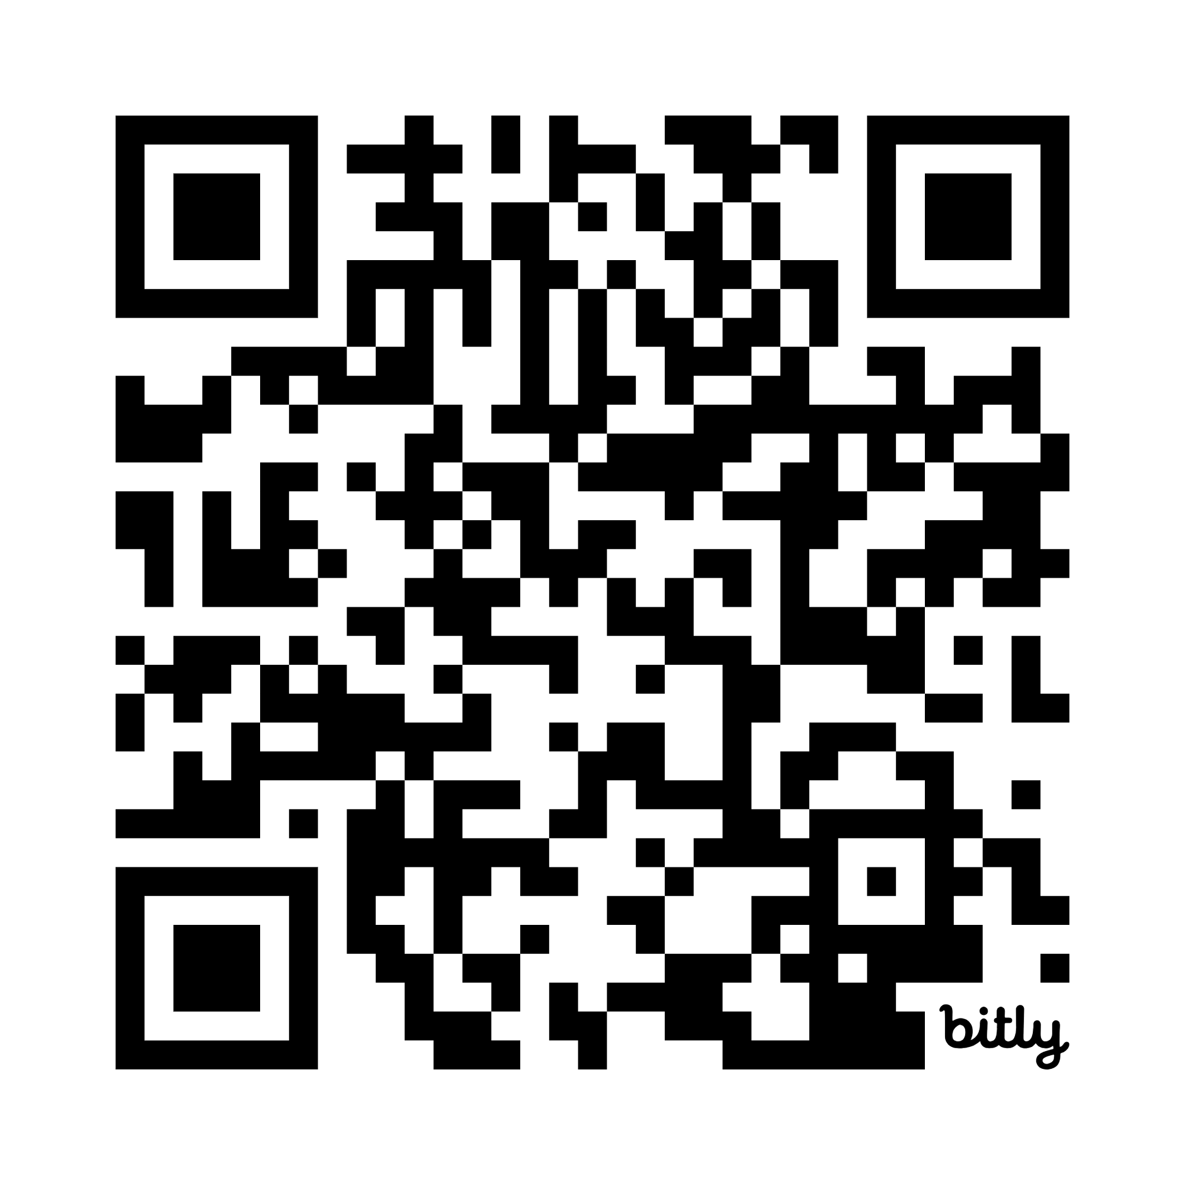
The Department of Public Utilities (DPU)
To view this slideshow in another language or an accessible format,
please visit https://www.mass.gov/lists/dpu-reception-area-presentation
Or use the QR below
Department of Public Utilities
Privileged, confidential, protected communication, for intended recipient only

Slide 2
Mission Statement
The Department of Public Utilities (DPU) is an adjudicatory agency overseen by a three-member Commission. It is responsible for oversight of investor-owned electric power, natural gas, and water utilities in the Commonwealth. In addition, the DPU is charged with developing alternatives to traditional regulation, monitoring service quality, regulating safety in the transportation and gas pipeline areas, and the siting of energy facilities. The mission of the DPU is to ensure that consumers’ rights are protected, and that utility companies are providing the most reliable service at the lowest possible cost. The DPU oversees the public safety from transportation and gas pipeline-related accidents, and the energy facilities siting process. The DPU seeks to promote safety, security, reliability of service, affordability, equity, and greenhouse gas emission reductions.
Department of Public Utilities
Privileged, confidential, protected communication, for intended recipient only

Slide 3
The DPU Commission
The Department is overseen by the three-member Commonwealth Utilities Commission appointed by the Secretary of the Executive Office of Energy and Environmental Affairs with approval by the Governor. The Secretary designates one of the Commissioners as Chair.
Department of Public Utilities
Privileged, confidential, protected communication, for intended recipient only

Slide 4
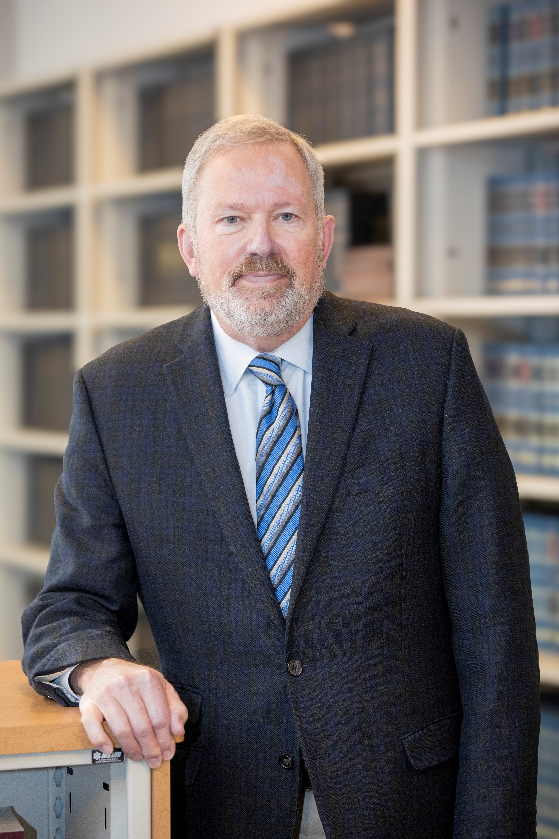
Chair James M. (Jamie) Van Nostrand
The DPU Commission
Jamie Van Nostrand was appointed Chair on March 15 for a term beginning on May 1, 2023. Prior to his appointment to the DPU, Van Nostrand was the Charles M. Love, Jr. Endowed Professor and Director of the Center for Energy and Sustainable Development at the West Virginia University College of Law. He is the author of THE COAL TRAP: HOW WEST VIRGINIA WAS LEFT BEHIND IN THE CLEAN ENERGY REVOLUTION (Cambridge University Press, 2022). Before moving to WVU in July 2011, Van Nostrand spent three years as a member of the adjunct faculty at the Elisabeth Haub School of Law at Pace University in White Plains, NY and Executive Director of the Pace Energy and Climate Center.
Department of Public Utilities
Privileged, confidential, protected communication, for intended recipient only

Slide 5
Chair James M. (Jamie) Van Nostrand
Continued
The DPU Commission
Prior to his transition to law school teaching, Van Nostrand had a successful career in private law practice as a partner in the energy and environmental practice groups of two large law firms based in the Pacific Northwest (Perkins Coie LLP and Stoel Rives LLP). In his 22-year career in private practice, Van Nostrand represented energy clients in state regulatory proceedings in eight western states, as well as proceedings before the Federal Energy Regulatory Commission. Mr. Van Nostrand was recognized by the Energy Bar Association as its 2007 State Regulatory Practitioner of the Year.
Mr. Van Nostrand received his LL.M. in Environmental Law from the Elisabeth Haub School of Law at Pace University, his J.D. from the University of Iowa College of Law, his master’s degree in economics from SUNY at Albany, and an undergraduate degree in economics from the University of Northern Iowa.
Department of Public Utilities
Privileged, confidential, protected communication, for intended recipient only

Slide 6
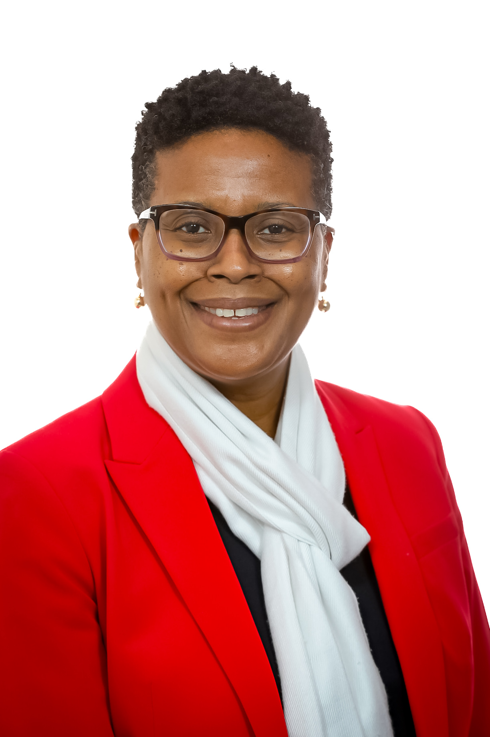
Commissioner Cecile M. Fraser, Esq.
The DPU Commission
Cecile Fraser was first appointed as a Commissioner to the Department of Public Utilities in June of 2017. In January 2023, she was appointed Acting Chair, and served as Acting Chair until May 1, 2023. Prior to her appointment, Fraser served with the Department as counsel in the Division of Regional and Federal Affairs and the Consumer Division. Fraser is an attorney with over a decade of experience in the energy and utilities industry. Prior to joining the Department, Fraser worked in private law practice and as an in-house counsel engaged in a range of matters involving utility rates and regulation, infrastructure siting, consumer service issues and related activities.
Department of Public Utilities
Privileged, confidential, protected communication, for intended recipient only

Slide 7
Commissioner Cecile M. Fraser, Esq.
Continued
The DPU Commission
As counsel with the Department, Fraser has worked on issues involving New England’s wholesale electric markets and transmission system, as well as consumer issues. Fraser received a Bachelor of Arts degree in Political Science from Fordham University and her J.D. from Rutgers University School of Law-Camden.
Department of Public Utilities
Privileged, confidential, protected communication, for intended recipient only

Slide 8
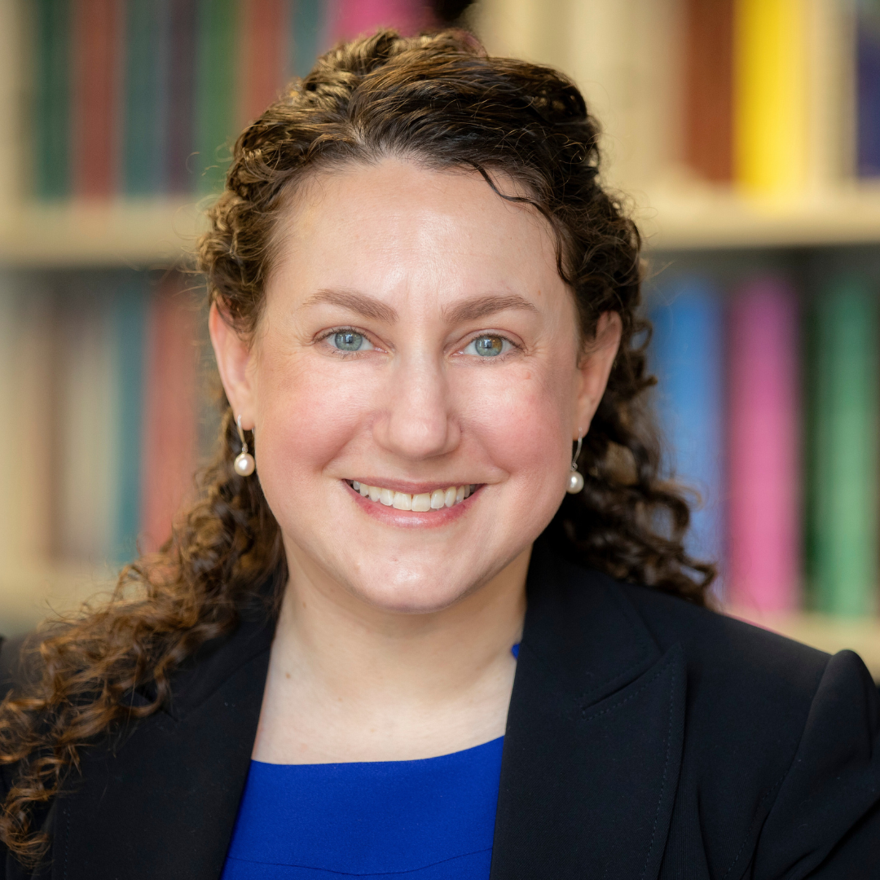
Commissioner Staci Rubin, Esq., MPH, MELP
The DPU Commission
Staci Rubin was appointed as a Commissioner to the Department of Public Utilities in April 2023 marking her return to the agency. Prior to her appointment, Rubin was the Vice President, Environmental Justice at Conservation Law Foundation (CLF) where she partnered with residents of historically marginalized communities to address challenges regarding transportation, climate justice, zero waste, and lead poisoning prevention in the six New England states. She embedded environmental justice throughout CLF’s culture and achieved victories using a community lawyering approach to improve transit operations and prevent energy and waste facilities in low-income communities and communities of color. Rubin successfully advocated for environmental justice laws in Massachusetts and Vermont.
Department of Public Utilities
Privileged, confidential, protected communication, for intended recipient only

Slide 9
Commissioner Staci Rubin, Esq., MPH, MELP
Continued
The DPU Commission
Prior to CLF, Rubin served as Senior Counsel and Hearing Officer at the Department of Public Utilities where she specialized in distributed generation and public records matters. Preceding her role in state government, she was the Senior Attorney and Director of the Environmental Justice Legal Services program at Alternatives for Community & Environment, Inc. where she provided legal representation to resident groups and nonprofit organizations in low-income communities and communities of color regarding energy efficiency, transit fare programs, energy facility siting, community gardening, and other community-led initiatives. She has also taught Energy Law and Policy at Northeastern University School of Law.
Rubin earned a law degree from Northeastern University School of Law, a Master of Public Health degree from Tufts University School of Medicine, a Master of Environmental Law and Policy degree from Vermont Law School, and an undergraduate degree from New York University.
Department of Public Utilities
Privileged, confidential, protected communication, for intended recipient only

Slide 10
DPU Divisions
The Department of Public Utilities (DPU) oversees investor-owned electric power, natural gas, and water companies in Massachusetts. In addition, the DPU regulates the safety of bus companies, moving companies, and transportation network companies. We also oversee the safety of natural gas pipelines.
To facilitate its work in these areas, the Department of Public Utilities has created the following divisions: Consumer Division, Electric Power Division, Gas Division, Pipeline Safety Division, Transportation Network Companies (TNC) Division and Transportation Oversight Division.
Department of Public Utilities
Privileged, confidential, protected communication, for intended recipient only

Slide 11
Consumer Division
DPU Divisions
The Consumer Division of the Department of Public Utilities (DPU) assists consumers with their utility companies through dispute resolution, evaluation of regulatory compliance and customer service, and education. Contact us if you need help resolving a problem with your electric, gas, or investor-owned water utility.
Department of Public Utilities
Privileged, confidential, protected communication, for intended recipient only

Slide 12
Electric Power Division
DPU Divisions
The mission of the Electric Power Division is to ensure that electric distribution companies in Massachusetts provide their customers with the most reliable resource at the lowest possible cost. EPD also oversees and implements initiatives that encourage clean and renewable energy.
Department of Public Utilities
Privileged, confidential, protected communication, for intended recipient only

Slide 13
Gas Division
DPU Divisions
The mission of the Gas Division is to ensure that gas companies in Massachusetts provide their customers with the most reliable resource at the lowest possible cost.
Department of Public Utilities
Privileged, confidential, protected communication, for intended recipient only

Slide 14
Pipeline Safety Division
DPU Divisions
The Pipeline Safety Division acts as the enforcement arm of the Department of Public Utilities, ensuring that operators of natural gas distribution companies, municipal gas departments, steam distribution companies, and other intrastate operators are in compliance with state and federal regulations governing safety. The Division also oversees utility operators and excavators to preserve public utility service through enforcement of the Dig Safe Law.
Department of Public Utilities
Privileged, confidential, protected communication, for intended recipient only

Slide 15
Siting Division
DPU Divisions
The DPU Siting Division reviews requests to construct and operate transmission lines and issues necessary exemptions from municipal zoning for energy facilities. The DPU Siting Division administers DPU siting functions, and also serves as staff to the Energy Facilities Siting Board (EFSB). When proposed energy facilities involve both the DPU and EFSB, the DPU assigns its responsibilities to the EFSB in a consolidated proceeding.
Department of Public Utilities
Privileged, confidential, protected communication, for intended recipient only

Slide 16
Siting Division
Continued
DPU Divisions
While the Energy Facilities Siting Board oversees the siting of many large energy facilities, the DPU also plays a complementary role that long pre-dates the creation of the EFSB.
The DPU reviews proposals to:
  Construct and operate electric transmission lines
  Exempt necessary energy facilities from municipal zoning ordinances
  Authorize the survey of land for proposed energy facilities
  Authorize the taking of land (or easements) for necessary energy facilities
Department of Public Utilities
Privileged, confidential, protected communication, for intended recipient only

Slide 17
Transportation Oversight Division
DPU Divisions
The Transportation Oversight Division regulates the rates and practices of common carriers used to transport passengers and property, including trucks, railways, buses, household moving companies, towing companies, and hazardous waste companies. In addition, we license all intrastate Massachusetts-based motor bus companies. The most critical function of the Division is public safety.
Department of Public Utilities
Privileged, confidential, protected communication, for intended recipient only

Slide 18
Transportation Network Company (TNC) Division
DPU Divisions
The Transportation Network Company (TNC) Division of the Department of Public Utilities oversees rideshare companies, rideshare services, and rideshare drivers in Massachusetts. This would include companies like Uber and Lyft as well as their drivers.
Department of Public Utilities
Privileged, confidential, protected communication, for intended recipient only

