Slide 1
Drinking water renewals
April 10th, 2020

Slide 2
Agenda
Open Items
Job-Aid Walk Through
Q & A

Slide 3
Open items
Upgraded Licenses
Phone Number – 617-701-8732
Emails – drinkingwaterboard@mass.gov
Late Fee - Waived

Slide 4
Job-aid walk through
Creating an ePLACE Portal Account
Linking a License
Renewing a License via ePLACE Portal

Slide 5
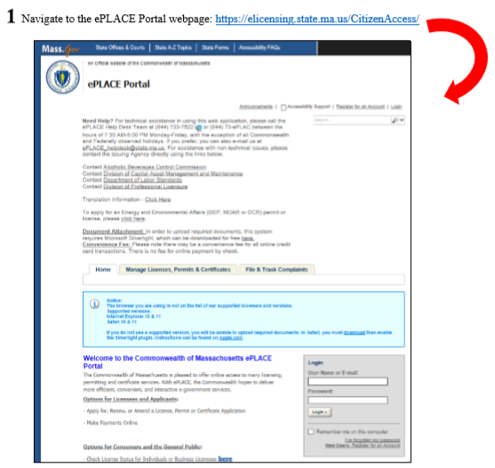
Creating an ePLACE Portal Account

Slide 6
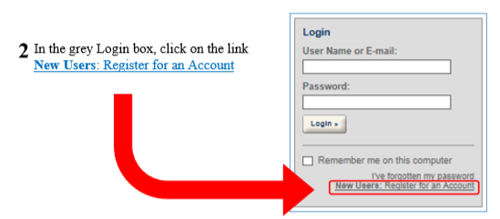
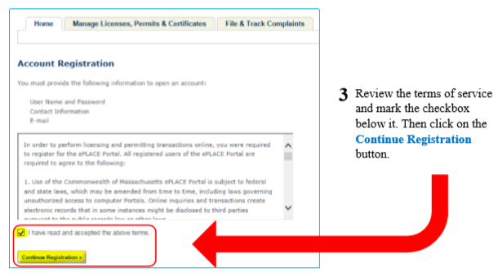
Creating an ePLACE Portal Account

Slide 7
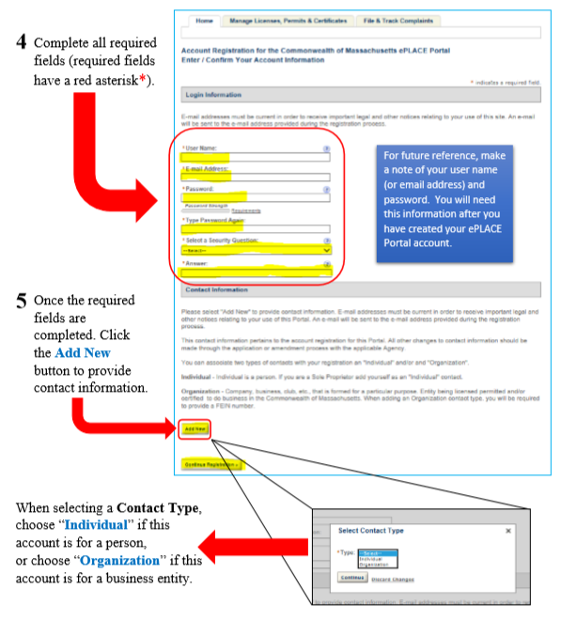
Creating an ePLACE Portal Account

Slide 8
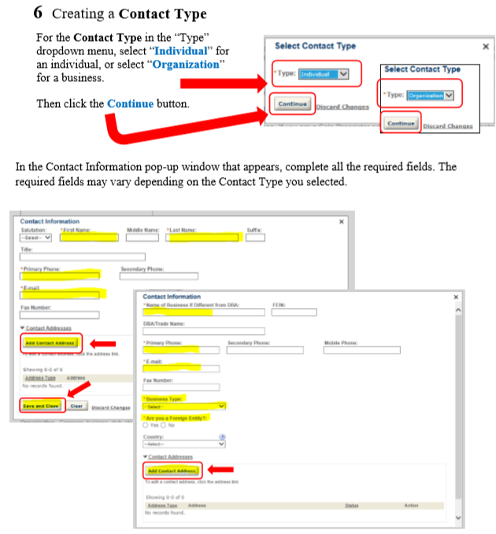
Creating an ePLACE Portal Account

Slide 9
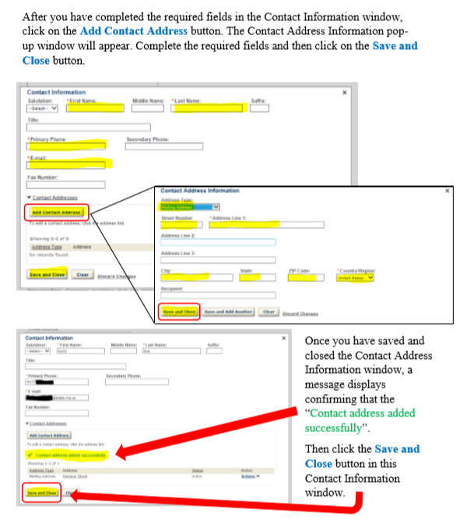
Creating an ePLACE Portal Account

Slide 10
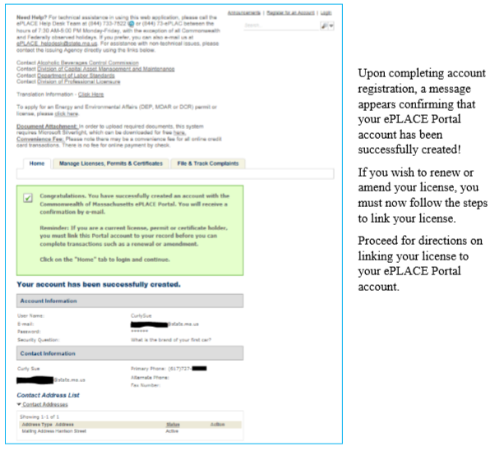
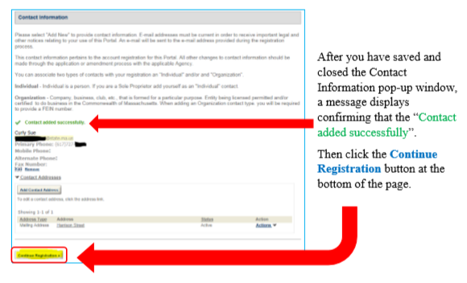
Creating an ePLACE Portal Account

Slide 11
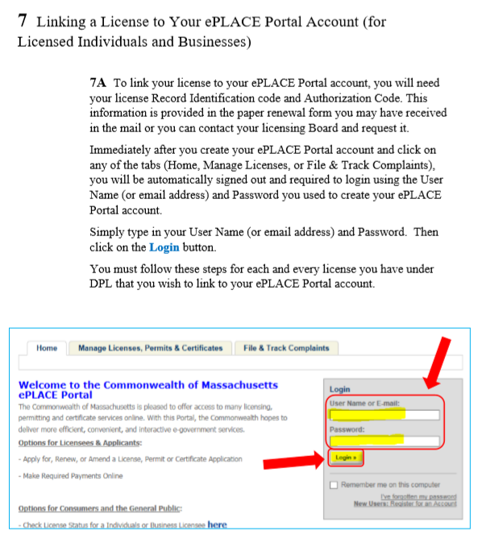
Linking a license to your ePLACE portal Account

Slide 12
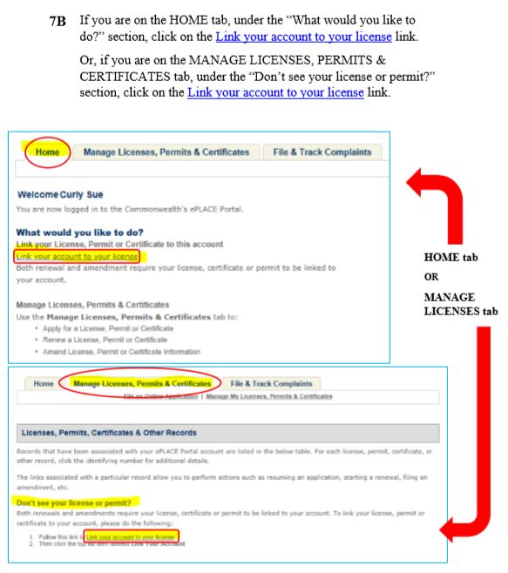
Linking a license to your ePLACE portal Account

Slide 13
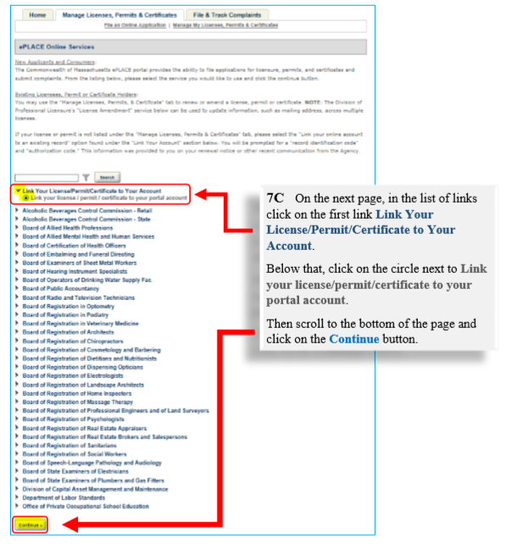
Linking a license to your ePLACE portal Account

Slide 14
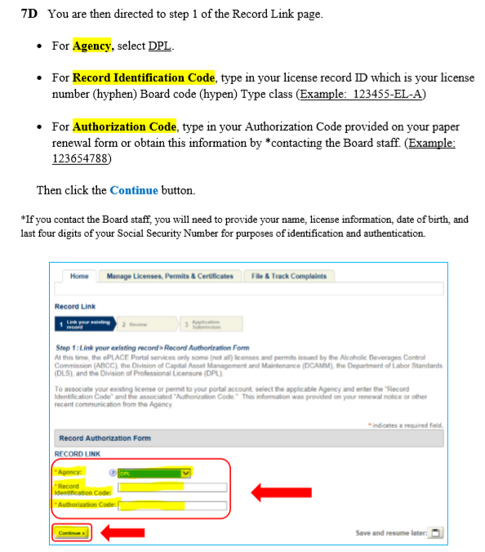
Linking a license to your ePLACE portal Account

Slide 15
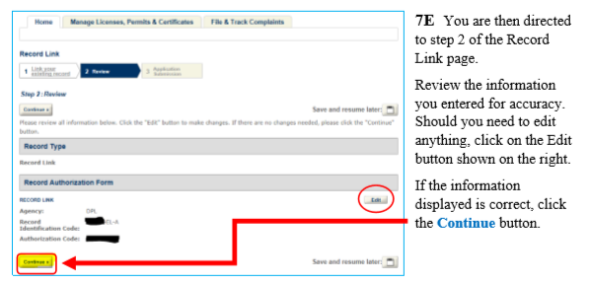
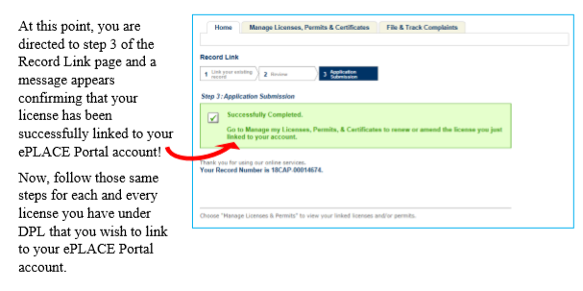
Linking a license to your ePLACE portal Account

Slide 16
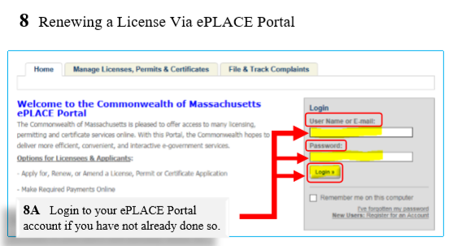
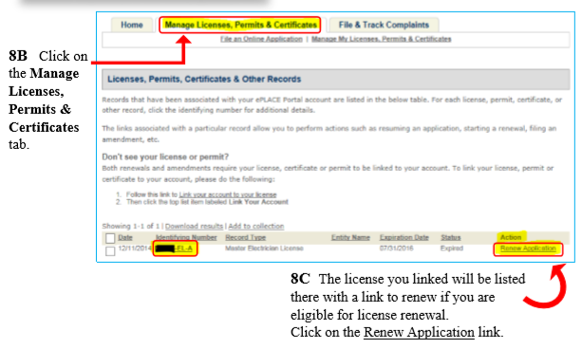
Renewing a license via your ePLACE portal Account

Slide 17
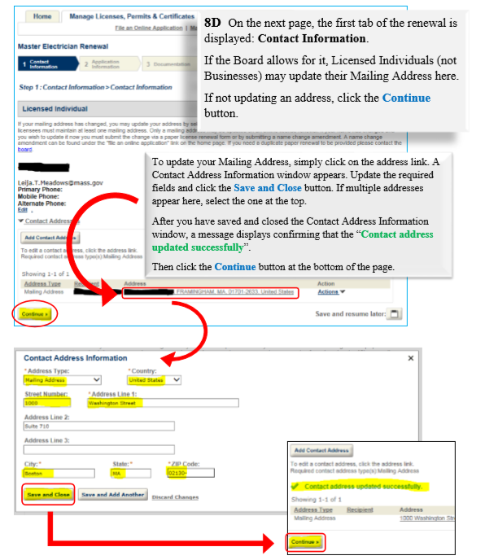
Renewing a license via your ePLACE portal Account

Slide 18
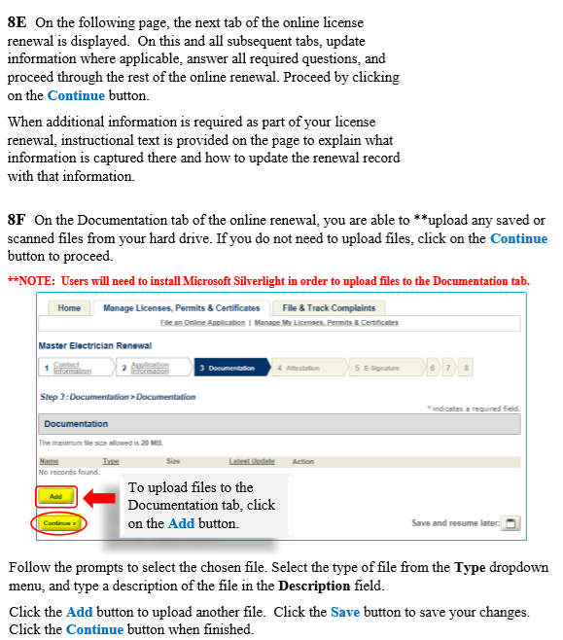
Renewing a license via your ePLACE portal Account

Slide 19
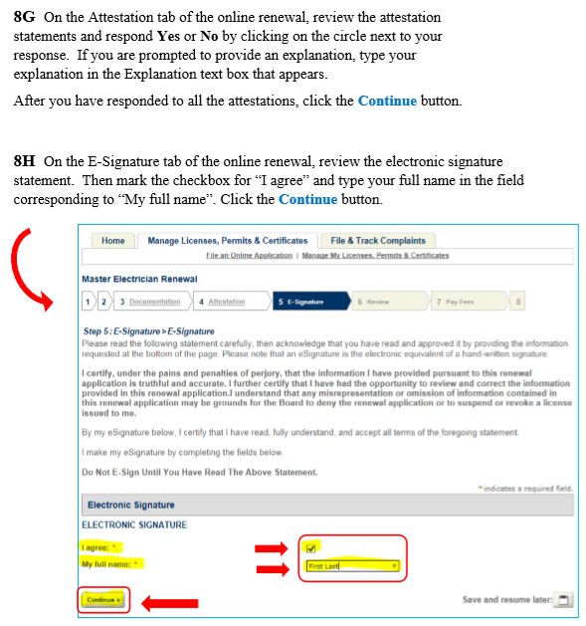
Renewing a license via your ePLACE portal Account

Slide 20
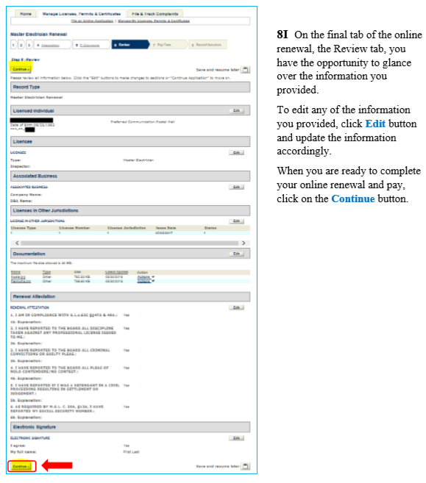
Renewing a license via your ePLACE portal Account

Slide 21
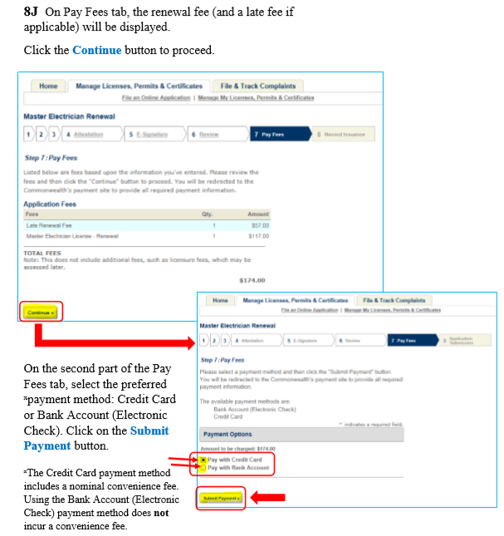
Renewing a license via your ePLACE portal Account

Slide 22
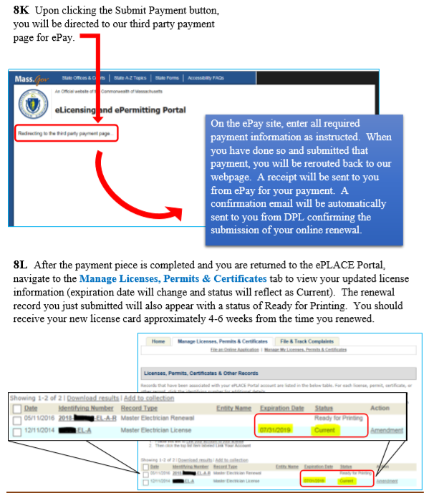
Renewing a license via your ePLACE portal Account

