Slide 1


Presentation for the D.P.U. 25-10 & D.T.C. 25-1 Technical Sessions
June 23-27, 2025​

Slide 2

Topics Addressed
Topic 1: Technical, Safety, and Engineering Considerations for Pole Attachments (June 23, 2025)
Topic 3: Attachment Applications, Survey, and Make-Ready Work and Associated Costs (June 23, 2025)
Topic 6: Massachusetts Formula and Inputs (June 25, 2025)
Topic 7: Memorandum of Agreement and Dispute Resolution (June 25, 2025)
2

Slide 3
Introductions
NECTA
Tim Wilkerson, President
Dave Soutter, Director of Public Policy and Regulatory Affairs
Patricia Kravtin, Owner and Consulting Economist, Patricia Kravtin Consulting
Comcast
Sean Carroll, Senior Director, Government and Regulatory Affairs
Terry O’Brien, Senior Director, Construction
Charter Communications
Michael Chowaniec, Vice President, State Government Affairs
Danielle Duplessis, Director, Legal Counsel
Nancy Clark, Director, Government Affairs
Cox Communications
Lindsay DeRoche, Director, Regulatory Affairs
Breezeline
Fran Bradley, Director of Government Affairs
Shannon Galvin, Associate Counsel
3

Slide 4




Our Members
In addition, NECTA Affiliate members represent a broad spectrum of entities that develop
and deliver the products and services that entertain, transport, teach, employ,
and provide the necessities and joys of a 21st century connected society.
4

Slide 5
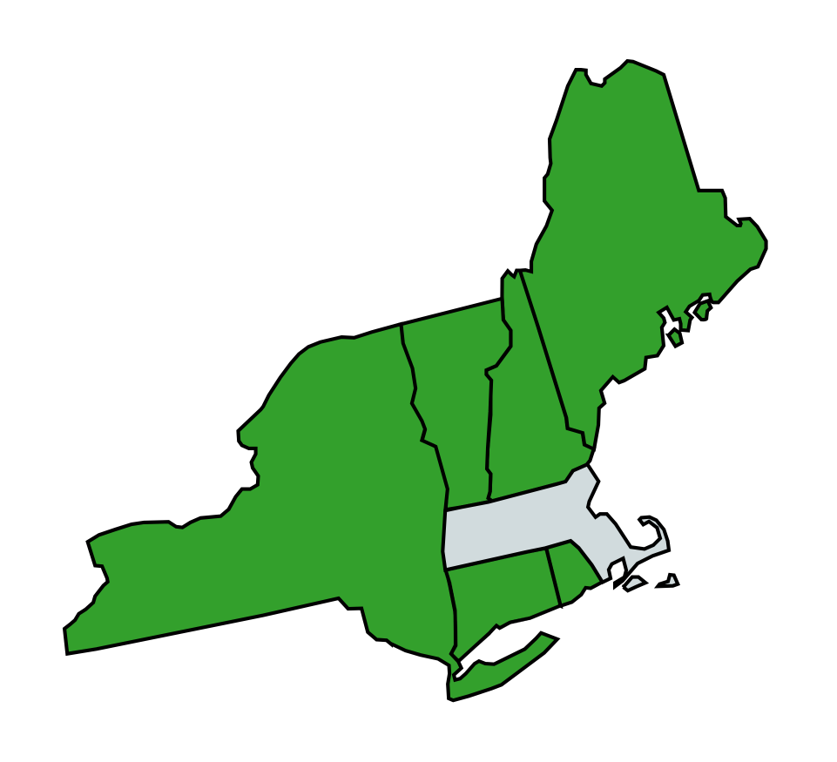
Topic 1
Technical, Safety, and Engineering Considerations for Pole Attachments
Massachusetts pole owners and NECTA Members operate across borders in the region and beyond
Safety and reliability of networks are paramount
FCC Rules already meet technical, safety and engineering considerations
5

Slide 6
Pole Owners and Attachers
Work Well Together
Massachusetts pole owners and NECTA Members have a collaborative relationship in the field and attach on nearly 2 million poles, mostly without issue
The relationship is generally good, but issues are complex. NECTA and the NECTA Members are here looking for solutions to these problems
One area for improvement: Chunking
6

Slide 7
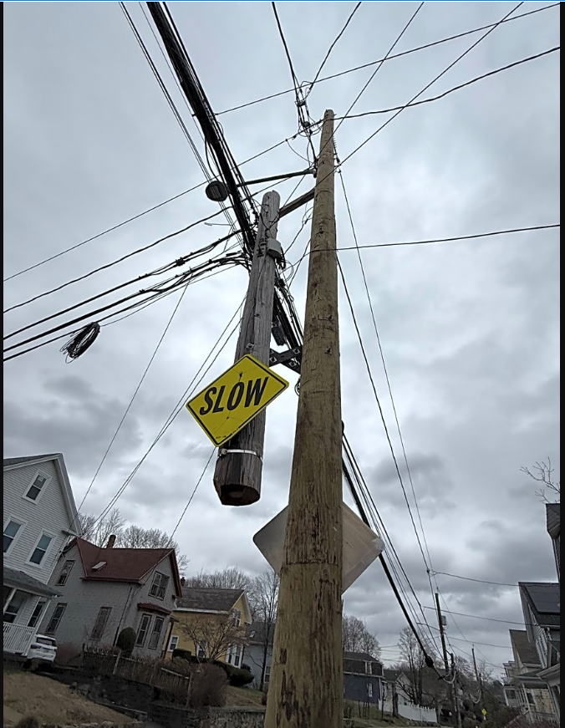
Chunking
Chunking is a common practice
Cut and Kick Method is sometimes necessary
Not only a safety issue but also delays removal of double poles
The #1 issue is the placement of the brackets when affixing the old pole to the replacement pole
The Departments should require that any method to affix the old pole to the new be placed below any attachments to be transferred
7

Slide 8
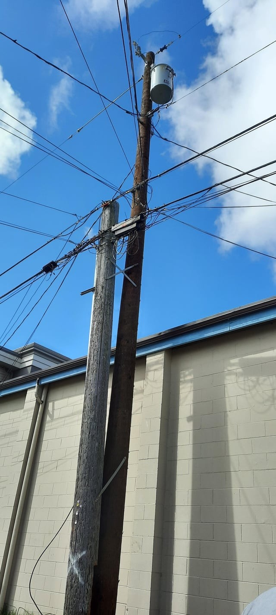
Chunking:
Preferable Method
The brackets are below the wires to be transferred
A properly “topped” example, where the pole is cut above the next wire to be transferred
Simple “up and over” transfer to the new pole
8

Slide 9
Conclusion of Topic 1 Presentation

Slide 10

Topic 3
Attachment Applications, Survey, and Make-Ready Work and Associated Costs
Adopt the FCC rules, which meet today’s needs
      One-touch make-ready
      Enforceable timelines for surveys, estimates, and make-ready
      Use of qualified contractors
Rules that are consistent across state lines create efficiency and operational benefits
Allow greater use of temporary attachments
Designate or require pole owners to designate a single pole administrator (SPA) for each pole
10

Slide 11
Timeline Exemptions –
Already in FCC Rules
47 CFR 1.1411(g): Adds time into the process for large pole applications
47 CFR 1.1411(h): “Deviation from the time limits specified in this section” due to:
  No pole attachment agreement
  “Good and sufficient cause”
  Complex make-ready for reasons of safety or service interruption
11

Slide 12
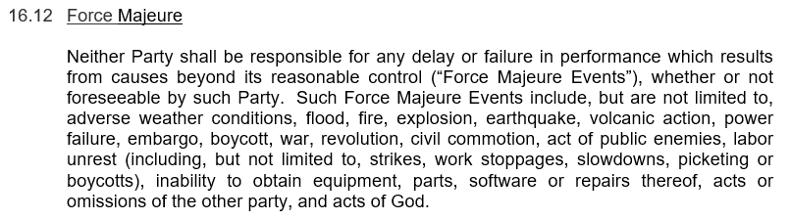
Timeline Exemptions –
Already in Pole Attachment Agreements
Excerpt from Verizon’s standard Pole Attachment Agreement:
12

Slide 13
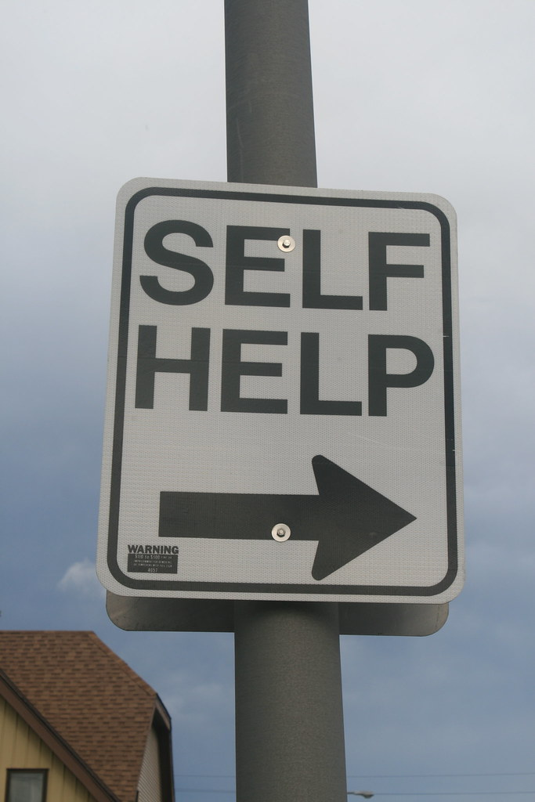
Self Help–
No Statutory Impediment
Self-help does not mean attaching without consent
If self-help occurs, in the context of physically attaching to a pole, it is only after a pole owner(s) approves an attachment application
This docket is not addressing transmission poles/ “electricity in bulk”
13

Slide 14
FCC Rules Fully
Compensate Pole Owners
Attachers pay full freight for application fees, engineering fees and make-ready costs, including true-ups if the make-ready estimate is low
Under the Massachusetts Formula, pole owners are fully compensated for ongoing pole costs with rental rates
Properly calculated pole attachment rates mean that electric customers do not subsidize costs for broadband attachers/customers
14

Slide 15
In Conclusion:
A Quote from the FCC
“With OTMR as the centerpiece of this new pole attachment regime, new attachers will save considerable time in gaining access to poles (with accelerated deadlines for application review, surveys, and make-ready work) and will save substantial costs with one party (rather than multiple parties) doing the work to prepare poles for new attachments. A better aligning of incentives for quicker and less expensive attachments will serve the public interest through greater broadband deployment and competitive entry.”
FCC, In re Accelerating Wireline Broadband Deployment by Removing Barriers to Infrastructure Investment, WC Docket No. 17-84, Third Report & Order & Declaratory Ruling, 33 FCC Rcd. 7705, ¶ 16 (2018).
15

Slide 16
Conclusion of Topic 3 Presentation

Slide 17
Topic 6
Massachusetts Formula and Inputs
The Statute
The Departments are required to determine a just and reasonable pole attachment rate “by assuring the utility recovery of not . . . more than the proportional capital and operating expenses of the utility attributable to that portion of the pole, duct, or conduit occupied by the attachment.” G.L. c. 166, § 25A.
17

Slide 18
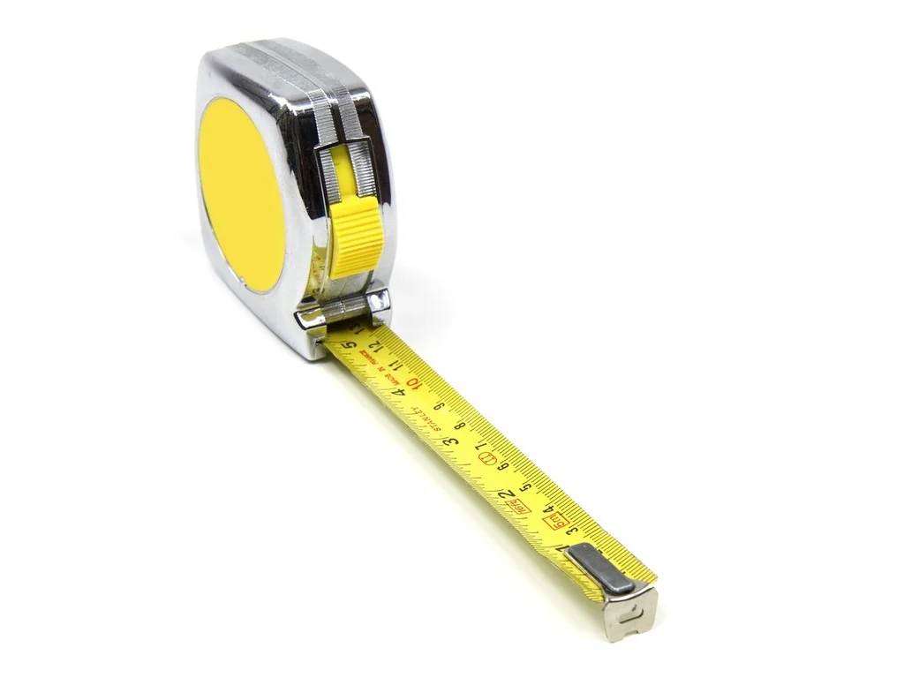
Average Pole Height
The record is clear that the average pole height in MA is now taller than the Departments’ 37.5’ presumption
Options:
  Modernize the presumption to 40’ and enable the pole owners to rebut the presumption with their actual average pole heights, or
  Require each pole owner to use its actual average pole height in the formula
18

Slide 19
Appurtenance Factor
Equipment not used or useful to the attacher
Given network hardening and other factors, pole owners’ average investment in appurtenances is now greater than the Departments’ 15% presumption, meaning the presumption results in an overstatement of pole investment
Options:
  Modernize the presumption to, for example, 22.5% and enable the pole owners to rebut with actual investment in appurtenances, or
  Require pole owners to use their actual investment in appurtenances as part of the formula
19

Slide 20

Tariffing & Transparency
An alternative – tariffing attachment rates
Pole owners should closely and accurately track all data relevant to the Massachusetts Formula and report such data to the Departments
Pole owners should provide attachers detailed data and a calculation supporting any rate increase concurrent with notice of the increase
20

Slide 21
Conclusion of Topic 6 Presentation

Slide 22
Topic 7
Memorandum of Agreement and Dispute Resolution
The Departments’ MOA
Joint Adjudications
  In the event of an impasse, the position of the agency that would have had jurisdiction under the original MOA should be adopted
Neither agency should have unilateral authority to dismiss a “complaint which seeks relief that is more appropriate for a rulemaking”
Neither agency should have unilateral authority based on its own assessment of the impact on “the reliability of the electric system, the safety of electrical workers, or the costs of the electric distribution system”
Both agencies must give the parties the opportunity to be heard and subsequently make a joint decision
22

Slide 23
Expedited Dispute Resolution
Resolutions are needed more quickly than a six-month timeframe
Lengthy delays impact customers who want our service and can delay closing the digital divide
Getting the other party to the table is sometimes an insurmountable hurdle
Negotiation > Complaint & Mediation > Complaint
Models
  DPU: Distributed Generation and Clean Energy Ombudsperson’s Office
  DTC: 207 CMR 15.00, Accelerated Docket for Disputes
  FCC, federal default states, and some certified states: Rapid Broadband Assessment Team (“RBAT”)
  Maine PUC: Rapid Response Process Team (“RRPT”)
23

Slide 24
Conclusion of Topic 7 Presentation

