Slide 1


EEA Environment & Climate One Stop
(ECO One Stop)
Request for Responses Informational Session
January 2026

Slide 2
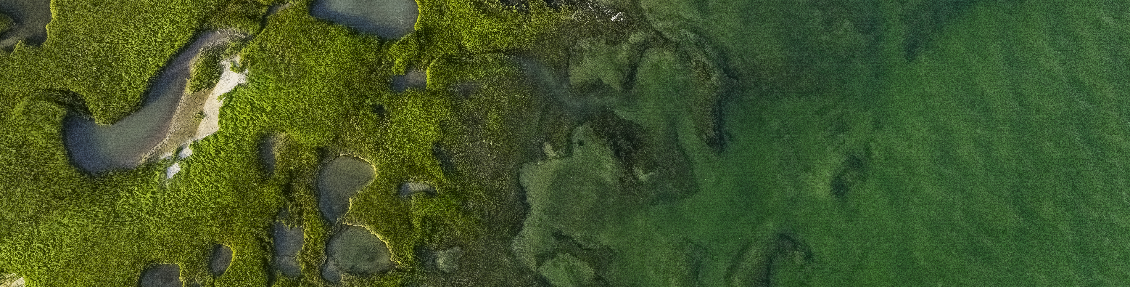
Agenda
Welcome from Stephanie Cooper, Undersecretary for Environment
Introductions
Overview of ECO One Stop, Timeline, & Summary of Expressions of Interest (EOIs)
Overview of ECO One Stop Request for Responses and Application
  Grants Catalogue
  Grants Management System
  Piloting the MassEnviroScreen Tool
Q&A
Note: This webinar will be recorded.

Slide 3

The Environment & Climate One Stop aims to make applying for grant funding easier and more efficient for our constituents.
Streamlines the grant application process to one single point of entry (e.g., Common App)
Aligns program requirements and application questions as much as possible
Links projects to the best source of funding
Implements a key strategic priority of the Resilient Mass Finance Strategy
Will be able to grow to include more programs over time
Is inspired by and learning from the EOED Community One Stop

Slide 4
The Environment & Climate One Stop pilot includes 7 programs (and we hope this grows!)
MVP Action
Offers financial resources to communities that are seeking to advance priority climate adaptation actions to address climate change impacts in alignment with the MVP Core Principles.
CZM Coastal Resilience
Provides financial and technical support for local and regional efforts to address coastal flooding, erosion, and sea level rise.
CZM Coastal Habitat and Water Quality
Provide financial resources for projects that assess and treat stormwater pollution and support comprehensive habitat restoration.
EEA Cooling Corridors
Offers financial resources for conducting tree planting and related activities to assist with mitigating extreme heat and to enhance the tree canopy within neighborhoods and public spaces.
EEA Planning Assistance
Supports sustainable land use practices, including zoning for diverse housing, climate change mitigation, and land conservation, in alignment with the state's Sustainable Development Principles.
EEA Dams and Seawalls
Offers financial resources to support projects for the repair and removal of dams, levees, seawalls, and other forms of flood control.
DER Culvert Replacement Municipal Assistance and Training Site Initiative
Supports replacing or removing an undersized, perched, and/or degraded culverts or small bridges located in an area of high ecological value.

Slide 5
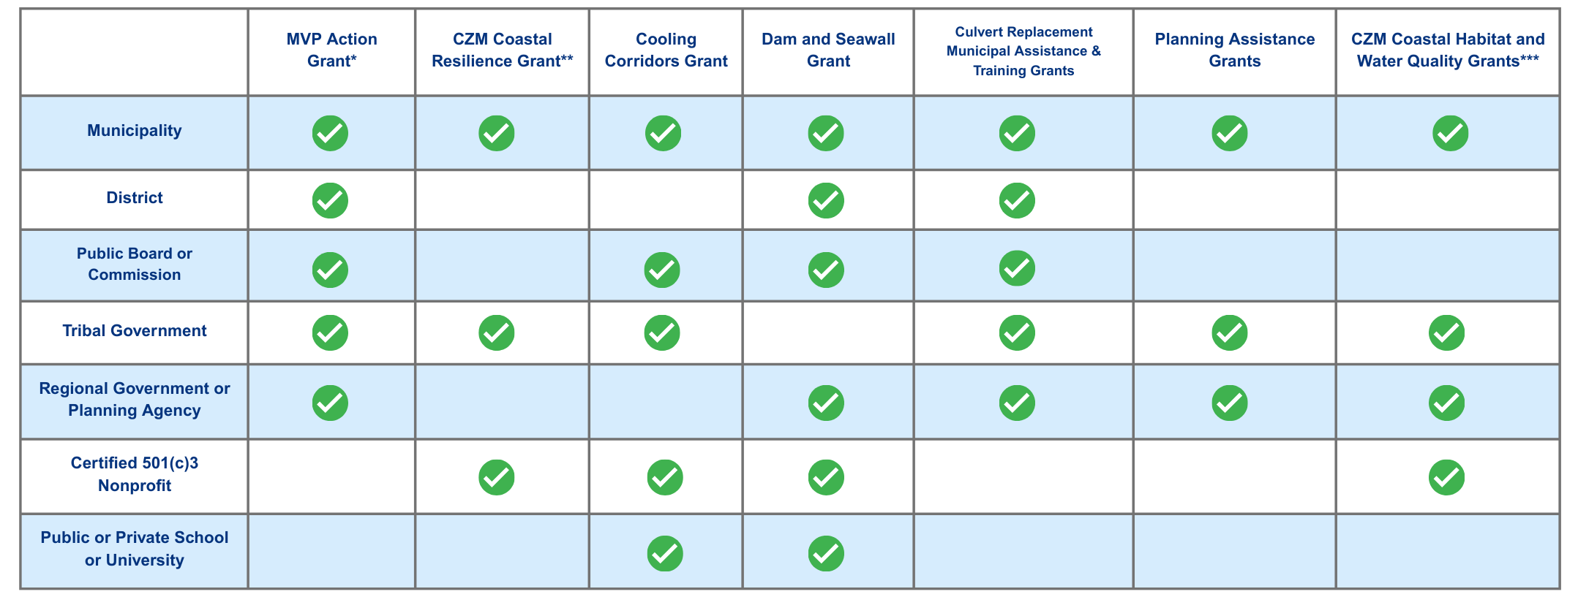
Different programs still have different eligibility requirements
*Non-municipality applicants to MVP Action, aside from Tribal Governments, must apply for projects that align with an MVP plan and include a letter of support from the municipality/ies related to the project.
**Projects applying to CZM Coastal Resilience must be located in a Massachusetts Coastal Zone.
***Projects applying to CZM Coastal Habitat and Water Quality must be located in a Massachusetts Coastal Watershed. Non-municipality applicants must be directly partnering with a municipality.

Slide 6

2026 Grant Application Timeline
January 2026
  Application (RFR) opens – January 22
  RFR and Application Webinar: January 27, 2026, 10:00 AM – 11:00 AM
  RFR and Application Webinar: January 28, 2026, 12:00 – 1:00 PM
  Grant Management System (GMS) How-To Webinar: January 29, 2026, 10:00 AM – 11:00 AM
  MassEnviroScreen Office Hours: NEW February 4, 2026, 12:00 PM – 1:00 PM; February 11, 2026, 3:00 PM – 4:00 PM; March 11, 2026, 12:00 PM – 1:00 PM
February 2026
  Deadline for Questions to be submitted – February 18, 11:59pm
  Responses to Questions published - February 25, 11:59pm (estimated)
March 2026
  Application closes – March 20, 11:59pm
June 2026
  Awards announced (expected); funding allocated and projects underway in July 2026
Notes:
6

Slide 7

Expression of Interest (EOI) Summary
In September we opened our Expression of Interest period.
We received a total of 541 submissions from 286 different applicants.
Our team held approximately 261 feedback calls between October 2025 and January 2026.
The most common project types were "Culvert or Small Bridge Upgrade or Removal" and "Stormwater Management.“
*Note: You did not need to submit an EOI to submit a formal application*

Slide 8
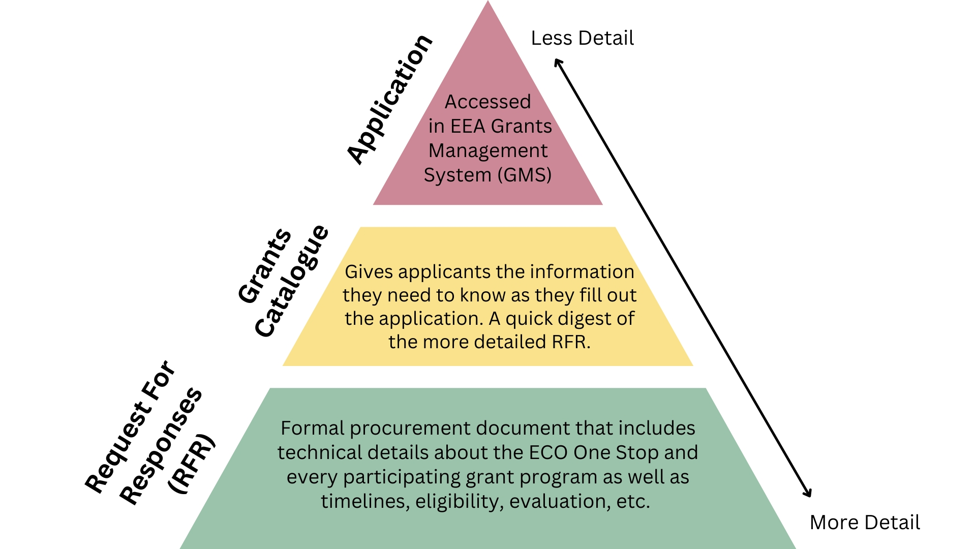
Overview of Important Resources

Slide 9
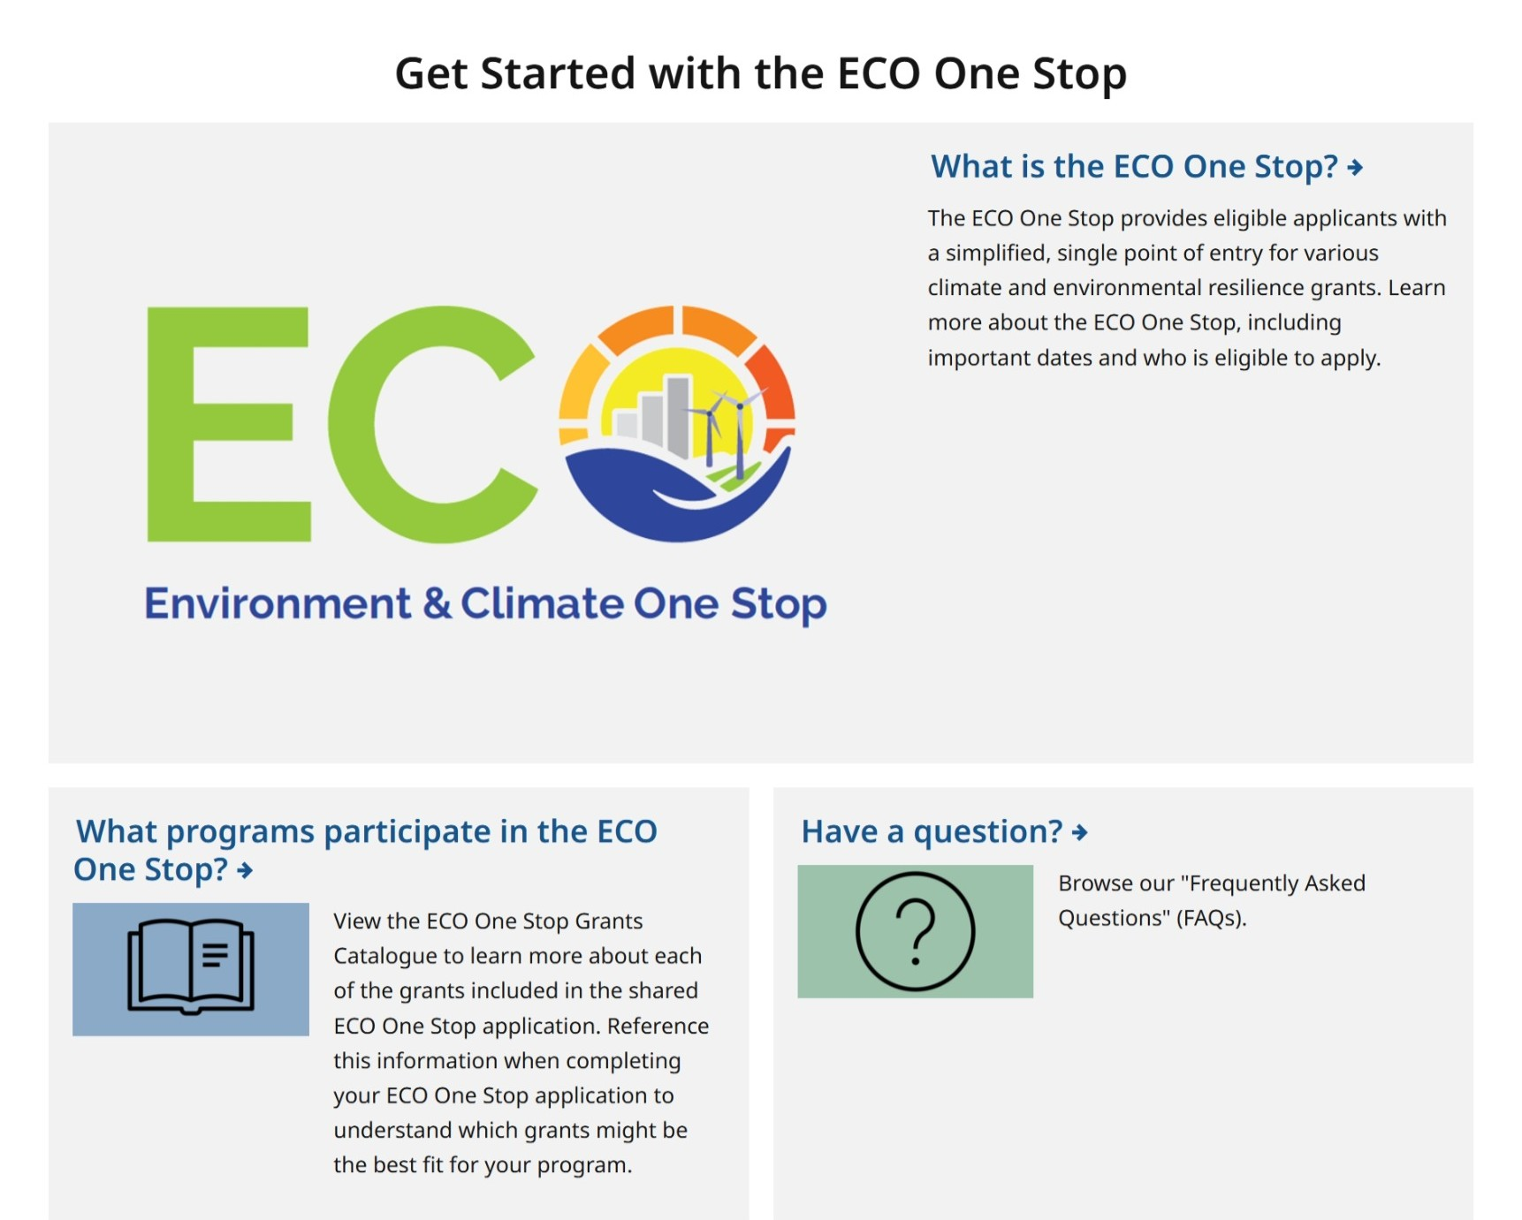
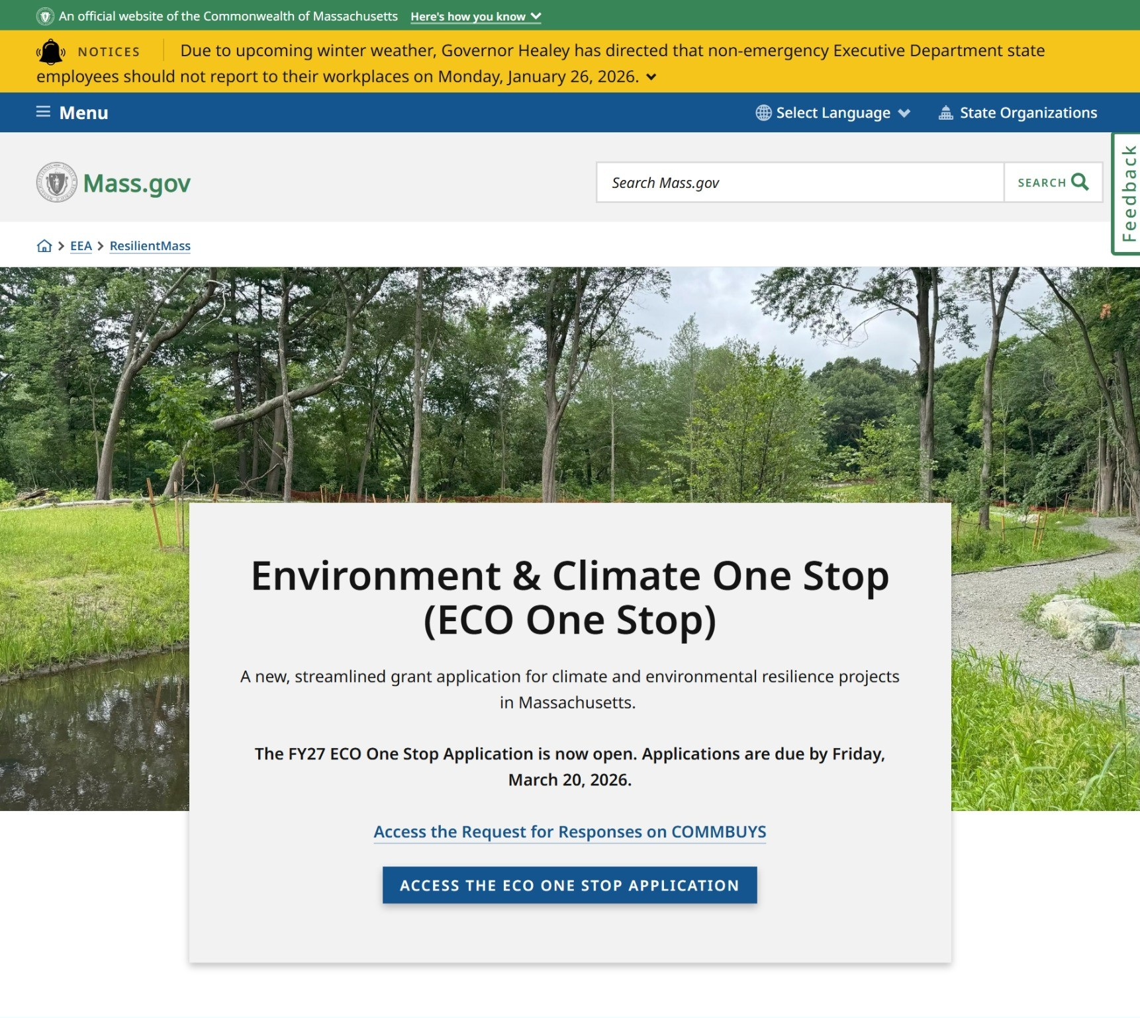
www.mass.gov/environment-climate-one-stop

Slide 10
Request for Responses
Official procurement document posted to Commbuys: COMMBUYS - Bid Solicitation
Includes a "General Section" at the beginning that has requirements for all ECO One Stop programs—goes over items like eligibility, match, contract duration, etc.
Each program has its own section at the end with program-specific requirements.
Attachments on COMMBUYS example application, scope and budget spreadsheet, grants catalogue question guidance spreadsheet

Slide 11
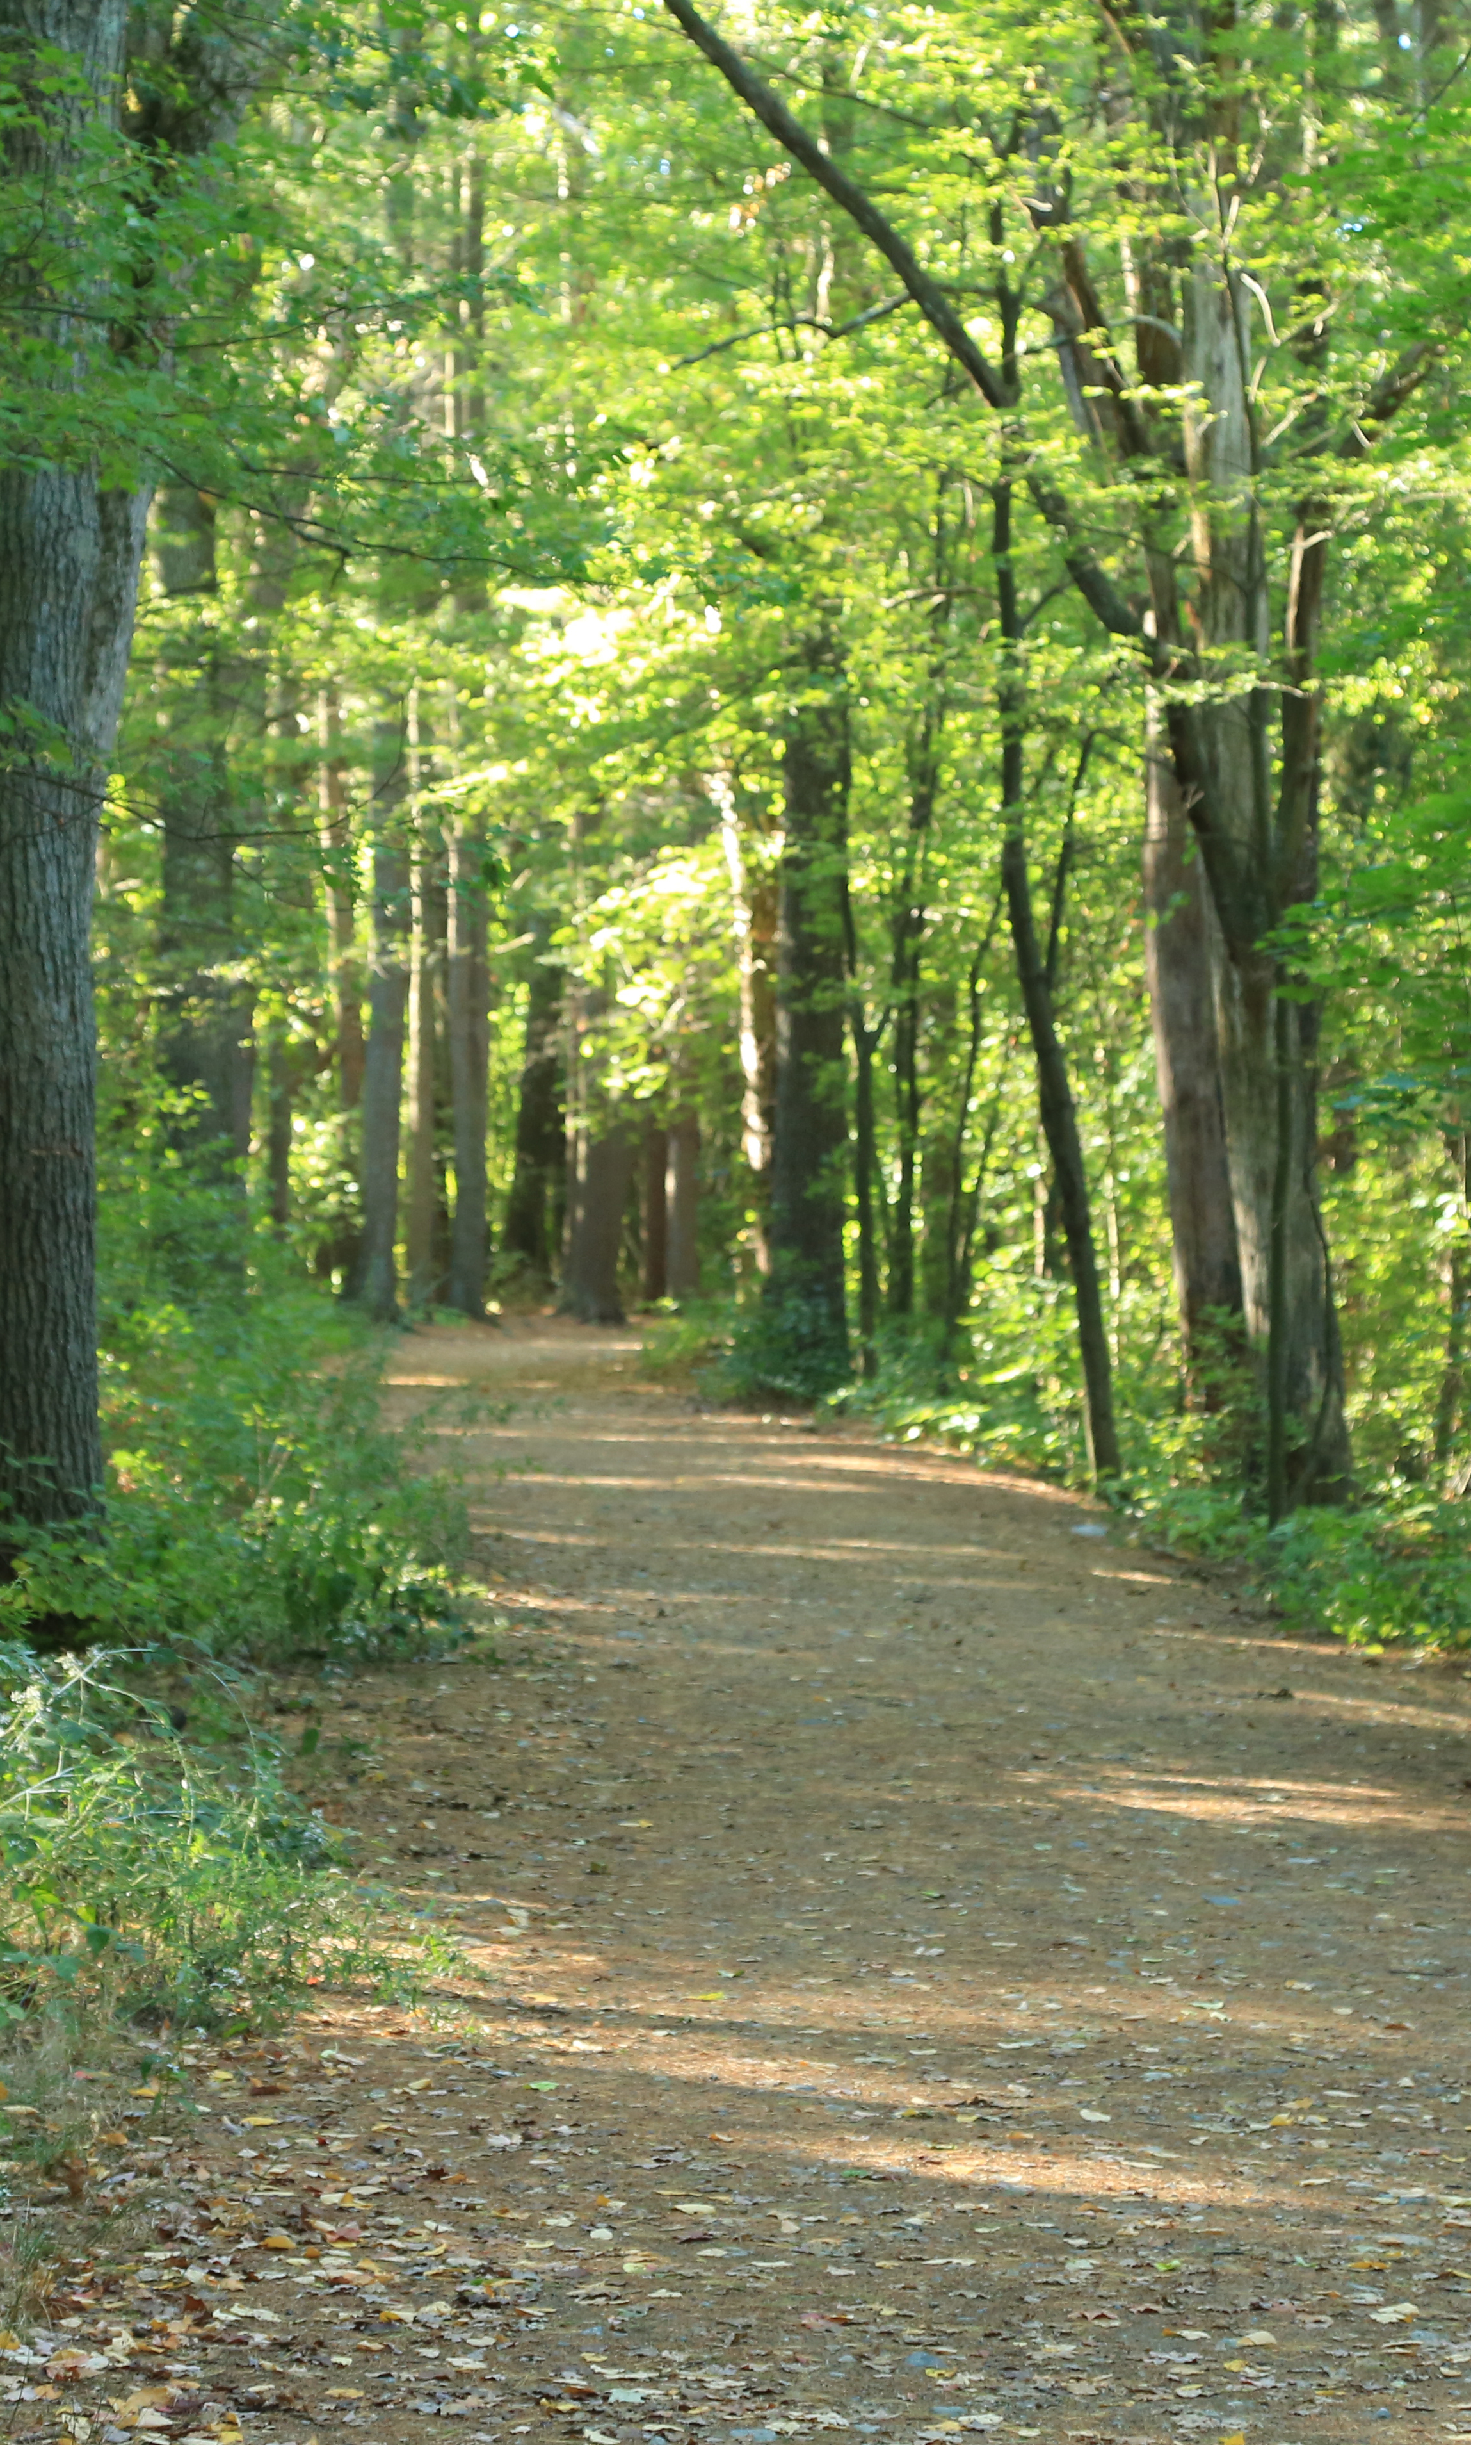
Significant Changes to Note:
Match
10% local match required (calculated based on the amount of grant funding requested)
  Example: If a project is requesting $100K in grant funds it will need a $10K match
In-kind (e.g., applicant staff time) and cash match accepted
No match is required for rural and small towns (as designated by the Office of Rural Affairs) and Tribal Governments
Culverts
For culvert and small bridge replacement projects, the use of a designer that is prequalified by the MassDOT Architects and Engineers Review Board in Basic Bridge Design and Rating is strongly encouraged for any design work valued above $50,000
MassEnviroScreen
In collaboration with the EEA EJ Office, piloting a new state tool to identify Burdened Areas and communities
Grants Management System
Applications are required to be submitted through the GMS.
*Please also note that only expenses incurred after the contract is in place will be eligible for reimbursement.*

Slide 12
Application:
Application Information - Required for all applicants.
Eligibility Questions - Responses dictate which programs appear in Eligible Programs section.
Eligible Programs/program selection - Lists programs that may be a good fit for your project.
Core questions - Apply across multiple grants.
Program-specific questions – Unique to each grant program you selected.
Review and Submit
Important notes:
If you don't see the program you wanted to apply to on the program selection page, go back and click "other" for your project type.
An attachment may be optional in the core questions but required in a program's specific section. You can upload the same attachment twice or wait until the program section to upload.
Do not leave submitting your application for the last minute—if you miss a question, it may take a while to find and make the correction in the GMS application. GMS pages also may take a minute to load—you can see the progress on the yellow bar at the top of the page.

Slide 13
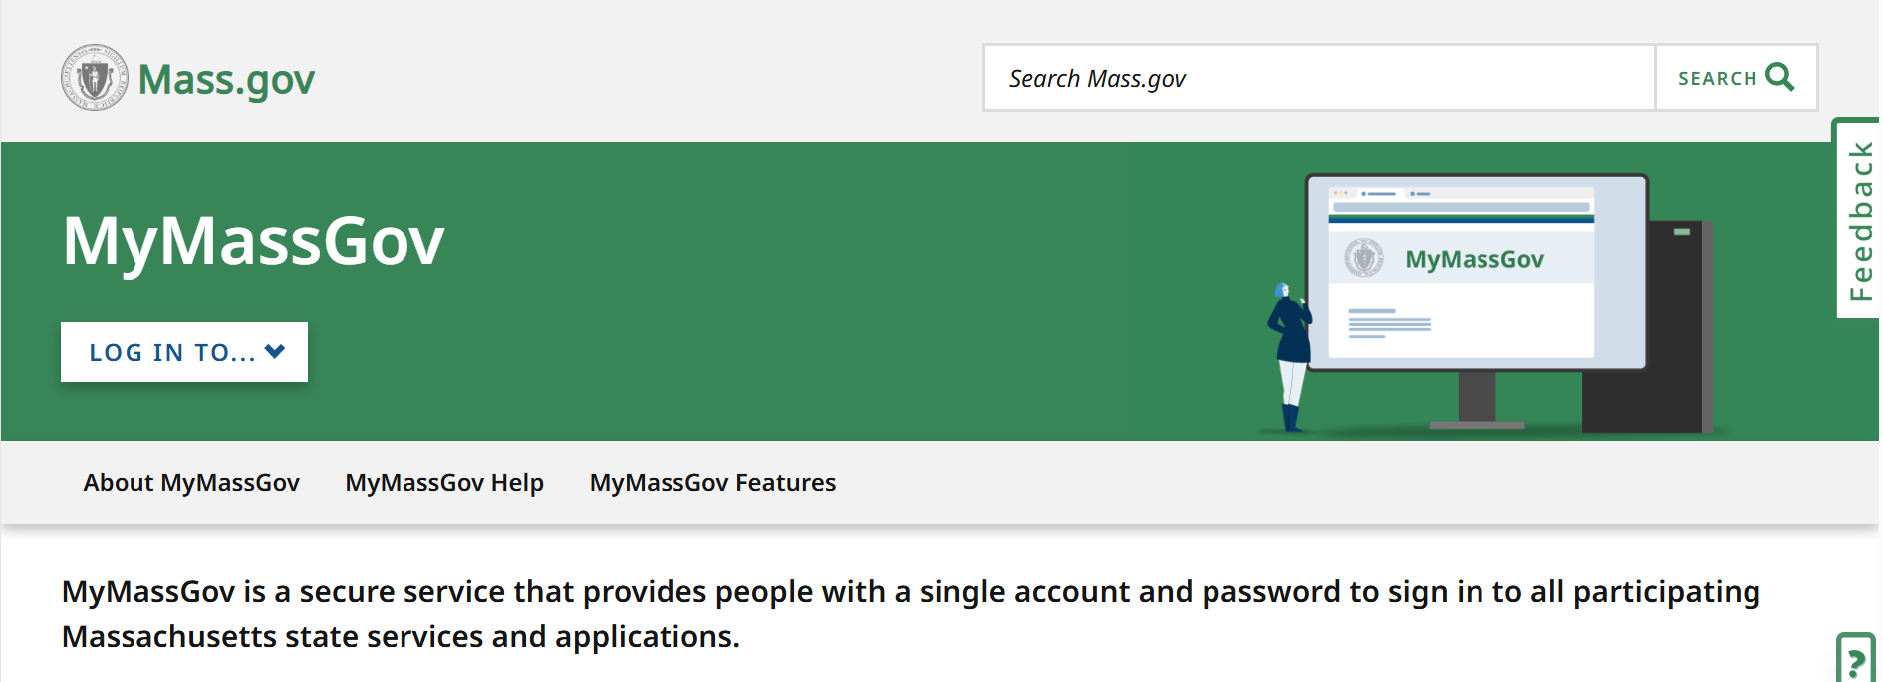
Grant Management System (GMS)
The application will be submitted via EEA's new Grants Management System
It is easy and fast to sign up with MyMassGov! Create a “Business Account” NOT a personal one.
Webinar to go over the GMS specifically Thursday, January 29, 2026 10-11am. Will be recorded and posted.
MyMassGov credentials can help your organization access 18 Commonwealth of Massachusetts Systems!

Slide 14
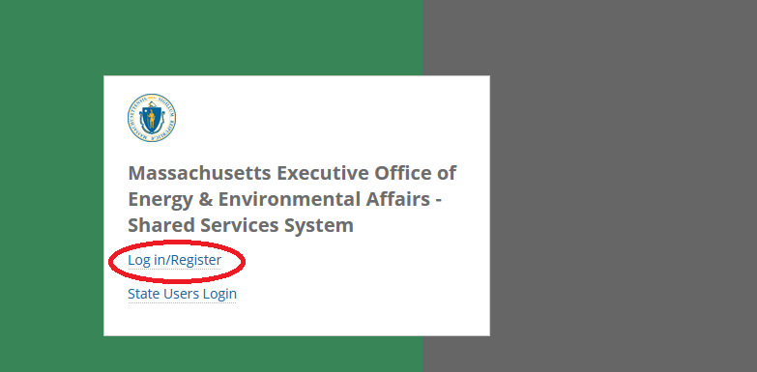
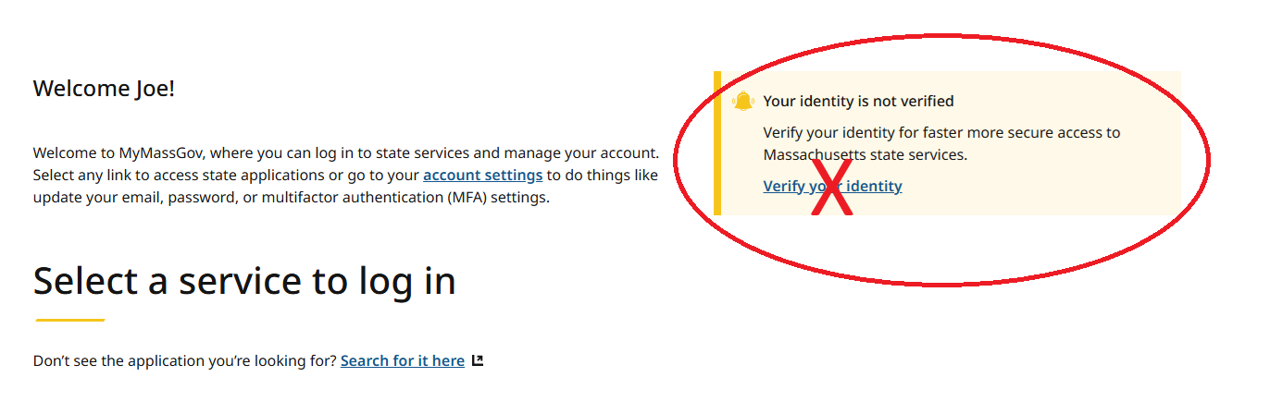
Grant Management System (GMS) Assistance
Here's how to sign up for GMS: Visit Grants Management System (GMS) | Mass.gov for instructions
Watch our instructional playlist on YouTube: https://youtube.com/playlist?list=PLzQVK6KiTOqyPW5PUOcFE42iRJgdm8LA_&si=Wm2l78OgFDZ-1nA_
See our user guide at the GMS Portal: Help - Executive Office of Energy & Environmental Affairs Grants Management System
Tips and Tricks

Slide 15
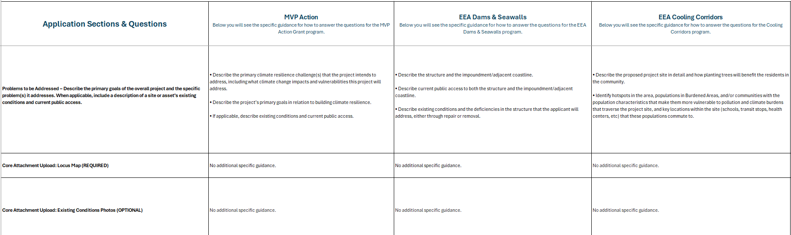
Grants Catalogue
https://www.mass.gov/info-details/environment-climate-one-stop-eco-one-stop-grants-catalogue
Grant Program Descriptions (Mass.gov Webpage)
Question Guidance (Excel Spreadsheet)

Slide 16
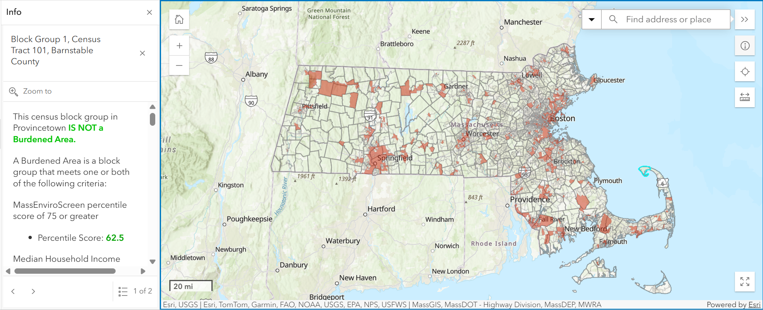
Piloting the MassEnviroScreen Tool
https://mass-eoeea.maps.arcgis.com/apps/instant/sidebar/index.html?appid=4be63e892a3d42d69334615a64095a39

Slide 17
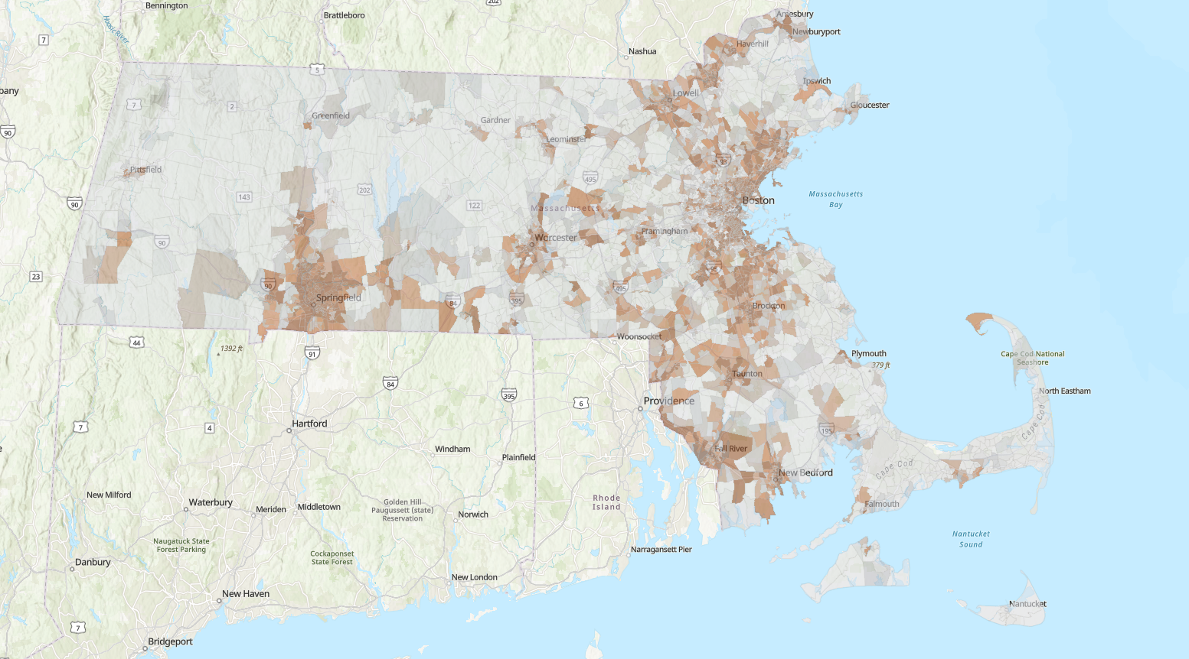
What is MassEnviroScreen?
The MassEnviroScreen (MES) is a statewide environmental justice screening and mapping tool developed by OEJE
Uses statewide data to identify communities facing cumulative environmental, climate, health and socioeconomic stressors
Provides a consistent, transparent baseline for identifying communities that may experience greater cumulative impacts
How communities can use MES:
    Understand local conditions
    Support advocacy and organizing
    Engage more effectively in public processes and community engagement

Slide 18
MassEnviroScreen Components
MassEnviroScreen’s 30 indicators fall into five broad components:
Environmental exposure indicators are based on measurements of different types of pollution that people may come into contact with.
Environmental effects indicators are based on the locations of toxic chemicals in or near communities.
Climate risk indicators are based on exposures to climate hazards.
Sensitive populations indicators measure the number of people in a community who may be more severely affected by pollution or climate hazards because of their health.
Socioeconomic factor indicators are conditions that may increase people’s stress or make healthy living difficult and cause them to be more sensitive to pollution’s effects.
These components together provide a comprehensive picture of cumulative impact in the Commonwealth.

Slide 19
MassEnviroScreen Output
Indicator Percentile Values:
    For each indicator, raw data values are converted into percentiles
    Percentiles show how a community compares to all other communities in Massachusetts
MassEnviroScreen assigns a cumulative burden score (0 – 100) to every census block group in Massachusetts
Higher scores = a combined greater pollution, climate burden and social vulnerability
Communities are designated as Burdened Areas when they meet one or both of the following criteria:
    cumulative burden percentile score (i.e, MassEnviroScore) of 75 or greater, OR
    annual median household income is 65 percent or less of the statewide annual median household income

Slide 20
How MassEnviroScreen will be utilized in the ECO One Stop
MassEnviroScreen is undergoing finalization and may be refined over time as methodology and stakeholder feedback are incorporated.
For the purposes of this RFR, the version of MassEnviroScreen released at the time of the RFR will be used to identify Burdened Areas. Designations in effect at the RFRs release will be respected and applied consistently throughout the grant evaluation process. Accordingly, MassEnviroScreen will be referenced as "draft" in this RFR to reflect its ongoing development
MassEnviroScreen will be utilized the same way the EJ Map was, to identify if proposed projects are located in and benefitting burdened and vulnerable communities.
Importantly, a community not identified as a BA may still exhibit elevated percentile values for individual indicators; in these cases, applicants are encouraged to review MES at the indicator level to better understand localized conditions and explain how their project is benefitting these more vulnerable individuals.
Programs will incorporate into their project scoring the same way they did for the EJ & Priority Populations.

Slide 21
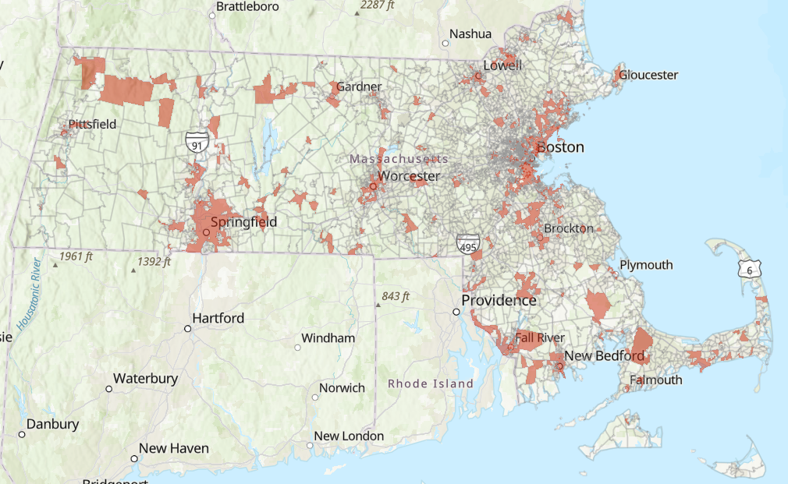
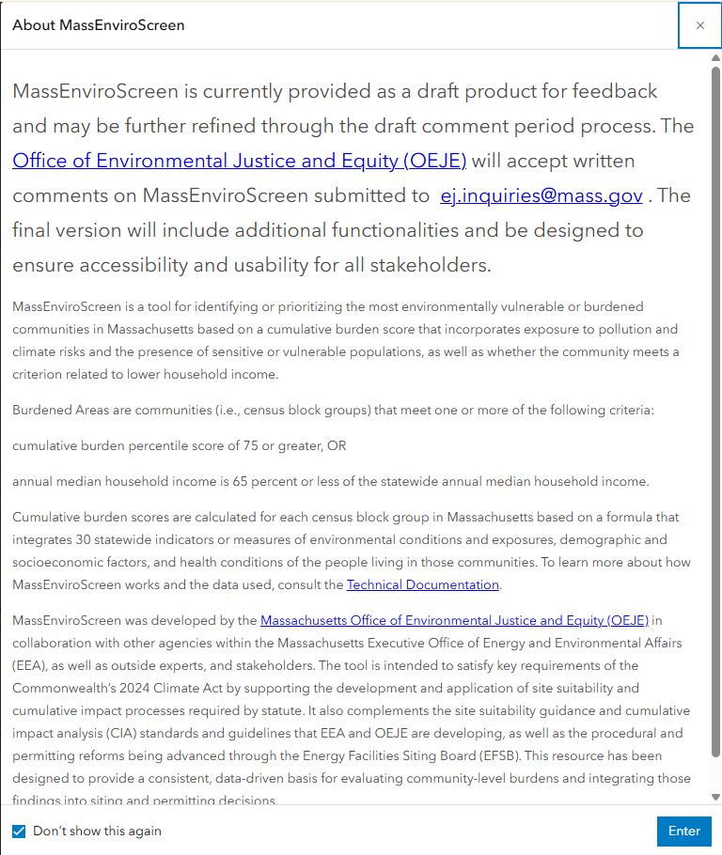
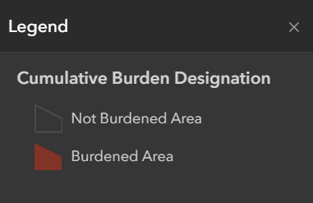
Draft MassEnviroScreen: Map of Burdened Areas

Slide 22
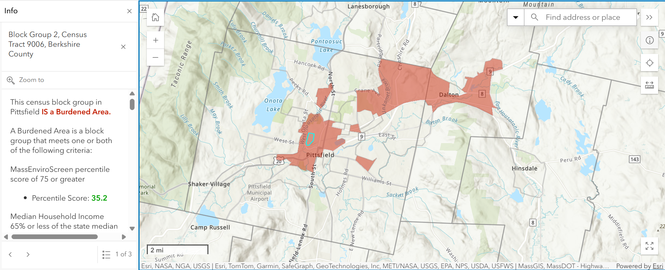
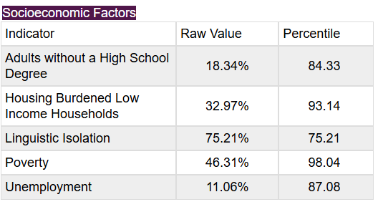
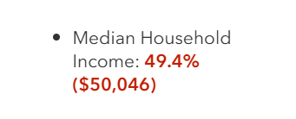
MassEnviroScreen: Pittsfield – Block Group 2, Census Tract 9006

Slide 23
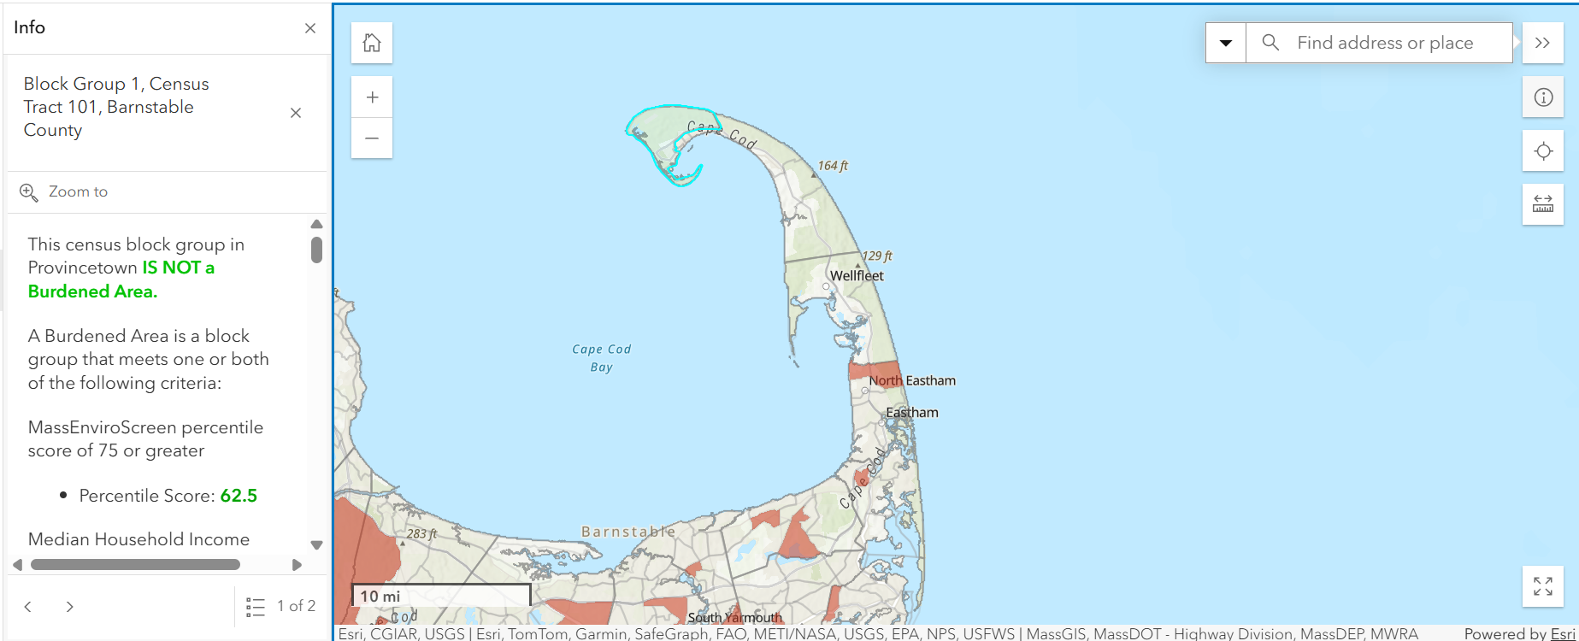
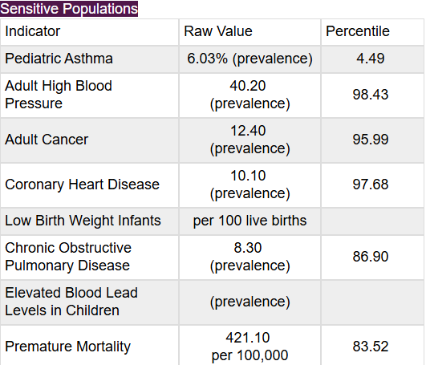
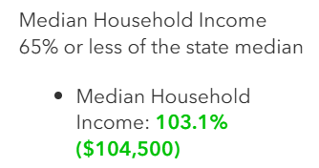
MassEnviroScreen: Provincetown – Block Group 1, Census Tract 101

Slide 24

Contact Us
EcoOneStop@mass.gov - all questions for the Q&A period (due Feb 18) should go to this address or posted directly to COMMBUYS
Mass.gov/environment-climate-one-stop

