Slide 1


EEA Environment & Climate One Stop (ECO One Stop)
Using the EEA Grants Management System
January 29, 2026
William W. Hinkley
Executive Office of Energy and Environmental Affairs
william.hinkley@mass.gov

Slide 2
Today’s Agenda
Introduction to the Grants Management System
Creating a Username/Password with MyMassGov
Creating your profile in the GMS
The ECO One Stop application in GMS
Assuring the correct applicant for the ECO One Stop
Participating as a consultant/partner
Deadlines and support
Please note that there will be a large number of slides in this presentation so that the steps and information can be available when the presentation is posted to https://www.mass.gov/environment-climate-one-stop
This presentation is being recorded and will be posted to the website.

Slide 3
What is the Grants Management System?
A central location to manage your grant work with EEA agencies
A portal to find and apply for grants
A secure way to transmit, retain, and view documents and messages
A tool to track the progress of your grant application
An in-app contracting tool
A way to send in payment requests and deliverables
A place to collaborate with your team and save records and access them for the future

Slide 4
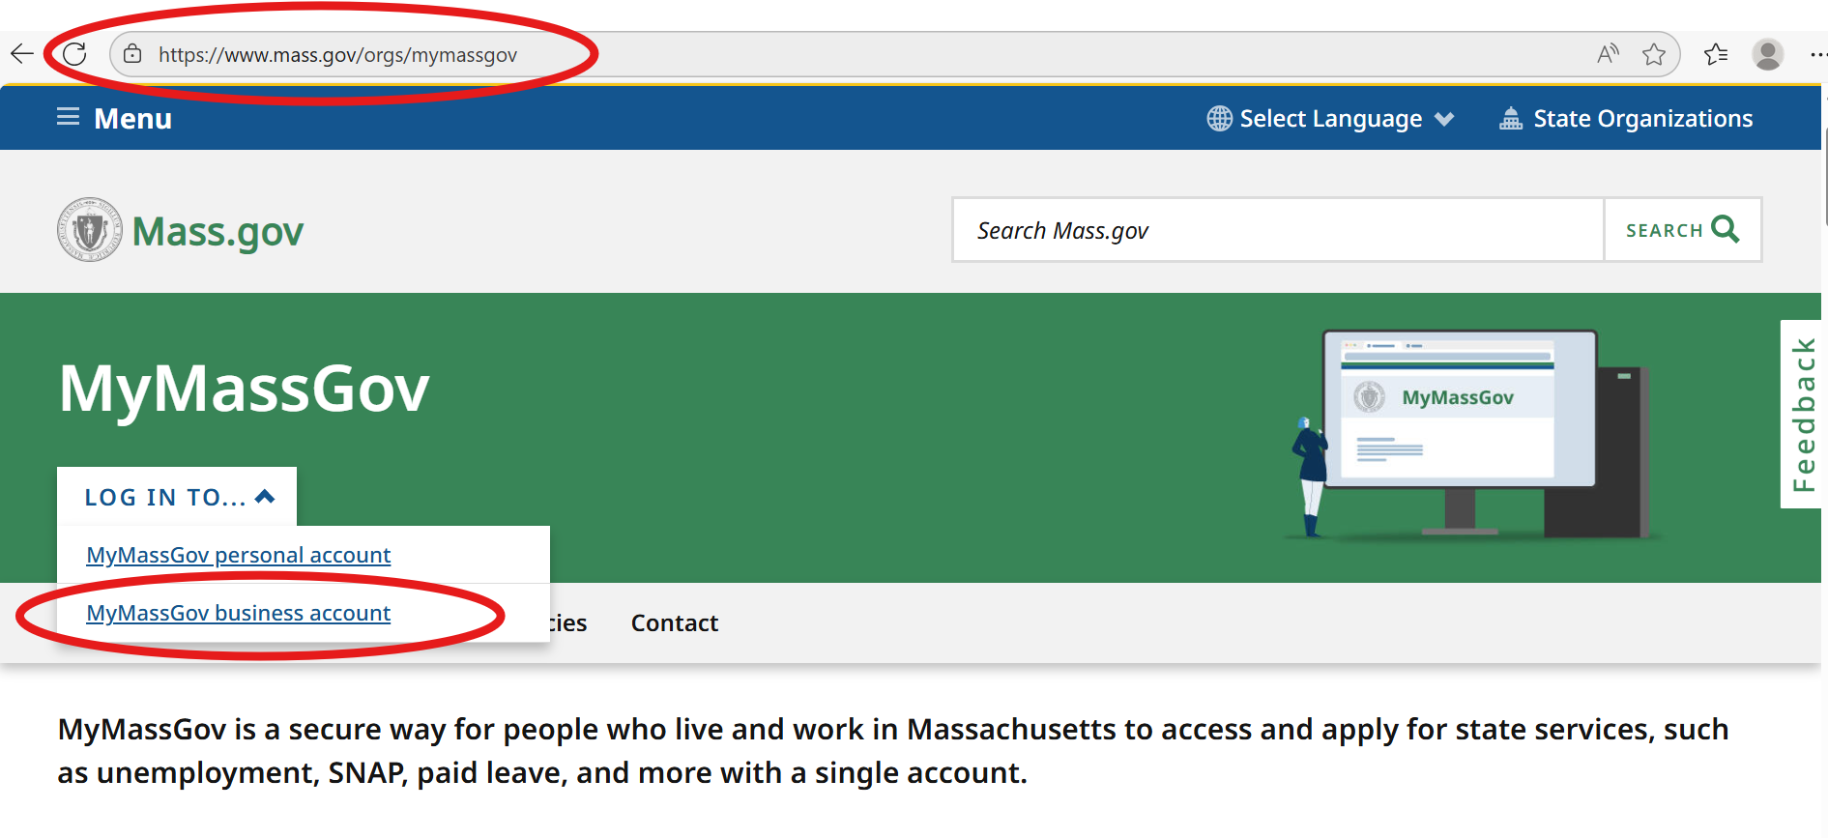

How to Register for a MyMassGov Username and Password
You may already have a MyMassGov sign-in if you use many state services, including MassDOT grants. You do not need a new account.

Slide 5
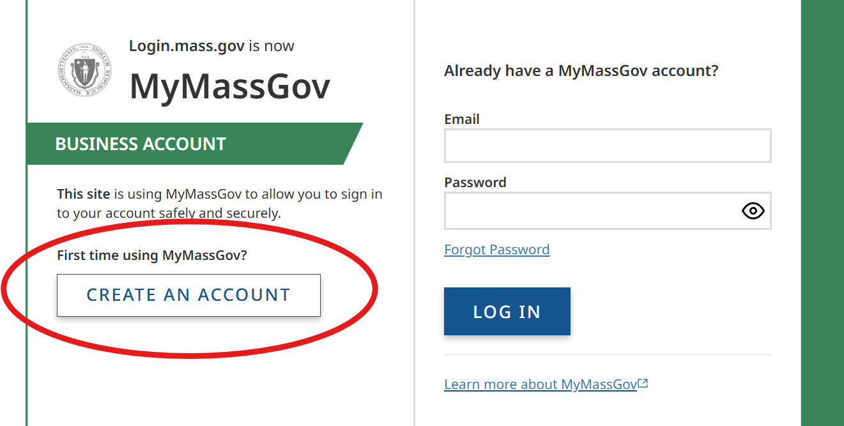
How to Register for a MyMassGov Username and Password Continued

Slide 6
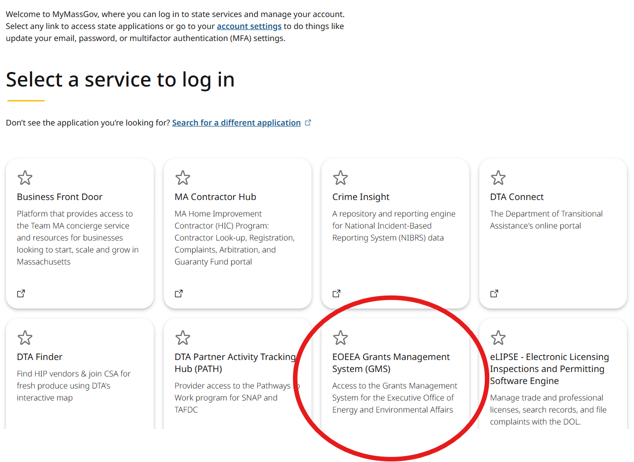
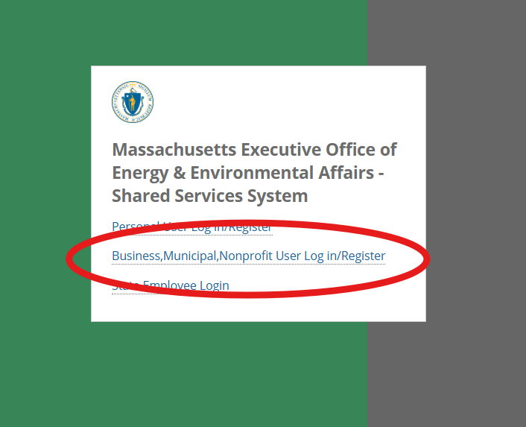
Creating and Updating your GMS Profile

Slide 7
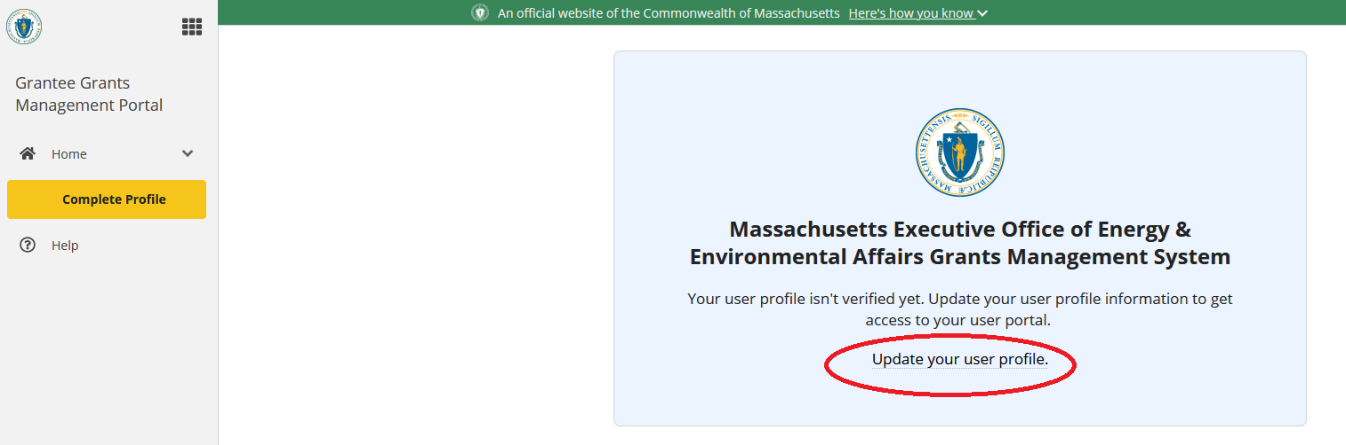
Updating your GMS Profile
First time users will need to enter their information to get established in the GMS

Slide 8
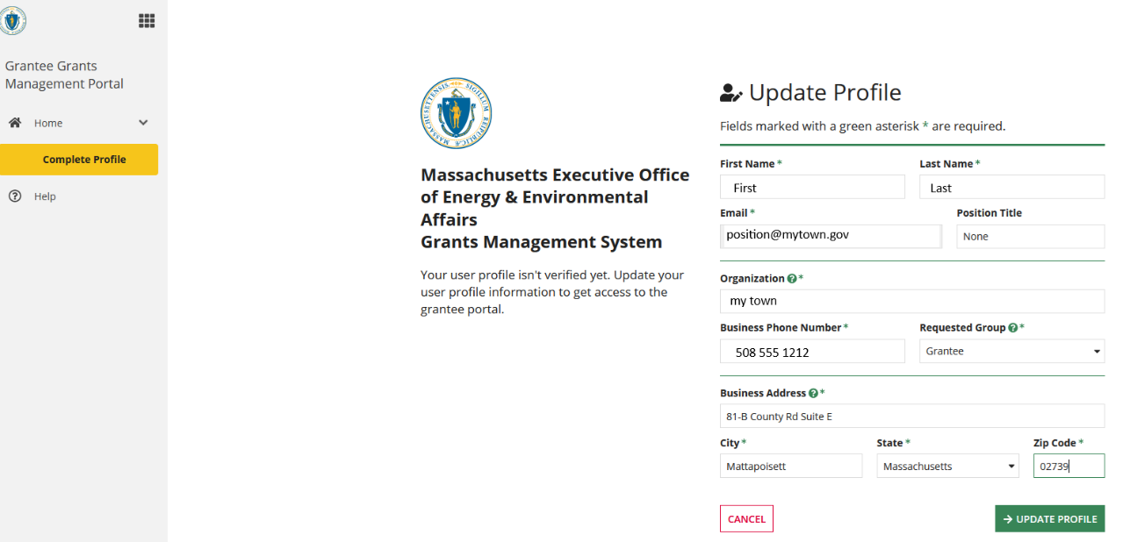
Updating your GMS Profile for First Time Users
Complete these fields and click “Update Profile” to send for verification
If not updated, we won’t receive the request!

Slide 9
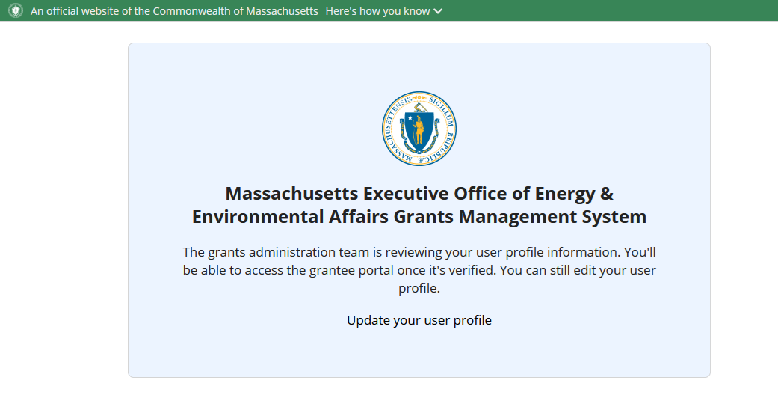
Profile Review and Verification
Profile is now under review.
Depending on volume of requests this could take a couple of days!

Slide 10
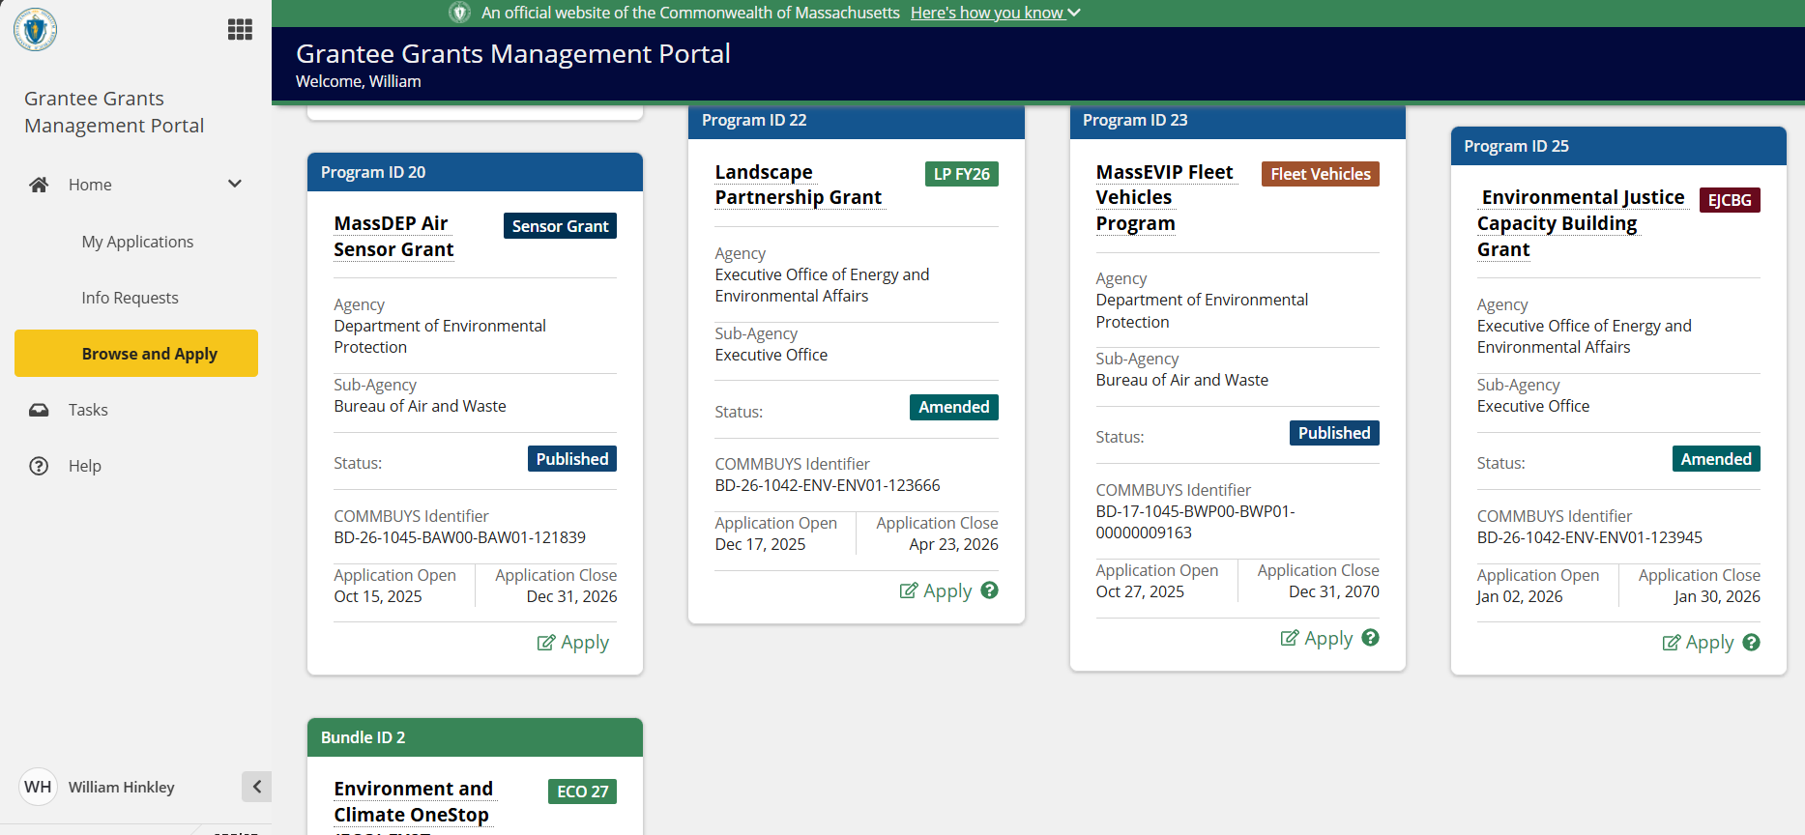
The GMS Portal – Menu, Browse and Apply
The “Browse and Apply” tab on the left side menu shows all grant programs currently open in the GMS
Menu Bar
Access your profile and logout here

Slide 11
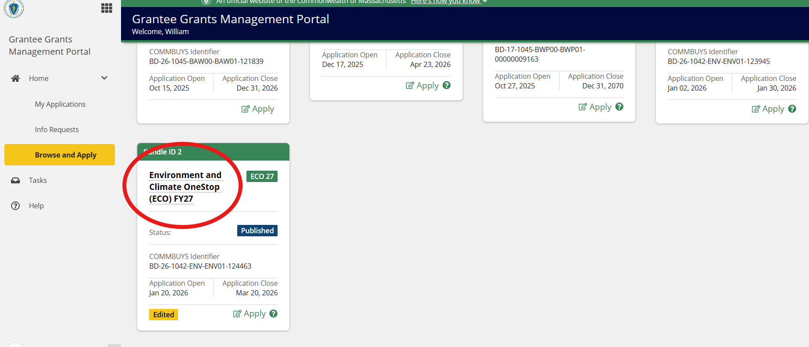
The GMS Portal – Browse and Apply
In the Browse and Apply menu:
Click the link to open the ECO One Stop record to learn more and begin application

Slide 12
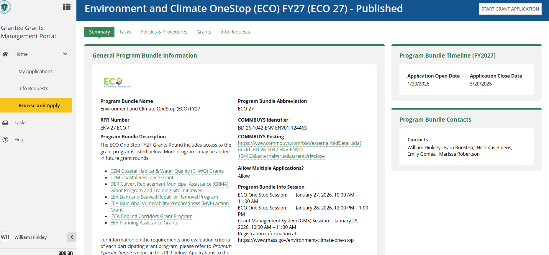
ECO OneStop Record
You can learn more about the programs on this page.
Select “Start Grant Application” to begin.

Slide 13
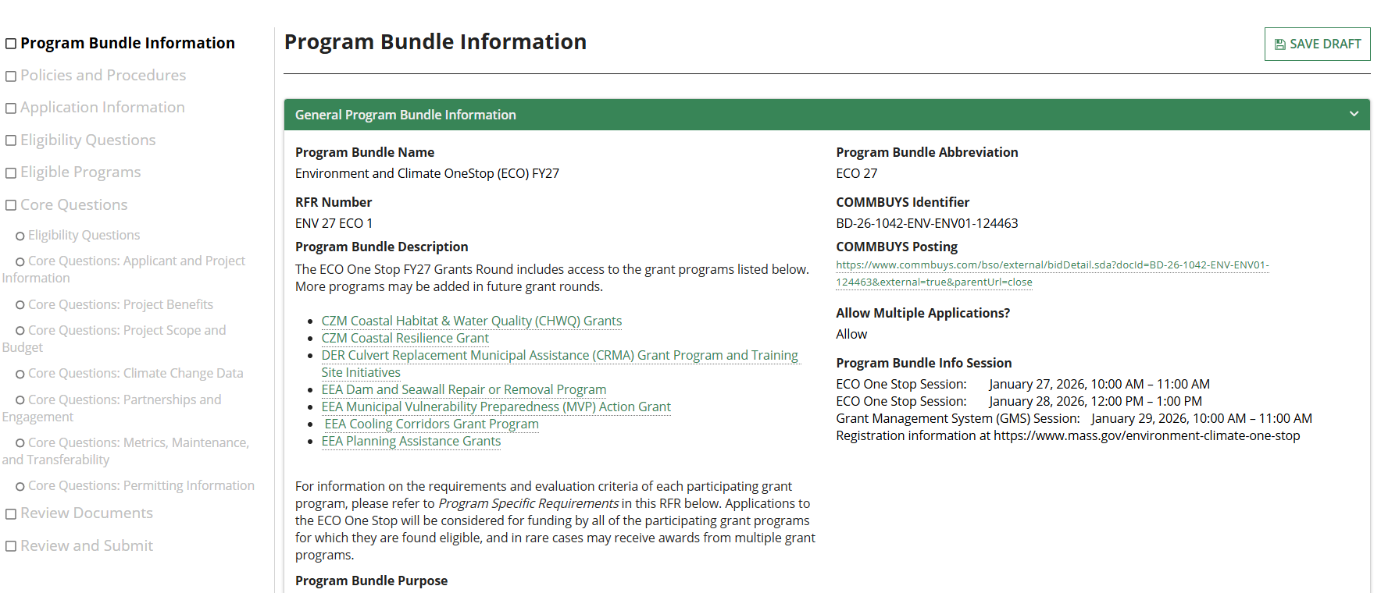

The ECO Application - Information
The first page provides information about the ECO One Stop.
Note the “grayed out” menu on the left side. This will help you track your work.
Always use the NEXT button to record your work and then Save Draft – even if you haven’t finished on the page. You can always select the BACK button.

Slide 14
Beginning the ECO OneStop Application and Saving Your Draft
To save the information in each section, you must select NEXT before moving on.
Be sure to select SAVE DRAFT after using the NEXT
When you select SAVE DRAFT, you will exit the application back to your My Applications portal. You may re-enter by clicking the link in your drafts.
Note: If you don’t immediately see your draft, refresh your browser.

Slide 15
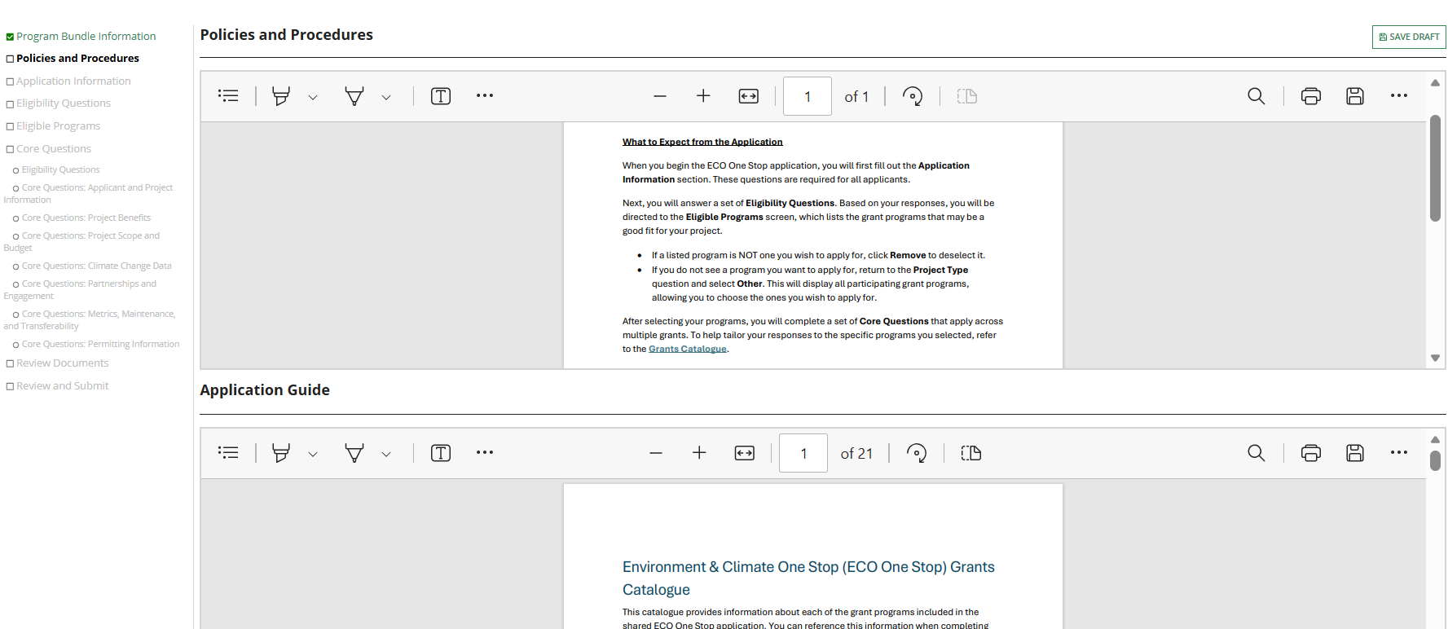
The ECO Application – Policies and Procedures
This page has information on the program and the ECO One Stop Grants Catalogue for easy reference.

Slide 16
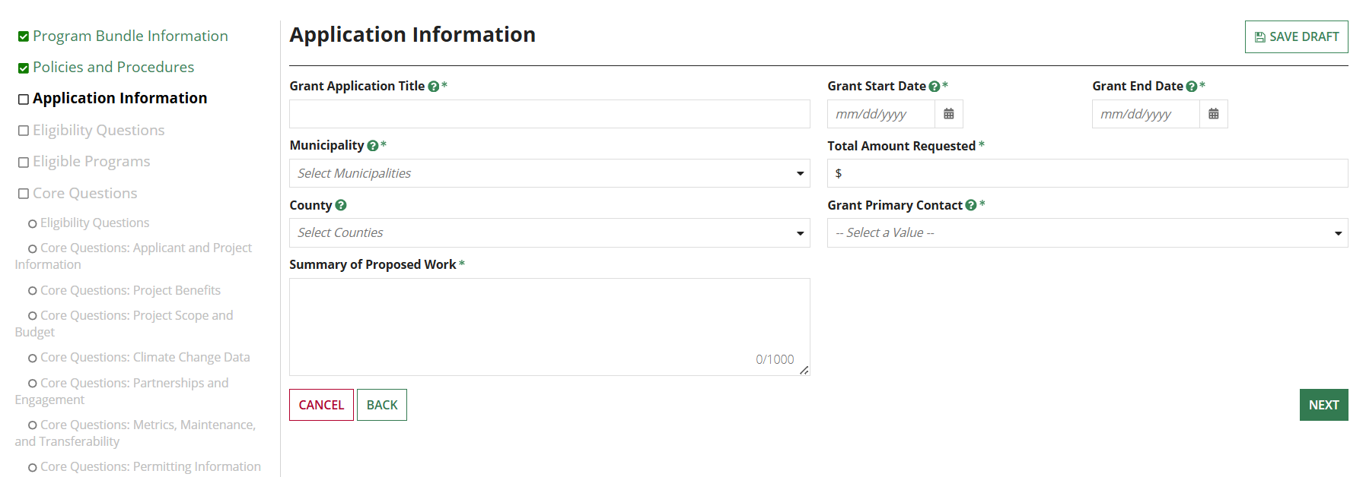

The ECO Application – Application Information
This is the first set of questions.
The icon is a tip that you can click or hover for more info.
The primary contact field is populated with GMS users in your organization only.
The asterisk * symbol indicates a response is required. You cannot submit your application unless all required questions are complete

Slide 17
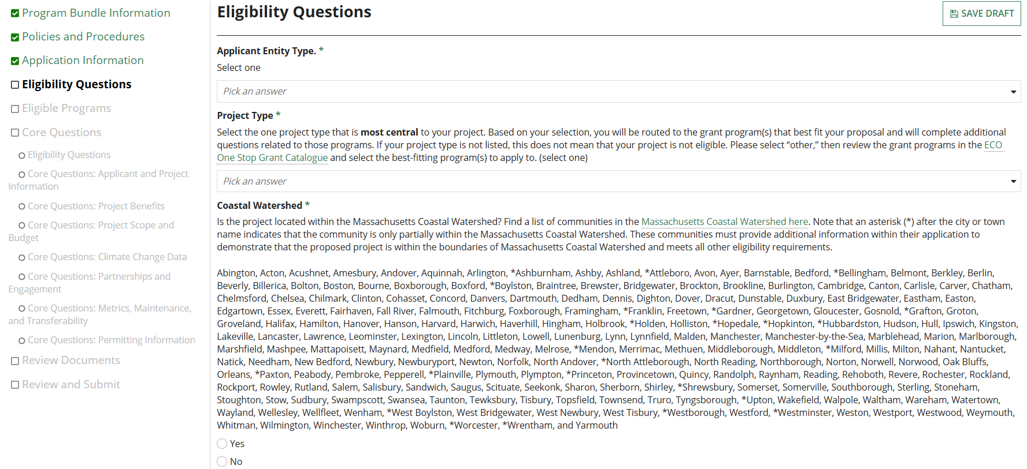
The ECO Application – Eligibility Questions
These eligibility questions will help determine what programs your project may be eligible for.

Slide 18
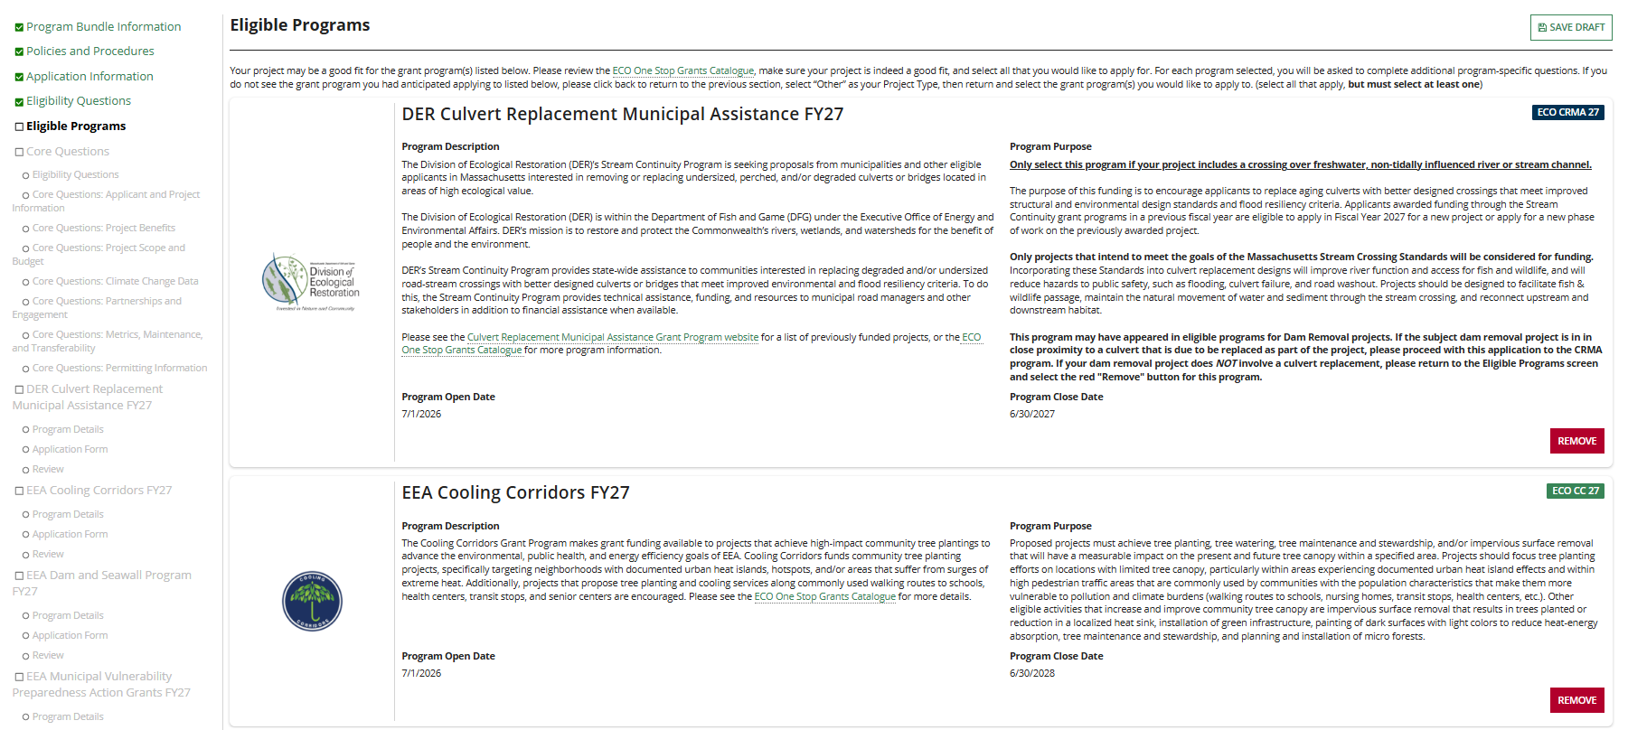
The ECO Application – Eligible Programs
The GMS will show you programs you seem to be eligible for. If you do not wish to apply to a program, select REMOVE. You may add it back later. You must select at least 1 program.
If you don't see the program you were intending to apply to, go back and click “other” for project type

Slide 19
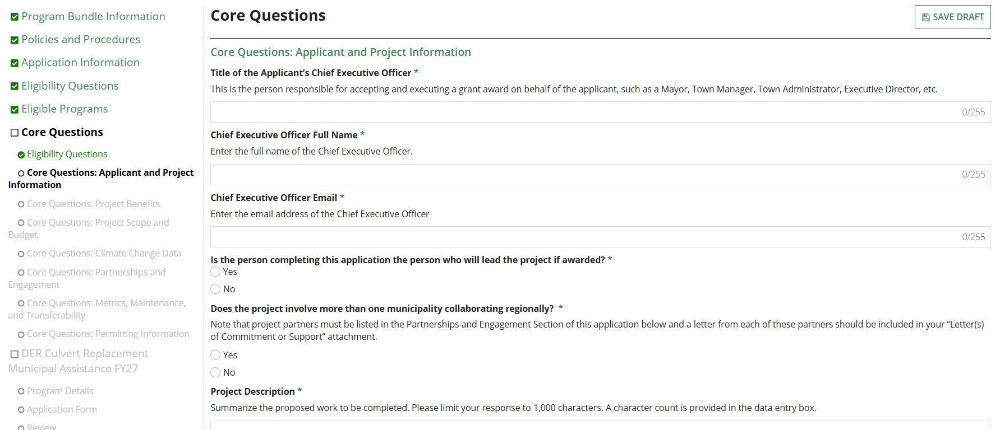
The ECO Application – Core Questions
The Core Questions section is completed once. Answers provided here will be provided to all programs you apply for.
There are seven screens of Core Questions.

Slide 20
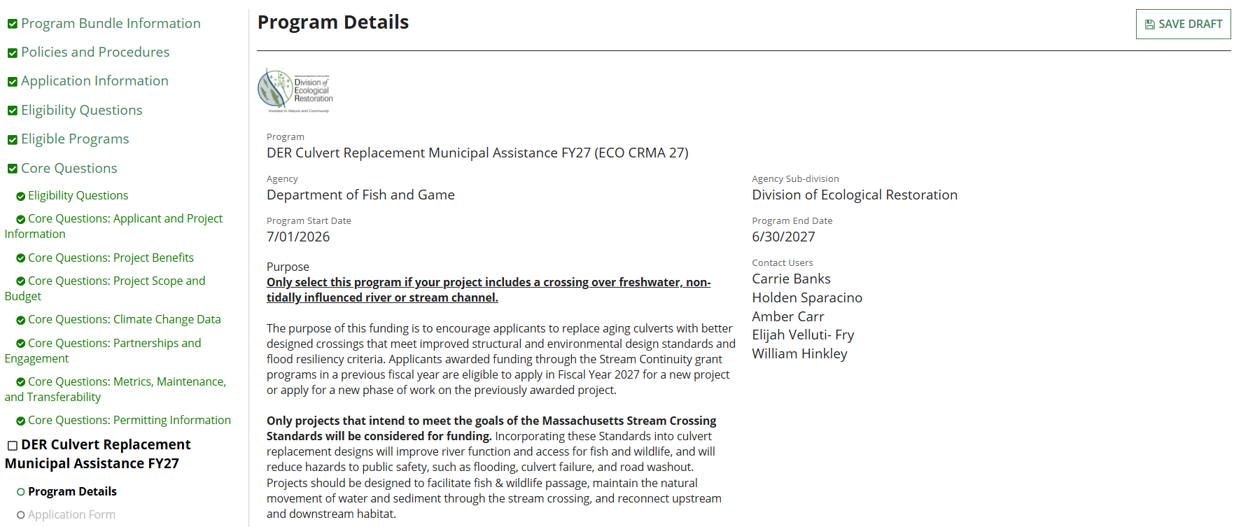
The ECO Application – Program Specific Questions
You will then be directed to the questions specific to each program you are applying for.

Slide 21
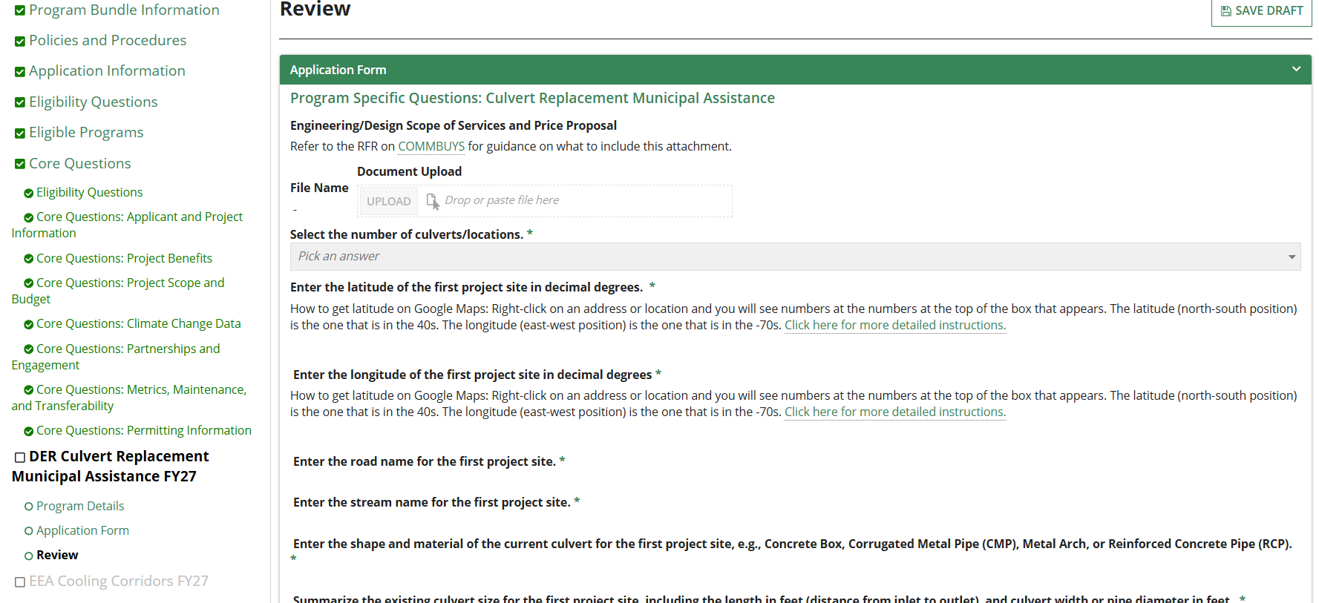
The ECO Application – Program Specific Questions (cont.)
You can review your responses before moving on to the next program-specific section.

Slide 22
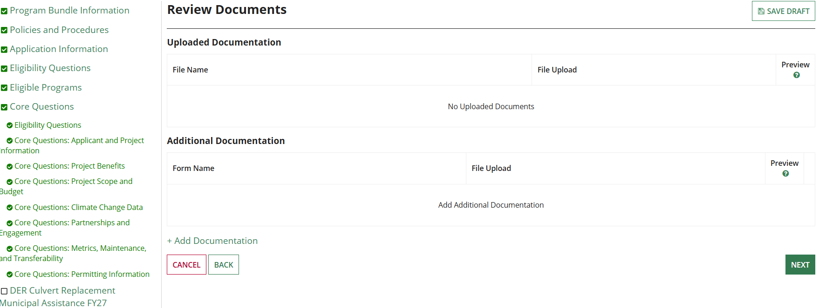
The ECO Application – Review Documents
You can review your uploaded documents on this page and add additional documents on this page.

Slide 23
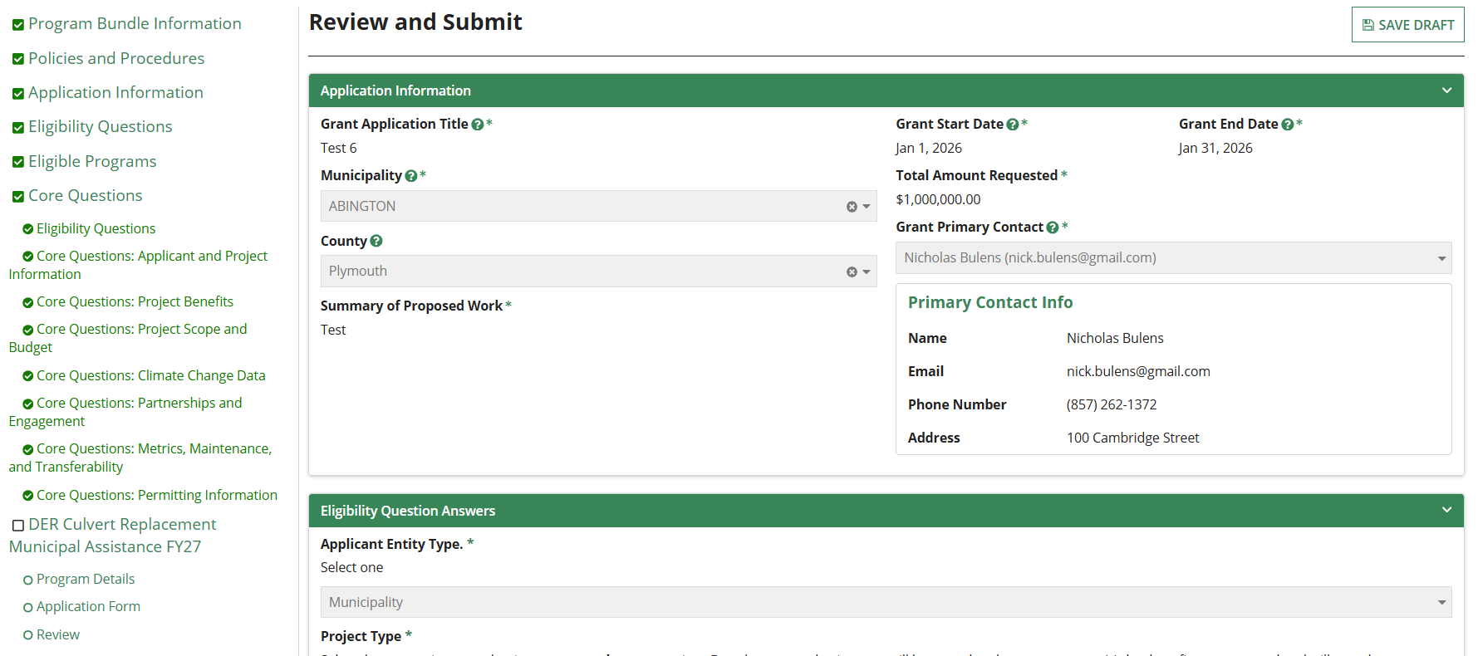
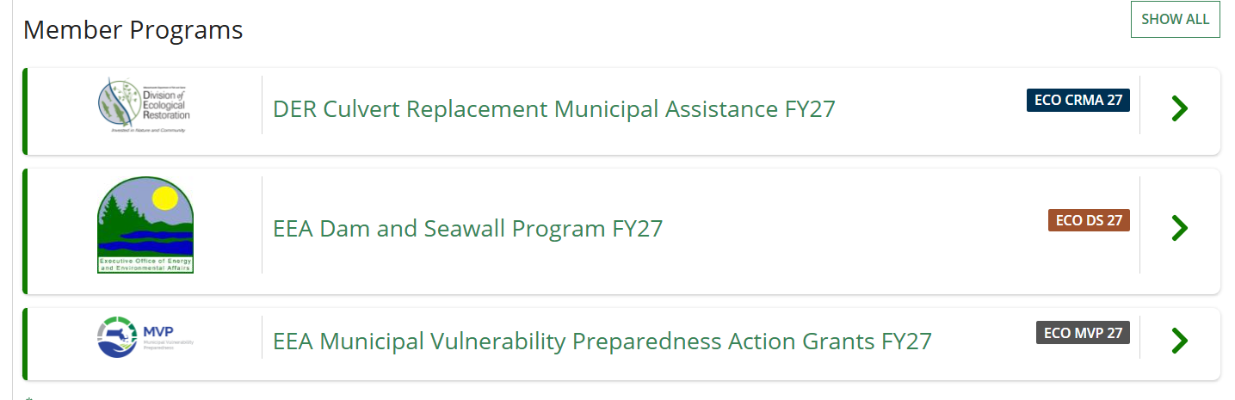
The ECO Application – Review and Submit
The last screen compiles all your responses into one page and looks for missing information.
To edit a field you need to return to that screen.
To see your responses in the member programs, click the > arrow to expand the section

Slide 24
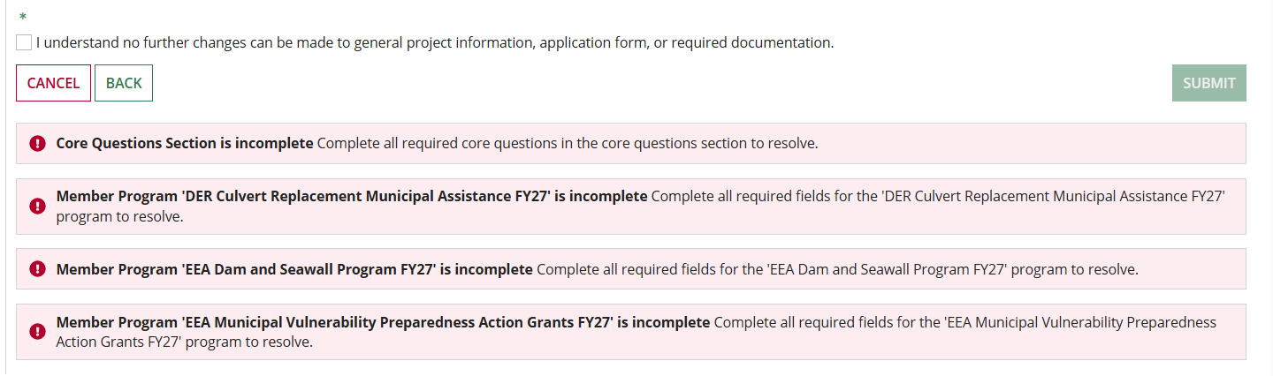
The ECO Application – Review and Submit (cont.)
If there is missing information, they system will display error messages.
If there are no errors, you need to click the "I understand" box and the SUBMIT button.
Once the application is submitted it CANNOT be edited, changed, or updated. Check your work carefully before submitting the application!

Slide 25
The ECO Application – Submission
When the application is submitted, the primary contact will receive an email from the GMS
The record will show as “Submitted”
The record will show in the “Apply” column on the My Applications tab
All records will be maintained in the GMS.
Drafts that are not submitted by the deadline will show as “Expired” and will remain in the GMS for 1 year.

Slide 26
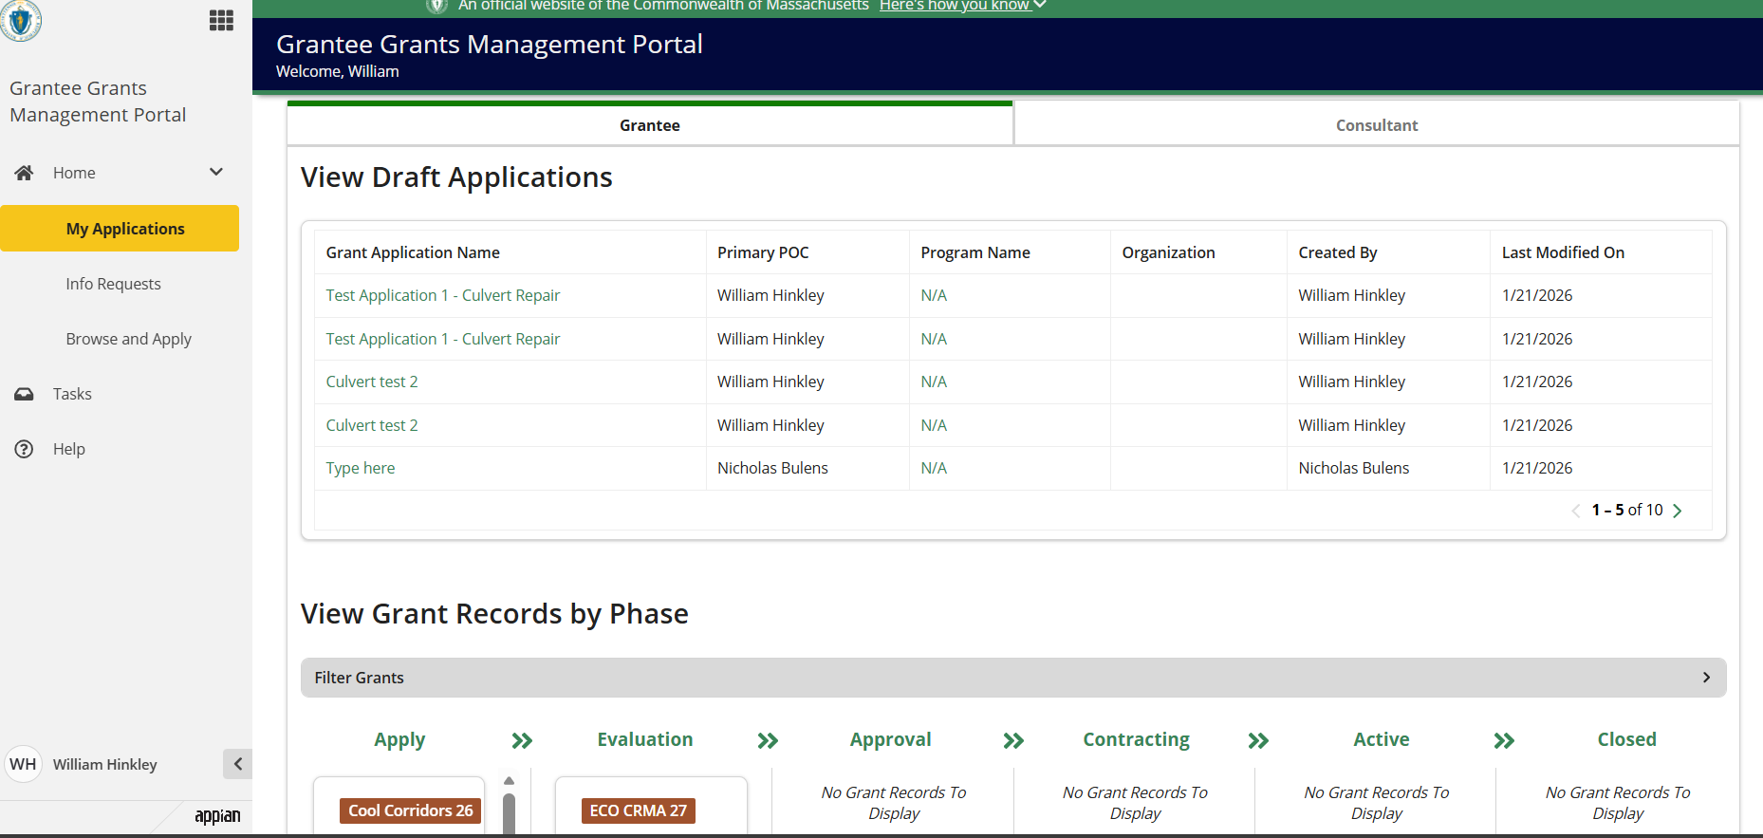
The GMS Portal – My Applications
Once you create and save an application, it will appear in the Draft Applications area.
Once submitted it will appear in the “Apply” column.

Slide 27
Who May Apply for ECO in GMS?
The application MUST be started and submitted by the entity that would ultimately receive and hold the grant contract.
In a partnership project there must be a single lead applicant. The program cannot split the grant scope into separate contracts. The application MUST be originated by the LEAD APPLICANT.
Consultants may NOT start or submit an application on behalf of an eligible entity. Applications submitted by consulting firms or grant writers under their own firm’s account will be rejected as ineligible applicants.

Slide 28
Becoming a Consultant/Partner in GMS
Create your Grantee Profile in GMS
Send an email to ecoonestop@mass.gov and request to have the Consultant permission enabled on your account
Once this is enabled, it will allow your name to be seen by clients/partners

Slide 29
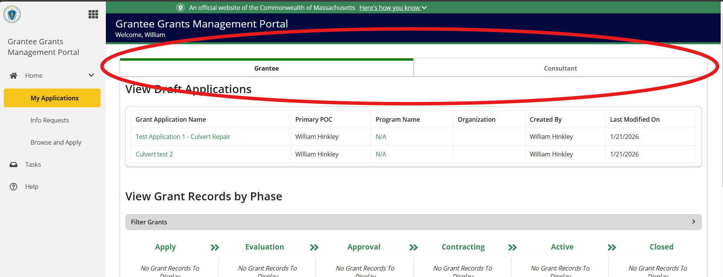
Accessing Consultant Dashboard from Grantee Dashboard

Slide 30
Consultant/Partner Access
The EEA GMS team can add consultants and partners to your application. However, this may take a day or more depending on volume. To make these changes, send an email to ecoonestop@mass.gov
Organizations may select a member to serve as the Organizational Administrator. This person can add and remove users and consultants quickly.
If your organization wants to have an Administrator, send an email to ecoonestop@mass.gov to request. User tools will be provided.

Slide 31
Lockout Feature
We have enabled a lockout feature to make sure your work is not overwritten. Use is exclusive to a user while they are in the application. If there are 2 hours of inactivity, the application will be opened to others and your work may not have been saved!
Be sure to exit the application with the save draft button to open it up to other users.

Slide 32
Deadlines and Support
The application will automatically close at 11:59:59 on 3/20/2026
Once an application is submitted no changes can be made and no further information may be provided.
Applicants are strongly urged to give themselves plenty of time to complete and submit the application.
We can help! ecoonestop@mass.gov
User guides are available in the GMS portal and your user portal under the HELP tab.

Slide 33
Questions and Answers
Please use the Q&A tool in Zoom to post questions.
Thank you for joining us today!

