Slide 1
EEA General Request Claim Authorization Form
Notes:
1
Bill Oates

Slide 2
Overview
This presentation is to assist in completing a Claim Authorization Request
Use this form to link to an existing authorization that is not currently available in the EEA ePlace Portal.
You will need to complete this process first before trying to Amend/Modify or Renew your current existing approval.
This presentation will take you screen by screen through the ePlace online permitting application process

Slide 3
How to Apply
First time users:
Click or type this address on your browser: https://eplace.eea.mass.gov/citizenaccess
Follow the prompts to create a new user account
Log into your account in ePlace using your username/password

Slide 4
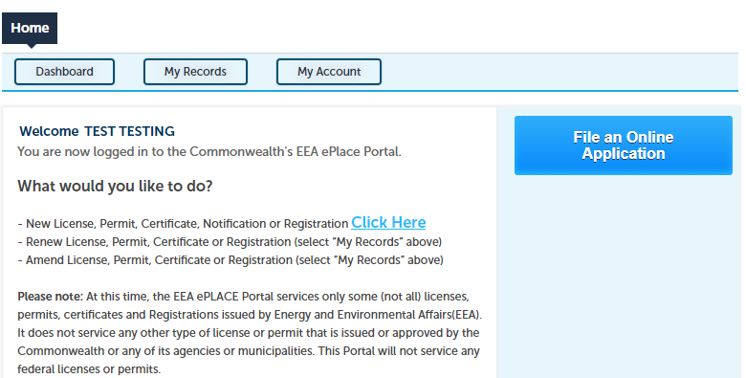
File an Online Application
Click here to start

Slide 5
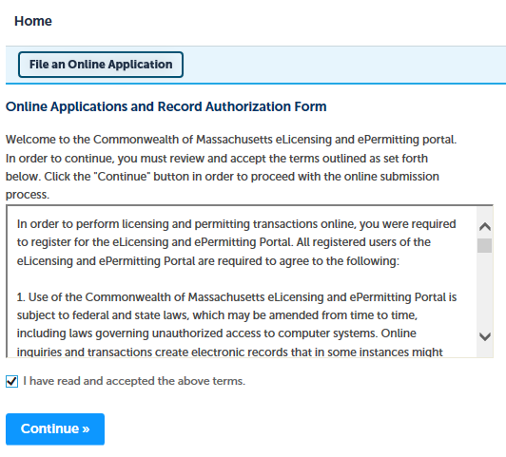
File an Online Application
Read and accept the Terms and Conditions
Click the checkbox and click “Continue”

Slide 6
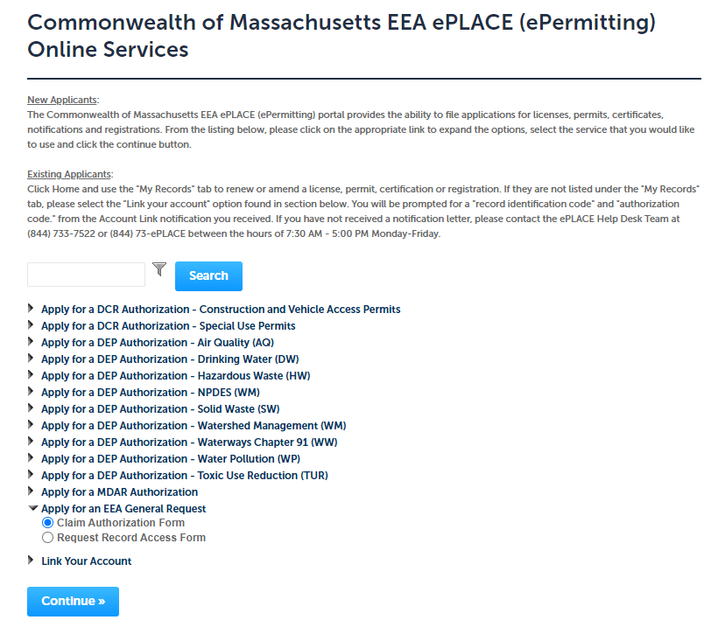
Apply for EEA General Request
Click on “Apply for an EEA General Request” and select “Claim Authorization Form”.

Slide 7
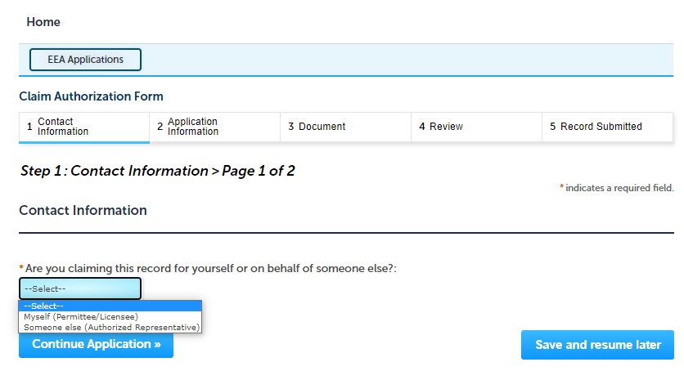
Step 1: Contact Information
Click and Select whether you are claiming this record for yourself or on behalf of someone else.
Click “Continue Application”

Slide 8
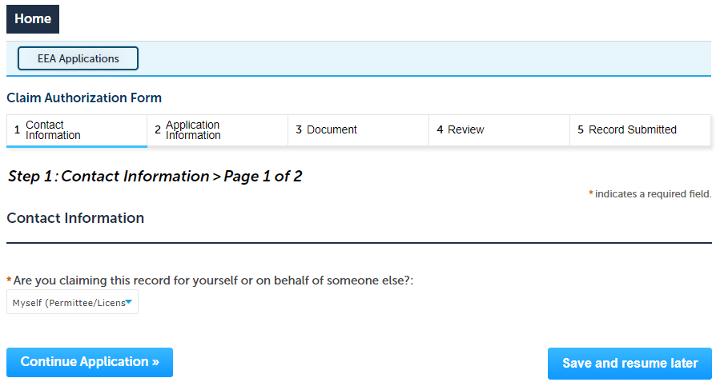
Step 1: Contact Information
If you are claiming this record for yourself, please select “ Myself” and click continue.

Slide 9
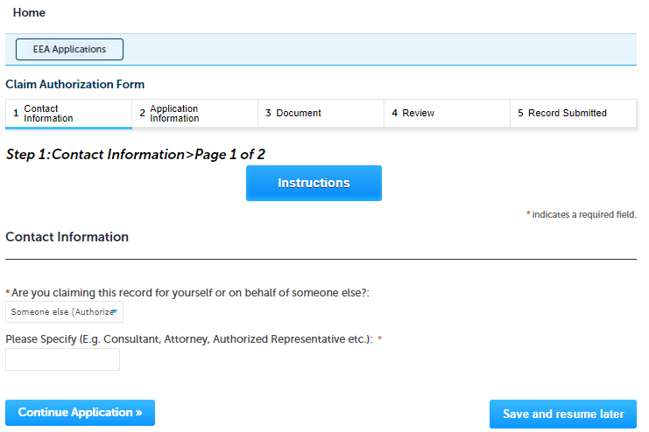
Step 1: Contact Information
If you are claiming this record on behalf of someone else. Please specify “Who you are?” as you are submitting this application on behalf of someone else.

Slide 10
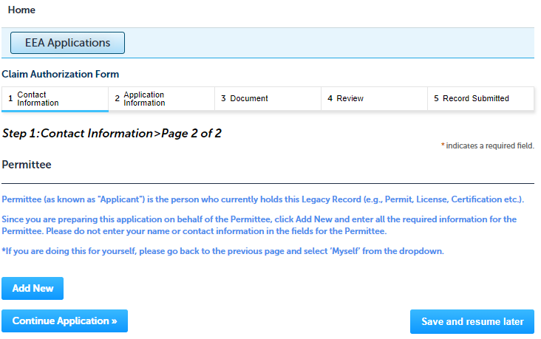
Step 1: Contact Information
When you claim this record on behalf of someone else, you will need to enter the information of the person who holds the authorization
Please read the instructions and add the information accordingly

Slide 11
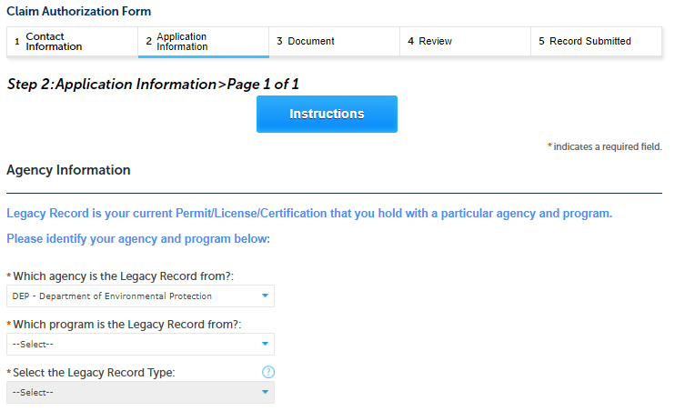
Step 2: Application Information
Please identify your agency, program and Legacy Record Type by clicking on each of the dropdown menus.
Note: Legacy Record is your current Permit/License/ Certification that you hold with a particular agency and program.

Slide 12
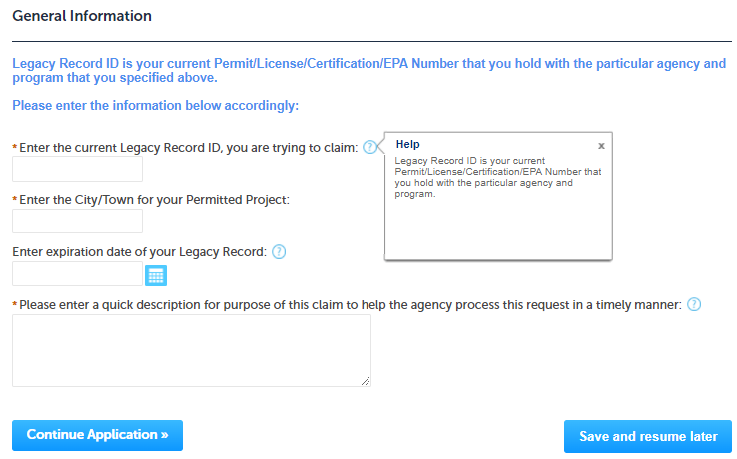
Step 2: Application Information
Please enter the information regarding your Legacy Record ID.
Note: Legacy Record ID is your current Permit/ License/ Certification/EPA Number that you hold with the agency and program.
For more information, please click on the Question mark button.

Slide 13
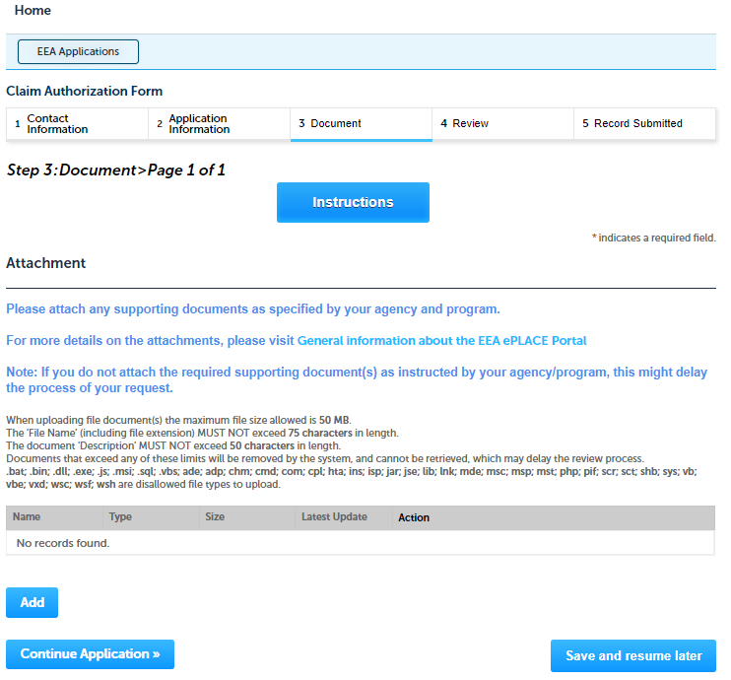
Step 3: Document
Please attach any supporting documents as specified by your selected agency and program
To begin attaching documents, click “Add” button

Slide 14
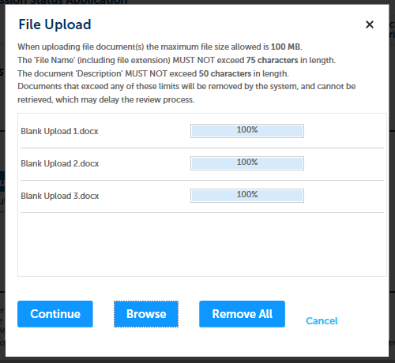
Step 3: Documents (Attaching)
A “File Upload” window opens
Click “Browse”
Choose the file(s) you want to attach.
When all files reach 100%, click “Continue”

Slide 15
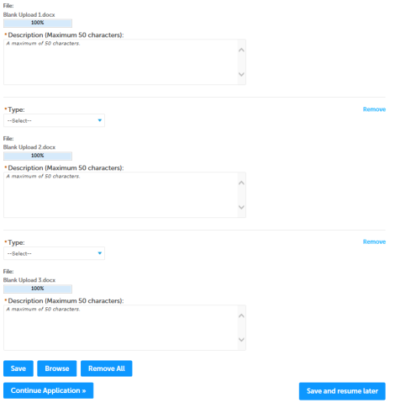
Step 3: Documents (Attaching)
Select the document type
Provide a description of each document that you uploaded
Click “Browse” to add more documents
When all documents are uploaded and described, click “Save”
Click “Continue Application”

Slide 16
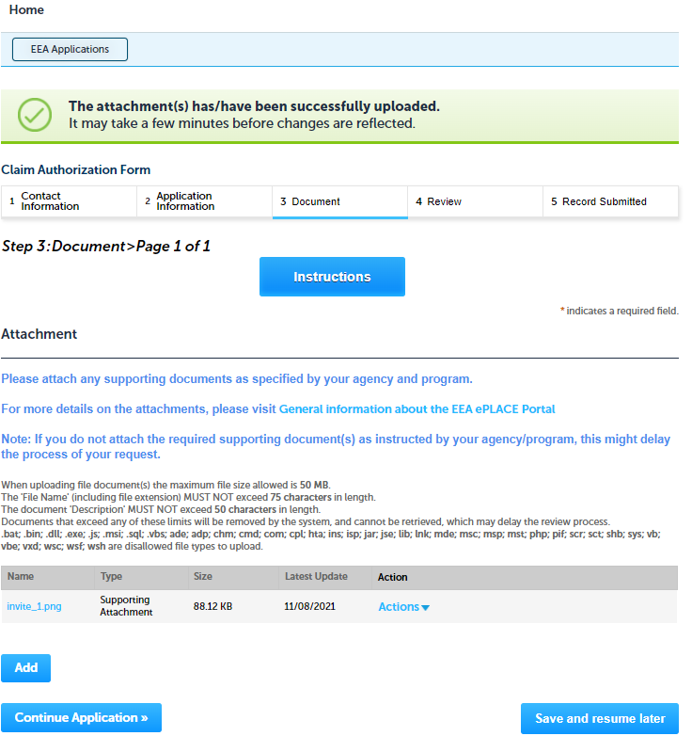
Step 3: Documents (Attaching)
You should see a message that you have successfully attached documents
Review the list of attached documents
When ready, click on “Continue Application”

Slide 17
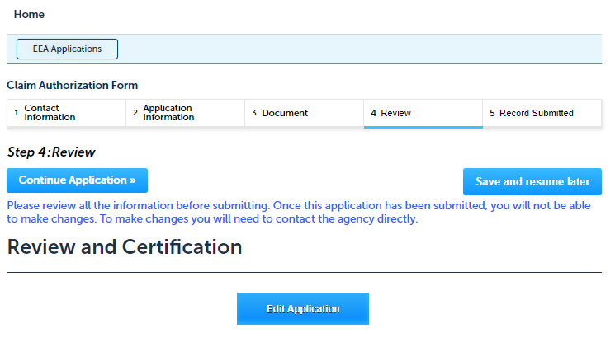
Step 4: Review
The application information can be reviewed at this step.
If you need to change, click “Edit Application” button.
Otherwise, continue to the bottom of the page

Slide 18
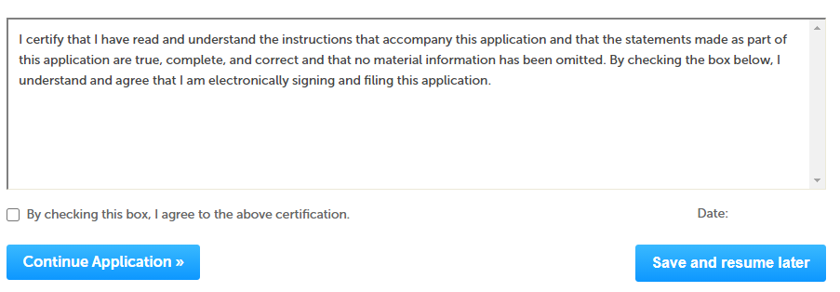
Step 4: Review
Read the Certification Statement
Click the check the box to complete your certification
Click on “Continue Application” to proceed with the submittal of your application

Slide 19
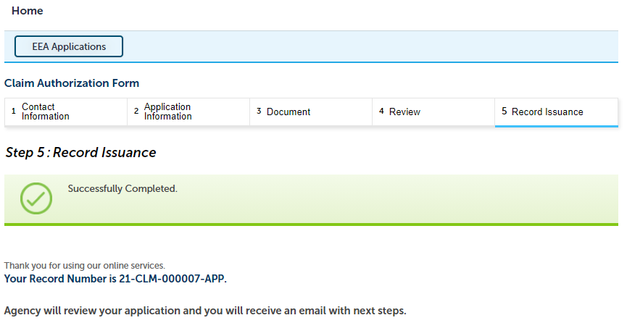
Step 5: Submission Successful!
When you submit your application, you will receive a Record ID so you can track the status of your application when you log back to EEA ePlace Portal.

Slide 20
Status of application
Log on to EEA ePlace portal
https://eplace.eea.mass.gov/citizenaccess
Go to your “My Records” page in ePlace to track the status of an application

Slide 21
Questions?
For technical assistance:
Contact the ePlace Help Desk Team at (844) 733-7522
Or send an email to: ePLACE_helpdesk@state.ma.us

