Slide 1
EEA General Request Request Record Access Form
Notes:
1
Bill Oates

Slide 2
Overview
This presentation is to assist in completing a Request Record Access.
Use this form to request access to record(s) you seek to transfer to your account.
This presentation will take you screen by screen through the ePlace online permitting application process

Slide 3
How to Apply
First time users:
Click or type this address on your browser: https://eplace.eea.mass.gov/citizenaccess
Follow the prompts to create a new user account
Log into your account in ePlace using your username/password

Slide 4
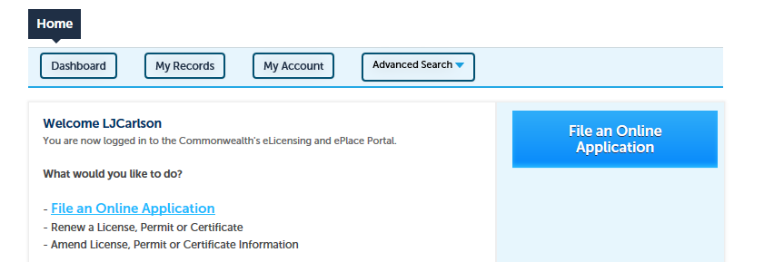
File an Online Application
Click here to start

Slide 5
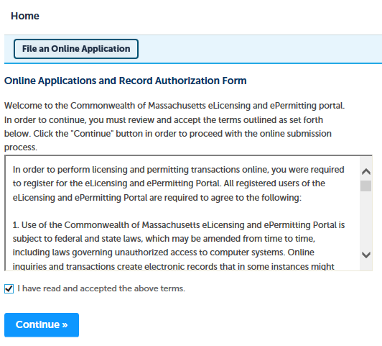
File an Online Application
Read and accept the Terms and Conditions
Click the checkbox and click “Continue”

Slide 6
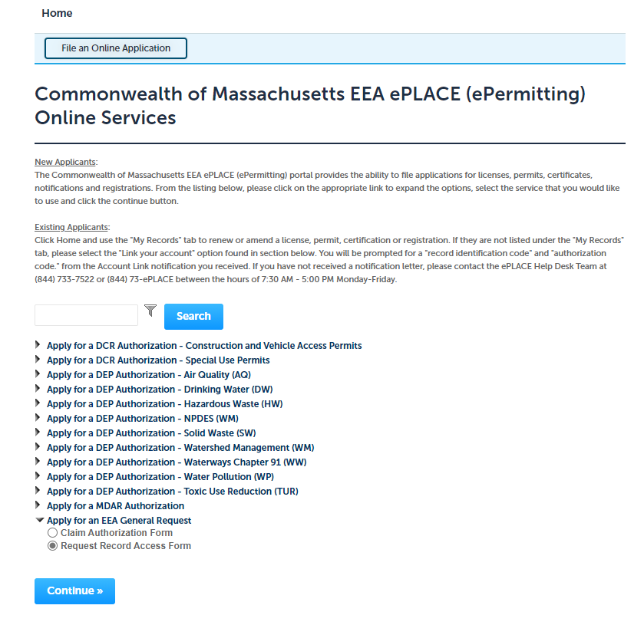
Apply for EEA General Request
Click on “Apply for an EEA General Request” and select “Request Record Access Form”

Slide 7
Step 1: Application Information
Record Details:
Please identify your agency and program by clicking on each of the dropdown menus.

Slide 8
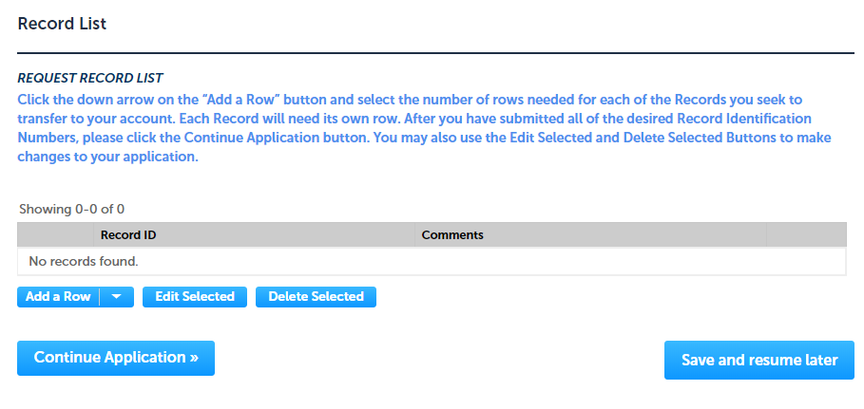
Step 1: Application Information
Record List:
Please read instructions on how to add records you seek to transfer to your account
Add row and enter the Record ID that you are requesting access
Click “ Continue Application”

Slide 9
Step 2: Document
Attachment:
Please read instructions to attach any supporting documents that indicates your permission to transfer the records from the existing account to your account
To begin attaching documents, click “Add”

Slide 10
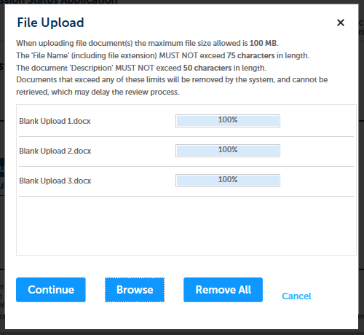
Step 2: Documents (Attaching)
A “File Upload” window opens
Click “Browse”
Choose the file(s) you want to attach
When all files reach 100%, click “Continue”

Slide 11
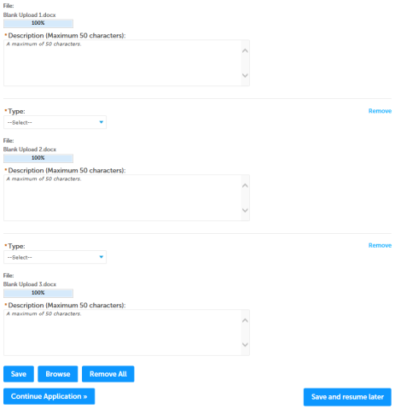
Step 2: Documents (Attaching)
Select the document type
Provide a description of each document that you uploaded
Click “Browse” to add more documents
When all documents are uploaded and described, click “Save”
Click “Continue Application”

Slide 12
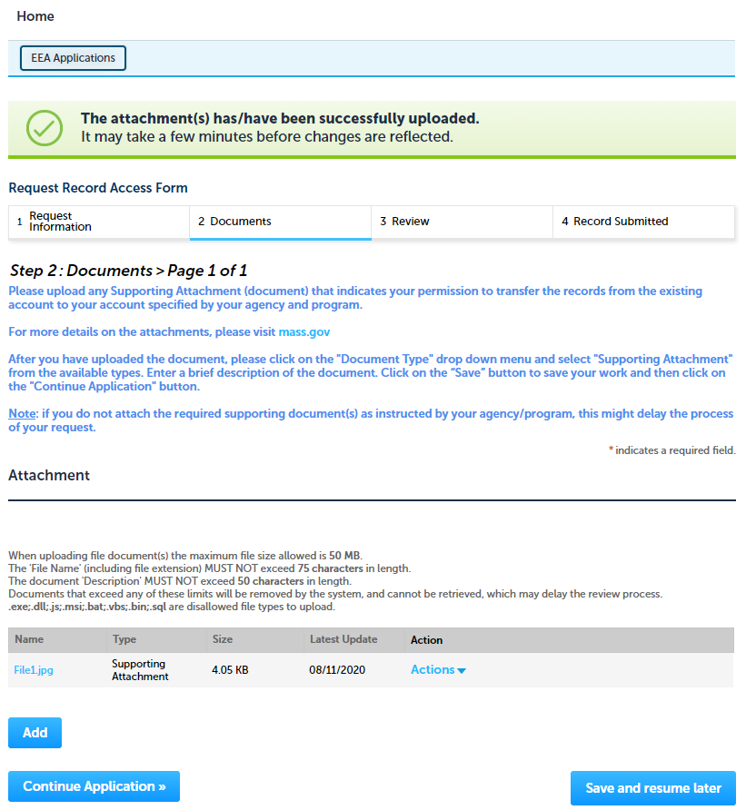
Step 2: Documents (Attaching)
You should see a message that you have successfully attached documents
Review the list of attached documents
When ready, click on “Continue Application”

Slide 13
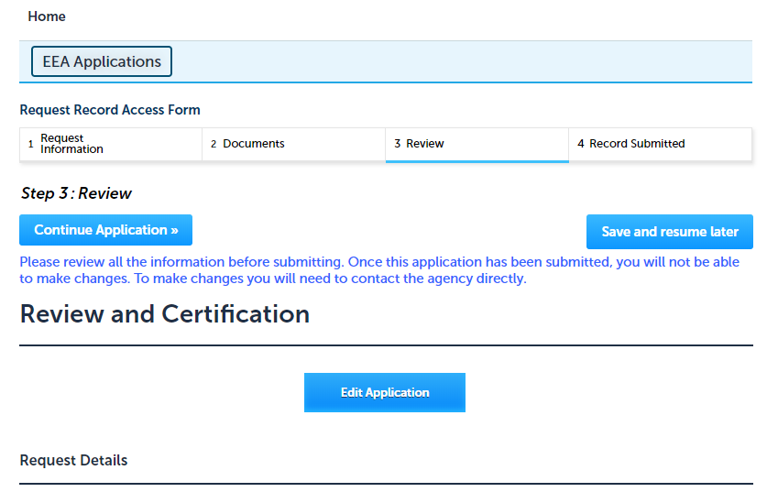
Step 3: Review
The entire application is shown on a single page for your review
If you note something you want to change, click “Edit Application”
Otherwise, continue to the bottom of the page

Slide 14
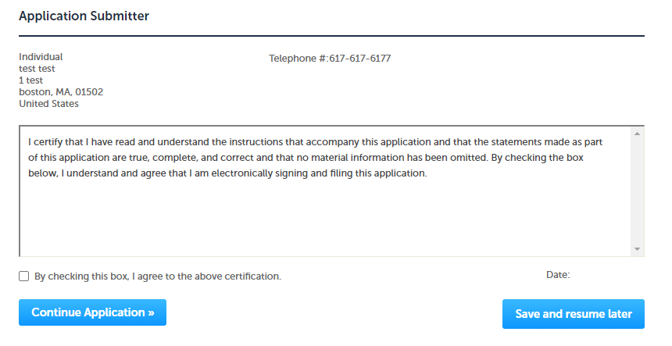
Step 3: Review
Read the Certification Statement.
Click the check the box to complete your certification
Click on “Continue Application” to proceed with the submittal of your application

Slide 15
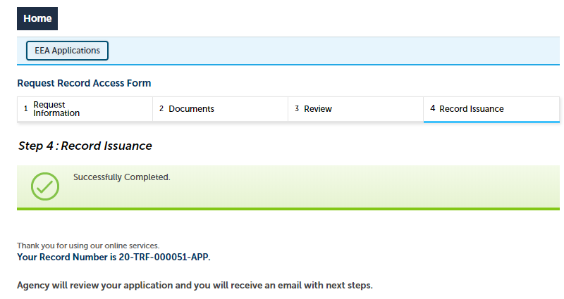
Submission Successful!
When you submit your application you will receive a Record ID so you can track the status of your application when you log back in to ePlace
The Agency will review your application and you will receive an email with the next steps

Slide 16
Status of application
Log on to EEA ePlace portal
https://eplace.eea.mass.gov/citizenaccess
Go to your “My Records” page in ePlace to see or track the status of an application

Slide 17
Questions?
For technical assistance:
Contact the ePlace Help Desk Team at (844) 733-7522
Or send an email to: ePLACE_helpdesk@state.ma.us

