Slide 1

Commonwealth of Massachusetts
Department of Early Education and Care
EEC Advisory Council
September 8, 2022

Slide 2
Market Rate Survey and Narrow Cost Study
2

Slide 3



MA EEC Market Rate | Narrow Cost Analysis
Center for Early Learning Funding Equity
9.8.22
Notes:
keep simple, no changes

Slide 4
Two primary sets of information are needed to set subsidy rates and overall funding policy for child care:
Prices and Costs
Prices
The Market Rate Survey provides information about how much providers in the marketplace are charging private-pay families for care.
Costs
The Narrow Cost Analysis provides information about how much it is costing providers to operate their programs meeting required standards for health and safety (and higher levels of quality).
This information helps the Commonwealth understand the extent to which subsidy rates allow parents to access the full market of care available.
This information helps the Commonwealth understand the extent to which subsidy rates (and market rates) allow providers cover the full cost of care.

Slide 5
New Approach for this Cycle & Limitations
Market Rate Survey
  LEAD now allows providers to publish rates, which is required for providers participating in C3. This allows EEC to use administrative data for the MRS, rather than a facilitated survey design.
  The administrative data resulted in a more robust and representative sample (30% more providers than 2018) with fewer biases in the analysis.
Narrow Cost Analysis (Cost Model)
  Massachusetts completed the first Narrow Cost Analysis in 2018.
  That process included extensive data gathering and stakeholder input.
  Based on the thorough work done at that time, we built upon and updated that model to account for inflation.
Notes:
Notes:
Approximately one-third of the providers had not updated their rates in the past year and were subsequently dropped from the dataset.
Extreme outliers, likely caused data-entry errors were addressed through data cleaning, reducing sample by approximately 5%

Slide 6
Methodology Overview
All providers receiving C3 funding were required to complete tuition and hours of operation in the child care search.
Providers were asked to verify and update LEAD data in April 2022.
After cleaning and removing duplicates, outdated data, and outliers, 4,237 providers remained in the final dataset
All rates were converted to a “daily rate” and outliers whose rates were under $20/day and greater than $200/day were removed from the sample
Provider capacity was used as a weight to calculate the total number of “slots” per region and age-group.
All results were statistically significant with a 95% confidence interval and 5% or lower margin of error.

Slide 7
The administrative dataset resulted in a robust and representative sample
Table: Sample targets for total provider universe (FCC and Group and School Age)
Region | Provider Universe | Target Sample (95% CL, +/- 5.0 margin of error) | Providers Included in Final Dataset | Percent of Universe | Percent of Target Sample Achieved
Region 1- Western | 983 | 277 | 547 | 55% | 197%
Region 2- Central | 1,088 | 284 | 628 | 58% | 221%
Region 3- Northeast | 1,538 | 308 | 808 | 53% | 262%
Region 4- Metro | 1,884 | 320 | 1,096 | 58% | 343%
Region 5- Southeast | 1,131 | 287 | 677 | 60% | 236%
Region 6- Metro Boston | 912 | 271 | 521 | 57% | 192%
*A power analysis was used to calculate confidence level and margin of error
These numbers outpace the 2018 survey response rates.

Slide 8
The 2018 Narrow Cost Model was updated to reflect 2022 conditions
Salaries were adjusted using the BLS Employment Cost Index for Boston-Worcester-Providence for the 24-month period ending March 2022
Health insurance costs were inflated using data from Center for Health Information and Analysis
Worker’s Compensation was updated using data from The Workers' Compensation and Inspection Bureau of Massachusetts
Non-personnel costs (e.g. physical space, materials, etc.) were updated with data from the most recent version of the Provider Cost of Quality Calculator

Slide 9

Summary of 2022 NCA Results
As expected, costs for providing infant and toddler care far exceed the cost of providing care for preschool and school-age children.
This is driven by the fact that infants and toddlers need to be cared for in smaller groups, with fewer children per teacher
Estimated costs for providing care did not vary as substantially across geographies as prices charged for care.
  Data collected on wages paid by child care providers in 2020 did not vary widely across the state. This low variation was also evident in the BLS data.
  The cost model was not able to directly estimate different costs for occupancy (rent & utilities) across regions, as this information was unavailable.
9
Notes:
ADD TO STAKEHOLDER DECK

Slide 10
GSA Rates, MRS findings, and Cost Estimates
Region | Infant | EEC Infant Subsidy Percentile | Infant 25th Percentile | Toddler | Infant 75th Percentile | Current Toddler EEC Subsidy | Preschool | Toddler 25th Percentile | Toddler 50th Percentile | School Age
 | Current Rate | 75th Percentile MRS | Narrow Cost Estimate | Current Rate | 75th Percentile MRS | Narrow Cost Estimate | Current Rate | 75th Percentile MRS | Narrow Cost Estimate | Current Rate | 75th Percentile MRS | Narrow Cost Estimate
Region 1- Western | $65.71 | $74.00 | $127.62 | $60.26 | $65.00 | $100.20 | $45.82 | $54.00 | $56.64 | $42.13 | $45.00 | $42.70
Region 2- Central | $67.51 | $85.13 | $127.62 | $61.65 | $79.34 | $100.20 | $48.81 | $64.00 | $56.64 | $42.14 | $51.00 | $42.70
Region 3- Northeast | $79.40 | $104.00 | $129.58 | $69.05 | $97.00 | $101.70 | $49.91 | $73.90 | $57.43 | $43.57 | $49.00 | $43.24
Region 4- Metro | $90.41 | $129.56 | $132.12 | $82.08 | $117.00 | $103.65 | $63.22 | $99.45 | $58.44 | $44.79 | $59.00 | $43.94
Region 5- Southeast | $65.71 | $84.20 | $128.60 | $61.65 | $77.50 | $100.95 | $47.03 | $62.50 | $57.03 | $42.14 | $48.00 | $42.97
Region 6- Metro Boston | $85.68 | $146.42 | $132.02 | $79.86 | $135.33 | $103.58 | $50.37 | $88.00 | $58.40 | $44.79 | $57.50 | $43.92
In all regions of the Commonwealth, for every age group and program type, the existing subsidy rates are below the 75th percentile market-rate, and many are also below the 50th percentile. This is consistent with the findings of the 2018 MRS.

Slide 11
FCC Rates, MRS findings, and Cost Estimates
Region | Under Age 2 |  |  |  | Over Age 2
 | Current Rate | 75th Percentile MRS Infant | 75th Percentile MRS Toddler | Narrow Cost Estimate | Current Rate | 75th Percentile MRS Preschool | 75th Percentile MRS School-Age | Narrow Cost Estimate
Region 1- Western | $42.79 | $50.00 | $48.00 | $69.13 | $36.89 | $45.00 | $45.00 | $46.82
Region 2- Central | $48.90 | $60.00 | $55.00 | $69.13 | $38.83 | $55.00 | $50.00 | $46.82
Region 3- Northeast | $48.90 | $58.00 | $55.00 | $70.06 | $38.90 | $55.00 | $54.00 | $47.31
Region 4- Metro | $73.34 | $85.00 | $80.00 | $71.28 | $44.38 | $76.00 | $74.50 | $47.94
Region 5- Southeast | $48.90 | $56.00 | $60.00 | $69.59 | $38.83 | $60.00 | $58.75 | $47.06
Region 6- Metro Boston | $55.00 | $80.00 | $70.00 | $71.23 | $39.94 | $60.00 | $60.00 | $47.92
In all regions of the Commonwealth, for every age group and program type, the existing subsidy rates are below the 75th percentile market-rate, and many are also below the 50th percentile. This is consistent with the findings of the 2018 MRS.

Slide 12





A deeper analysis of program costs and revenues is planned in the coming months
The Narrow Cost Estimate Results should be considered preliminary
While the process included extensive stakeholder engagement, the current NCA relies on a relatively limited sample of providers.
Costs for occupancy will be a key focus, as the current estimate is likely lower than true costs, especially in the Boston area.
Future models will also include more information about other revenue sources, such as the Child and Adult Care Food Program.
Notes:
ADD TO OUTREACH DECK

Slide 13
Appendix

Slide 14
Compliance with Federal Requirements
Market Rate Survey (MRS):
  EEC required to conduct a valid and reliable Child Care Market Rate Survey (MRS) for gathering data on private-pay child care rates every three years.
  The Market Rate Survey must:
    represent the full child care market,
    provide complete and current data,
    use rigorous data collection procedures,
    reflect geographic variation, and
    analyze data in a manner that captures other relevant differences.
  Federal guidance establishes the 75th percentile (of market rates) as the benchmark for providing equal access.
  Use of administrative data is an approved approach to completing a Market Rate Survey.
Narrow Cost Analysis
  States must also complete a Narrow Cost Analysis, estimating the cost of meeting health and safety standards and a higher level of quality for each type of care.
CENTER FOR EARLY LEARNING FUNDING EQUITY

Slide 15
Looking back:
2019 subsidy rates mostly fell below the 50th percentile of the 2018 MRS
The red subsidy rates fell below the 50th percentile of market rates in the 2018 MRS
 | Group and School Age Providers |  |  |  | Family Child Care Providers |  |  |  |  | Before and After School Only
 | Infant | Toddler | Preschool | School Age | Infant | Toddler 1 | Toddler 2 | Preschool | School Age | FCC Before | FCC After | Center Before | Center After
Region 1- Western | $56.65 | $51.95 | $39.51 | $36.33 | $38.56 | $38.56 | $33.25 | $33.25 | $33.25 | $19.95 | $19.95 | $8.59 | $18.03
Region 2- Central | $58.20 | $53.15 | $39.51 | $36.33 | $44.07 | $44.07 | $33.25 | $33.25 | $33.25 | $19.95 | $19.95 | $8.59 | $18.03
Region 3- Northeast | $65.00 | $59.47 | $42.18 | $37.56 | $44.07 | $44.07 | $35.07 | $35.07 | $35.07 | $21.04 | $21.04 | $9.11 | $20.17
Region 4- Metro | $70.39 | $63.92 | $43.42 | $38.62 | $66.10 | $66.10 | $35.07 | $35.07 | $35.07 | $21.04 | $21.04 | $9.35 | $20.71
Region 5- Southeast and Cape | $56.65 | $53.15 | $39.51 | $36.33 | $44.07 | $44.07 | $33.25 | $33.25 | $33.25 | $19.95 | $19.95 | $8.59 | $18.03
Region 6- Metro Boston | $73.86 | $68.85 | $43.42 | $38.62 | $49.57 | $49.57 | $35.07 | $35.07 | $35.07 | $21.04 | $21.04 | $9.35 | $20.71
Notes:
NOTE: The 2018 report used the 2019 subsidy rates in their analysis

Slide 16
Reimagining the Child Care Financial Assistance System
16

Slide 17


Financial Assistance for Child Care (Subsidy):
Updates from May Advisory Council Meeting
EEC has begun holistic, listening and feedback-driven and analysis of the child care financial assistance system (subsidy).
Initial areas of focus have been identified to simplify the process for families, reduce the burden on CCRRs/providers and collect better data on system needs.
EEC project team is focused on increasing placements, reconciling waitlist data, innovative efforts to connect families to referral services, and revising policies to facilitate family access.
Interviewing Mass211 and CCRRs about pain points and processes
Conduct interviews with contracted providers and providers with voucher agreements
Collect feedback on existing subsidy IT systems for needed enhancements
Reviewing previous engagements, family surveys and EEC strategic plan, and legislative reports
Reviewing existing policies, procedures, regulations and forms
Engagement with families and key stakeholders
Complete
Underway or planned

Slide 18
Significant opportunities exist to streamline and modernize the child care financial assistance system in Massachusetts
Opportunities for improvement and reform:
Simplify policies, processes and procedures for families seeking subsidy for timely and need-responsive placements
Align with Public Benefit Programs
Wait List Administration
Expand Access
Streamline Processes
Collaborate with other public benefit programs to align eligibility requirements, verifications, and definitions
Revisit KinderWait, EEC’s waitlist management system, to expedite family enrollment, improve data quality, and reconcile current Wait List
Implement eDocuments with eSignature capability and encourage virtual appointments to facilitate document collection, verification process and enrollment
Use Technology
Expand access to providers serving families with a subsidy across geographic regions, age groups, and hours of operation

Slide 19
Tools to Address Opportunities for Improvement and Reform
System assessment and identification of “pain points”
Pilot: targeted family outreach, application support and waitlist reconciliation
New capacity and structure at EEC to oversee and support Child Care Financial Assistance (Subsidy) Programs
Revisions to Child Care Financial Assistance Policy Guide and Regulations
CCRR and subsidized provider contract procurements
Development of digital future/road map for subsidy system (and other EEC systems)

Slide 20
Introduction to Pilot
Mass211 agents are augmenting CCRR’s work by making outbound calls (and emails) to provide technical assistance to customers who are being offered a child care subsidy.
Mass211 agents will complete two tasks on the phone:
  1) Support Family in Application + Eligibility Process:
    Conduct a pre-screening and “soft” eligibility check of the family
    Support family to complete an Intake Application
    Prepare family for CCRR appointments by informing family of required documentation, how to find childcare placement, and next steps
  2) Conduct waitlist reconciliation
    Confirm child/parent/caregiver information, current interest in care,
    Update client’s information on KinderWait and/or remove the child from the Kinder Wait database, if appropriate.
PILOT GOALS
Increase the number of children who receive voucher childcare placements and are moved off the wait list
Conduct reconciliation of KinderWait Wait List
Improve the experience of families navigating the EEC Subsidy System

Slide 21
Pilot: Addressing Family Feedback
Family Experience |  | Addressed in pilot…
Families find the process of attaining subsidized Child Care to be confusing and overwhelming, from beginning to end Example: families lose their place on the Wait List if they do not respond to a Financial Assistance Letter within 30 days – even if they never receive it in the mail |  | After the CCRR sends the Financial Assistance Letter, a Mass211 agent reaches out via phone. They will follow the Intake Script. If the parent does not pick up the phone, Mass211 will leave a Voicemail and e-mail and call back New educational resources for families that explain the Subsidy Process: a Road Map and an FAQ Guide. Translated in multiple languages.
Families find the Eligibility Check Process challenging and the eligibility requirements baffling Example: Families must compile multiple types of documentation; often bring in incomplete or incorrect documents Example: Families might go through the entire intake process only to find they are ineligible at the last stage |  | Created a Documentation One-Pager for families, which clearly lays out requirements. Translated in multiple languages. The Policy Team is analyzing the eligibility documentation requirements to determine which requirements can be amended
The current intake process does not prioritize the family experience Example: Families need to complete multiple forms during the intake process. Example: when they have questions, families have a hard time successfully reaching CCRR’s on the phone |  | Compiled into a single Intake Application with e-signature capability, that is mobile- and desktop-friendly. AdobeSign document that is editable, has required fields, and logic. Mass211 is available 24/7 and has a sophisticated call center setup

Slide 22
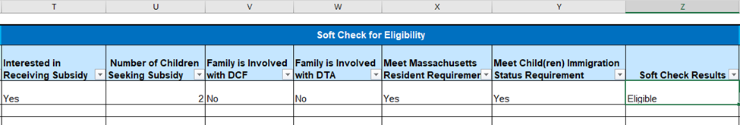
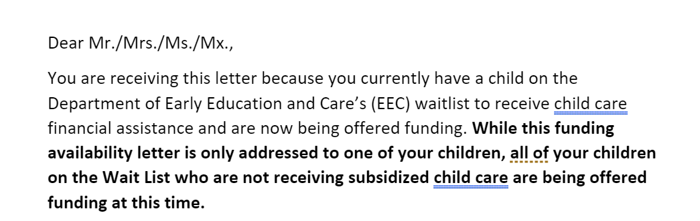
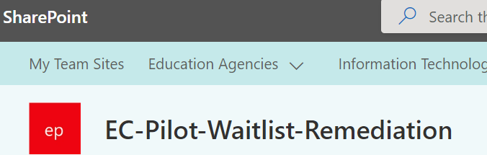




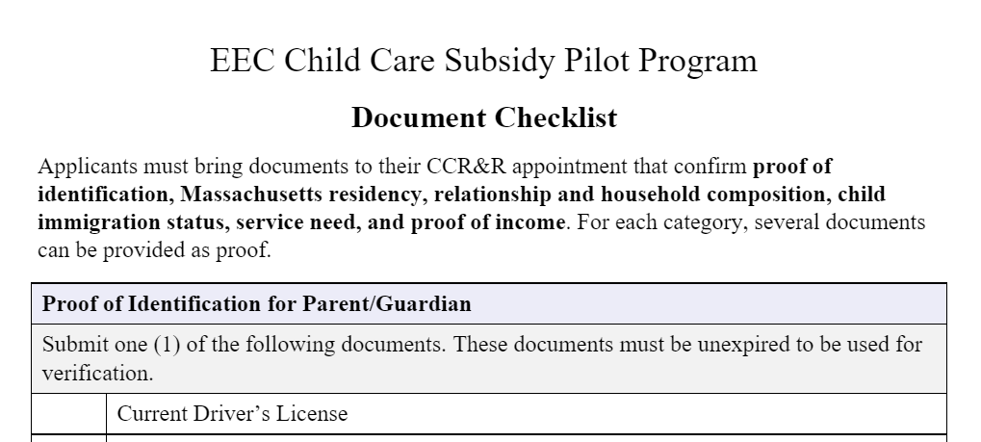

New Materials Created to Support Pilot
Case Tracker for Mass211 and CCR&R's to track applicants through the subsidy issuance process
Funding Availability Letter Insert for Pilot Participants
Educational resources for families: a Road Map and FAQ Guide
SharePoint site for application repository and Case Tracker; facilitate communication between Mass211 and CCR&Rs
Single Intake Application: electronic form with required fields, logic and e-signature capability; mobile- and desktop-friendly
Training Guide for Pilot Support Staff, includes script for Mass211 agents
AdobeSign to support Single Intake Application and document journey
Document Checklist for families: clearly lays out document submission requirements
22

Slide 23


Key Metrics for Child Care Financial Assistance Reforms
Increase…
Decrease…
The number of children in families receiving child care financial assistance, including:
  Low-income families (income-eligible)
  Infants and toddlers
  Families receiving SNAP and/or TAFDC through DTA
  Supportive Child Care through DCF
  Families facing housing insecurity/homelessness
The number of providers participating in the child care financial assistance system
The number of families on the Income Eligible Waitlist
The timeline between a family’s application for assistance to placement in a program.
The timeline for appeals decisions

Slide 24
Wrap up and Discussion
Increasing access for priority populations, e.g. DCF and DTA related care
Improving waitlist data and processes and getting families access to care more quickly
Identifying and removing barriers to family access by streamlining policies, businesses processes and structures
Areas for Discussion:
Given the efforts and activities we discussed:
  Is EEC moving in the right direction in better supporting programs seeking to enroll subsidized families, as well as ensuring affordable access?
  Is EEC moving in the right direction in reviewing and revising regulations and policies to allow for less burdensome subsidy processes/policies and to mitigate existing inconsistencies and inflexibilities?
  Is EEC moving in the right direction in streamlining eligibility policies and simplify processes to prioritize key populations and increased enrollment across all subsidy programs?

Slide 25
Appendix for Child Care Financial Assistance

Slide 26
Background and Context
The Child Care and Development Fund (CCDF) is a federal and state partnership program authorized under the Child Care and Development Block Grant Act (CCDBG).
States use CCDF to provide financial assistance to low-income families to access child care so they can work or attend a job training or educational program.
In addition, states use the CCDF to invest in quality initiatives to benefit millions more children by building the skills and qualifications of the teacher workforce, supporting child care programs to achieve higher standards, and providing consumer education to help parents select child care that meets their families’ needs.
The Massachusetts EEC child care financial assistance program is primarily funded by CCDF.
Family’s income cannot exceed 85 percent of the applicable state median income, and the family cannot have countable assets in excess of $1,000,000
Parents or guardians must be working or attending a job training or educational program, with some options for states to grant exceptions.
Children served by CCDF funded subsidies must be under 13 years of age (unless the child has special needs)
Federal policies establish the basic requirements for eligibility for CCDF-funded child care subsidies
EEC must follow these policies in order to use CCDF monies for its child care financial assistance program, and EEC develops its regulations and policies accordingly.
26

Slide 27






How Child Care Financial Assistance Works
Eligible Family - States set their rules for eligibility within the CCDF regulations. To establish and maintain enrollment in a subsidy program, families must meet both federal and state-specific eligibility requirements, including that families meet the income limits and employment or training requirements, and have a need for child care services (a service need) for a child within the State’s age definition (0-13).
Established Service Need - The service need is the amount of time that neither parent/guardian is available to care for the child(ren) because they are working, going to school, looking for employment, or are incapacitated. To qualify for full-time child care services, a family must have at least 30 hours of service need. To qualify for part-time child care services, a family must have at least 20 but less than 30 hours of service need.
Parent Fees - States subsidize the cost of care using a rate schedule determined by the State. States subtract from the rate a family co-payment. The co‐payment is based on a sliding fee schedule set by the State. 98% of families receiving subsidized child care services pay a co-payment fee that is 7% of income or less (in keeping with federal guidelines) As of 2/1/22, families do not pay any fees on income below 100% of federal poverty level.
Provider Capacity - Subsidy is available for eligible families as long as funding and a provider with an opening for the age/needs of the child is available. If there is no funding or available placement, the child will be placed on the waitlist (Kinderwait).
Funding Availability – The number of income eligible subsidies offered by EEC may be limited by the amount of available funds appropriated by the Legislature and approved by the Governor. For DCF and DTA related child care, EEC is required under budget language to serve all children referred for those programs, so EEC works closely with A&F and the Legislature to ensure sufficient funding

Slide 28
How a Family is Referred for Child Care Financial Assistance
(By Program)
Income Eligible Child Care Program: Provides child care to eligible low-income and at- risk families, as allowed by funding. All children enrolled in the Income Eligible (IE) program must come from the centralized waitlist.
Teen Parent Child Care Program: Administered by 25 contracted entities to provide child care for Young Parents who are participating in full-time high-school or high-school equivalency (GED) program who are not eligible for care under DCF- or DTA-Related child care programs. Teen parents eligible for this program must be placed on the centralized waitlist but may be prioritized for immediate enrollment by an EEC Teen Parent Contract Provider.
Homeless Child Care Services: Children are entered into the waitlist system, but do not remain on the waitlist for homeless child care if care is available immediately at a contracted entity. Homeless children who cannot access care through a contracted entity may also be prioritized for a regular income eligible subsidy.
The referral from DHCD or DCF is the main eligibility documentation, although parents must also submit income documentation.
DCF-Involved Child Care Program: Provides child care to children with active cases at DCF
90 contract providers have contracts to work with DCF directly in placing children; additional children are enrolled in vouchers by DCF staff based on DCF eligibility
DCF documents eligibility and sends a referral to EEC. The referral and a photo ID are the only eligibility documentation required from EEC
DTA-Involved Child Care Program: Provides child care to eligible children from certain families receiving Transitional Aid to Families with Dependent Children (TAFDC) through DTA and families receiving SNAP benefits who are engaged in an approved Path to Work Activity.
DTA documents eligibility and sends a referral to EEC. The referral and a photo ID are the only eligibility documentation required from EEC.

