Slide 1
Commonwealth of Massachusetts
Department of Public Health
Dr. Catherine Brown, State Epidemiologist and
State Public Health Veterinarian
WEST NILE VIRUS AND EEE 2020 UPDATE
August 12, 2020

Slide 2
Human Disease
WNV
  Incubation period 3 to 14 days
  Age-related severity
  80% Mild and sub-clinical infection
  20% Headache, sore throat, fatigue, muscle and joint aches, fever (moderate to high),
  <1% Aseptic meningitis, encephalitis, meningoencephalitis
EEE
  Rare but severe mosquito-borne infection
  Incubation period 3-10 days
  Abrupt onset: fever, chills, headache, muscle aches, nausea and vomiting, seizures, coma
  ~30-50% mortality rate
  ~80% of those who recover have permanent neurological damage
  Children: 10/38 cases (40%) mortality rate; Adults 28/38 cases (60%)
Notes:
2

Slide 3
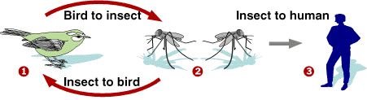
WNV and EEE Transmission Cycles
Enzootic Cycle:
Virus Amplification by Ornithophilic (bird-biting) Mosquitoes
Epizootic Cycle:
Incidental Transmission by Zoophilic (mammal-biting) Mosquitoes
EEEV mosquitoes involved: Culiseta melanura and Coquillettidia perturbans
WNV mosquito involved: Culex pipiens and Culex restuans

Slide 4
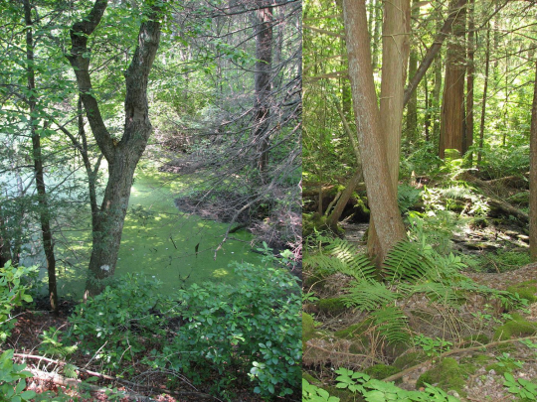
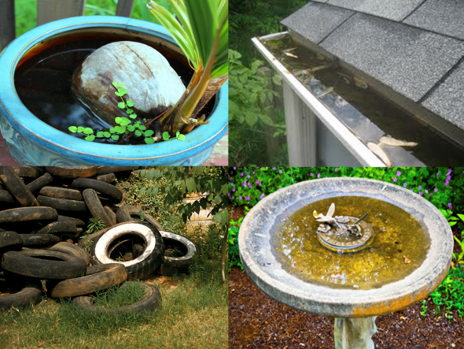
Habitats for EEE versus WNV
Eastern equine encephalitis (EEE)
  Red maple/white cedar swamps are source habitat (for birds and mosquitoes)
  Type of habitat most common in SE MA
West Nile virus
  Urban habitats that accumulate small collections of stagnant water are source habitat

Slide 5
So Far This Year
WNV
  Hot weather increases mosquito and viral reproduction
  Relatively dry this year may be suppressing mosquito populations
  Already had one human case
EEE
  Second year of EEE outbreak cycle
  Dry fall and spring may have suppressed some mosquito populations
  Large mammal-biting mosquito population
  Hot weather increases mosquito and viral reproduction
  Already identified one very early human case

Slide 6
Human and Mosquito EEE, 1970-2019

Slide 7
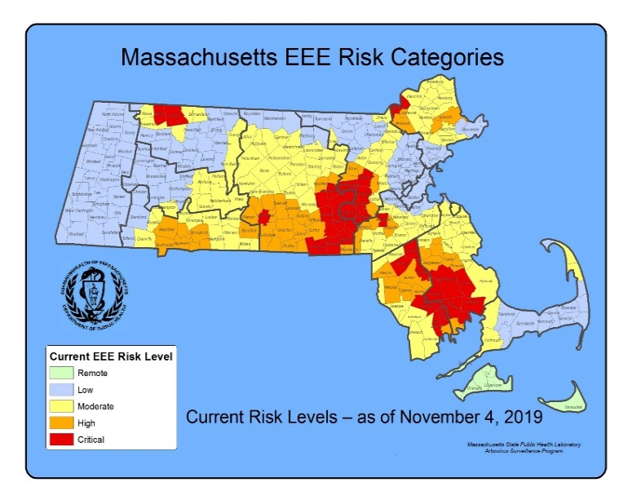
EEE: Expanding Activity

Slide 8
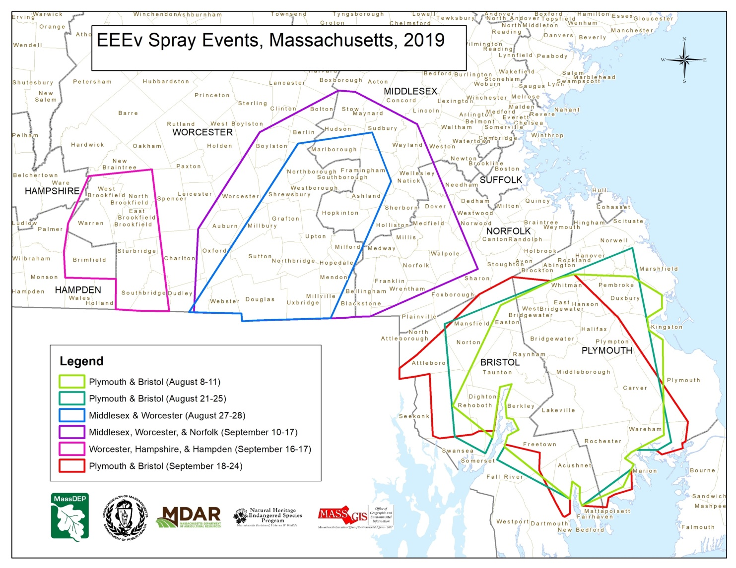
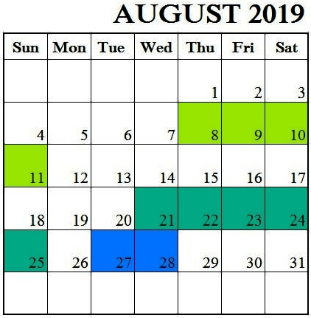
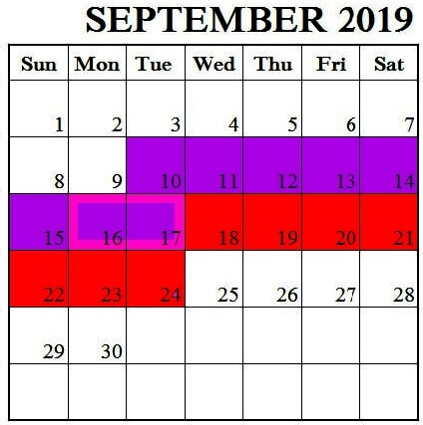
2019 EEE Aerial Spray Events

Slide 9
Prevention Tools
Aerial spraying to kill infected adults
Increasing Risk
Ground spraying to kill infected adult mosquitoes
Frequency of use
Awareness
Repellents
Clothing
Avoiding peak mosquito activity time
Larviciding in EEE environments has shown limited efficacy to date but the data are also limited. Given the unique level of EEE activity that occurs in MA, research is being done to investigate & seek to expand available tools.

Slide 10
Precautions
Apply insect repellent when outdoors. Use a repellent with an EPA-registered ingredient (DEET, permethrin, picaridin, oil of lemon eucalyptus)
  https://www.epa.gov/insect-repellents
  http://npic.orst.edu/ingred/ptype/repel.html
Reduce exposed skin. Wear long-sleeves, long pants and socks when outdoors.
Avoid peak mosquito hours. The hours from dusk to dawn are peak biting times for many mosquitoes. Consider rescheduling outdoor activities.
Reduce mosquito breeding. Dump standing water; stagnant water is used by mosquitoes to lay their eggs.

Slide 11
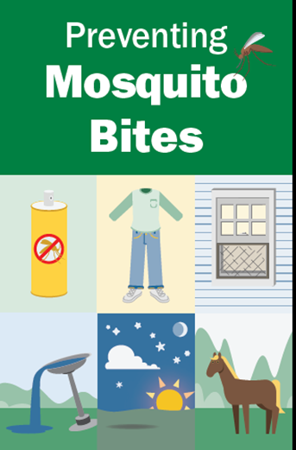
2020 Public Communications Campaign
Newly designated website
Press release on summer safety: mosquito/tick safety awareness
Video assets with Dr. Brown
TV, paid social media and digital media
DOT billboards, electronic signs, infographics, printed materials
Stakeholder-specific calls, fact sheets
www.mass.gov/mosquitoesandticks

Slide 12
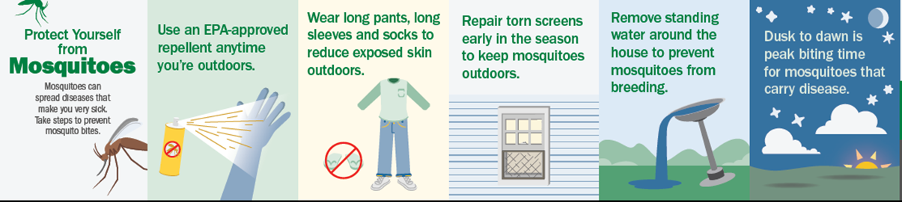
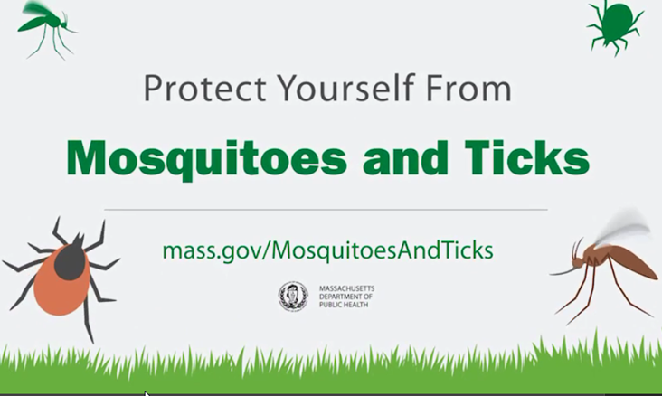
Public Communications – Sample Materials

Slide 13
Aerial spray decision making
Mosquito abundance – how large are the populations of concern?
Mosquito infection rates – how much EEE virus is in the populations?
Geography – is risk widespread +/- occurring in areas where truck-based mosquito control is not available or unlikely to be effective due to habitat?
Weather
Time of season
Aerial spray decision-making inputs:
DPH – risk assessments and geographic distribution of virus
MDAR/State Reclamation & Mosquito Control Board – pesticide regulation and subject matter expertise
Mosquito Control Districts – field condition awareness and mosquito control expertise
Mosquito Advisory Group – mosquito control expertise advisory group

Slide 14
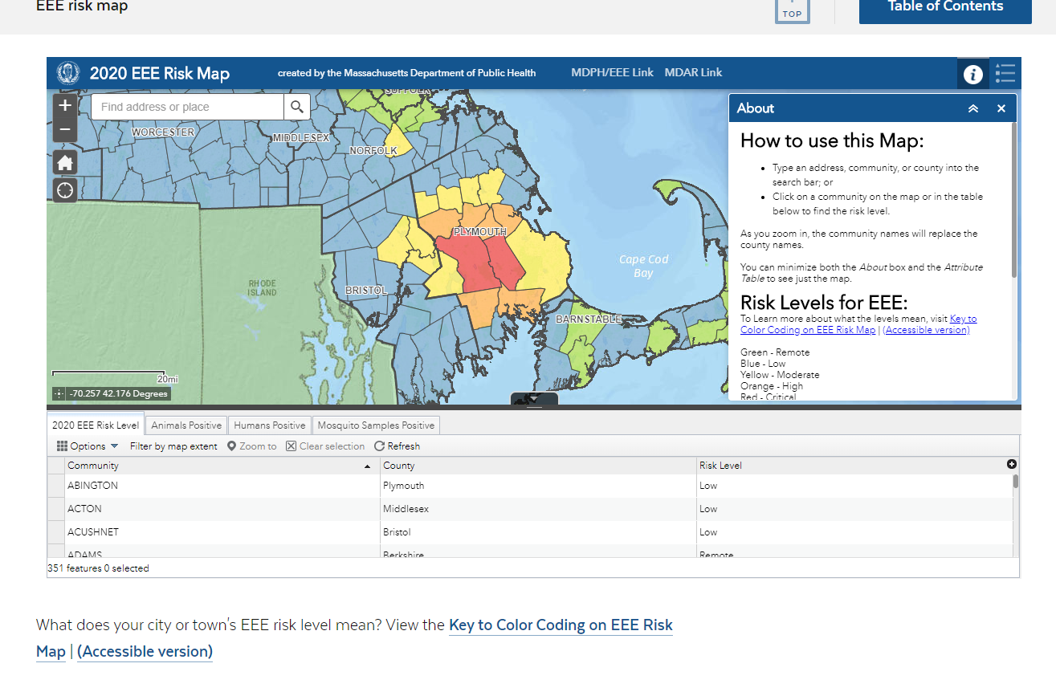
www.mass.gov/eee

Slide 15
Low bird-biting mosquito population

Slide 16
High mammal-biting mosquito population

Slide 17
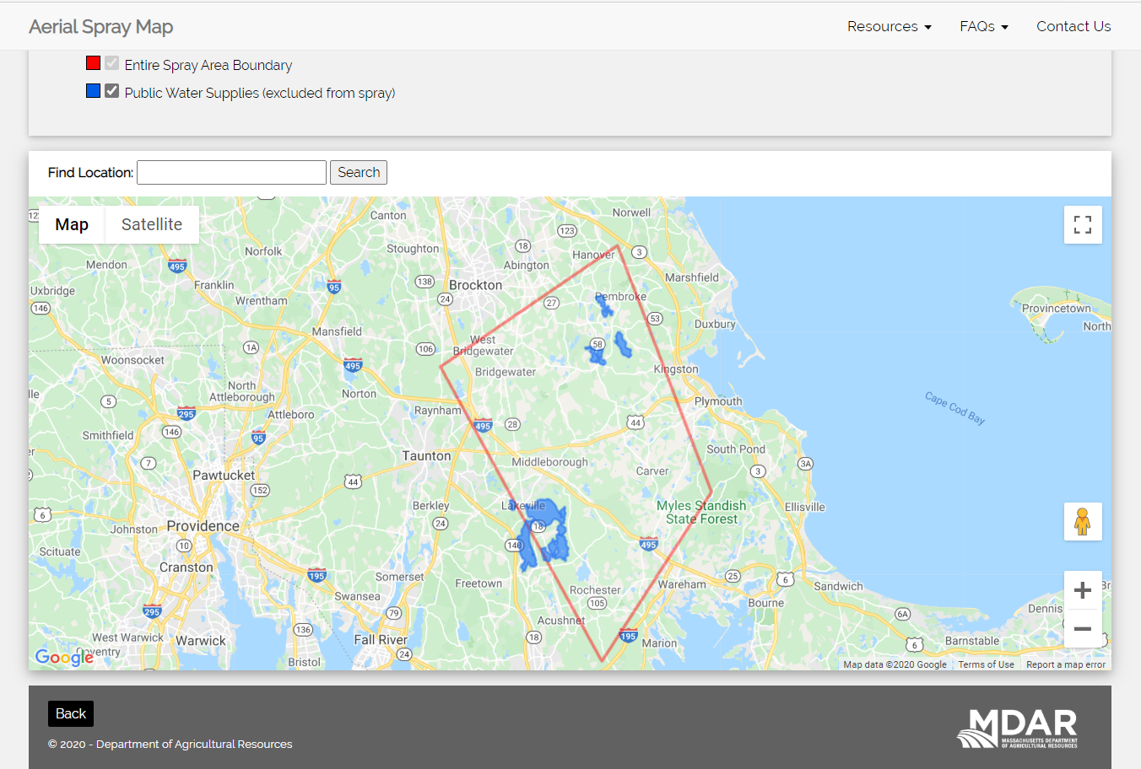
2020 Spray Map

