Slide 1
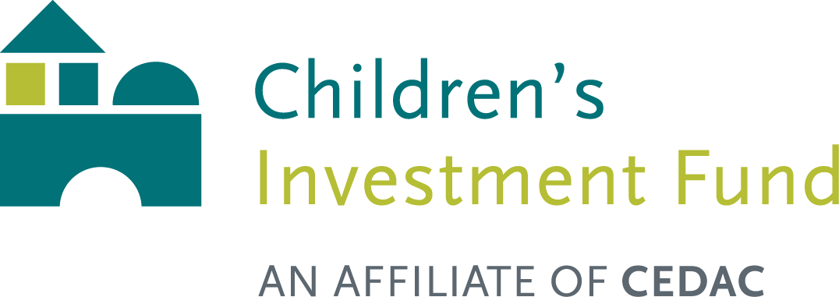
Building for Quality
Presentation for the Fiscal & Oversight Committee
of the Board of Early Education and Care
February 6, 2018

Slide 2
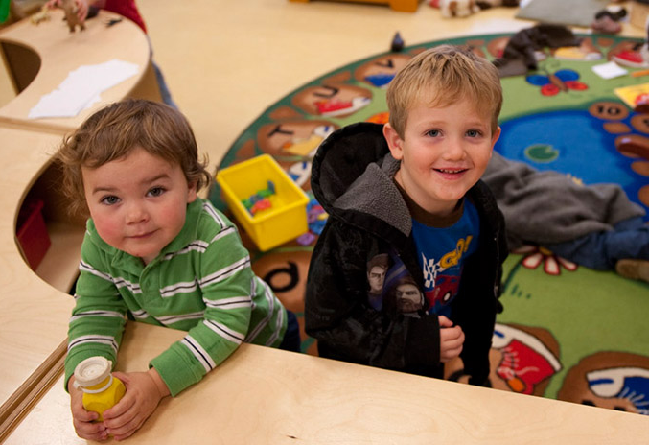
Children’s Investment Fund
Children’s Investment Fund believes that all children deserve to learn in safe physical environments designed to support their healthy growth and development.
We help non-profit organizations in Massachusetts develop high-quality facilities for children from low- and moderate-income families.
We Provide:
Training
Technical Assistance
Loan Financing
Grants

Slide 3
Early Education and Out of School Time Capital Grant
EEOST

Slide 4
What is EEOST?
The Early Education and Out of School Time (EEOST) Capital Fund was created by An Act Financing the Production and Preservation of Housing for Low and Moderate Income Residents (S.L. 2013, Ch. 129, §2) in November 2013.
$45M was allocated over five years through this bond bill.
EEOST is a competitive grant program intended to fund facilities improvement projects for licensed, non-profit, center-based providers.
The Department of Early Education and Care (EEC) designated Children’s Investment Fund to administer EEOST
EEOST can fund acquisition costs, construction costs, and other costs associated with expanding or building centers that provide early childhood education (ECE) and/or out-of-school time (OST) services

Slide 5
Who is eligible to apply?
Non-profit organizations serving children eligible for public subsidy.
Eligible licensed Large Group grantees must operate a full time year round program and School Age Child Care Programs must provide wrap-around care during the summer.
Projects must, when completed, improve all their physical environment criteria for Level 3 or Level 4 status as stated in the MA Quality Rating and Improvement System (QRIS).

Slide 6
Grant Review Score Sheet
Criteria Maximum Points Available
1. Capital Project Readiness 20
2. QRIS Progression & Maintenance 15
3. Project Feasibility 15
4. Site Consideration 10
5. Development Team & Project Manager 10
6. Development Costs 10
7. Expansion of Affordable Slots 10
8. Preferences 10
Total 100

Slide 7
Round 1 – FY14/FY15
Combined round (two fiscal years)
19 full applications received, with $16.7M in requests
10 organizations were funded
$7.45M granted

Slide 8
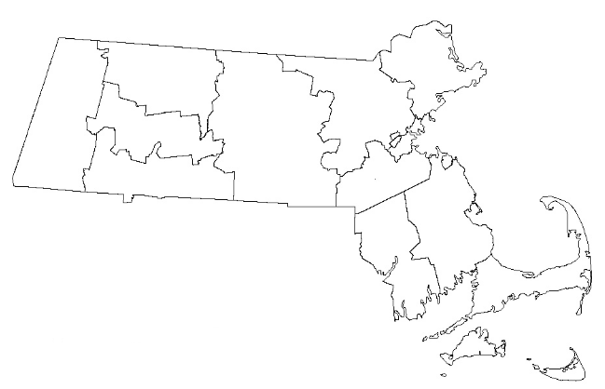
Round 1 – FY14/FY15 Locations of Applications Received
Lowell
Lawrence
North Adams
Beverly
Lynn
Cambridge
Revere
Boston
Braintree
Chicopee
Southbridge
Attleboro
Fall River
New Bedford

Slide 9
Round 2 – FY16
23 pre-applications received, with $15.8M in requests
16 of those organizations, with $12.2M in requests, were invited to submit a full application
6 organizations were funded
$3.6M granted

Slide 10
Round 2 – FY16 Locations of Pre-Applications Received
Lawrence
North Adams
Beverly
Lynn
Worcester
Cambridge
Boston
Canton
Webster
Fall River
New Bedford

Slide 11
Round 3 – FY17
15 pre-applications received, with $12.4M in requests
11 of those organizations, with $10.05M in requests, were invited to submit a full application
5 organizations were funded
$4.1M granted

Slide 12
Round 3 – FY17 Locations of Pre-Applications Received
Lawrence
North Adams
Adams
Belchertown
Lynn
Boston
Brockton
Chicopee
Webster
West Barnstable
Fall River
New Bedford

Slide 13
Round 4 – FY18
$3.6M available
25 pre-applications received October 30, 2017, with $21.4M in requests
9 of those organizations, with $9M in requests, were invited to submit a full application on December 12, 2017
8 applications were submitted to EEC on January 18, 2018
Awards will be made May 2018

Slide 14
Round 4 – FY18 Locations of Pre-Applications Received
Winchendon
Haverhill
Lawrence
Gloucester
Framingham
Lynn
Cambridge
Worcester
Winthrop
Boston
Brockton
Westfield
Springfield
Fall River
Hyannis
Falmouth
New Bedford

Slide 15
EEOST SUCCESSES
21 projects funded so far through the Early Education and Out of School Time Capital Fund, totaling $15.2M
Organization Name | Community | EEOST Round | EEOST Award
Beverly Children's Learning Center | Beverly | FY14/FY15 | $1,000,000
Catholic Charitable Bureau of the Archdiocese of Boston, Inc. | Lynn | FY14/FY15 | $750,000
Community Teamwork, Inc. | Lowell | FY14/FY15 | $500,000
For Kids Only Afterschool, Inc. | Revere | FY14/FY15 | $400,000
Robbins Children's Programs, Inc. | Attleboro | FY14/FY15 | $1,000,000
Tri-Community YMCA of Southbridge | Southbridge | FY14/FY15 | $800,000
Ellis Memorial & Eldredge House, Inc. | Boston | FY14/FY15 | $800,000
The United Teen Equality Center, Inc. | Lowell | FY14/FY15 | $400,000
Merrimack Valley YMCA | Lawrence | FY14/FY15 | $800,000
Valley Opportunity Council | Chicopee | FY14/FY15 | $1,000,000
Aspire Developmental Services | Lynn | FY16 | $1,000,000
Brookview House, Inc. | Boston | FY16 | $450,000
Community Art Center, Inc. | Cambridge | FY16 | $750,000
Epiphany School | Boston | FY16 | $500,000
Guild of St. Agnes of Worcester, Inc. | Webster | FY16 | $700,000
Rainbow Child Development Center | Worcester | FY16 | $200,000
Action for Boston Community Development | Boston | FY17 | $743,740
Belchertown Day School, Inc. | Belchertown | FY17 | $1,000,000
Child Care of the Berkshires, Inc. | North Adams | FY17 | $1,000,000
Worcester Community Action Council, Inc. | Webster | FY17 | $600,000
YWCA of Southeastern Massachusetts | New Bedford | FY17 | $800,000

Slide 16
EEOST SUCCESSES
21 projects funded so far through the Early Education and Out of School Time Capital Fund
Creating 448 new slots and impacting over 2,000 children, 86% of them from families with low income
Creating an estimated 34 educator jobs and 360 construction jobs
Leveraging $44M in additional public and private investment

Slide 17
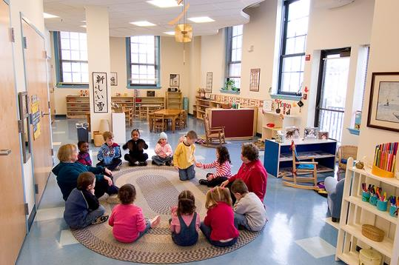
EEOST Capital Fund Reauthorization
Current allocations to-date:
FY14 - $4M
FY15 - $4M
FY16 - $4M
FY17 - $4M
FY18 - $4M
CHAPA (Citizens’ Housing and Planning Association) and its “Building Blocks Coalition” included EEOST in the re-filing of the FY19-FY23 Housing Bond Bill

Slide 18
EEOST Capital Fund Reauthorization
Timeline:
January 20, 2017: Bill filed
July 2017 – January 2018: Joint Housing Committee reviewed; House committees reviewed
January 2018: House approved bond bill
January 2018 – June 2018: Senate committees review
July 2018: Expected approval of the bill
Features of Proposed Bill, FY19 – FY23:
$45M request over five years (same as previous cycle)
Two changes:
Eligibility: At least 50 percent* of the slots in the facility shall serve low-income families who are eligible for public subsidy
At the time of initial application, currently providing early education and care or out of school time care for low income families who are eligible for public subsidy…
*A change from the FY14-FY18 bond bill which set a threshold of 25%

Slide 19
An Ongoing Need
There is strong demand for additional capital, with new projects emerging every year.
Twenty-four organizations across Massachusetts applied to EEOST between 2014 and 2017 but were not funded. They collectively serve 3,500 low-income children and are located in communities such as:
Adams Braintree Canton Lawrence
Beverly Brockton Chicopee Lynn
Boston Cambridge Fall River West Barnstable
Source:
Children’s Investment Fund application data from EEOST rounds FY14-FY17.

Slide 20
EEOST Evaluation
Evaluation by independent research firm currently underway through 2019
Measuring impact of EEOST grants on:
Quality of facility
Quality of classroom learning environment
Teacher-child interactions
Child well-being
Educator well-being
Organizational stability and capacity

Slide 21
EEOST Project PHOTOS (Photos will be projected during the fiscal committee Meeting.

