Slide 1
The Ellen Story Commission on Postpartum Depression
Cate McAnulty, Director

Slide 2
History
Legal Authority: Chapter 313 of the Acts of 2010
Purpose: to recommend policies to promote greater public awareness, screening and treatment of PPD
Assess current research on the subject, including evidence-based best practices on the prevention, detection and treatment of postpartum depression
Review current policies and practices with respect to screenings for postpartum depression, including frequency, locations, who administers screenings, the availability of reimbursement and issues surrounding medical necessity and third-party coverage
Assist DPH & other entities in the development of educational materials on postpartum depression & referral lists for postpartum depression treatment, in building on existing resources, and in designating authorized validated screening tools
Assist DPH & other entities with applications for federal funding to support efforts consistent with the mission and purpose of the commission
Any other matters that the special considers relevant to the fulfillment of its mission and purpose
Founded by Representative Ellen Story

Slide 3
Structure
Special Legislative Commission:
34 members, including legislators, agency appointees, subject matter experts, and women with lived experience
Co-chaired by 1 House member and 1 Senate member
No specified end date
Quarterly meetings (or more)
Annual reports
Annual Awareness Day (beginning 2015)

Slide 4
Accomplishments
Since first meeting in December 2011:
Collaborated with DPH to promulgate PPD screening reporting requirements
Helped conceive and advocated funding for MCPAP for Moms, an expansion of the Massachusetts Child Psychiatry Access Program, to provide real-time perinatal psychiatric consultation, resource and referral to obstetric, pediatric, primary care and psychiatric providers
Conceptualized and helped secure funding for PPD Pilot Programs at 4 Community Health Centers across the state to establish best practices for screening and referral systems in women’s health and pediatric settings
Advocated for PPD screening and reimbursement in pediatric and obstetric settings (MassHealth began reimbursements in 2015)
Established annual Perinatal Mental Health Awareness Day the State House
Updated DPH PPD website to educate providers and families in the Commonwealth
Filed a joint resolution proclaiming May as Maternal Mental Health Month

Slide 5
Accomplishments
Continued
Commission members provided assistance to the federal legislation that passed in December of 2016, Bringing Postpartum Depression out of the Shadows Act as part of the 21st Century Cures Act.
Renamed the Ellen Story Commission on Postpartum Depression following her retirement in 2016
Created Commission website, www.ppdcommission.com as a resource for the public, policymakers, providers, and families as well as to help share the work of the Commission
Conceived & advocated funding for substance use disorder expansion of MCPAP for Moms, including providing substance use-specific provider toolkits
Recommended legislation which has been filed, HD.1736, An Act relative to the well-being of new mothers and infants

Slide 6
Changes over the years
Scope: from PPD to Perinatal Mental Health
Postpartum Psychosis
Maternal Morbidity and Mortality
Perinatal Substance Use
Leadership:
Representative Ellen Story & Senator Thomas McGee
Representative James O’Day & Senator Joan Lovely

Slide 7
Current Projects - Best Practices
PPD Pilot Programs
3 CHCs currently engaged: Holyoke, Lynn, and Worcester (previously Southern Jamaica Plain)
State money funds Community Health Workers who manage referrals and navigate resources for new moms accessing treatment
Expansion
Conceived and currently advocating funding for Parental Mental Health Project Coordinator at DPH to oversee pilot programs, disseminate best practices across the state, provide assistance with implementation of USPSTF PPD Prevention Recommendations, generally serve as maternal mental health, morbidity, and mortality expert

Slide 8
Current Projects - Postpartum Psychosis
HD1736, An Act relative to the well-being of new mothers and infants
Filed by Senator Lovely and Representative O’Day
Worked with group of national advocates to develop language, following footsteps of Illinois law PA-100-0574 which recognizes postpartum psychosis as a mitigating factor in sentencing in criminal cases
Any defendant who gave birth within 12 months prior to crime is screened for perinatal psychiatric complications
Any examination ordered following a positive screen is completed within 48 hours by a reproductive psychiatric expert
Any person suffering perinatal psychiatric complication who is committed to treatment following not guilty by reason of mental illness finding is given treatment plan (including parent capacity building, parent-child dyadic therapy, etc) made in consultation reproductive psychiatric expert
Creates outpatient treatment commitment program for individuals found not guilty by reason of mental illness who pose no danger to the health and safety of others

Slide 9
Current Projects - Outcomes Disparities
Awareness Campaign
Conceived and currently advocating for funding in the FY20 budget for DPH to conduct participatory market research and carry out a two-pronged perinatal mental health awareness campaign to a) provide empowerment and resources to marginalized new mothers and fathers and b) to provide implicit bias training and capacity building to perinatal mental health providers across the care continuum

Slide 10
Current Projects - Evaluation
Perinatal Mental Health Outcome Measures:
Conceived and currently advocating for funding for DPH to produce a report to define a set of measures to track the annual perinatal mental health outcomes for all deliveries in the Commonwealth
rate of screening for postpartum depression
the identification of perinatal mental health diagnoses
the incidence of postpartum psychosis
Outline a process for the collection and reporting of these measures, including the cost, timing, and feasibility, completed by FY21

Slide 11
Current Projects - Maternal Morbidity & Mortality
Perinatal-Neonatal Quality Improvement Network of Massachusetts
Collaborating with PNQIN to advocate for funding to stabilize grant-funded implementation of maternal safety bundles on high risk maternal conditions in birthing facilities, clinics, and hospitals across the state to address the rise in maternal mortality and severe maternal morbidity rates
PNQIN is a joint venture of the Massachusetts Perinatal Quality Collaborative (MPQC) and the Neonatal Quality Improvement Collaborative of Massachusetts (NeoQIC)
collaborative, volunteer approach avoids legislative mandates, enables organizations to access valuable data and improve their care systems
https://www.pnqinma.org/

Slide 12
Shared Mission
Preventive Services Task Force released recommendations on preventive interventions for perinatal depression
Cognitive: Mothers and Babies Program
6 to 12 group sessions during pregnancy and 2 to 5 postpartum booster sessions
modules on the cognitive behavioral theory of mood and health; physiological effects of stress; the importance of pleasant and rewarding activities; how to reduce cognitive distortions and automatic thoughts; and the importance of social networks, positive mother-child attachment, and parenting strategies to promote child development and secure attachment in infants
Interpersonal: Reach Out, Stand Strong, Essentials for New Mothers (ROSE) program
4 or 5 prenatal group sessions & 1 individual 50-minute postpartum session
psychoeducation on the “baby blues” and postpartum depression, stress management, development of a social support system, identification of role transitions, discussion of types of interpersonal conflicts common around childbirth and techniques for resolving them, and role-playing exercises with feedback from other group members

Slide 13
Upcoming
Next Commission meeting is May 8th, 5:30-7:30 State House room 222
5th Annual Perinatal Mental Health Awareness Day is Thursday, May 16th 11-2pm in the Great Hall
Addressing inequities in perinatal mental health

Slide 14
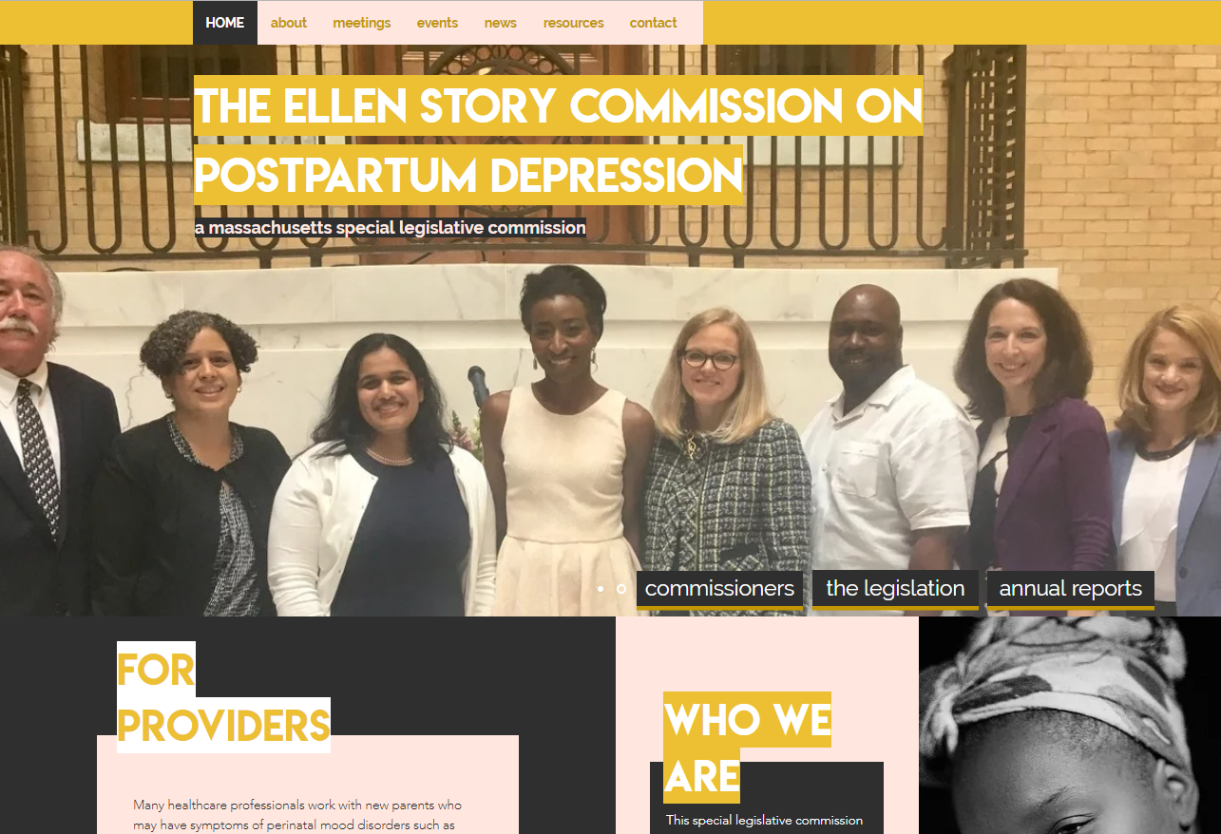
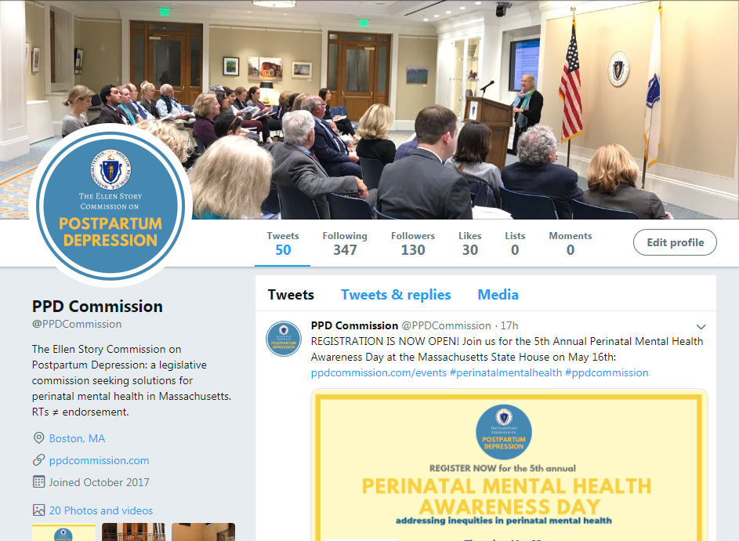
Contact
www.ppdcommission.com
Twitter @ppdcommission
cate.mcanulty@mahouse.gov

