Slide 1

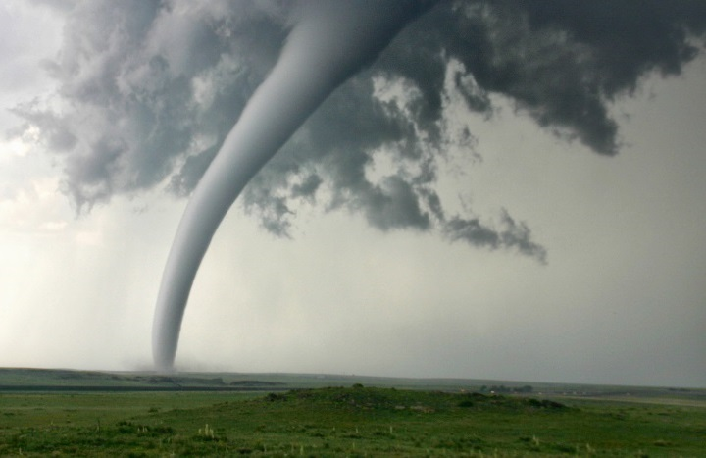
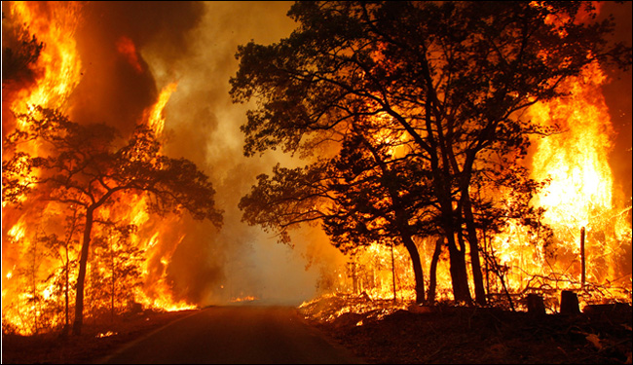
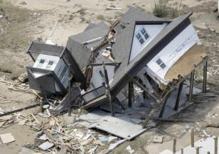
Overview of the Emergency Management Assistance Compact
Massachusetts Emergency Management Agency

Slide 2









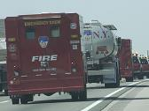
What is EMAC ?
The Emergency Management Assistance Compact (EMAC), is a State-to-State mutual aid compact that facilitates the sharing of services, personnel and equipment across state lines during times of disaster and emergency.
Under EMAC, a state can share any resource with another member state so long as the Governor of the impacted state has declared a state of emergency.
Notes:
https://youtu.be/Gc8oHnu0PxE

Slide 3
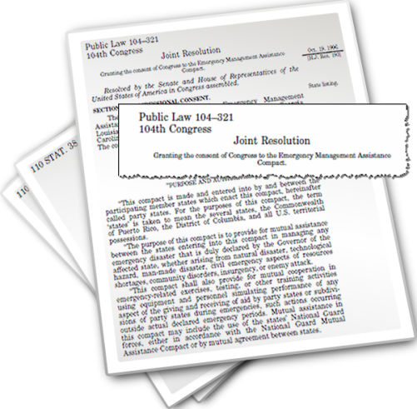
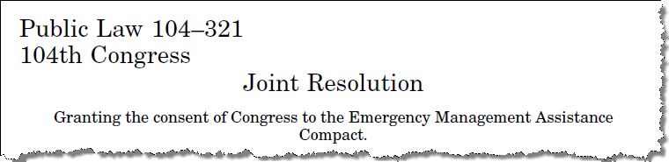
EMAC: Enacted into Federal Law
Congress Ratified EMAC as Public Law 104-321
October 1996
Congress ratified the Compact, thus giving congressional consent to the EMAC 13-Articles of Agreement. This made EMAC the first interstate compact to be ratified by Congress since the 1950 Civil Defense Act.
Notes:
https://www.congress.gov/104/plaws/publ321/PLAW-104publ321.pdf

Slide 4
MA GL CHAPTER 339, the acts of 2000
This compact is made and entered into by and between the participating member states which enact this compact, hereinafter called party states. For the purposes of this contract, the term "states" is taken to mean the several states, the Commonwealth of Puerto Rico, the District of Columbia, and all U.S. territorial possessions.
The purpose of this compact is to provide for mutual assistance between the states entering into this compact in managing any emergency disaster that is duly declared by the governor of the affected state, whether arising from natural disaster, technological hazard, manmade disaster, civil emergency aspects of resources shortages, community disorders, insurgency or enemy attack.
On behalf of the governor of each state participating in the compact, the legally designated state official who is assigned responsibility for emergency management shall establish procedures necessary to implement this compact.
Approved December 15, 2000.
Notes:
https://malegislature.gov/Laws/SessionLaws/Acts/2000/Chapter339

Slide 5

EMAC Members
EMAC has 55 members: EMAC law defined as the term ‘states’ is taken to mean the several states, the Commonwealth of Puerto Rico, The District of Columbia, and all U.S. territorial possessions.
All 55 Member States have enacted the EMAC Articles of Agreement into law.

Slide 6
What EMAC Does
Provides a responsive and straightforward mutual aid system for sharing resources
Maximizes the use of available member state resources
Establishes a firm legal foundation
  Provides immunity and tort protection
  Provide professional license reciprocity
Deploys resources as part of a coordinated response through the state EMAs
(resources do not self-deploy)
Is the primary mutual aid resource provider when federal support is not warranted
Supports state response and recovery operations while respecting state sovereignty
Authorizes use of the National Guard in State Active Duty or Title 32 status

Slide 7
What EMAC Does NOT do
Endorse self deployment
Replace the need for Federal support
Replace existing mutual aid agreements
Hoard / stockpile / prioritize / allocate resources
Permit the use of the National Guard resources for military purposes
Move resources directly from county-to-county or city-to-city level. (EMAC is state-to-state only)

Slide 8
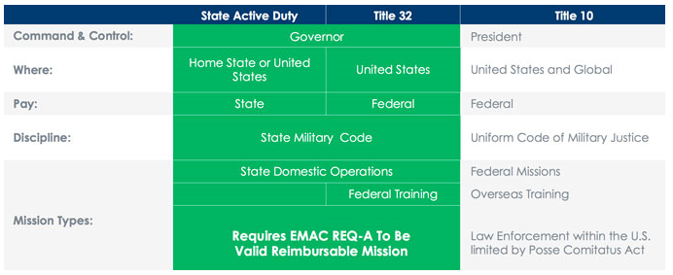
EMAC and the National Guard
National Guard resources deploy under the duty status of State Active Duty or Title 32.
(command and control is under the governor of the home state.)
National Guard personnel may not be deployed for military purposes outside their home state.
* When under the command and control of the President, the National Guard resources deploy under Title 10, outside of the EMAC process.
https://www.emacweb.org/index.php/learn-about-emac/module-positions/national-guard-a-emac
Notes:
https://www.emacweb.org/index.php/learn-about-emac/module-positions/national-guard-a-emac

Slide 9




The EMAC Process
PRE-EVENT PREPARATION
The EMAC Process:
comprises five distinctive phases
involves states affected by an emergency as well as states assisting them
begins before emergency occurs
ends when Requesting State reimburses Assisting State
ACTIVATION
REQUEST & OFFER
RESPONSE
REIMBURSEMENT

Slide 10
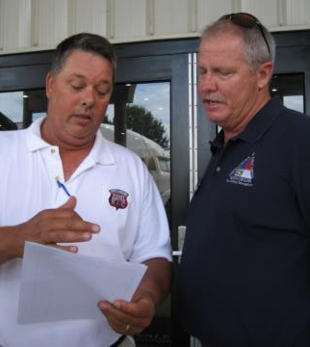
Pre-Event Preparedness Actions
Develop internal plans and procedures to implement EMAC as Requesting or Assisting State
Train local and state Resource Providers on EMAC procedures
Organize resources under state sponsorship (state sponsored teams, regional teams, strike teams, task forces & etc.
Establish “mission packaged” resources with estimated costs.
  Mission Ready Packages

Slide 11
Activation Activities
Local resources exhausted or it is reasonably anticipated that resources will be exhausted
Governor declares a State of Emergency
Affected state opens an event in the EMAC Operating System

Slide 12
Request and Offer Activities
A-Team receives resource requests from affected state and Authorized Representative (AR) authorizes the request
A-Team contacts states and works to source resource requests
Assisting States work with Resource Providers to update Mission Ready Packages and compile offer
  You have the right to say no when your MRP is requested.
  Logistics support for the MRP will need to be addressed before the MRP deploys.
Resource Support Agreements finalized

Slide 13
Response Activities
Resource prepare to mobilize
Deploying personnel should be provided a pre-deployment briefing and be given a copy of the Mission Order
Deploy and perform assigned missions
Track all costs, damages, issues, etc. Keep-in-contact with home state EMAC rep for any issues that arise.
  For larger teams, a dedicated finance/logistics member is recommended
Demobilize from incident and return home

Slide 14
Reimbursement Activities
Resource Provider submit reimbursement package to the Assisting State
  This should be completed once payroll records can be provided (~2weeks after mission ends, NLT 45 days after mission ends)
Assisting State audits package and sends to Requesting State
  This should be completed NLT 45 days after receiving package from the Resource Provider.
Requesting State audits package and issues payment to Assisting State
  This should be completed NLT 45 days after receiving package from the Assisting State.
Assisting State reimburses Resource Providers
  This should be completed NLT 45 days after receiving funds from the Requesting State.

Slide 15
The EMAC Process - Summary
1. Governor declares a state of emergency due to a natural or man-made disaster.
2. State requests resources from EMAC member states through the state emergency management agencies.
3. State emergency management personnel and local resource providers work together to identify available resources and estimated mission costs.
4. The Requesting and Assisting States execute the EMAC Form RSA.
5. Personnel deploying are given a Mission Order Authorization Form which outlines the mission, helpful information, and guidance.
6. At the completion of the mission, resources demobilize and return to the home state.
7. Deployed personnel provide required documentation to assemble reimbursement packages.
8. Reimbursement package is sent to the Requesting State.
9. Requesting State reimburses the Assisting State.
Notes:
SOE is the mechanism to enter into the EMAC contract to mobilize resources into the state.
The SOE can be lifted while the resources are deployed. If new resources are needed, an SOE would have to be re-declared.
Article IV of the EMAC Articles

Slide 16
Deployment Under EMAC
State/Local EOC Support
Damage assessment
Disaster recovery services
Logistics support
Donations management
Law Enforcement services
Communications
Fire fighting
Aviation support
Biological/chemical response teams
Medical support services
Hazard mitigation
Community outreach
Search and Rescue
Debris clearance services
Public Health services
Environmental Health services
HazMat Response Teams
Human services/mass care
Animal control services
Incident Management Teams
Any capability from Member States can be shared
* Deployment under EMAC follows the incident command system – keeping the mission under the control of the state.
Notes:
Under EMAC states are able to share any capability they wish with another member state.
While this list is not comprehensive, it does illustrate that EMAC has the ability to deploy resources from a multitude of disciplines.
Further, deployment under EMAC follows the incident command system – keeping the mission under the control of the state.

