Slide 1

TURA Enforcement
Leoni Desai, MassDEP
May 2026

Slide 2
TURA Program Enforcement
TURA Enforcement covers a range of infractions
  Types of enforcement: Warning Letter, Notice of Noncompliance, Reporting Penalty Assessment Notice, Administrative Consent Order with Penalty
Enforcement can be issued to facilities, planners, or both facilities and planners depending on the situation
Reporting based enforcement is preceded by outreach

Slide 3
Avenues of Enforcement (Facility)
Evaluated during a Planning Year
Failure to File
  Report
  Planner Certification
Incomplete Report
  Missing Chemical(s)
  Failure to Respond to QA/QC
  Missing Plan Summary(ies)
  Missing RC Progress Report
  Missing/Invalid TUR Planner Certification
  Miscellaneous Issues

Slide 4
Avenues of Enforcement (TUR Planners)
Evaluated during a Planning Year
Invalid Certification
  Certifying a plan when expired/inactive
  Certifying for an alternate plan type for which you have not been permitted

Slide 5
TURA Facility Audits
TURA Facility Audits continue. Facilities will be receiving Request For Information (RFI) letters for their plan.
Audits include an onsite inspection portion

Slide 6
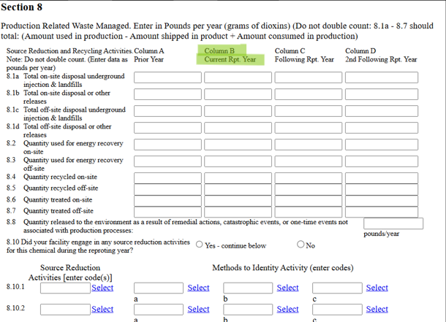
QA/QC Issues - 1
BYP and Form R data do not match
  BYP > Trans + Rels + ON-SITE (Tmt + Recyc + Energy Recovery)
  BYP < Trans + Rels

Slide 7
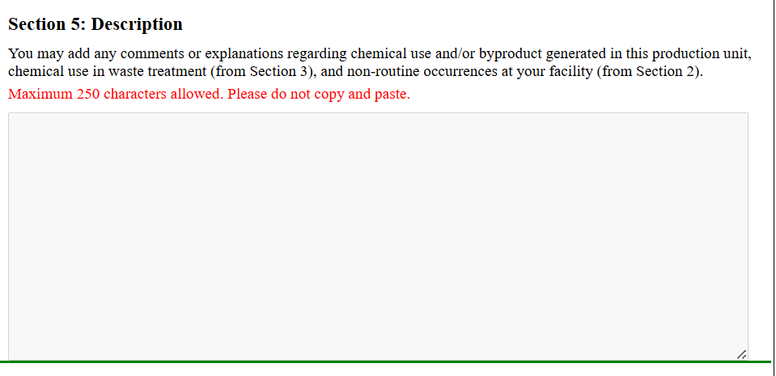
QA/QC Issues - 2
Non-Routine Production Ratio or Activity Index
  Prod Ratio Act Index < 0.5 OR > 2.0
  Prod Ratio Act Index = 0

Slide 8
QA/QC Issues - 3
Does not meet eligibility for State Only Form A
To meet eligibility:
Company must use less than 1,000,000 lbs of the chemical
Company must generate less than 500 lbs of TURA BYP
The chemical cannot be a PBT, PFAS, or TURA Higher Hazard Substance

Slide 9
Reminders for the Upcoming Year Reminder 1
Reminders for the Upcoming Year - 1
Maintain your onsite paperwork to meet regulatory record keeping requirements
  Detailed, well-labeled records improve reporting accuracy and data quality and reduce replication of effort by serving as SOPs for future years
The TURA program cannot make changes to reports for filers. All changes must be made electronically via the AMEND feature.
eDEP has been updated to allow any user who has been granted access to a transaction to initiate an AMEND

Slide 10
Reminders for the Upcoming Year, Reminder 2
Reminders for the Upcoming Year - 2
The Authorized Signature name on the fee page should match the first and last name of the person signing that fee page
The Senior Management Official name on any of the EMS, RC, or TUR Certifications should match the first and last name of the person signing that certification page
The TUR Planner name on the TUR Planner Certification should match the first and last name of the person signing that certification page

Slide 11
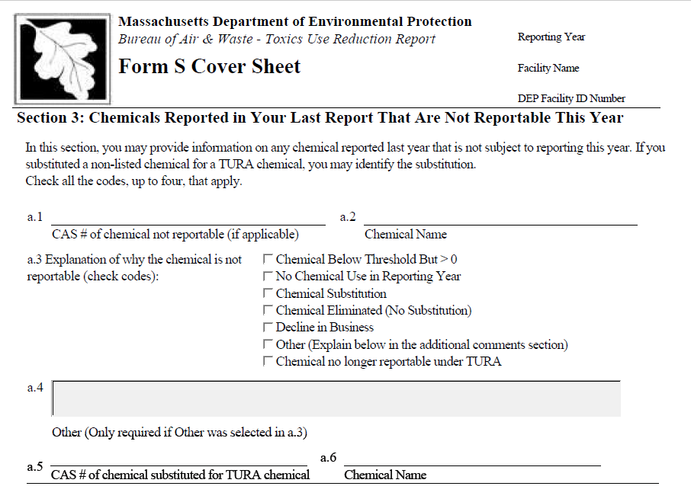
Reminders for the Upcoming Year, Reminder 3
Reminders for the Upcoming Year - 3
Be sure to include BELOW THRESHOLD chemicals on form S Section 3 only
TUR Reporting Non-Applicability Form

Slide 12
Reminders for the Upcoming Year, Reminder 4
Reminders for the Upcoming Year - 4
If your facility is closing, please complete the TUR Reporting Facility Closure Form
If you have a question or issue when completing your filing, contact the TURA Program via email for assistance
If you find a mistake in your filing, AMEND it
If you report to EPA’s TRI Program, please ensure that the data in your TRI report is consistent with the data in your TURA Report

Slide 13
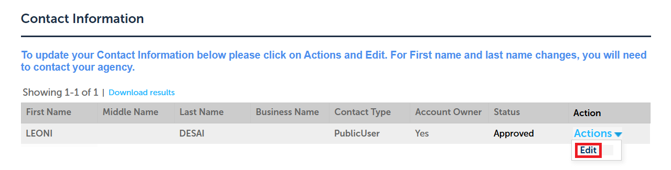
Reminders for TUR Planners - 1
To update your address or phone number in ePLACE, go to Account Management and scroll down to Contact Information > Actions > Edit
Contact the ePLACE helpdesk to update your name in ePlace
To update your ePLACE email, submit an EEA ePLACE Portal Email Support Request

Slide 14
Reminders for TUR Planners - 2
Make sure your application/renewal matches what you want to apply for
TUR Planner Continuing Education Credit Pre-Approval Form

Slide 15
Self Disclosure
If you need to self disclose a violation or are working with a company that needs to self disclose a violation, contact enforcement program staff so that we can provide the correct information and necessary forms

Slide 16
New Filers Project
DEP has begun outreach to identify Massachusetts businesses who meet TURA reporting requirements but aren’t currently reporting

Slide 17

Questions?
Leoni Desai
MassDEP
leoni.desai@mass.gov
(617) 939-6775
MassDEP Toxics Use Reduction Program webpage

