Slide 1
Guide to Hosting a community forum on the COVID-19 vaccine
CHILDREN & TEENS EDITION
Updated January 25, 2022
Notes:
Key updates since the previous version (dated 1/6):
Updated information about booster eligibility for people who received the Moderna vaccine (slide 17)

Slide 2
Instructions for using this guide
This guide is designed for providers, community groups, and others to host local meetings or forums about the COVID-19 vaccine for children and teens.
It includes information from the Massachusetts Department of Public Health (DPH) in response to commonly asked questions.
There are additional talking points in the notes section of each slide.
You may use some or all of this content based on your community’s interests and needs.
Additional information to inform your forum can be found at https://www.mass.gov/covid-19-vaccine-in-massachusetts

Slide 3
What is a vaccine and how does it work?
Vaccines prevent diseases that can be dangerous, or even deadly. They work with your body’s natural defenses to safely develop protection from a disease.
A vaccine helps your immune system to produce antibodies, just like it would if you were exposed to the disease. After getting vaccinated, you have protection from that disease, without having to get the disease first.
This is what makes vaccines such powerful medicine. Unlike most medicines, which treat or cure diseases, vaccines prevent them.
Notes:
Sources:
https://www.cdc.gov/vaccines/hcp/conversations/understanding-vacc-work.html
https://www.cdc.gov/vaccines/vpd/vpd-vac-basics.html

Slide 4
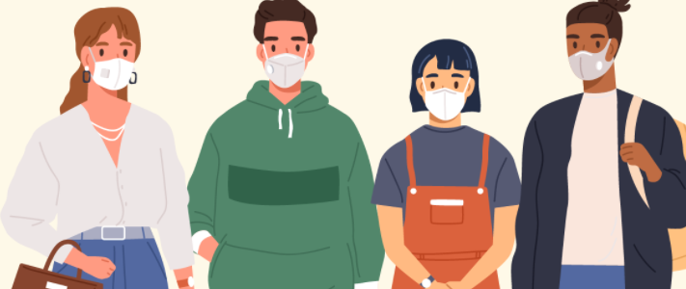
Why should children and teens get a COVID-19 vaccine?
Vaccination can help keep children and teens from getting seriously sick even if they do get COVID-19.
Vaccination can help protect family members, including siblings who are not eligible for vaccination and family members who may be at increased risk of getting very sick if they are infected.
Vaccinating children and teens can help keep them in school and help them safely participate in sports, playdates, and other group activities.
Notes:
Source: https://www.cdc.gov/coronavirus/2019-ncov/vaccines/recommendations/children-teens.html

Slide 5
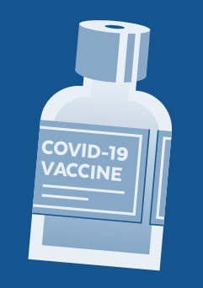
What vaccines are available for children and teens?
Three vaccines have been approved or received Emergency Use Authorization from the Food and Drug Administration: Pfizer/Comirnaty, Moderna, and Janssen (Johnson & Johnson).
All three COVID-19 vaccines are safe and highly effective against serious illness, hospitalization, and death.
The Pfizer/Comirnaty vaccine is available for people ages 5 and older.
The Moderna and Johnson & Johnson vaccines are available for people ages 18 and older.
Notes:
The Pfizer vaccine is authorized for people ages 5 and older and has full approval for people ages 16 and older.
What does it mean that the Pfizer COVID-19 vaccine has FDA approval?
On 8/23/21, the FDA approved the first COVID-19 vaccine. The vaccine has been known as the Pfizer COVID-19 Vaccine and will now be marketed as Comirnaty (koe-mir’-na-tee), for the prevention of COVID-19 in people 16 years of age and older.
Comirnaty is the same vaccine as the Pfizer vaccine.
The Pfizer vaccine is also still available under emergency use authorization (EUA) for people ages 5 through 15 and for a third dose for certain immunocompromised individuals.
Compared to an EUA, FDA approval of vaccines requires even more data on safety, manufacturing, and effectiveness over longer periods of time and includes real-world data.
The full approval by the FDA means that the Comirnaty vaccine now has the same level of approval as other vaccines routinely used in the U.S., such as vaccines for hepatitis, measles, chicken pox, and polio.
The Pfizer COVID-19 vaccine was the first vaccine to receive emergency authorization, which is why it is the first to have enough data to receive full approval. It does not mean anything about the safety and effectiveness of the Moderna or Johnson & Johnson vaccine.
What is an Emergency Use Authorization (EUA)?
The United States FDA has made the Pfizer, Moderna, and Janssen COVID-19 Vaccines available under an emergency mechanism called an EUA. The EUA is supported by a Secretary of Health and Human Services (HHS) declaration that a situation exists to justify the emergency use of pharmaceuticals during the COVID-19 pandemic.
FDA may issue an EUA when certain criteria are met, which includes that there are no adequate, approved, available alternatives. The FDA decision is also based on scientific evidence available showing that the product may be effective to prevent COVID-19 during the pandemic and that the known and potential benefits of the product outweigh the risks. All of these criteria must be met to allow for the product to be used during the COVID-19 pandemic.

Slide 6
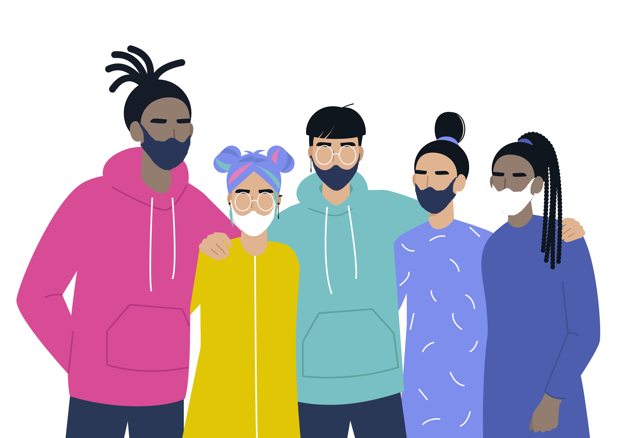
Are the COVID-19 vaccines safe for children?
Yes. CDC recommends everyone ages 5 and older get a COVID-19 vaccine.
Scientists have conducted clinical trials with thousands of children and determined it to be safe and effective.
COVID-19 vaccines are being monitored for safety with the most comprehensive and intense safety monitoring program in U.S. history.
Children may have some side effects from the vaccine, similar to those seen in adults and with other vaccines. These are normal signs that their body is building protection and should go away in a few days.
Notes:
The Pfizer COVID-19 Vaccine is over 90% effective at preventing COVID-19 in children ages 5 through 11 years.

Slide 7






How do we know the vaccine is safe?
Vaccines go through more testing than any other pharmaceuticals:
Small groups of people receive the trial vaccine
The vaccine is given to specific groups of people (for example, people of a certain age, race, or physical health).
The vaccine is given tens of thousands of people and tested for effectiveness and safety.
Notes:
We understand the importance of being open and honest about the safety and development of the vaccine— especially for communities who have suffered consequences of medical mistreatment.
It’s important to know that vaccines go through more testing than any other pharmaceuticals. Before any vaccine is made available, it must go through rigorous development and testing. Manufacturing is critical — every dose must consistently be high quality. Additionally, there is extensive testing in clinical trials to prove safety.
Source: https://www.cdc.gov/coronavirus/2019-ncov/vaccines/safety.html

Slide 8




How do we know if the vaccine is safe?
The CDC’s Advisory Committee on Immunization Practices looks at the data to see if the vaccine works and is safe. They give advice to the U.S. Food and Drug Administration (FDA).
The FDA looks at the data and the advice from the Advisory Committee and decides whether to approve the vaccine.
The vaccine is only approved after all of these steps are done and various teams of reviewers are sure that it works and is safe.
Notes:
Safety is a top priority, and safety monitoring for the COVID-19 vaccines has been the most intense and comprehensive in U.S. history.

Slide 9




How is it safe if it happened so fast?
The timeline was sped up but never cut corners on safety. Here is how:
We already had helpful information about coronaviruses, so we weren’t starting from scratch.
The U.S. and other governments invested a lot of money to support vaccine companies with their work.
A lot of people participated in clinical trials and we didn’t need to spend time finding volunteers.
Manufacturing happened at the same time as safety studies, so vaccines were ready to be distributed once they were approved.
Notes:
The COVID-19 vaccine was developed quickly but all of the same safety steps were followed for this vaccine that are used for all vaccines.
Vaccine companies moved quickly because:
We already had helpful information: The COVID-19 virus is a part of a coronavirus family that has been studied for a long time. Experts learned important information from other coronavirus outbreaks that helped them to develop the COVID-19 vaccine, so we weren’t starting from scratch.
Governments funded vaccine research: The United States and other governments invested a lot of money to support vaccine companies with their work. Working together with other countries also helped researchers move quickly.
Tens of thousands of people participated in vaccine studies: Studies of the vaccine (called Clinical Trials) were conducted to prove the vaccine is safe and effective. Tens of thousands of people signed up for the studies, so companies did not need to spend a lot of time finding volunteers.
Manufacturing happened at the same time as the safety studies: Vaccine companies started making the vaccine at the same time as studies were happening in hopes that it would be proven safe and effective. This meant vaccines were ready to be distributed once they were approved

Slide 10
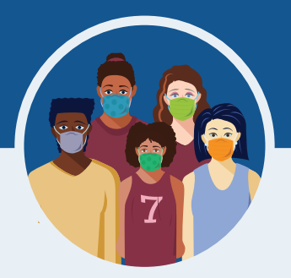
What are the possible side effects of the COVID-19 vaccine?
Serious side effects from vaccines, including the COVID-19 vaccine, are rare.
Your child may have some side effects, which are normal signs that their body is building protection.
These side effects may affect your child’s ability to do daily activities, but they should go away in a few days.
The most common side effects are minor and include:
Tiredness
Headache
Pain at the injection site
Muscle pain
Chills
Nausea and/or vomiting
Fever
Notes:
If your child experiences a severe allergic reaction after getting a COVID-19 vaccine, vaccine providers can rapidly provide care and call for emergency medical services, if needed.
Ask your child’s healthcare provider for advice on using a non-aspirin pain reliever and other steps you can take at home after your child gets vaccinated. In general, aspirin is not recommended for use in children and adolescents less than 18 years of age. Placing a cool, damp cloth on the injection site can help with discomfort.

Slide 11

What is the risk of myocarditis (inflammation of the heart)?
Overall, the risk of side effects from the COVID-19 vaccine is very low in children.
There have been rare cases of myocarditis in adolescent males which have been linked to COVID-19 vaccination.
The risk of developing myocarditis due to COVID-19 infection is much higher than developing myocarditis after getting the vaccine.
Most patients with myocarditis who received care responded well to medicine and rest and felt better quickly.

Slide 12
Should children and teens with allergies get the COVID-19 vaccine?
Children and teens should not get the COVID-19 vaccines if they have a history of severe allergic reaction (also called “anaphylaxis”) to any ingredient in the vaccine.
The vaccines do not contain eggs, gelatin, preservatives, or latex. The ingredient lists can be found at:
Pfizer/Comirnaty: https://www.fda.gov/media/144414/download (page 3)
Moderna: https://www.fda.gov/media/144638/download (page 2)
Janssen (J&J): https://www.fda.gov/media/146305/download (page 2)
People with a history of a severe allergic reaction to something else that’s not in the vaccine (like peanut butter) should discuss with their health care provider before receiving the vaccine.
Notes:
Although there is a small chance that the COVID-19 vaccines could cause a severe allergic reaction, this would usually happen within a few minutes to one hour after getting the vaccine.
Signs of a severe allergic reaction can include:
• Difficulty breathing
• Swelling of face and throat
• A fast heartbeat
• A bad rash all over the body
• Dizziness and weakness
If your child has a history of allergic reactions, their vaccination provider may ask them to stay longer at the place where they received their vaccine for monitoring afterwards.

Slide 13
Is there a fertility or developmental concern with vaccinating children before they reach puberty?
No.
There is no evidence that any vaccines, including COVID-19 vaccines, can cause female or male fertility problems.
There is no evidence that vaccine ingredients or antibodies developed following COVID-19 vaccination will cause any problems with becoming pregnant. Similarly, there is no evidence that the COVID-19 vaccine affects puberty.
Notes:
Source: https://www.cdc.gov/coronavirus/2019-ncov/vaccines/faq-children.html

Slide 14
Will a COVID-19 vaccine change my child’s DNA?
No. COVID-19 vaccines do not change or interact with our DNA in any way.
Vaccines teach our immune system how to fight against a specific virus.
To do its job, the COVID-19 vaccine doesn’t need to go inside the nucleus of the cell, which is where our DNA is kept. This means the vaccine never interacts with our DNA in any way and has no way to change it.
Notes:
Vaccines teach our immune system how to fight against a specific virus. They work with the body’s natural defenses to safely develop immunity to disease. In order to do its job, the COVID-19 vaccine doesn’t need to go inside the nucleus of the cell, which is where our DNA is kept. This means the vaccine never interacts with our DNA in any way and has no way to change it.
At the end of the process, our bodies have learned how to protect against future infection. That immune response and making antibodies is what protects us from getting infected if the real virus enters our bodies. (source: https://www.cdc.gov/coronavirus/2019-ncov/vaccines/facts.html)

Slide 15
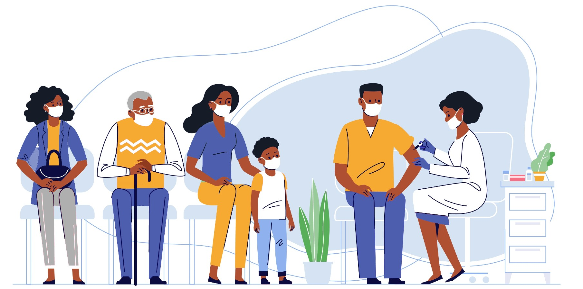
Can my child get COVID-19 from the COVID-19 vaccine?
No. The vaccines do not contain the live virus that causes COVID-19. This means that your child can’t catch COVID-19 from the vaccine.

Slide 16

Will the vaccines work against COVID-19 variants?
It is normal for viruses to change as they spread, and for new variants to appear.
So far, studies suggest that the vaccines provide protection from the known variants.
Even when a vaccinated person gets infected with COVID-19, they are very protected against severe disease and death.
Notes:
Notes about Omicron (source: https://www.cdc.gov/coronavirus/2019-ncov/variants/about-variants.html)
Early evidence suggests that fully vaccinated people who become infected with the Omicron variant can spread the virus to others.
The recent emergence of the Omicron variant further emphasizes the importance of vaccination and boosters.

Slide 17
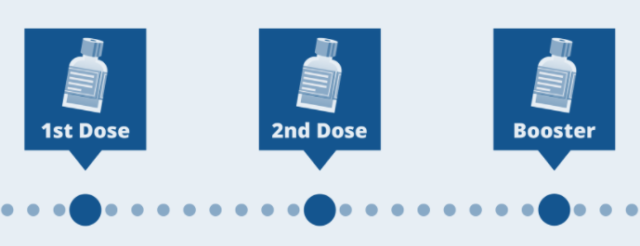
Should children and teens get a booster shot?
COVID-19 vaccines work well to prevent severe illness, hospitalization, and death. However, public health experts are starting to see less protection against mild and moderate disease. Boosters keep the vaccines effective for longer.
Everyone age 12+ can get a booster if:
Pfizer & Moderna: It’s been at least 5 months since your second dose
Johnson & Johnson: It’s been at least 2 months since your first dose
If you are ages 12-17, you can only get a Pfizer booster. Otherwise, you can choose which booster vaccine you want.
Notes:
You can choose which booster vaccine you want. Some people may want the type they originally received; others may prefer to get a different booster.
The side effects following the booster are similar to those after the second dose.
You are still considered fully vaccinated if you do not receive a booster shot.
You can get a COVID-19 vaccine and other vaccinations like a flu or shingles vaccine at the same time or close together.
You don’t need an ID or health insurance and don’t need to show a vaccine card.
For answers to more commonly asked questions about boosters, visit: https://www.mass.gov/info-details/covid-19-booster-frequently-asked-questions

Slide 18

How do I make an appointment?
Visit VaxFinder.mass.gov to search for appointments (including boosters) at pharmacies, health care providers, and other community locations.
You can sort by which vaccine is offered so that people under 18 can find places that only offer the Pfizer/Comirnaty vaccine.
You can also sort by locations that are offering the booster of your choice.
People who can’t use the internet may call the Massachusetts Vaccine Scheduling Resource Line: 2-1-1 (877-211-6277)
Notes:
These methods apply to people looking for booster shots as well.
The Scheduling Resource Line is for people who cannot access the internet. It is available in 100 languages. Representatives have the same access to appointments as on the public website. Their hours are:
Monday – Thursday from 8:30 AM to 8:00 PM
Friday – Sunday from 8:30 AM to 5:00 PM

Slide 19

Will I have to pay for the vaccine?
No. The vaccine (including booster) is free for all Massachusetts residents.
You will never be asked for a credit card number to make an appointment.
You can get a vaccine even if you do not
have insurance, a driver’s license,
or a Social Security number.
Notes:
Health insurance (including Medicare and Medicaid) will cover the cost of administering the vaccine. Bring your health insurance card, if you have one. Your insurance will be billed at no cost to you.
Health care providers can also be reimbursed from the federal government for the cost of administering vaccine to undocumented immigrants.

Slide 20
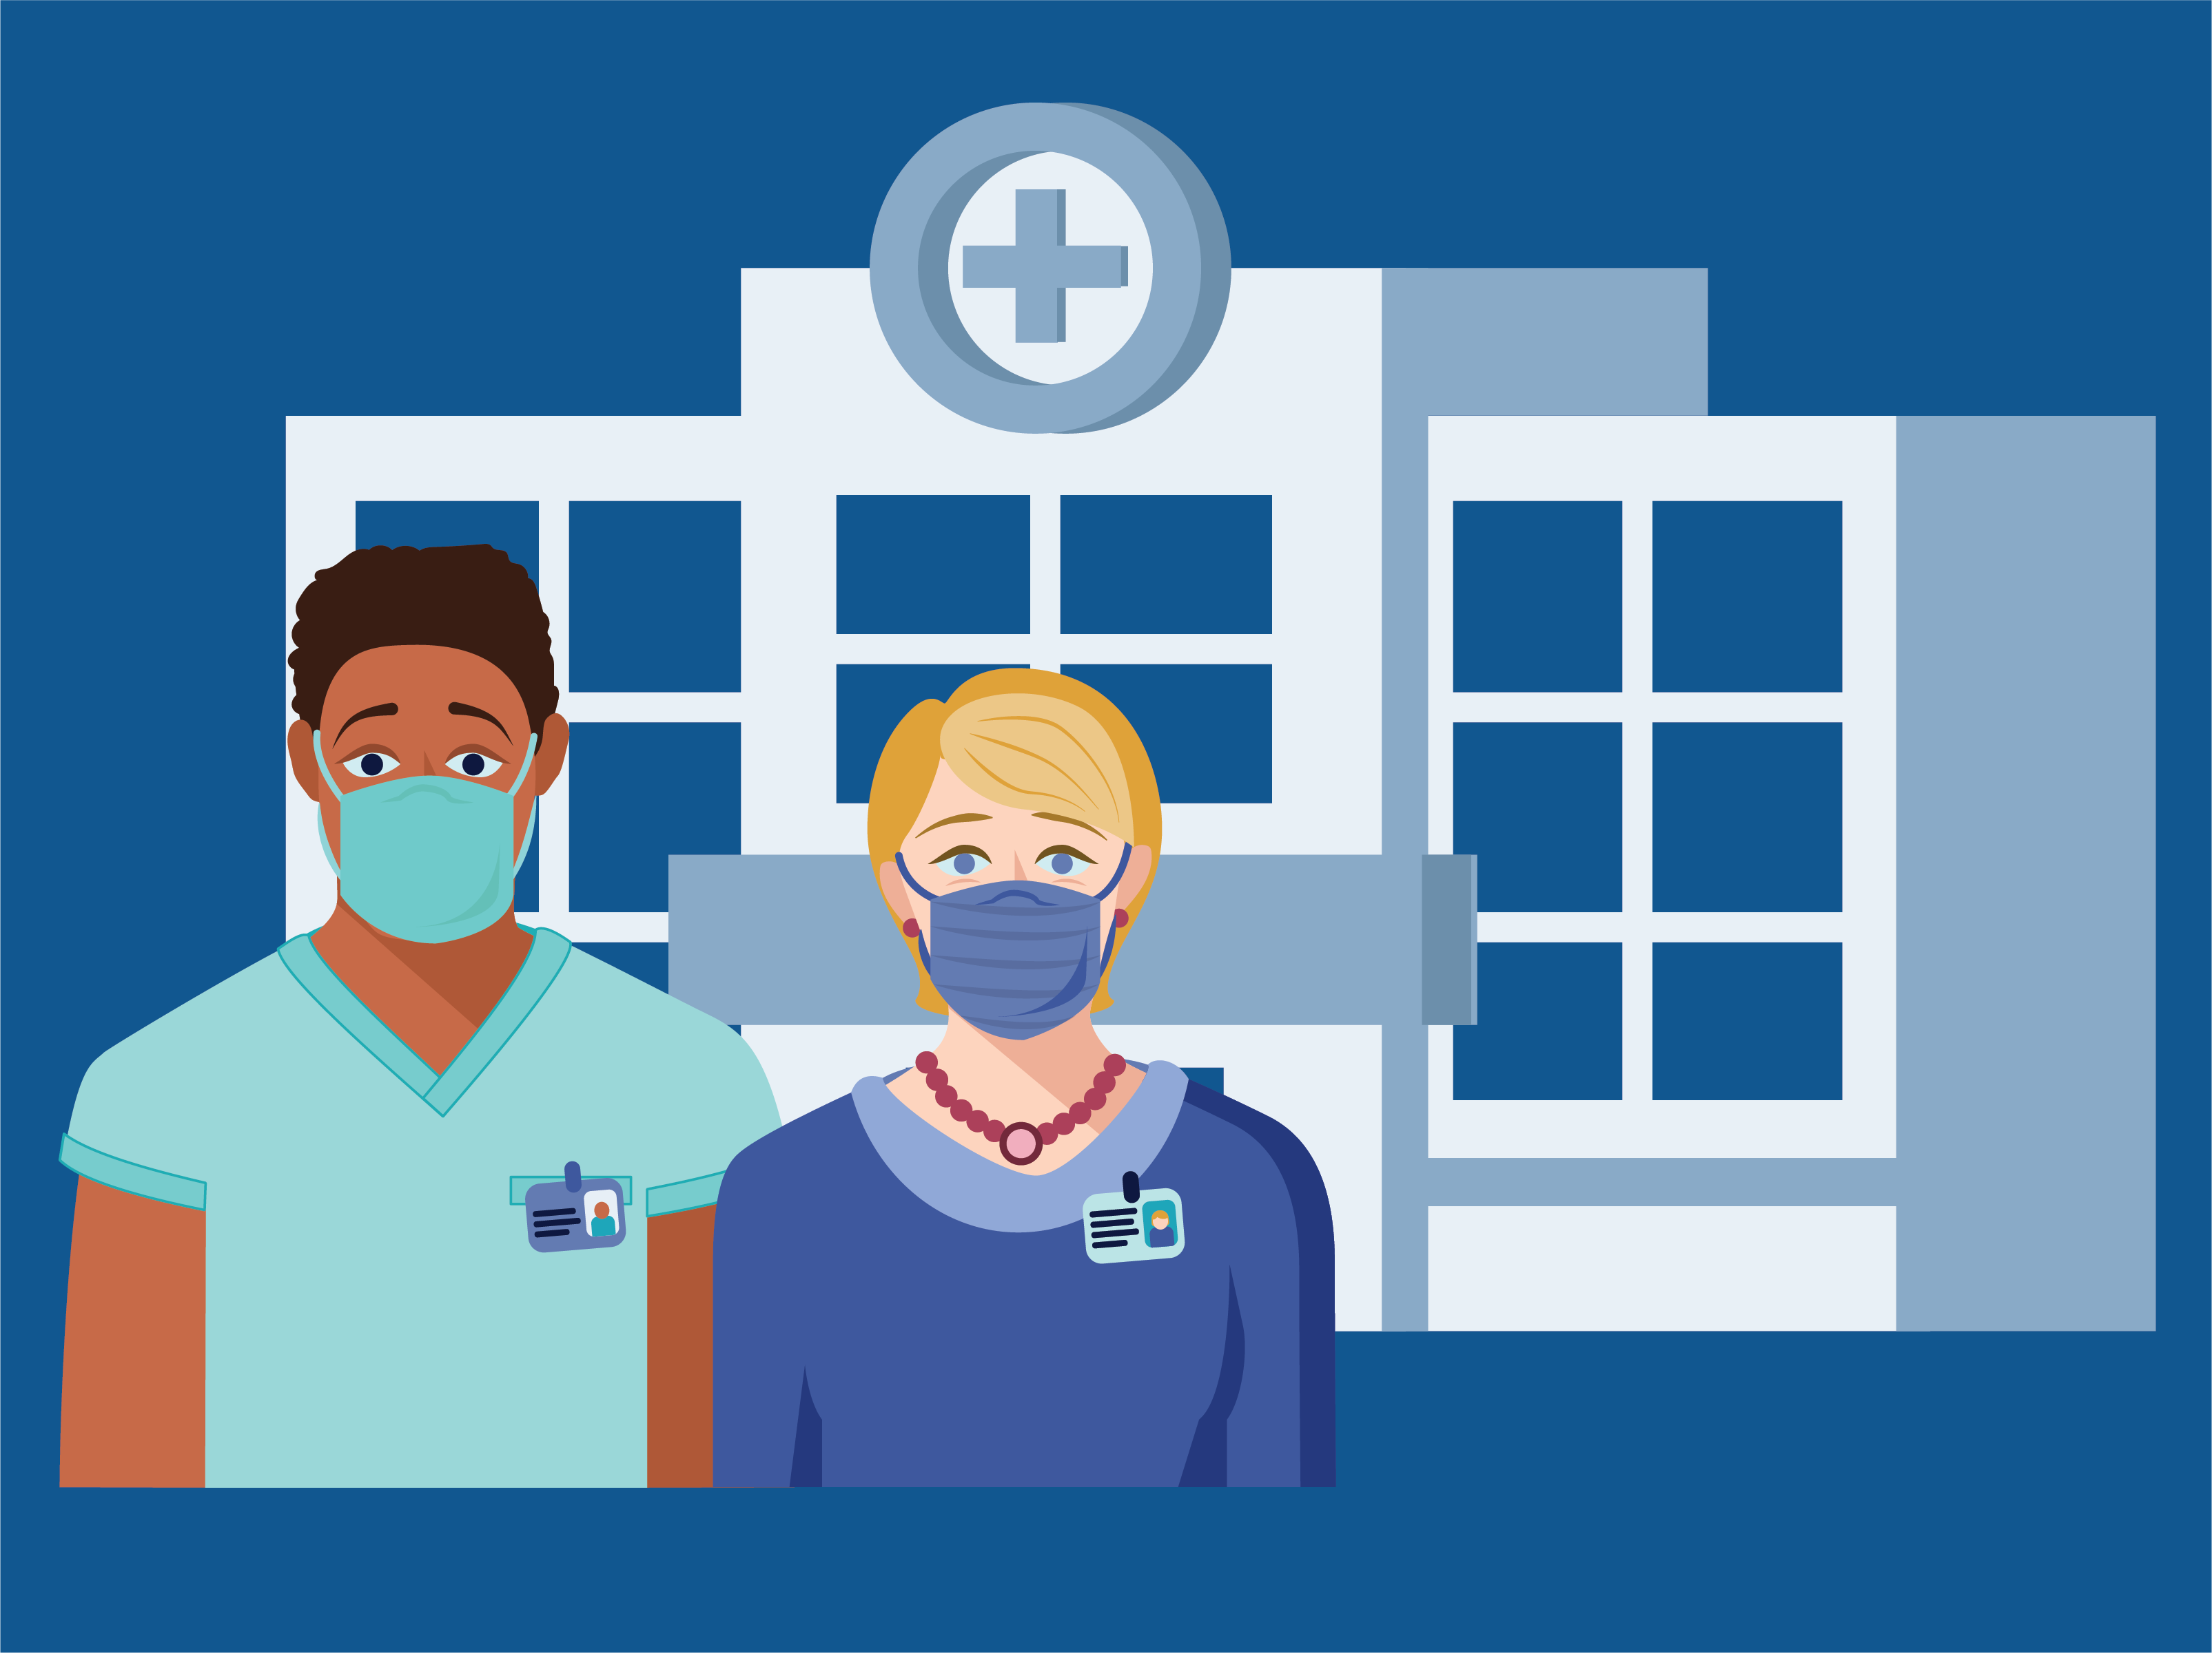
Who can help me make decisions about getting my child vaccinated?
If you have more questions about your child’s health or about deciding to get the vaccine, talk to a trusted healthcare provider, like your child’s doctor, nurse, insurance care manager, pharmacist, or community health worker.

