Slide 1
Guide to Hosting a community forum on the COVID-19 vaccine
Updated January 25, 2022
Notes:
Key updates since the previous version (dated 1/6):
Updated information about booster eligibility for people who received the Moderna vaccine (slide 23)

Slide 2
Instructions for using this guide
This guide is designed for providers, community groups, and others to host local meetings or forums about the COVID-19 vaccine, with the goal of increasing vaccine confidence.
It includes information from the Massachusetts Department of Public Health (DPH) in response to commonly asked questions and encourages discussion and feedback.
There are additional talking points in the notes section of each slide.
You may use some or all of this content based on your community’s interests and needs.
  Additional information to inform your forum can be found at https://www.mass.gov/covid-19-vaccine-in-massachusetts
The guide will be updated based on new information about the COVID-19 vaccine and feedback from its users.
Please remove this slide from the deck before your forum.

Slide 3
How to request a DPH ambassador
You may request a DPH COVID-19 vaccine ambassador to attend your community forum. Ambassadors are not necessarily vaccine experts or clinicians but are public health professionals with experience in community settings.
Ambassadors can speak, answer questions, or listen to your feedback to share with DPH.
If you would like to invite a DPH ambassador to your forum, please complete this form.
If possible, please request an ambassador at least 2 weeks before your forum. DPH will make every effort to fulfill requests.
Please remove this slide from the deck before your forum.

Slide 4
Acknowledging structural racism, ableism and other forms of oppression
The Massachusetts Department of Public Health recognizes that historical and current structural racism, ableism, and other forms of oppression have made it difficult for some communities (such as Black people and people with disabilities) to fully trust the public health, medical and scientific community. We want to be open and honest about the safety and development of the COVID-19 vaccine—what we know and what we don’t know.
This guide provides a foundation to have these conversations but does not address all the unique and valid needs and concerns of different populations and communities. We encourage you to tailor the language and format in a way that is most relevant and resonant for the people with whom you work.

Slide 5
What is a vaccine and how does it work?
Vaccines prevent diseases that can be dangerous, or even deadly. They work with your body’s natural defenses to safely develop protection from a disease.
A vaccine helps your immune system to produce antibodies, just like it would if you were exposed to the disease. After getting vaccinated, you have protection from that disease, without having to get the disease first.
This is what makes vaccines such powerful medicine. Unlike most medicines, which treat or cure diseases, vaccines prevent them.
Notes:
Sources:
https://www.cdc.gov/vaccines/hcp/conversations/understanding-vacc-work.html
https://www.cdc.gov/vaccines/vpd/vpd-vac-basics.html

Slide 6
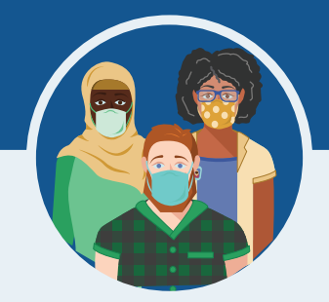
What are the benefits of getting a COVID-19 vaccine?
COVID-19 vaccination will help keep you from getting sick from COVID-19.
All COVID-19 vaccines available in the U.S. have been shown to be very effective.
The combination of getting vaccinated and following CDC’s recommendations to protect yourself and others will offer the best protection from COVID-19.
The more people who get vaccinated, the faster we can get back to our normal lives.
Notes:
We understand that some people may be concerned about getting vaccinated. While more COVID-19 vaccines are being developed as quickly as possible, routine processes and procedures remain in place to ensure the safety of any vaccine that is authorized or approved for use.
Safety is a top priority, and there are many reasons to get vaccinated.

Slide 7
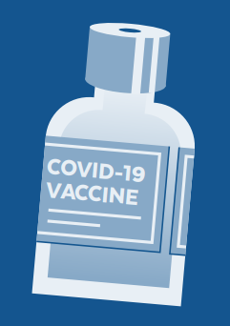
What vaccines are available?
Three vaccines have been approved or received Emergency Use Authorization from the Food and Drug Administration named Pfizer/Comirnaty, Moderna, and Janssen (Johnson & Johnson).
All three COVID-19 vaccines are safe and highly effective against serious illness, hospitalization, and death.
The Pfizer/Comirnaty and Moderna vaccines require 2 doses given at least 3-4 weeks apart. People should get both doses to be fully vaccinated in order to be effective.
Johnson & Johnson (J&J) is only 1 dose.
Notes:
What does it mean now that the Pfizer COVID-19 vaccine has FDA approval?
On 8/23/21, the FDA approved the first COVID-19 vaccine. The vaccine has been known as the Pfizer COVID-19 Vaccine and will now be marketed as Comirnaty (koe-mir’-na-tee), for the prevention of COVID-19 in people 16 years of age and older.
Comirnaty is the same vaccine as the Pfizer vaccine.
The Pfizer vaccine is also still available under emergency use authorization (EUA) for people ages 5 through 15 and for a third dose for certain immunocompromised individuals.
Compared to an EUA, FDA approval of vaccines requires even more data on safety, manufacturing, and effectiveness over longer periods of time and includes real-world data.
The full approval by the FDA means that the Comirnaty vaccine now has the same level of approval as other vaccines routinely used in the U.S., such as vaccines for hepatitis, measles, chicken pox, and polio.
The Pfizer COVID-19 vaccine was the first vaccine to receive emergency authorization, which is why it is the first to have enough data to receive full approval. It does not mean anything about the safety and effectiveness of the Moderna or Johnson & Johnson vaccine.
What is an Emergency Use Authorization (EUA)?
The United States FDA has made the Pfizer, Moderna, and Janssen COVID-19 Vaccines available under an emergency mechanism called an EUA. The EUA is supported by a Secretary of Health and Human Services (HHS) declaration that a situation exists to justify the emergency use of pharmaceuticals during the COVID-19 pandemic.
FDA may issue an EUA when certain criteria are met, which includes that there are no adequate, approved, available alternatives. The FDA decision is also based on scientific evidence available showing that the product may be effective to prevent COVID-19 during the pandemic and that the known and potential benefits of the product outweigh the risks. All of these criteria must be met to allow for the product to be used during the COVID-19 pandemic.

Slide 8






How do we know if the vaccine is safe?
Vaccines go through more testing than any other pharmaceuticals:
Small groups of people receive the trial vaccine
The vaccine is given to specific groups of people (i.e by age, race, and physical health).
The vaccine is given tens of thousands of people and tested for effectiveness and safety.
Notes:
We understand the importance of being open and honest about the safety and development of the vaccine— especially for communities who have suffered consequences of medical mistreatment.
It’s important to know that vaccines go through more testing than any other pharmaceuticals. Before any vaccine is made available, it must go through rigorous development and testing. Manufacturing is critical — every dose must consistently be high quality. Additionally, there is extensive testing in clinical trials to prove safety.
Source: https://www.cdc.gov/coronavirus/2019-ncov/vaccines/safety.html

Slide 9




How do we know if the vaccine is safe?
The CDC’s Advisory Committee on Immunization Practices looks at the data to see if the vaccine is safe and works. They give advice to the U.S. Food and Drug Administration (FDA).
The FDA looks at the data and the advice from the Advisory Committee and decides whether to approve the vaccine.
The vaccine is only approved after all of these steps are done and various teams of reviewers are sure that it works and is safe.
Notes:
Safety is a top priority, and safety monitoring for the COVID-19 vaccines has been the most intense and comprehensive in U.S. history.
The pause of the J&J vaccine from 4/13/21-4/23/21 was an example of safety monitoring in action.
Out of an abundance of caution, on 4/13/21, the FDA and CDC paused use of the J&J COVID-19 vaccine because 6 people out of 7 million who had gotten the J&J vaccine developed a rare but serious type of blood clot about 2 weeks after getting the vaccine.
On 4/23, after further study and review, including two meetings of the CDC’s Advisory Committee on Immunization Practices, the FDA and CDC ended the pause and allowed immediate use of the J&J vaccine.
The FDA and CDC have confidence that this vaccine is safe and effective in preventing COVID-19, and that the vaccine’s known and potential benefits outweigh its known and potential risks in individuals 18 years of age and older.

Slide 10




How is it safe if it happened so fast?
The timeline was sped up but never cut corners on safety. Here is how:
We already had helpful information about coronaviruses, so we weren’t starting from scratch.
The U.S. and other governments invested a lot of money to support vaccine companies with their work.
A lot of people participated in clinical trials and we didn’t need to spend time finding volunteers.
Manufacturing happened at the same time as safety studies, so vaccines were ready to be distributed once they were approved.
Notes:
The COVID-19 vaccine was developed quickly but all of the same safety steps were followed for this vaccine that are used for all vaccines.
Vaccine companies moved quickly because:
We already had helpful information: The COVID-19 virus is a part of a coronavirus family that has been studied for a long time. Experts learned important information from other coronavirus outbreaks that helped them to develop the COVID-19 vaccine, so we weren’t starting from scratch.
Governments funded vaccine research: The United States and other governments invested a lot of money to support vaccine companies with their work. Working together with other countries also helped researchers move quickly.
Tens of thousands of people participated in vaccine studies: Studies of the vaccine (called Clinical Trials) were conducted to prove the vaccine is safe and effective. Tens of thousands of people signed up for the studies, so companies did not need to spend a lot of time finding volunteers.
Manufacturing happened at the same time as the safety studies: Vaccine companies started making the vaccine at the same time as studies were happening in hopes that it would be proven safe and effective. This meant vaccines were ready to be distributed once they were approved

Slide 11
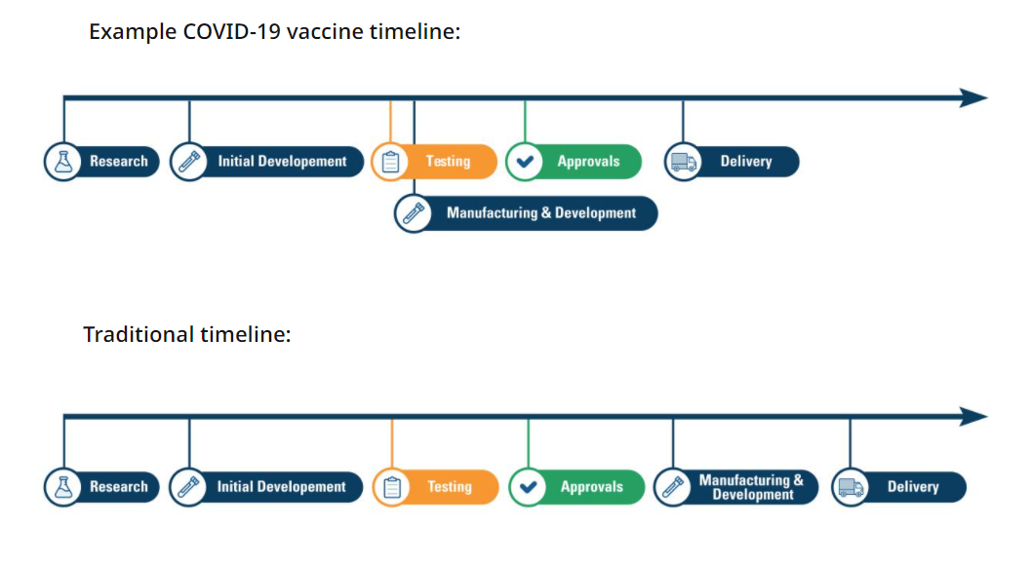

Slide 12
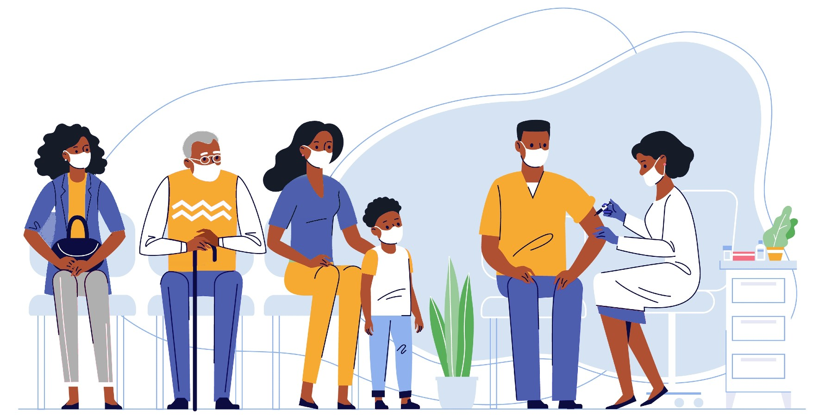
Can I get COVID-19 from the COVID-19 vaccines?
No. The vaccines do not contain the live virus that causes COVID-19. This means that you can’t catch COVID-19 from the vaccine.

Slide 13
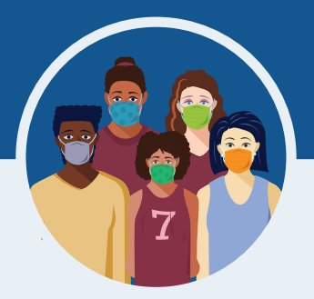
Do the COVID-19 vaccines have any side effects?
Serious side effects from vaccines, including the COVID-19 vaccine, are rare.
It is possible that some people may have side effects, which are normal signs that your body is building protection.
These side effects may affect your ability to do daily activities, but they should go away in a few days.
The most common side effects are minor and include:
    Tiredness
    Headache
    Pain at the injection site
    Muscle and/or joint pain
    Chills
    Nausea and/or vomiting
    Fever
Notes:
Serious side effects from vaccines, including the COVID-19 vaccine, are rare. In the Pfizer, Moderna, and Janssen clinical trials, serious side effects happened at the same frequency as they do in the general population (among less than 1.0% of participants who received the vaccine). There were no notable differences in serious adverse events by age, race, ethnicity, or medical conditions. The side effects in adolescents 12-15 years old were consistent with those reported in clinical trial participants 16 years of age and older.
If you got the J&J COVID-19 vaccine and develop any of the symptoms below within 3 weeks after vaccination, get medical care right away:
Severe headache or blurred vision
Shortness of breath
Gut pain that does not go away
Chest pain
Leg swelling
Easy bruising or tiny blood spots under the skin
In the Moderna vaccine trial, examples of serious side effects included two people with facial swelling, one person with difficult-to-control nausea and vomiting, and one report of Bell’s palsy. In the Pfizer vaccine trial, examples included a shoulder injury at the vaccination site and swollen lymph nodes in the armpit opposite the vaccination arm. In the Janssen vaccine trial, examples included four people with seizures and six people with deep vein thrombosis. We don’t know if these serious side effects are related to the vaccine or not.
Some instances of severe allergic reactions have been reported outside of clinical trials. See slide 19 for more information about allergic reactions.
Minor side effects are more common after the second dose of Moderna and Pfizer than the first.
https://www.fda.gov/emergency-preparedness-and-response/mcm-legal-regulatory-and-policy-framework/pfizer-biontech-covid-19-vaccine-frequently-asked-questions
https://www.fda.gov/emergency-preparedness-and-response/mcm-legal-regulatory-and-policy-framework/moderna-covid-19-vaccine-frequently-asked-questions
https://www.fda.gov/emergency-preparedness-and-response/mcm-legal-regulatory-and-policy-framework/janssen-covid-19-vaccine-frequently-asked-questions
https://www.fda.gov/media/146305/download

Slide 14
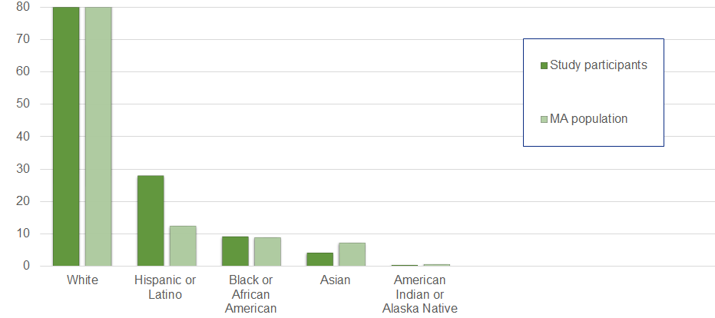
Who was the Pfizer vaccine tested on?
The safety of the Pfizer vaccine was evaluated in 43,448 people 16 years of age and older in two clinical studies conducted in the United States, Europe, Turkey, South Africa, and South America. Additional studies were done with 2,260 adolescents ages 12-15 and 3,000 children ages 5-11.
Notes:
Overall, 50.6% of participants in the Pfizer safety trials were male and 49.4% were female, 83.1% were White, 9.1% were Black or African American, 28.0% were Hispanic or Latino, 4.3% were Asian, and 0.5% were American Indian or Alaska Native. The safety of the Pfizer vaccine in younger adolescents was studied in 2,260 adolescents ages 12-15 and 3,000 children ages 5-11.
https://www.fda.gov/media/144413/download

Slide 15
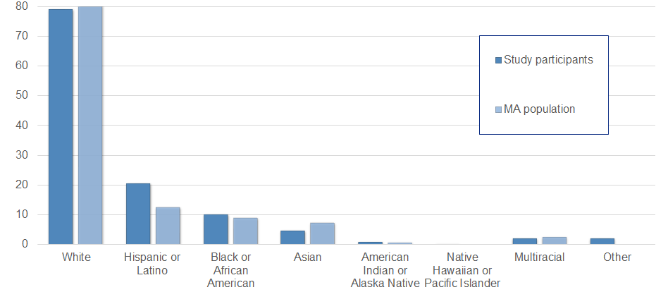
Who was the Moderna vaccine tested on?
The safety of the Moderna vaccine was evaluated in 30,351 people 18 years of age and older in the United States.
Notes:
Overall, 52.7% of participants in Moderna safety trials were male, 47.3% were female, 79.2% were White, 10.2% were Black or African American, 20.5% were Hispanic or Latino, 4.6% were Asian, 0.8% were American Indian or Alaska Native, 0.2% were Native Hawaiian or Pacific Islander, 2.1% were Other, and 2.1% were Multiracial.
The average age of participants was 52; 75.2% were 18 to 64 years of age and 24.8% were 65 years of age and older.
The demographic characteristics were similar among participants who received Moderna COVID-19 Vaccine and those who received placebo.
https://www.fda.gov/media/144637/download

Slide 16
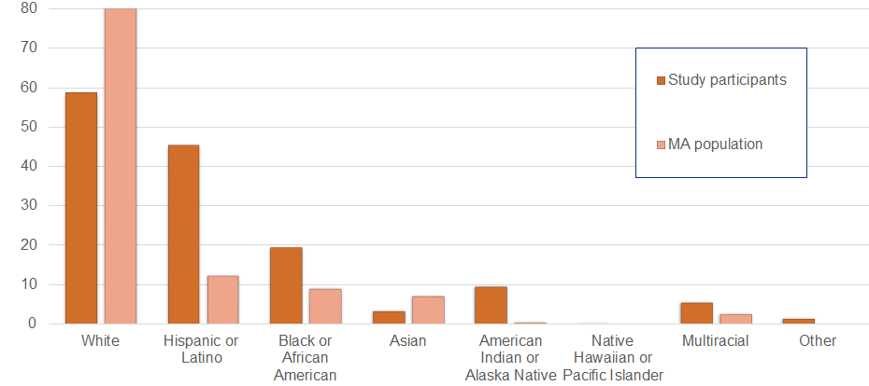
Who was the Johnson & Johnson vaccine tested on?
The safety of the Janssen (Johnson & Johnson) vaccine was evaluated in 43,783 people 18 years and older in the U.S., Brazil, South Africa, Colombia, Argentina, Peru, Chile, and Mexico
Notes:
Overall, 45% of Janssen participants were female, 55% were male, 58.7% were White, 19.4% were Black or African American, 45.3% were Hispanic or Latino, 3.3% were Asian, 9.5% were American Indian/Alaska Native 0.2% were Native Hawaiian or other Pacific Islander, 5.6% were from multiple racial groups and 1.4% were unknown races. The average age of participants was 52.
The demographic characteristics were similar among participants who received Janssen COVID-19 Vaccine and those who received placebo.
https://www.fda.gov/media/146304/download

Slide 17
Should someone with allergies get the COVID-19 vaccine?
You should not get the COVID-19 vaccines if you have a history of severe allergic reaction (also called “anaphylaxis”) to any ingredient in the vaccine.
The vaccines do not contain eggs, gelatin, preservatives, or latex. The ingredient lists can be found at:
  Pfizer/Comirnaty: https://www.fda.gov/media/144414/download (page 3)
  Moderna: https://www.fda.gov/media/144638/download (page 2)
  Janssen (J&J): https://www.fda.gov/media/146305/download (page 2)
If you have a history of a severe allergic reaction to something else that’s not in the vaccine (like peanut butter), discuss with your health care provider before receiving the vaccine.
Notes:
Although there is a small chance that the COVID-19 vaccines could cause a severe allergic reaction, this would usually happen within a few minutes to one hour after getting the vaccine.
Signs of a severe allergic reaction can include:
• Difficulty breathing
• Swelling of your face and throat
• A fast heartbeat
• A bad rash all over your body
• Dizziness and weakness
If you have a history of allergic reactions, your vaccination provider may ask you to stay longer at the place where you received your vaccine for monitoring afterwards.
CDC looked at data reported to the federal Vaccine Adverse Event Reporting (VAERS) system from mid-December to mid-January, and there were rare reports of severe allergic reaction after COVID-19 vaccination, which happened at similar rates to what is seen with other commonly used vaccines like the flu.

Slide 18
I would like to have a baby one day. Is it safe for me to get a COVID-19 vaccine?
Yes!
CDC recommends COVID-19 vaccination for people who are trying to become pregnant now or who might become pregnant in the future.
There is no evidence that antibodies made following COVID-19 vaccination or that vaccine ingredients will cause any problems.
There is no evidence that fertility problems in women or men are a side effect of any vaccine.
Notes:
COVID-19 vaccines are being studied carefully now and will continue to be studied for many years, similar to other vaccines.
Here’s why it’s safe:
The COVID-19 vaccine, like other vaccines, works by teaching our bodies to develop antibodies that fight against the virus that causes COVID-19, to prevent future illness.
There is no evidence right now that antibodies formed from COVID-19 vaccination will cause any problems with pregnancy, including the development of the placenta.
In fact, there is no evidence that fertility problems are a side effect of ANY vaccine.

Slide 19
Can someone who is pregnant or breastfeeding get a COVID-19 vaccine?
Yes!
The CDC and American College of Obstetricians and Gynecologists recommend COVID-19 vaccination for pregnant and breastfeeding individuals.
The benefits of receiving a COVID-19 vaccine outweigh any known or possible risks of vaccination during pregnancy.
Getting sick with COVID-19 during pregnancy increases the risk of severe illness and preterm birth.
Getting vaccinated is a personal choice for people who are pregnant or breastfeeding. If you have questions, talk with your healthcare provider.

Slide 20
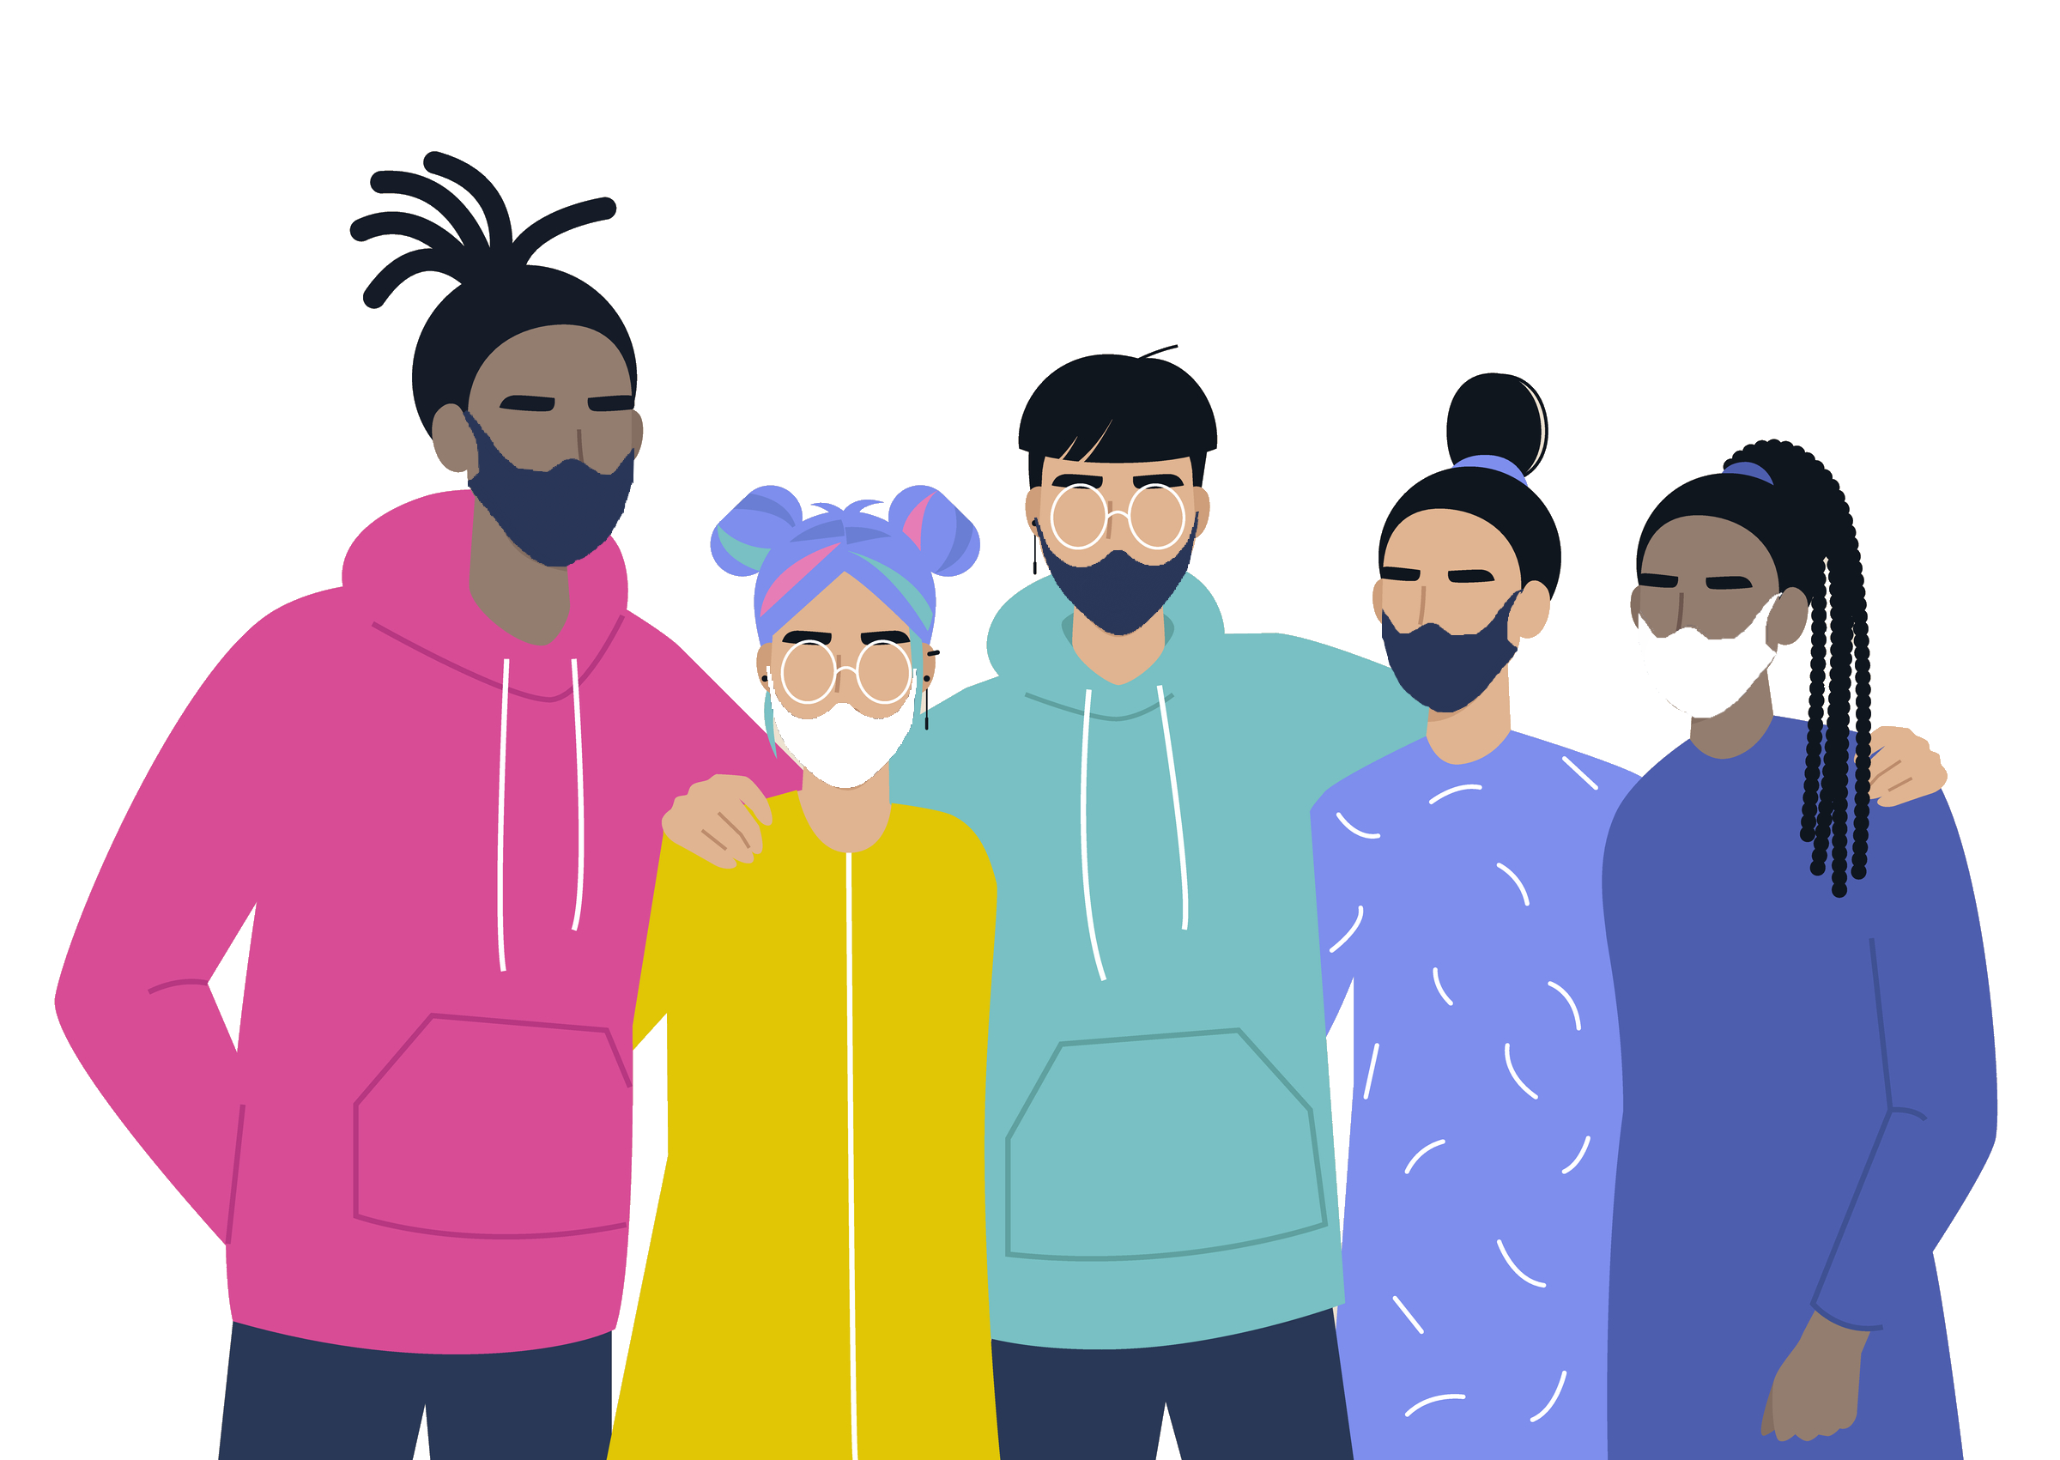
Are the COVID-19 vaccines safe for children?
Yes!
CDC recommends everyone ages 5 and older get a COVID-19 vaccine.
Scientists have conducted clinical trials with thousands of children and determined it to be safe and effective.
The Pfizer vaccine is authorized for people ages 5 and older and has full approval for people ages 16 and older.
The Moderna and Johnson & Johnson vaccines are authorized for people ages 18 and older.
Notes:
Notes:
The Pfizer COVID-19 Vaccine is over 90% effective at preventing COVID-19 in children ages 5 through 11 years.
Getting children vaccinated can help protect them against COVID-19, as well as reduce disruptions to in-person learning and group activities by helping slow community transmission.
Children may have some side effects from the vaccine, similar to those seen in adults and with other vaccines. These are normal signs that their body is building protection, but they should go away in a few days.

Slide 21
Will a COVID-19 vaccine change my DNA?
No. COVID-19 vaccines do not change or interact with your DNA in any way.
Vaccines teach our immune system how to fight against a specific virus.
In order to do its job, the COVID-19 vaccine doesn’t need to go inside the nucleus of the cell, which is where our DNA is kept. This means the vaccine never interacts with our DNA in any way and has no way to change it.
Notes:
No. COVID-19 vaccines do not change or interact with your DNA in any way.
Vaccines teach our immune system how to fight against a specific virus. They work with the body’s natural defenses to safely develop immunity to disease. In order to do its job, the COVID-19 vaccine doesn’t need to go inside the nucleus of the cell, which is where our DNA is kept. This means the vaccine never interacts with our DNA in any way and has no way to change it.
At the end of the process, our bodies have learned how to protect against future infection. That immune response and making antibodies is what protects us from getting infected if the real virus enters our bodies. (source: https://www.cdc.gov/coronavirus/2019-ncov/vaccines/facts.html)

Slide 22

Will the vaccines work against COVID-19 variants?
It is normal for viruses to change as they spread, and for new variants to appear.
So far, studies suggest that the vaccines provide protection from the known variants (like Delta and Omicron).
Even when a vaccinated person gets infected with COVID-19, they are very protected against severe disease and death.
Notes:
The CDC is monitoring virus changes in the United States, including changes with the Omicron variant.
Scientists are working to learn more about how easily each variant spreads, whether they could cause more severe illness, and whether the vaccines we already have will protect people against specific COVID-19 variants.

Slide 23
Will I need a booster shot?
COVID-19 vaccines work well to prevent severe illness, hospitalization, and death. However, public health experts are starting to see less protection against mild and moderate disease. Boosters keep the vaccines effective for longer.
Everyone age 12+ can get a booster if:
  Pfizer & Moderna: It’s been at least 5 months since your second dose
  Johnson & Johnson: It’s been at least 2 months since your first dose
If you are ages 12-17, you can only get a Pfizer booster. Otherwise, you can choose which booster vaccine you want.
You can get a booster shot anywhere they are available including your primary care provider, a pharmacy or a community vaccination clinic.
Notes:
You can choose which booster vaccine you want. Some people may want the type they originally received; others may prefer to get a different booster.
The side effects following the booster are similar to those after the second dose.
You are still considered fully vaccinated if you do not receive a booster shot.
You can get a COVID-19 vaccine and other vaccinations like a flu or shingles vaccine at the same time or close together.
For answers to more commonly asked questions about boosters, visit: https://www.mass.gov/info-details/covid-19-booster-frequently-asked-questions

Slide 24

How do I make an appointment?
Use VaxFinder.mass.gov to search for appointments (including boosters) at pharmacies, health care providers, and other community locations.
Many sites accept walk-in appointments.
You can sort by which vaccine is offered so that people under 18 can find places that only offer the Pfizer/Comirnaty vaccine.
People who can’t use the internet may call the Massachusetts Vaccine Scheduling Resource Line: 2-1-1 (877-211-6277)
Notes:
These methods apply to people looking for booster shots as well.
The Scheduling Resource Line is for people who cannot access the internet. It is available in 100 languages. Representatives have the same access to appointments as on the public website. Their hours are:
Monday – Thursday from 8:30 AM to 8:00 PM
Friday – Sunday from 8:30 AM to 5:00 PM

Slide 25
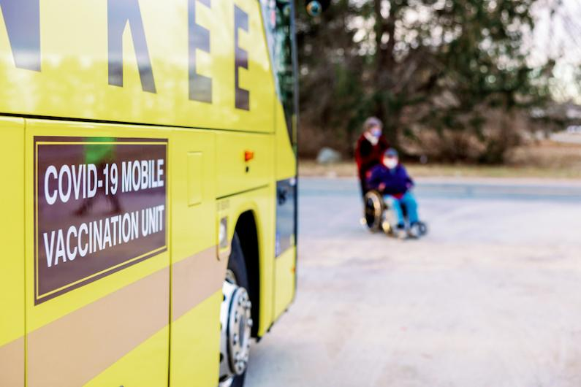
What if I need help getting to a vaccination site?
In-home vaccinations are available to anyone who can’t get to a vaccination site – call the Intake Line at (833) 983-0485
MassHealth provides free transportation to vaccine appointments to anyone with MassHealth or the Health Safety Net.
  Call your health plan or MassHealth at 800-841-2900 to schedule
LYFT is offering free or discounted rides to and from vaccination appointments.
Organizations like employers, schools, and community and faith-based organizations may request a free mobile, on-site clinic to vaccinate individuals.
Notes:
The Homebound Program intake line is open Monday through Friday from 9 AM to 5 PM and has representatives who speak English and Spanish, as well as interpreters in 100+ languages.
When you are registered with the Homebound Program, you will generally be called within 5 business days to schedule your appointment. In-home vaccinations will be:
Performed by medical professionals, following all public health guidelines
Tailored to meet the individual needs of the homebound individual, as discussed on the scheduling call
Scheduled based on geography of homebound residents, not on a first-come first-served basis
Performed using the Johnson & Johnson single-dose vaccine, which is easier to transport and requires only one appointment
Individuals 12-17 years old will be offered the Pfizer vaccine
MassHealth transportation coverage includes people with MassHealth Limited, Children’s Medical Security Program (CMSP) and MassHealth Family Assistance (FA). In addition, members can request transportation services directly through MassHealth’s Customer Service, rather than needing to request services through a health care provider.
There also may be local community organizations, such as Aging Services Access Points (ASAPs) and Councils on Aging (COAs) that can assist you in finding transportation.

Slide 26
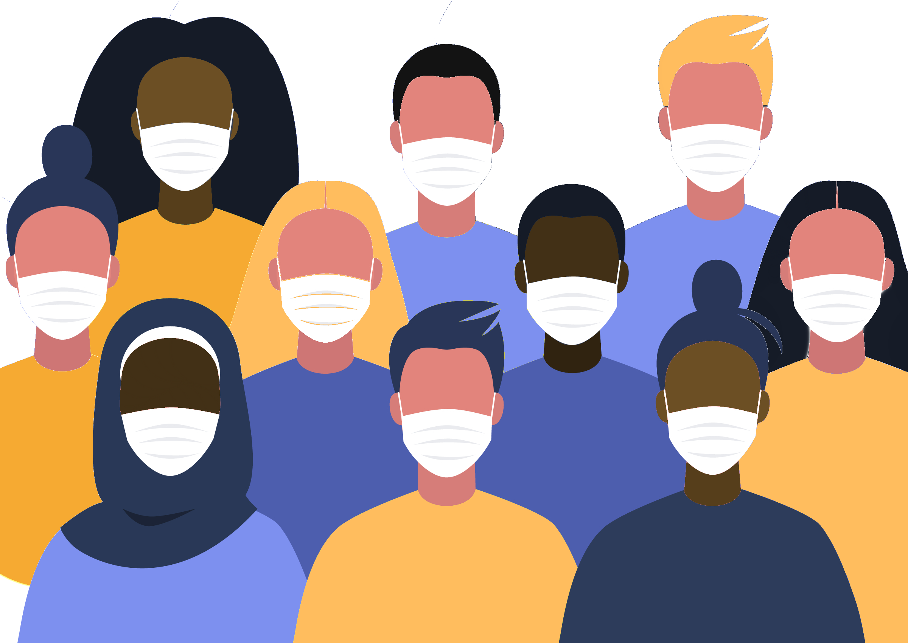
Will I have to pay for the vaccine?
No. The vaccine (including booster) is free for all Massachusetts residents.
  You will never be asked for a credit card number to make an appointment.
  You can get a vaccine even if you do not
  have insurance, a driver’s license,
  or a Social Security number.
Notes:
Health insurance (including Medicare and Medicaid) will cover the cost of administering the vaccine. Bring your health insurance card, if you have one. Your insurance will be billed at no cost to you.
Health care providers can also be reimbursed from the federal government for the cost of administering vaccine to undocumented immigrants.

Slide 27
Will getting the vaccine impact a person’s immigration status?
No. Getting the vaccine will not change whether you are able to stay in the US, get a green card, or get public benefits like housing or SNAP.
No matter what your immigration status, it is important for you and your family to be safe from COVID-19.
You can get a vaccine even if you do not have insurance, a driver’s license, or a Social Security number.
Notes:
No. The federal government has confirmed that it will not consider COVID-19 treatment (including a vaccine) as part of a determination of whether someone is a “public charge” or as it relates to the public benefit condition for certain individuals seeking an extension of stay or change of status, even if the vaccine is paid for by Medicaid or other federal funds.
Bring an ID with your name, if you have one, to verify your name in the vaccination system. It is not required.
Bring your health insurance card, if you have one. Your insurance will be billed at no cost to you. You do not need to be insured to receive the vaccine.

Slide 28
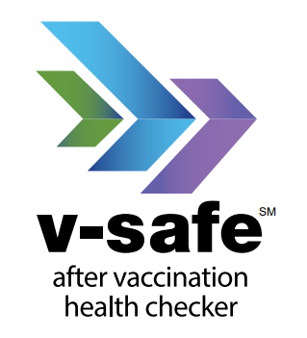
What should I do if I experience symptoms after receiving a COVID-19 vaccine?
If you have a lot of pain or discomfort, talk to your healthcare provider.
If you do not have a healthcare provider or want to report any side effects to the CDC, visit cdc.gov/vsafe
You can use v-safe on a smartphone to quickly tell CDC if you have any side effects after getting the COVID-19 vaccine and to get personalized health check-ins after you receive a COVID-19 vaccination.
Notes:
If you have any significant pain or discomfort, talk to your healthcare provider, who may recommend over-the-counter medicine, such as ibuprofen or acetaminophen. To reduce pain and discomfort where you got the shot apply a clean, cool, wet washcloth over the area, and use or exercise your arm. To reduce discomfort from fever, drink plenty of fluids and dress lightly.
In most cases, discomfort from fever or pain is normal, but contact your healthcare provider if the redness or tenderness where you got the shot increases after 24 hours or your side effects are worrying you or do not seem to be going away after a few days
V-safe is a smartphone-based tool that uses text messaging and web surveys to provide personalized health check-ins after you receive a COVID-19 vaccination. Through v-safe, you can quickly tell CDC if you have any side effects after getting the COVID-19 vaccine. Depending on your answers, someone from CDC may call to check on you and get more information. And v-safe will remind you to get your second COVID-19 vaccine dose if you need one. To sign up for v-safe, please visit cdc.gov/vsafe.

Slide 29
How long after getting the COVID-19 vaccine does it take to be effective? How long does it last?
It usually takes a few weeks for the body to build immunity after vaccination.
That means it's possible a person could be infected with the virus that causes COVID-19 just before or just after vaccination and get sick. This is because the vaccine has not had enough time to provide protection.
We do not know yet how long the COVID-19 vaccines will provide protection.
Recent studies show that protection against the virus may decrease over time. That is why the CDC recommends certain groups get a booster shot.

Slide 30
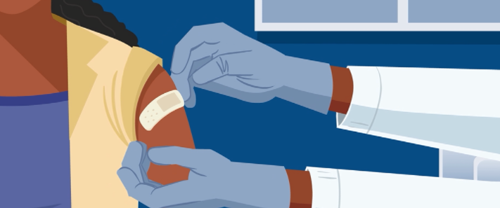
Do I need to keep wearing a mask if I am fully vaccinated?
Only in certain situations, including public transportation, health care facilities, schools, and other settings with vulnerable populations, like congregate care.
Stay home and get tested if you feel sick.
Isolate if you test positive for COVID-19.
Notes:
People are fully vaccinated for COVID-19 if they have received two doses of either the Moderna or Pfizer COVID-19 vaccines or a single dose of the Johnson & Johnson vaccine more than 14 days ago.
Together, COVID-19 vaccination and following CDC’s recommendations for how to protect yourself and others offer the best protection from getting and spreading COVID-19.
DPH guidance for people who have been fully vaccinated can be found at https://www.mass.gov/guidance/guidance-for-people-who-are-fully-vaccinated-against-covid-19

Slide 31
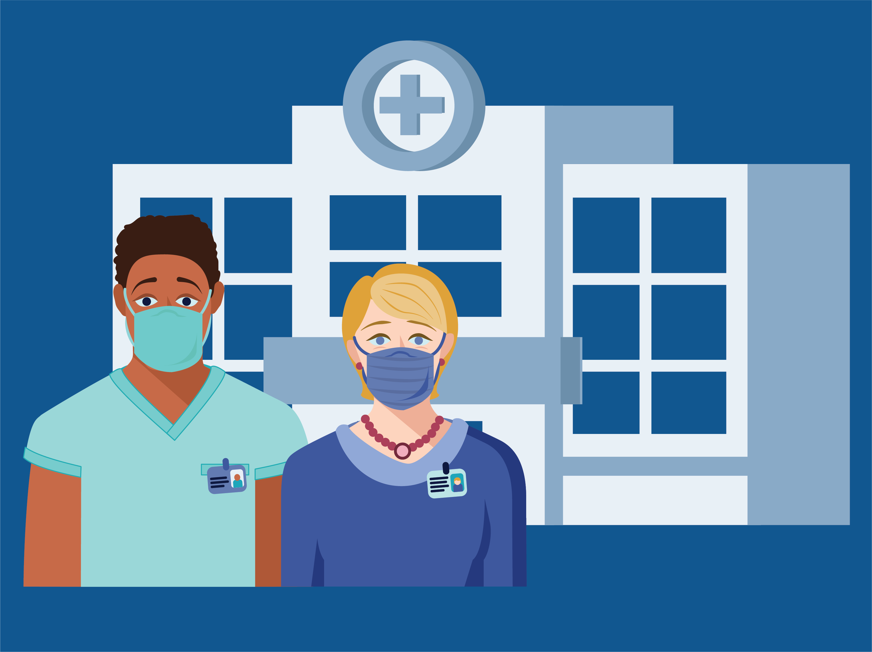
Who can help me make decisions about getting the vaccine?
If you have more questions about your own health or about deciding to get the vaccine, talk to a trusted healthcare provider, like your doctor, nurse, insurance care manager, pharmacist, or community health worker.

Slide 32
Discussion questions
What concerns do you have regarding the COVID vaccine?
  What concerns do people in your community have regarding the COVID vaccine?
What information would help you trust the vaccine?
  What information would help people in your community trust the vaccine?
What would make you more likely to get the vaccine?
  What would make people in your community more likely to get the vaccine?
What barriers make it harder for you to get the COVID vaccine (for example, location, time off from work, needing two doses)?
  What are the things that might make it harder for people in your community to get the COVID vaccine?
What would make it easier for you to get the vaccine?
  What would make it easier for people in your community to get the vaccine?

Slide 33
Where to learn more
Who has gotten the vaccine so far
COVID-19 Vaccination Program | Mass.gov
FAQs for the general public
COVID-19 Vaccine Frequently Asked Questions | Mass.gov
Vaccine Equity
COVID-19 Vaccine Equity Initiative | Mass.gov
COVID-19 Vaccine information from CDC
COVID-19 Vaccines | CDC
For other questions related to COVID-19 vaccine in Massachusetts, please email:
COVID-19-Vaccine-Plan-MA@mass.gov
Notes:
The Massachusetts Department of Public Health posts online a weekly vaccination report that shows information such as:
Number of doses of vaccine shipped to Massachusetts
Number of people who have been vaccinated;
Number of people who have been vaccinated by county
Number of people who have been vaccinated by age and race/ethnicity
Vaccines given by different types of providers (e.g. school, community health center)

Slide 34
Additional resources for forum organizers

Slide 35
Examples of other questions in the FAQ for the general public
COVID-19 Vaccine Frequently Asked Questions | Mass.gov
Should someone who is COVID-19-positive receive the vaccine?
Should someone who has had COVID-19 be vaccinated?
What can I expect at my appointment to get vaccinated for COVID-19?
Will people who live in another state or country part time (e.g. students, retirees, people with dual citizenship) be able to get the COVID-19 vaccine in Massachusetts?
What is an Emergency Use Authorization?
Notes:
Please also refer to the FAQ for the general public for responses to other questions that you might want to address during your meeting.

Slide 36
Tools and resources
Flyers and social media graphics in multiple languages
Stop COVID-19 – Vaccine graphics | Mass.gov
Trust the Facts, Get the Vax Campaign Materials, including videos
Trust the Facts, Get the Vax Campaign Materials | Mass.gov
COVID-19 Vaccine Communication Toolkit for Community-Based Organizations
COVID-19 Vaccine Communication Toolkit for Community-Based Organizations: Getting Started | CDC
Fact sheets on topics such as mask wearing, social distancing, and stopping the spread of germs
COVID-19 Printable Fact Sheets | Mass.gov

