Slide 1
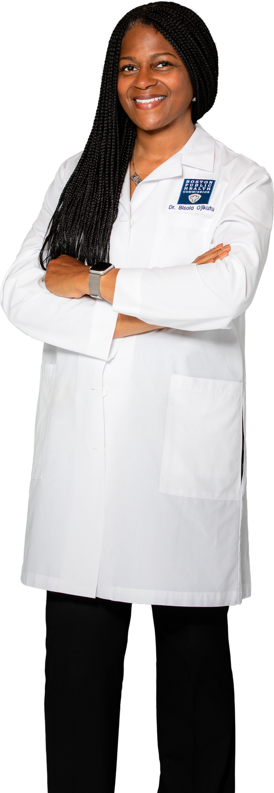

The COVID vaccine was updated
in September 2024.
It gives protection against new variants.

Slide 2
Everyone aged 5 years to 64 years
should get 1 dose of an updated
COVID vaccine.

Slide 3
People aged 65 and over should get
two doses of the updated COVID vaccine.

Slide 4
Children aged 6 months to 4 years should
get between 1-3 doses of an updated
COVID vaccine.
Ask your health care provider what’s
right for your child.

Slide 5
You may still get COVID after getting an
updated vaccine...
...but your risk of Long COVID,
other severe illness, hospitalization,
and death is much lower.

Slide 6
You can get the COVID and flu shots
at the same time.

Slide 7
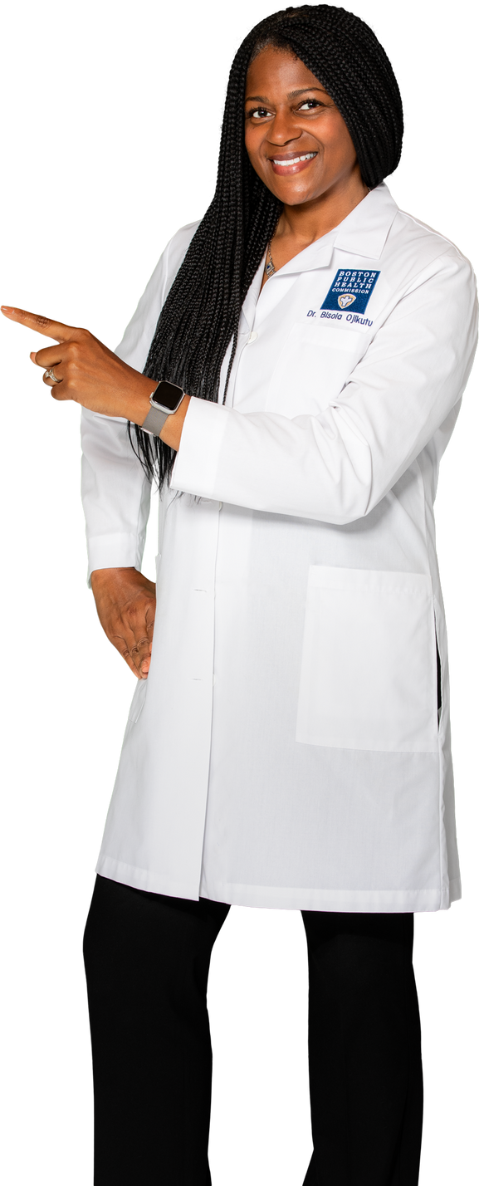
Ask your health care provider about an updated COVID vaccine or visit mass.gov/CovidVaccine.

Slide 8
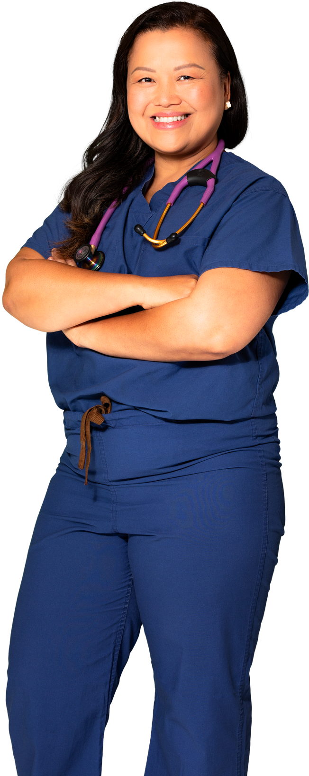
I’ve never had a COVID vaccine before.
How many doses do I need?

Slide 9

If you are 5 years or older, you only need
one dose of an updated COVID vaccine...
...even if you’ve never been vaccinated
for COVID before!

