Slide 1
Ensuring Success
Integrated Resource Team
Approach

Slide 2
Presenters
Kelli Collomb
Transition Coordinator
Malden High School
Marianne Mastrangelo
President & Co-Founder
Academy for Healthcare Training
Taciana Saab
Director of Workforce Development
Triangle, Inc.
Kevin Schlegel
Nurse Assistant
Spaulding Rehabilitation Network - Cambridge
Colleen Moran
Director of Workforce Development
Spaulding Rehabilitation Network

Slide 3
Agenda
Disability Employment Initiative: Career Pathways Overview
Participant Success Story
Malden High School
Introduction to Triangle, Inc.
Academy for Healthcare Training
Spaulding Rehabilitation Network
Q&A

Slide 4
Career Pathways Metro North Partnership (DEI-V)
Increase the employment options by providing career pathways for 100 individuals with a range of disabilities: allied health (6 participants), nurse assistant (50), and culinary arts (44)
Increase connections and partnerships with workforce development and higher education
Facilitate job placement and career development for participants in high growth career sectors

Slide 5
Career Pathways Outcomes
 | Healthcare | Hospitality | Total
Enrollments | 60 | 50 | 110
Currently in Training | 0 | 0 | 0
Completed Training | 55 | 48 | 103
Preparing for Certification Exam | 5 | 0 | 5
Certifications | 31 | 47 | 78
Placements with 30 days retention | 37 | 39 | 76

Slide 6
Success Story - Kevin Schlegel
Referred by Mass Rehabilitation Commission
Successfully Completed HHA/CNA Program
Identified Employment Goals
Completed Additional Training: Basic Life Supports, First Aid/CPR through American Heart Association
Applied for and secured employment at Spaulding Rehabilitation Network
Now Enrolled in a Nursing Program at Regis College

Slide 7
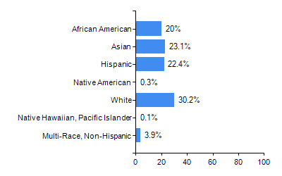
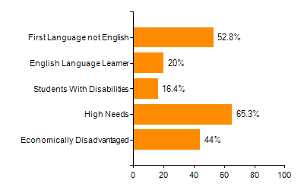
Malden Public Schools
Student Race and Ethnicity | Selected Populations
Most diverse school system in the state

Slide 8
Malden Public Schools
Internships
Employability Skills Groups
Community Service
School to Career
Transition Skills
Competitive Employment

Slide 9
Malden Public Schools
Testing
Informational Interviews
Job Shadowing
Pre-Apprenticeship – Agreement with Division of Apprentice Standards
Mayor’s Summer Youth Employment Program
Since 2012, over 1700 youth employed, over 50 sites

Slide 10
Partnerships & Community Involvement
City of Malden
YWCA
Triangle- IMPACT: Ability, internships, Career Pathways, serves as a strong resources and advocate.
MATV, YMCA, Library, Senior Center, MTEC, Malden Food Service
MRC- Counselors and PreETS
MNREB- Advanced Manufacturing, NAMC, Retail Training, Career Based field experiences
Commonwealth Corporation- Signal Success, pilot program, coaching
Connecting Activities (DESE)- job search, interview skills, resume
Massachusetts Clean Energy Center- Learn and Earn Grant

Slide 11
Malden Public Schools
Graduation rate
Proactive problem solving
Individual Teams support individual needs
The community as an Integrated Resource Team
Youth employment
Long term relationships with employers and community partners

Slide 12
Triangle, Inc.
Our Mission
Through support, challenge and opportunity, Triangle empowers people with disabilities and their families to enjoy rich, fulfilling lives. We are committed to helping the world recognize that we are all people with ability.

Slide 13
Employment Services
Job Coaching, Training and Placement Services: At Triangle's employment service assists people with disabilities develop the skills and receive the assistance they need to train for, seek, and sustain competitive employment.
Transition Services program partners with high schools from 15 underserved communities to help special education students participate in community-based career training and receive professional placement supports they need to transition into employment or advance their careers.

Slide 14
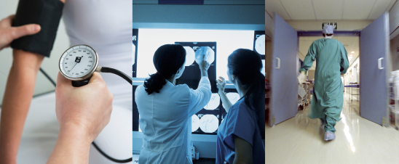
Academy for Healthcare Training
Training since September 2015
Approximately 300 students completed training
Triangle, Inc. - 34 participants
MRC - 6 participants

Slide 15
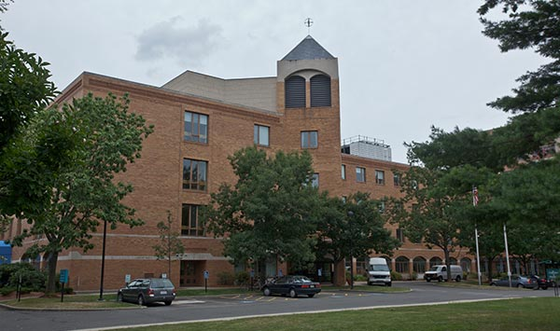
Spaulding Rehabilitation Network
Mission Statement
Spaulding Rehabilitation Network is committed to delivering compassionate care across the healthcare continuum to improve quality of life for persons recovering from, or learning to live fully with, illness, injury and disability.
Primary Workforce Development Programs
Working Partners
Project SEARCH
CNA Pipeline Development

Slide 16
Q & A

