Slide 1
FY27 H.2 Budget Overview
Executive Office of Health & Human Services
January 28, 2026

Slide 2
Executive Office of Health and Human Services
EOHHS H.2 Budget Overview
Mission
The Executive Office of Health and Human Services (EOHHS) is the largest secretariat in state government, with 11 agencies and the MassHealth program, over 23,000 employees, and over $33 billion in projected FY26 spending. We are responsible for the health, resilience, and independence of people across Massachusetts. We directly serve nearly 1 in every 3 Massachusetts residents and touch every community in the state through public health programming.
FY27 Overview
The Healey-Driscoll Administration’s FY27 House 2 budget proposal recommends funding EOHHS at $33.774 billion, a $889.4 million (3%) increase from the FY26 GAA, including MassHealth, driven by substantial non-discretionary cost increases including healthcare cost growth, Ch. 257 provider rate increases, collective bargaining salary increases, and caseload and acuity growth.
These slides are available online.

Slide 3
EOHHS Strategic Priorities
EOHHS H.2 Budget Overview
H.2 is aligned with EOHHS’s key priorities, maintaining the following core commitments:
Advance Health Equity in Massachusetts
Promote equitable outcomes across all demographics and geographies served by HHS.
Support High Need Youth & Adults
Identify most common profiles of youth with high ED boarding and establish cross-agency case management.
Prepare for an Aging Population
Analyze impact of aging on program demand & budgets. Incorporate aging analysis into planning.
Manage and mitigate the negative impacts of federal policy changes.
Attend to the stability and sustainability of the health and human services ecosystem.
Stability and Sustainability
Invest in Economic Empowerment & Prevention
Identify profiles of families most “at risk” and identify most impactful intervention points.
Navigate Federal Changes

Slide 4
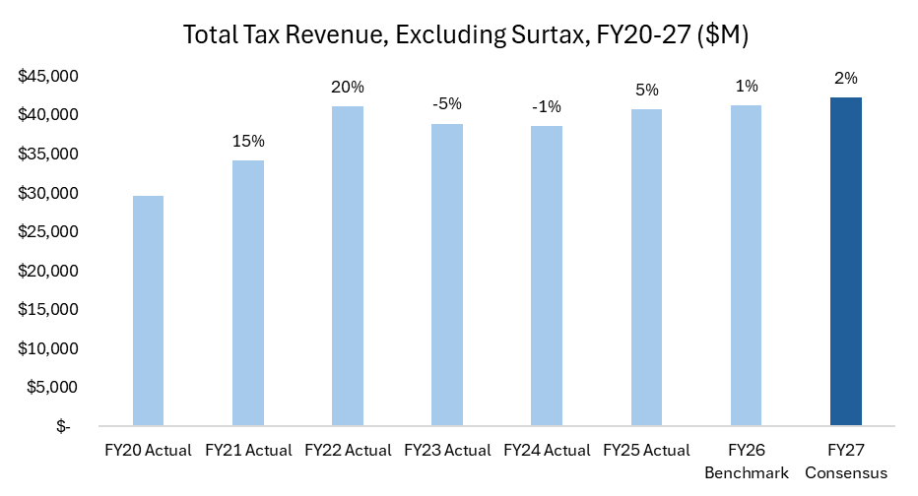
Overall Fiscal Constraints
EOHHS H.2 Budget Overview
Consensus tax revenue estimates for FY27 total 2.4% over FY26 benchmarks, excluding surtax
Major cost drivers such as healthcare, labor, and caseload have been growing at a rate that far exceeds revenue growth, creating significant fiscal constraints for the state in FY26 and FY27
H.2 maintains our core service delivery while acknowledging the long-run structural challenge

Slide 5
Funding and Policy Highlights
EOHHS H.2 Budget Overview
H.2 invests in core programs, prioritizes supports for the state’s most vulnerable individuals, and maintains previous investments in administration priorities despite difficult fiscal conditions.
Workforce
  Maintains Chapter 257 benchmarked to the 53rd percentile of BLS wage data
  Supports the Nursing Council on Workforce Sustainability
  Equity
  Sustains the 10% benefit increases to TAFDC and EAEDC implemented in April 2025
  Supporting Youth and Families
  Fully funds the Maternal Health Law to implement the Universal Home Visiting System and Fetal & Infant Mortality Review Program
  Affordability
  Extends the ConnectorCare expansion pilot through December 2027
  Responding to Federal Pressures
  Invests in administrative infrastructure at MassHealth and DTA due to federal policy changes
  Implements recommended savings from PCA working group and sets additional savings target
  Continue affordability work and start new working groups on Adult Day Health, Adult Foster Care, and Pharmacy
  Maintains the Massachusetts Access to Counsel Initiative for immigration legal services
  Food Security
  Invests in AGE’s Nutrition Services Program to address food insecurity among elderly populations
  Fully funds the DTA Healthy Incentives Program

Slide 6
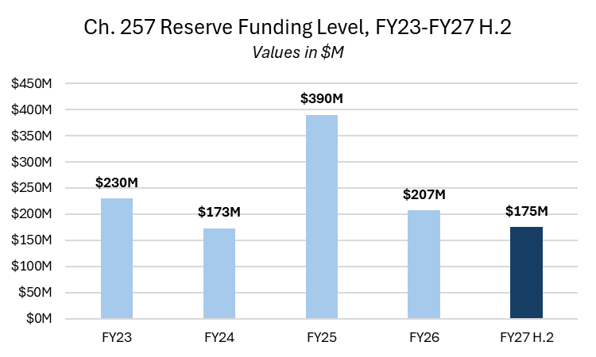
Chapter 257 Reserve Overview​
EOHHS H.2 Budget Overview
The Chapter 257 Reserve is used to support the projected costs of rate increases to human service providers​.
H.2 recommends maintaining Chapter 257 rates benchmarked to the 53rd percentile of Bureau of Labor Statistics (BLS) wage data at an estimated cost of $260M in FY27. Of this, $175M is funded through the Ch. 257 reserve in H.2, with the remaining amount to be covered in a future vehicle through an extension of existing resources into FY27 or filing for additional funds as needed.
The BLS benchmark was increased from the 50th to 53rd percentile beginning in FY24 through FY26. H.2 would maintain the 53rd percentile benchmark.
The past four years have seen historic investments in provider rate growth, with approximately $1B in rate increases supported through the Ch. 257 reserve in the FY23-26 GAAs.

Slide 7
Office of the Secretary
EOHHS H.2 Budget Overview
Agency Mission
The Executive Office of Health and Human Services works with many of Massachusetts’ most vulnerable residents. We support individuals with intellectual and developmental disabilities; older adults; blind, Deaf, and hard of hearing residents; those struggling with substance use disorders, mental illness, or co-occurring illness; refugees and immigrants; system-involved youth; survivors of sexual assault, domestic violence, and human trafficking; and so many more people throughout the Commonwealth.
H.2 funds the Office of the Secretary at $461.3M, a $2.0M (+0%) increase above the FY26 GAA, excluding Chapter 257 and consolidated transportation funding. Highlights of this budget include:
Invests in MassHealth eligibility staff to respond to federal Medicaid policy changes
Maintains funding for the Safe and Successful Youth Initiative and Unaccompanied Homeless Youth Services
Sustains funding for maintenance and development of IT systems that enable Commonwealth residents to access EOHHS agency services and benefits
Supports the continued rollout of the combined Certified Nursing Assistant/Home Health Aide role through new curriculum, online training, and communication
Establishes a new consolidated transportation line item to support MassHealth and agency transportation costs (further detail on next slide)

Slide 8
Human Services Transportation Proposal
EOHHS H.2 Budget Overview
H.2 proposes to consolidate human services transportation funding under a new centralized line item funded through the Office of the Secretary at $450M.
This new line item will support transportation costs at MassHealth, DDS, and DMH.
Note: Because this proposal consolidates existing funding under EHS, the consolidation will appear as a funding reduction for the applicable agencies, notably in the elimination of the DDS Transportation line item in H.2. This proposal consolidates and expands the amount of transportation funding in H.2 available to these agencies.
Agency | Funding
MassHealth | $354M
DDS | $91M
DMH | $5M
Total | $450M

Slide 9
Department of Public Health ​
EOHHS H.2 Budget Overview
Agency Mission
The Department of Public Health (DPH) promotes and protects health and wellness and prevents injury and illness for all people, prioritizing racial equity in health by improving equitable access to quality public health and healthcare services and partnering with communities most impacted by health inequities and structural racism.
H.2 funds DPH at $1.080B, a $69.3M (+7%) increase from the FY26 GAA. Highlights include:
Growth relative to GAA largely driven by a $50M increase to the purchasing ceiling for the HIV Drug Assistance Program (HDAP) to provide medication assistance to Massachusetts residents whose medication costs currently are covered by the Health Safety Net (HSN)
Fully funds the implementation of the Maternal Health Law, including Universal Home Visiting System and Fetal & Infant Mortality Review Program, $4.4M
Increases operating budget grant funding for the Local Boards of Health to support capacity and training initiatives statewide, $5.7M
Amends Section 35 Payor of Last Resort statute at the Bureau of Substance Addiction Services to adjust policies that dictate payment for services to insured individuals
Restores funding for Sexual Assault and Domestic Violence Services at current levels following a funding reduction in FY26 GAA relative to H.1

Slide 10
Department of Transitional Assistance ​
EOHHS H.2 Budget Overview
Agency Mission
Department of Transitional Assistance (DTA) assists and empowers low-income individuals and families to meet their basic needs, improve their quality of life, and achieve long-term economic self-sufficiency. We serve one in six residents of the Commonwealth with direct economic assistance (cash benefits) and food assistance (SNAP benefits), as well as workforce training opportunities.
H.2 funds DTA at $1.178B, a $21.3M (+2%) increase above the FY26 GAA. Highlights of this budget include:
Sustains TAFDC and EAEDC 10% benefit increases implemented in April 2025, $40 monthly rental allowance, and $500 clothing allowance
  Proposes to restore an asset limit for EAEDC at $2,000
Funds the Healthy Incentives Program for the full year maintaining current benefit levels, +$9.6M vs. GAA
Restructures TAFDC’s Earned Income Disregard policy to better preserve clients’ eligibility for SNAP benefits
Supports administrative resources at greater state cost due to federal changes to SNAP administration reimbursement
  Restores Caseworkers Reserve funding following -$42M cut in FY26 GAA relative to H.1

Slide 11
Department of Developmental Services​
EOHHS H.2 Budget Overview
Agency Mission
The Department of Developmental Services (DDS) provides supports for individuals with intellectual and developmental disabilities including Autism Spectrum Disorder to enhance opportunities to become fully engaged members of their community.
H.2 funds DDS at $3.354B, a $91.4M (+3%) increase above the FY26 GAA. Highlights of this budget include:
Fully annualizes funding for the FY25 and FY26 Turning 22 classes and adds new investment to support the incoming class, estimated to be 1,475 individuals
Increased investment for Autism services by 32% to support rapid caseload growth
Additional funding for individuals with changing support needs as they and their caregivers age
Maintains staffing investments in state-operated group homes and facilities to end reliance on temporary direct care and nursing workforce
Expands DDS transportation funding alongside consolidation of transportation funds to a centralized line item at EOHHS
Sustains FY26 collective bargaining commitments and Chapter 257 provider rate increases, reinforcing workforce stability across the system

Slide 12
Executive Office of Aging and Independence
EOHHS H.2 Budget Overview
Agency Mission
The Executive Office of Aging & Independence (AGE), formerly the Executive Office of Elder Affairs (EOEA), envisions a state in which every person has the tools, resources, and support they need to fully embrace the aging experience. Together, we support aging adults to live and thrive safely and independently – how and where they want.
H.2 funds Aging & Independence at $1.056B, a $91.9M (+10%) increase above the FY26 GAA. Highlights of this budget include:
Supports projected demand growth for Home Care and Community Choices program and annualization of FY26 rate increase to providers
  FY24-26 have seen historically high rates of caseload growth for AGE programs
  H.2 maintains restrictions currently in place on new Home Care Basic and ECOP enrollment
Maintains Council on Aging formula grant at $16 per elder
Expands nutrition services through home delivered and group meals, $750K
Recommends savings through reducing Congregate Housing sites and eliminating policy allowing vendors to bill for short term vacancies

Slide 13
Department of Children and Families ​
EOHHS H.2 Budget Overview
Agency Mission
The Department of Children and Families (DCF) strives to protect children from abuse and neglect and, in partnership with families and communities, ensures children are able to grow and thrive in a safe and nurturing environment.
H.2 funds DCF at $1.469B, a $10.0M (-1%) decrease below the FY26 GAA. Highlights of this budget include:
Proposes a 2.92% increase for supports to DCF foster parents, raising the average daily reimbursement rate to $38.83
Proposes a 3% rate increase for 766 Residential Schools, $3M
Maintains all 33 current Family Resource Centers
Funds 8 new Emergency Residence/Intensive Emergency Residence (ER/IER) bed expansions
Maintains prior year increases in collective bargaining payroll increases and Ch. 257 provider rate growth
Overall funding decrease relative to FY26 GAA driven largely by historically low caseloads
  Total DCF caseload has dropped -45% from May 2016-November 2025.

Slide 14
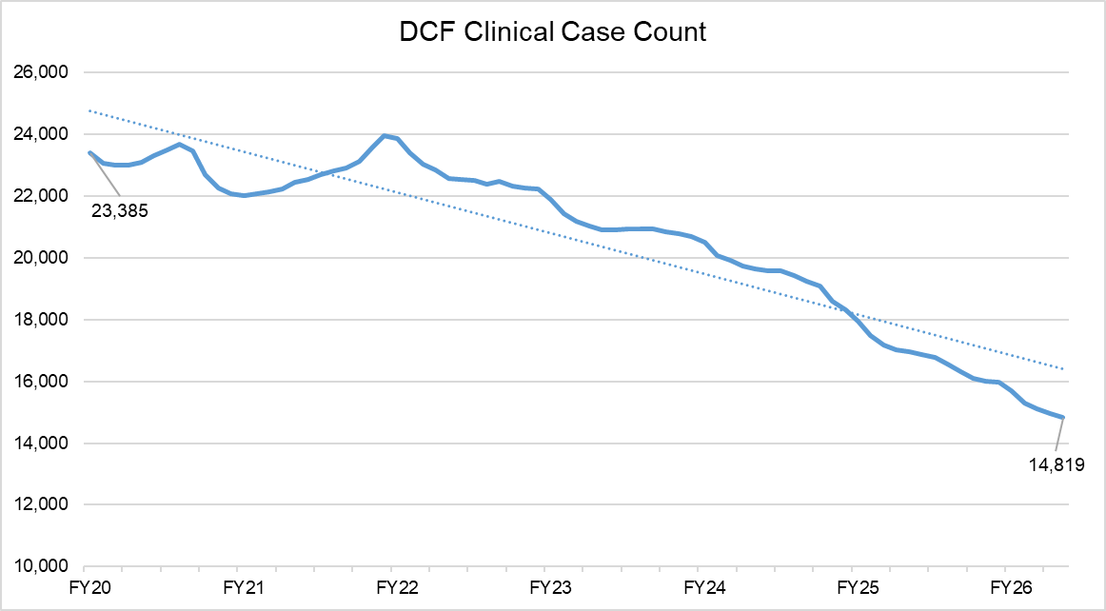
Department of Children and Families - Caseload Highlights​
EOHHS H.2 Budget Overview
Since FY20, DCF caseload has declined by over 8,500 cases, representing a 37% overall decrease over 77 months.

Slide 15
Department of Mental Health ​
EOHHS H.2 Budget Overview
Agency Mission
The Department of Mental Health (DMH), as the State Mental Health Authority, assures and provides access to services and supports to meet the mental health needs of individuals of all ages; enabling them to live, work and participate in their communities.
H.2 funds DMH at $1.316B, a $4.1M (+0%) increase above the FY26 GAA. Highlights of this budget include:
Maintains funding for case managers at current staffing levels
Maintains funding for intensive clinical services (ClRT, IRTP, Therapeutic Group Care). Aligns some Child, Youth and Service funding with current utilization trends (Flex, Therapeutic Day Services, and Intensive Home-Based Therapeutic Care)
Transitions transportation costs to a centralized line item funded through the Office of the Secretary
Supports Jail Diversion grant funding at $4M, consistent with FY26 H.1 budget proposal
Proposes to transition DMH clients from MassHealth's Community Partners Program supports to other MassHealth care management programs and DMH Case Management Services
Introduces an adjusted payment model for Adult Community Clinical Services providers with higher-than-average clinical staff vacancy rates

Slide 16
MassAbility
EOHHS H.2 Budget Overview
Agency Mission
MassAbility (formerly Massachusetts Rehabilitation Commission, MRC) works to break down barriers and make a better state possible for people with disabilities — one that is truly equitable, accessible, and inclusive.
H.2 funds MassAbility at $93.3M, a $1.3M (-1%) decrease below the FY26 GAA. Highlights of this budget include:
MassAbility receives significant federal grant funding that is outside the scope of the operating budget. H.2 recommends an investment of $775K to temporarily support an anticipated shortfall in federal funding
Maintains FY26 collective bargaining and Chapter 257 provider rate increases
Creates targeted savings through FTE attrition, reduction in administrative costs, and Home Care program adjustments

Slide 17
Department of Youth Services​
EOHHS H.2 Budget Overview
Agency Mission
As the Juvenile Justice agency for the Commonwealth of Massachusetts, the Department of Youth Services (DYS) promotes positive change in the youth in our care and custody.
H.2 funds DYS at $183.1M, a $5.5M (+3%) increase above the FY26 GAA. Highlights of this budget include:
Maintains FY26 collective bargaining and Chapter 257 provider rate increases
Invests in Girls’ residential bed capacity, $1.7M
Includes targeted savings through planned consolidation of Boys’ residential program capacity and community operations, including District Offices, consistent with caseload trends

Slide 18
Office for Refugees and Immigrants​
EOHHS H.2 Budget Overview
Agency Mission
The Office for Refugees and Immigrants (ORI) welcomes and empowers all immigrants in Massachusetts to access resources and supports.
H.2 funds ORI at $7.3M, a $0.3M (-4%) decrease below the FY26 GAA. Excluding earmarks, ORI is level funded to the FY26 GAA. Highlights of this budget include:
Annualizes the Massachusetts Access to Counsel Initiative started in FY26 to provide legal representation to eligible, income-qualified immigrants, $5M
Reduction relative to GAA due to backing out one-time earmark funds

Slide 19
Massachusetts Commission for the Blind​
EOHHS H.2 Budget Overview
Agency Mission
The Massachusetts Commission for the Blind (MCB) provides individualized training, education, and empowerment to people who are blind and visually impaired, and advocate for inclusive policies across the Commonwealth, with the goal of life-long independence and full community participation.
H.2 funds MCB at $30.8M, a -$2.2M (-7%) decrease below the FY26 GAA. Highlights of this budget:
Maintains FY26 collective bargaining and Chapter 257 provider rate increases
Reduction relative to GAA largely due to backing out one-time funds for earmarks and legislative expansions

Slide 20
Massachusetts Commission for the Deaf and Hard of Hearing​
EOHHS H.2 Budget Overview
Agency Mission
The Massachusetts Commission for the Deaf and Hard of Hearing (MCDHH) is the principal agency in the Commonwealth which is tasked with raising awareness of the issues of Deaf and hard of hearing people of all ages and backgrounds. MCDHH provides accessible communication, education, and advocacy to consumers and private and public entities so that programs, services, and opportunities are fully accessible to persons who are Deaf and hard of hearing.
H.2 funds MCDHH at $11.3M, a $660K (+6%) increase above the FY26 GAA. Highlights of this budget include:
Fully funds prior year investments including the Sign Language Interpreter Mentorship Program and After-Hour Emergency Services
Maintains FY26 collective bargaining and Chapter 257 provider rate increases
Maintains supports for internal and client facing communication needs to preserve access to services

Slide 21
Health Connector
EOHHS H.2 Budget Overview
Mission
The Health Connector advances access to high-quality health insurance by serving as a transparent and transformative Marketplace for Massachusetts residents and small businesses to come together and easily find, compare, and enroll in affordable health coverage.
Responding to Federal Pressures
In response to the loss of federal enhanced premium tax credits, the Healey-Driscoll Administration is increasing the state investment in the ConnectorCare program by an estimated $250 million through the Commonwealth Care Trust Fund to limit premium increases for members.
Connector Eligibility Expansion Pilot
H.2 additionally extends the eligibility expansion pilot through the end of calendar year 2027. The expansion is currently scheduled to end in December 2026. Due to the availability of federal reimbursement, this extension will have no net impact to state balance. The pilot extends subsides to individuals up to 500% of FPL, however, due to federal policy changes, members between 400-500% of FPL are no longer eligible for subsidized coverage.

Slide 22
MassHealth
EOHHS H.2 Budget Overview
Agency Mission
To improve the health outcomes of our diverse members and their families by providing access to integrated, high-quality, and member-centric health care services that sustainably promote equitable health, well-being, and independence​
Behavioral Health and Primary Care
Provide access to high-quality, member-centric care in the community
Member Experience
Offer a high-quality member experience, especially streamlined eligibility & enrollment
Health Equity
Address health inequities and health-related social needs, including standing up a first-in-the nation health equity incentive program​
Member Independence
Promote independence and choice of care setting, including diversion and discharge from nursing homes

Slide 23
MassHealth
EOHHS H.2 Budget Overview
Context
Rising health care costs continue to place pressures on states
Like the commercial sector, MassHealth spending is growing at an unsustainable rate – driven by:
  Prescription drug spending increased by 18%; GLP-1 drugs accounted for under half of the growth in drug spending
  Outpatient behavioral health spending increased by 18%; notable driver was Applied Behavior Analysis, which has grown 25 percent year-over-year over two years
  Long-term services and supports spending increased by 13%. Home and community-based services (HCBS) accounted for 81 percent of the LTSS spending increase with institutional services accounting for the remaining 19 percent
H.2 Details
MassHealth’s FY27 H.2 budget is filed at $22.701 B in total spending, at a net cost of $9.299 B, a 7% increase above FY26 GAA – without measured, initial steps to put MassHealth on more sustainable footing, growth would be in the double-digits
To bring FY27 spending down to proposed levels, the administration will:
  Continue to aggressively expand program integrity initiatives
  Institute a moratorium on all provider rate increases or program expansions not required by federal law
  Implement one-time measures that bridge to FY28, allowing time for policy development and stakeholder engagement over the next 18 months
  Make targeted optional benefit reductions that bring MassHealth in line with peer states and commercial payors

Slide 24
MassHealth
EOHHS H.2 Budget Overview
Optional benefit reductions
  Removing coverage for weight-loss GLP1s. This mirrors actions taken by California, Pennsylvania, and several other states.
  Capping adult dental spending at $1,000 per member per year. Several states, such as Connecticut and Vermont, cap adult dental. There will continue to be no cap on pediatric dental benefits nor on adult members who are served by Department of Developmental Services.
  Reducing funding for care management and eliminating the requirement that ACOs contract with Community Partner organizations. By aligning care management enrollment levels with peer states (approximately 8 percent of members per year, versus nearly 16 percent in Massachusetts today), ACOs will tailor these high-value programs to the greatest clinical need.
MassHealth will partner with stakeholders in developing new approaches to providing coverage to MassHealth members at a sustainable rate of spending growth:
  Build on and continue the personal care attendant (PCA) workgroup to identify additional savings. The FY27 budget assumes that MassHealth fully implements consensus recommendations made by the working group to date and that the group identifies an additional $68 million in total savings, or $34 million in net.
  Convene a new Adult Day Health (ADH) workgroup and Adult Foster Care (AFC) workgroup. These groups will be asked to identify solutions to reduce annual ADH spending by $30 million gross/$15 million net in total savings and annual AFC spending by $70 million gross/$35 million net in total savings.
  Convene a workgroup to discuss carving out pharmacy benefits from health plan management, which would simplify operations and generate savings

Slide 25
We look forward to working with you and the Legislature
EOHHS H.2 Budget Overview
Thank you for your attention and commitment to help us better serve people across the Commonwealth in a fiscally prudent manner.
These slides are available online at mass.gov/eohhs.
We will now address questions.

