Slide 1

EPA Brownfields Program
Jim Byrne
EPA Region 1
September 9, 2025

Slide 2
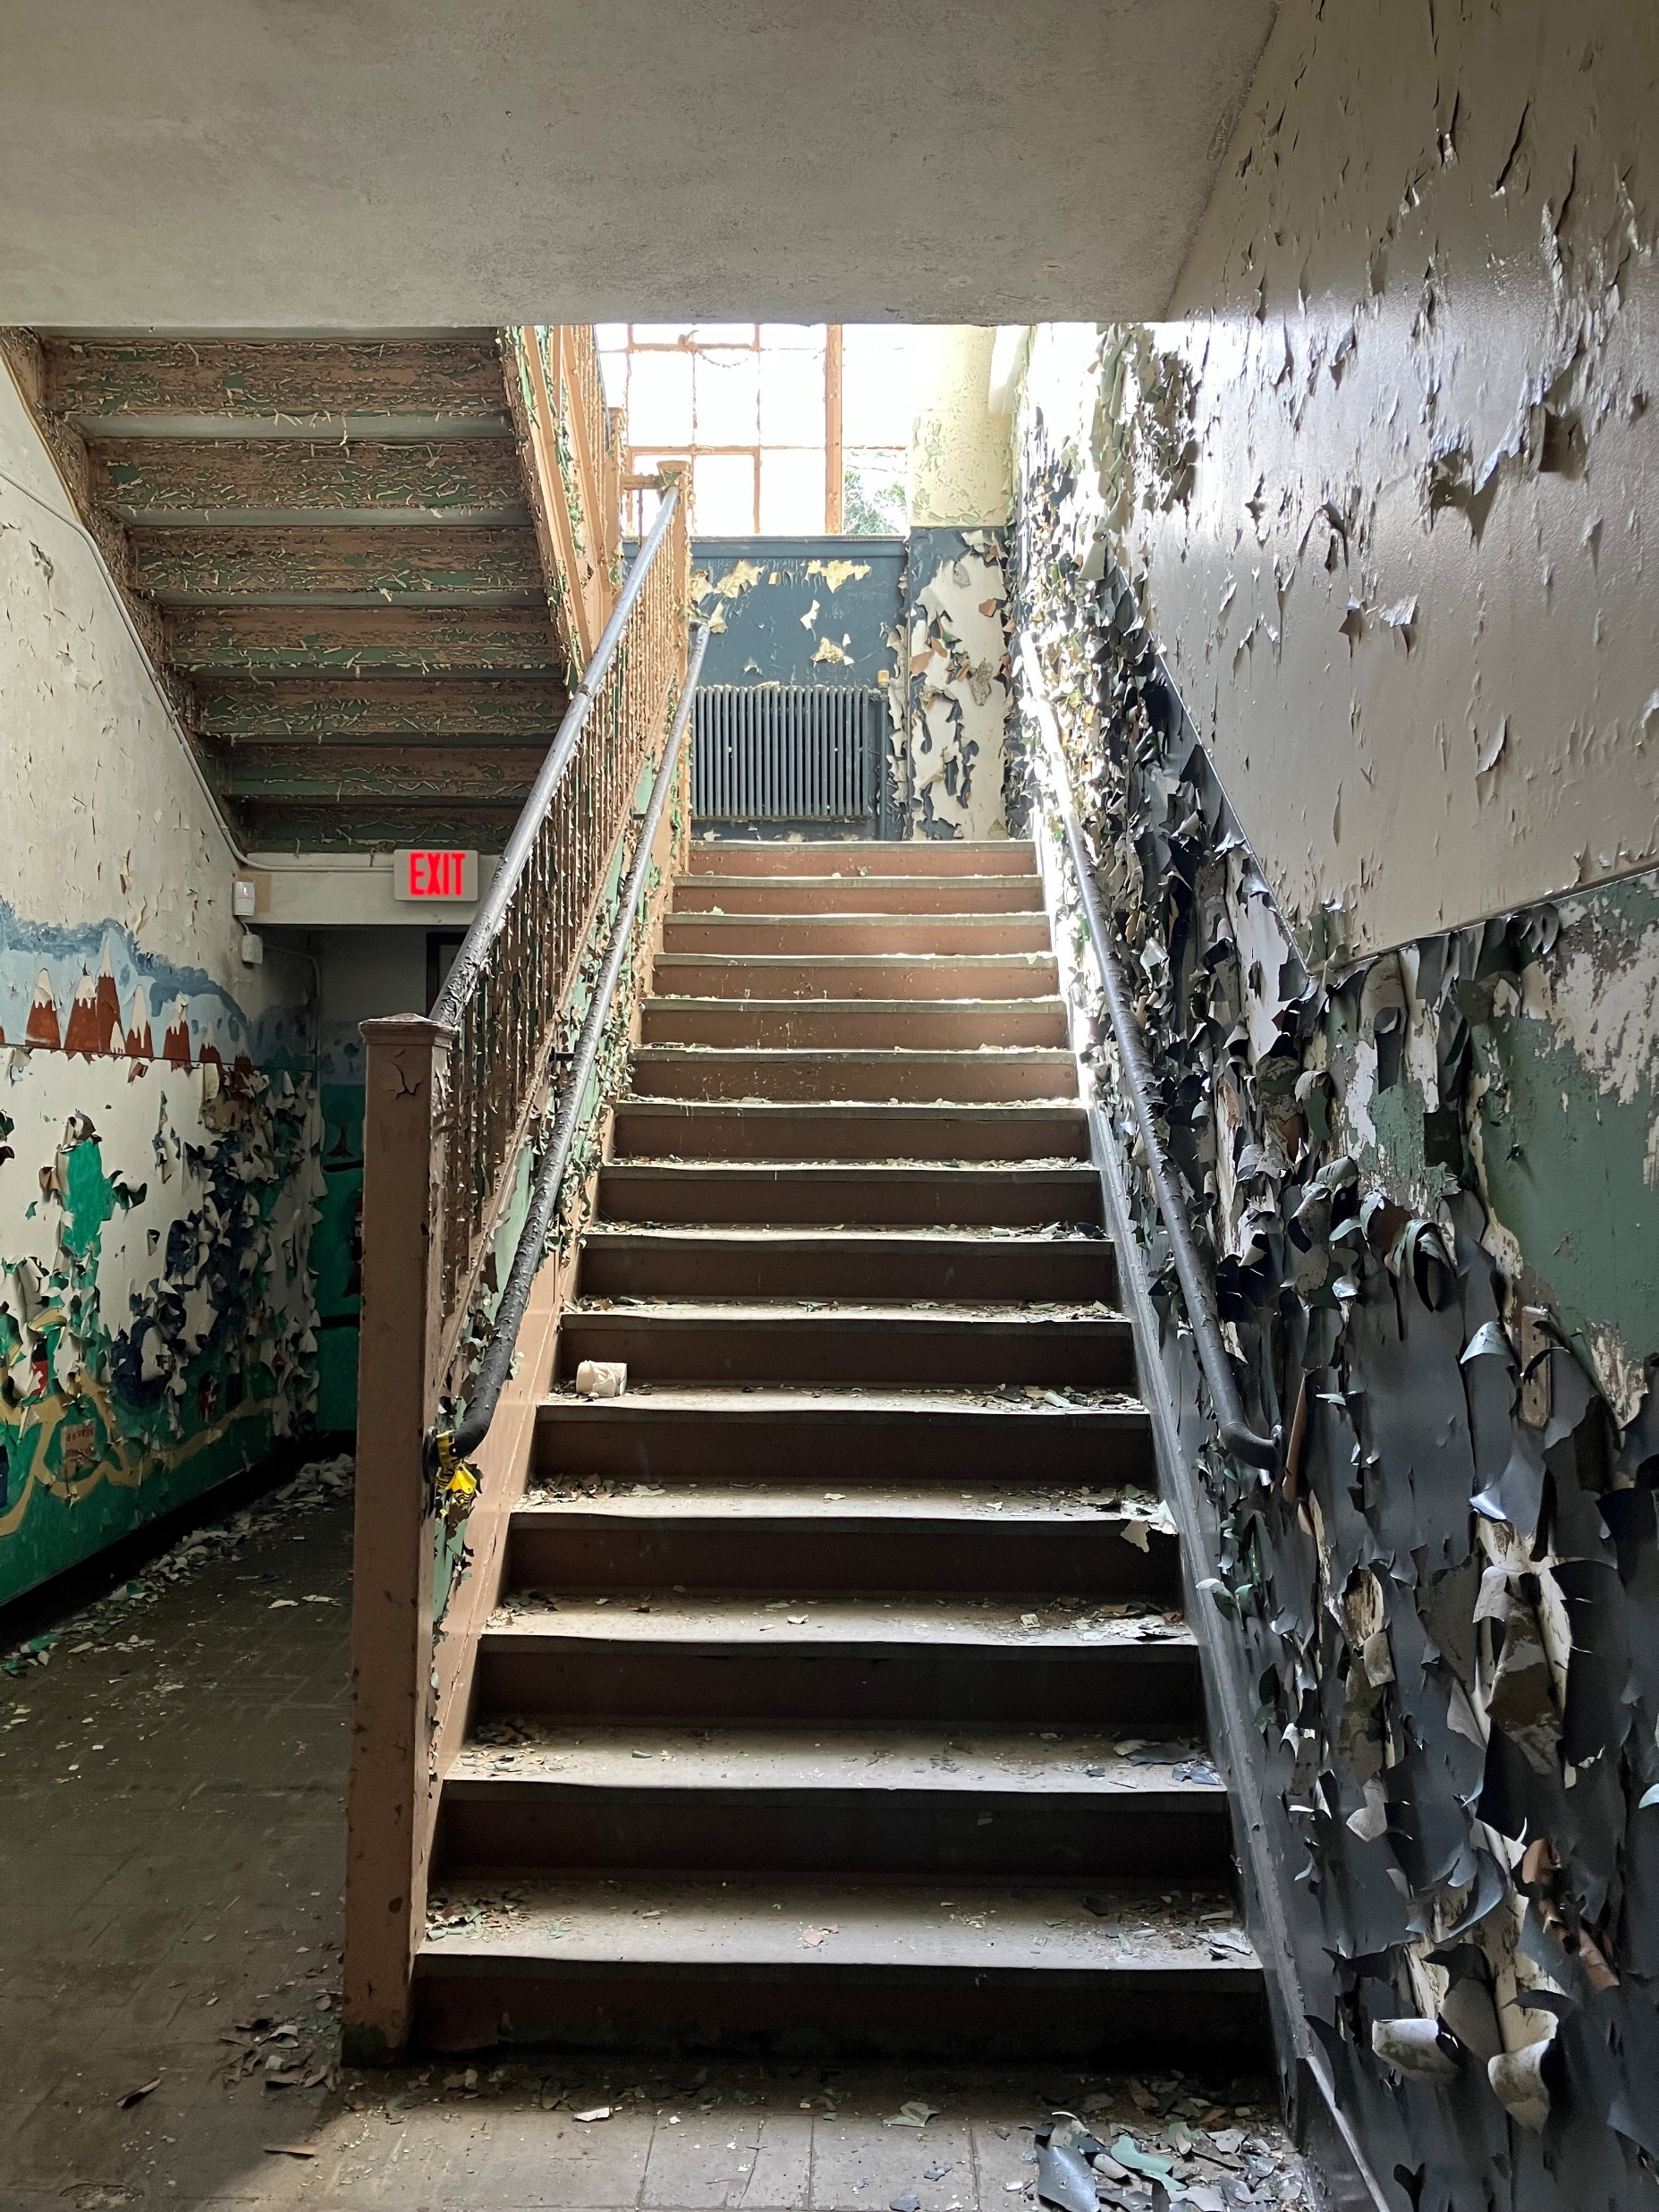
Brownfields 101
Witt School – Stafford, CT
What is a Brownfield?
  A property might be a “brownfield” due to potential contamination from past uses that is inhibiting continued use or reuse of the site. Brownfields are often concentrated in historically underserved communities.
Brownfield sites might include:
  Former gas stations
  Former industrial sites
  Former dry cleaners
  Old buildings
  Vacant lots
  Historic mills or factories
https://www.epa.gov/brownfields/understanding-brownfields

Slide 3
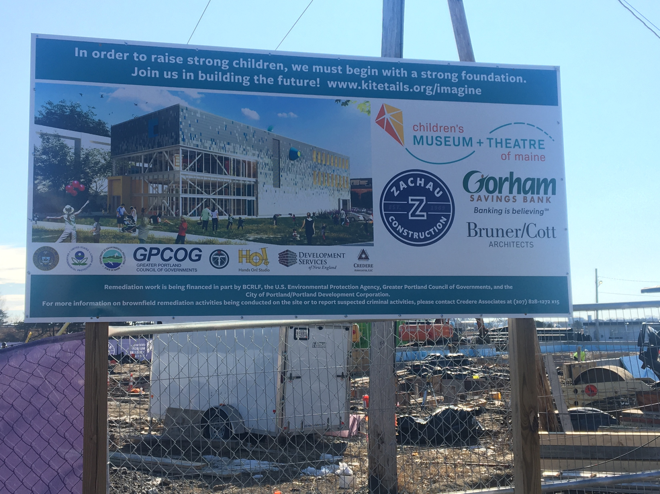

WHAT A BROWNFIELD CAN BECOME
With help from federal and/or state programs, Brownfields can be safely cleaned-up and repurposed into various economic and non-economic uses.
EPA supports sustainable development and economic growth through the identification, cleanup and reuse of these properties.
Grants can provide direct funding to eligible applicants to assess, cleanup and plan for the reuse of brownfield sites.
Technical Assistance can help further assess a site, develop area-wide brownfield strategies, or plan for site reuse.
https://www.epa.gov/brownfields/understanding-brownfields

Slide 4

Eligible entities for EPA grants
General Purpose Unit of Local Government
Land Clearance Authority
Government Entity Created by State Legislature
Regional Council or group of General-Purpose Units of Local Government
Redevelopment Agency that is chartered or otherwise sanctioned
by a state
State
Federally recognized Indian tribe other than in Alaska
Nonprofit organization described in section 501(c)(3) of the
Internal Revenue Code
Qualified community development entity as defined in section 45D(c)(1) of the Internal Revenue Code of 1986

Slide 5

Summary of EPA Grant Types
Assessment
$500k - $2M
RLF (Initial)
$1M
Cleanup
$500k - $4M
Job Training
$500k
Multipurpose
$1M

Slide 6
Summary of Grant Programs For Assessment and Cleanup
Grant Type​ | ​Description​
Assessment​ (CW/Coalition) | To develop inventory, characterize, and conduct assessments to determine if sites are contaminated (if so, to what extent), perform community involvement, and plan for cleanup​
​Cleanup​ | For eligible municipalities and nonprofits to clean up contaminated properties ​
​Revolving Loan Fund​ | For larger organizations to capitalize funds for issuing cleanup loans and subgrants​
​Multipurpose​ | For a flexible range of planning, assessment, and cleanup activities within a certain target area​
Grant Guidelines and Resources:
https://www.epa.gov/brownfields/marc-grant-application-resources

Slide 7

Job training grants
Competitive grants that recruit, train, and place unemployed/under-employed residents of communities affected by brownfields and other issues in jobs within the environmental field.
Training topics can include:​
  Waste Site Cleanup​
  Health & Safety​
  Heavy Equip. Operator/CDL​
  Wastewater Treatment​
  Asbestos Abatement​
  Lead Paint/RRP​
  Stormwater/infrastructure management
https://www.epa.gov/brownfields/brownfields-job-training-grants

Slide 8
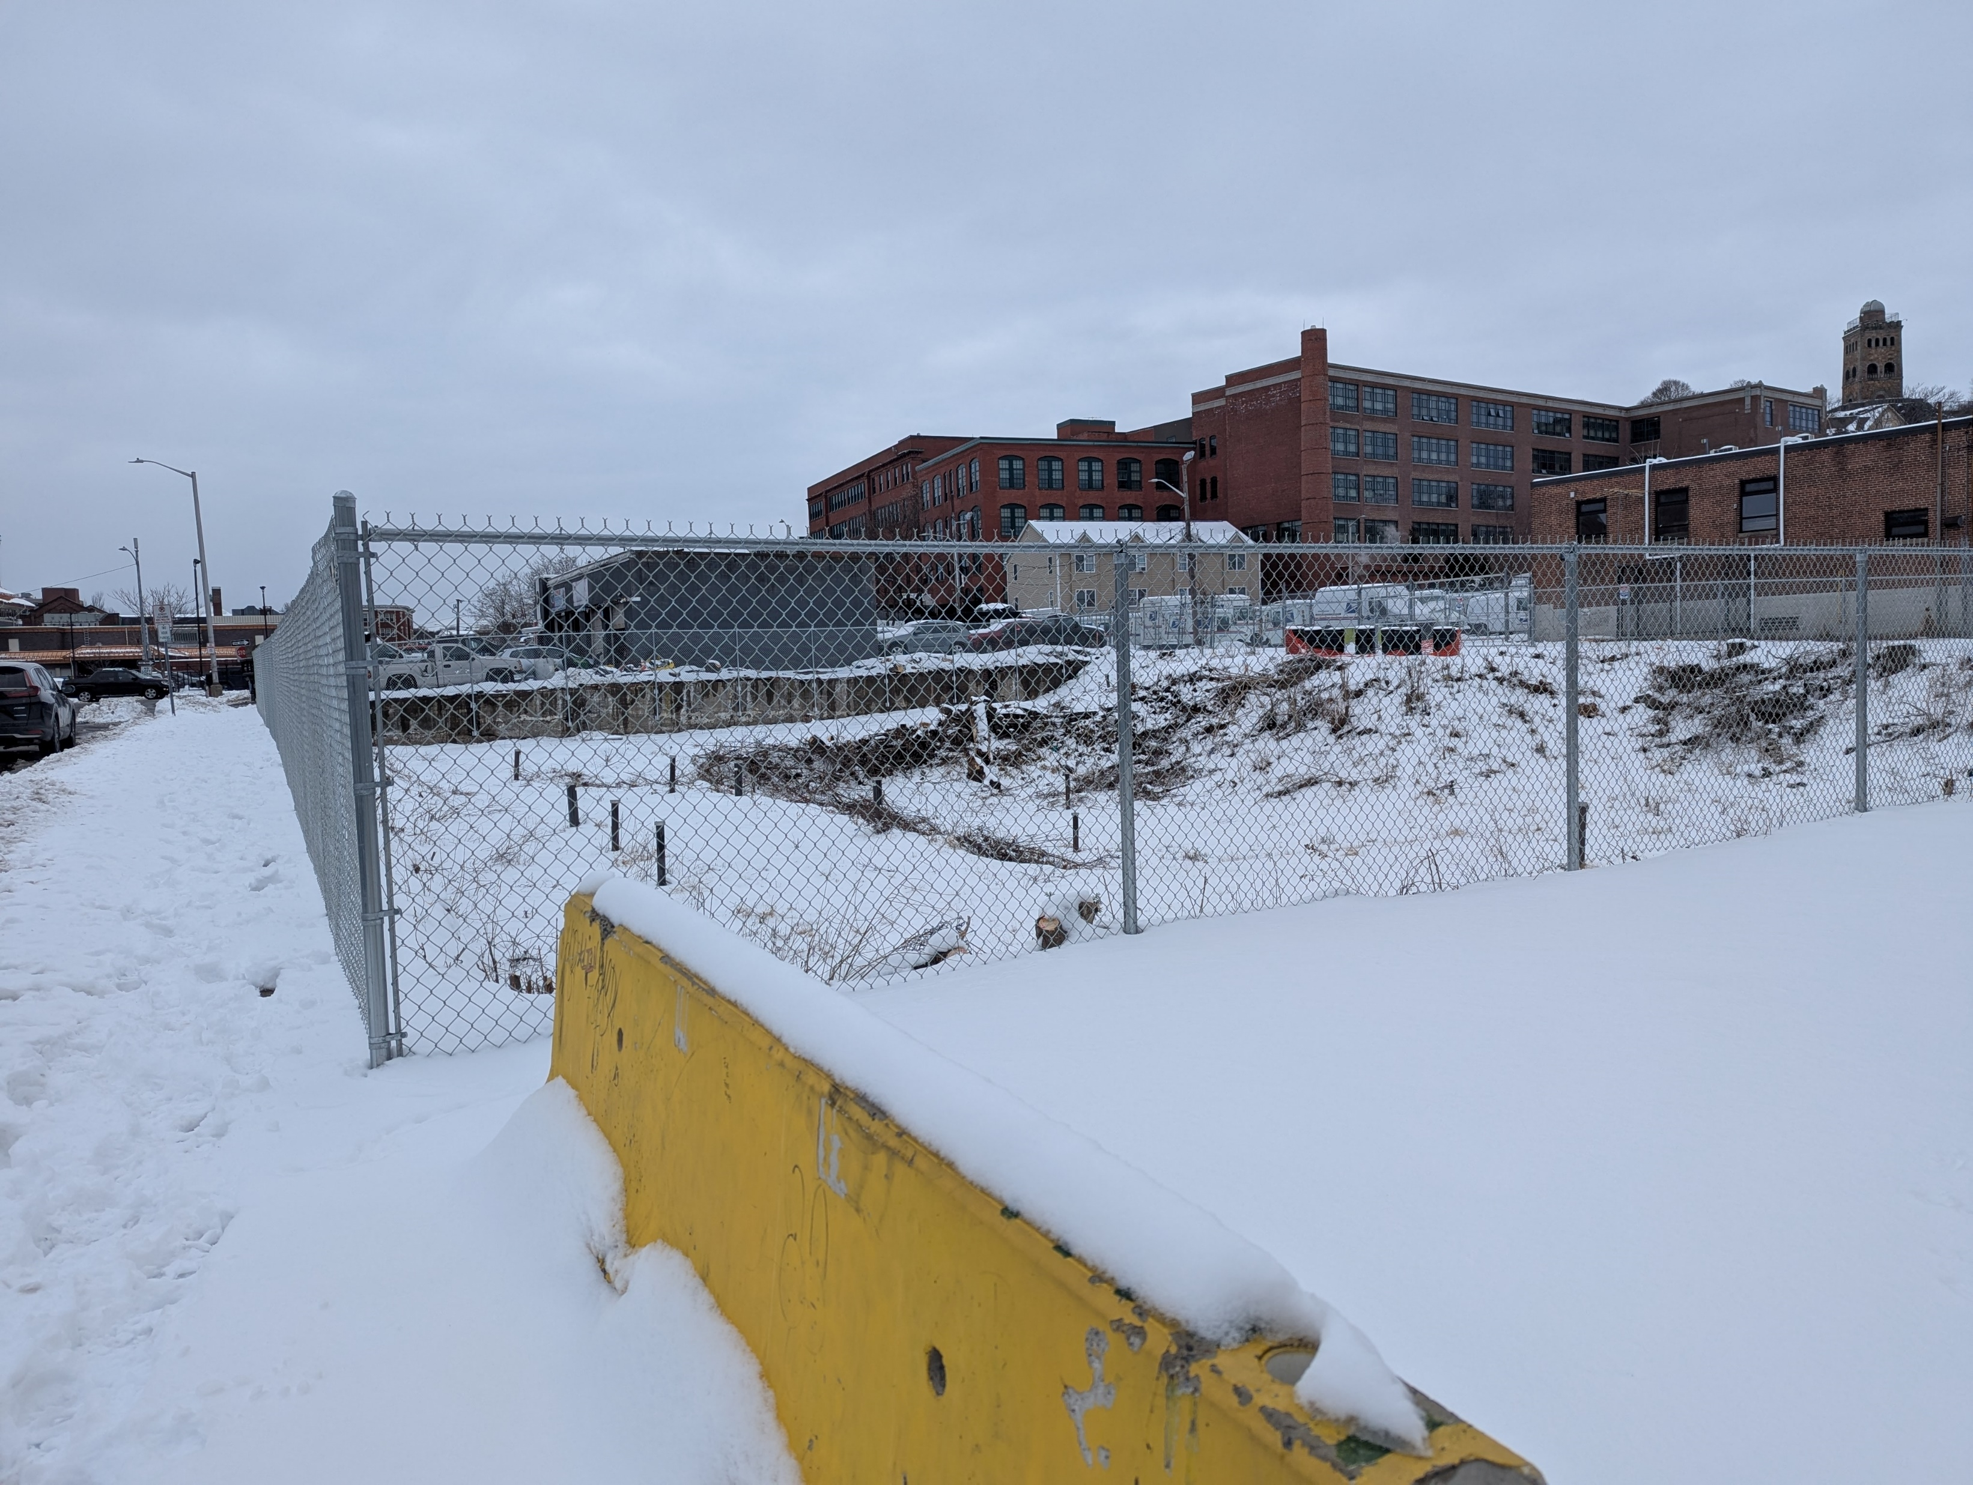
State and tribal funding
Under CERCLA 128(a), EPA provides non-competitive grants annually to states and tribes to operate and manage a Brownfields Program.
This funding allows them to conduct the following brownfields activities:
  Inventory of sites on state or tribal land
  Oversee brownfields resources and enforce state/tribal authority
  Provide opportunities for local stakeholders’ meaningful participation in brownfields decisions
  Approve site cleanup plans, and verify/certify that cleanup goals are completed
Whyte’s Laundry -- Lynn, MA

Slide 9
Technical assistance programs
In addition to the assessment and cleanup grants of the Brownfields and Land Revitalization Program, there are various free resources available to help inform assessment, cleanup, and reuse decisions. ​
These technical assistance programs can help further the success of a brownfield investment, particularly considering things such as market analyses, sustainable development, and extreme weather resiliency. This can help bring both project success and broad, long-lasting benefits to a community.​
Targeted Brownfields Assessment (TBA) Program
Land Revitalization TA Program
Technical Assistance to Brownfields (TAB) Programs
https://www.epa.gov/brownfields/technical-assistance

Slide 10
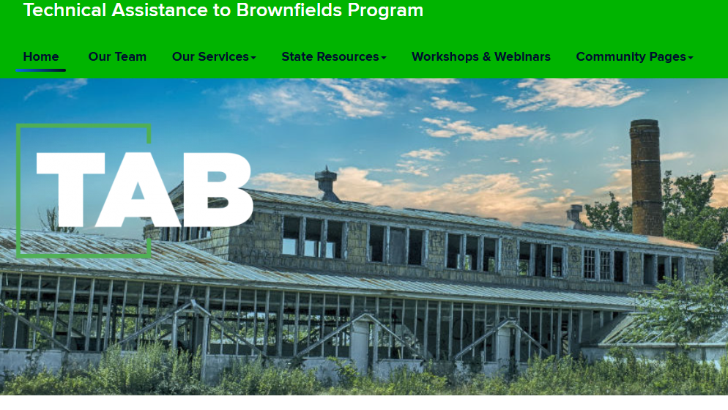
Technical assistance to brownfields (tab) programs
Region 1: University of Connecticut (UConn) TAB
National TABs:
Kansas State University – TA for Tribal Nations
Center for Community Progress – Land Banking TA
Groundwork USA – Brownfields and Land Use TA
UMass Dartmouth – BRADS Program
Tetra Tech – Job Training TA
Grow America/ICMA – Brownfields RLF TA

Slide 11
Region 1 Brownfields by the numbers
FY06-FY25
$724,847,095 in New England funding ​since the Brownfields Program inception
3,791 sites assessed
1,055 sites cleaned up/made ready for re-use (totaling over 10,044 acres)
Over 24,500 jobs leveraged
Over $4.5B leveraged from cleanup, construction, and redevelopment of brownfields (almost 8:1 multiplier effect)
Source: Grantee-reported Data as of April 9, 2025

Slide 12

Anticipated FY26 Brownfields program schedule
FY25 Assessment, Revolving Loan Fund, and Cleanup (ARC) projects start October 2025
FY26 Multipurpose, Assessment, and Cleanup Competition Guidelines Anticipated to be Released September 2025 ​
    Applications Anticipated to be Due November 2025 ​
    National Review Period and Panel Discussions​ January-March 2026
    Awards Announced in the Spring ​2026

Slide 13
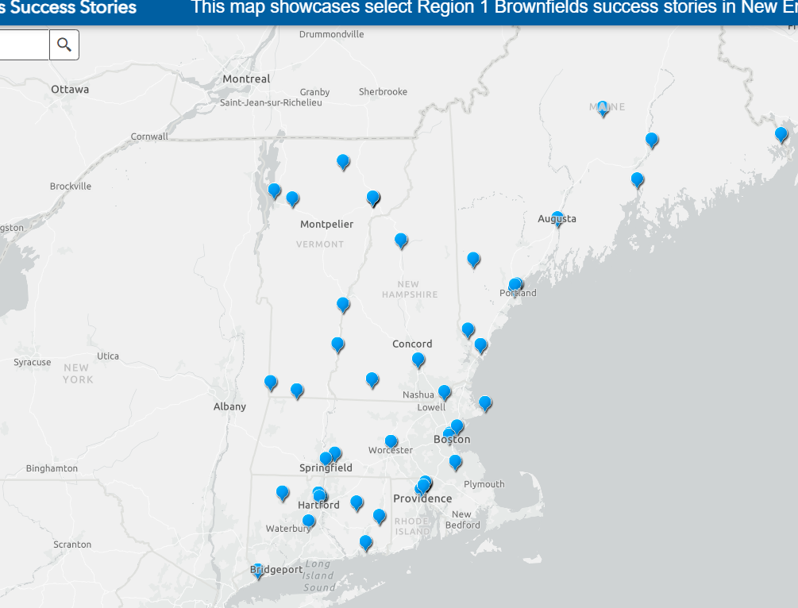
Links/Resources
R1 Brownfields Web Site
Success Stories - Story Map
Team Contact List
Funding History
Region 1 Brownfields Success Story Mapping Tool

Slide 14
Contact information
Jim Byrne
Byrne.James@epa.gov

