Slide 1
EPIA – June 2021 All Ages
Number of Referrals in Period: 451

Slide 2
Expedited Psychiatric Inpatient Admission Dashboard | Jun-21 |  |  |  |  | May-21 |  |  | Jun-20 |  |  |  | Variance (Jun 20 vs. Jun 21) |  | Percent Change (Jun 20 vs. Jun 21)
 | Referrals |  | Time to Placement (Days) |  |  | Referrals |  | ATP³ | Referrals |  | Time to Placement |  | Referrals | ATP³ | Referrals | ATP³
 |  |  | Average | Median | Max |  |  |  |  |  | Average | Max
SUMMARY | 451 |  | 2.78 | 1.00 | 27 | 541 |  | 3.59 | 325 |  | 1.74 | 15 | 126 | 1.04 | 39% | 60%
Age Groups
0-12 | 51 | 11% | 5.96 | 3.00 | 20 | 74 | 14% | 6.24 | 26 | 8% | 2.15 | 9 | 25 | 3.81 | 96% | 177%
13-17 | 122 | 27% | 3.49 | 2.00 | 27 | 190 | 35% | 4.71 | 41 | 13% | 3.07 | 15 | 81 | 0.42 | 198% | 14%
Subtotal: 0-17 | 173 | 38% | 4.22 | 2.00 | 27 | 264 | 49% | 5.14 | 67 | 21% | 2.61 | 15 | 106 | 1.61 | 158% | 62%
18-22 | 26 | 6% | 2.50 | 2.00 | 10 | 27 | 5% | 1.89 | 15 | 5% | 1.60 | 6 | 11 | 0.90 | 73% | 56%
23-64 | 213 | 47% | 1.80 | 1.00 | 14 | 224 | 41% | 2.06 | 190 | 58% | 1.34 | 9 | 23 | 0.46 | 12% | 34%
65+ | 39 | 9% | 1.92 | 1.00 | 8 | 26 | 5% | 2.81 | 53 | 16% | 2.02 | 11 | -14 | -0.10 | -26% | -5%
Insurance Coverage
Commercial | 47 | 10% | 2.98 | 2.00 | 11 | 85 | 16% | 4.93 | 35 | 11% | 2.00 | 11 | 12.00 | 0.98 | 34% | 49%
Health Safety Net | 4 | 1% | 1.25 | 2.00 | 1 | 3 | 1% | 1.33 | 9 | 3% | 2.22 | 4 | -5.00 | -0.97 | -56% | -44%
MassHealth ACO/MCO⁴ | 284 | 63% | 3.03 | 1.00 | 27 | 345 | 64% | 3.71 | 119 | 37% | 1.83 | 15 | 165.00 | 1.20 | 139% | 66%
MassHealth Fee-for-Service | 3 | 1% | 1.33 | 1.00 | 2 | 2 | 0% | 4.00 | 3 | 1% | 2.00 | 3 | 0.00 | -0.67 | 0% | -34%
MassHealth (Unspecified) | 9 | 2% | 3.22 | 1.00 | 15 | 6 | 1% | 3.00 | 9 | 3% | 1.33 | 3 | 0.00 | 1.89 | 0% | 142%
Medicare Only | 15 | 3% | 2.07 | 1.00 | 8 | 19 | 4% | 2.74 | 16 | 5% | 1.62 | 6 | -1.00 | 0.45 | -6% | 28%
Medicaid only - Out of State | 4 | 1% | 2.50 | 1.00 | 4 | 4 | 1% | 1.75 | 5 | 2% | 3.50 | 9 | -1.00 | -1.00 | -20% | -29%
Medicaid-Medicare | 76 | 17% | 2.00 | 1.00 | 14 | 63 | 12% | 1.89 | 89 | 27% | 1.53 | 7 | -13.00 | 0.47 | -15% | 31%
Uninsured | 9 | 2% | 2.44 | 2.00 | 5 | 14 | 3% | 2.50 | 39 | 12% | 1.49 | 17 | -30.00 | 0.95 | -77% | 64%
DCF | 54 |  | 4.87 | 3.00 | 27 | 88 |  | 5.07 | 25 |  | 3.76 | 15 | 29 | 1.11 | 116% | 30%
DDS | 4 |  | 3.00 | 2.00 | 8 | 7 |  | 4.86 | 6 |  | 1.50 | 3 | -2 | 1.50 | -33% | 100%
DMH | 51 |  | 2.67 | 1.00 | 14 | 67 |  | 3 | 43 |  | 2.04 | 15 | 8 | 0.63 | 19% | 31%
DYS | 1 |  | 7.00 | 7.00 | 7 | 1 |  | 0 | 0 |  | 0.00 | 0 | 1 | 7.00 | #DIV/0! | #DIV/0!

Slide 3
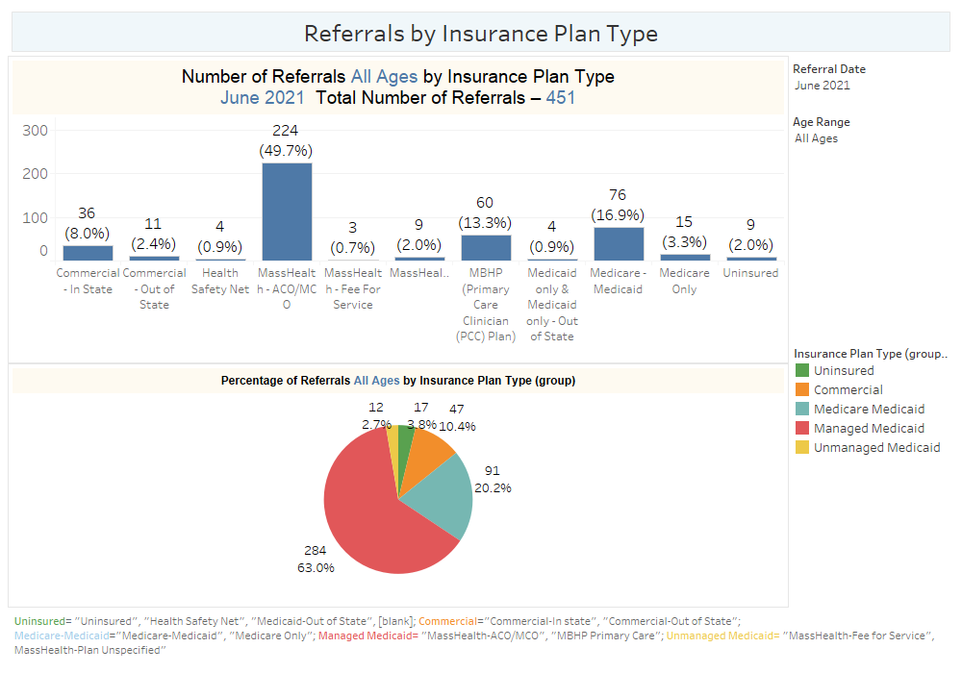

Slide 4
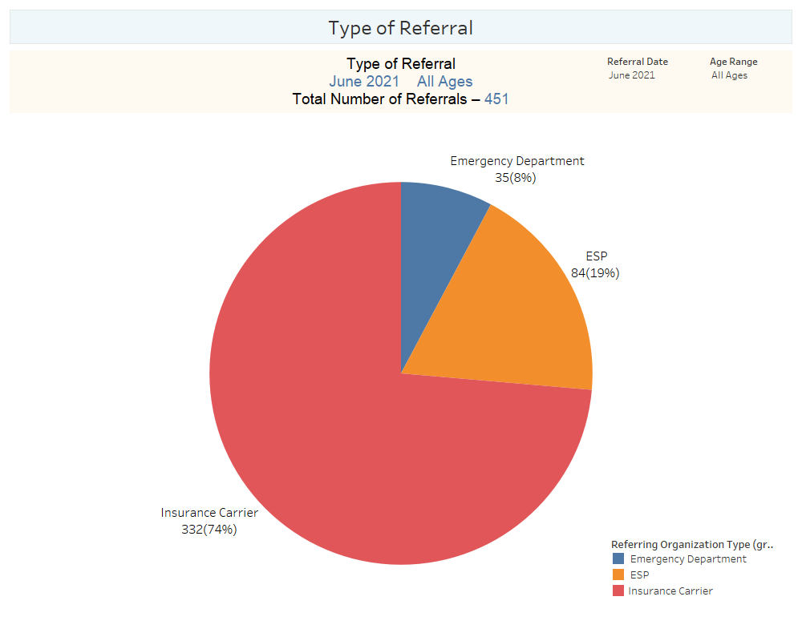

Slide 5
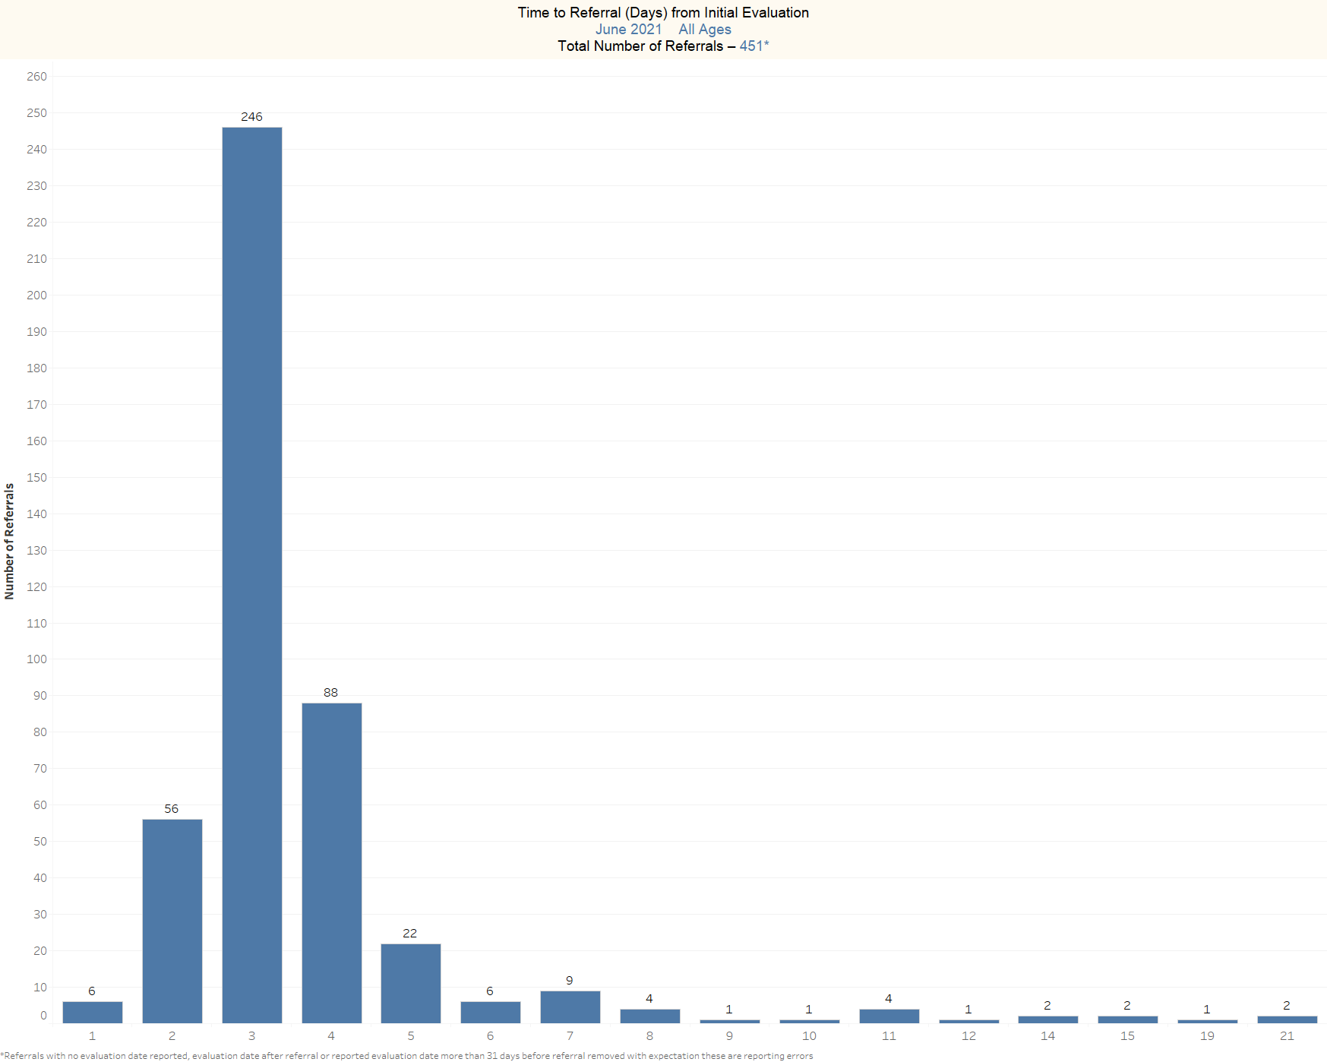

Slide 6
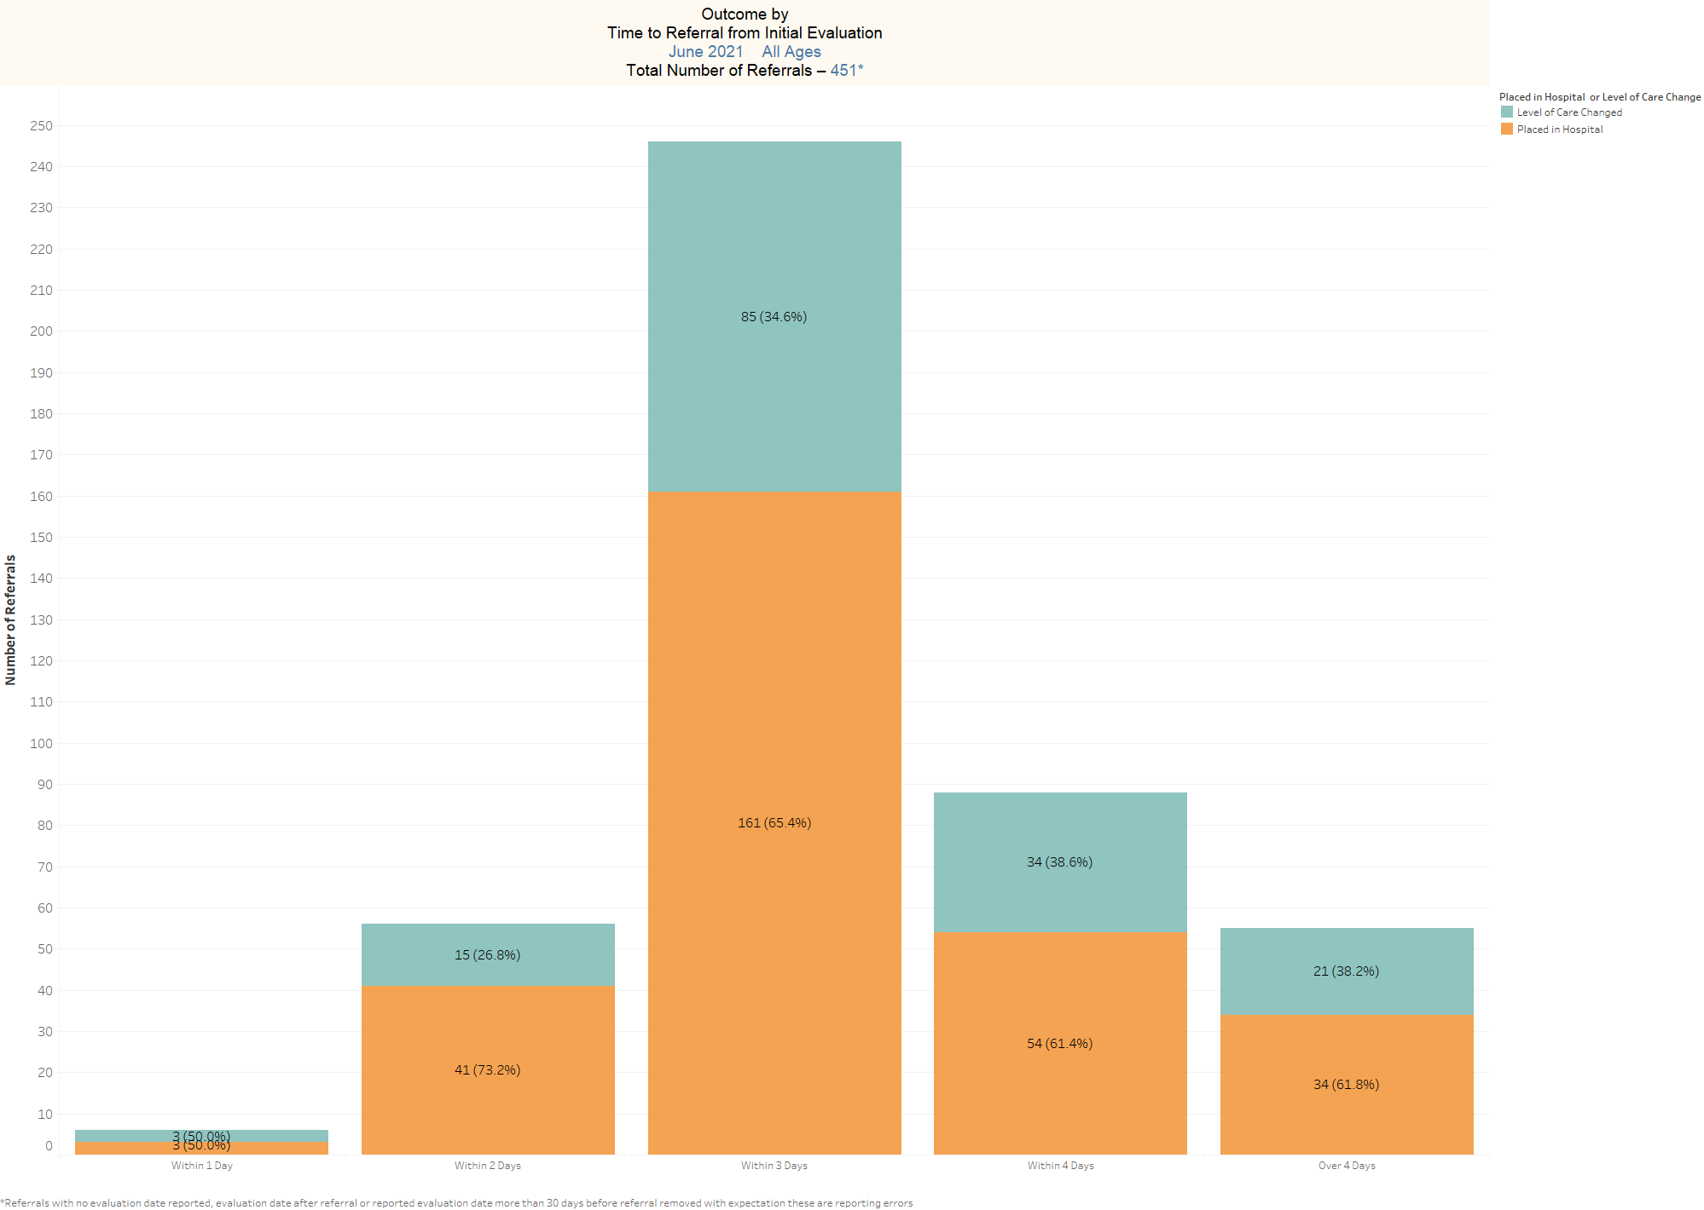

Slide 7
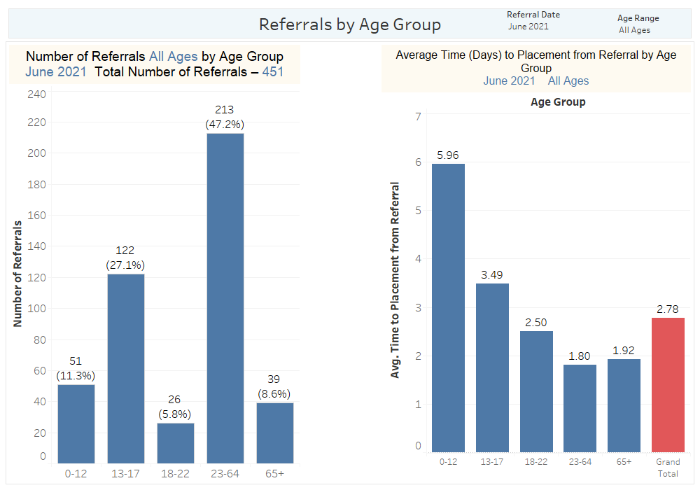

Slide 8
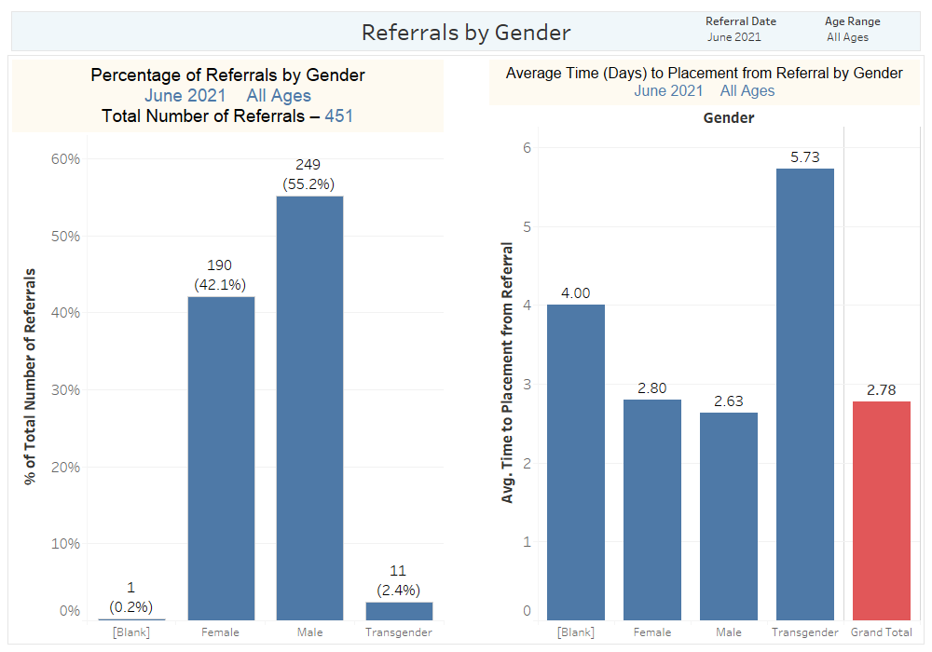

Slide 9
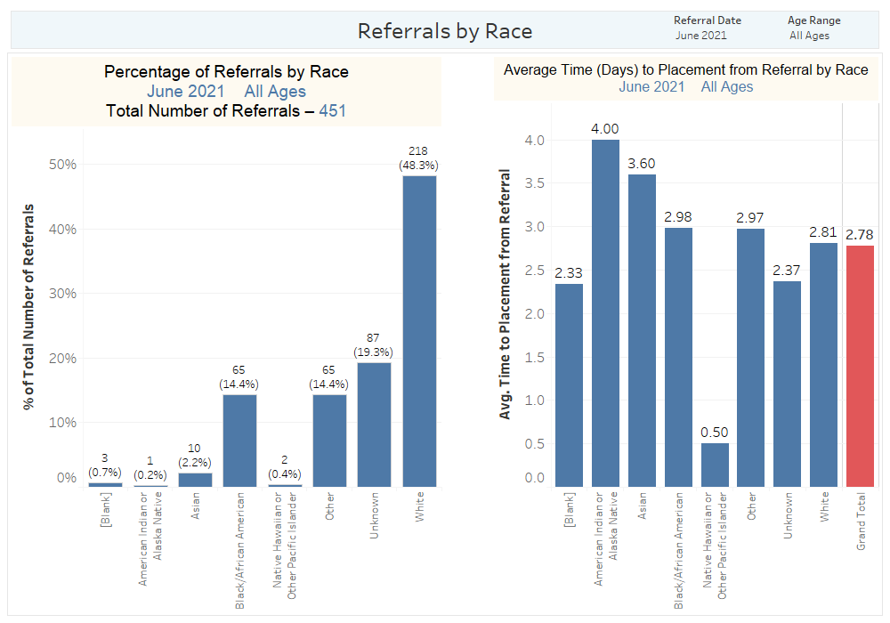

Slide 10
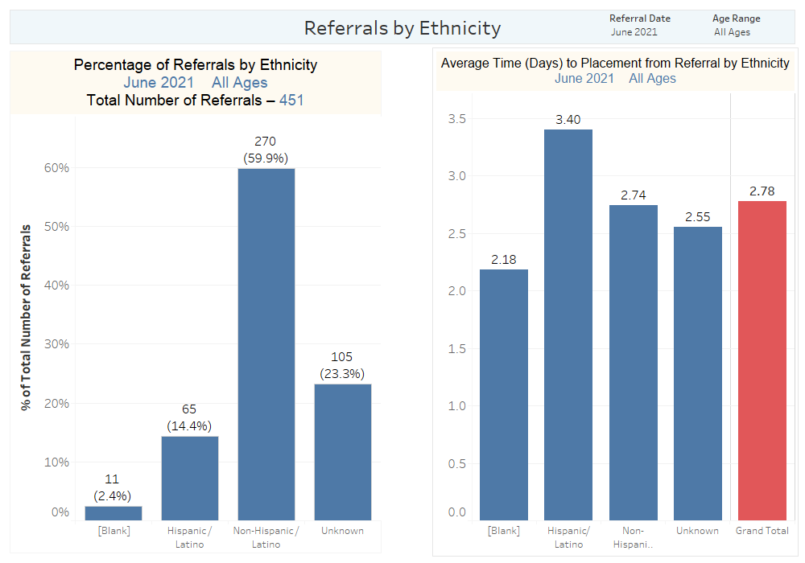

Slide 11
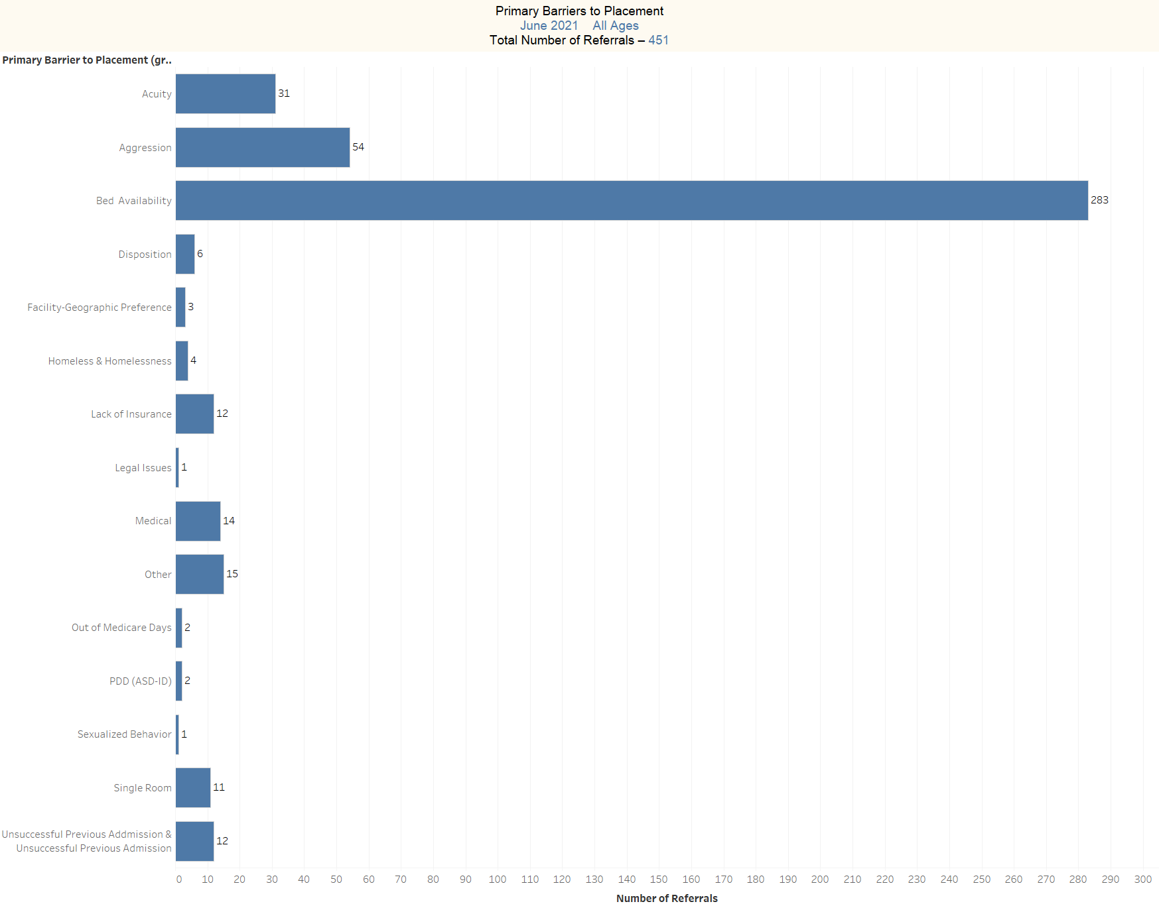

Slide 12
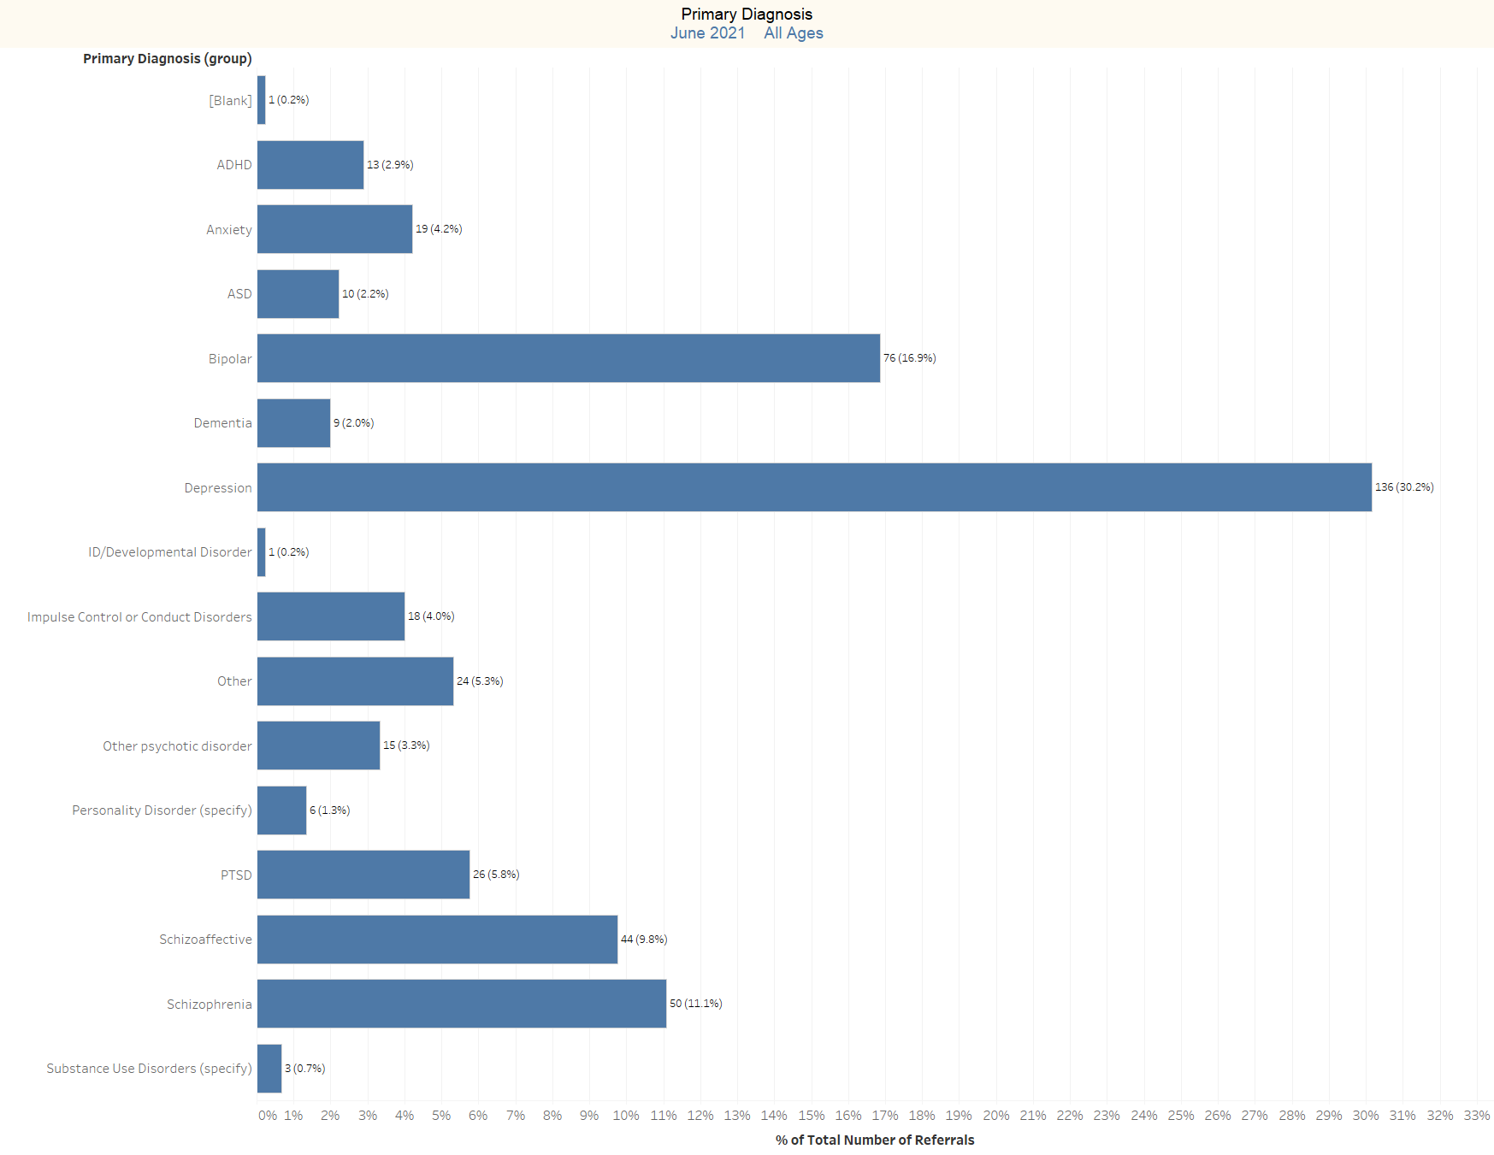

Slide 13
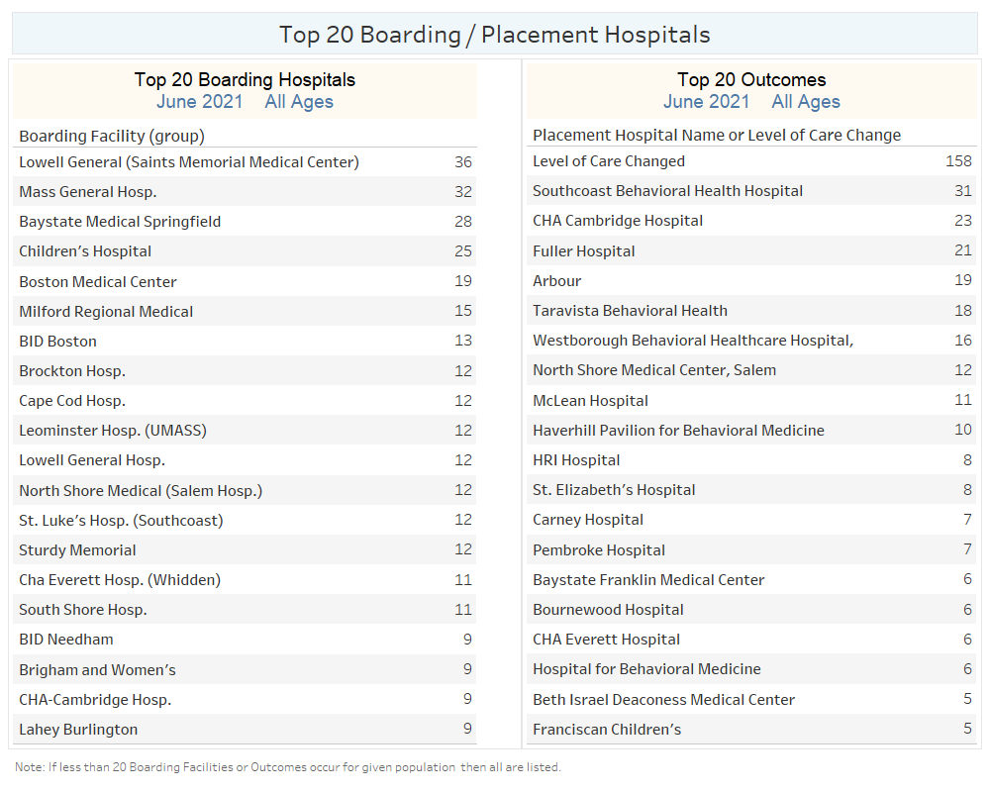

Slide 14
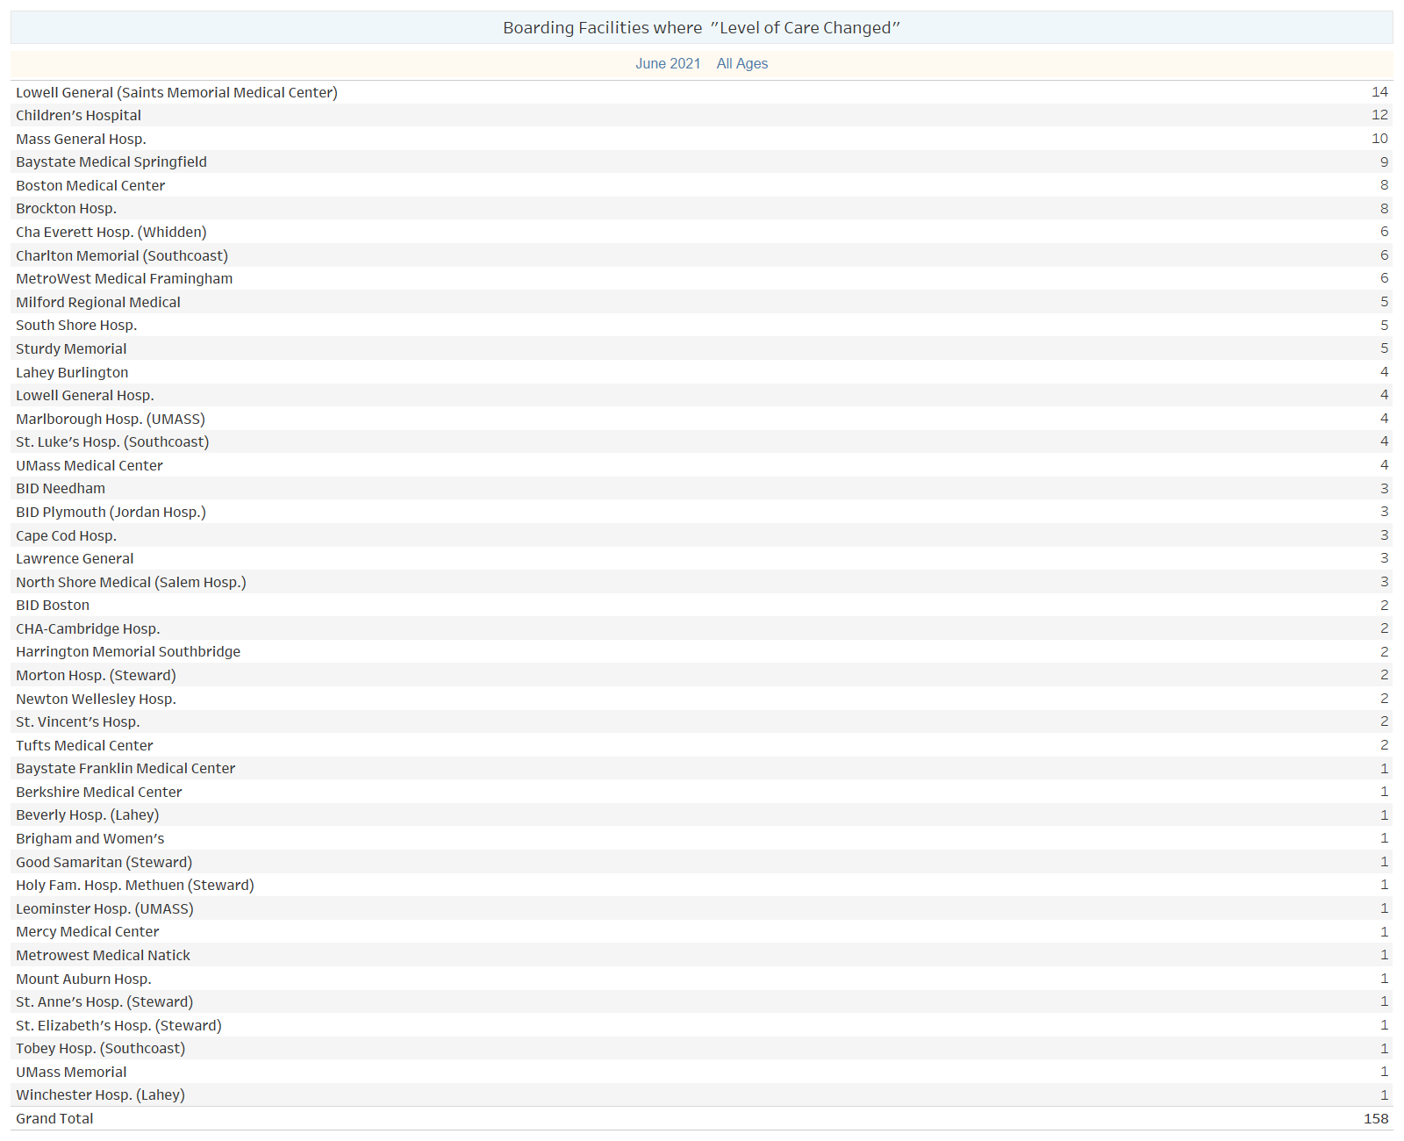

Slide 15
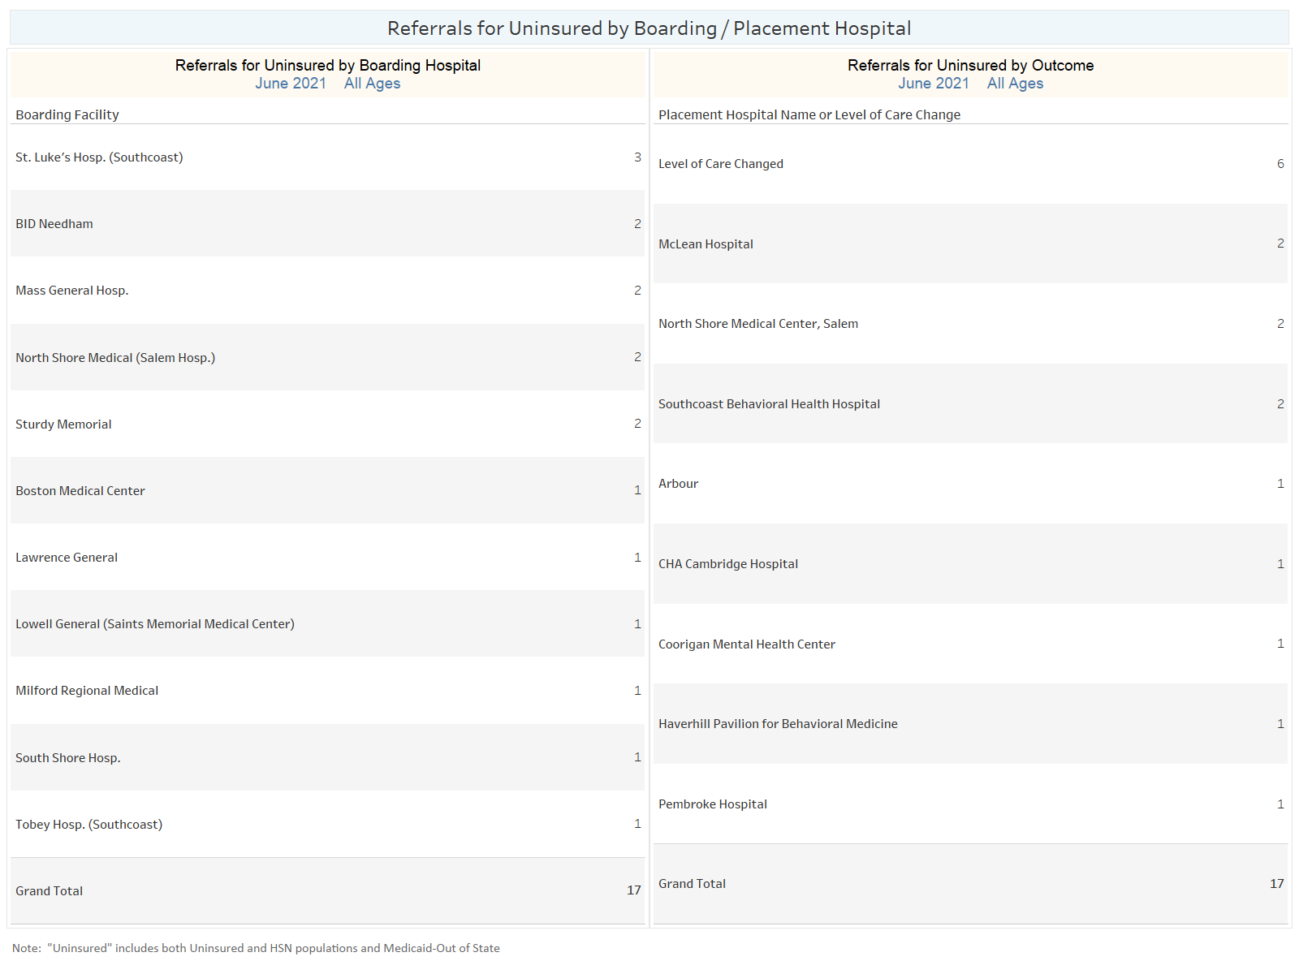

Slide 16
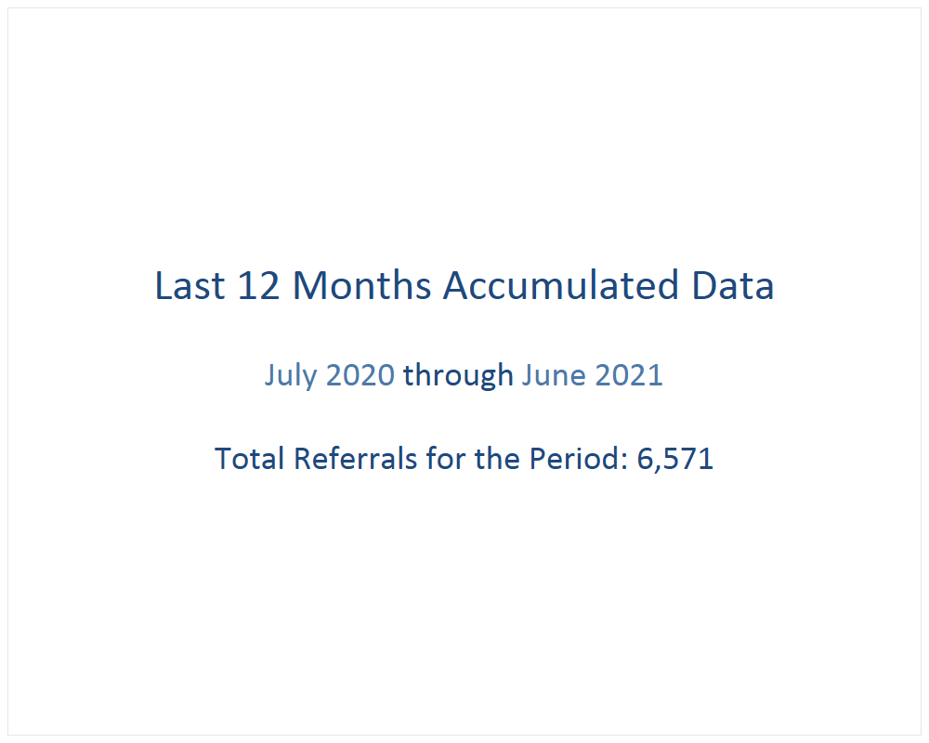

Slide 17
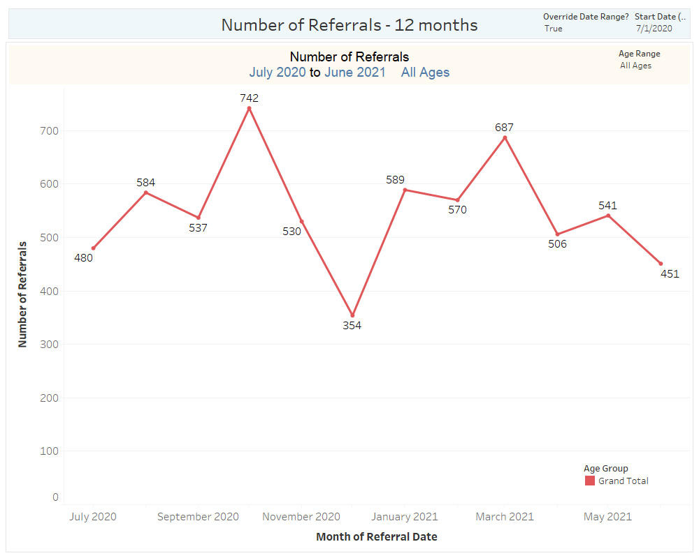

Slide 18
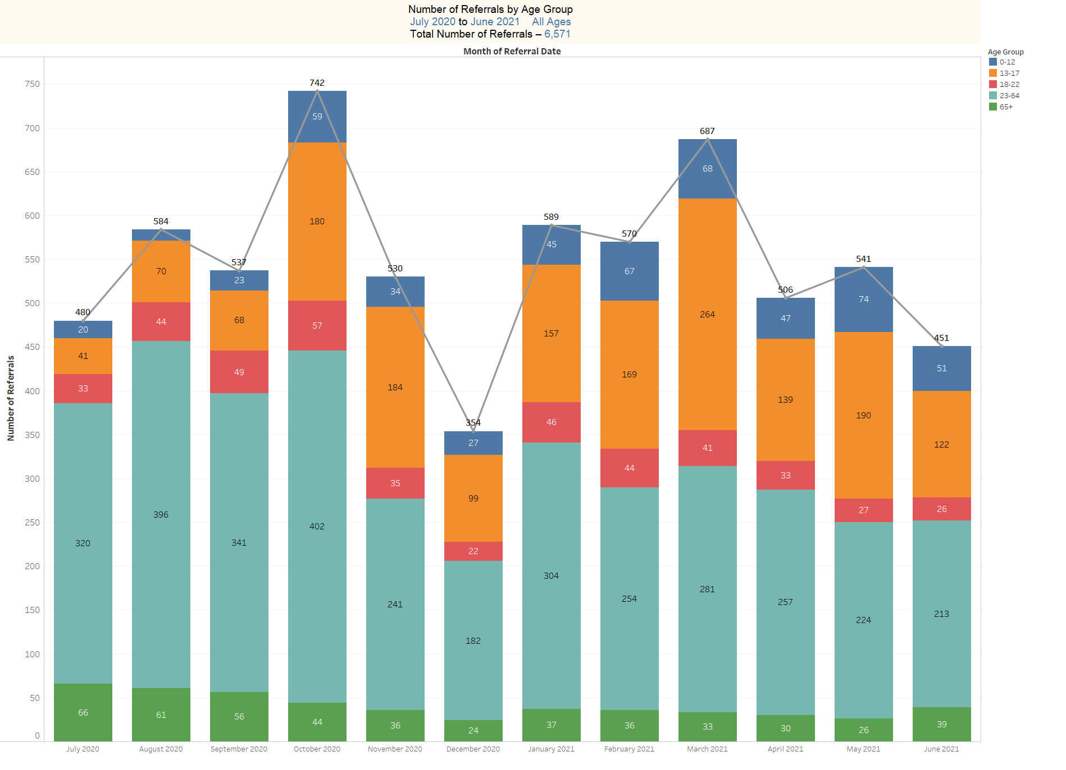

Slide 19
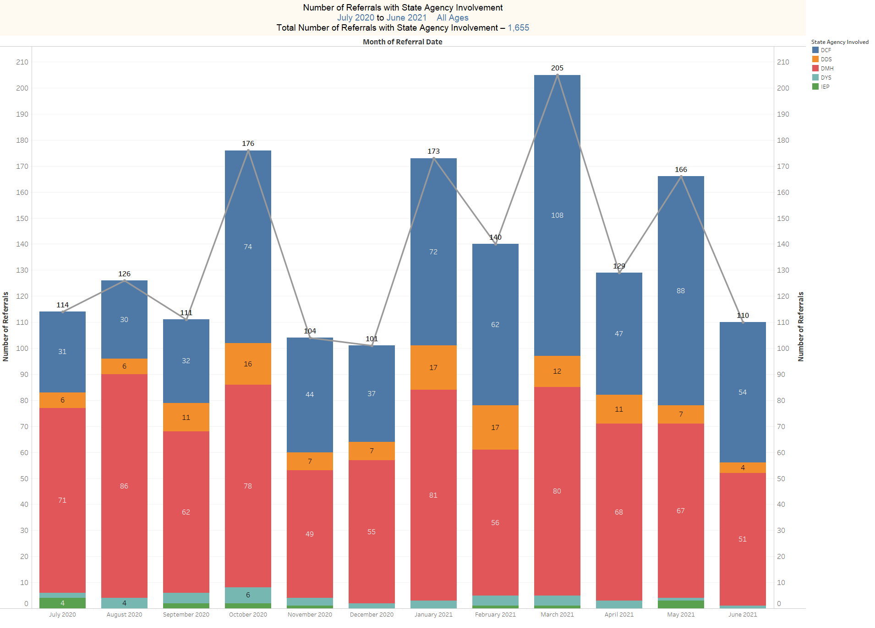

Slide 20
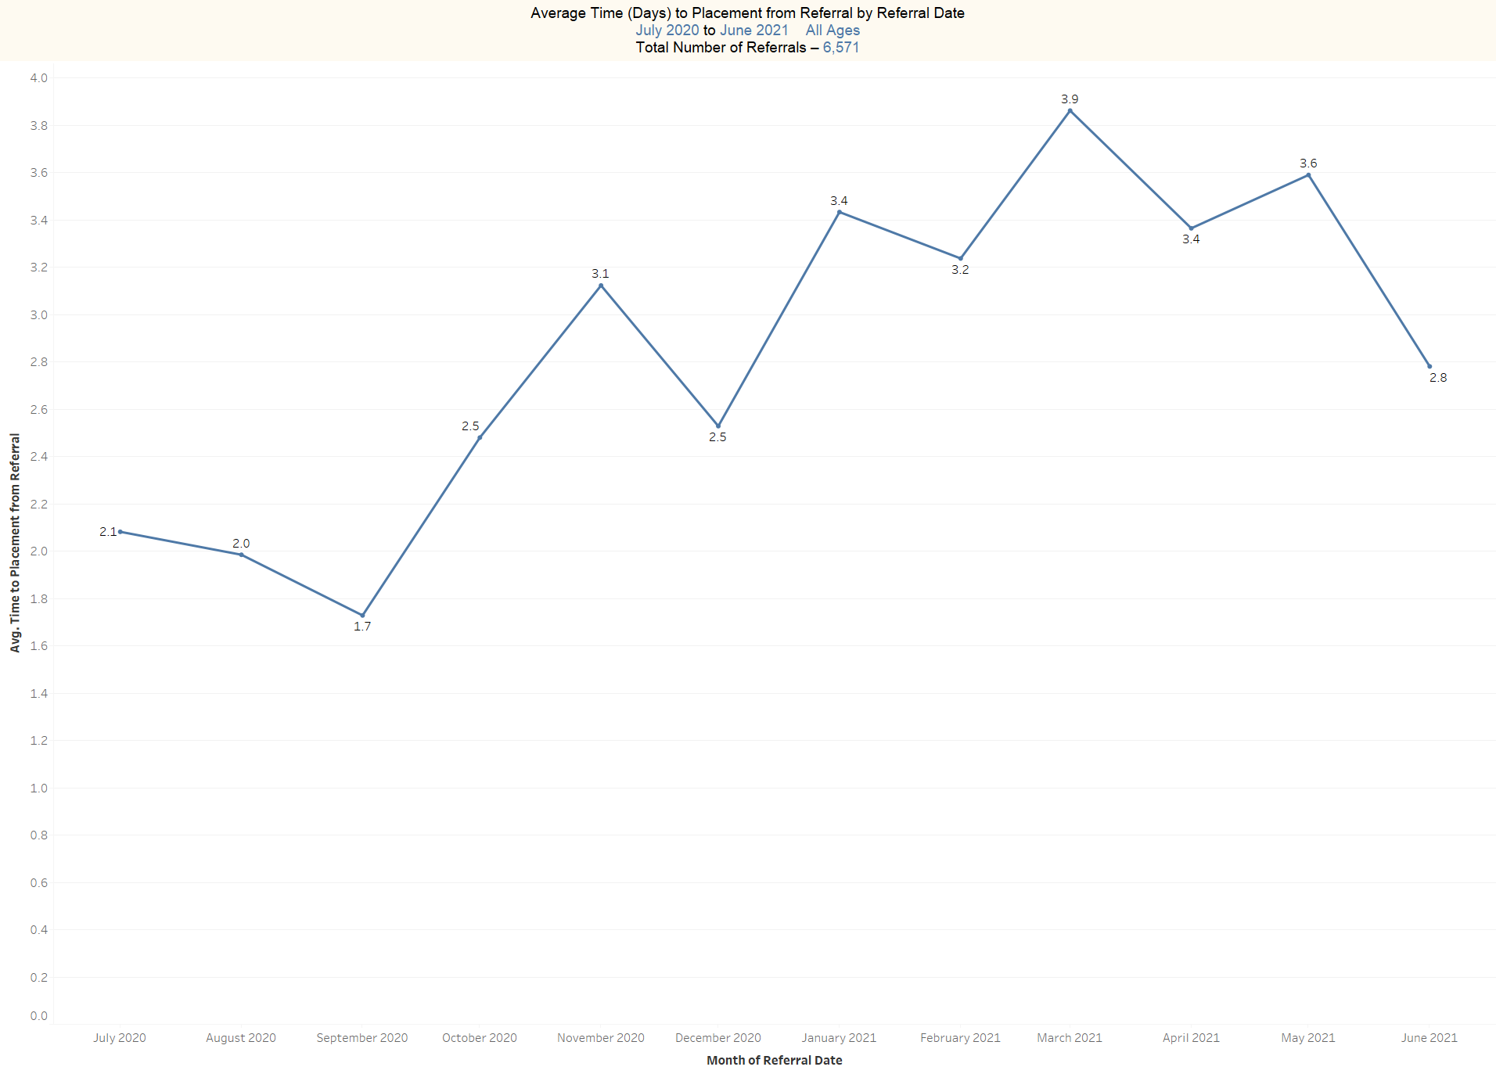

Slide 21
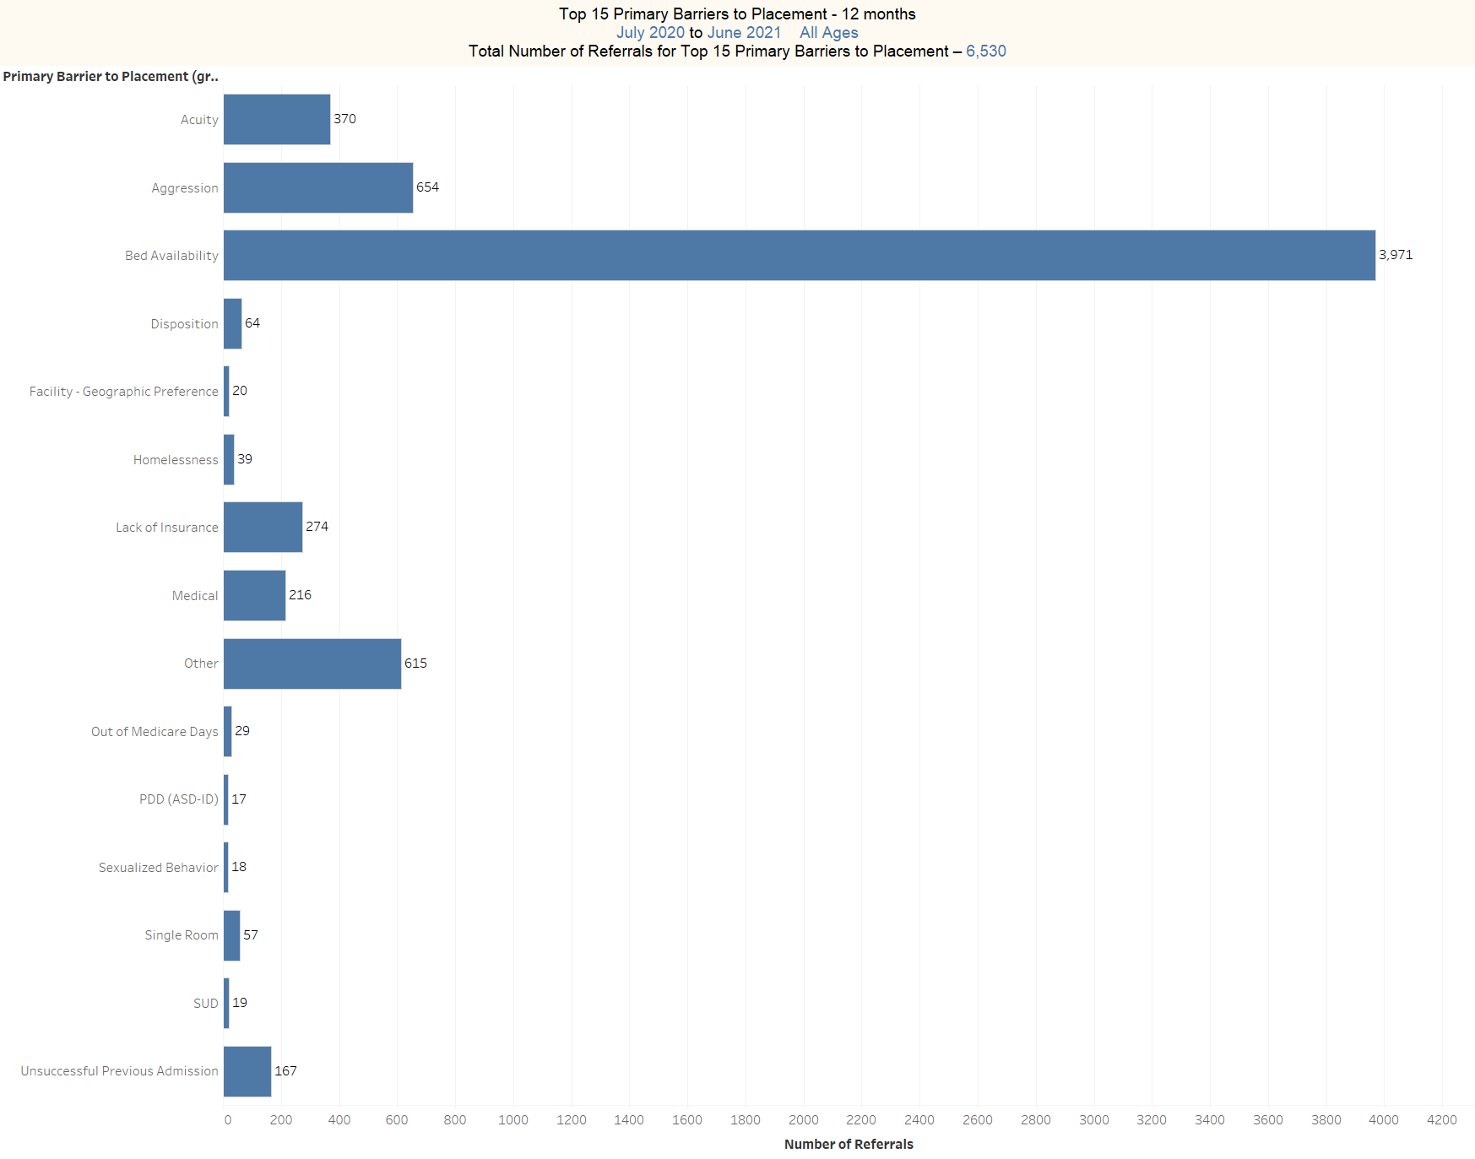

Slide 22
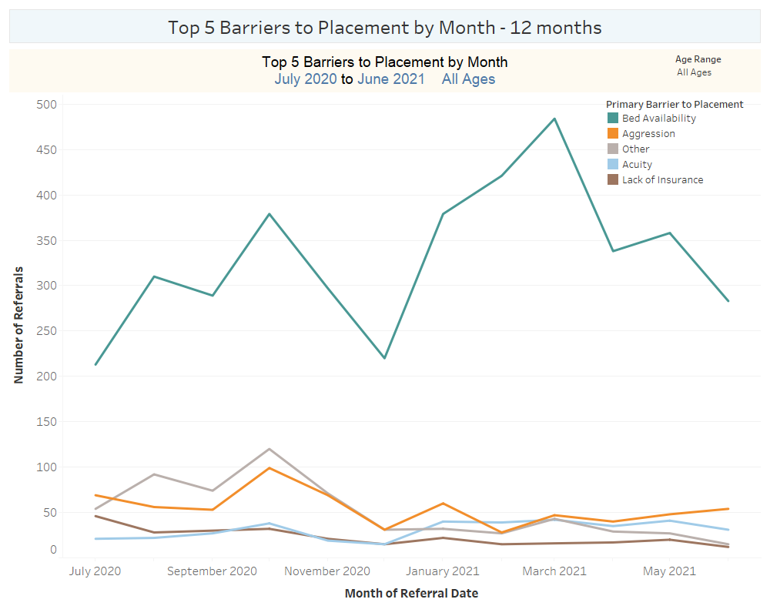

Slide 23
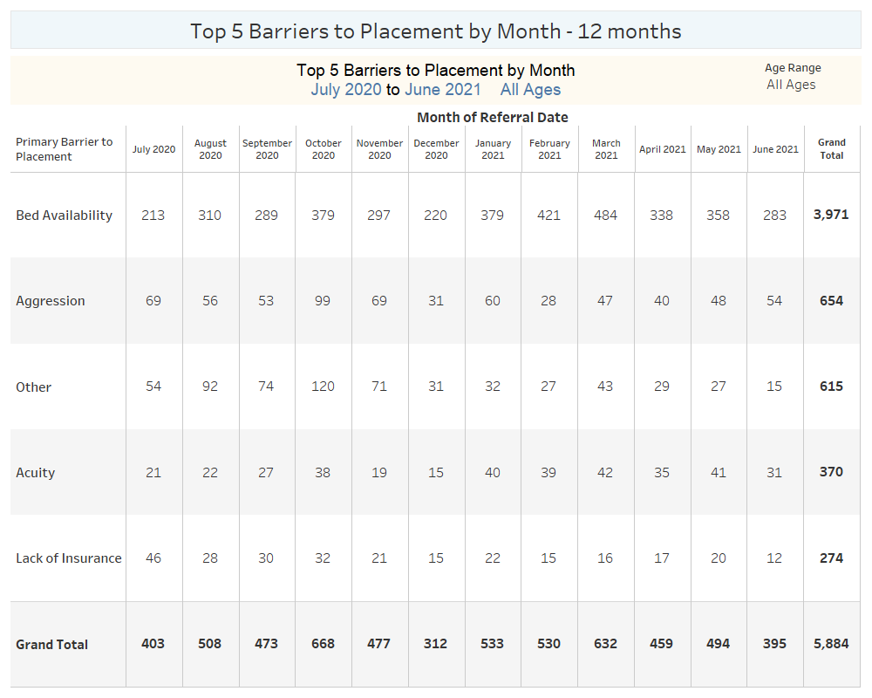

Slide 24
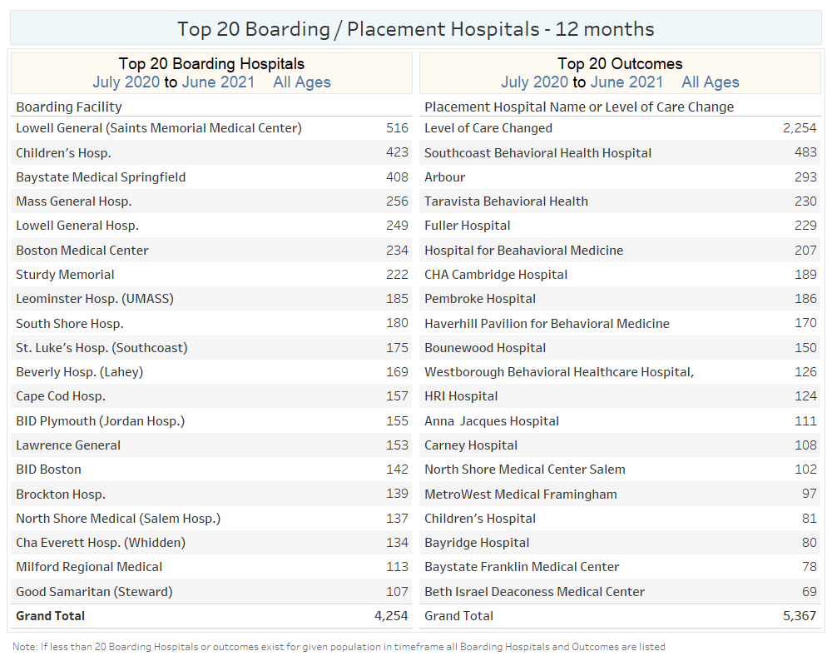

Slide 25
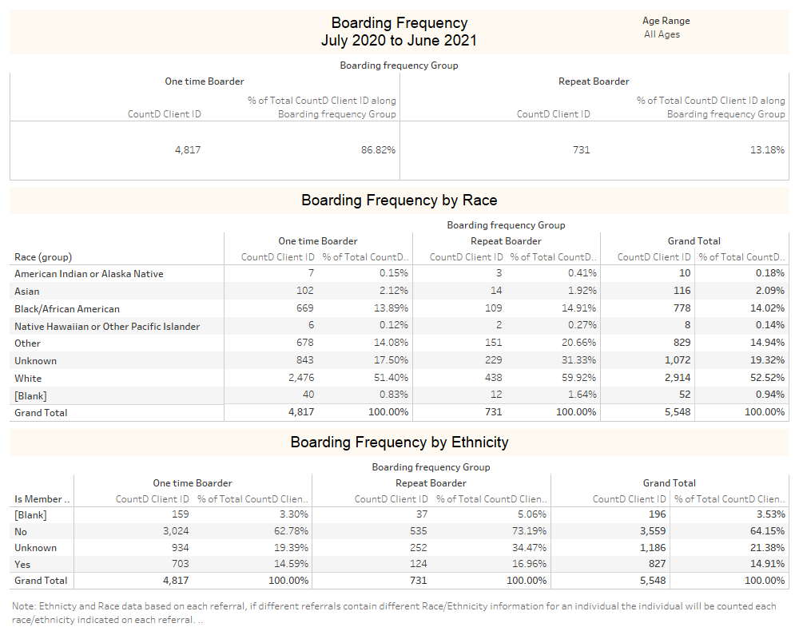

Slide 26
