Slide 1

Commonwealth of Massachusetts
Extended Producer Responsibility Commission
MEETING 2
Wednesday, May 21, 2025 | 10 a.m.–12:30 p.m.
100 Cambridge Street, 2nd floor conference room | Boston
and via Zoom
Draft: For Policy Development Purposes

Slide 2

Housekeeping: roll call
Member | Agency / organization
CHAIR: John Beling | Deputy Commissioner, Massachusetts Department of Environmental Protection
Senator Mike Barrett | Chair, Joint Committee on Telecommunications, Energy, and Utilities
Sharon Byrne Kishida | Nominee, Senate Minority Leader
Leigh-Anne Cole | Executive Director, Community Action Works
Rep. Michael Day | Massachusetts House of Representatives
Jose Delgado | Arise for Social Justice
Janet Domenitz | Executive Director, MassPIRG
Lew Dubuque | Vice President, Northeast Chapter, National Waste and Recycling Association
Magda Garncarz | Vice President of Government Affairs, Associated Industries of Massachusetts
Sarah Kalish | Executive Office of Economic Development
Dalene LaPointe | Assistant Director, Environmental Toxicology Program at Massachusetts Department of Public Health
David Melly | Legislative Director, Environmental League of Massachusetts
Conor O’Shaughnessy | Budget Director and Environmental Policy Analyst, Office of Senator Bruce Tarr
Andrew Potter | Chair, Select Board, Town of West Stockbridge
Catherine Ratte | Director, Land Use and Environment Department, Pioneer Valley Planning Commission
Bill Rennie | Senior Vice President, Retailers Association of Massachusetts
Neil Rhein | Executive Director, Keep Massachusetts Beautiful
Waneta Trabert | Vice President, MassRecycle
Tracy Triplett | Senior Enforcement Counsel, Office of Attorney General Andrea Joy Campbell
Abbie Webb | Vice President of Sustainability, Casella Waste Management
Note: the DEP is still seeking an individual to fill one vacancy
2
Notes:
John

Slide 3
Housekeeping: staff and consultants
Staff/consultant | Organization
Greg Cooper | Director, Hazardous and Solid Waste, Massachusetts Department of Environmental Protection
John Fischer | Deputy Director, Hazardous and Solid Waste, Massachusetts Department of Environmental Protection
Courtney Rainey | Deputy Chief of Saff and Director of Government Affairs, Massachusetts Department of Environmental Protection
Julie McNeill | Attorney, Bureau of Air and Waste, Massachusetts Department of Environmental Protection
Jennifer Haugh | Vice President of Planning, GreenerU
Craig Altemose | Director of Programs, GreenerU
Madeline Rawson | Project Manager, Planning, GreenerU
3
Notes:
John

Slide 4
Today’s meeting goals and agenda
Wednesday, May 21, 2025
10 a.m.–12:30 p.m.
Goals
Approve agenda, minutes, and amended Commission ground rules
Establish advisory groups
Level set on past and present paint EPR efforts
Hear ideas, concerns, support
Identify and discuss support for proposed paint EPR recommendations
    Agenda
    Roll call
    Approval of agenda and minutes
    Discuss and vote on advisory groups
    Presentation: overview of paint EPR
    Presentation: paint EPR in Mass and other states
    Clarifying questions
    Discussion: proposed paint EPR recommendation
    Public input
    Next steps
4
Notes:
Jen

Slide 5
Housekeeping
    Adopt May 21 meeting agenda
    Adopt April 14 meeting minutes
    Adopt ground rules with the following amendments:
        Strike from §II.5: “The timekeeper will also be responsible for tracking the three-minute allotment per Member on a given topic, as set forth in Section III below.”
        Amend §III.7 to “Members should focus their remarks on the topic being discussed and should avoid returning to items that have already been discussed.”
        Strike §III.8: “Members may be given three (3) minutes to speak on any agenda item, at the discretion of the Chair and may be limited or extended as deemed appropriate by the Chair.”
5
Notes:
John B

Slide 6
Advisory groups
    Two proposed advisory groups: (a) electronics and (b) plastics and packaging
    Advisory group members will be charged with performing research and presenting findings to the Commission
    Meetings do not need to be held in accordance with Massachusetts open meeting law
    Advisory groups will meet at least twice
    Findings on electronics EPR should be completed by August 31 to be shared at the September full Commission meeting; findings on plastics and packaging should be completed by September 30 to be shared in October
    Advisory groups may not consist of more than nine members
6
Notes:
John B / Jen

Slide 7
Advisory group membership
    Commission Chair John Beling and/or MassDEP staff member or consultant
    Related industry representative
    Non-Commission members optional
        Advisory group member volunteers are requested. Please contact Greg Cooper at greg.cooper@mass.gov by 5 p.m. May 30, 2025, to express interest.
7
Notes:
John B / Jen

Slide 8
Advisory group vote
    A motion is requested to:
    form two advisory groups on (a) electronics and (b) plastics and packaging to perform research and present findings to the EPR Commission in September and October 2025.
8
Notes:
John B / Jen

Slide 9
Presentations

Slide 10





Paint Stewardship
May 2025

Slide 11
How did we get here??
Paint Product Stewardship Initiative (PPSI) Facilitated by Product Stewardship Institute
2002 – 2008
April 2005 – agreement to 8 projects at cost of $2M public/private funding
October 2007 - elements of draft legislation
ACA and Paint Industry
State and Local Government
Processors
Environmental NGOs
US Environmental Protection Agency

Slide 12
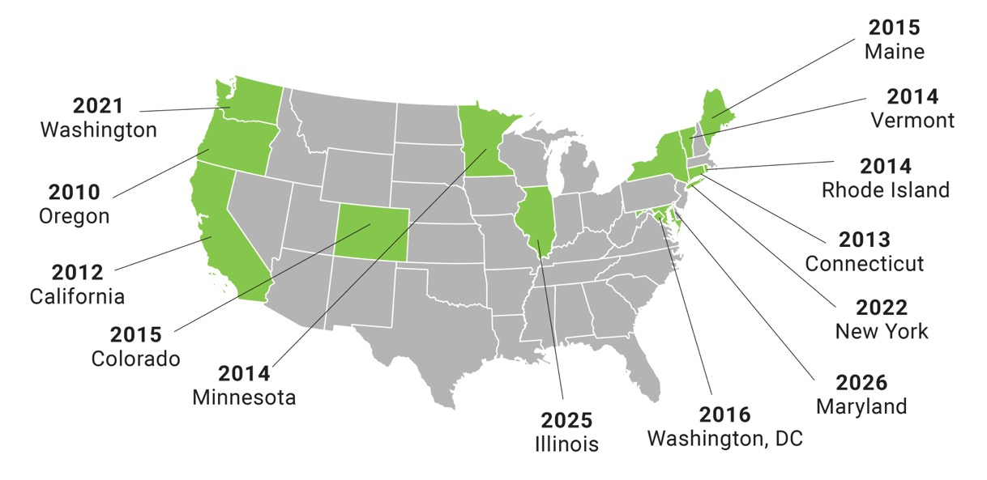
Paint Stewardship in the US
Notes:
And here we have a map showing the present and future PaintCare states. After a lull in the mid-teens, we now have a program starting nearly every year, even in consideration of the pandemic. Illinois will be the next to start and Maryland not far behind. We’ll now have programs covering over 35% of the US population once MD is up and running.

Slide 13
Model Paint Stewardship Legislation
Statewide Legislation
Sustainable Financing
Anti-Trust Protection
Consistency within the state and across states
Level playing field for all stakeholders
To ensure sustainability over time
To allow program to establish uniform fee assessment

Slide 14
Requirements of the Paint Stewardship Law
Obligation is on Paint Manufacturers
provide a paint management system or join stewardship organization (SO) to do so
System or SO must provide for recycling and proper disposal of leftover paint; reduce the generation of postconsumer paint, and promote reuse
Develop Program Plan
  Convenient paint collection locations
  Environmentally responsible paint management
Provide annual report to oversight agency
  Total volume of paint collected
  Method of disposition
  Independent financial audit
  Education and outreach
Pay for oversight agency review of program plan, annual report and enforcement
??? What if they don’t???

Slide 15
Requirements of the Paint Stewardship Law
Role of State Agency
Ensure Compliance with Stewardship Law
Maintain information about PaintCare
Review and approve Annual Reports, including financial reports
Enforcement activities
Review and approve Program Plan, including financial reports and fee structure

Slide 16

Network of Drop-Off Locations
Retailers
VOLUNTARY to be collection sites;
Must collect paint assessment at sale
Benefits:
Increased foot traffic
Value added customer service
Good corporate citizen
Local Government Collection Sites
VOLUNTARY
Benefits:
Significant Cost Savings

Slide 17







How PaintCare is Funded
PaintCare (Paint Stewardship Organization)
Stewardship fee paid on paint sold in state
PAINT COLLECTION
AND RECYCLING, OUTREACH, AND ADMINISTRATION
PAINT MANUFACTURER
Invoice and purchase price includes fee
PAINT RETAILER
Purchase price of paint includes fee
CONSUMER
Notes:
Funded through fee on new paint sales
Manufacturers add the PaintCare Fee to containers of architectural paint sold to their dealers (distributors and retailers)
Retailers and distributors pass the PaintCare Fee to their customers by including it in the final sale price
Manufacturers report sales and submit fees to PaintCare monthly

Slide 18
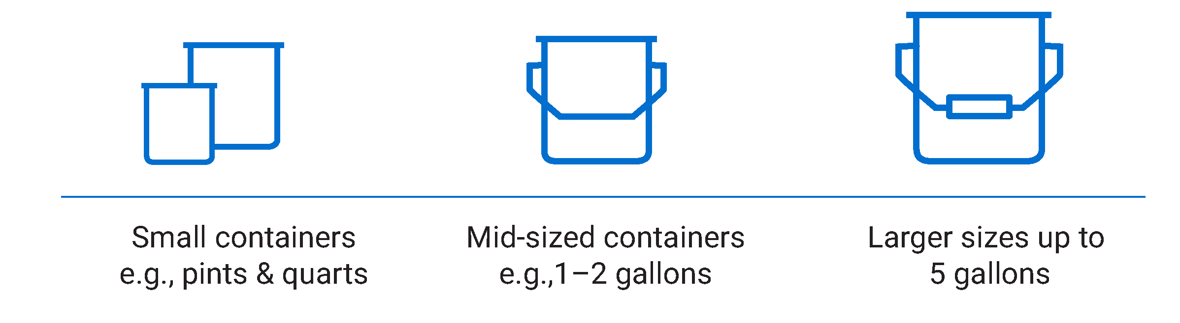
Fee Schedules
$0.30–$0.65
$0.65–$1.35
$1.50–$2.45
Notes:
Fees differ by state and container size, range from $0.30­–$1.99
Program is funded by paint consumers vs. general taxpayer or garbage rate payer

Slide 19

What Does the PaintCare Fee Fund?
67% for paint collection,
transportation, processing
23% for staffing, admin, overhead,
and state oversight fees
10% for outreach and education
Notes:
Kevin
State specific budget information can be found in annual reports.
67% of costs are for paint collection, transportation, processing
10% for outreach and education
23% for staffing, admin, overhead, and state oversight fees
Program cost per gallon of paint managed ranges from $7.09 to $12.31; State specific information can be found in annual reports.
Expenses include:
Paint transportation and processing
Paint collection containers, spill kits, site materials
Site improvement (e.g. canopy, fencing)
Outreach and education
In-state (and national/corporate) staff
State agency fees
Insurance, legal fees, consulting services

Slide 20
Paint Processing by State
Notes:
Dan

Slide 21
Paint Processing Over the Years
Notes:
Dan

Slide 22
More than a Decade of Results
Active States: CA, CO, CT, DC, OR, ME, MN, RI, VT, WA, NY
IL active in 2025, MD active in 2026
97.7% of population in active states live within 15 miles of drop-off site
Over 200 manufacturers registered in PaintCare
Collection statistics:
  2,542 year-round collection sites
  9,525 HHW and paint only events
  12,413 large volume direct pick ups
Collected almost 79 million gallons of paint
2025 Legislative Campaign: Wisconsin, Massachusetts, Missouri, New Jersey and New Hampshire

Slide 23
Contact Us
Jeremy Jones
Director of EPR
Heidi McAuliffe
Sr. Vice President
American Coatings Association
(202) 893-2212
(202) 329-1065
jjones@paint.org
hmcauliffe@paint.org

Slide 24
Paint data in the Commonwealth
Table 1. — Percentage of Massachusetts communities and residents with leftover paint collection access
Collection frequency | % of communities | % of population
Year-round | 26% | 23%
Weekly/monthly | 2% | 2%
6-11 months of the year | 5% | 7%
< 6 months of the year | 16% | 25%
0 | 32% | 32%
No data | 18% | 11%
24
Notes:
Current access to paint collection in MA: roughly 25% of residents have year-round opportunities to recover leftover paint.
Another third only have access through HHW events and a 1/3 have no access.
This is self-reported data from municipalities and does not include all municipalities (18%)

Slide 25
Paint data in the Commonwealth
Table 2. — Paint generation and disposition in Massachusetts (estimated)
Paint generation and disposition | Gallons (est.) | Percent of total
Total leftover paint generated annually | 1,800,000 | 100%
Disposed of in trash | 1,000,000 | 56%
Landfill | 330,000 | 18%
Massachusetts combustion facility | 670,000 | 37%
Collected at household hazardous waste event for reuse, recycling, or disposal | 800,000 | 44%
Processed by Recolor into recycled paint | 360,000 | 20%
No data available yet | 440,000 | 24%
25
Notes:
The limited data we have on amounts recovered lead us to believe that a good portion of the 440,000 gallons may be going down the drain or another disposal option such as C&D processing/transfer facilities.

Slide 26
Paint data in the Commonwealth
MassDEP programs supporting leftover paint recovery:
    Municipal assistance coordinators helping communities institute reciprocal household hazardous waste event arrangements
    Recycling Dividends Program, which provides credit to municipalities that have paint collection programs locally and hold household hazardous waste events
    Regional Permanent Center Grants, which provide support for establishing collection centers offering more access
    State contract of household hazardous waste, a contract that provides a variety of services to assist municipal collection, including individual material collection, one-day event pricing, etc.
    End-market support, a Recycling Business Development Grant program that offers grants to businesses such as Recolor to expand infrastructure locally
    RecyclingWorks, which assists small businesses in identifying options for managing hazardous materials
26

Slide 27
Discussion

Slide 28
Clarifying questions
What questions do you have for the presenter(s)?
28
Notes:
Jen

Slide 29
Discussion
Do you think the Paintcare program would work in Massachusetts?
What are your concerns about the proposed approach?
Does the Commission have other policy recommendations?
Is there any information missing that requires further research?
29
Notes:
John B / Jen

Slide 30
Public comment
Thank you for your interest in participating in today’s EPR Commission meeting.
Please state your name and affiliation clearly for the record and keep your comments succinct (under three minutes).
30
Notes:
John B / Jen

Slide 31
Straw poll
—To support a recommendation to enact legislation to establish an extended producer responsibility law for paint that aligns with the Paintcare model in surrounding states (Connecticut, Maine, Rhode Island, Vermont, and New York) to provide consistency across the region
31
Notes:
Jen

Slide 32
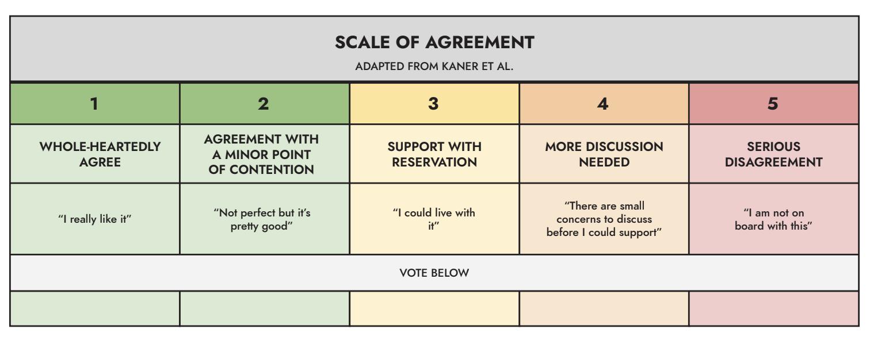
Straw poll
32
Notes:
Jen

Slide 33
Next steps
Draft EPR language on paint using recommendations template
Distribute prior to June meeting for review
Discuss, revise, and vote at June meeting
Committees on electronics and plastics/packaging to meet
33
Notes:
Jen

Slide 34
Next meeting and adjourn
Next meeting:
MATTRESSES
Wednesday, June 18, 2025
10 a.m.–12:30 p.m.
Agenda, Zoom link, and reading materials will be available at least one week prior to the meeting.
34
Notes:
Jen

