Slide 1

Commonwealth of Massachusetts
Extended Producer Responsibility Commission
MEETING 5
Wednesday, September 17, 2025 | 9:30 a.m. – 12:30 p.m.
100 Cambridge Street, 2nd floor conference room | Boston
and via Zoom
Draft: For Policy Development Purposes

Slide 2
Housekeeping

Slide 3

Housekeeping: roll call
Member | Agency / organization
CHAIR: John Beling | Deputy Commissioner, Massachusetts Department of Environmental Protection
Rep. Christine Barber | House Chair, Joint Committee on Environment and Natural Resources Appointee, Massachusetts House of Representatives
Sen. Mike Barrett | Senate Chair, Joint Committee on Telecommunications, Energy, and Utilities
Sharon Byrne Kishida | Nominee, Senate Minority Leader
Leigh-Anne Cole | Executive Director, Community Action Works
Jose Delgado | Arise for Social Justice
Janet Domenitz | Executive Director, MassPIRG
Lew Dubuque | Vice President, Northeast Chapter, National Waste and Recycling Association
Magda Garncarz | Vice President of Government Affairs, Associated Industries of Massachusetts
Sarah Kalish | Executive Office of Economic Development
Kris Callahan | Director of Policy and Regulatory Affairs, Bureau of Climate and Environmental Health, Massachusetts Department of Public Health
David Melly | Legislative Director, Environmental League of Massachusetts
Conor O’Shaughnessy | Budget Director and Environmental Policy Analyst, Office of Representative Bradley Jones, House Minority Leader
Andrew Potter | Chair, Select Board, Town of West Stockbridge
Catherine Ratte | Director, Land Use and Environment Department, Pioneer Valley Planning Commission
Bill Rennie | Senior Vice President, Retailers Association of Massachusetts
Neil Rhein | Executive Director, Keep Massachusetts Beautiful
Waneta Trabert | Vice President, MassRecycle
Tracy Triplett | Senior Enforcement Counsel, Office of Attorney General Andrea Joy Campbell
Abbie Webb | Vice President of Sustainability, Casella Waste Management
Note: the DEP is still seeking an individual to fill one vacancy
3
Notes:
John

Slide 4
Housekeeping: staff and consultants
Staff/consultant | Organization
Greg Cooper | Director, Hazardous and Solid Waste, Massachusetts Department of Environmental Protection
John Fischer | Deputy Director, Hazardous and Solid Waste, Massachusetts Department of Environmental Protection
Courtney Rainey | Deputy Chief of Saff and Director of Government Affairs, Massachusetts Department of Environmental Protection
Julie McNeill | Attorney, Bureau of Air and Waste, Massachusetts Department of Environmental Protection
Jennifer Haugh | Vice President of Planning, GreenerU
4
Notes:
John

Slide 5
Review of meeting goals and agenda
Wednesday, September 17, 2025
9:30 a.m. – 12:30 p.m.
Goals
Roll call, approve agenda, and minutes
Vote on mattress recommendation
Discuss battery EPR recommendation
Level set on past and present electronics EPR efforts
Hear ideas, concerns, support
Identify and discuss support for proposed electronics EPR recommendations
    Agenda
    Roll call
    Approval of agenda and minutes
    Vote on mattress recommendation
    Discussion on battery EPR and vote using scale of agreement
    Presentation: overview of electronics EPR
    Presentation: electronics in Mass
    Clarifying questions
    Discussion: proposed electronics EPR recommendation
    Public input
    Next steps
5
Notes:
Jen

Slide 6
Approval of agenda and minutes
    Adopt September 17 meeting agenda
    Adopt July 16 meeting minutes
      Proposed changes to July 16 meeting minutes: none submitted
6
Notes:
John B

Slide 7
Mattress EPR policy recommendation

Slide 8
EPR Commission recommendation on mattresses
The Commission recommends that the Massachusetts Legislature enact legislation to establish an extended producer responsibility program for mattresses. The Commission recommends the development and implementation of a program that aligns with existing programs in other states to the greatest extent possible.
The Commission acknowledges proposed mattress EPR legislation under consideration before the Massachusetts legislature at the time of this recommendation—H.1023, H.3985, and S.614—but does not endorse any specific bill. H.1023 incorporates some of the elements contained in Oregon’s updated law, which the Commission recommends exploring.
The Commission recommends consideration of the following questions:
    Should the mattress fee be a flat fee or variable based on size of mattress or cost? (Current mattress EPR programs have a flat fee regardless of mattress size or cost.)
    Should the cost of disposal of mattresses that cannot be collected and recycled through the program be included?
    Should the fee be collected at the wholesale or retail level? (Current mattress EPR program fees are collected at the point of retail sale.)
8
Notes:
Jen

Slide 9
Battery EPR policy discussion

Slide 10
Discussion on batteries EPR recommendation
The Commission recommends that the Massachusetts Legislature enact legislation to establish an extended producer responsibility program for batteries. The Commission recommends the development and implementation of a program that aligns with existing programs in other states to the greatest extent possible.
The Commission acknowledges proposed battery EPR legislation under consideration before the Massachusetts legislature at the time of this recommendation—H.968 and S.556—but does not endorse any specific bill.
The Commission recommends consideration of the following questions:
    Should standards be for performance, convenience, or both?
    What size and type of primary (single-use) and rechargeable medium-format batteries should be included—removable or embedded?
    Should take-back programs be the responsibility of retailers or voluntary?
    Should Massachusetts adopt PBRA’s model legislation?
    Should labeling be required to aid in proper disposal?
10
Notes:
Jen

Slide 11
Roll call vote on batteries EPR recommendation
Member | Agency / organization
CHAIR: John Beling | Deputy Commissioner, Massachusetts Department of Environmental Protection
Rep. Christine Barber | House Chair, Joint Committee on Environment and Natural Resources Appointee, Massachusetts House of Representatives
Sen. Mike Barrett | Senate Chair, Joint Committee on Telecommunications, Energy, and Utilities
Sharon Byrne Kishida | Nominee, Senate Minority Leader
Leigh-Anne Cole | Executive Director, Community Action Works
Jose Delgado | Arise for Social Justice
Janet Domenitz | Executive Director, MassPIRG
Lew Dubuque | Vice President, Northeast Chapter, National Waste and Recycling Association
Magda Garncarz | Vice President of Government Affairs, Associated Industries of Massachusetts
Sarah Kalish | Executive Office of Economic Development
Kris Callahan | Director of Policy and Regulatory Affairs, Bureau of Climate and Environmental Health, Massachusetts Department of Public Health
David Melly | Legislative Director, Environmental League of Massachusetts
Conor O’Shaughnessy | Budget Director and Environmental Policy Analyst, Office of Representative Bradley Jones, House Minority Leader
Andrew Potter | Chair, Select Board, Town of West Stockbridge
Catherine Ratte | Director, Land Use and Environment Department, Pioneer Valley Planning Commission
Bill Rennie | Senior Vice President, Retailers Association of Massachusetts
Neil Rhein | Executive Director, Keep Massachusetts Beautiful
Waneta Trabert | Vice President, MassRecycle
Tracy Triplett | Senior Enforcement Counsel, Office of Attorney General Andrea Joy Campbell
Abbie Webb | Vice President of Sustainability, Casella Waste Management
11
Notes:
Jen

Slide 12
Presentations

Slide 13

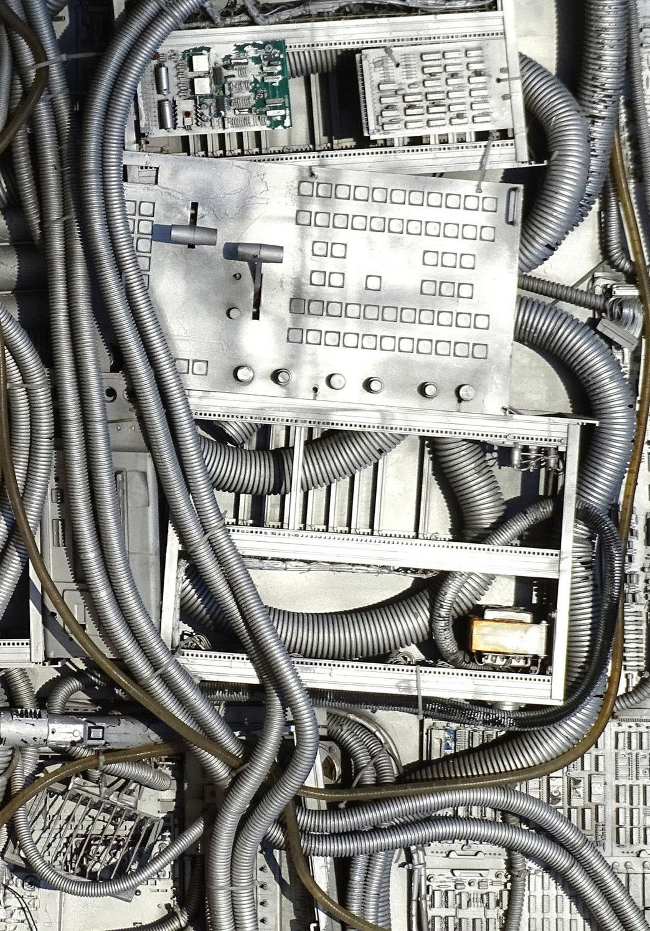
Electronics EPR in the US
September 2025
Jason Linnell, National Center for Electronics Recycling

Slide 14
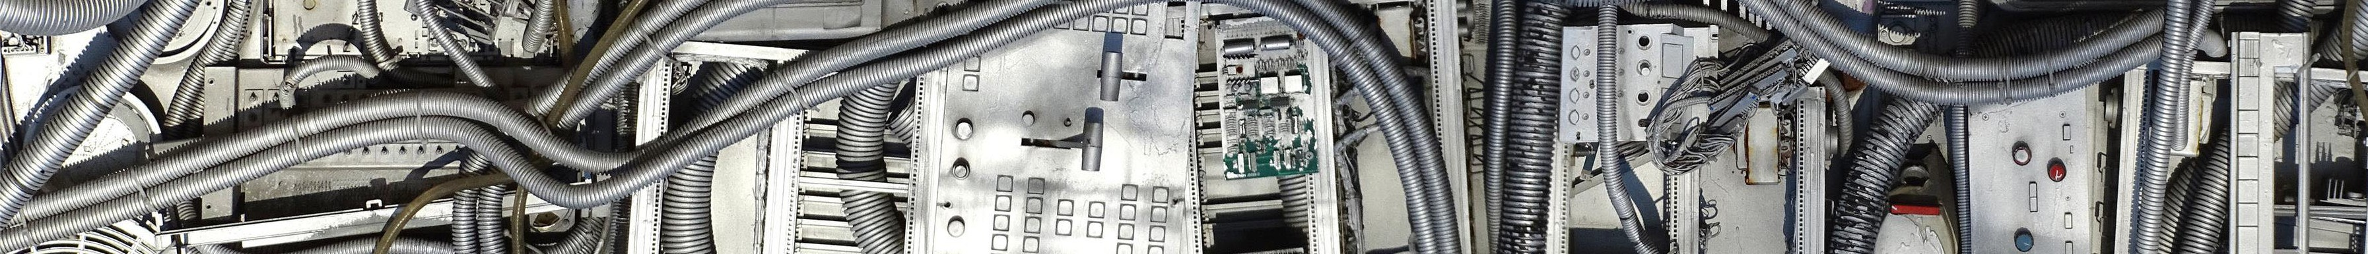

National Center for Electronics Recycling:
About NCER
Non-profit 501c3, est. 2005, in Vienna, WV
Involved in Federal, State & Association Projects
Conduct Research, Run Collection Programs
Partner with NERC on Electronics Recycling Coordination Clearinghouse (ERCC)
Manage Oregon State Contractor Program, Vermont State Standard Plan, administer ERRO Illinois and South Carolina Manufacturer Clearinghouse
Our Mission: Dedicated to the development and enhancement of a national infrastructure for the recycling of used electronics in the U.S.

Slide 15
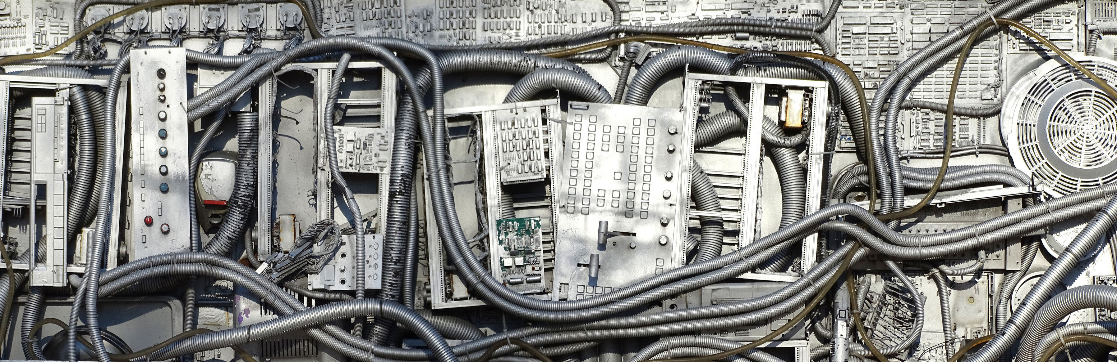
U.S. Policy Situation
Few programs 20 years ago, many discussions on how to offer more, including federal
But, no Federal Law, so programs developed through state legislation
Now almost half the states with Extended Producer Responsibility
  But, no new States have passed last in over 10 years

Slide 16
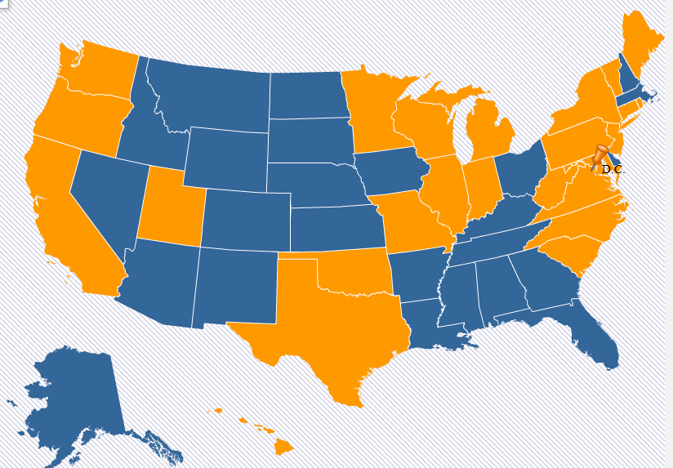
States with E-Waste Laws
States highlighted in orange have some
type of electronics recycling program law

Slide 17

25 State Program Laws + DC
  2003: California
  2004: Maine
  2005: Maryland
  2006: Washington
  2007: Connecticut, Minnesota,
  Oregon, Texas, North Carolina
  2008*: New Jersey, Oklahoma, Virginia, W. Virginia, Missouri, Hawaii, Rhode Island, Illinois, Michigan
  2009: Indiana, Wisconsin
  2010: Vermont, South Carolina, New York, Pennsylvania
  2011: Utah
  2014: DC
  2015-2025 - none

Slide 18
How are US Electronics laws different?
Products accepted, definition of “producer” or “manufacturer”
Who can use the collection system
Financing
  Consumer fee or manufacturer funding? (only CA with a fee)
  Manufacturers pay recyclers directly, through mgmt. orgs, or to states
Industry organization
  No single electronics org in U.S.
  Contributed to patchwork of state approaches
Pounds goals for manufacturers to meet? Or requirements for offering collection (convenience)?

Slide 19
“Producer Responsibility Organization/s”and Electronics EPR
Electronics laws – some of the first US-based “EPR” programs starting with Maine in 2004
Discussions of an industry “third party org” like batteries but none developed
Early laws based on return share – manufacturers pay for their returned brands in recycling = less of a need for PRO
Laws currently have a variety of methods for manufacturers to comply, but still no PRO similar to other industries
Required costs for manufacturers to cover can vary – collection, transport, supplies, recycling and educations

Slide 20
How State Laws Differ #2
Covered Entities
All Cover Household/Consumer products
  After that, some cover:
    Small business (up to certain size)
    Schools/Government
    Non-Profits
    All entities/businesses (rare)

Slide 21
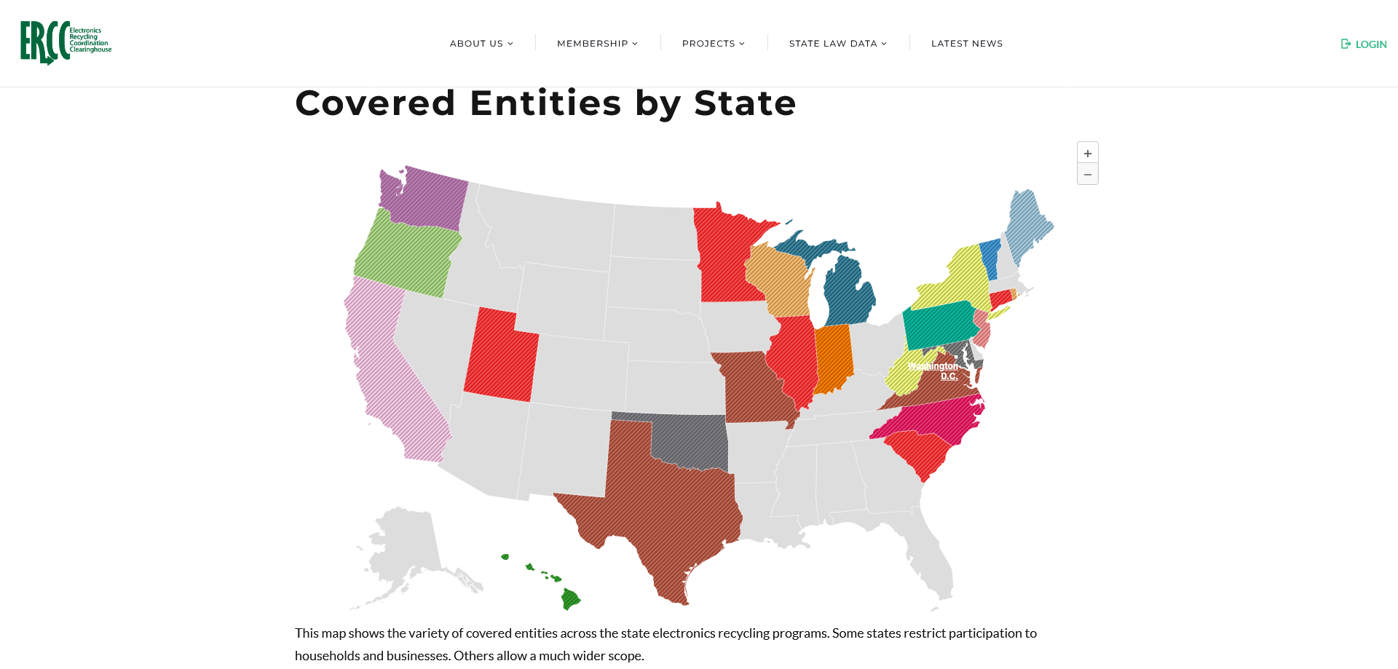

Slide 22
How State Laws Differ #1
Covered Products
Minimum: Monitors, Laptops
Maximum: + TVs, Computers, Printers, Keyboards, Mice, Small Servers, Personal Audio, Mobile Phones, VCR/DVD, DVRs, cable/satellite boxes, 3D printers, game consoles
Most in between with “big five” TVs, desktops, laptops, monitors, and printers

Slide 23
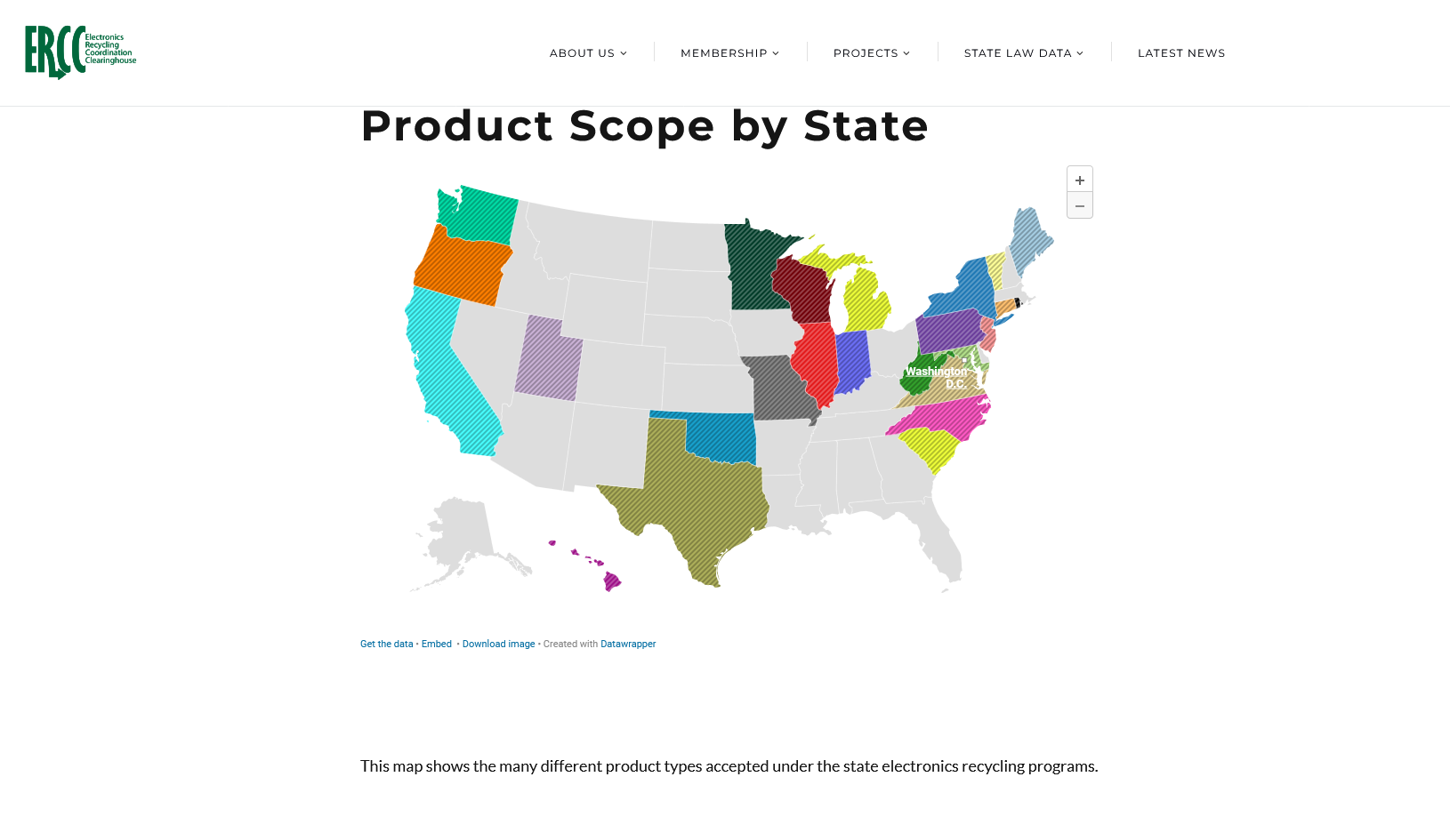

Slide 24
How are covered devices collected?
Each State’s collection method varies, and can depend on how collection occurred pre-EPR law
Heavy municipal collection – ex. ME, VT. Mostly smaller municipal or contracted depots for many recyclables, including electronics
Non-profit retail locations – ex. WA, OR. Goodwill/Salv Army, others are predominant collection locations in addition to landfill/transfer stations
Others – electronics retailers (i.e. Best Buy, Staples), repair stores, curbside collection
Collection events – to meet convenience requirements in places where no suitable permanent sites exist
Mailback – smaller volumes but provides options where others inconvenient

Slide 25
How State Laws Differ #3
Program Funding
What the Funding Covers
All EPR states – recycling costs of covered devices
Variations for costs of:
Transportation from all collection sites, particularly to small collection locations
Collection costs, including payments to collection sites
Consumer drop-off fees
Some laws allow, other prohibit
Manufacturer Funding Requirements
Manufacturer fee - 2 states
Manufacturer Market share – 12 states
Manufacturer Return share & market share – 1 states
Manufacturer Clearinghouse with Market Share within Return Product Categories – 2 state
No financing specified, but manufacturers run their own programs

Slide 26
Overall Per Capita Rates by State
CONTEXT MATTERS:
No two States with identical product types, covered entities, goals, convenience requirements
Higher per capita rate compared to other another State’s lower rate DOESN’T necessarily mean better performance.
Data represent ONLY what is reported as covered device collections – other activity is happening and not captured – i.e. non-covered devices, collections outside of regulated programs, voluntary initiatives
Year over year change can be impacted by changes to the laws – adding/subtracting product scope, changing targets

Slide 27
States with 2023 Data (or FY)
Per Capita

Slide 28
2020-23 Data (or FY)
Per Capita

Slide 29
Other States 2020-23 (or FY)

Slide 30
Percent Change

Slide 31
2019-23 Percent Change by State

Slide 32
2019-23 Percent Change by State

Slide 33
Convenience
Requirements for how many collection locations or events or services are needed under the state law
Types of convenience:
  Certain number of sites per city, county or other geographic region; for example X number of collection sites for each city over 10k population
  Based on population or population density
  Average distance resident must travel to a collection location
One day or recurring collection events may substitute for collection location requirement under certain laws
  Downside to events – time dependent and unpredictable collection volumes

Slide 34
Clearinghouse Model (IL/SC)
Manufacturer responsibility, but instead of pounds targets, “convenience” standard
Counties and certain municipalities “opt in” to the manufacturer program
Each manufacturer must provide an “e-waste program” to transport/recycle residential CEDs for the ENTIRE ROSTER of counties (at least minimum number of sites) who opted in independently……OR
Through a “manufacturer clearinghouse” – collection of manufacturers representing 50% or more of the total collection obligations
All manufacturers in both states comply through a single Clearinghouse (admin by NCER)

Slide 35
Benefits and Drawbacks
Convenience approach = no swings/penalties for targets based on sales
Consistent sites for local government, no limits on lbs of covered material
Funded by manufacturers for all truckload transport and recycling costs, no fees on upfront but collectors can charge at drop off
Opt-In: allows for flexibility if local government not able to participate; can leave gaps in rural areas
IL/SC laws- collection costs covered by local government as part of shared responsibility. Some cannot fund for sites/events

Slide 36
Transitions to EPR Programs
Collectors and recyclers operating before EPR programs will see changes, depending on who they work with
Manufacturers and their “group plans” select recyclers to fulfill requirements that meet their standards
  Not necessarily the same recyclers that service municipalities and other collectors before the program takes effect

Slide 37
What products should be covered, and how can programs adapt?
How to balance equity and costs for manufacturers, collectors and recyclers
  Pounds goals, convenience, cost sharing?
Challenges with multiple PROs/plans to approve and oversee, but allow choice for manufacturers
Markets for problematic materials and markets
  CRT glass for many years
  Plastics, LCD screens, mercury
Batteries – how to collect/manage safely, both for removable and embedded battery devices
Key Challenges & Common Issues

Slide 38
Thank You!
www.electronicsrecycling.org
Jason Linnell, NCER Phone: (304) 374-8144
jlinnell@electronicsrecycling.org
www.ecycleclearinghouse.orgwww.electronicsrecycling.org

Slide 39

Clarifying questions
What questions do you have for the presenters?
39
Notes:
Jen

Slide 40
Bio break: 10 minutes

Slide 41
Discussion
Do you think an electronics EPR program would work in Massachusetts?
What are your concerns?
Does the Commission have other policy recommendations?
Is there any information missing that requires further research?
41
Notes:
John B / Jen

Slide 42
Public comment
Thank you for your interest in participating in today’s EPR Commission meeting.
Please state your name and affiliation clearly for the record and keep your comments succinct (under three minutes).
Written comments may be submitted through the EPR Commission website:
https://www.mass.gov/info-details/extended-producer-responsibility-commission
42
Notes:
John B / Jen

Slide 43
Action

Slide 44
Discussion topics: elements of electronics EPR
Potential program parameters
Covered products* | monitors, televisions, laptops, printers
Additional products | cell phones, video game consoles, video players, tablets
Covered entities | household, government (including public schools)
Program funding | market share vs. returned share
Program goals | performance, convenience, both
Options for vote or discussion:
Identify additional issues for consideration
Identify additional information needed
44
Notes:
Jen

Slide 45
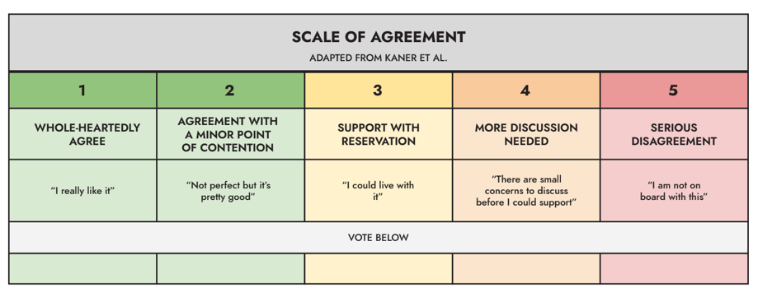
Temperature check on electronics EPR recommendation
45
Notes:
Jen

Slide 46
Temperature check on electronics EPR recommendation
Member | Agency / organization
CHAIR: John Beling | Deputy Commissioner, Massachusetts Department of Environmental Protection
Rep. Christine Barber | House Chair, Joint Committee on Environment and Natural Resources Appointee, Massachusetts House of Representatives
Sen. Mike Barrett | Senate Chair, Joint Committee on Telecommunications, Energy, and Utilities
Sharon Byrne Kishida | Nominee, Senate Minority Leader
Leigh-Anne Cole | Executive Director, Community Action Works
Jose Delgado | Arise for Social Justice
Janet Domenitz | Executive Director, MassPIRG
Lew Dubuque | Vice President, Northeast Chapter, National Waste and Recycling Association
Magda Garncarz | Vice President of Government Affairs, Associated Industries of Massachusetts
Sarah Kalish | Executive Office of Economic Development
Kris Callahan | Director of Policy and Regulatory Affairs, Bureau of Climate and Environmental Health, Massachusetts Department of Public Health
David Melly | Legislative Director, Environmental League of Massachusetts
Conor O’Shaughnessy | Budget Director and Environmental Policy Analyst, Office of Representative Bradley Jones, House Minority Leader
Andrew Potter | Chair, Select Board, Town of West Stockbridge
Catherine Ratte | Director, Land Use and Environment Department, Pioneer Valley Planning Commission
Bill Rennie | Senior Vice President, Retailers Association of Massachusetts
Neil Rhein | Executive Director, Keep Massachusetts Beautiful
Waneta Trabert | Vice President, MassRecycle
Tracy Triplett | Senior Enforcement Counsel, Office of Attorney General Andrea Joy Campbell
Abbie Webb | Vice President of Sustainability, Casella Waste Management
46
Notes:
Jen

Slide 47
Next steps
DEP/GreenerU/PSI to finalize background document on electronics
DEP to distribute electronics background/recommendation document prior to October meeting for review
Commission to discuss, revise, and finalize vote on electronics and introduce packaging EPR at October meeting
Commission to consider an additional meeting in November for final vote on recommendations for packaging and overall materials for legislature
47
Notes:
Jen

Slide 48
Next meeting and adjourn
Next meeting:
PACKAGING
Wednesday, October 29, 2025
9:30 a.m. to 12:30 p.m.
Agenda, Zoom link, and reading materials will be available at least one week prior to the meeting.
48
Notes:
Jen

