Slide 1

ETPL Workgroup February 27, 2015
The Workforce Innovation and
Opportunity Act of 2014

Slide 2
Agenda
Introductions
Define the purpose of the group
Overview of the current process
WIOA Requirements
BREAK
Define Subgroups and Action Items
Schedule next meeting(s)

Slide 3
With the passage of WIOA…….
The passage of WIOA provides an opportunity to bring stakeholders together to discuss how the Massachusetts’ workforce system can collaborate across partner agencies and core programs regarding various topics and issues.
This is also an opportunity to coordinate and leverage resources to prepare job seekers with skills to enter the workforce and meet employer needs.

Slide 4
Purpose
Provider Eligibility Process
Appeal Process
Notification to Providers about changes
Develop Policy Guidance
Training Pro

Slide 5
Important Actions
Implementation by July 1
Notification to Providers
Policy Issuance
TrainingPro changes

Slide 6
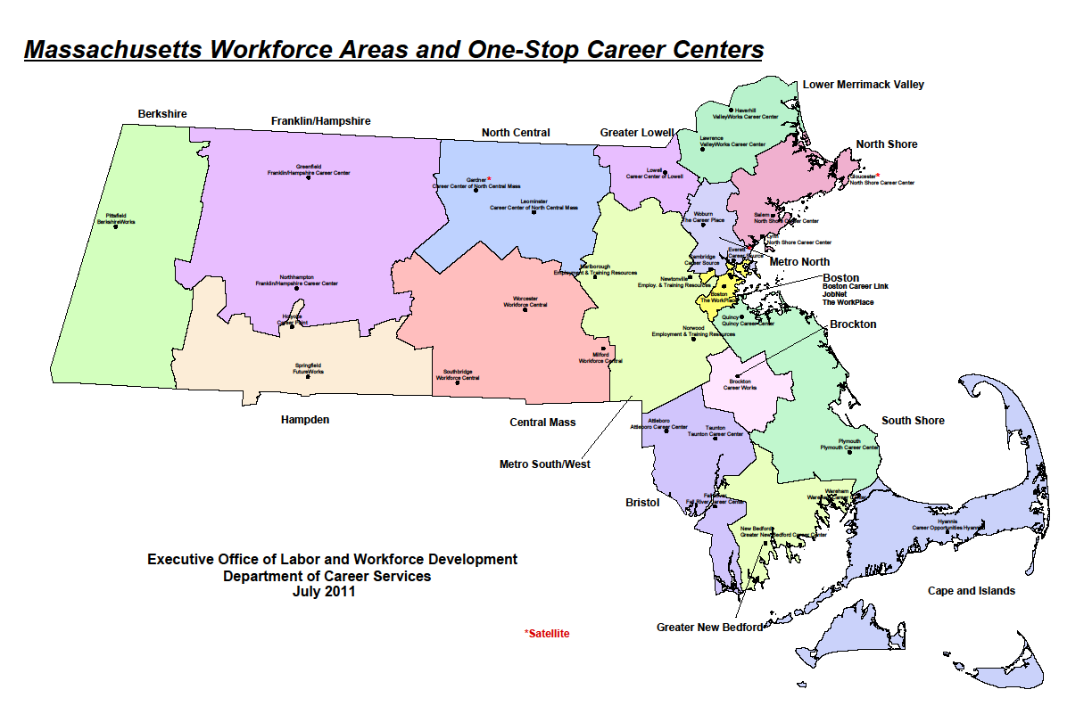

Slide 7
Overview of Funding
One Stop Career Centers provide access to an extensive array of information and services to assist job seekers and employers.
Majority of funding is federal (blue circles)
Career Center
WIA Adult
WIA Youth
WIA Dislocated Worker
Federal Discretionary Grants
Wagner
Peyser
WIA Labor Exchange
State Funding
Other
Trade
Adjustment
Assistance
Notes:
The job seeker or employer doesn’t need to understand the daisy chain of funding.
Socks integrate services to provide one “face” to the customer.
Very difficult given continued separate financing and reporting requirements that cannot be put into one “pot” but must be delivered as if.

Slide 8
Current Process
Refer to FlowChart
https://web.detma.org/provider/prl.asp
(for provider registration)
http://web.detma.org/JobQuest/Training.aspx
(to search providers/courses)

