Slide 1
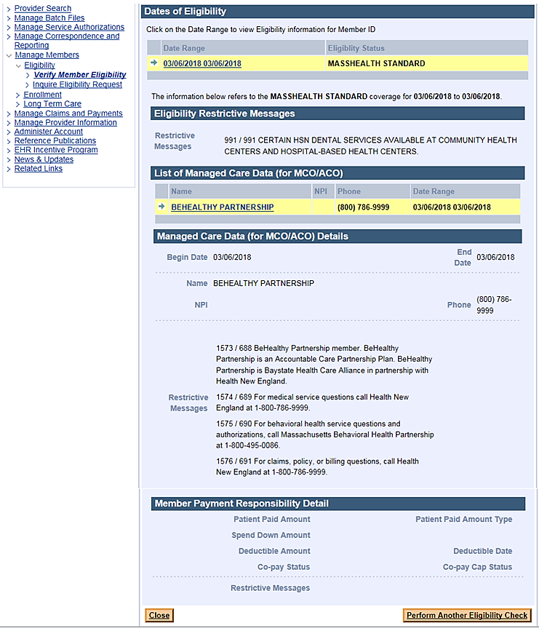
EVS Screenshot Examples
Restrictive Messages for 2019 Managed Care Health Plans
1. BeHealthy Partnership – Accountable Care Partnership Plan
Note: EVS only displays a member’s current eligibility, not future eligibility.
View and download the EVS Quick Reference Guide and Health Plan Contact Matrix for 2018 managed care health plans on the Provider PCDI Resources webpage
https://www.mass.gov/lists/provider-pcdi-resources

Slide 2
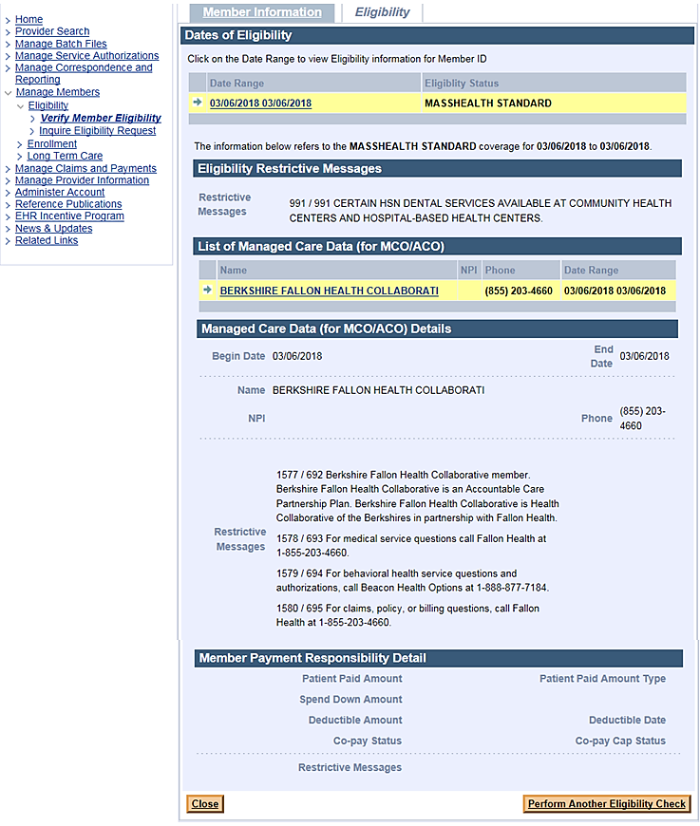
EVS Screenshot Examples
Restrictive Messages for 2019 Managed Care Health Plans
2. Berkshire Fallon Health Collaborative– Accountable Care Partnership Plan
Note: EVS only displays a member’s current eligibility, not future eligibility.
View and download the EVS Quick Reference Guide and Health Plan Contact Matrix for 2018 managed care health plans on the Provider PCDI Resources webpage
https://www.mass.gov/lists/provider-pcdi-resources

Slide 3
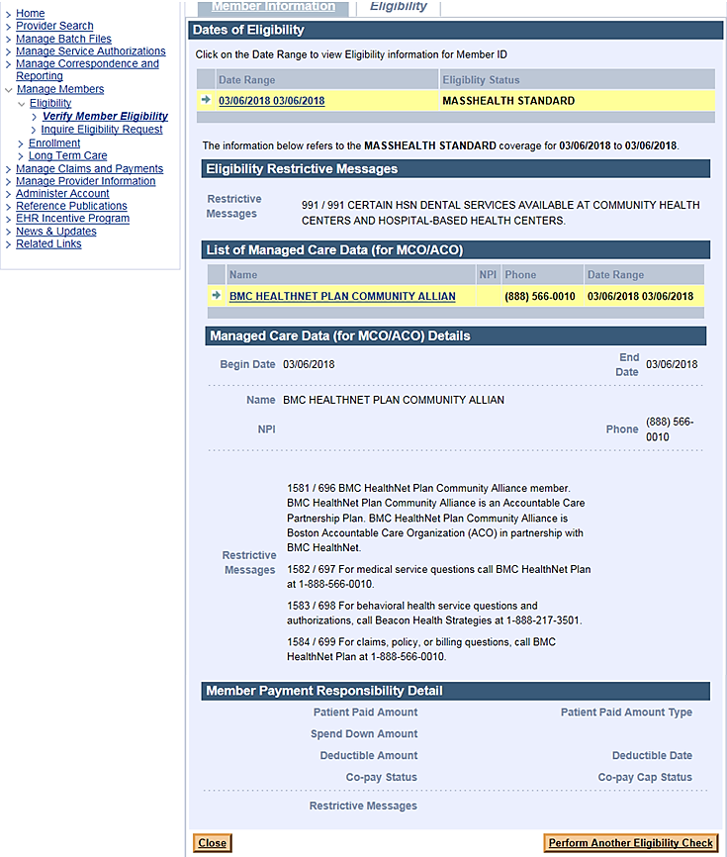
EVS Screenshot Examples
Restrictive Messages for 2019 Managed Care Health Plans
3. BMC HealthNet Plan Community Alliance– Accountable Care Partnership Plan
Note: EVS only displays a member’s current eligibility, not future eligibility.
View and download the EVS Quick Reference Guide and Health Plan Contact Matrix for 2018 managed care health plans on the Provider PCDI Resources webpage
https://www.mass.gov/lists/provider-pcdi-resources

Slide 4
EVS Screenshot Examples
Restrictive Messages for 2019 Managed Care Health Plans
4. BMC HealthNet Plan Mercy Alliance– Accountable Care Partnership Plan
Note: EVS only displays a member’s current eligibility, not future eligibility.
View and download the EVS Quick Reference Guide and Health Plan Contact Matrix for 2018 managed care health plans on the Provider PCDI Resources webpage
https://www.mass.gov/lists/provider-pcdi-resources

Slide 5
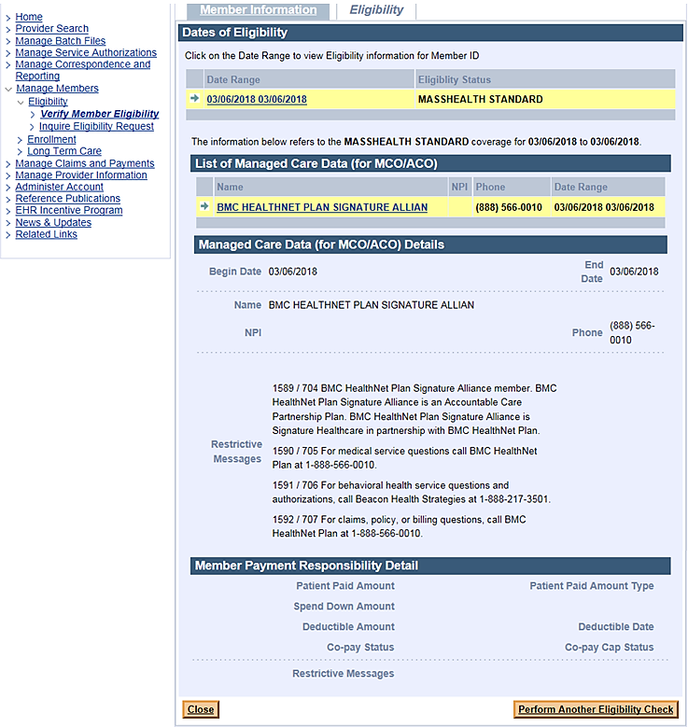
EVS Screenshot Examples
Restrictive Messages for 2019 Managed Care Health Plans
5. BMC HealthNet Plan Signature Alliance– Accountable Care Partnership Plan
Note: EVS only displays a member’s current eligibility, not future eligibility.
View and download the EVS Quick Reference Guide and Health Plan Contact Matrix for 2018 managed care health plans on the Provider PCDI Resources webpage
https://www.mass.gov/lists/provider-pcdi-resources

Slide 6
EVS Screenshot Examples
Restrictive Messages for 2019 Managed Care Health Plans
6. BMC HealthNet Plan Southcoast Alliance– Accountable Care Partnership Plan
Note: EVS only displays a member’s current eligibility, not future eligibility.
View and download the EVS Quick Reference Guide and Health Plan Contact Matrix for 2018 managed care health plans on the Provider PCDI Resources webpage
https://www.mass.gov/lists/provider-pcdi-resources

Slide 7
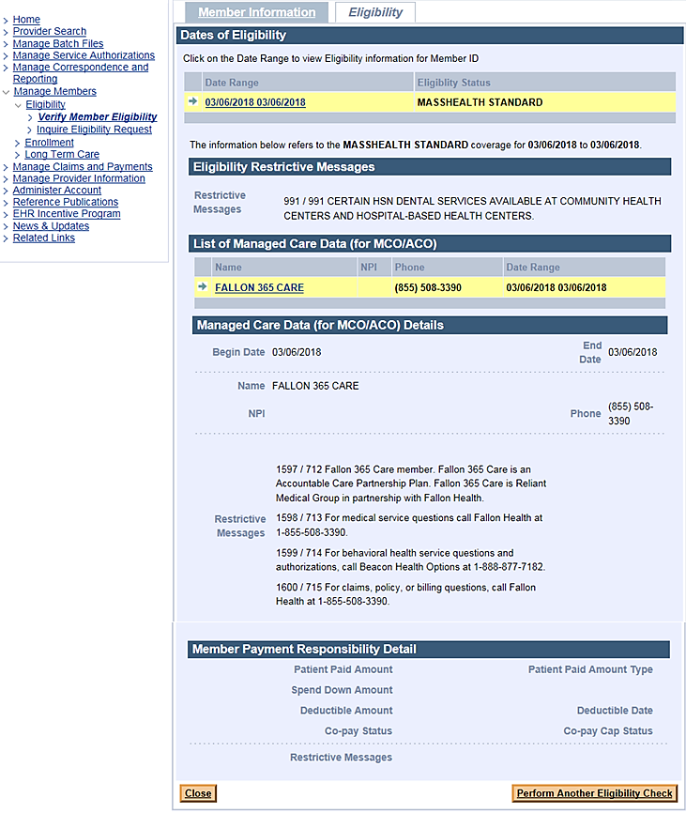
EVS Screenshot Examples
Restrictive Messages for 2019 Managed Care Health Plans
7. Fallon 365 Care – Accountable Care Partnership Plan
Note: EVS only displays a member’s current eligibility, not future eligibility.
View and download the EVS Quick Reference Guide and Health Plan Contact Matrix for 2018 managed care health plans on the Provider PCDI Resources webpage
https://www.mass.gov/lists/provider-pcdi-resources

Slide 8
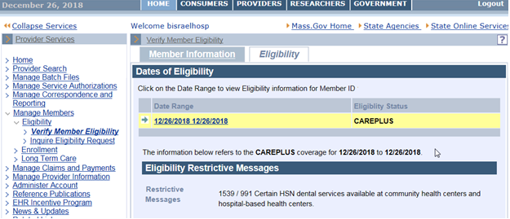
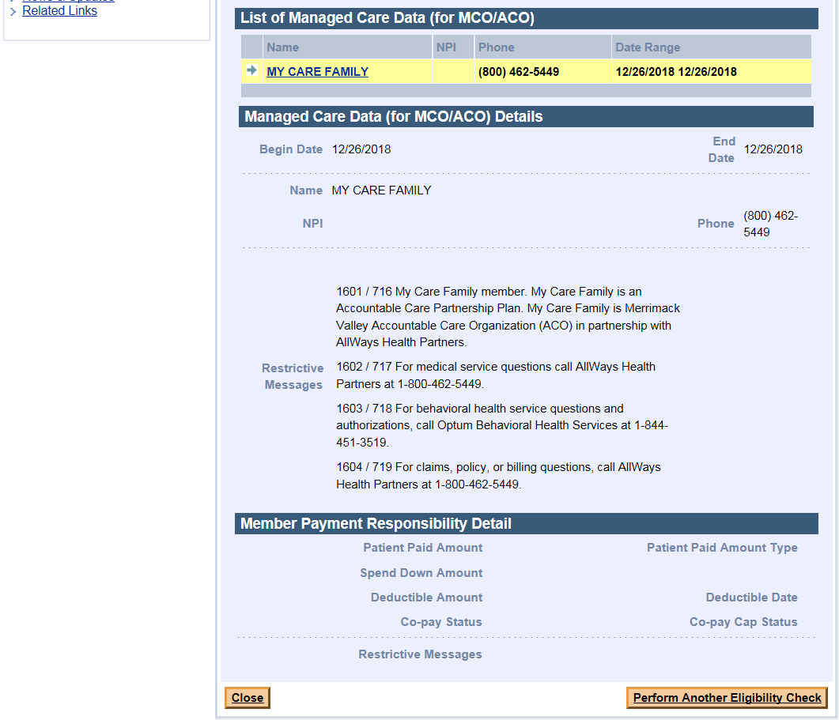
EVS Screenshot Examples
Restrictive Messages for 2019 Managed Care Health Plans
8. My Care Family– Accountable Care Partnership Plan
Note: EVS only displays a member’s current eligibility, not future eligibility.
View and download the EVS Quick Reference Guide and Health Plan Contact Matrix for 2018 managed care health plans on the Provider PCDI Resources webpage
https://www.mass.gov/lists/provider-pcdi-resources

Slide 9
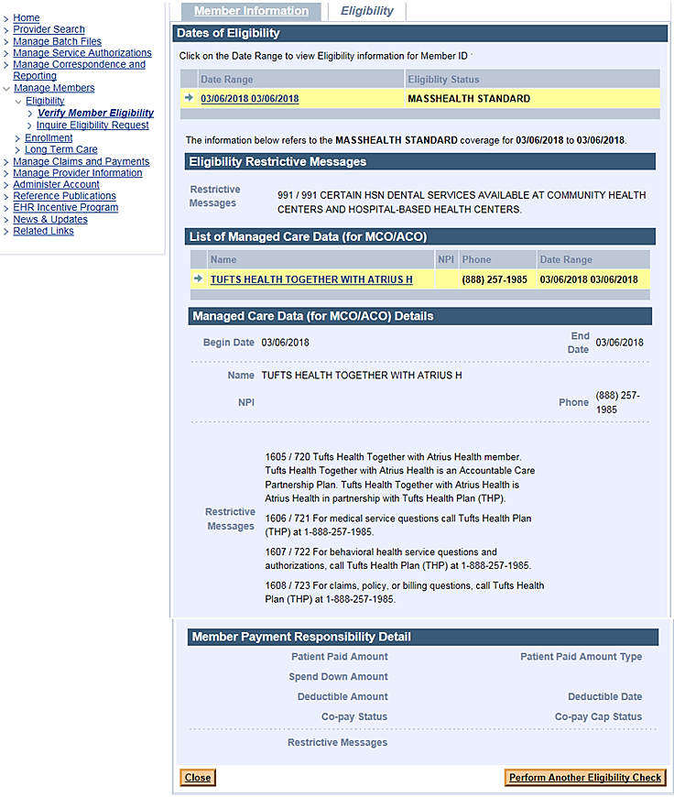
EVS Screenshot Examples
Restrictive Messages for 2019 Managed Care Health Plans
9. Tufts Health Together with Atrius Health – Accountable Care Partnership Plan
Note: EVS only displays a member’s current eligibility, not future eligibility.
View and download the EVS Quick Reference Guide and Health Plan Contact Matrix for 2018 managed care health plans on the Provider PCDI Resources webpage
https://www.mass.gov/lists/provider-pcdi-resources

Slide 10
EVS Screenshot Examples
Restrictive Messages for 2019 Managed Care Health Plans
10. Tufts Health Together with BIDCO – Accountable Care Partnership Plan
Note: EVS only displays a member’s current eligibility, not future eligibility.
View and download the EVS Quick Reference Guide and Health Plan Contact Matrix for 2018 managed care health plans on the Provider PCDI Resources webpage
https://www.mass.gov/lists/provider-pcdi-resources

Slide 11
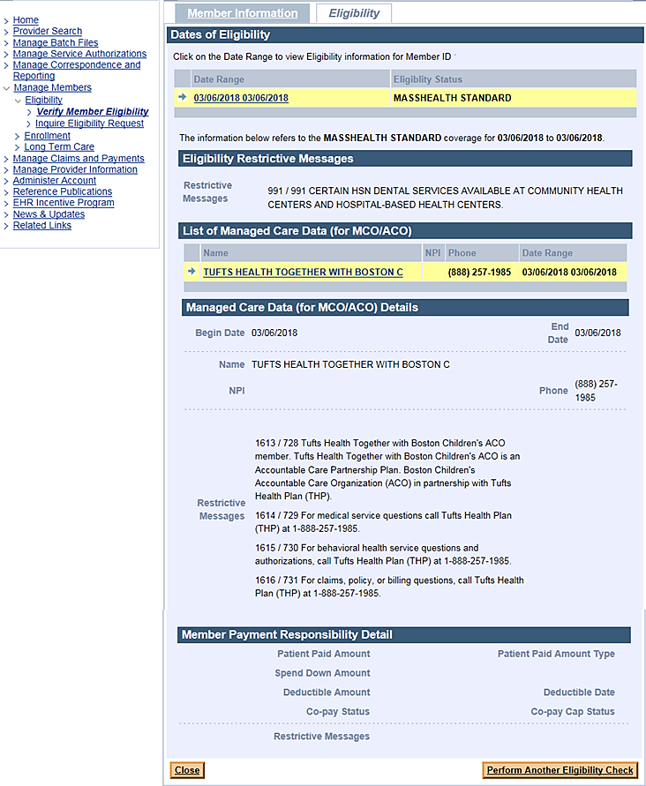
EVS Screenshot Examples
Restrictive Messages for 2019 Managed Care Health Plans
11. Tufts Health Together with Boston Children’s ACO – Accountable Care Partnership Plan
Note: EVS only displays a member’s current eligibility, not future eligibility.
View and download the EVS Quick Reference Guide and Health Plan Contact Matrix for 2018 managed care health plans on the Provider PCDI Resources webpage
https://www.mass.gov/lists/provider-pcdi-resources

Slide 12
EVS Screenshot Examples
Restrictive Messages for 2019 Managed Care Health Plans
12. Tufts Health Together with CHA– Accountable Care Partnership Plan
Note: EVS only displays a member’s current eligibility, not future eligibility.
View and download the EVS Quick Reference Guide and Health Plan Contact Matrix for 2018 managed care health plans on the Provider PCDI Resources webpage
https://www.mass.gov/lists/provider-pcdi-resources

Slide 13
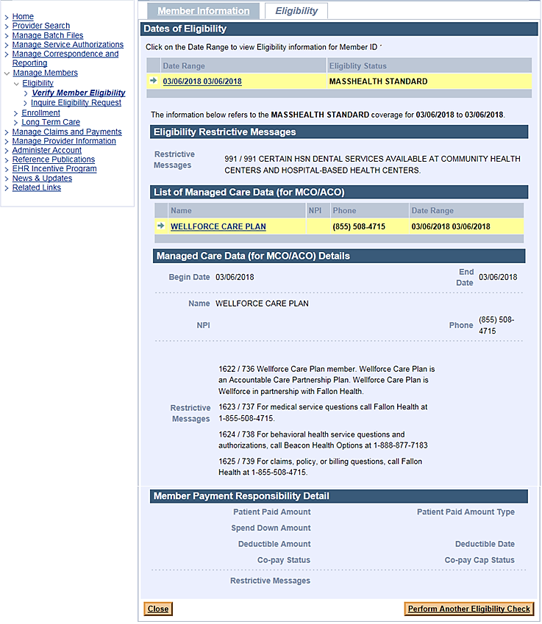
EVS Screenshot Examples
Restrictive Messages for 2019 Managed Care Health Plans
13. Wellforce Care Plan – Accountable Care Partnership Plan
Note: EVS only displays a member’s current eligibility, not future eligibility.
View and download the EVS Quick Reference Guide and Health Plan Contact Matrix for 2018 managed care health plans on the Provider PCDI Resources webpage
https://www.mass.gov/lists/provider-pcdi-resources

Slide 14
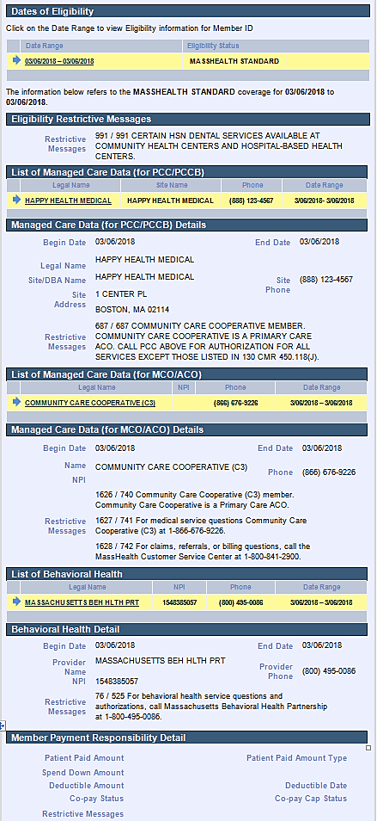
EVS Screenshot Examples
Restrictive Messages for 2019 Managed Care Health Plans
1. Community Care Cooperative (C3) – Primary Care ACO Plan
Note: EVS only displays a member’s current eligibility, not future eligibility.
View and download the EVS Quick Reference Guide and Health Plan Contact Matrix for 2018 managed care health plans on the Provider PCDI Resources webpage
https://www.mass.gov/lists/provider-pcdi-resources

Slide 15
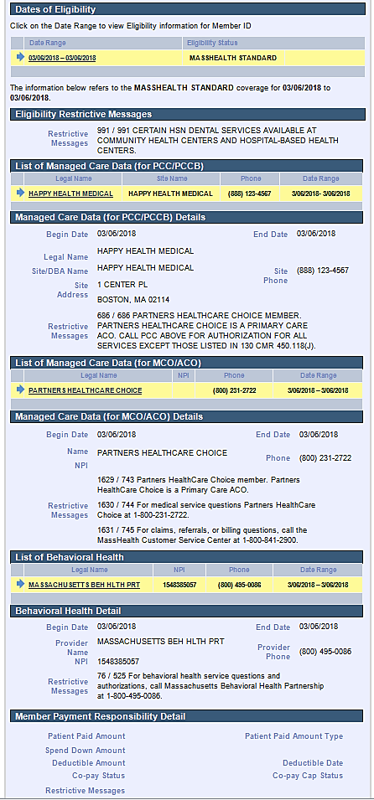
EVS Screenshot Examples
Restrictive Messages for 2019 Managed Care Health Plans
2. Partners HealthCare Choice – Primary Care ACO Plan
Note: EVS only displays a member’s current eligibility, not future eligibility.
View and download the EVS Quick Reference Guide and Health Plan Contact Matrix for 2018 managed care health plans on the Provider PCDI Resources webpage
https://www.mass.gov/lists/provider-pcdi-resources

Slide 16
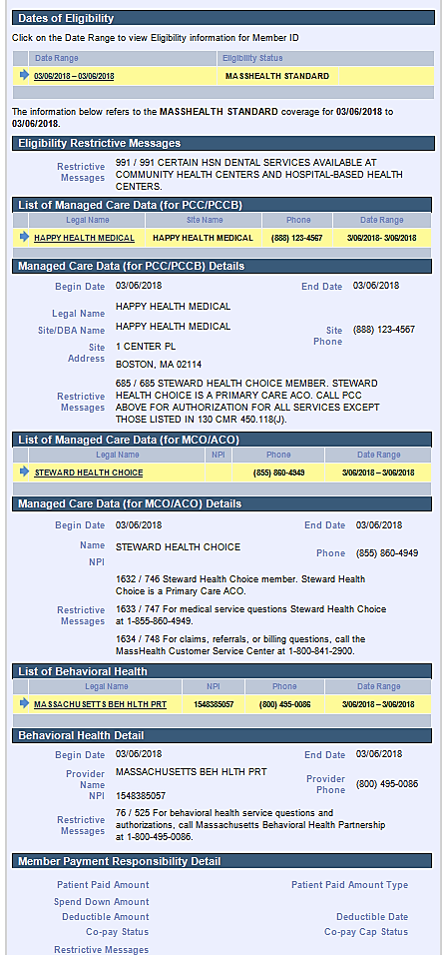
EVS Screenshot Examples
Restrictive Messages for 2019 Managed Care Health Plans
3. Steward Health Choice – Primary Care ACO Plan
Note: EVS only displays a member’s current eligibility, not future eligibility.
View and download the EVS Quick Reference Guide and Health Plan Contact Matrix for 2018 managed care health plans on the Provider PCDI Resources webpage
https://www.mass.gov/lists/provider-pcdi-resources

Slide 17
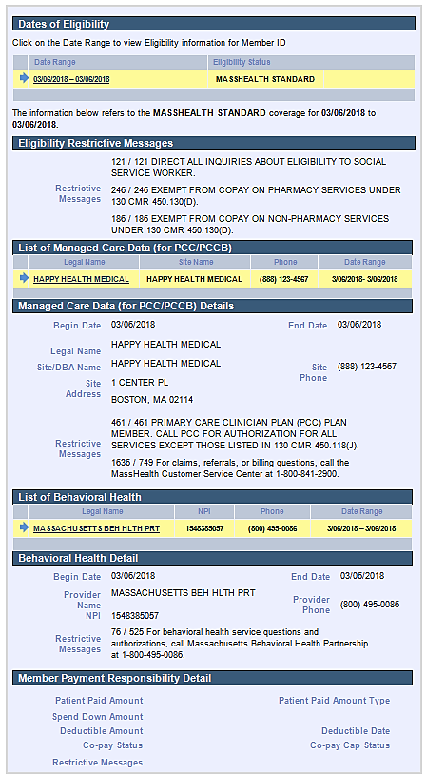
EVS Screenshot Examples
Restrictive Messages for 2019 Managed Care Health Plans
Primary Care Clinician (PCC) Plan
Note: EVS only displays a member’s current eligibility, not future eligibility.
View and download the EVS Quick Reference Guide and Health Plan Contact Matrix for 2018 managed care health plans on the Provider PCDI Resources webpage
https://www.mass.gov/lists/provider-pcdi-resources

Slide 18
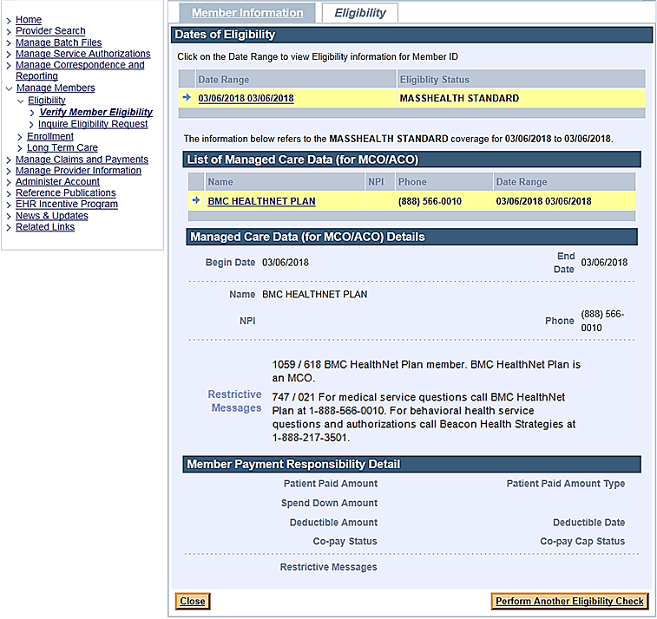
EVS Screenshot Examples
Restrictive Messages for 2019 Managed Care Health Plans
1. BMC HealthNet Plan – Managed Care Organization (MCO) Plan
Note: EVS only displays a member’s current eligibility, not future eligibility.
View and download the EVS Quick Reference Guide and Health Plan Contact Matrix for 2018 managed care health plans on the Provider PCDI Resources webpage
https://www.mass.gov/lists/provider-pcdi-resources

Slide 19
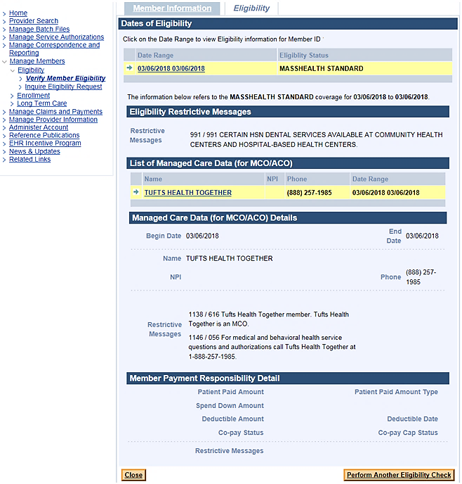
EVS Screenshot Examples
Restrictive Messages for 2019 Managed Care Health Plans
2. Tufts Health Together – Managed Care Organization (MCO) Plan
Note: EVS only displays a member’s current eligibility, not future eligibility.
View and download the EVS Quick Reference Guide and Health Plan Contact Matrix for 2018 managed care health plans on the Provider PCDI Resources webpage
https://www.mass.gov/lists/provider-pcdi-resources

